Slide 1

Toronto Weather, Pedestrians,
Vehicles, and Air Quality
Web Maps
Amr Shalaby

Slide 2
Air and Traffic Data ETL Design Data Sources
1. Canada Environment Air Quality and Weather Data
1: Best 1 to 11: Worst from February 1, 2023 – Today
2. City of Toronto Open Data Portal
Traffic Volume January 18 , 1984 – December 19, 2023
3. ArcGIS Data Portal
Pedestrians and Vehicles Counts Dec 1, 2003 – September 7, 2016
4. Canada Natural Resources
Geo Stations Meta Data from Jan 1, 1850 – March 5, 2024

Slide 3


Air and Traffic Data ETL Design Code Structure
Data Ingestion
Config.ini
Configuration Object
Data Frames Object
Extremely Efficient
(DB Connections Bypassed)
User Requirements DB Credentials, Auto ML Duration, Forecast Horizon

Slide 4
Air and Traffic Data ETL Design Air and Traffic Data Pipeline
1,430,988
Rows
426,584
( 23% )
Transform
Air Data Transposed
WGS 26917
Projection to WGS:26917
2
4
1
3
5
Load
3:1 Duplicates-to-Unique Eliminated
Aggregation
Averages and Lifetime
Extraction
Web Scraping Data

Slide 5

Air and Traffic Data ETL Design Execution Phases
$$\sum{Steps}=411 Seconds$$
1 Second
Configurator
DB Credentials
Auto ML Duration
Extractor
Web Scraping
Ingesting Scraped Data into Stage Schema
Transformer
Create Projection Tables PostGIS
Transpose Air Data (Station ID were Columns)
Save Locally Flag
Skip DB Ingestion
Skip Prediction
Insert Timestamp of Inserted Records
Loader
Pushes Staging Table into Public Schema
Tracks Performance
Data Frames Creator
Pandas
GeoPands
H2O
Data Frames
Maps Creator
Creates Web Maps from Data Frames
Maps Tester
Performance Testing of Each Map Type
279 Seconds
64 Seconds
55 Seconds
7 Seconds
4 Seconds
34 Seconds
Notes:
© Copyright PresentationGO.com – The free PowerPoint and Google Slides template library

Slide 6
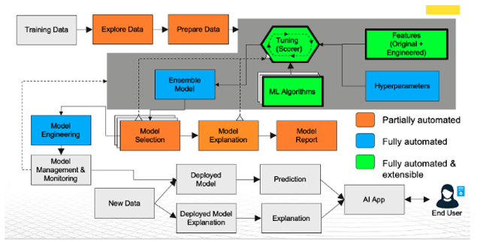
Air and Traffic Data ETL Design H₂O AutoML
Notes:
© Copyright PresentationGO.com – The free PowerPoint and Google Slides template library

Slide 7

Air and Traffic Data ETL Design Auto ML Layer and Load Testing
H₂O
GeoPandas
Shapely
Database
Turf
Folium
Mapbox
Load Testing
Optimal Map
Historical and Forecasted Data
Optimal Browser
Locust
Data Frames Object
selenium
Historical & Predictive Data
Notes:
© Copyright PresentationGO.com – The free PowerPoint and Google Slides template library

Slide 8
Air and Traffic: Optimal Maps (Loading Time)

Slide 9
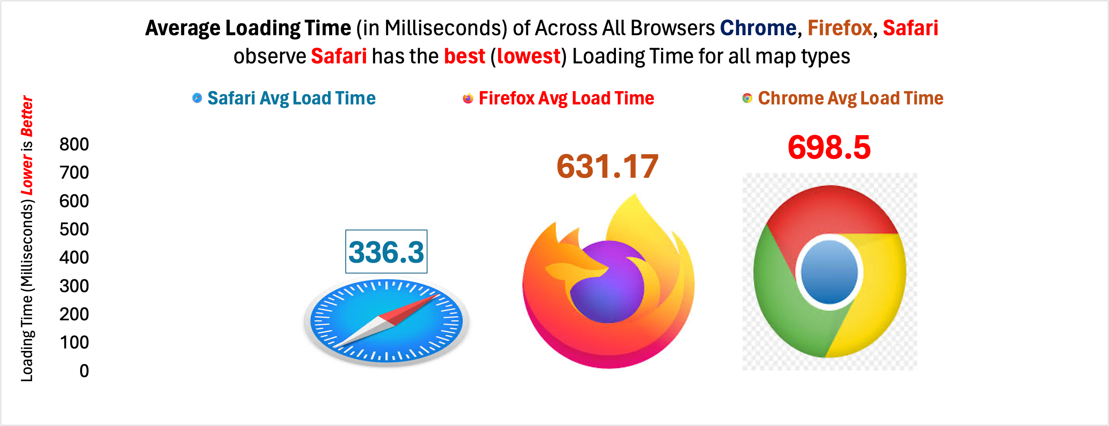
Air and Traffic: Optimal Browser (Loading Time)

Slide 10
Air and Traffic Data ETL Design Maps Efficient Implementation
Map
Control Layer
Feature Group
Markers
Marker Cluster
. add to
. add Child
No Bugs
Bugs

Slide 11
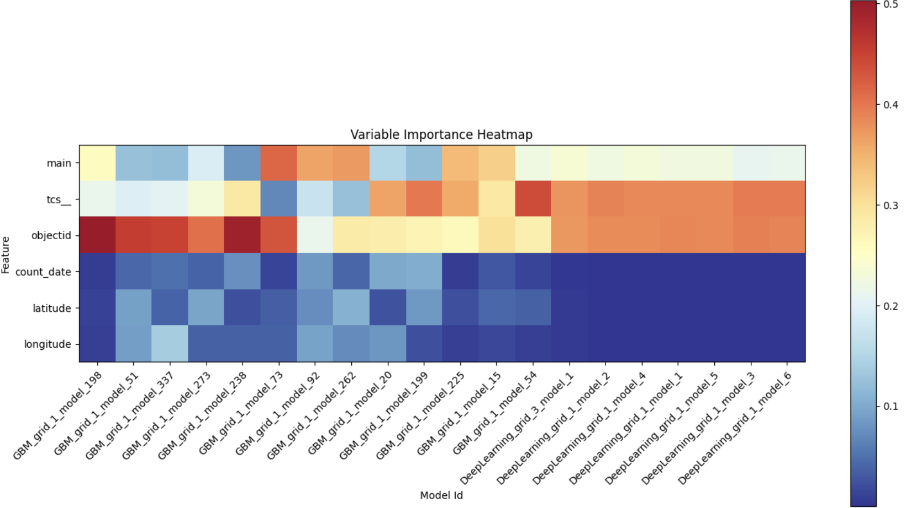
Air and Traffic: H₂O Traffic More Spatial Less Temporal

Slide 12
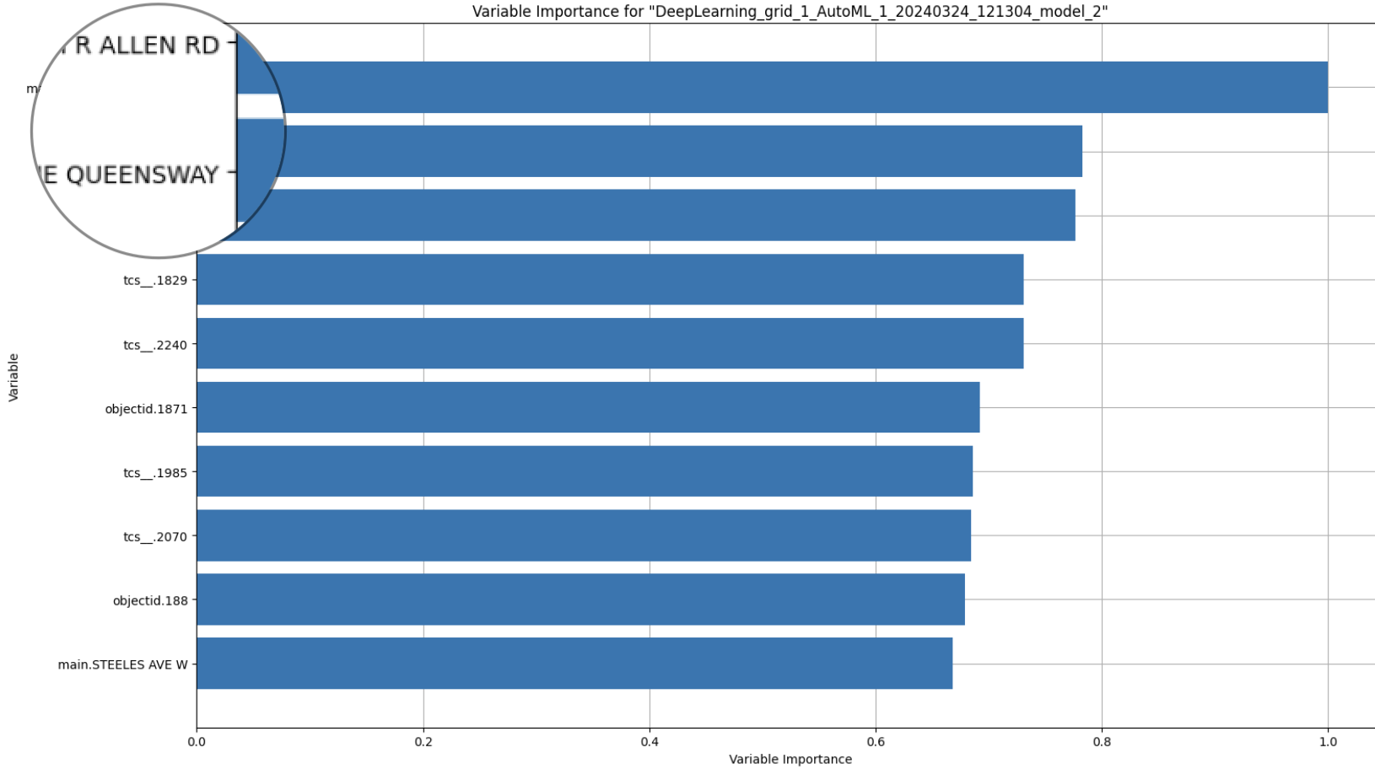
Where is: H₂O Traffic More Spatial Less Temporal

Slide 13
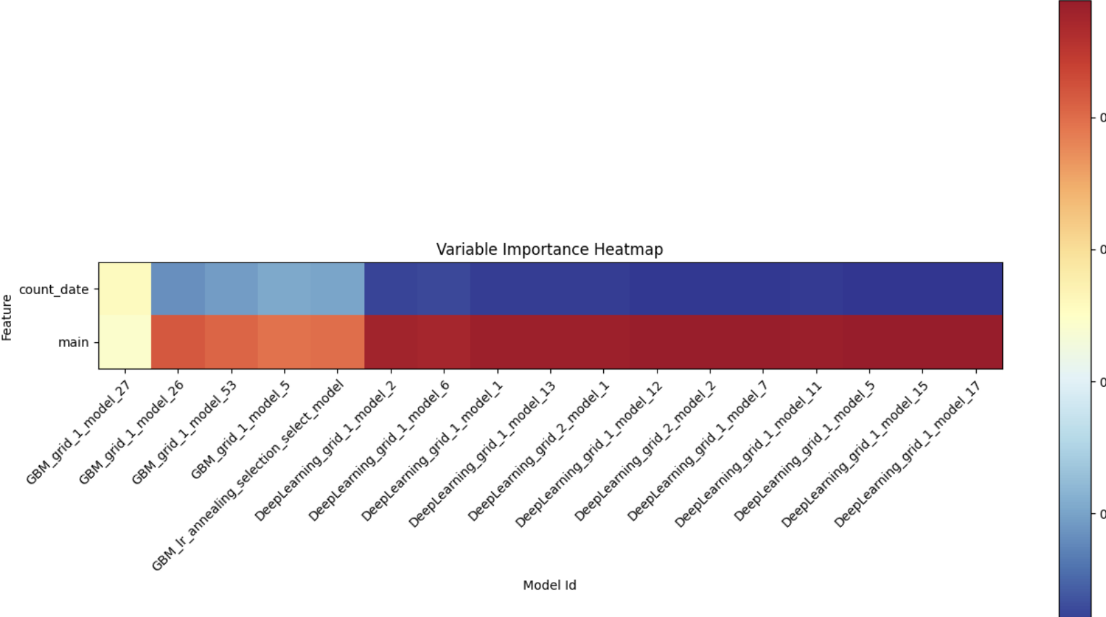
Air and Traffic : H₂O Pedestrains More Spatial Less Temporal

Slide 14
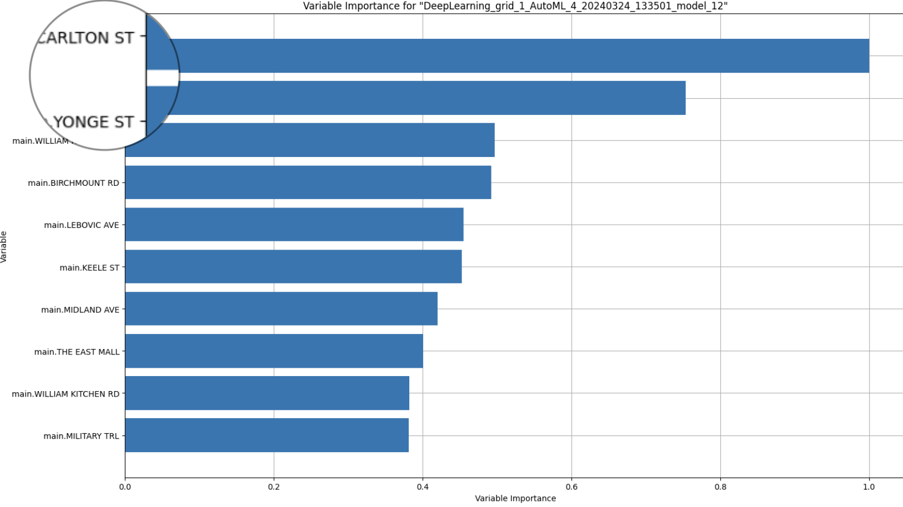
Where is: H₂O Pedestrains More Spatial Less Temporal

Slide 15
Finally: The Map
https://amr-y-shalaby.github.io/ggr_472_project/
https://github.com/amr-y-shalaby/ggr_472_project

