Slide 1
Distributed SLAM
Adam Wright, Tim Kuehn, Nathan Slobody
CMU 15-780
May 3rd, 2013

Slide 2
Simultaneous Localization and Mapping (SLAM)
Use a probabilistic method to solve mapping and localization as a single problem
(Extended) Kalman filter, Particle filters, least squares
Kalman filter based approaches more popular
Smoothing based approaches are popping up now

Slide 3
Kalman Filter (System Model)
X_{k} = F_{k} x_{k-1} + B_{k} u_{k} + w_{k} (transition model)
Describes how the state at one time relates to the previous state
Z_{k} = H_{k}x_{k} + v_{k} (measurement model)
Describes the relationship between your sensor and the system state

Slide 4
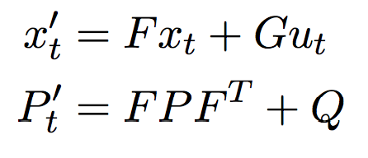
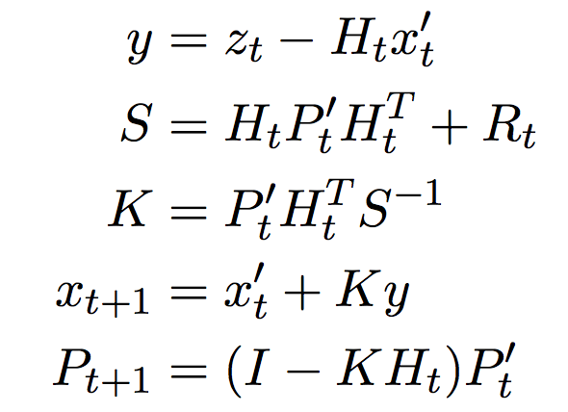
Kalman filter
Predict:
Update:
Motion covariance
Measurement covariance

Slide 5
Matrices
H = Motion model
P = Covariance matrix
R = Measurement uncertainty
x = System state
Q = Motion covariance/uncertainty

Slide 6
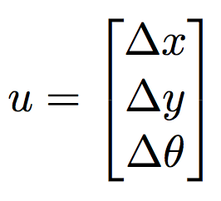
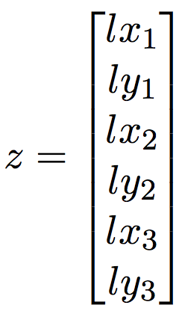
Our System Model
Simulator takes 'motor command' of x, y, heading velocities as input. Called u:
Simulator gives sensor measurement of relative landmark positions as output:
Robot
Robot
Robot

Slide 7
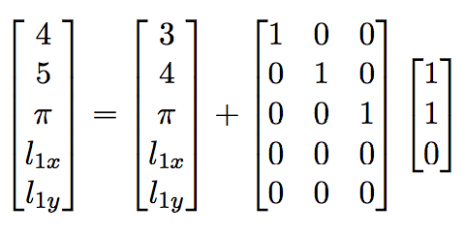
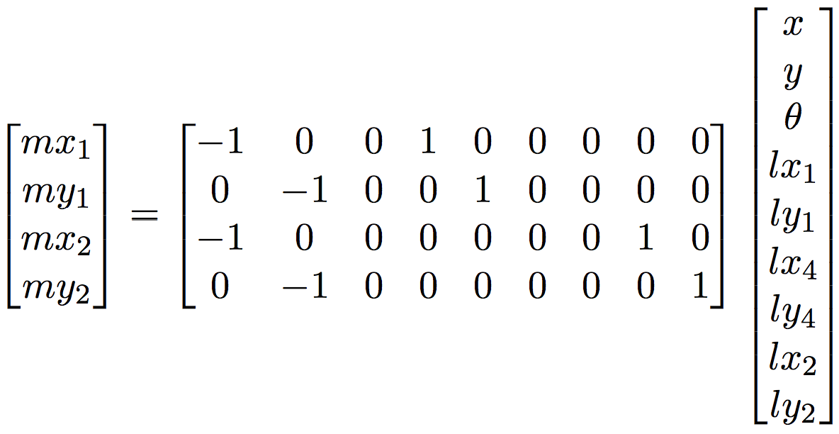
Our System Model (example)
Transition model:
x' = x + G u
Measurement model:
z = H x

Slide 8
Implementation
Python with our own simulator using Tkinter
Assume simple linear system with gaussian transition and sensor noise
Use covariance matrices to express relationships between landmarks and robot positions/landmarks and each other

Slide 9
Combining Robots' matrices
Use another Kalman filter
Do not use predict, only use update
Treat each robot's state vector as a measurement, and the covariance as the measurement noise/covariance
Feed resulting estimates back into each robot at each iteration

Slide 10
Results
Multiple robots achieve stable results (no map combination)
Landmarks successfully updated based on related landmarks

Slide 11
Final Remarks
I couldn't, I couldn't, I just couldn't – Tim

