Slide 1
Team 4 By Hasan , Michael , Tom and Jordan

Slide 2
Brief
The aim of this project was to Create an Implement a Music Hosting Web application using HTML, CSS, Bootstrapp and Javascript for the construction of the Front end While the back end utilised Java and the SpringBoot framework where the program will be rigorously tested throughout the Software Development Life Cycle

Slide 3
Planning
In order to assess what the requirements of the project will be, we must create the following
Entity relationship diagram
Universal Modeling Language
Risk Matrix
User stories

Slide 4
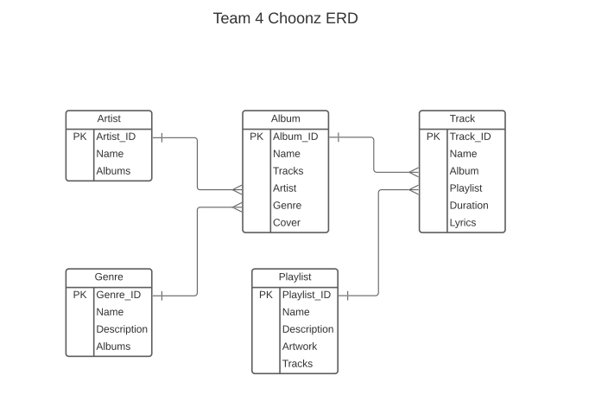
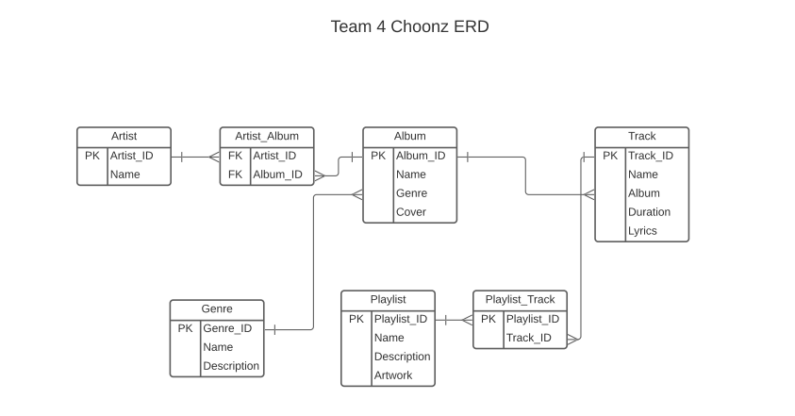
ERD
First ERD
Latest ERD

Slide 5
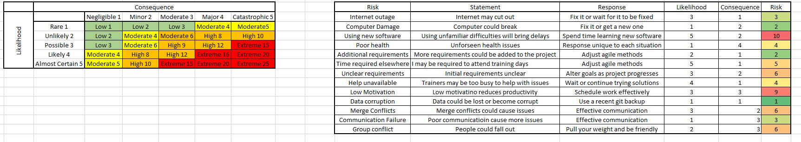
Risk Assessment

Slide 6
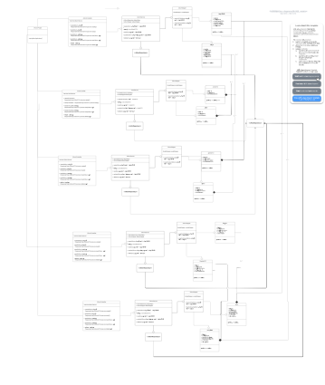
UML

Slide 7
Planning – Using Jira
Jira is a powerful web-based work management that allows us to plan, manage and track the workflow of the project whilst also allowing us to create and track epics, sprints and tasks.

Slide 8
Planning – Using Jira – user stories
User Stories are a highly effective way of determining the software requirements based on what the user would typically expect the software to do. For example, "As a User I want to use the read functions in the genres page so that I can view a genre"
However, with jira, tracking the progress of a task becomes a lot more streamlined with the use of smart commits

Slide 9
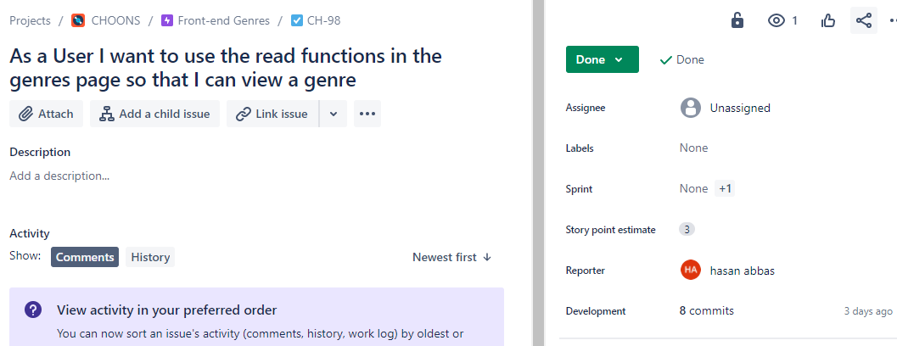
Planning – Using Jira – user stories issue example

Slide 10
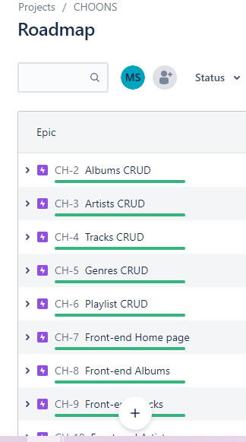
Planning – Using Jira -creating epics
Epics are essentially a large body of work that can be broken down Into smaller tasks or user stories(issues in Jira)

Slide 11
Planning – Using Jira – planning sprints
Sprints are typically a set period of time in which a specific work must be completed and ready for review. Each sprint usually consists of a planning meeting with the product owner and the development team to agree on what exactly needs to be accomplished by the end of the sprint. Jira however, simplifies the process of planning sprints with the ability to not only plan what task needs to be completed when but as we seen before with smart commits, it also allows us to track who did what.

Slide 12
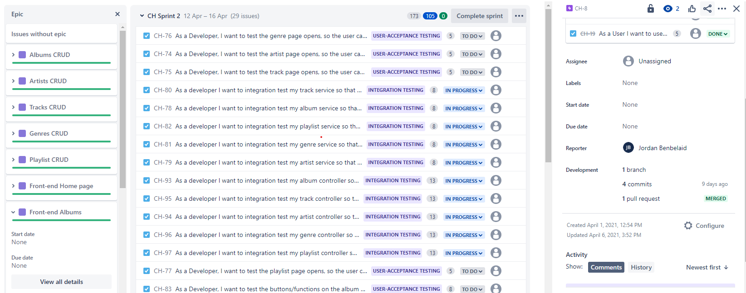
Planning – Using Jira – planning sprints

Slide 13
Planning – Daily Stand-Ups
During each sprint period, there was a daily standup. The purpose of the daily stand up was to discuss what each group member worked on, what they plan to work on next and what isses they had with any given task (known as blockers).

Slide 14
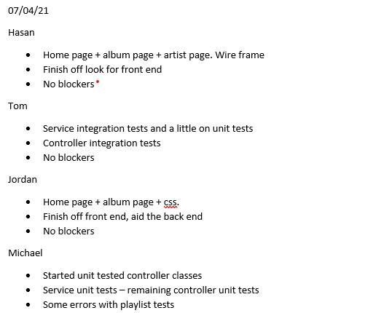
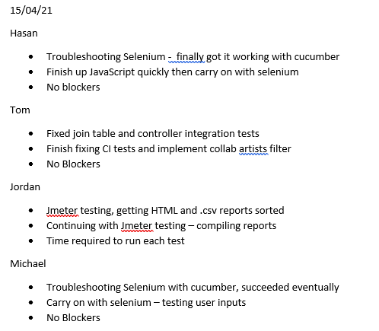
Planning – Daily Stand-Ups

Slide 15
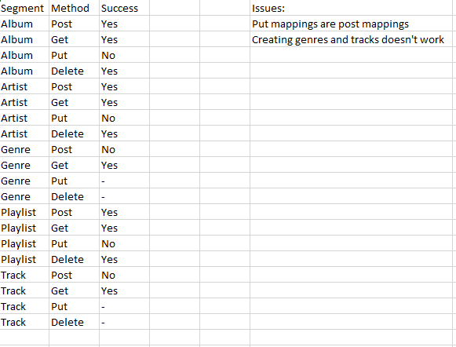
Initial Functionality of the program

Slide 16
The Front End
The front end was programmed in HTML, CSS, Bootstrap and javascript. However, in order to ensure the front end would operate as a given user would expect it to, it was rigirously tested using Selenium, Cucumber and Gerkhin.
However, In order to plan the layout of the web application, Wire-Frame's where used to create a template for the web application.

Slide 17
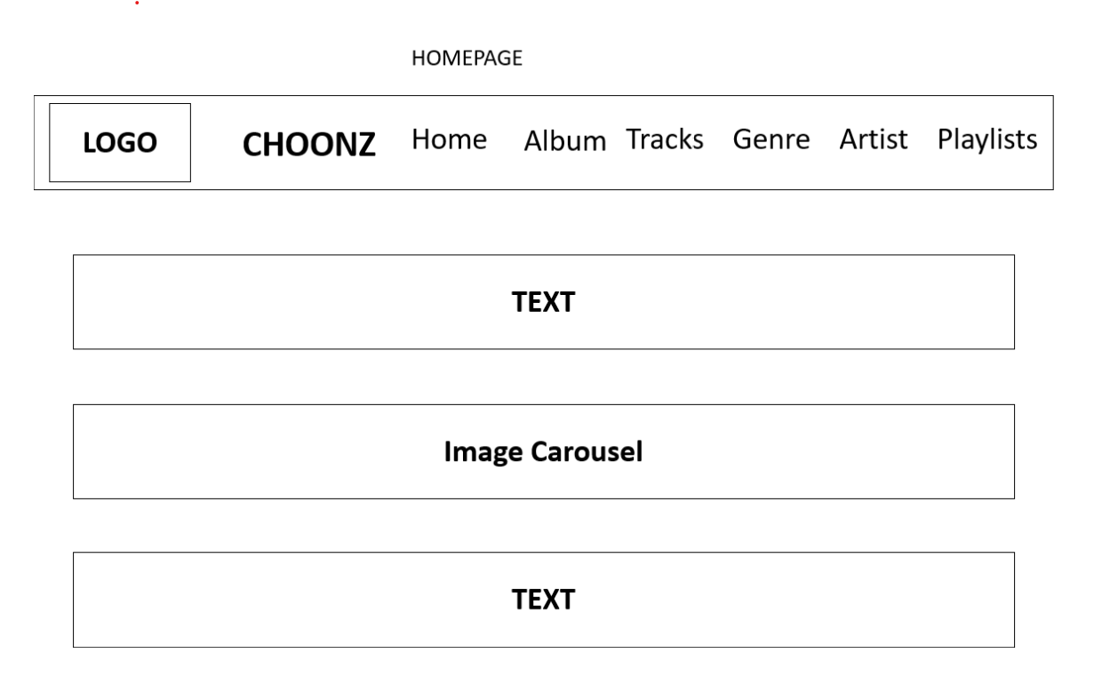
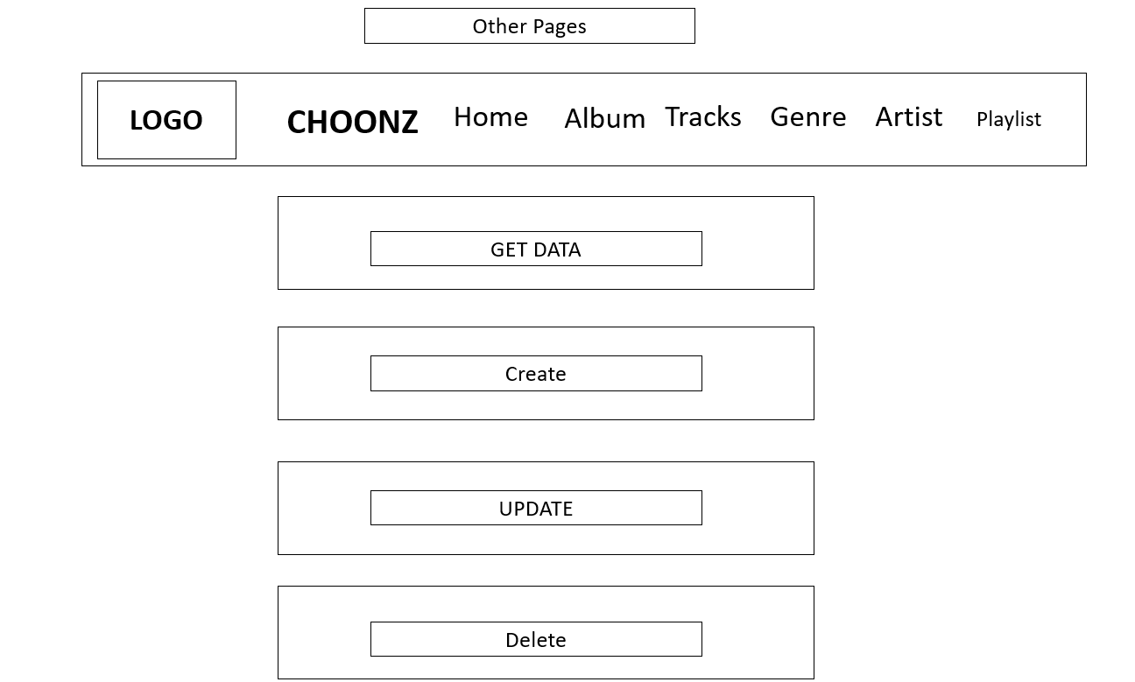
The Front End - Wire-Frame's

Slide 18
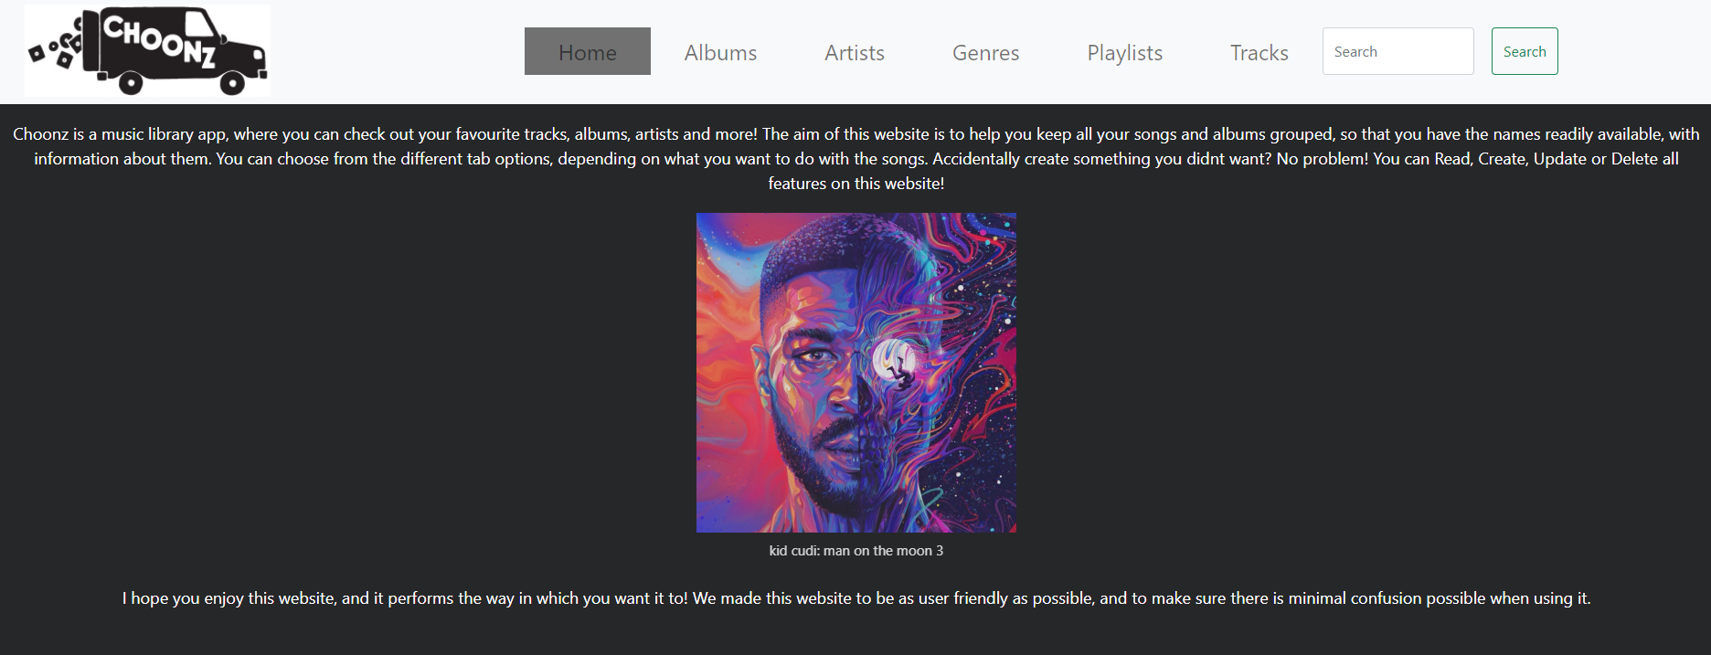
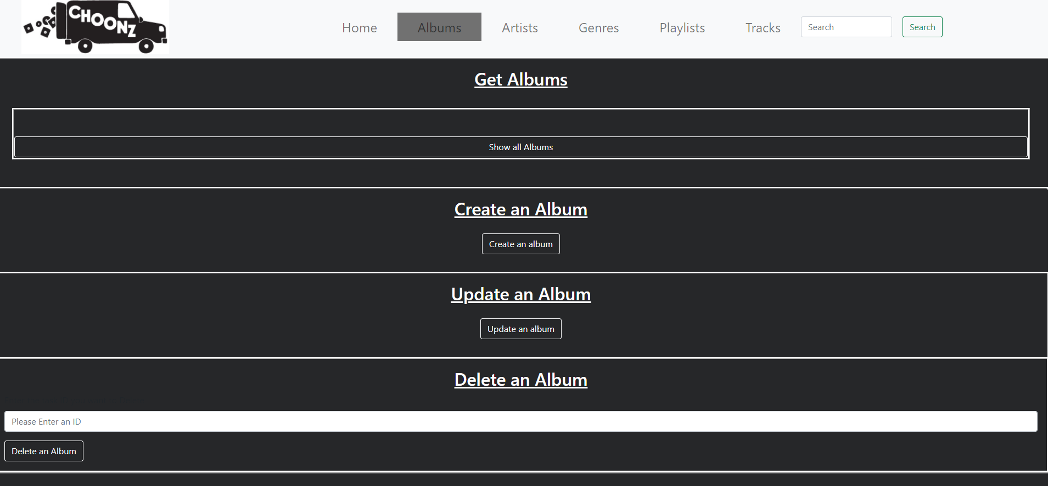
The Front End – Home Page

Slide 19
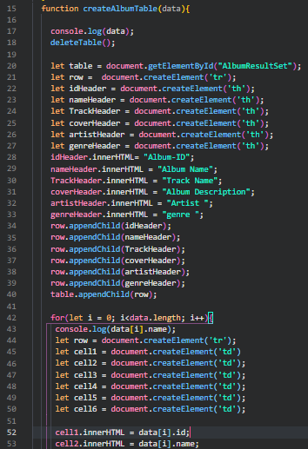
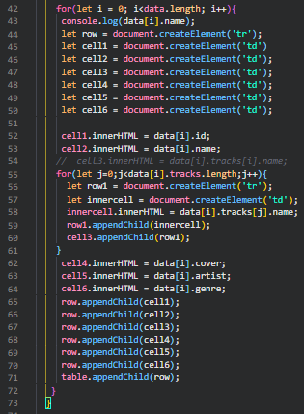
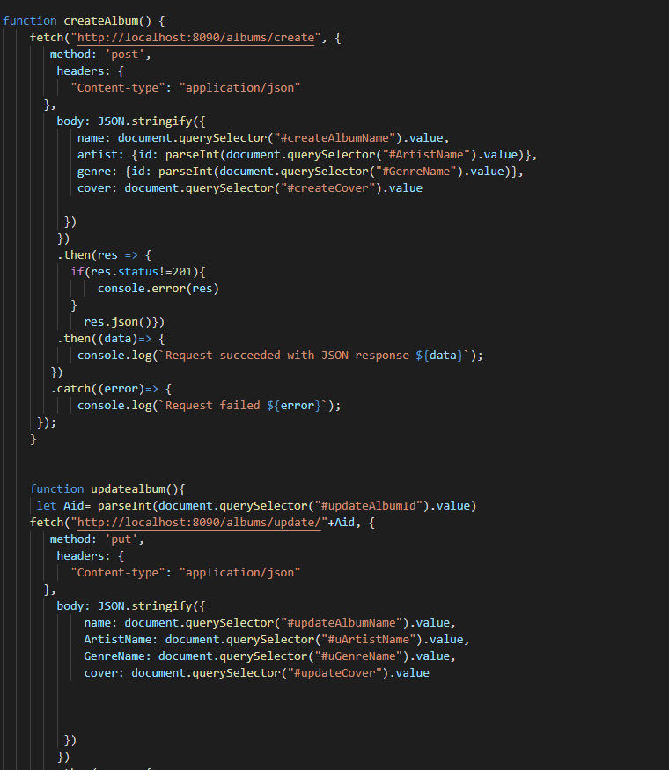
The Front End – Javascript

Slide 20
The Front End – Automation Testing
As Discussed earlier, the front end was tested Using Selenium, gherkin and Cucumber where Selenium allows for the program to mimic and automate a users actions and input while Cucumber and gherkin allows for the tester to write and structure the code in a way that almost anyone can interpret

Slide 21
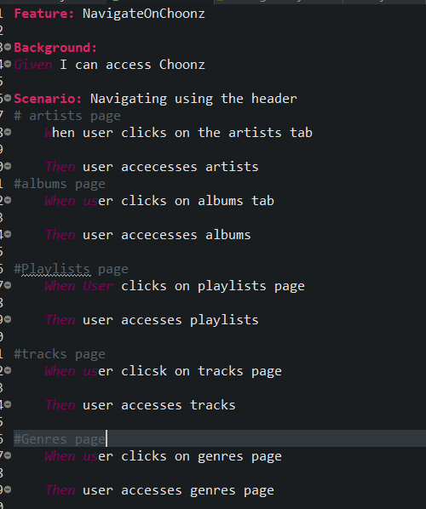
The Front End – Automation Testing -Cucumber Features

Slide 22
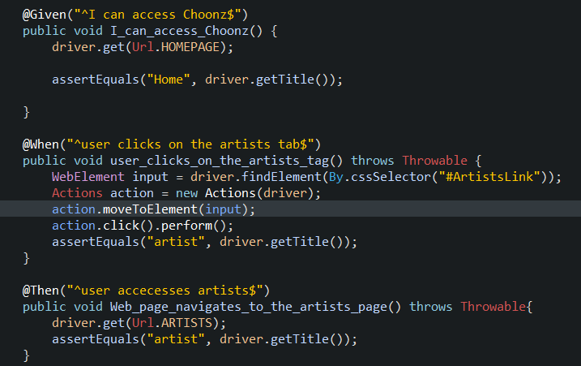
Automation testing - navigation

Slide 23
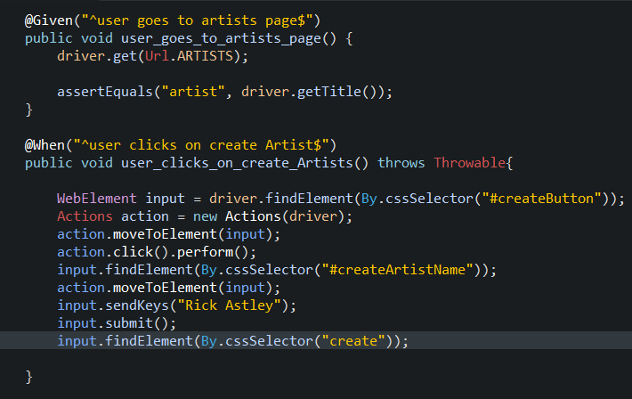
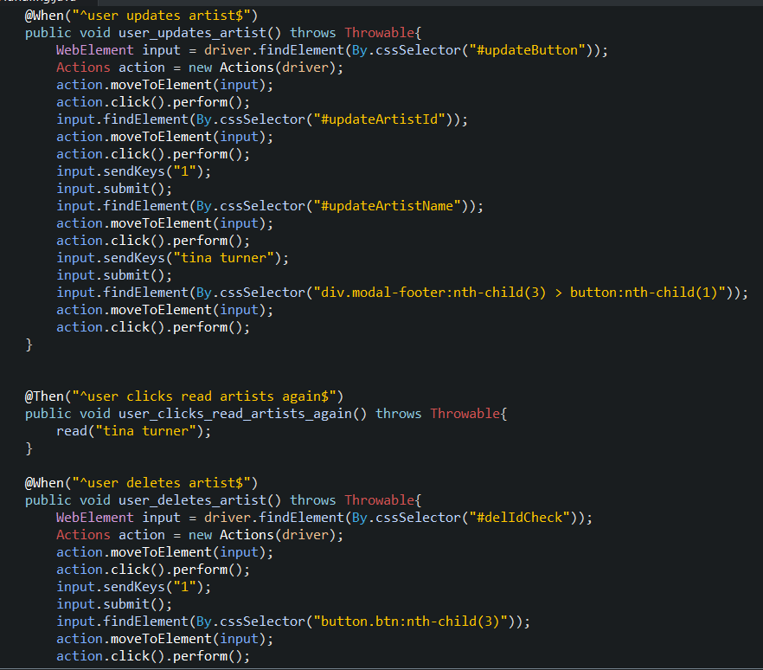
Automation Testing – data handling

Slide 24
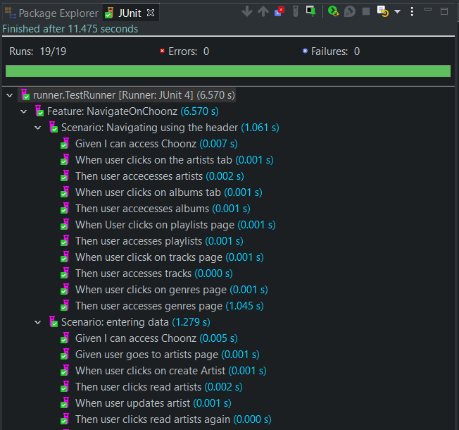
Automation Testing – results

Slide 25
The Back End
As the Back end had allready been started, it was decided that the best approach in determining what worked and what didn’t was to write the tests first before we begun writing the code. This provided the time saving benefit of simply running the tests to ensure a feature worked as intended as well as adhearing to a Test Driven Development workflow.

Slide 26
The Back End – Unit tests
Unit Testing is the process of testing individual units/components of code within the program to be tested. The purpose Unit testing fulfills is to ensure that each code component tested performs as it should do.

Slide 27
The Back End – Unit tests – testing the controllers
program when it is being run as an API. Here it is responsible for handling all the different post, fetch and put methods for our API that will be transmitted back and forth from the front end. Therefore the Unit tests for the controllers are designed to verify that the Data object we are able

Slide 28
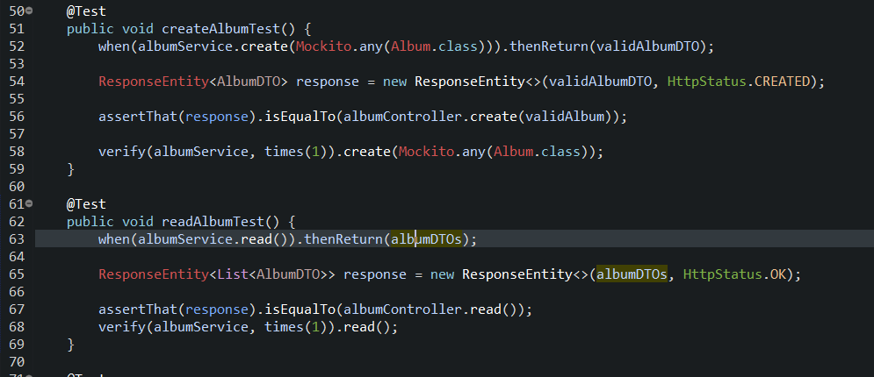
The Back End – Unit tests – testing the controllers

Slide 29
The Back End – Unit tests – testing the Services
The service classes are responsible for handling the SQL data obtained through the repository into data we can handle through JAVA

Slide 30

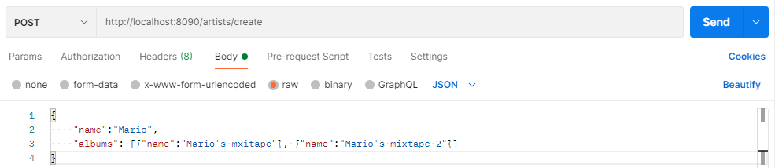
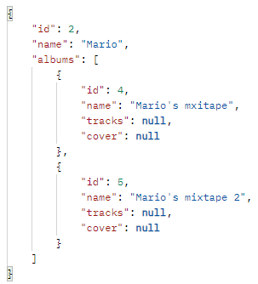

Back end showcase

Slide 31
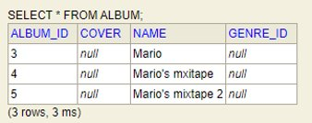
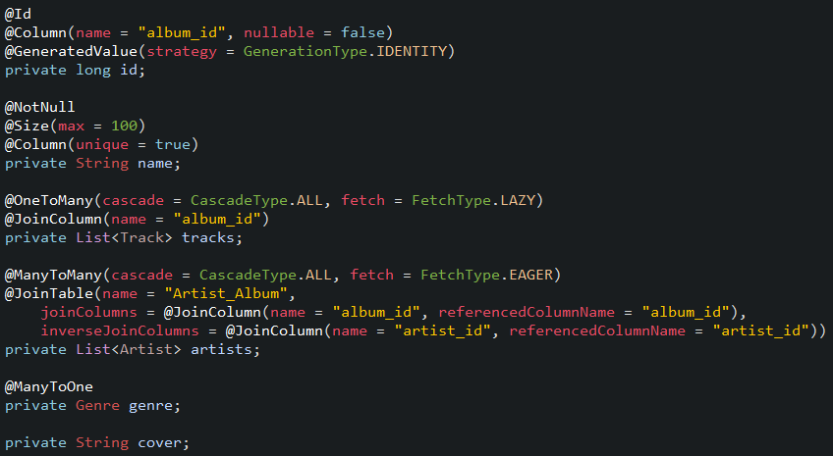
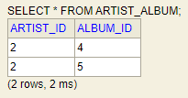
Albums automatically created
Join table automatically populated

Slide 32
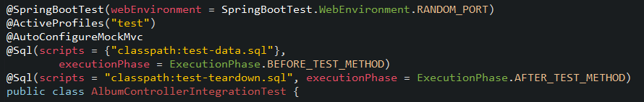
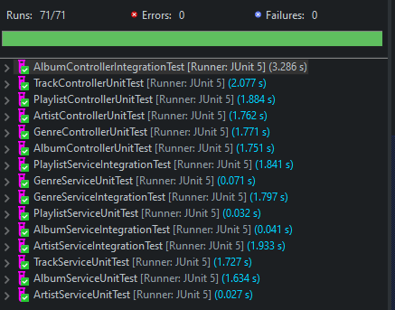

Back End Tests

Slide 33
Non-functional testing - JMeter
Load Tests – Purpose of this test is to make sure the expected load can be handled
Spike Tests – Purpose of this test is to see how well the site can handle users joining in a large amount at a specific time
Soak Tests – Purpose is to run over a long time (normally 3 days/weekend) to see how well it handles prolonged usage
Stress Tests – Purpose is to overload the system and see how well it copes

Slide 34
ANY QUESTIONS?

