Slide 1
Signal.
Operational issue & risk management
FHNW · AI-assisted Software Development
20 October 2026
Notes:
Capstone introduction. Signal connects issues, accountable owners, risk assessments and corrective actions. All people and portfolio records are fictional demo data. The application itself does not use an LLM.

Slide 2
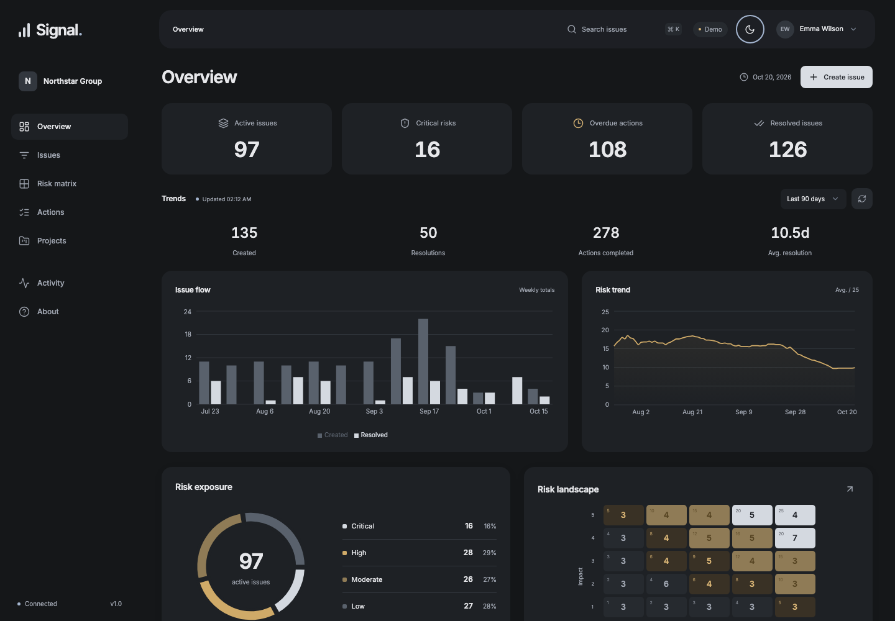
The operational workspace
219
fictional issues
25 / 25
matrix cells populated
Signal
02
Notes:
Show the current admin dashboard. Source: the local application and docs/screenshots/dark-overview.png. The portfolio was expanded additively to 219 fictional issues, with at least three active issues in all 25 risk-matrix cells. Charts replay persisted records rather than random data. Values visible in the screenshot include disposable browser test records.

Slide 3
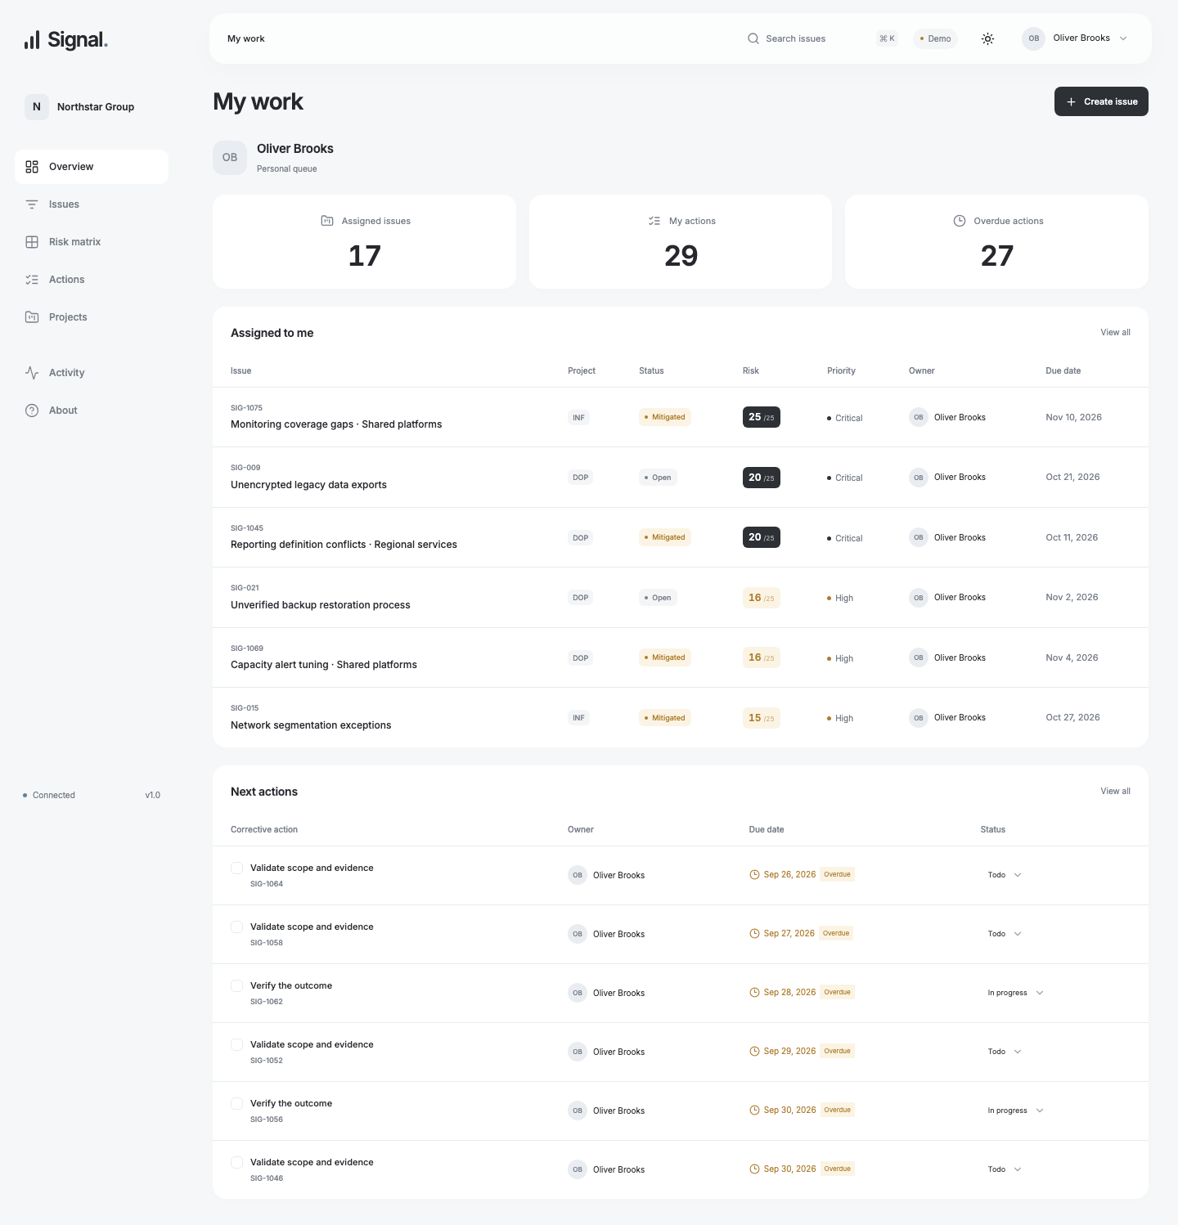
A focused start for each role
Admins
Portfolio exposure
Managers
Project priorities
Members
Assigned issues and actions
Signal
03
Notes:
The existing user roles determine home presentation, not authorization. Admins see the portfolio overview. Managers see the projects they own and their own action queue. Members see assigned active issues and owned actions. All navigation remains available. Demo identity is not production authentication. Source: frontend/src/pages/home.tsx and member-home.png.

Slide 4
Resolution requires evidence
20 → 4
01
Complete the required actions
02
Review residual risk afterwards
Likelihood × impact
03
Resolve with an audit record
5 × 4 before mitigation
2 × 2 after review
04
Reopen without losing history
Signal
04
Notes:
The domain is authoritative. All non-cancelled actions must be complete, with at least one DONE action and a risk reassessment strictly after the final action completion. Mutations lock the parent row and check expected_version; changes and audit commit atomically. Reopening retains immutable assessments and comments. Sources: docs/specs/UC-003.md, UC-004.md and domain/rules.py.

Slide 5
Architecture and data boundaries
React + FastAPI
PostgreSQL
User interface and explicit contracts
Application
SQLAlchemy adapters
Alembic migrations
Atomic business + audit changes
Immutable assessment history
Use cases and persistence ports
Domain
Pure scoring and workflow rules
Signal
05
Notes:
The seven domain entities are framework-independent dataclasses. Application services depend on repository and unit-of-work protocols. SQLAlchemy implements those ports; interfaces call application services. The native stack is React/TypeScript, FastAPI, SQLAlchemy, Alembic and PostgreSQL. Source: docs/ARCHITECTURE.md and ADR-001; ADRs remain Proposed pending owner review.

Slide 6
Verified local behavior
66
10
8
backend tests
frontend tests
browser scenarios
Domain / Application coverage
97.7%
Signal
06
Notes:
Sources: docs/evidence/modern-backend.txt, modern-browser.txt, docs/VALIDATION.md and TDD.md. Native validation covers PostgreSQL transactions, stale writes, migrations, scoring, role filters, UI controls and Chromium workflows. Original test-first sequence: 42 failures on explicit stubs, followed by 44 unit passes after implementation. Coverage is not proof of all correctness.

Slide 7
AI-assisted development
Specify
Four use cases before core code
Develop
Observed failures, then implementation
Validate
Real database and browser checks
Owner review and publication remain manual
Local delivery · Docker and GitHub CI remain unverified
Signal
07
Notes:
The human supplied the original scope, stack and autonomy constraints, then refined the UI. Codex authored specifications, proposed architecture, wrote failing tests, implemented, and checked the local result. Human code review, formal ADR acceptance, Docker runtime verification and actual GitHub CI are outstanding. Sources: docs/AI_USAGE.md, TASKS.md, TDD.md, VALIDATION.md. No commits, external deployments or human approvals are fabricated.

Slide 8
Live demonstration
00:00
Role views, themes and portfolio charts
00:45
Create an issue and assess its risk
02:00
Assign and complete mitigation
03:00
Reassess, resolve and inspect history
04:00
Architecture, tests and review limits
Signal
08
Notes:
Five-minute plan. 0:00 role views, 0:40 select a populated risk cell, 1:15 create an issue with score 20, 2:00 plan and complete mitigation, 3:00 reassess to 4 and resolve, 4:00 history and engineering evidence. Use Emma Wilson as admin. Theme controls are in the floating header. Fallback: current screenshots and the verified native commands in README. Docker is configured but runtime execution is unverified; GitHub Actions has not run.

