Slide 1
FORGEOPS ENERGY
01
Problem Statement
INDIAN SME MANUFACTURING / FOUNDRY & FORGING
Energy waste hides
between the meter
and the machine.
BELGAUM FOUNDRY · SYNTHETIC DEMO
9.8
11.2
BASELINE
kWh per good tonne
INCIDENT
kWh per good tonne
Plant teams see the monthly bill. They often lack a trusted, machine-level view of what changed, why it changed, and which fix preserves output.
+14.3%
specific energy intensity
A decision-support prototype for energy-intensive Indian SMEs
SCENARIO VALUES ARE SYNTHETIC
INDUSTRIAL ENERGY DECISION SUPPORT · HACKATHON PROTOTYPE
1 / 12
Notes:
Opening problem framing. The 9.8 and 11.2 kWh/t readings and +14.3% anomaly are from the repository’s synthetic Belgaum foundry fixture, not measured plant data. Challenge context supplied by the team describes limited real-time visibility and high energy cost exposure in SMEs. Design study: PitchDeckInspo’s climate category and Dandelion Energy’s public deck teardown informed the concise problem-first narrative and quantified opening; no company slide or claim was copied. Sources: https://www.pitchdeckinspo.com/categories/Climate and https://startupfundraising.com/library/articles/dandelion-energy-pitch-deck-teardown .

Slide 2
FORGEOPS ENERGY
02
Proposed Solution
Turn a spike into an evidence-backed intervention—with a person still in control.
01
02
03
04
05
Sense
Triage
Investigate
Simulate
Review
Normalize meter, machine and production context
Compare SEC against the line baseline
Gather evidence and test competing causes
Compare cost, downtime and safety limits
Operator approves; measure the result
DESIGN PRINCIPLE
Optimize kWh per good tonne, subject to throughput, quality and safety constraints.
INDUSTRIAL ENERGY DECISION SUPPORT · HACKATHON PROTOTYPE
2 / 12
Notes:
The product loop is based on the current repository workflow and user-supplied challenge. Plant I/O, physical dispatch and independently verified savings are deployment targets, not connections in the current live demo.

Slide 3
FORGEOPS ENERGY
03
Alignment to the Selected Challenge
The challenge asks for practical efficiency gains without disrupting production. Here is how the prototype maps to that brief.
CHALLENGE REQUIREMENT
FORGEOPS ENERGY RESPONSE
Measure energy use
SEC baseline and anomaly view by line / asset
Find the cause
Four-role investigation flow with typed evidence tools
Protect production
What-if options checked against output, quality and safety constraints
Prove the benefit
Baseline-to-scenario comparison; field M&V is a pilot gate
Fit SME conditions
Retrofit-first, vendor-neutral interfaces and staged deployment plan
PROTOTYPE TODAY
Synthetic fixtures · no live OT adapter · no field-verified savings
INDUSTRIAL ENERGY DECISION SUPPORT · HACKATHON PROTOTYPE
3 / 12
Notes:
This slide mirrors the requested hackathon outcomes. Current-product status is cross-checked against README.md and implementation_plan/06_built_so_far.md in the repository.

Slide 4
FORGEOPS ENERGY
04
Key Features or User Journey
One incident, five clear operator decisions.
01
02
03
04
05
Notice
Investigate
Compare
Approve
Verify
Line 2 SEC rises above its baseline
Review compressor, pressure and quality evidence
Test repair and operating scenarios
Plant lead reviews risk, cost and downtime
Compare normalized post-action SEC
HUMAN GATE
The system recommends and prepares a decision. A plant role owns approval; automated machine control is out of scope.
INDUSTRIAL ENERGY DECISION SUPPORT · HACKATHON PROTOTYPE
4 / 12
Notes:
Illustrative user journey for the Belgaum synthetic case. The interface includes investigation, simulation and approval concepts; external CMMS dispatch and real-world verification are not connected.

Slide 5
FORGEOPS ENERGY
05
Technical Approach
A retrofit-friendly decision layer sits above existing plant systems.
PLANT SIGNALS
EDGE & BASELINE
API & ORCHESTRATION
HUMAN DECISION
Meters · compressor · furnace
Normalize · buffer · baseline
React UI ↔ FastAPI contracts
Role-based review and audit trail
Plant historian / MES
SYSTEM 1
SYSTEM 2 · 4 ROLES
ACTION PLAN
Production · quality · events
Fast anomaly triage + guardrails
Planner → Research → Analysis → Execution
Scenario options · work-order draft
ERP / CMMS
DATA & SIMULATION
MCP TOOL LAYER
MEASURE & LEARN
Tariff · work-order context
Synthetic case · engineering models
Typed, scoped evidence retrieval
Normalize outcome; update baseline
Built in prototype
Integration target
Field adapters and live equipment data are not connected. System 1 currently uses a deterministic fallback; Sol-2B is an optional local model path, not a validated GPU runtime.
INDUSTRIAL ENERGY DECISION SUPPORT · HACKATHON PROTOTYPE
5 / 12
Notes:
Architecture status: React/TypeScript workbench, FastAPI backend, four-role pipeline, typed MCP tools and deterministic simulation exist in the repository. The live deployment exposes synthetic demo data. Plant sensors, PLC/SCADA, MES, CMMS, QMS and ERP connections are integration targets. Sol-2B model card: https://huggingface.co/vllm-sr/Decision-2.0-Sol-2B ; local CUDA device visibility has not been confirmed.

Slide 6
FORGEOPS ENERGY
06
Innovation
Spend reasoning effort only when the signal earns it.
SYSTEM 1 · FAST LOOP
SYSTEM 2 · DEEP INVESTIGATION
Screen every state
1
2
3
4
Baseline envelope
Anomaly classification
Deterministic safety checks
Only a confirmed anomaly escalates
Plan
Research
Analyze
Prepare
Causal evidence · physics checks · scenario trade-offs · human review
MODEL FALLBACK ACTIVE IN DEMO
The differentiator is governed decision support: traceable evidence and production constraints sit beside model output.
INDUSTRIAL ENERGY DECISION SUPPORT · HACKATHON PROTOTYPE
6 / 12
Notes:
Product innovation claim is the design of a two-stage industrial decision loop with deterministic guardrails, evidence gathering and human approval. Sol-2B is not described as currently running.

Slide 7
FORGEOPS ENERGY
07
Expected Impact
The demo case models a lower SEC after a leak repair and pressure adjustment.
kWh per good tonne
11.2
MODELLED CASE
−18%
9.8
versus incident peak
9.2
10.2 t/h
throughput constraint held in scenario
97.6%
yield fixture
NORMAL
BASELINE
INCIDENT
+14.3%
MODELED
AFTER ACTION
Synthetic inputs; no plant measurement or independent M&V.
INDUSTRIAL ENERGY DECISION SUPPORT · HACKATHON PROTOTYPE
7 / 12
Notes:
Source: repository synthetic Belgaum fixture and implementation_plan/06_built_so_far.md. 9.8 kWh/t baseline, 11.2 incident, 9.2 modeled option; 10.2 t/h throughput and 97.6% yield are synthetic scenario values. The 18% is calculated from 11.2 to 9.2 and is a modeled case improvement from the incident spike. Relative to the normal 9.8 baseline, 9.2 is 6.1% lower. No measured savings or field M&V is claimed.

Slide 8
FORGEOPS ENERGY
08
Implementation Roadmap
Move from a synthetic workflow to a measured, site-approved pilot.
0–30 DAYS
Prepare
Select one foundry partner; confirm meter points, product mix, tariff and data owner.
Gate: baseline plan signed
31–90 DAYS
Connect
Install a read-only retrofit gateway and collect energy + output signals for a stable baseline.
Gate: ≥95% data completeness
3–6 MONTHS
Pilot
Run anomaly review and shadow-mode recommendations; operator approves each intervention.
Gate: no quality / throughput regression
6–12 MONTHS
Scale
Compare normalized SEC, document payback; replicate through cluster and auditor channels.
Gate: third-party M&V review
NO AUTOMATIC MACHINE WRITES IN PILOT
INDUSTRIAL ENERGY DECISION SUPPORT · HACKATHON PROTOTYPE
8 / 12
Notes:
Proposed roadmap, not a committed schedule. Pilot success gates are recommended acceptance criteria and should be agreed with the participating plant.

Slide 9
FORGEOPS ENERGY
09
Team Introduction
Add a photo, name, profile links, and a short bio for each team member.
ADD PHOTO
ADD PHOTO
ADD PHOTO
ADD PHOTO
K
V
S
V
[Team member 1 name]
[Team member 2 name]
[Team member 3 name]
[Team member 4 name]
About you
About you
About you
About you
Experience & achievements: [add a short summary]
Experience & achievements: [add a short summary]
Experience & achievements: [add a short summary]
Experience & achievements: [add a short summary]
LinkedIn: [add profile URL]
LinkedIn: [add profile URL]
LinkedIn: [add profile URL]
LinkedIn: [add profile URL]
GitHub: [add profile URL]
GitHub: [add profile URL]
GitHub: [add profile URL]
GitHub: [add profile URL]
Editable placeholders — add professional photos, names, experience, achievements, LinkedIn links, and GitHub profile links.
INDUSTRIAL ENERGY DECISION SUPPORT · HACKATHON PROTOTYPE
9 / 12
Notes:
Names and role ownership are taken from implementation_plan/05_team_role_divide_plan.md.

Slide 10
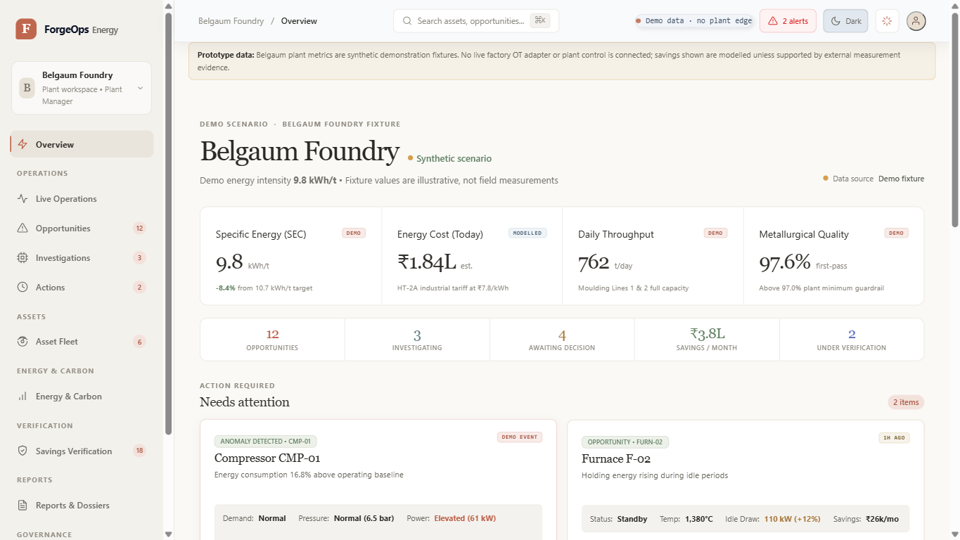
FORGEOPS ENERGY
10
Product Demo: Plant Overview
Current ForgeOps Energy app screen · synthetic demonstration fixtures.
FORGEOPS ENERGY / BELGAUM FOUNDRY
PRODUCT SCREEN
DEMO DATA
Plant overview
NORMAL SEC
CURRENT SEC
THROUGHPUT
SEC anomaly on Line 2
9.8
11.2
10.2
Energy and production KPIs, opportunities, and an explicit synthetic-data notice are visible in the current local app build.
Compressed-air leak hypothesis · review evidence
kWh / good t
+14.3%
t / h
The hosted site may show an earlier deployment than this source snapshot.
ANOMALY
SEC TREND · SCENARIO TRACE
OPEN THE HOSTED WEBSITE
https://forge-ops-energy.vercel.app/
Project source
Baseline envelope
GitHub repository
Repository access may be restricted.
Interface illustration; values are synthetic. Live plant connection is not enabled.
INDUSTRIAL ENERGY DECISION SUPPORT · HACKATHON PROTOTYPE
10 / 12
Notes:
Product screenshot captured from the current local ForgeOps Energy app build on 2026-10-04. The application visibly labels plant values as synthetic demonstration fixtures; no live factory adapter or plant control is connected. Hosted product: https://forge-ops-energy.vercel.app/ . Git remote: https://github.com/shalcoder/ForgeOps-Energy (public access was not confirmed). The hosted site may be an earlier deployment than this local source snapshot.

Slide 11
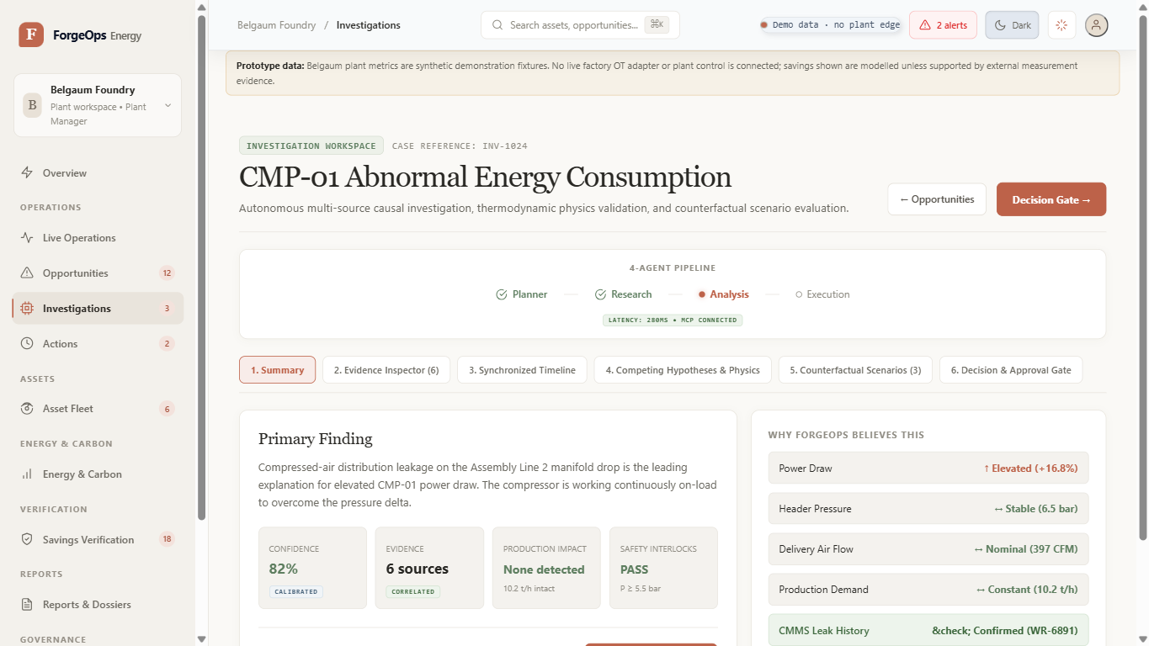
FORGEOPS ENERGY
11
Product Demo: Investigation & Approval
Current ForgeOps Energy app screen · synthetic demonstration fixtures.
PRODUCT SCREEN
COMPETING CAUSES
WHAT-IF OPTIONS
Investigation workspace
Manifold gasket leak
OPTION A
OPTION C
OPTION D
Seal repair
Repair + tune
Four-role analysis, evidence review, competing hypotheses, and a human decision gate.
Pressure drop + compressor load align with the SEC spike.
Replace compressor
SEC 9.8
SEC 9.2
SEC scenario
LEADING HYPOTHESIS
₹9.5k · 48 min
₹9.5k · 1.5 mo model payback
₹14.5L · 18 mo model payback
Shown values are synthetic. The prototype records demo approvals; it does not dispatch a live CMMS work order.
Approval gate
Plant lead reviews constraints and evidence; the prototype does not dispatch a real work order.
Website and source links
ForgeOps Energy website
Project GitHub repository
Team profiles are placeholders on slide 9.
All option outputs and payback figures are scenario estimates from synthetic inputs.
INDUSTRIAL ENERGY DECISION SUPPORT · HACKATHON PROTOTYPE
11 / 12
Notes:
Product screenshot captured from the current local ForgeOps Energy app build on 2026-10-04. The investigation view uses synthetic demonstration data. Agent labels and workflow demonstrate the prototype; no real plant telemetry or CMMS integration is connected. Website: https://forge-ops-energy.vercel.app/ . Repository: https://github.com/shalcoder/ForgeOps-Energy (public access was not confirmed).

Slide 12
FORGEOPS ENERGY
12
Market, Business Viability & Revenue
Start where energy audits, retrofit decisions and financing already meet.
BEACHHEAD
REVENUE MODEL · PRICING ASSUMPTIONS
ILLUSTRATIVE SITE ECONOMICS
Foundry & forging SMEs
₹45k–₹1.2L
3.65 GWh/y × ₹7.80/kWh
ADEETIE spans 60 clusters and 14 energy-intensive sectors. BEE describes an initial coverage of about 9,000 units.
gateway + installation
10% energy reduction → ₹28.47L gross annual savings
₹6k / month
₹0.72L/y subscription
site subscription
₹1.2L install → ~0.52-month simple payback*
9,000
+
Energy audit / DPR / M&V via qualified partners
potential initial units
Modeled, not customer-verified
3.65 GWh × ₹7.80 = ₹2.847cr annual bill; ₹28.47L gross savings − ₹0.72L SaaS = ₹27.75L net annual benefit. Illustrative only.
*Assumptions: 3.65 GWh/year site baseline, ₹7.80/kWh, 10% savings, ₹1.2L install and ₹6k/month software. Excludes finance, maintenance, tax and downtime. Scenario only.
Project GitHub: github.com/shalcoder/ForgeOps-Energy (access may be required)
INDUSTRIAL ENERGY DECISION SUPPORT · HACKATHON PROTOTYPE
12 / 12
Notes:
Official scheme sources: BEE ADEETIE overview https://www.beeindia.gov.in/show_content.php?lang=1&level=1&lid=384&ls_id=234 (scheme support and eligible loan interest subvention); SIDHIEE scheme details https://sidhiee.beeindia.gov.in/ProjectComponent/ADEETIE (5% for micro/small and 3% medium enterprises, subject to conditions). Pricing is a ForgeOps Energy planning assumption. Arithmetic: 3,650,000 kWh × ₹7.80 = ₹28,470,000 = ₹2.847 crore baseline bill; 10% savings = 365,000 kWh and ₹2,847,000 = ₹28.47 lakh gross annual savings; subtract ₹72,000 annual subscription = ₹2,775,000 net operating benefit; ₹120,000 / (₹2,775,000 / 12) = 0.52 months simple payback. Assumed emissions factor 0.82 kg CO2e/kWh yields 299.3 tCO2e/year if the same boundary applies. All unit economics are illustrative and unverified; no saving or incentive is guaranteed. Repository URL is https://github.com/shalcoder/ForgeOps-Energy; public access was not confirmed.

