Slide 2


<Name>
<Date>

Slide 3

Outline
Executive Summary
Introduction
Methodology
Results
Conclusion
Appendix

Slide 4
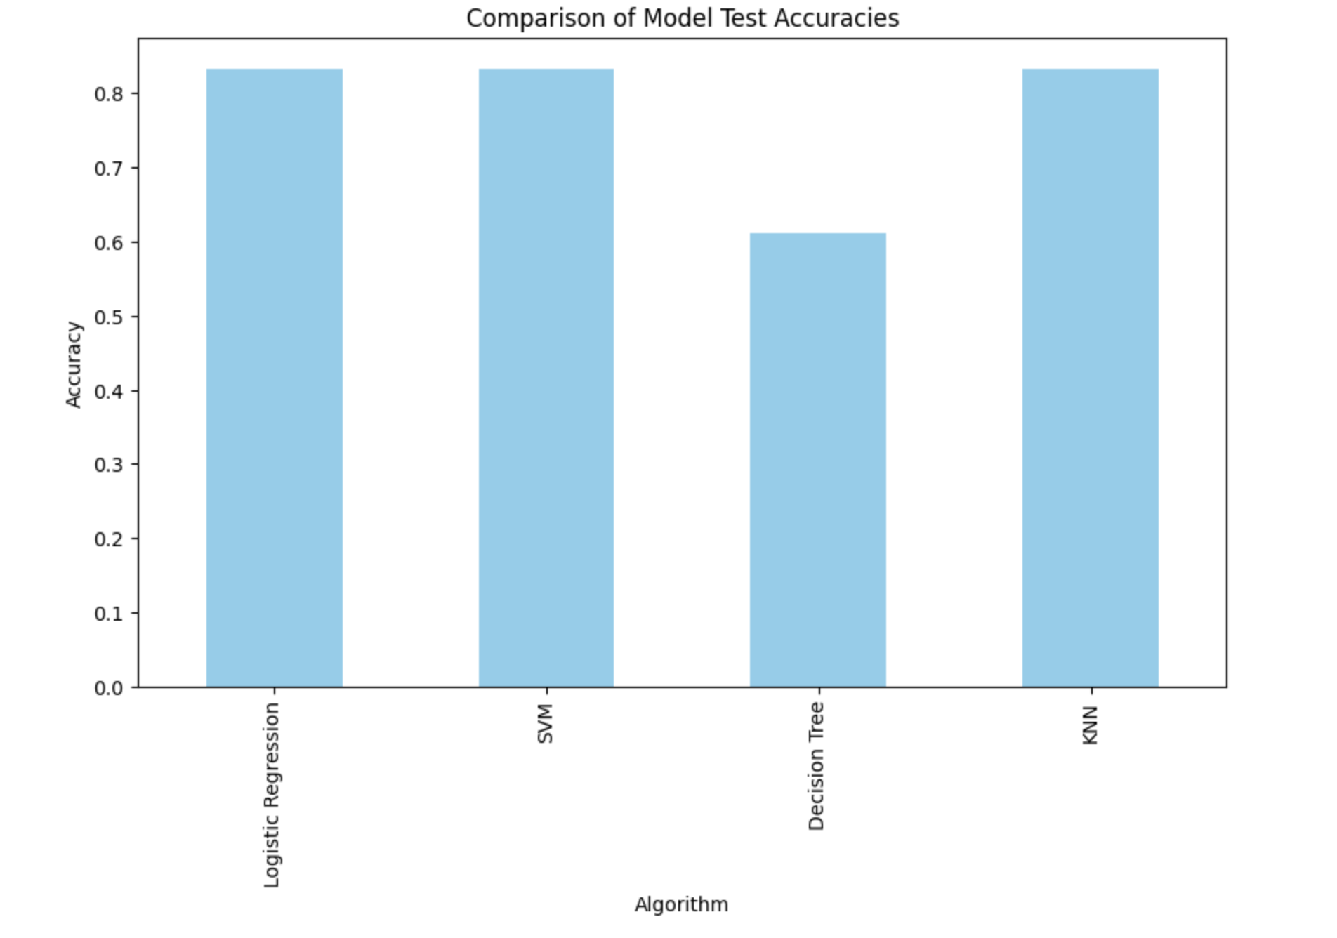
Executive Summary
Data was collected, cleaned and analyzed.
Several models performed well offering a variety of options.

Slide 5
Introduction
The purpose of this project is to predict if SpaceX will recover stage 1 after launch. If SpaceX recovers stage 1 they realize significant cost savings. If they don’t recover stage one it may be a good opportunity for a competitor to bid against them.
Based on the available Data is it possible to predict stage 1 recover and what factors may be best predictors?

Slide 6

Section 1

Slide 7
Methodology
Executive Summary
Data collection methodology:
Publicly available SpaceX data was collected via API and web scraping.
Perform data wrangling
Several landing outcomes were simplified into a simple binary variable for successful or unsuccessful landing.
Perform exploratory data analysis (EDA) using visualization and SQL
Perform interactive visual analytics using Folium and Plotly Dash
Perform predictive analysis using classification models
Several models were built and tuned. Three of the 4 models had similar accuracy giving us multiple predictive options.

Slide 8
Data Collection
Data collection was done from two sources - SpaceX API and web-scraping.
Links to both are provided below:
API notebook
Web-scraping notebook

Slide 9
Data Collection – SpaceX API
EXTRACT:
PARSE:
FILTER:
TRANSFORM:
CLEAN:
Request data from the SpaceX API.
Convert JSON response into a flat Pandas DataFrame.
Isolate Falcon 9 launches.
Extract nested data.
Handle Null Values to create a clean base dataset.

Slide 10
Data Collection - Scraping
SOURCE
REQUEST
IDENTIFY
EXTRACT
EXPORT
Target Falcon 9 Launch Wiki URL
Fetch HTML content using Requests
Parse <th> tags for column headers
Loop through <td> rows for mission data
Clean text & save as dataset_part_2.csv

Slide 11
Data Wrangling
Relationship between different variables examined and visualized.
Features were then engineered for final modeling.
Categorical variables were encoded and numerical variables were cast as floats.
Link to notebook is below:
EDA notebook

Slide 12
EDA with Data Visualization
Payload mass and flight number are examined. - Does success improve with more flights? With lighter payload (more fuel for recovery)?
Launchsite and flight number are examined. Is there a pattern to launchsite usage / success?
Payload mass and launchsite are examined. Are different launch sites used for different payloads?
Success rate vs orbit type and frequency are examined? Are some orbit types more successful than others?
Flight number and orbit type are examined. Is SpaceX strategy changing over time?
Payload mass and orbit type are examined? Are different payloads associated with different orbit types?
Chronological launch trend shows success rate is improving.

Slide 13
EDA with SQL
SQL was used to evaluate launch site data, payload data and booster data - specifically which boosters carried the max payload. Landing outcomes were also ranged by value counts.
Link provided below:
SQL EDA

Slide 14
Build an Interactive Map with Folium
Markers, circles, and lines, were added to a folium map to show the launch sites and the success or failed recovers associated with those launch sites.
Link to notebook is below.
Folium Maps

Slide 15
Build a Dashboard with Plotly Dash
Dash was built to show success rate as it relates to launch site and payload. Launch site is the primary selectable feature on the dash.
Code for this dash was transferred to a notebook. Link is below.
Dash Notebook

Slide 16
Predictive Analysis (Classification)
PRE-PROCESSING
DATA SPLIT
GRID SEARCH
EVALUATION
VISUALIZATION
Define features X and target y.
Segment into Training and Test sets
Tune hyperparameters for optimal results
Score models via Accuracy & R2
Generate Confusion Matrices for error analysis
Link: Model Notebook

Slide 17
Results
Exploratory data analysis results show several interesting relationships we will explore in the next slides - notably SpaceX has become much more successful at recovery over time.
Predictive analysis results show that Logistic Regression, SVM and KNN all performed well on training and testing data. Decision Trees did well on training data but underperformed on testing data.

Slide 18

Section 2

Slide 19
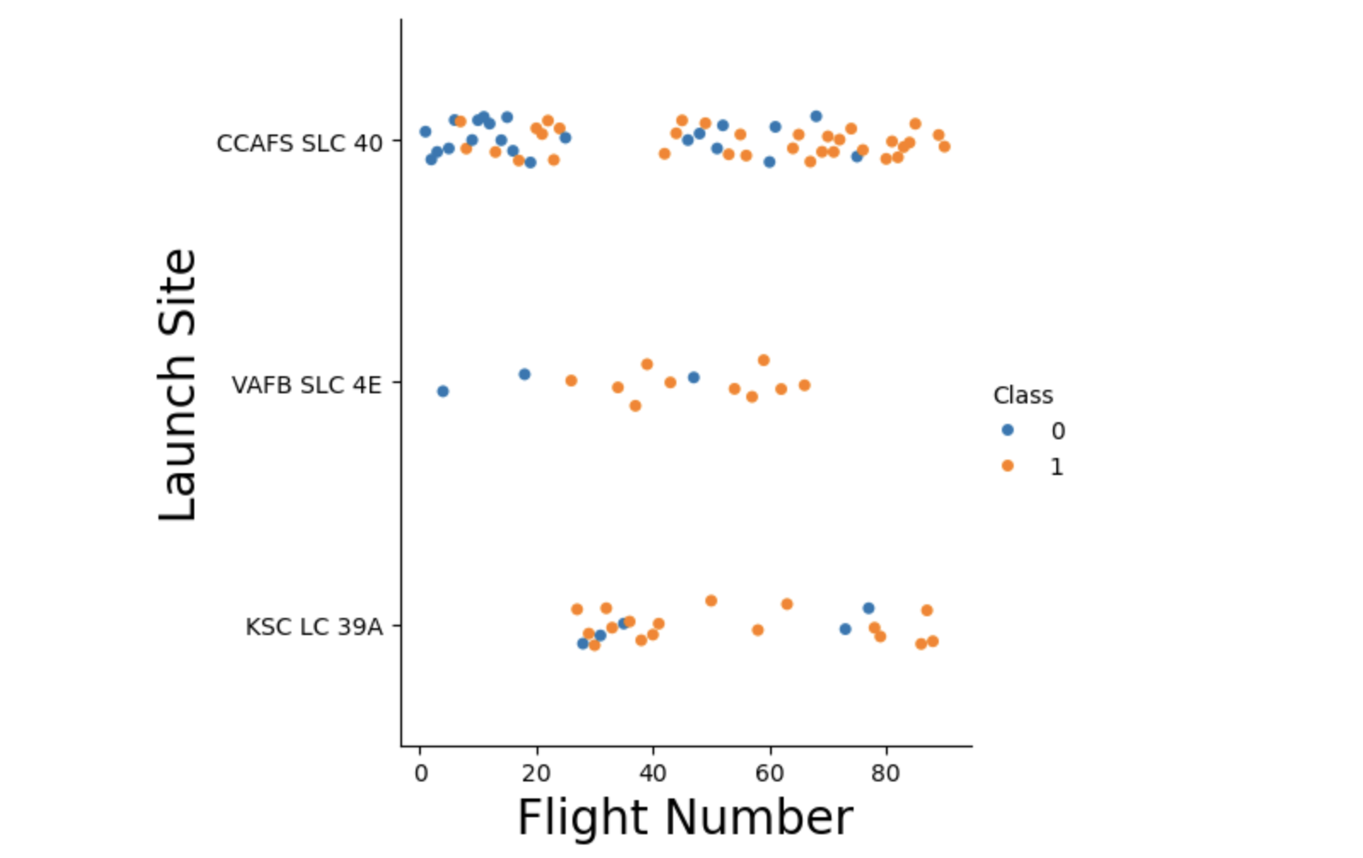
Flight Number vs. Launch Site
SLC 40 Launch site is the most commonly used.
KSC LC 39A launch site took on a higher load of launches for a period of time - it may be an alternate to SLC40.
Success rate improves over time.

Slide 20
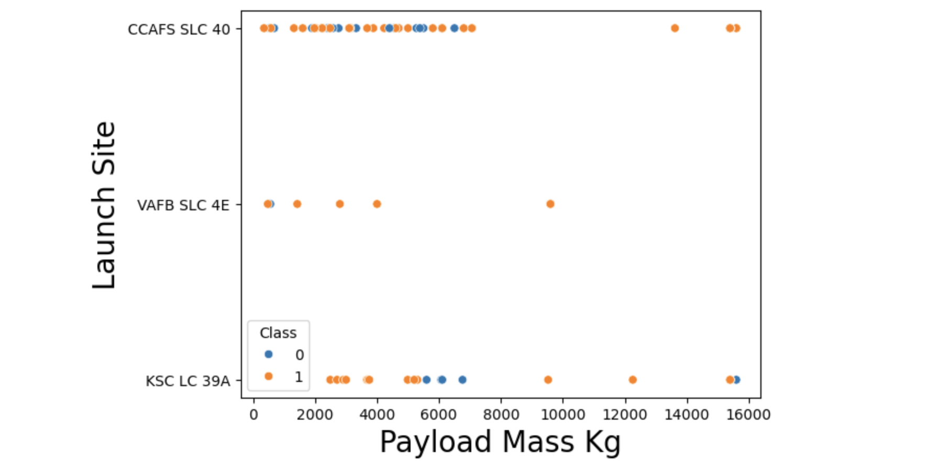
Payload vs. Launch Site
Most payloads are below 10,000
SLC 4E sight has never had payload greater than 10,000

Slide 21
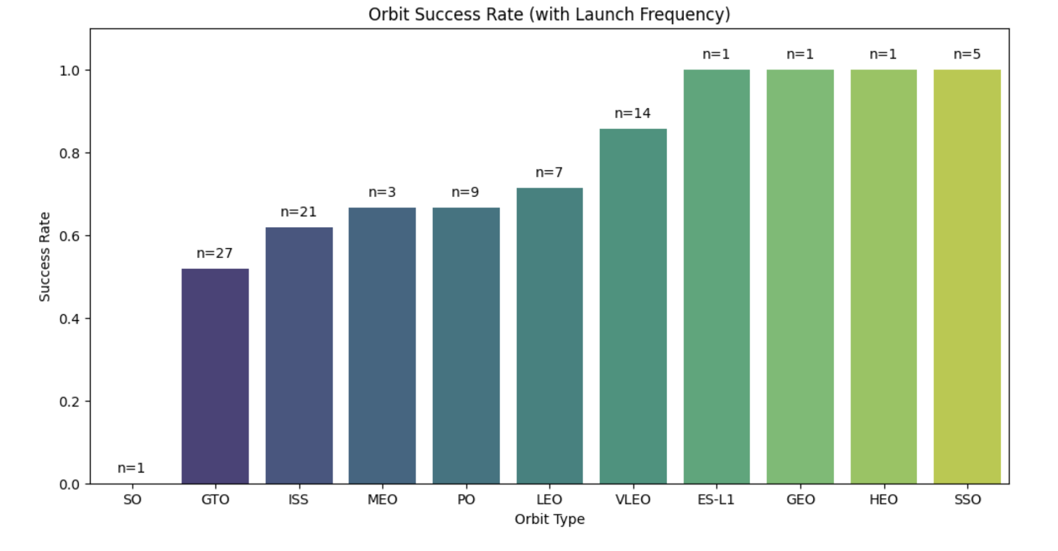
Success Rate vs. Orbit Type
VLEO has a moderate frequency of 14 launches with a success rate above 80%.
GTO has success rate below 60% with a frequency of 27 launches.

Slide 22
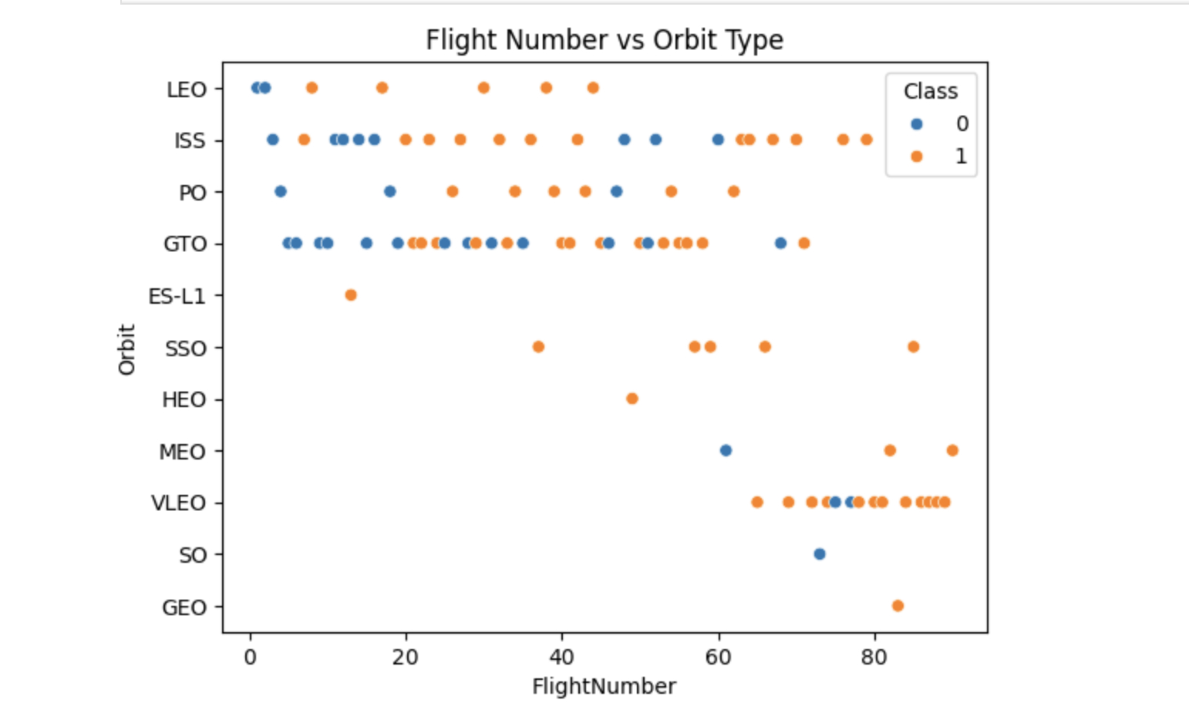
Flight Number vs. Orbit Type
ISS, PO, GTO are most common orbit types.
Uptick in VLEO orbits recently.

Slide 23
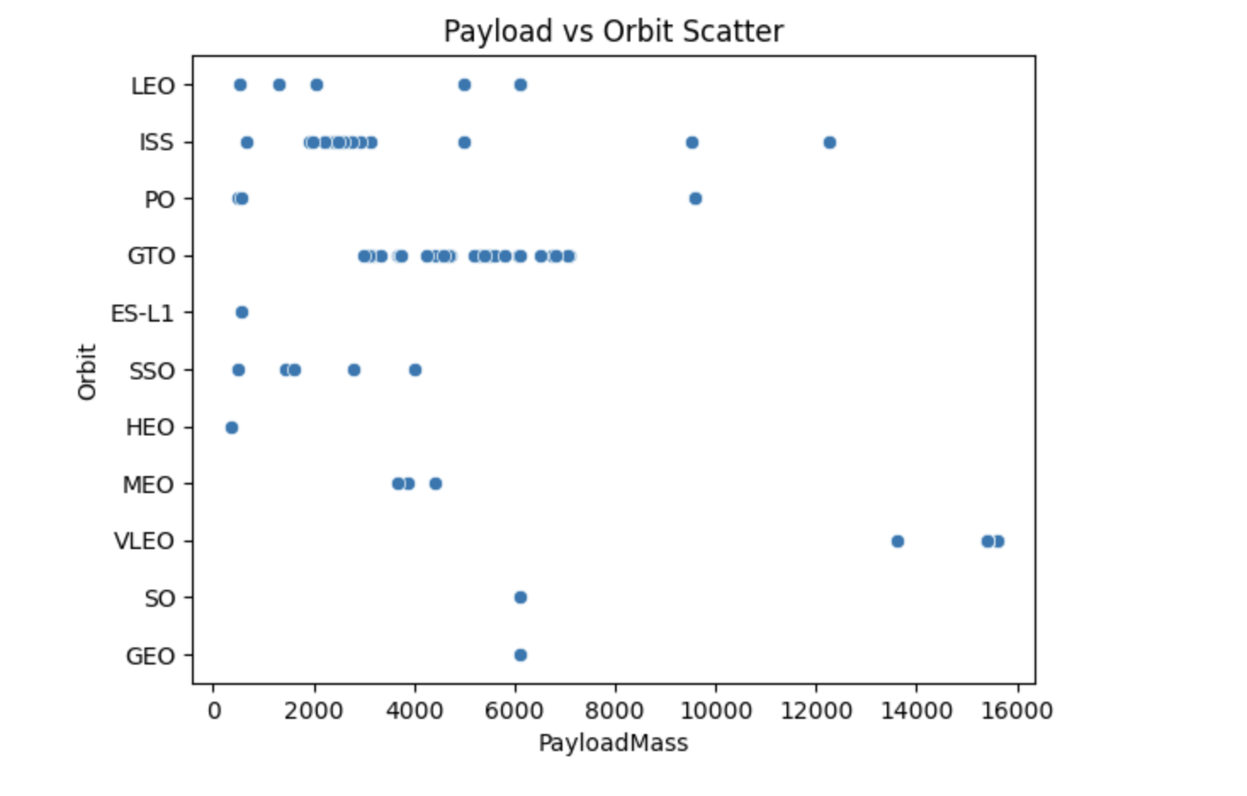
Payload vs. Orbit Type
Clusters or payload for ISS and GTO missions

Slide 24
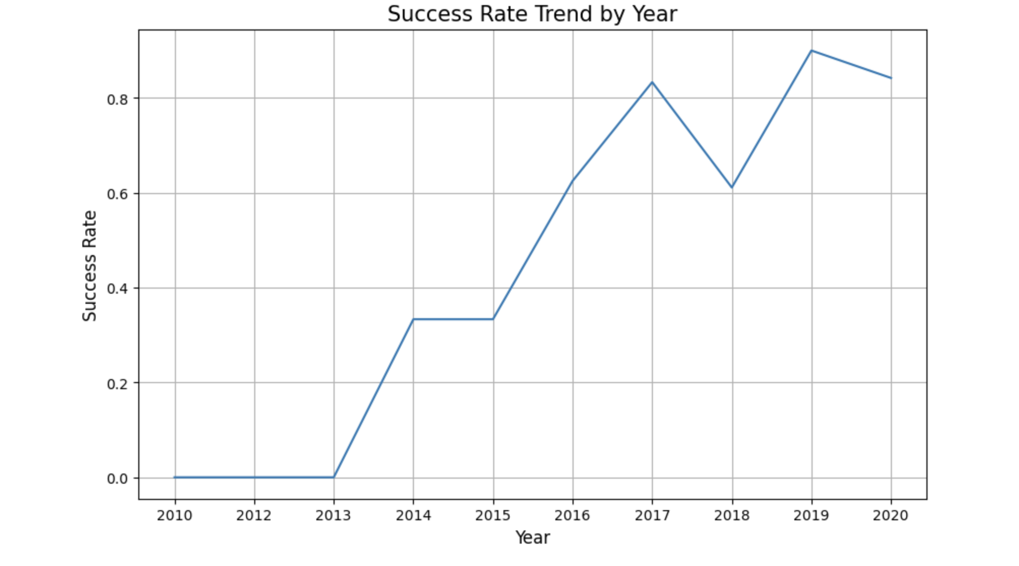
Launch Success Yearly Trend
Clear trend of success increase with time.

Slide 25
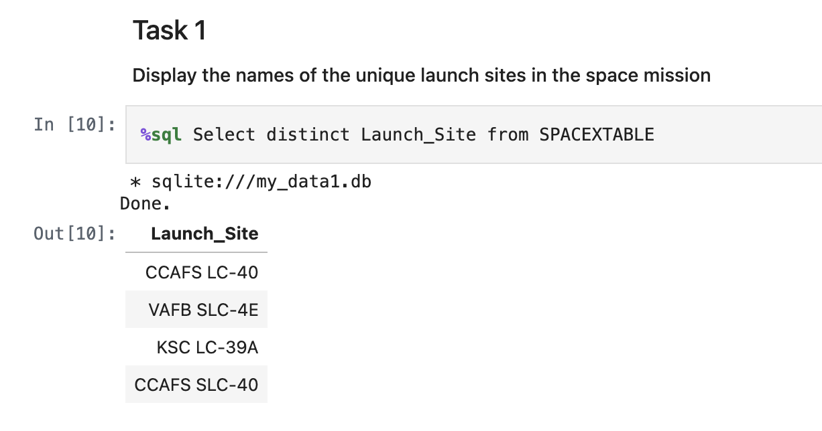
All Launch Site Names
Launch Sites:

Slide 26
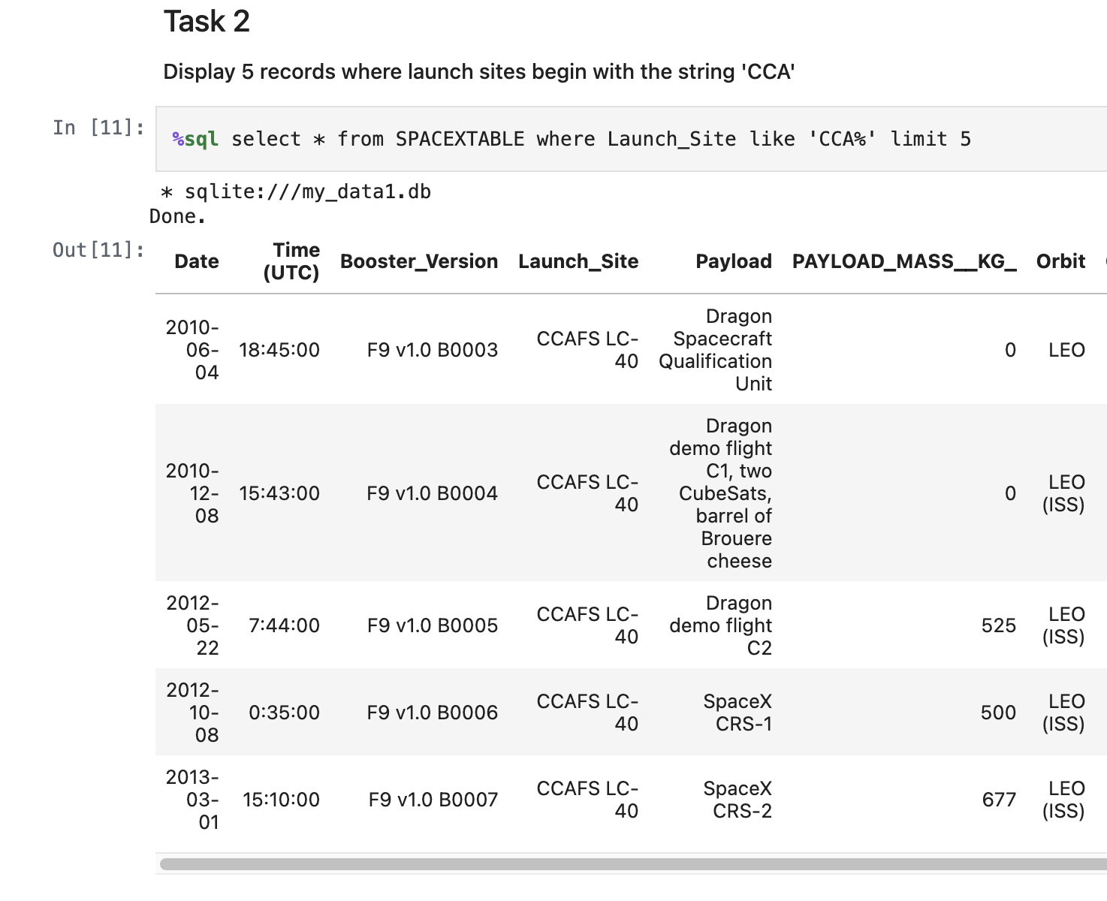
Launch Site Names Begin with 'CCA'
CCA Records:

Slide 27
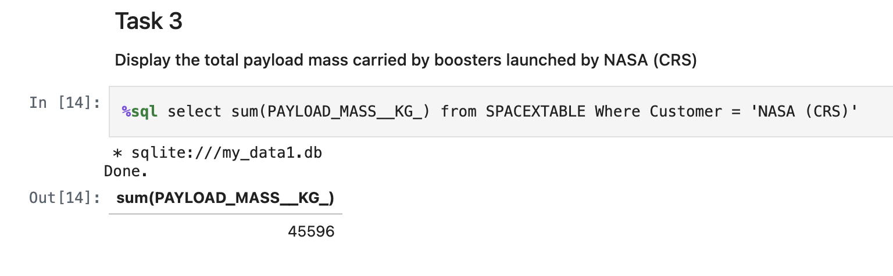
Total Payload Mass
Nasa Total Payload:

Slide 28
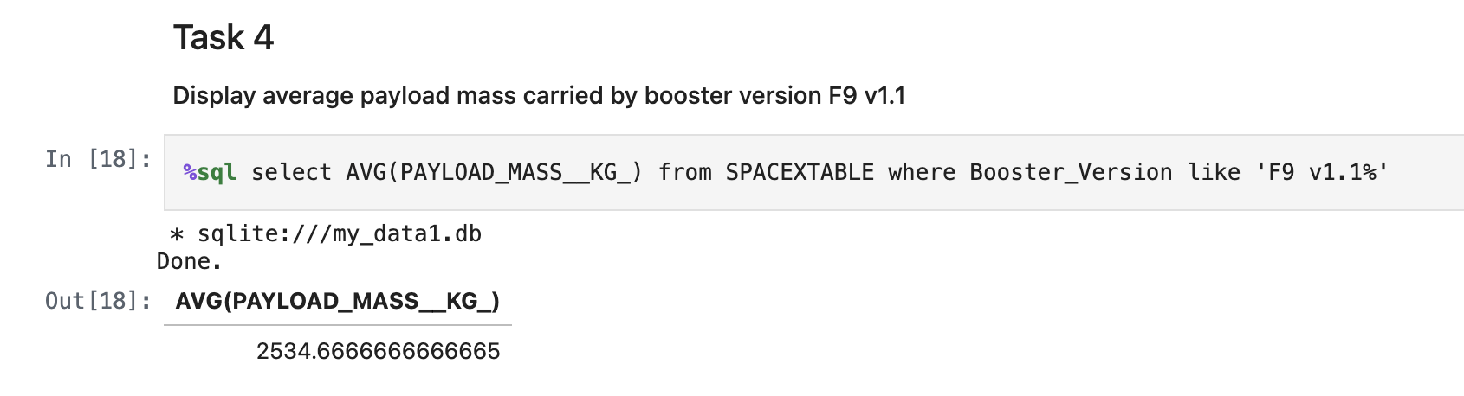
Average Payload Mass by F9 v1.1
Average F9 Mass

Slide 29
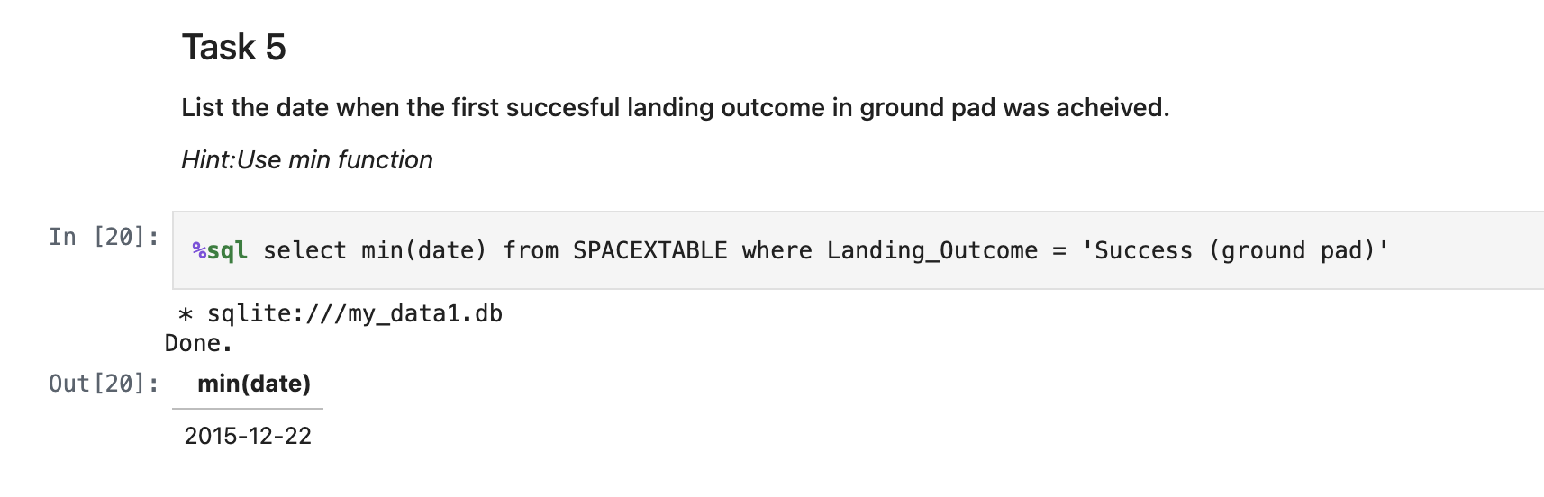
First Successful Ground Landing Date
Find successful ground landing:

Slide 30
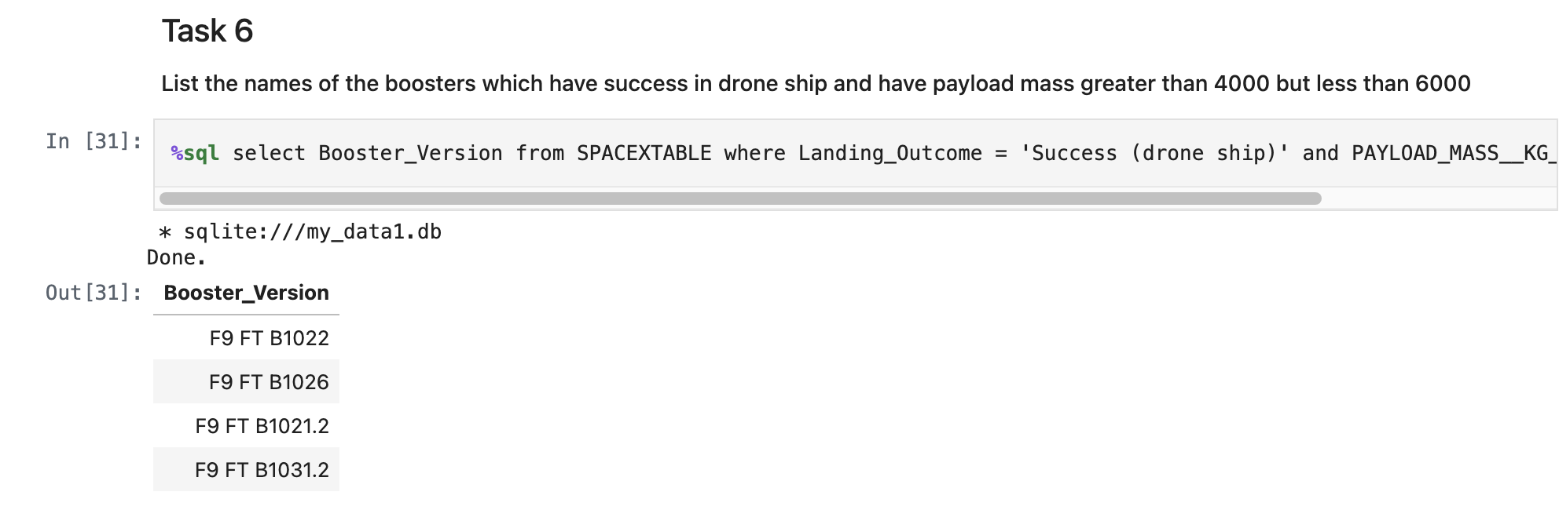
Successful Drone Ship Landing with Payload between 4000 and 6000
Boosters which have successfully landed on drone ship and had payload mass greater than 4000 but less than 6000:

Slide 31
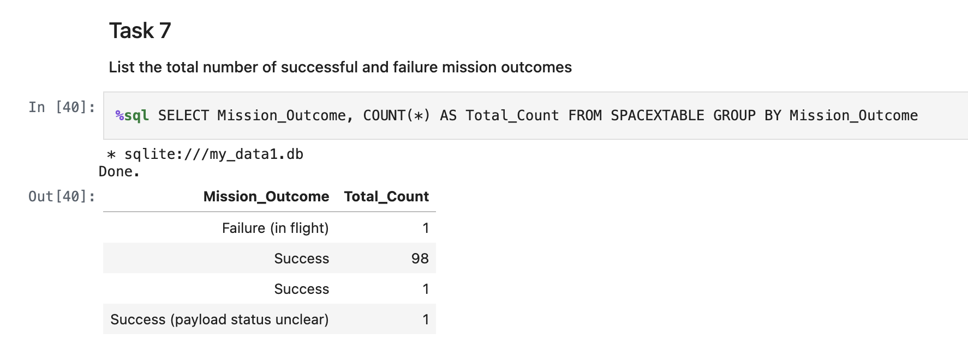
Total Number of Successful and Failure Mission Outcomes
Mission Success vs failure (not recovery success):

Slide 32
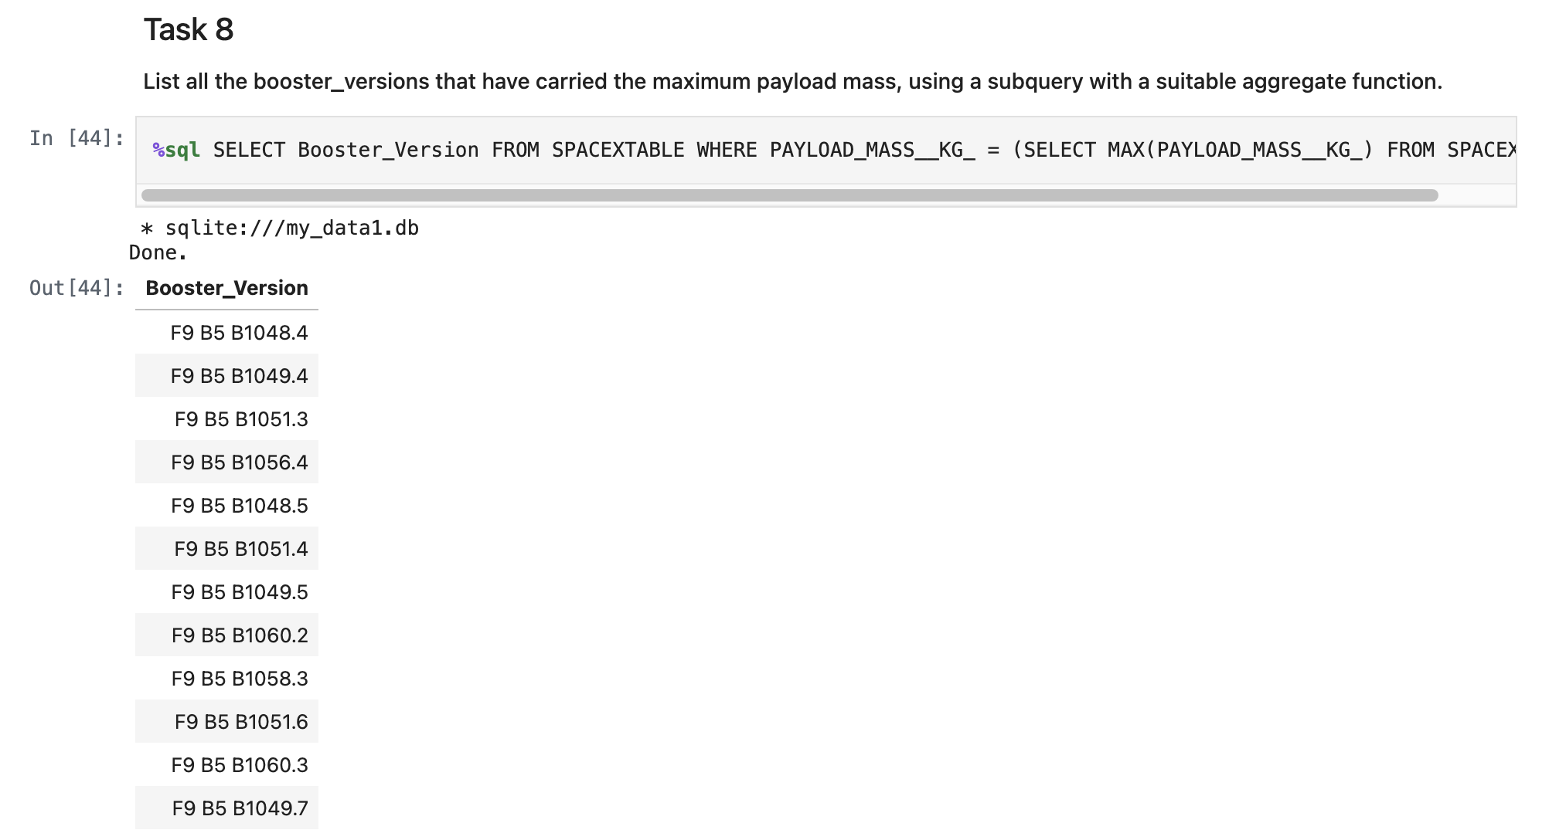
Boosters Carried Maximum Payload
Booster which have carried the maximum payload mass:

Slide 33
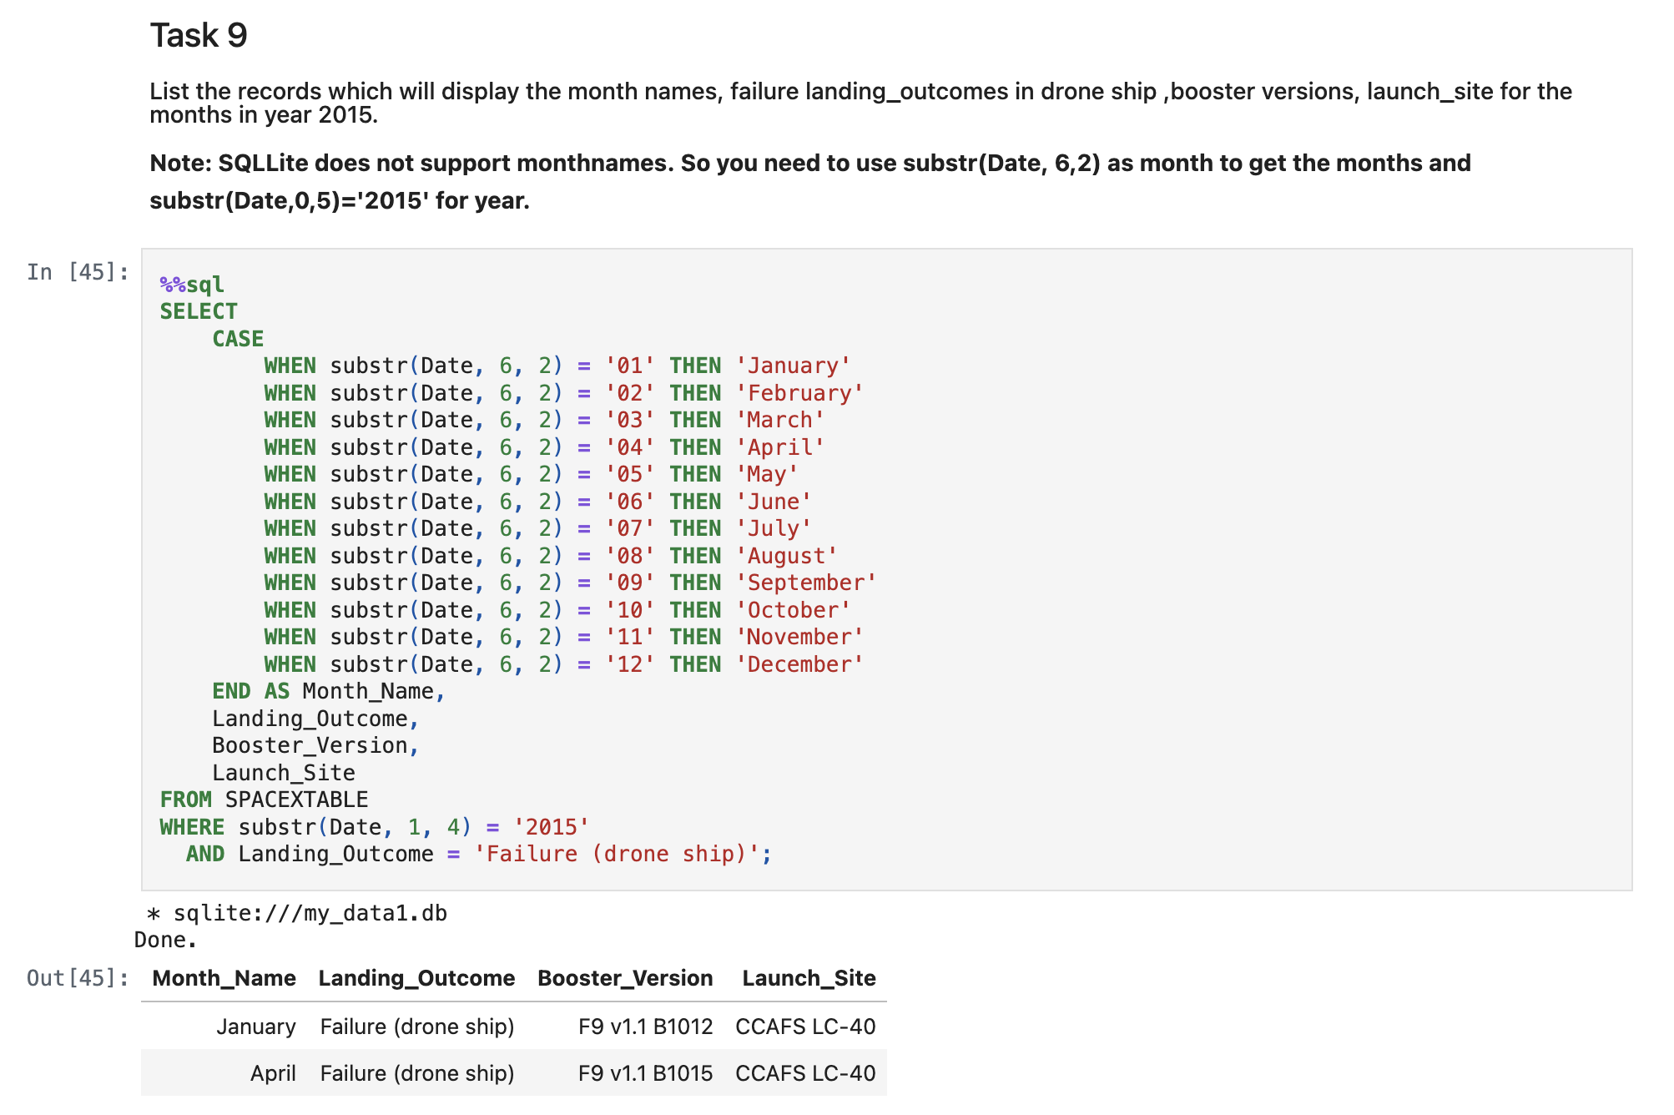
2015 Launch Records
Failed landing_outcomes in drone ship, their booster versions, and launch site names for in year 2015:

Slide 34
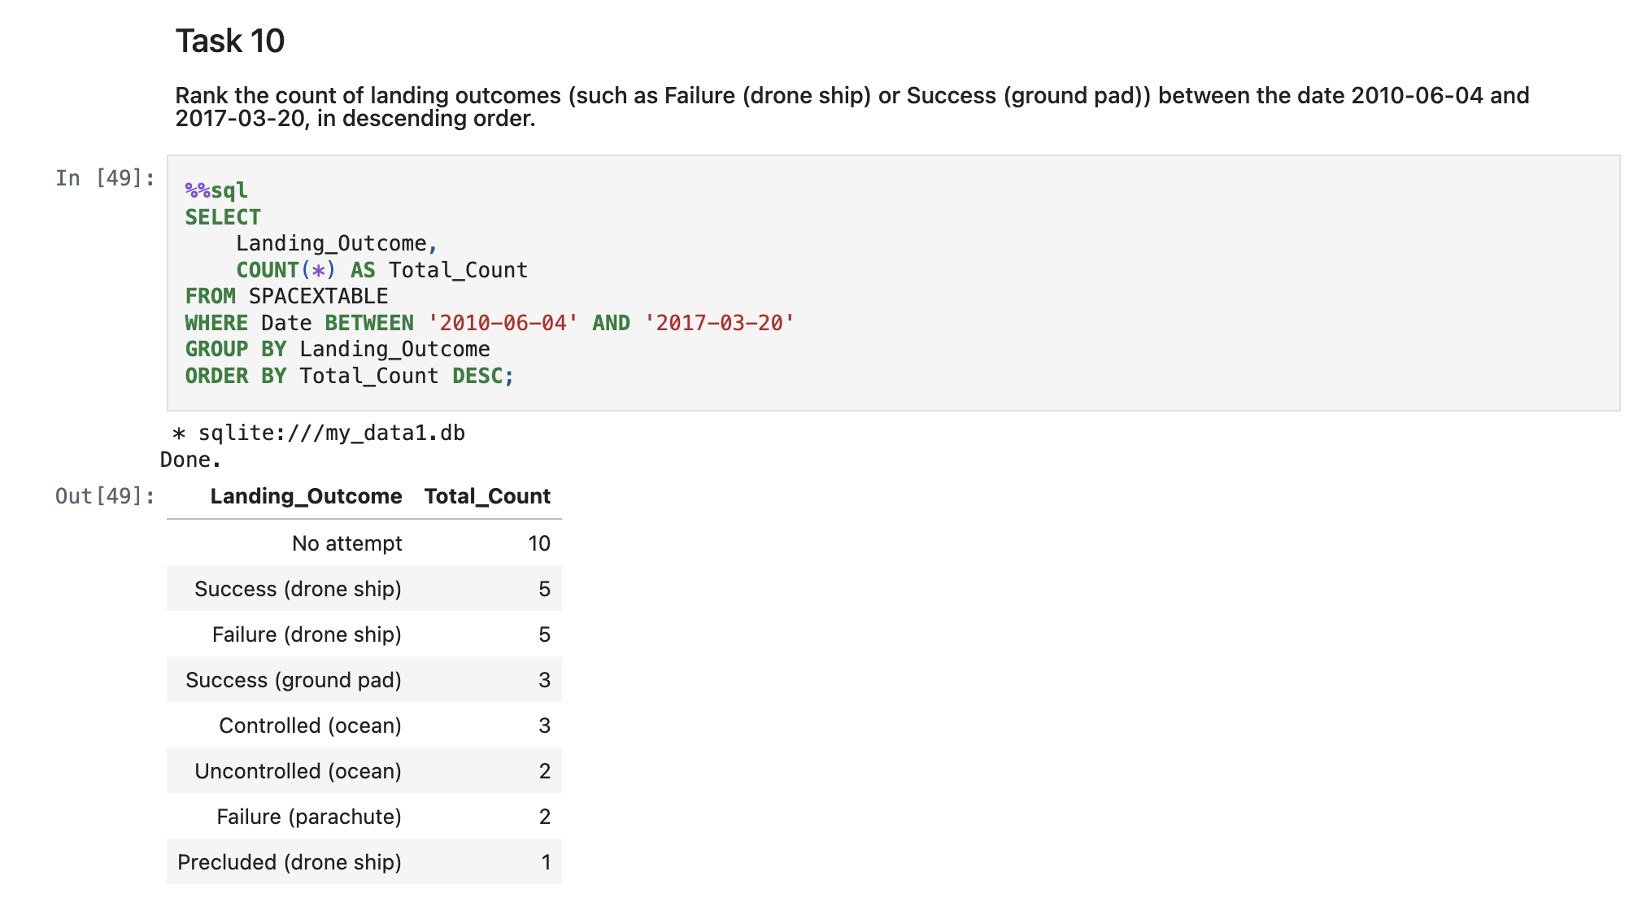
Rank Landing Outcomes Between 2010-06-04 and 2017-03-20
Ranked the count of landing outcomes:

Slide 35

Section 3

Slide 36
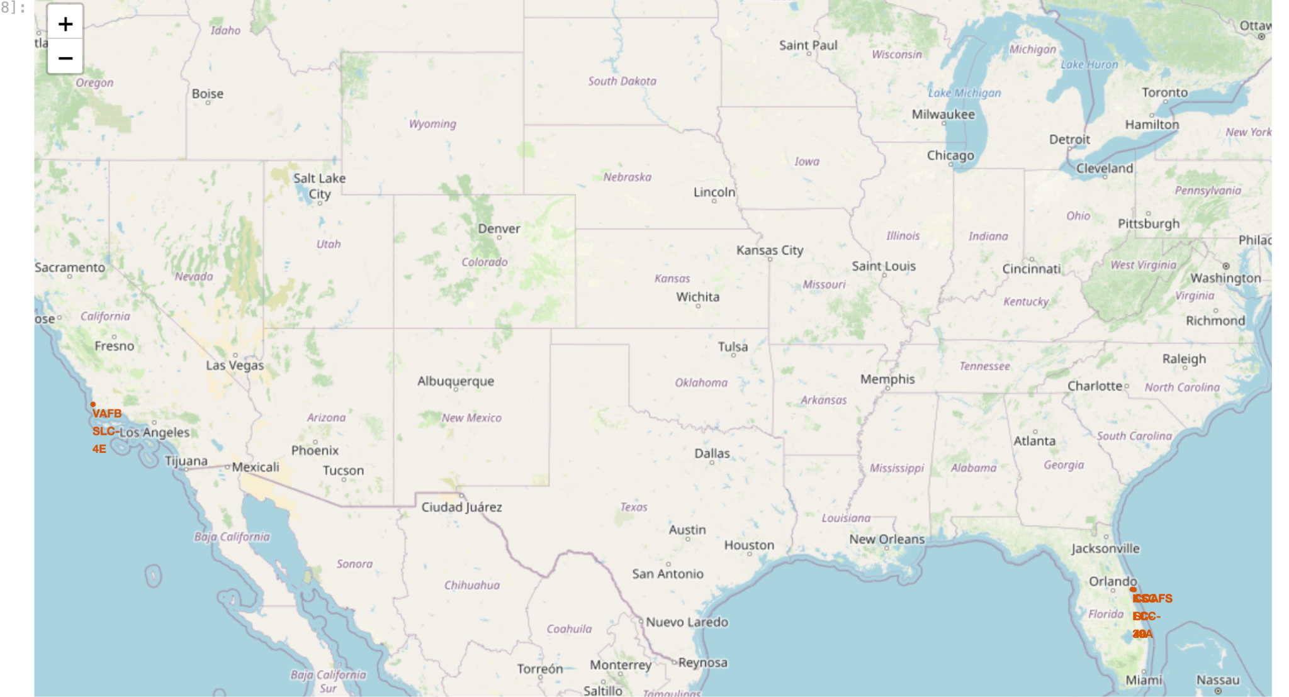
Launch Site Map

Slide 37
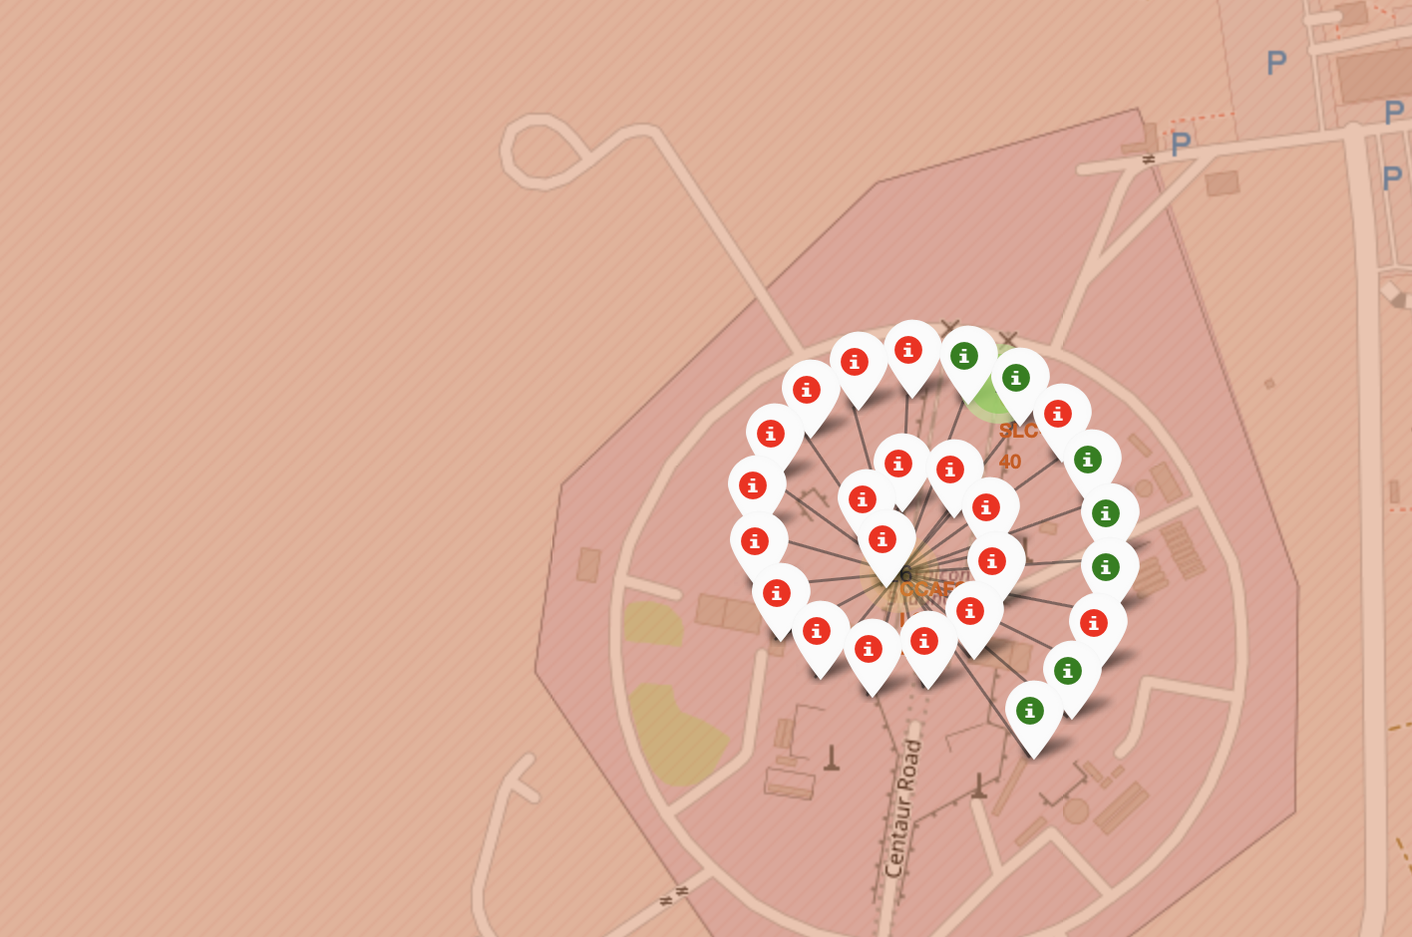
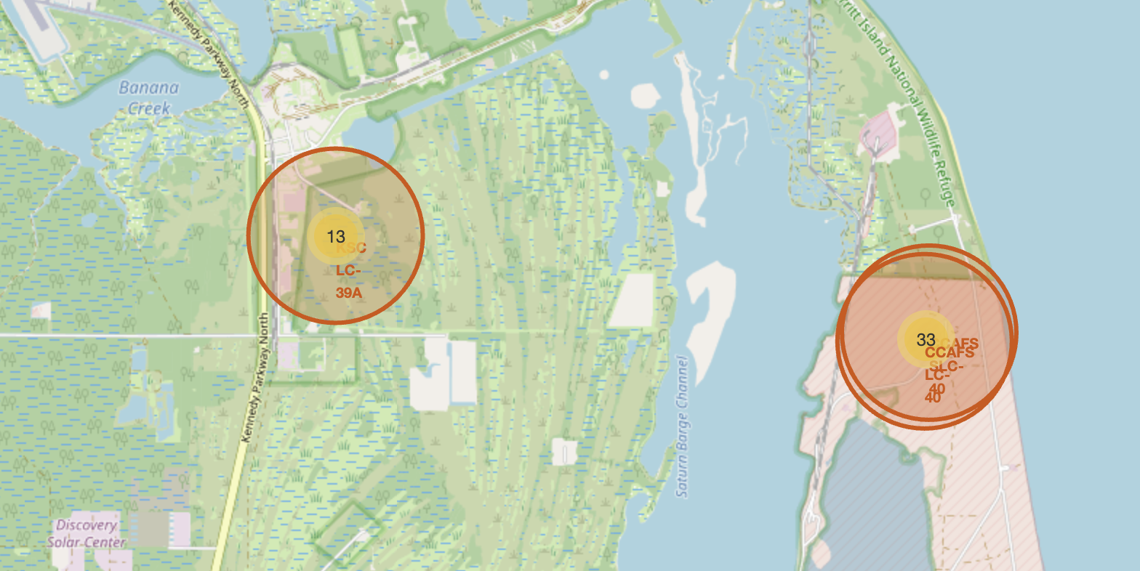
Launch Outcome Maps

Slide 38

Section 4

Slide 39
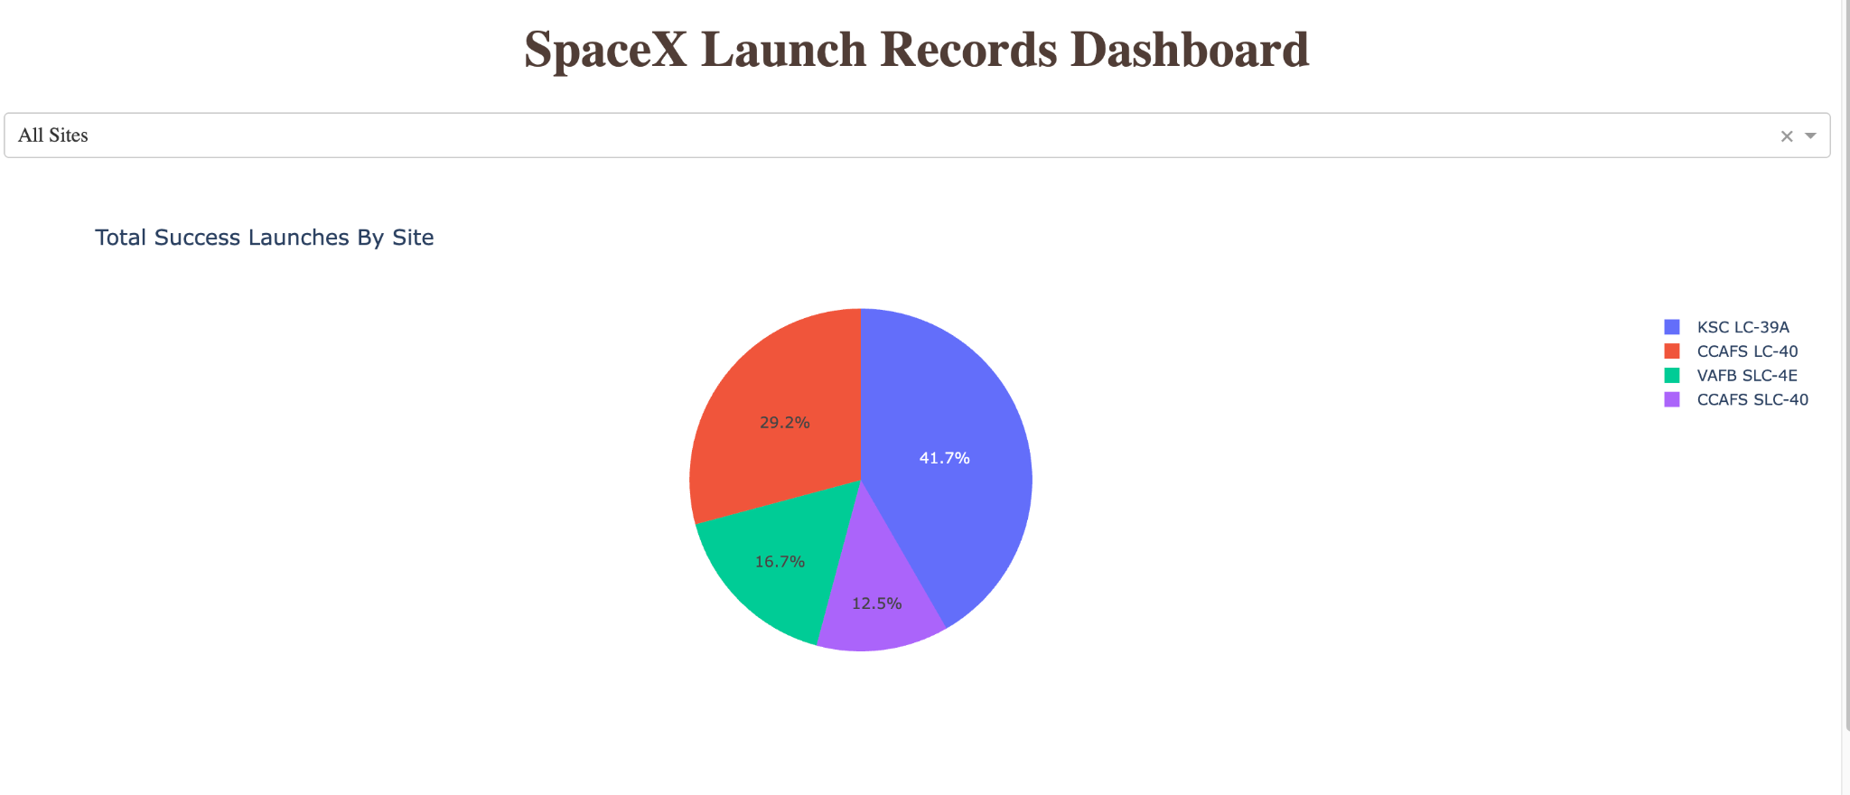
Launch Site Success Dash

Slide 40
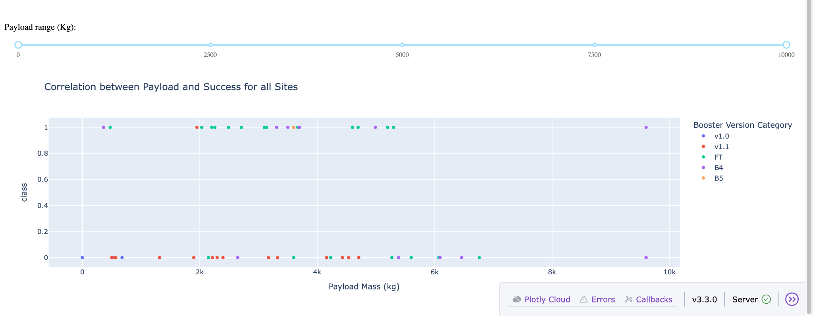
Pay Load vs Success Dash

Slide 41

Section 5

Slide 42
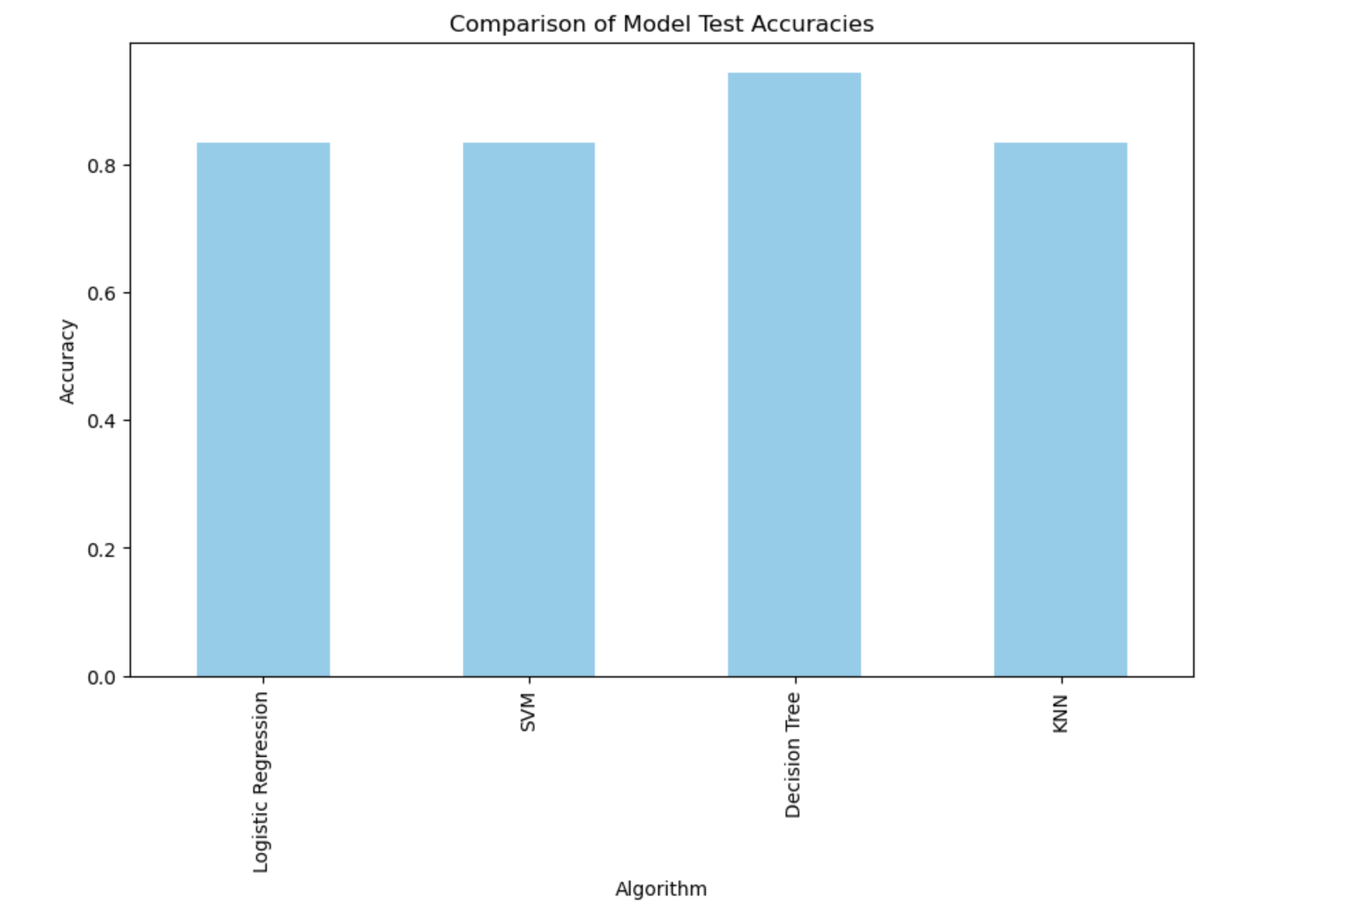
Classification Accuracy
Decision Tree had best Test accuracy

Slide 43
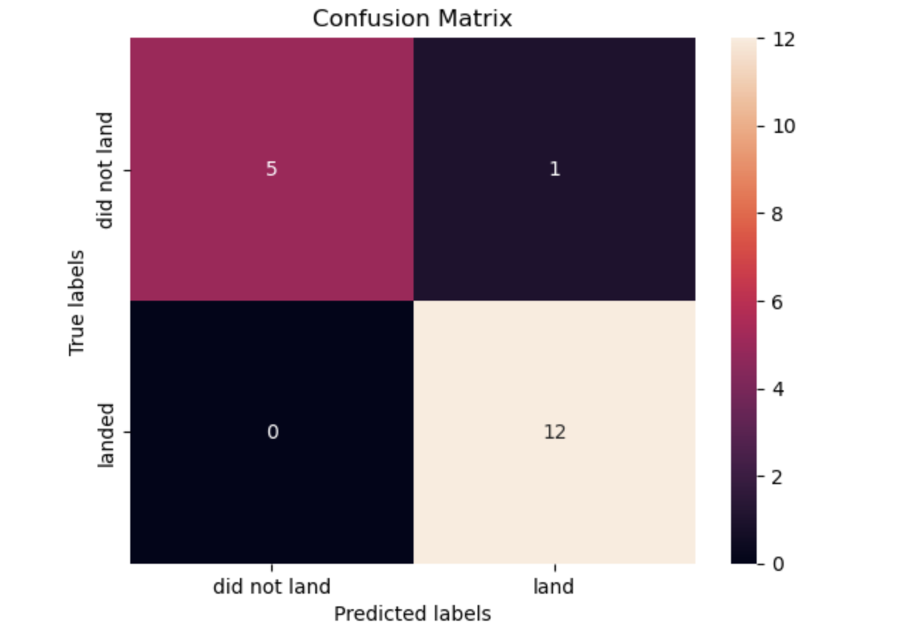
Decision Tree Confusion Matrix

Slide 44
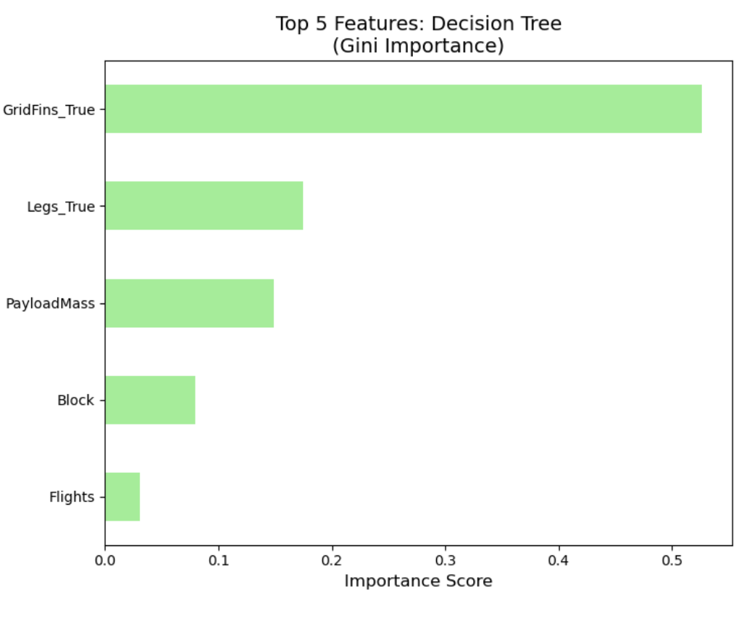
Conclusions
Several viable models.
Decision Tree is best.
Feature importances suggest hardware is major determinant.
Payload and iteration also play key roles.
Heavier payloads may leave less fuel for recovery
Iteration suggests institutional learning.

Slide 45


