Slide 1
Video Quality Assessment Analysis
PROBLEM DESCRIPTION
Video quality assessment is an important aspect of video transmission and delivery. This project aims to analyse subjective video quality (MOS) against the PDU (Percentage Dissatisfied Users), develop and evaluate various models and subsequently analyse the relationship between the two.
Visharad Bansal (201301438)
Shaleen Kumar Gupta (201301429)

Slide 2
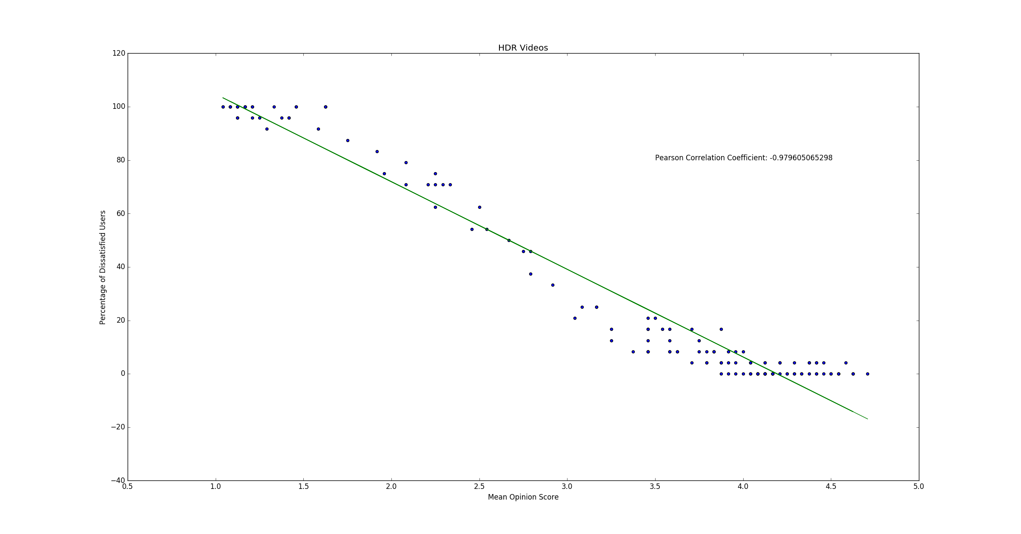
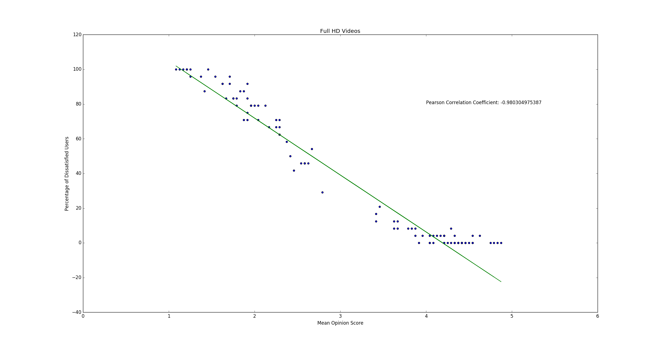
Correlation between MOS and PDUs
Still, you cannot say that the two are inversely related.

Slide 3
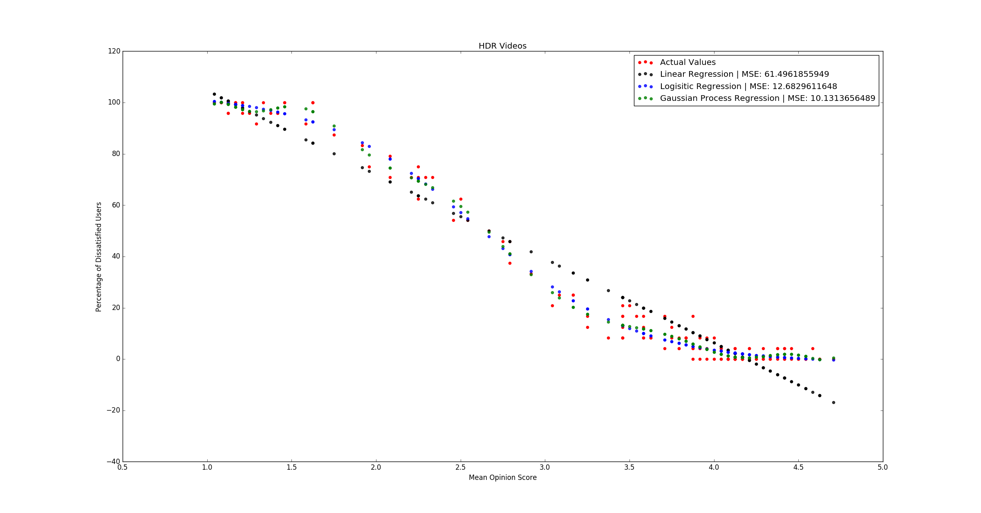
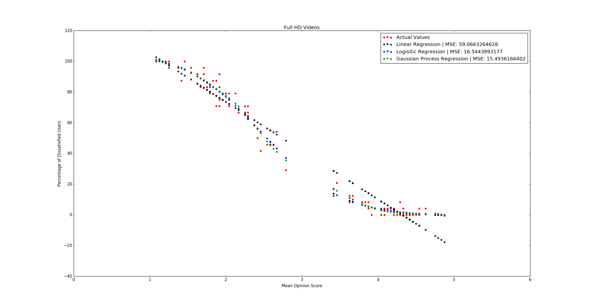
The Prediction Models

Slide 4
F-Test Analysis
 | HDR (F_{critical}= 1.31) |  | Full HD (F_{critical}= 1.39)
 | F - statistic | Null Hypothesis | F - statistic | Null Hypothesis
Linear vs. Logistic | 1.066 | Cannot be Rejected | 1.029 | Cannot be Rejected
Linear vs. Gaussian | 1.005 | Cannot be Rejected | 1.0006 | Cannot be Rejected
Logistic vs. Gaussian | 1.060 | Cannot be Rejected | 1.0299 | Cannot be Rejected
F-Test is not a good idea.
Small sample size
Data not Normally distributed

Slide 5
Non - Parametric Testing (Bootstrapping)
 | HDR |  | Full HD
 | CI (α = 0.05) | MSE | CI (α = 0.05) | MSE
Linear | (49.70, 76.12) | 61.50 | (45.43, 77.13) | 59.07
Logistic | (9.87, 16.51) | 12.68 | (11,68, 23.91) | 16.54
Gaussian | (8.07, 13.22) | 10.13 | (10.65, 22.88) | 15.49
Logistic and Gaussian show no overlap with Linear
Implies that Linear model’s MSE is significantly different from the other two.
Since Linear model’s MSE is larger, linear model comes out to be the worst performing model
Logistic and Gaussian intervals show a good overlap
Implies that the two models cannot be compared on the basis of MSE.

Slide 6
MSE - Training on Full HD videos and Testing on HDR videos
Model | Mean Squared Error | CI (α = 0.05)
Linear | 72.28 | (59.11, 90.21)
Logistic | 16.04 | (12.46, 20.92)
Gaussian | 16.75 | (12.82, 22.04)
Both Logistic and Gaussian models perform well compared to the Linear model.
Linear CI has no overlap with the CI’s of the other two models
Implies that linear model is the worst
However, logistic and gaussian model cannot be compared directly on the basis of MSE

