Slide 1

Namma Santhe
ನಮ್ಮ ಸಂತೆ
Local produce, local shops, local love
HEXAPLUSE (TEAM)

Slide 2
The Problem
Local products deserve a bigger stage!
SELLERS
• Limited online visibility and no searchable digital storefront
• Weak logistics and delivery reach outside walking distance
• High commissions (18% – 35% on large aggregators)
• Inventory and payment struggles with manual paper records
CUSTOMERS
• Few trusted local sellers available online in one place
• Fragmented shopping experience across physical markets
• Limited product assortment information and unknown stock
• Hard to compare nearby options and prices before traveling

Slide 3
Our Solution
Digital storefronts
(Kannada & English Catalog)
Orders
(Real-time live seller alerts)
NAMMA SANTHE
ನಮ್ಮ ಸಂತೆ
Secure payment
(Instant UPI & Escrow)
Delivery tracking
(Hyperlocal partner routing)
Seamless. Simple. Local.

Slide 4

How It Works
1 Discover
Browse nearby verified santhes & neighborhood shops
2 Compare
Check live rates for fresh produce across local stalls
3 Order
Add fresh items to cart with single-click ordering
4 Pay
Fast, secure UPI QR, card, or Cash on Delivery
5 Track
Real-time rider updates right to your doorstep
6 Support Local
Direct fair payment to local farmers and shopkeepers

Slide 5
Key Features
Nearby discovery
GPS radius locator, open/close status, and neighborhood santhe clusters.
Smart compare
Real-time price comparison of fresh produce across local sellers.
Personal offers
Festive discounts, bulk vegetable baskets, and community perks.
Seller analytics
Daily revenue, order volume, bestsellers, and peak hours tracking.
Digital dukaan
Kannada & English storefront, instant photo catalog, and stock toggles.
Secure wallet
Direct UPI payouts to sellers with zero predatory platform commissions.

Slide 6

User Journey
1
Browse local shops
2
Add to cart
3
Checkout
4
Delivery
Shop Local. Support Small.
Build Stronger Communities.

Slide 7
Seller Dashboard
Empowering local micro-merchants with actionable growth metrics
₹1.05L
Revenue
ಮಾಸಿಕ ಬೆಳವಣಿಗೆ | Monthly growth
82
Orders
4
Stock alerts

Slide 8
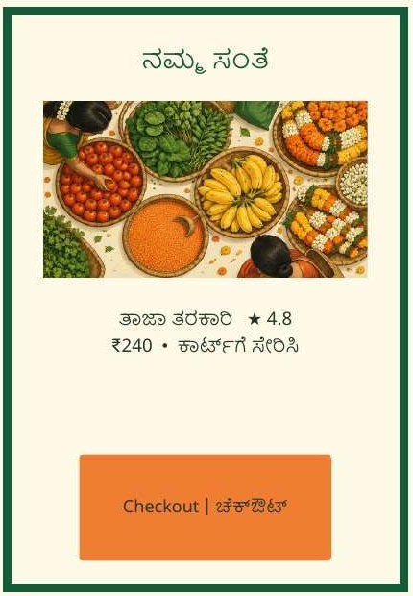
Customer View
A familiar local shopping experience — now in your pocket.
• Nearby shop listings and authentic community ratings
• Kannada & English bilingual product descriptions
• Clear product details, transparent weight units, and live prices
• Simple 1-tap cart and secure checkout with UPI
• Local vendor identity and farm stories front and center

Slide 9
Application Architecture & Database Design
CUSTOMER PWA • SELLER PORTAL
React 19 • TypeScript • Responsive Viewport • Tailwind CSS • Vite
Payment Gateway
UPI 2.0 • QR • Razorpay
API & BACKEND SERVICES
Product Catalog • Live Orders • Geo-Distance Engine • Merchant Analytics
Delivery Services
Hyperlocal Rider Routing
DATABASE & STORAGE
Categories • Products • Orders & Line Items • Sellers • Inventory Locks
Scalable • Robust • Secure

Slide 10
Security & Inventory Reliability
✓
Secure payments
Accurate stock
Protected payments
Responsive support
100% Trust Guarantee
✓
Verified sellers
✓
Real-time stock
✓
Quality assurance
✓
Customer support

Slide 11
Development Roadmap
Execution milestones from MVP to citywide community scale
1
2
3
4
01
Research & MVP
• Hyperlocal catalog
• Customer PWA & cart
• Pilot vendor testing
02
Seller onboarding
• Vernacular listing
• Direct UPI payout
• Merchant inventory app
03
Enhance & scale
• AI price intelligence
• Batch route dispatch
• Multi-santhe clusters
04
Market & engage
• ONDC integration
• Farmer collectives
• Citywide rollout

Slide 12
AI Tools & Tech Stack
Plan, prototype & build
REQUIREMENTS, IDEATION & BRAINSTORMING
Google AI Studio, Gemini, ChatGPT, Claude
Generates PRDs, database schemas, and system architectures. Gathers requirements, outlines business logic, user roles, and hyperlocal discovery features.
PROTOTYPING & CODING
Cursor, v0 by Vercel & Lovable
Rapidly scaffolds responsive UI components and writes full-stack code. Instantly turns natural language prompts into working user interfaces.
AGENTIC DEVELOPMENT
Antigravity & Open Code
Agentic development platforms where AI agents plan, build, run, and test application features and integrations autonomously.
ANALYTICS & INTELLIGENCE
Gemini API
Powers smart personalized product recommendations, vernacular voice search understanding, and bilingual Kannada-English catalog translation.

Slide 13
AI Tools & Tech Stack
Test, document, design & ship
TESTING & DEPLOYMENT
CodiumAI, Oxlint & Vercel
Automatically generates unit tests, runs rapid static code analysis, and streamlines continuous cloud deployment with preview URLs.
RESEARCH & DOCUMENTATION
Obsidian & Gravity Write
Obsidian organizes hyper-local research notes, market studies, and architectural docs. Gravity Write generates crisp customer-facing copy.
DESIGN & VISUAL ASSETS
Canva & Generative AI Studio
Designs branding identities, logos, santhe market illustrations, and high-fidelity promotional banners.
MANAGEMENT & VERSION CONTROL
GitHub
Handles source code tracking, branch protection rules, issue prioritization, and automated pairing workflows.

Slide 14

Support Local. Shop Local.
Grow Local.
ಸ್ಥಳೀಯವನ್ನು ಬೆಂಬಲಿಸಿ. ಸ್ಥಳೀಯವಾಗಿ ಖರೀದಿಸಿ.
ಒಟ್ಟಾಗಿ ಬೆಳೆಯೋಣ.
Support local businesses • Increase farmer incomes
Reduce food waste • Build community resilience
| Thank you
TEAM HEXAPLUSE

