Slide 1

The Use of Strontium Isotope and Element Geochemistry to Characterize Water from Fossil Fuel Sources
Liz Chapman, PhD, Geochemist
ECHELON Applied Geosciences
© Copyright 2014 EchelonAGC

Slide 2
Monitoring & Risk Assessment:
Sensitive Tools Required
For a variety of fluids (fresh water, brines, AMD-impacted and co-produced waters)
And many geologic rock types and materials
Coal, shale, permeable limestone and sandstone aquifers
Deep and shallow units
Cements/grouts/combustion byproducts (coal fly ash)
Must be able to identify contaminant source as well as provide ongoing monitoring
Introduced tracers
Major and trace element geochemical signatures
Natural isotopic signatures
© Copyright 2014 EchelonAGC

Slide 3
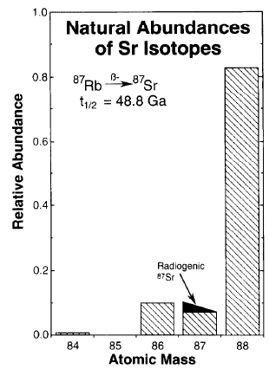
Strontium Isotopes: ⁸⁷Sr/⁸⁶Sr
Four naturally-occurring stable isotopes, including ⁸⁷Sr and ⁸⁶Sr
⁸⁷Sr is supplemented by the slow decay of ⁸⁷Rb (‘radiogenic isotope’)
Half-life: 48.8 Ga
⁸⁷Sr/⁸⁶Sr increases with time
Capo et al., 1998
© Copyright 2014 EchelonAGC

Slide 4
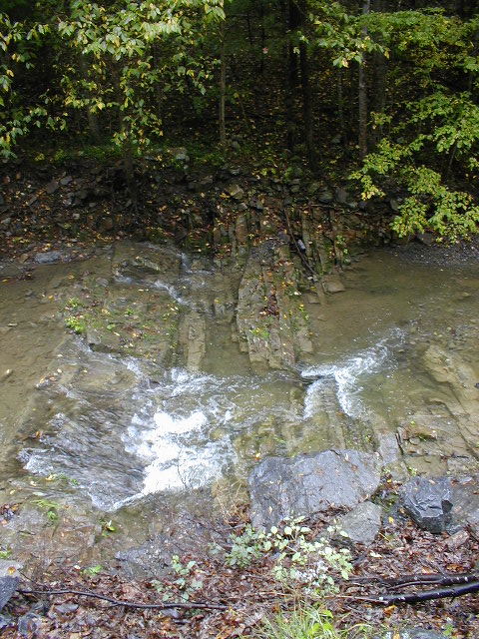
Strontium Isotopes
Rocks with different compositions and geological histories develop distinct ⁸⁷Sr/⁸⁶Sr ratios
Reflect sources of Sr available during formation
Waters which interact with these units can inherit their ⁸⁷Sr/⁸⁶Sr
⁸⁷Sr/⁸⁶Sr in geologic materials is an indicator of both age and geochemical origin
© Copyright 2014 EchelonAGC

Slide 5
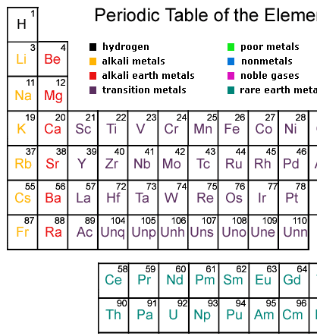
Why Strontium?
Systematics understood
Ubiquitous and abundant
One of the most abundant trace elements in crustal rocks
Proxy for calcium
Does not fractionate appreciably during physical, chemical, or biological processes
© Copyright 2014 EchelonAGC

Slide 6
Strontium Isotopes: Epsilon Notation
© Copyright 2014 EchelonAGC

Slide 7
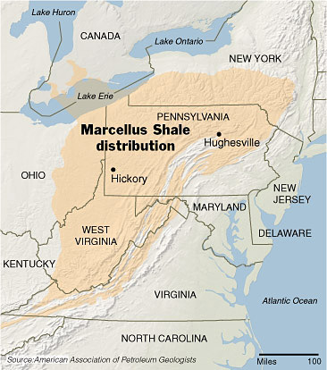
Isotope characterization of produced waters from Marcellus Shale gas extraction
Marcellus produced waters
Four Pennsylvania counties
Bradford
Westmoreland
Washington
Greene
Different sample types:
Individual well single samples
Impoundment samples
Produced water time series
Chapman et al., 2012; Kolesar et al., 2013; Capo et al., 2014

Slide 8
Marcellus Produced Waters
⁸⁷Sr/⁸⁶Sr
0.710
0.711
0.712
16
14
Bradford Co.
Bradford Co.
12
10
Washington Co.
n
Westmoreland Co.
8
Greene Co.
6
4
2
0
10
20
30
40
50
ε
SW
Sr
Chapman et al., 2012

Slide 9
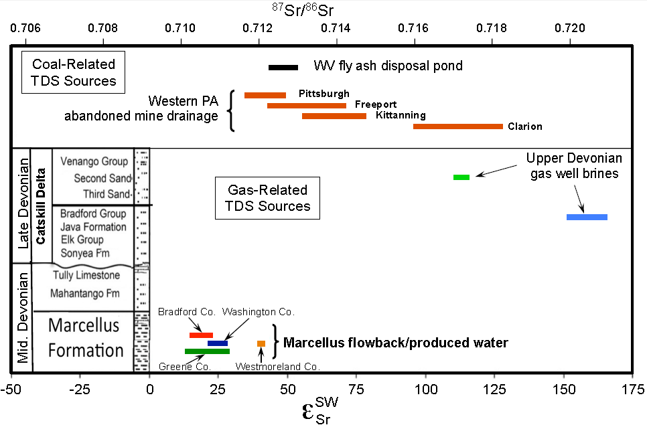
Marcellus Produced Waters vs Other Fossil Fuel-Related Fluids
Capo et al., 2014

Slide 10
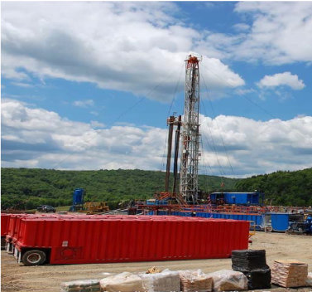
Potential Applications
Determination of origin of dissolved constituents in surface and ground waters affected by multiple sources
Quantification of mixing
Extremely sensitive tracking

Slide 11
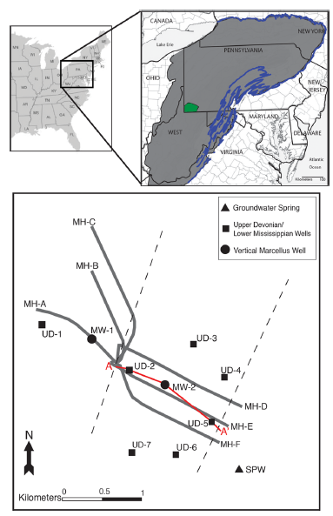
Sensitivity of Sr Isotopes in Monitoring Potential Fluid Migration
Greene County site with:
Six Marcellus laterals
One vertical Marcellus well
Five Upper Devonian (UD) gas wells
One shallow groundwater spring
Sr measured before and after hydraulic fracturing of laterals
Kolesar Kohl et al., 2014

Slide 12
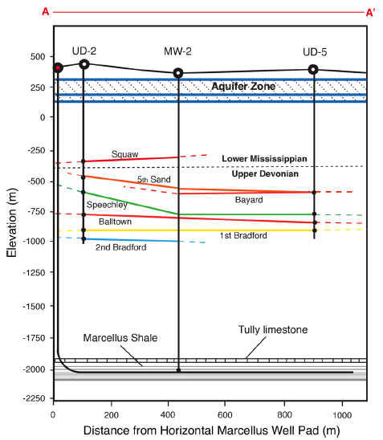
Sensitivity of Sr Isotopes in Monitoring Potential Fluid Migration

Slide 13
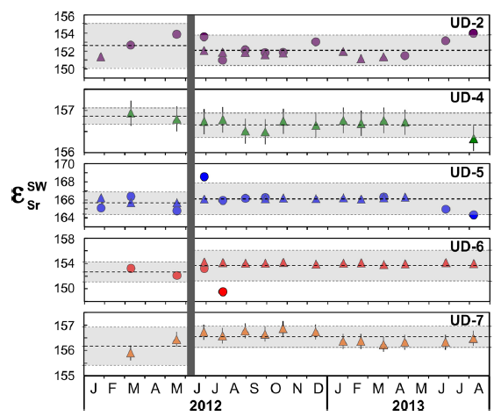
Pre-Frac vs Post-Frac: Upper Devonian Wells
Horizontal wells fractured
Most UD wells show no change after fracturing (p values >0.05)
For isotopic shifts to be considered significant enough to suggest Marcellus fluid incursion, ε_{Sr} would need to decrease by 1-3 units
Kolesar Kohl et al., 2014

Slide 14
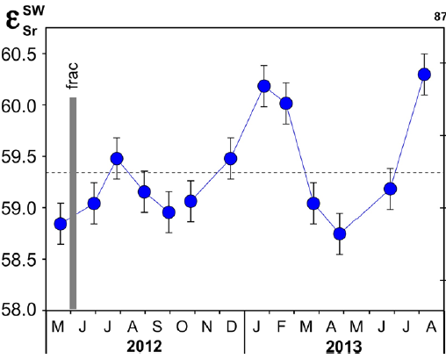
Sr in Spring Water
Sr isotope values fall between Marcellus and Upper Devonian values
Values shift on a semiannual basis (±0.8 from the mean)
Spring water contains very little Sr
Very sensitive to any potential mixing with produced water
Kolesar Kohl et al., 2014
Notes:
Mixing with 0.0003% Marcellus brine would shift downward >5
Mixing with 0.01% UD brine would shift upward 10
Importance of 2-3 seasons of baseline data to determine background variations (recharge, agriculture sources)

Slide 15
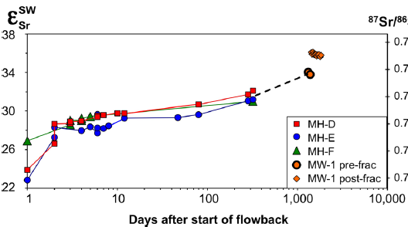
Vertical Marcellus Well
The only well in the study that showed a significant change in Sr isotope values after horizontal wells were fractured (from +33.8 to +35.9)
Sr concentration also increased by ~200 mg/L
New pathways within the Marcellus were opened up by fracturing
Kolesar Kohl et al., 2014
Notes:
Low p-value, 0.028, also suggests significant shift
Limitation: only 2 pre-frac values

Slide 16
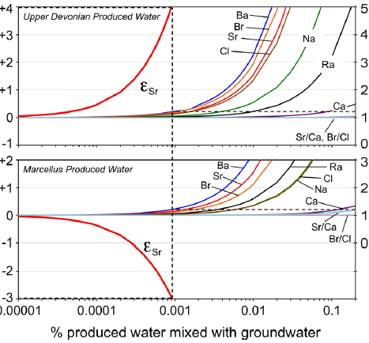
Sensitivity of Elemental Concentrations
shift
Elemental ratios
Calculated mixing models between produced waters and spring water
Most sensitive elements: Ba, Br, Cl, Sr
Elemental ratios (Sr/Ca, Br/Cl) less sensitive than absolute concentrations
Kolesar Kohl et al., 2014

Slide 17
Sensitivity of Sr Isotopes
shift
Elemental ratios
Greater sensitivity than elemental conc., especially in waters with natural seasonal variation
Unlike elemental concentration, Sr isotopes can distinguish between UD and Marcellus produced waters
Kolesar Kohl et al., 2014

Slide 18
Application #2 Conclusions
Subsequent to hydraulic fracturing, no significant migration of Marcellus-derived fluids was observed in Upper Devonian or shallow groundwater units
Shift in Sr isotopes of vertical Marcellus well suggests fracturing opened new flowpaths within the unit
Sr isotopes show greater sensitivity to potential brine migration than elemental concentrations or ratios

Slide 19
References
Capo, R.C., Stewart, B.W., Rowan, E., Kolesar, C., Wall, A.J., Chapman, E.C., Hammack, R.W., and Schroeder, K.T., 2014. The strontium isotopic evolution of Marcellus Formation produced waters, southwestern Pennsylvania. International Journal of Coal Geology, available online 28 Dec 2013.
Capo, R.C., Stewart, B.W., and Chadwick, O.A., 1998. Strontium isotopes as tracers of ecosystem processes: theory and methods. Geoderma, v. 82, p. 197-225.
Chapman, E.C., Capo, R.C., Stewart, B.W., Kirby, C.S., Hammack, R.W., Schroeder, K.T., and Edenborn, H.M., 2012. Geochemical and strontium isotope characterization of produced waters from Marcellus Shale natural gas extraction. Environmental Science & Technology, v. 46, p. 3545-3553.
Kolesar Kohl, C.A., Capo, R.C., Stewart, B.W., Wall, A.J., Schroeder, K.T., Hammack, R.W., and Guthrie, G.D., 2014. Strontium isotopes test long-term zonal isolation of injected and Marcellus Formation water after hydraulic fracturing. Environmental Science & Technology, v. 48, p. 9867-9873.
Kolesar, C.A., Capo R.C., Wall, A.J., Stewart, B.W., Schroeder, K.T., Hammack, R.W., 2013. Using strontium isotopes to test stratigraphic isolation of injected and formation waters during hydraulic fracturing, AAPG Search and Discovery Article #90163.
© Copyright 2014 EchelonAGC

Slide 20
Acknowledgements
University of Pittsburgh: Rosemary Capo, Brian Stewart, Courtney Kohl, Andrew Wall, James Gardiner
Department of Energy: Karl Schoeder, Rick Hammack, Hank Edenborn
© Copyright 2014 EchelonAGC

