Slide 1
Monitoring Design, Available Data, and Filling Data Gaps for Determining Whether Shale Gas Development Activities Contaminate Surface Water or Groundwater in the Susquehanna River Basin
Elin Betanzo
2015 Shale Network Workshop
May 8, 2015
State College, PA
Notes:
Good morning, I’m Elin Betanzo and I work for the Northeast-Midwest Institute. We are a nonprofit, and nonpartisan research organization dedicated to economic vitality, environmental quality, and regional equity for Northeast and Midwest states.
I’m going to talk about a collaborative study we did with the U.S. Geological Survey looking at the availability of water data to answer urgent water policy questions. In this study we identified the monitoring design, available data, and data gaps for determining whether shale gas development activities contaminate surface water or groundwater in the Susquehanna River Basin.

Slide 2
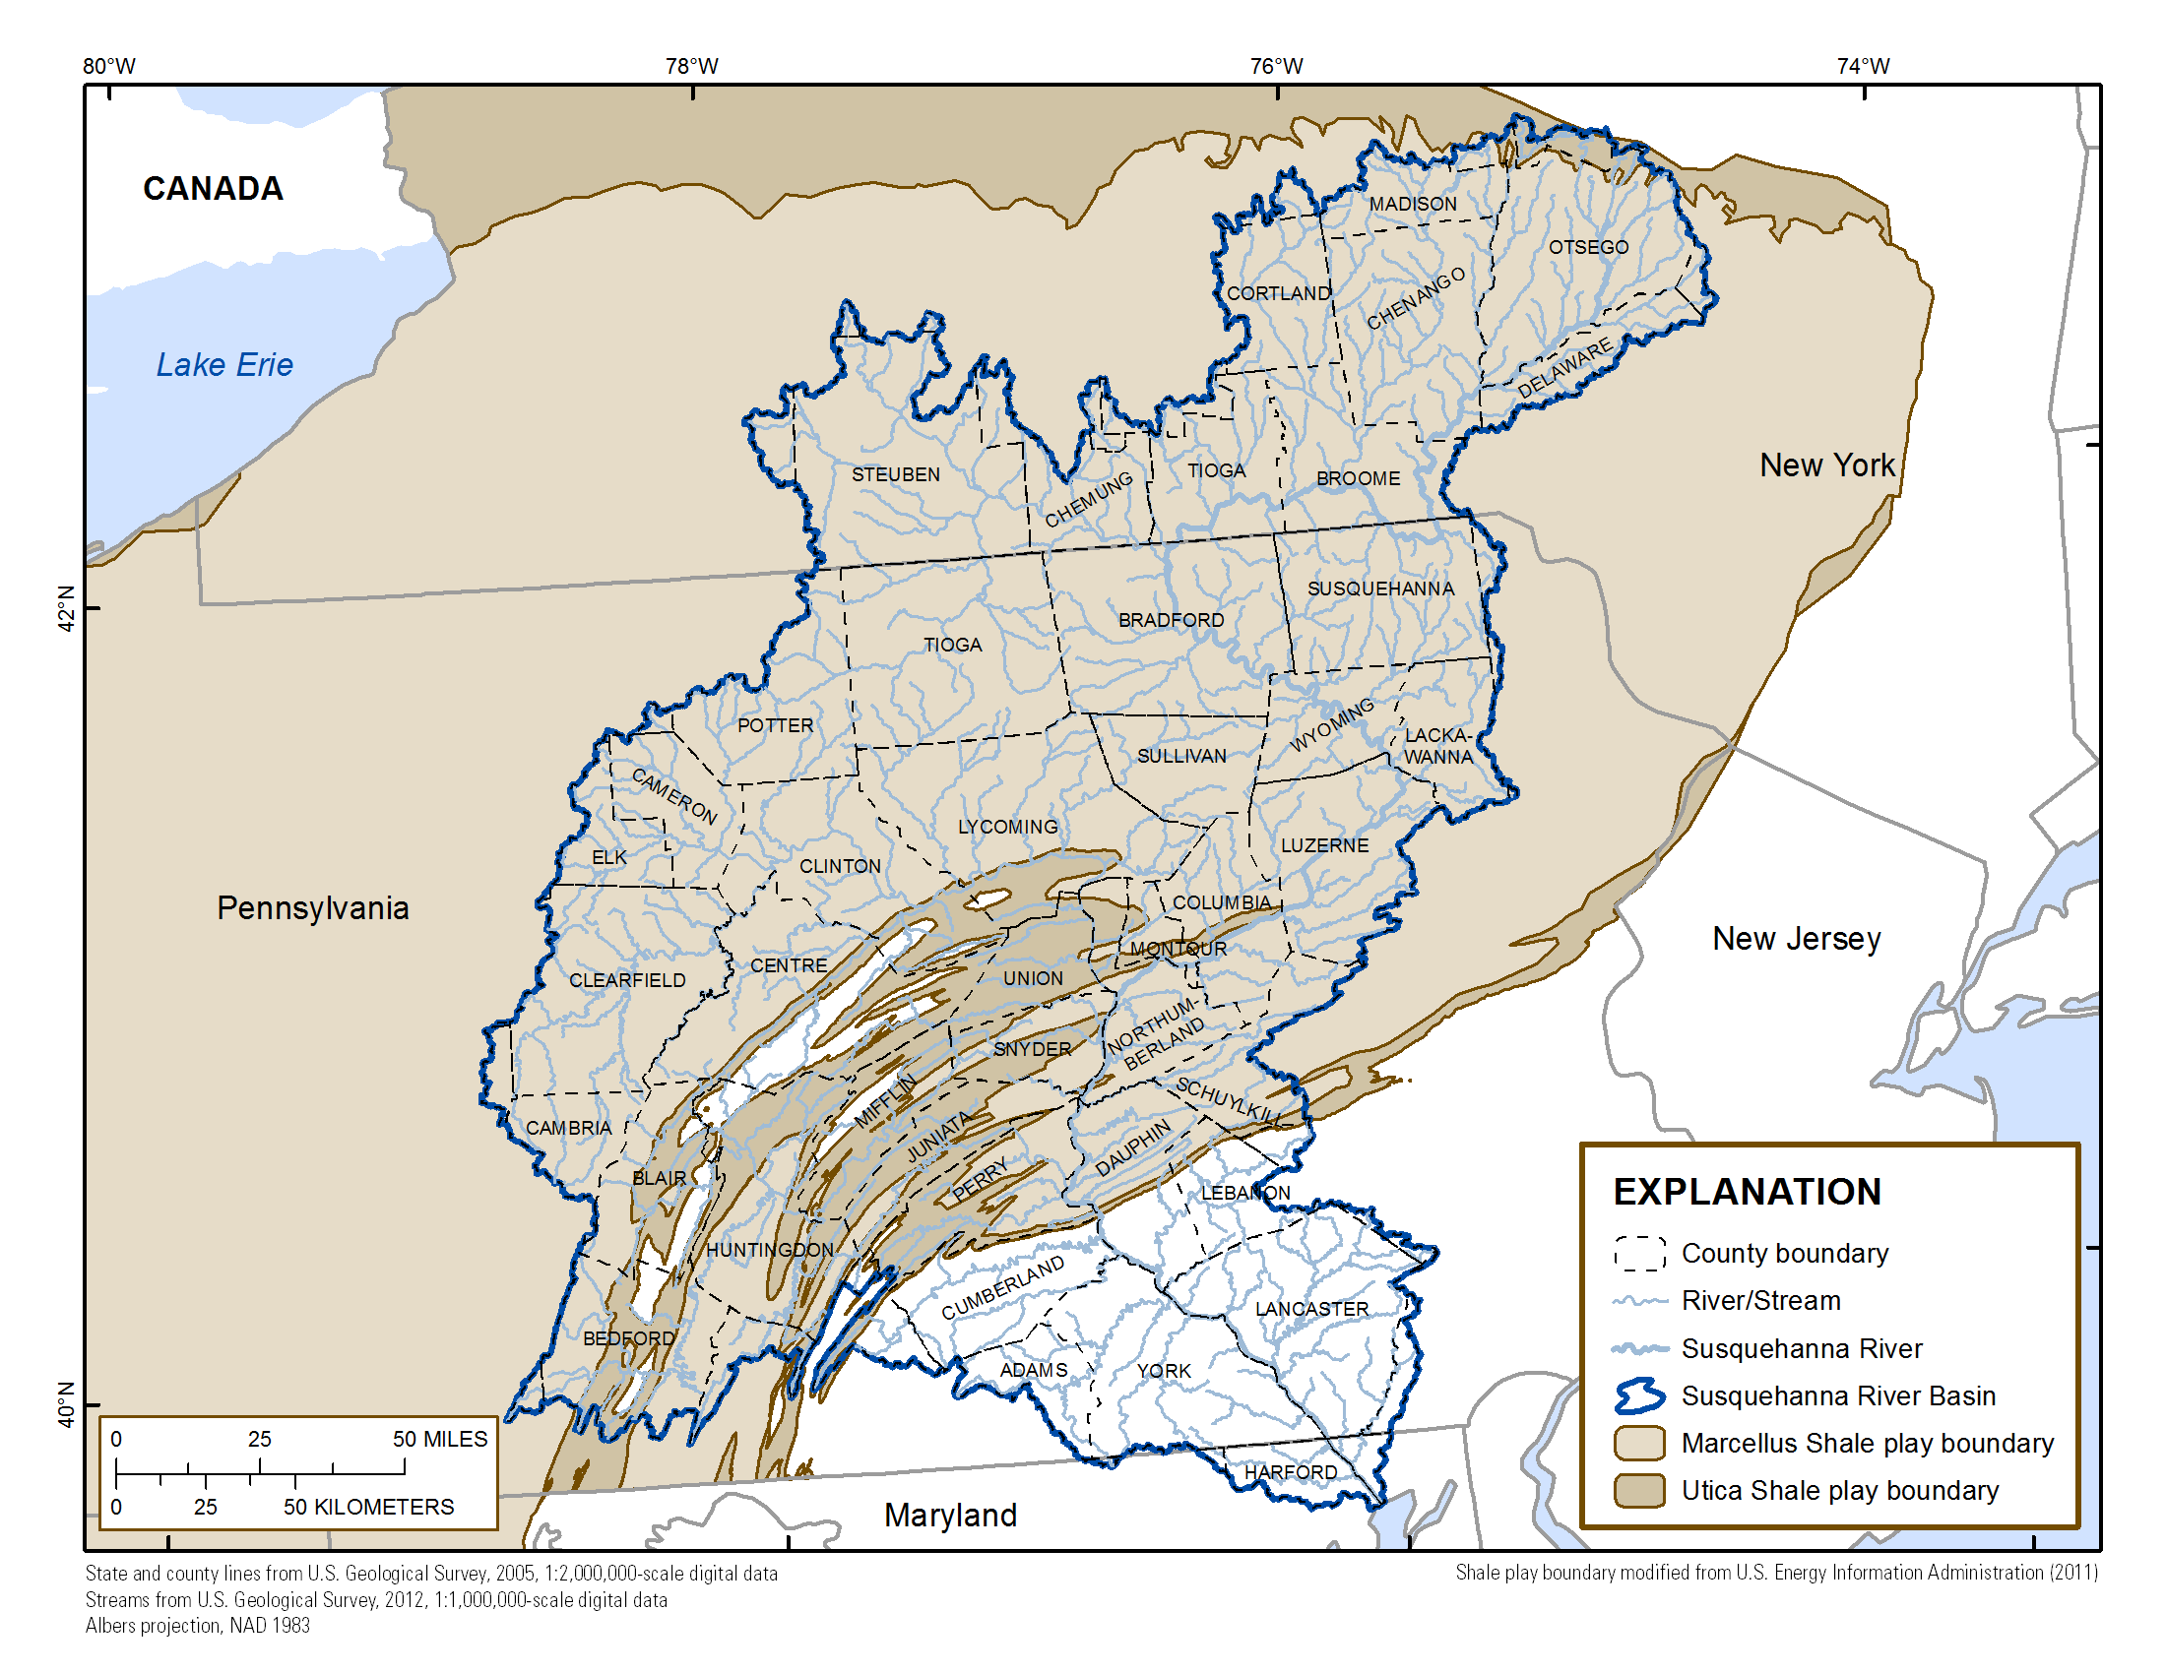
Toward Sustainable Water Information
Objective:
Investigate and describe the ability of the NEMW region’s water monitoring programs to support decision making
Primary Audience:
Congress and regional decision makers
Case Study:
Evaluate water data needed and available to answer “Do shale gas development activities contaminate surface water or groundwater in the Susquehanna River Basin?”
Notes:
The project is called “Toward Sustainable Water Information” and the objective is to Investigate and describe the ability of the NEMW region’s water monitoring programs to support decision making
Congress and regional decision makers are the primary audiences for this work. This study was designed with input from the Northeast-Midwest congressional coalition members.
Today I’m discussing a case study we are completing that evaluates water data needed and available to answer a policy question, “Do shale gas development activities contaminate surface water or groundwater in the Susquehanna River Basin?”
We worked with a technical advisory committee to identify a monitoring design to answer this question, compiled data throughout the SRB, determined how much data is available, identified data gaps and approaches for filling the gaps.

Slide 3
Study design to answer “Do shale gas development activities contaminate surface water?”
Tributary Water Data:
Water quality and streamflow data to detect change over time
Appropriate Monitoring Sites:
Monitoring sites in watersheds with high density of high volume hydraulic fracturing (HVHF) wells and reference watersheds
Ancillary Data:
Shale gas activity, geology, land-use, and climate data to correlate water-quality change with changes in the watershed
Notes:
I’ll start off discussing surface water.
There are three parts to the study design that must be in place to be able to answer whether shale gas development activities contaminate surface water.
First we need monitoring sites in the right places. Monitoring sites in watersheds with high density of HVHF wells and reference watersheds.
Second, Tributary water-quality and streamflow data must be collected at these monitoring sites with sufficient sampling frequency and longevity to evaluate trends in concentration over time.
Third, ancillary data on shale gas development activities and other changes in land use throughout the watershed must be available to correlate water-quality change with alterations on the land. If we don’t have detailed information on context, we cannot explain the causes of water quality change over time.

Slide 4
Water data needed to answer “Do shale gas development activities contaminate surface water?”
Focus on small watersheds (<70 sq miles)
Monitoring sites in each of the ecoregions with active or predicted HVHF activity
At least one monitoring site in a high density HVHF watershed per ecoregion
one reference watershed per ecoregion
26 chemical and field parameters, both specific and general indicators
Notes:
Small watersheds – higher density of HVHF development, fewer confounding factors, dilution in large watersheds would make change difficult to detect.
As I said, the location of monitoring sites is critical. Monitoring sites are needed in each ecoregion with ongoing or predicted shale gas development because each ecoregion is unique in its water chemistry. We need at least one monitoring site in a high density HVHF watershed per ecoregion and one reference site per ecoregion. We defined high density as >0.5 HVHF wells per square mile. Reference watersheds ideally have no current HVHF wells, and no plans for development.
With our TAC we identified a suite of surface water parameters, 26 chemical and field parameters representing the range of shale gas development activities that could affect stream water quality, including a range of specific and non-specific water-quality indicators and streamflow, that should be analyzed.
Today I will present our findings for Barium and specific conductance; one specific indicator (a parameter that is closely linked with hydraulic fracturing fluids, or shale formations and produced water; Barium is a highly specific signature of produced waters ) and one non-specific indicator (can identify change when we simply can’t analyze for the entire range of substances that are used in shale gas development). Measuring the suite of parameters allows for multiple lines of evidence needed to trace contamination to shale development as a source of contamination.
We developed our monitoring design to be able to detect a 20% increase in these parameters over background levels.

Slide 5
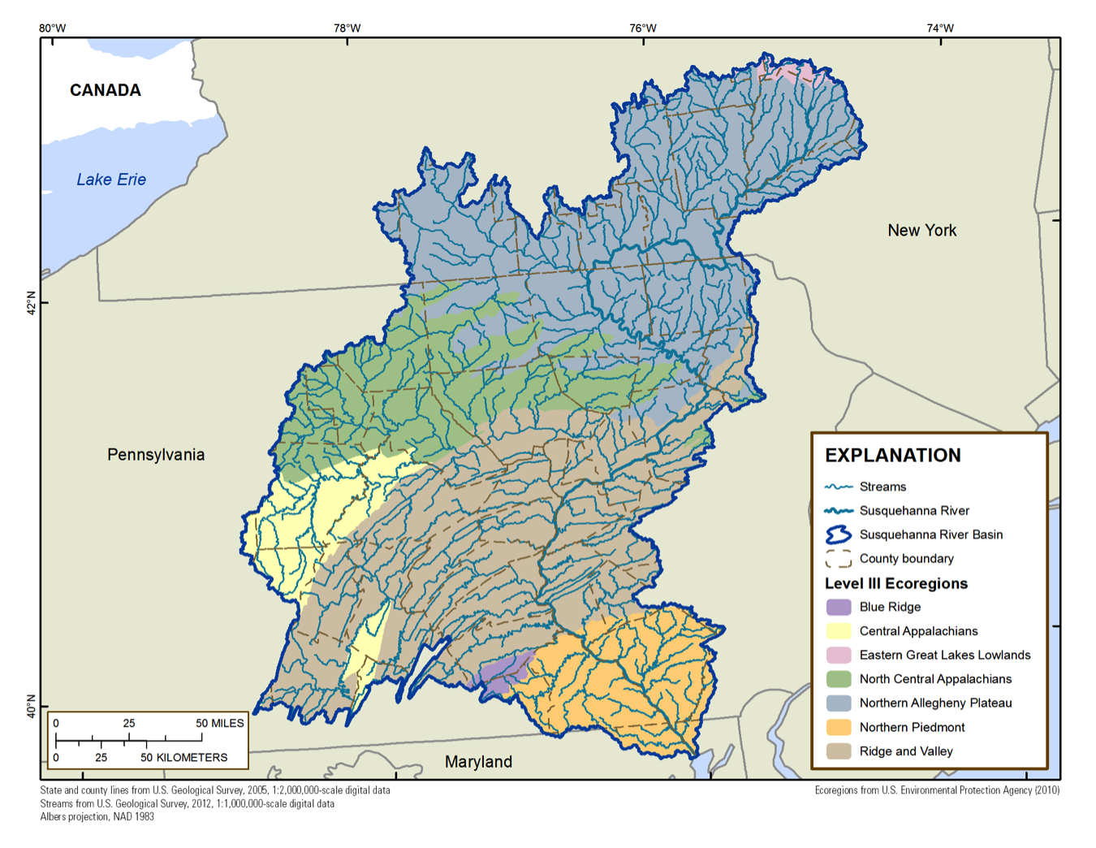
Ecoregions in the Susquehanna River Basin
Northern Allegheny Plateau
North Central Appalachians
Ridge and Valley
Central Appalachians
Notes:
We need monitoring sites in each ecoregion with ongoing or predicted shale gas development because each ecoregion is unique in its water chemistry.
The ecoregions with current or predicted development are
Northern Allegheny Plateau,
North Central Appalachians,
Ridge and Valley, and
Central Appalachians.

Slide 6
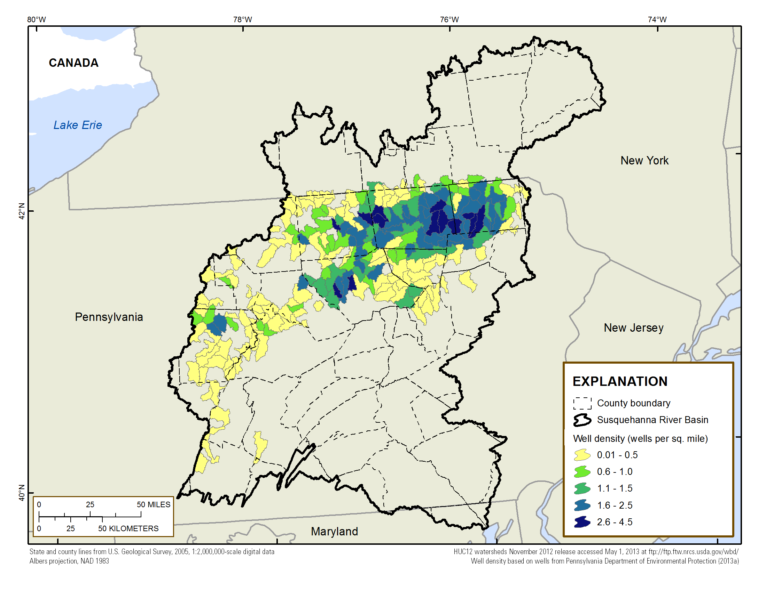
Density of permitted HVHF wells in the Marcellus and Utica Shale
Notes:
We calculated the density of HVHF permits per HUC-12 in the Susquehanna River Basin. HUC-12 HVHF densities range from 0.01 – 4.5 wells per square mile.
The HVHF well density is based on permit dates through 9/30/2013; the online well records for PA were retrieved on 11/01/2013.

Slide 7
Data needed for trend detection
3-5 years of monthly sampling are needed to detect a 20% change in median barium and specific conductance concentrations over background variability
Data covering both pre- and post- shale gas development (2007)
Notes:
We identified monitoring sites in each ecoregion with long-term records (>36 samples collected over more than 3 years) and we used these in a power analysis to identify the duration of sampling needed to detect statistically significant changes in concentration at a given monitoring site.
We found that 3-5 years of monthly sampling are needed to detect a 20% change in median barium and specific conductance concentrations over background variability, with some variations based on ecoregion. Some ecoregions require a longer data record because there is greater background variability.

Slide 8
Surface water monitoring organizations (n=35)
Preliminary Findings - Subject to Change. Data compilation through 2014; end year varied by agency.
Notes:
The USGS compiled all the water data sources we were aware of in the Susquehanna River Basin and that were available to us in electronic format; We consulted with the Shale Network to identify data sources. This pie chart summarizes the surface water monitoring organizations that collected the data we compiled for this study. We were not able to obtain any data from the private shale industry. We finished compiling data in 2014. A few records in our data compilation appear to start in 1901, but the bulk of the records start in 1949 and the most recent records in our compilation are from 2013.
As you see here, the categories with the most organizations collecting data are Volunteer, state, county, and federal governments. We obtained data from 35 different surface water monitoring organizations.
The Pennsylvania Fish and Boat Commission had the largest number of monitoring sites and USGS NWIS database had the largest number of records.

Slide 9
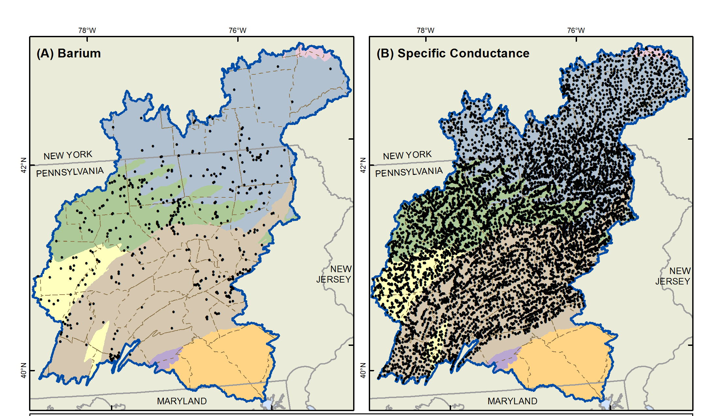
Surface water monitoring sites where total barium and specific conductance data have been collected
n=491 sites
n=13,548 sites
Preliminary Findings - Subject to Change. Data compilation through 2014; end year varied by agency.
Notes:
These maps show all the monitoring sites we identified in the Susquehanna River Basin where barium or specific conductance samples have been collected.
Barium n sites = 491 total
Specific conductance = 13,548
We explored these monitoring sites to identify sites where 3-5 years of monthly monitoring are available, and their proximity to high densities of HVHF wells. What we found is existing data are generally not available for the needed locations, parameters, or time period

Slide 10
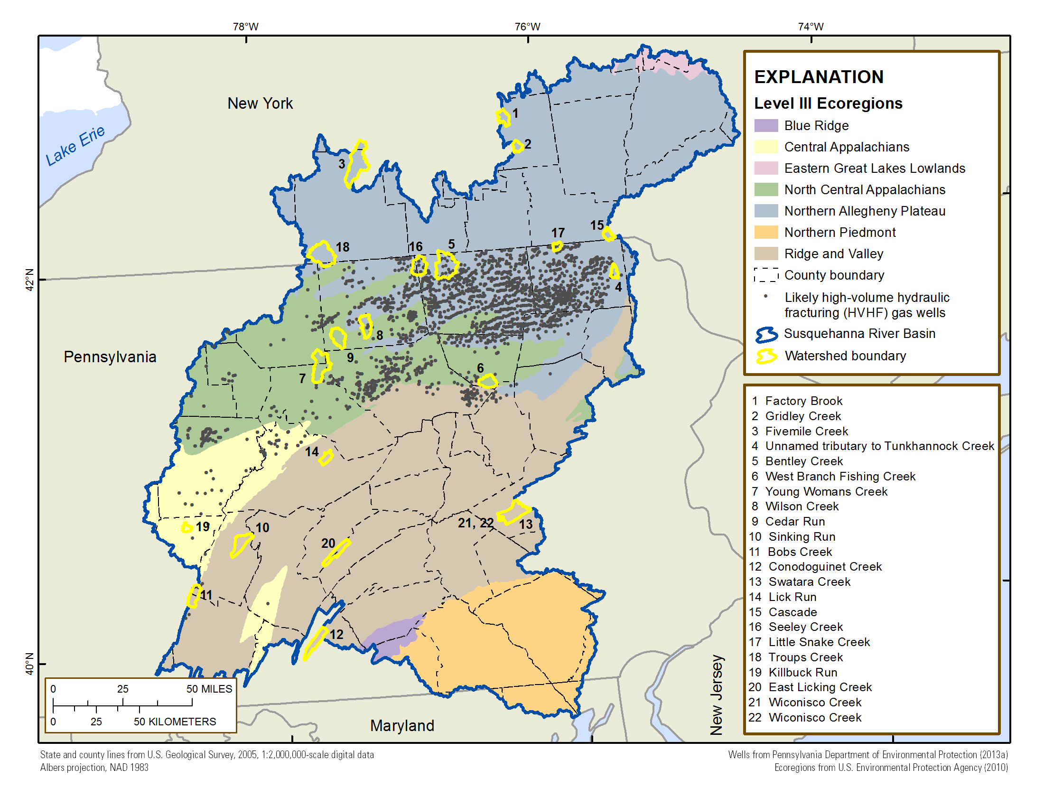
Watersheds with surface-water monitoring sites that have existing data that can be used to identify trends for specific conductance or barium
Preliminary Findings - Subject to Change. Data compilation through 2014; end year varied by agency.
Notes:
This map shows Watersheds with surface-water monitoring sites that have 3-5 years of records that can be used to identify trends for specific conductance or barium. Yellow outlines show watersheds with specific conductance or barium data, 36 or more samples. Gray dots are HVHF permits.
Only 3 out of these 22 sites are in watersheds with HVHF development, although most of these have data before and after 2007. The specific conductance sites have longer data records than for barium but specific conductance alone is too general to inform about shale gas development. We need the combination of specific conductance with more specific parameters to better identify whether shale gas development may be a source of contamination. In general, these monitoring sites with longer data records analyze for few of the suite of 26 parameters.

Slide 11
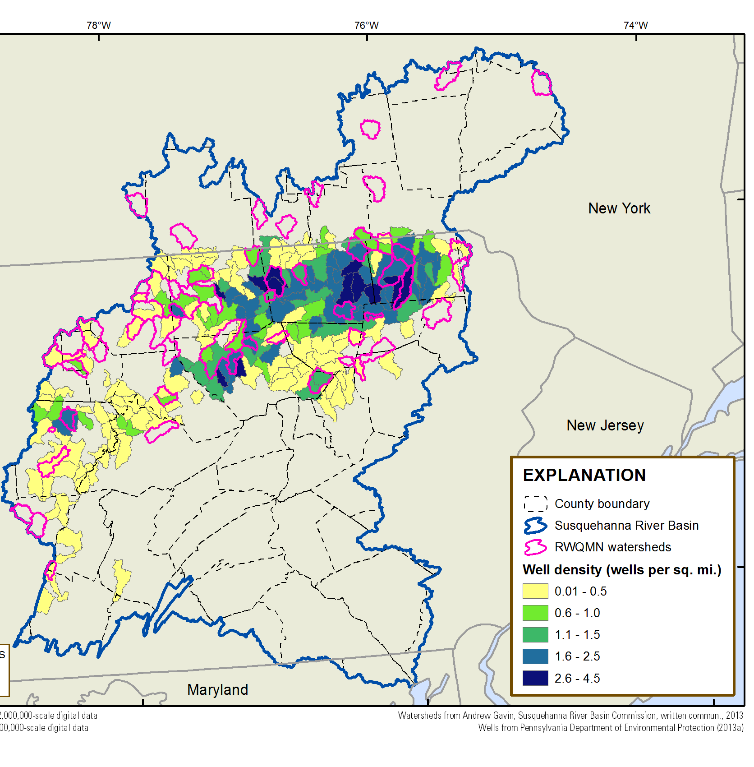
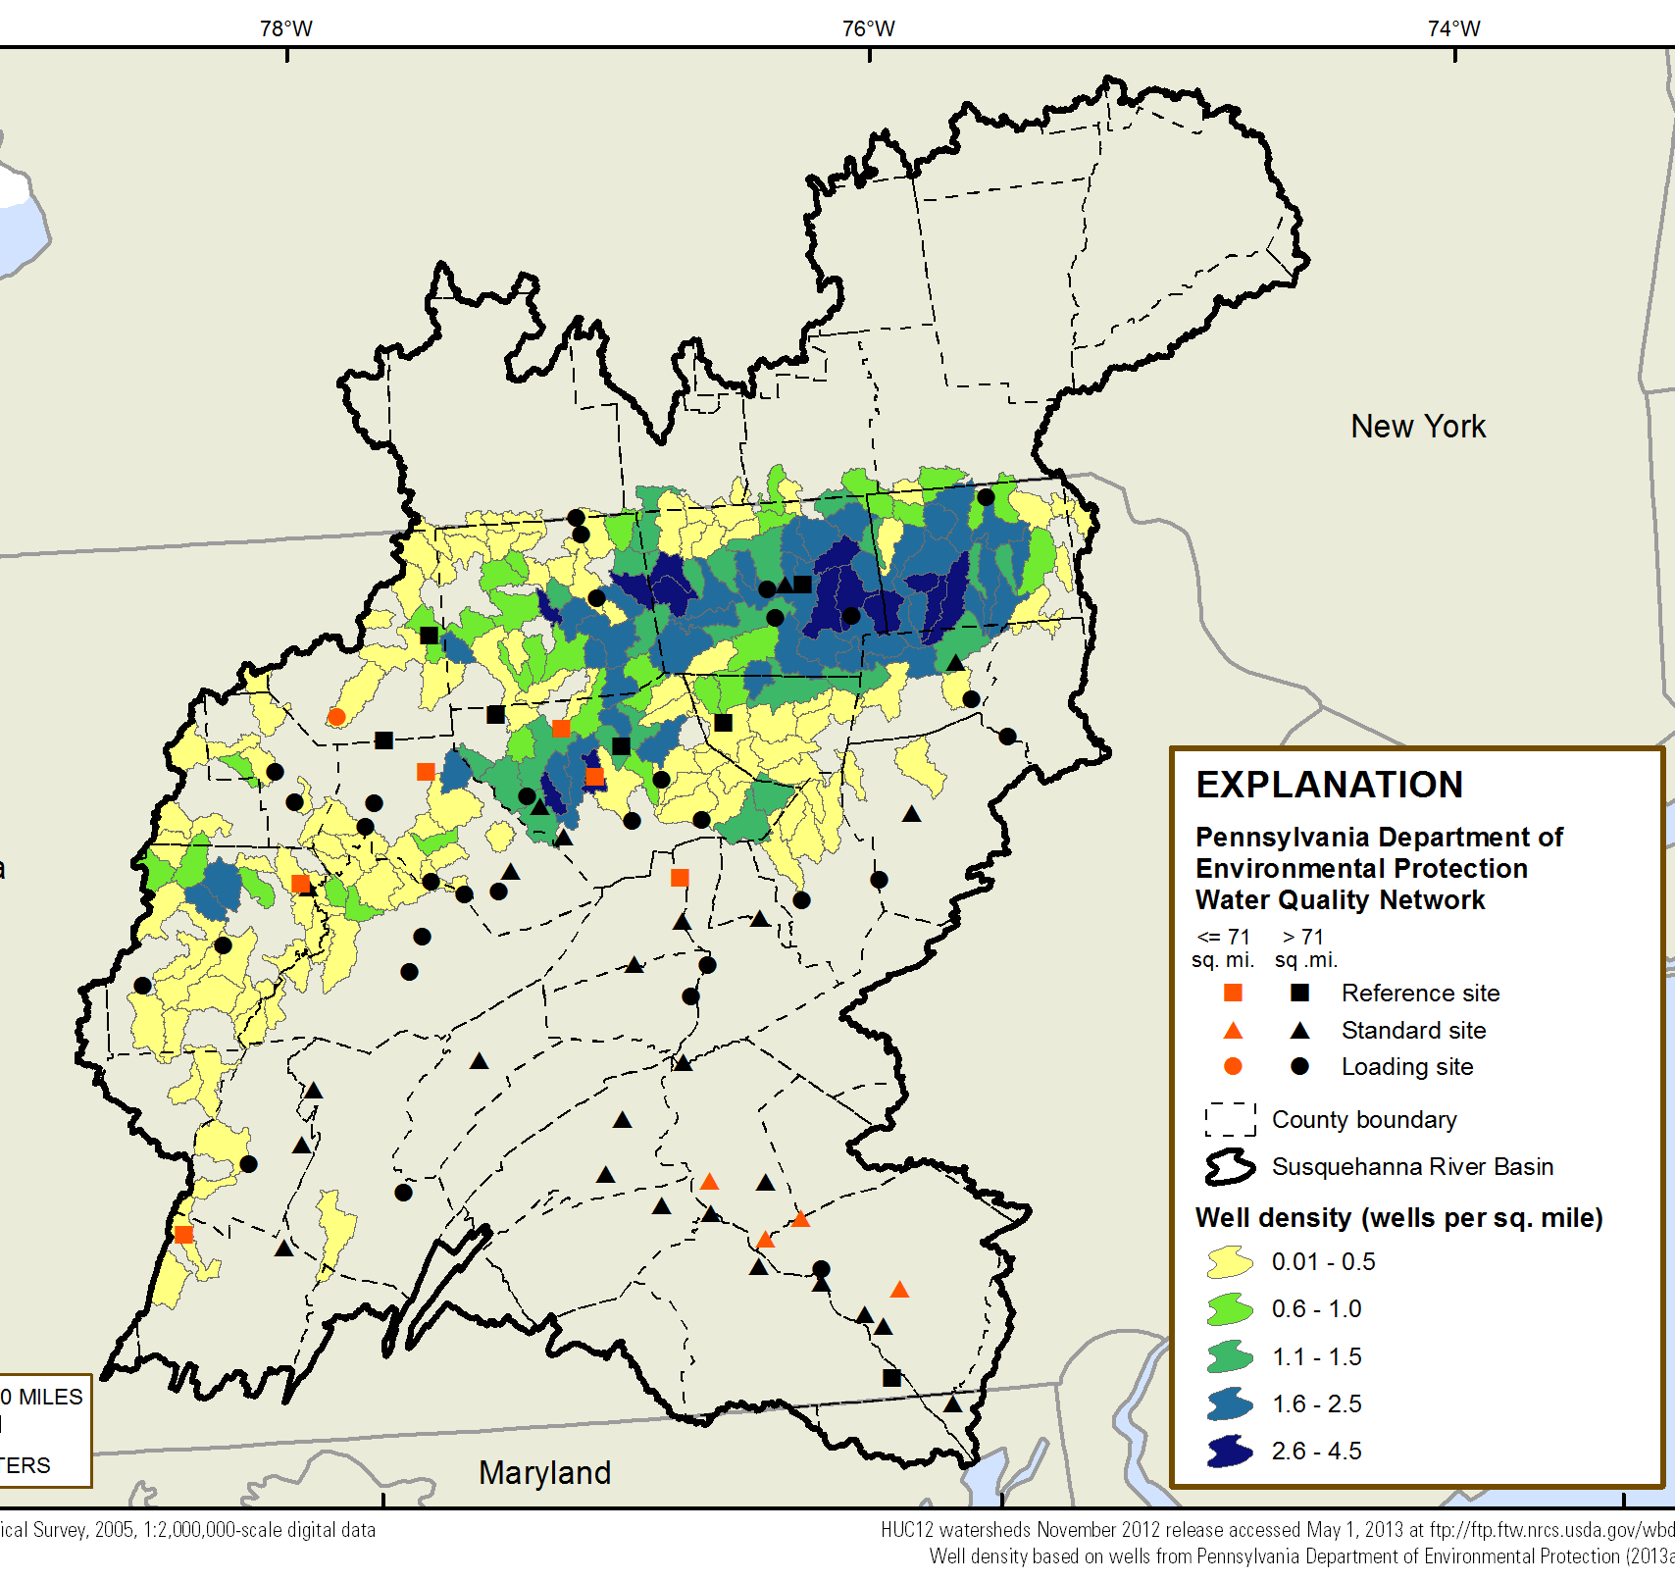
Recently initiated monitoring programs
Susquehanna River Basin Commission Remote Water Quality Monitoring Network (2013) n=56
Pennsylvania Department of Environmental Protection Fixed Water Quality Network (2012) n=74
Preliminary Findings - Subject to Change. Data compilation through 2014; end year varied by agency.
Notes:
Recently initiated monitoring programs from the Susquehanna River Basin Commission and PA DEP do a better job of targeting high density HVHF areas and reference sites.
Red PA DEP sites are <70 square miles.
There are 56 SRBC monitoring sites, and 22 of these are in watersheds with high density of HVHF wells.
There are 74 PA DEP monitoring sites, and 7 are in small watersheds in the marcellus and utica shale area.
Sampling frequency varies at these sites; SRBC samples collected quarterly and many sites do not have a streamgage. They don’t analyze for the full suite of parameters – some need to be added but most of them are already analyzed.

Slide 12
Recommendations for filling surface water data gaps
Increase sampling frequency at a subset of sites and maintain these sites for long-term monitoring.
Collect the full suite of surface-water parameters and streamflow at each monitoring site.
Any new monitoring to fill the data gaps should be implemented using an adaptive management approach and coordinated among monitoring agencies.
Notes:
Build on the new monitoring programs in the Susquehanna River Basin.
Increase sampling frequency at subset of sites and maintain these sites for long-term monitoring.
Collect the full suite of surface-water parameters and streamflow at each monitoring site.
Any new monitoring to fill the data gaps should be implemented using an adaptive management approach and coordinated among monitoring agencies.
The next slide shows a map of recommended sites for this increased monitoring.

Slide 13
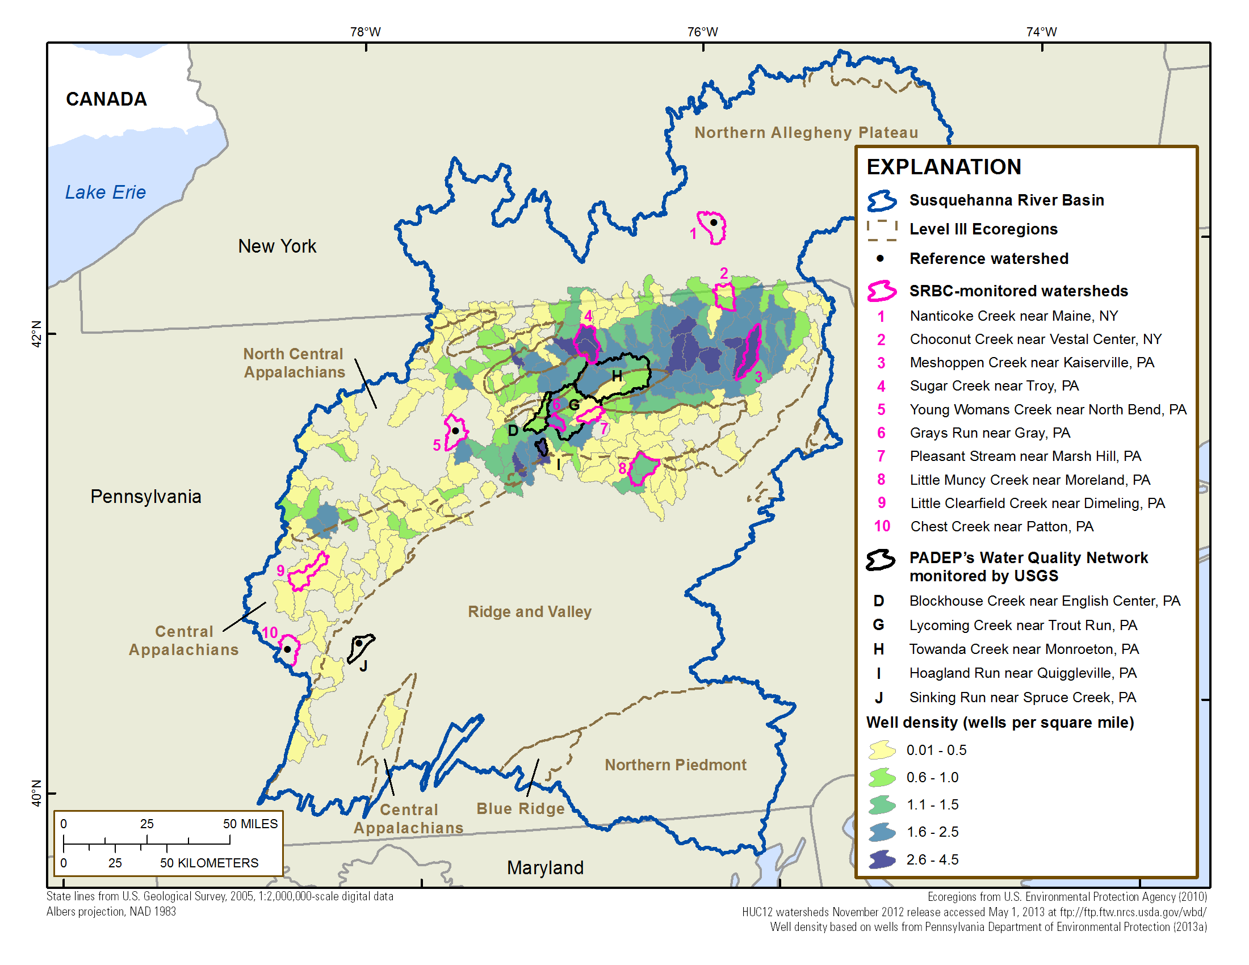
Monitoring site recommendations for increased sampling
Preliminary Findings - Subject to Change. Data compilation through 2014; end year varied by agency.
Notes:
These sites include 4 high density monitoring sites and one reference site in the Northern Allegheny Plateau ecoregion, 6 high density sites (one new that is not on the map) and one reference in North Central Appalachians, and one high density and one reference of each in the central Appalachians and ridge and valley ecoregions.
11 sites are in the SRBC network (one not on the map), and 5 are in the PA DEP network. Two of the PA DEP sites monitor larger watersheds with dense HVHF development, have streamgages, and provide a nested monitoring design.
Increased sampling frequency is needed at this set of monitoring sites, and most need streamgages. Increased sampling frequency will decrease the number of years before change can be detected. As mentioned some additional parameters will need to be analyzed for each monitoring site.
HVHF densities for the high density recommended watersheds range from 0.1 to 5.6 HVHF wells per square mile, with an average of 1.9 HVHF wells per square mile.

Slide 14
Groundwater monitoring organizations (n=10)
Notes:
Now I’ll shift my focus to groundwater data needed and available.
Far fewer groundwater monitoring organizations. 2 Federal, 2 state, and 2 academic organizations collected groundwater data that we compiled, for a total of 10 groundwater monitoring organizations.
No industry data. Confidentiality agreements with land owners makes most groundwater data related to shale gas development inaccessible.

Slide 15
Water data needed to answer “Do shale gas development activities contaminate groundwater?”
25 chemical and field parameters
Network monitoring design:
Network for each of 5 major drinking water aquifers, distinguished by topography, with dense shale gas development
25-30 sampling sites per network, each site within 1 mile of HVHF well
Two samples at each site, separated by approximately 10 years and taken before and after shale gas development
Notes:
Again, we identified the water data needed to detect changes in groundwater to answer the case-study policy question.
We identified 25 chemical and field parameters representing the range of shale gas development activities that could affect groundwater; they mostly overlap with the surface water parameters but some differences. For example, methane, and benzene are on the groundwater list but not on the surface water list.
Today I will present specific conductance, bromide and methane data.
Different statistical design than surface water. We explored the possibility of doing site-specific trend analysis similar to that done for the SW sites at wells with long data records (i.e. GW sites that had several years or decades of monthly QW samples) but we found these types of records are rare to non-existent. Based on the types of monitoring sites and data available, we decided a network monitoring design would be most appropriate for groundwater. We identified major drinking water aquifers in the Susquehanna River Basin that have dense shale gas development, and identified 5 aquifers distinguished by topography that should each have a network to monitor for changes in groundwater quality.
The network design requires 25-30 sampling sites, each within 1 mile of an HVHF well. For the network analysis you would collect two samples at each site, separated by approximately 10 years and taken before and after shale gas development. Do a spatial analysis to determine whether there is a change in water quality at the set of sites between the two time periods. In addition, select a subset of those sites to sample every 2 years to identify short-term changes between the two major sampling events. Allows for adaptive management.

Slide 16
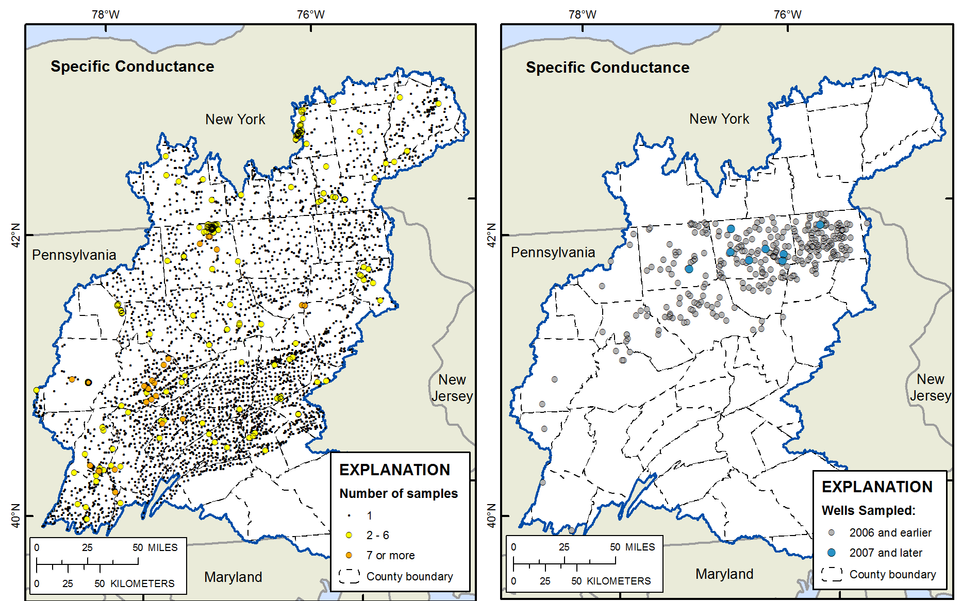
Existing groundwater monitoring sites for specific conductance
All sites (n = 3,899)
Sites within 1 mile of an HVHF well (n = 300)
Preliminary Findings - Subject to Change. Data compilation through 2014; end year varied by agency.
Notes:
Map on the left shows sites with specific conductance data – any site in our data compilation. Few of the sites have more than 1 sample.
On the right, sites with specific conductance monitoring sites within 1 mile of a HVHF well. None of these sites have data both before and after 2007.
Again, a nonspecific indicator. This needs more specific parameters to accompany it to be more meaningful.

Slide 17
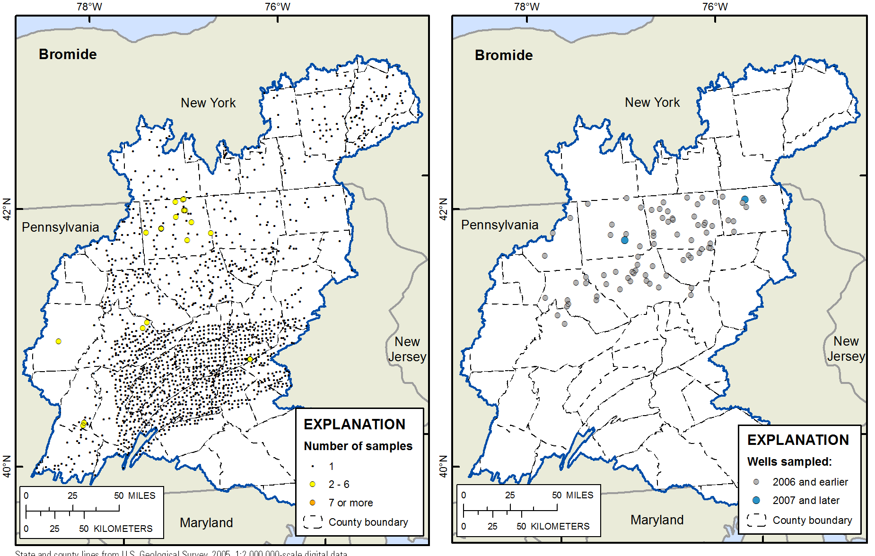
Existing groundwater monitoring sites for bromide
All sites (n= 902)
Sites within 1 mile of an HVHF well (n=63)
Notes:
Even fewer sites available when we use a parameter that is more closely linked to shale gas development, like bromide.

Slide 18
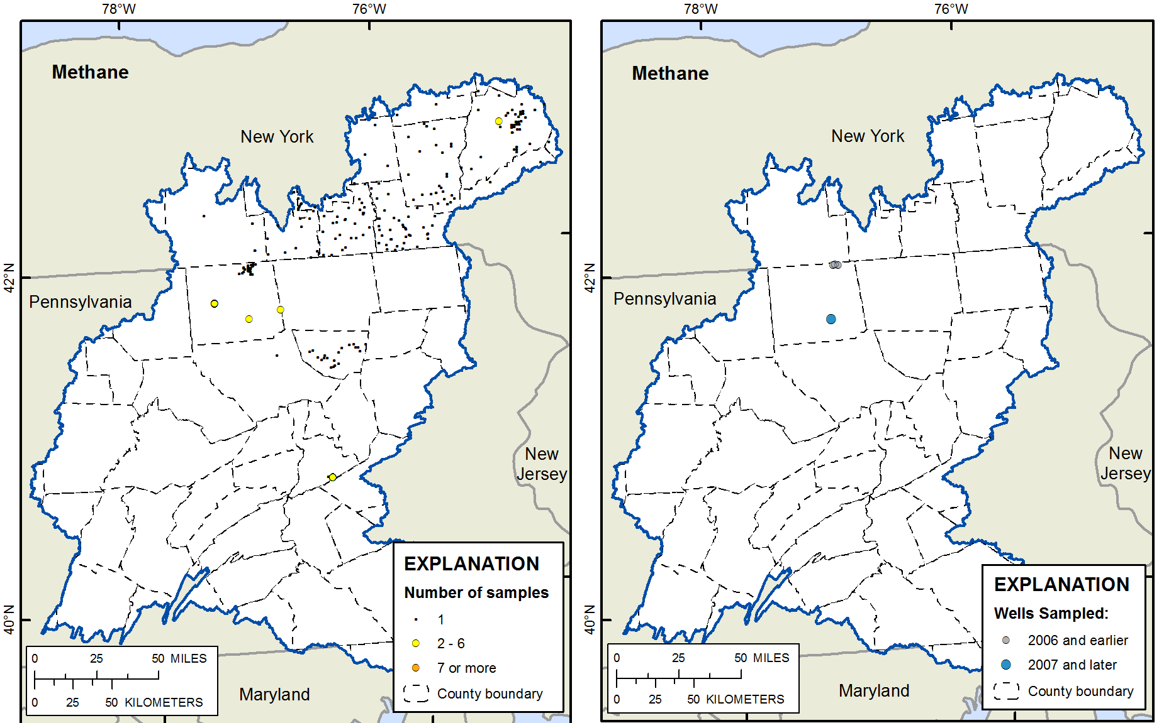
Existing groundwater monitoring sites for methane
All sites (n= 302)
Sites within 1 mile of an HVHF well (n=4)
Notes:
And even fewer when we get to methane.
The monitoring sites with data prior to shale gas development only have records for a few parameters; the suite of 25 groundwater parameters (multiple lines of evidence) are not available at the monitoring sites with pre-development data.
As you can see from the few sites that are within 1 mile of HVHF wells, we definitely do not have the coverage necessary for a network analysis for each of the 5 major drinking water aquifers. This means that the currently available data will not serve as a starting point for answering this policy question.
Our options for collecting the needed data are limited. We need to work with industry to get access to data taken prior to drilling, or we need to start a new monitoring program from scratch, which requires working with industry to identify where and when new HVHF wells will be developed.

Slide 19
Recommendations for filling groundwater data gaps
Design and implement a systematic, long-term groundwater monitoring program in the Susquehanna River Basin.
Acquire confidentiality agreements with industry and homeowners to obtain access to the industry set of “before” shale gas development water quality data.
Work with industry and homeowners to identify domestic wells for sampling prior to new shale gas development.
Notes:
We need to design and implement a systematic, long-term groundwater monitoring program in the Susquehanna River Basin to fill this critical data gap.
The shortest path timewise is to obtain access to the industry set of “before” shale gas development data. To do this we would need to acquire confidentiality agreements with industry and homeowners.
If this can’t be done, Work with industry and homeowners to identify domestic wells for sampling prior to new shale gas development. This option would require well over 10 years from now before the needed groundwater data could be available.

Slide 20
Conclusions
Needed water data to answer the policy question are not available for surface water or groundwater
Fill the surface water data gaps through modifications that build on new surface water monitoring programs
Groundwater monitoring to fill data gaps needs to start from scratch; substantial participation from the shale industry necessary to collect the needed data
Notes:
Overall, our study finds that the needed water data are not available for surface water or groundwater
Modifications to surface water monitoring programs can build on networks in place and decrease the time before changes in surface water quality can be detected.
Groundwater monitoring to fill the data gaps essentially needs to start from scratch. Substantial participation from the shale industry is needed to collect the needed groundwater data, either providing access to previously collected data or identifying new monitoring sites where new wells will be developed.

Slide 21
Questions?
Co-authors
Erik R. Hagen, NEMWI
John T. Wilson, USGS
Kenneth H. Reckhow, Professor Emeritus at Duke University
Laura Hayes, USGS
Denise M. Argue, USGS
Allegra A. Cangelosi, NEMWI
If you are interested in receiving a link to the final report, email: ebetanzo@nemw.org

