Slide 1

Presentation of Findings - Dissolved Methane Method Study
Shale Network Workshop
May 7-8, 2015
State College, PA
Presented by Rock J. Vitale, CEAC
Environmental Standards, Inc.

Slide 2

Agenda
Study Objectives
Laboratory Coordination
Sample Collection
Results
Conclusions

Slide 3

The Problem
Public concern
Data variability observed by MSC members
Several published procedures for dissolved light gases
No US EPA-published method
Lack of standardization

Slide 4

MSC Dissolved Methane Method
Workgroup
Formed to study this issue in early 2013
Compared notes and reviewed data/information:
Dissolved methane split sample data
Laboratory analytical protocols
Brainstormed as to cause of variability
THANK YOU
Requested funding from the MSC Board for a Round Robin Study
Competitive RFP issued to MSC members to complete the Study
MSC engaged Environmental Standards, Inc. to conduct the Study
Notes:
Bullet #1: Consisted of selected MSC Operator members (4) and 6 MSC Associate members
Group met periodically throughout 2013 and into 2014
Bullet #2, after last sub-bullet:
Majority of laboratories utilize their own variation of EPA RSK-175 with wide variation in techniques. (Note: there is no EPA-promulgated method for dissolved methane)
Duplicate samples run at one laboratory generally have good precision.
Many MSC Operators had experienced split samples run at multiple laboratories that were most often not precise.
No outside groups or agencies appeared to be investigating this problem.
Issue has national implications—can occur anywhere dissolved methane data are being generated and utilized.

Slide 5

Study Sponsors, Executor, and Participants
Select members of the MSC Dissolved Methane Method Work Group
Environmental Standards, Inc.
15 Participating Laboratories
(14 commercial, one government)

Slide 6
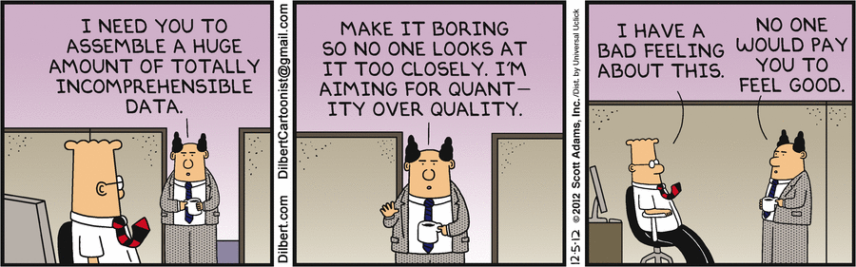
Study Objectives
Design and oversee a credible inter-laboratory study that can withstand scientific scrutiny
Determine the variability across 15 laboratories using controlled samples
Identify the critical laboratory variables that influence the quantitation of dissolved methane in groundwater
Recommend Best Practices for the analysis of dissolved methane in groundwater
Not a sample collection procedure study

Slide 7

Laboratory Coordination
Laboratory Key Elements Questionnaire
102 questions identifying critical laboratory variables
Detailed preparation and analytical procedures
Standard Operating Procedures
Sample receiving
Sample and standard storage
Dissolved gases sample preparation
Dissolved gases analytical methodology
Integration of chromatographic peaks

Slide 8
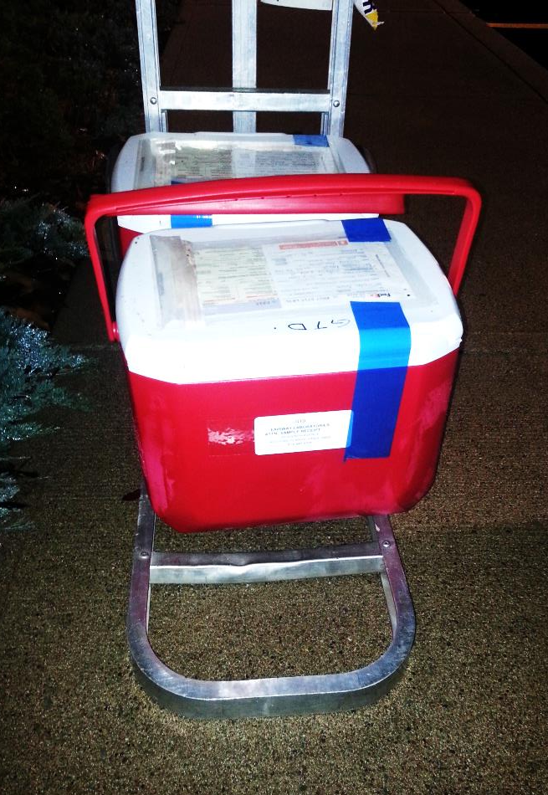
On-Site Sampling
Two domestic wells, confidential locations
Vial verification
Direct fill method employed
396 vials collected
Preserved and unpreserved
Use of butyl rubber-Teflon faced septa
Three measured time intervals collected
Effervescence observed

Slide 9
Laboratory Analysis
Each laboratory received 6 samples
Three samples per well
Nine vials per well per laboratory
Instructed laboratories to analyze based on their SOP and Questionnaire response
Each laboratory performed analysis within 48 hours of receipt
Laboratory deliverables: Certificate of Analysis, EDD, and Level IV data package

Slide 10

Data Analysis
Compiled analytical data
Compiled data from key elements questionnaire
Evaluated SOPs
Performed exploratory and statistical data analysis to identify “groupings” of data and controlling variables
Wilcoxon/Kruskal-Wallis Tests
Performed data verification of selected labs’ Level IV data package

Slide 11
Well 1 - Dissolved Methane Results

Slide 12
Well 2 - Dissolved Methane Results

Slide 13
Preserved vs. Unpreserved

Slide 14
Preliminary Conclusions
Range of reported concentrations verifies MSC observations
Methane variability is a concern when applying regulatory standards to groundwater
Based upon the 102 process questions and SOPs reviewed, there is a very broad range of laboratory approaches
No “smoking gun” to explain the variability of reported concentrations

Slide 15
Recommendations
The study recommendations include procedures specific for instrument calibration, sample handling/preparation, analysis, and calculations.
Seek collaboration from MSC laboratory members to develop a consensus procedure.
Of most importance is development of a certified performance sample that each laboratory can use to gauge their analysis.

Slide 16
Additional Studies Recommended
Repeat study at lower dissolved methane concentrations
Sample collection study to determine how varying procedures affect dissolved methane concentrations
Round robin study using a controlled dissolved gases analytical procedure developed by the MSC

Slide 17

Contact
Environmental Standards, Inc.
“Setting the Standards for Innovative Environmental Solutions”
Headquarters 1140 Valley Forge Road | PO Box 810 | Valley Forge, PA 19482 | 610.935.5577
Virginia 1208 East Market Street | Charlottesville, VA 22902 | 434.293.4039
Tennessee 8331 East Walker Springs Lane, Suite 402 | Knoxville, TN 37923 | 865.376.7590
Texas 2000 S. Dairy Ashford Road, Suite 450 | Houston, TX 77077 | 281.752.9782
New Mexico PO Box 29432 | Santa Fe, NM 87592 | 505.660.8521
Illinois PO Box 62 | Geneva, IL 60134 | 630.262.3979
www.envstd.com | solutions@envstd.com

