Slide 1
ABC Pte Ltd network infrastructure proposal
By Shalihin Ahmaddullah

Slide 2




AGENDA
- Logical Diagram (slide 4)
- IP Addressing (slide 5)
- Router Configuration (Slide 6)
- OSPF implementation (Slide 10)
- Details : Show run, IP route, IP protocol (slide 20)
- Budget Cost (slide 21)
- Future Recommendation(slide 23)

Slide 3



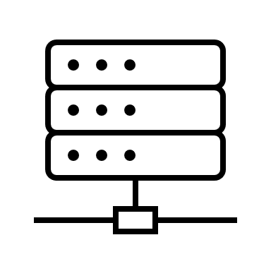
Requirements
Devices:
5 Routers (4 – Main office, 1 – remote office)
4 Switches ( 4 – Main office, 1 remote office)
2 servers ( Main office)
Addressing
Address given 186.40.70.0/24
4 employers In Admin office (main)
18 employers in remote Sales Office
10 employers in remote Engineering Office
30 addresses for internal Servers
Using VSLM due to the different size for each subnet area and to maximize the use if IP addresses.
- Expecting 100% growth within 5 – 10 years for all the office. (available IP address for each offices should be 100% more).

Slide 4
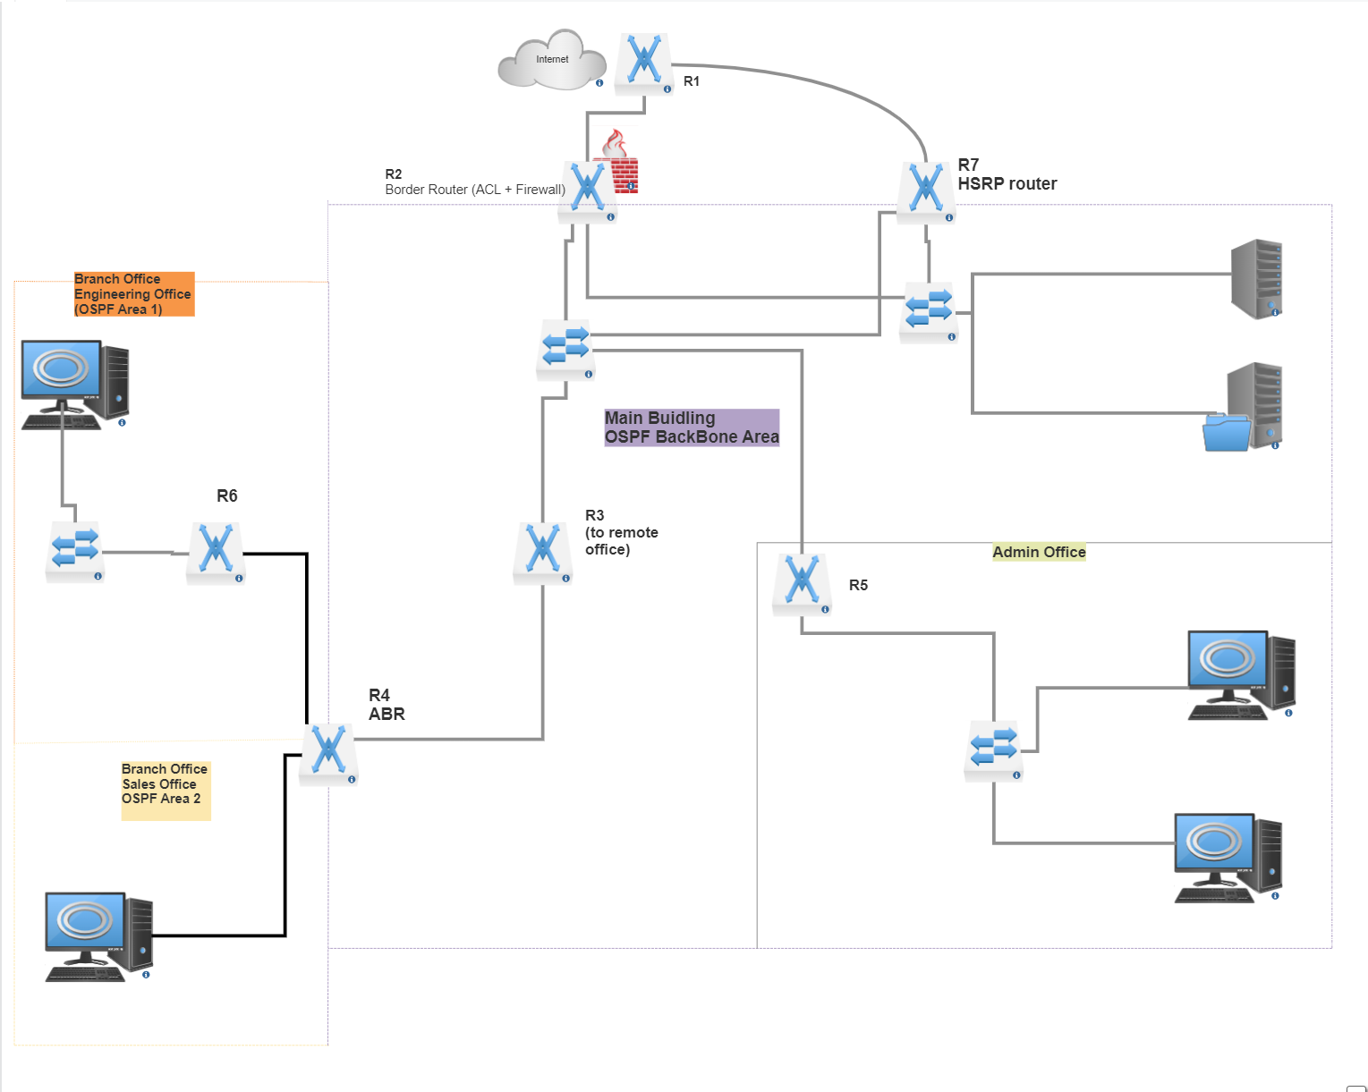
Logical diagram
A brief diagram of the network. With the OSPF area for connectivity.
A Total of 7 internal Networks in the area.
IP Addressing
With 7 network address and using VSLM for IP addressing.
Refer to slide 5 for the IP addressing and max host for each network.

Slide 5
Ip Addressing
Num of Host Address Required | Network Address | Broadcast Network | Subnet Mask | Max Number of Host Possible | Available Ip Address | Network Name
36 | 186.40.70.64/26 | 186.40.70.63 | 255.255.255.192 | 62 | 186.40.70.1 - 186.40.70.62 | Remote Sale
30 | 186.40.70.128/27 | 186.40.70.95 | 255.255.255.224 | 30 | 186.40.70.65 - 186.40.70.94 | Max server
20 | 186.40.70.160/27 | 186.40.70.127 | 255.255.255.224 | 30 | 186.40.70.97 - 186.40.70.126 | Engineering
8 | 186.40.70.192/28 | 186.40.70.143 | 255.255.255.240 | 14 | 186.40.70.129 - 186.40.70.142 | Admin
3 | 186.40.70.144 /29 | 186.40.70.151 | 255.255.255.248 | 6 | 186.40.70.145 - 186.40.70.150 | Main Building
2 | 186.40.70.208/30 | 186.40.70.155 | 255.255.255.252 | 2 | 186.40.70.153 - 186.40.70.154 | R3-R4
2 | 186.40.70.212/30 | 186.40.70.159 | 255.255.255.252 | 2 | 186.40.70.157 - 186.40.70.158 | R4-R6

Slide 6

Router Configuration
Backbone area (Main Office)
a. Router R2 (Border Router)
b. Router R3 (to remote Office)
c. Router R4 (Area Border Router)
d. Router R5
e. Router R7 (redundancy router)
2. Area 1 (Branch Office – Engineering)
a. Router R6
3. Area 2 (Branch office – Sales)

Slide 7
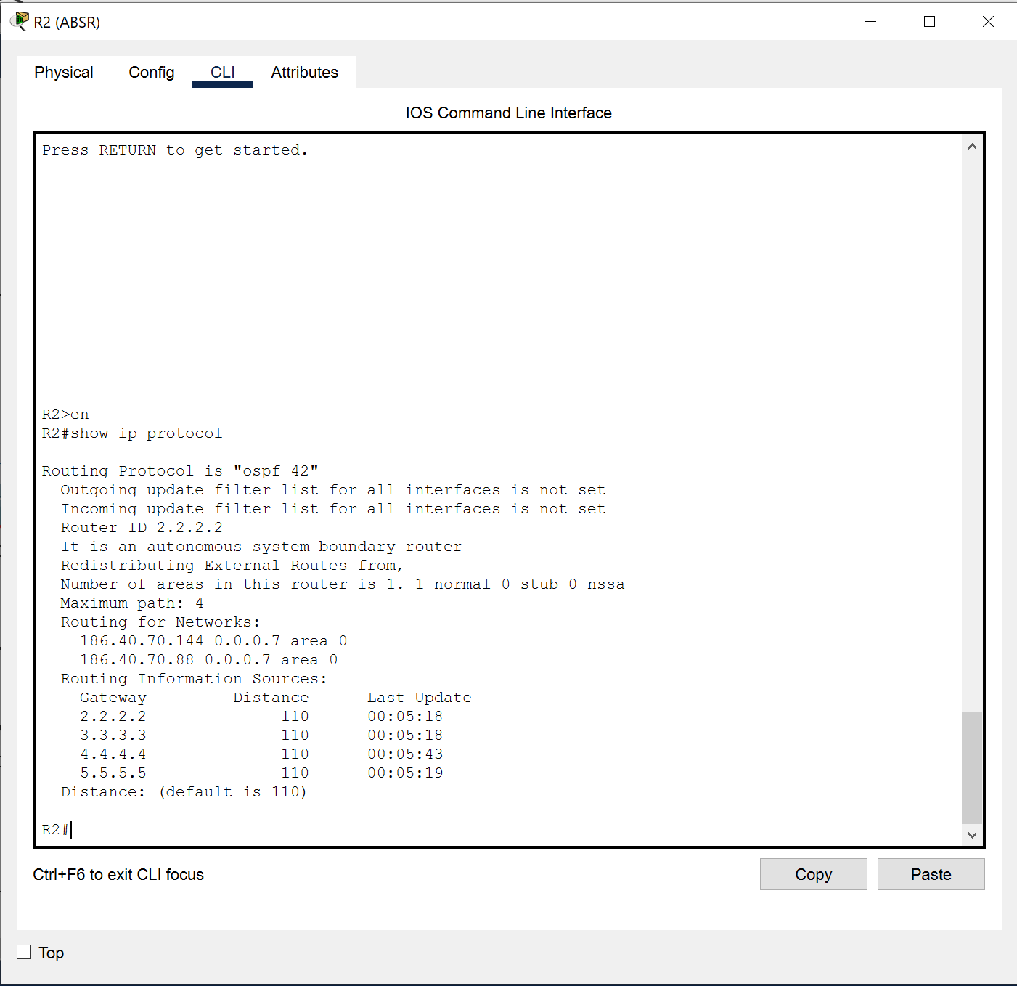
Main Office (BackBone Area) Router R2
Interface
Configuration
Password enable
ACL list configured to only allow traffic network from 220.220.130.0 pass.
HSRP enable with R7 as redundecy
- Standby version 2
- Standby Ip 180.40.70.150
- Standby priority 150
- Statice route via 220.220.30.1 to ISP.
Int Port No | DTE/DCE | Network Name | Int Address | Subnet Mask
Fa0/1 | Na | Main Building | 186.40.70.94 | 255.255.255.248
Fa0/0 | NA |  | 186.40.70.147 | 255.255.255.248
Se0/0/0 | DTE |  | 220.220.130.2 | 255.255.255.252

Slide 8
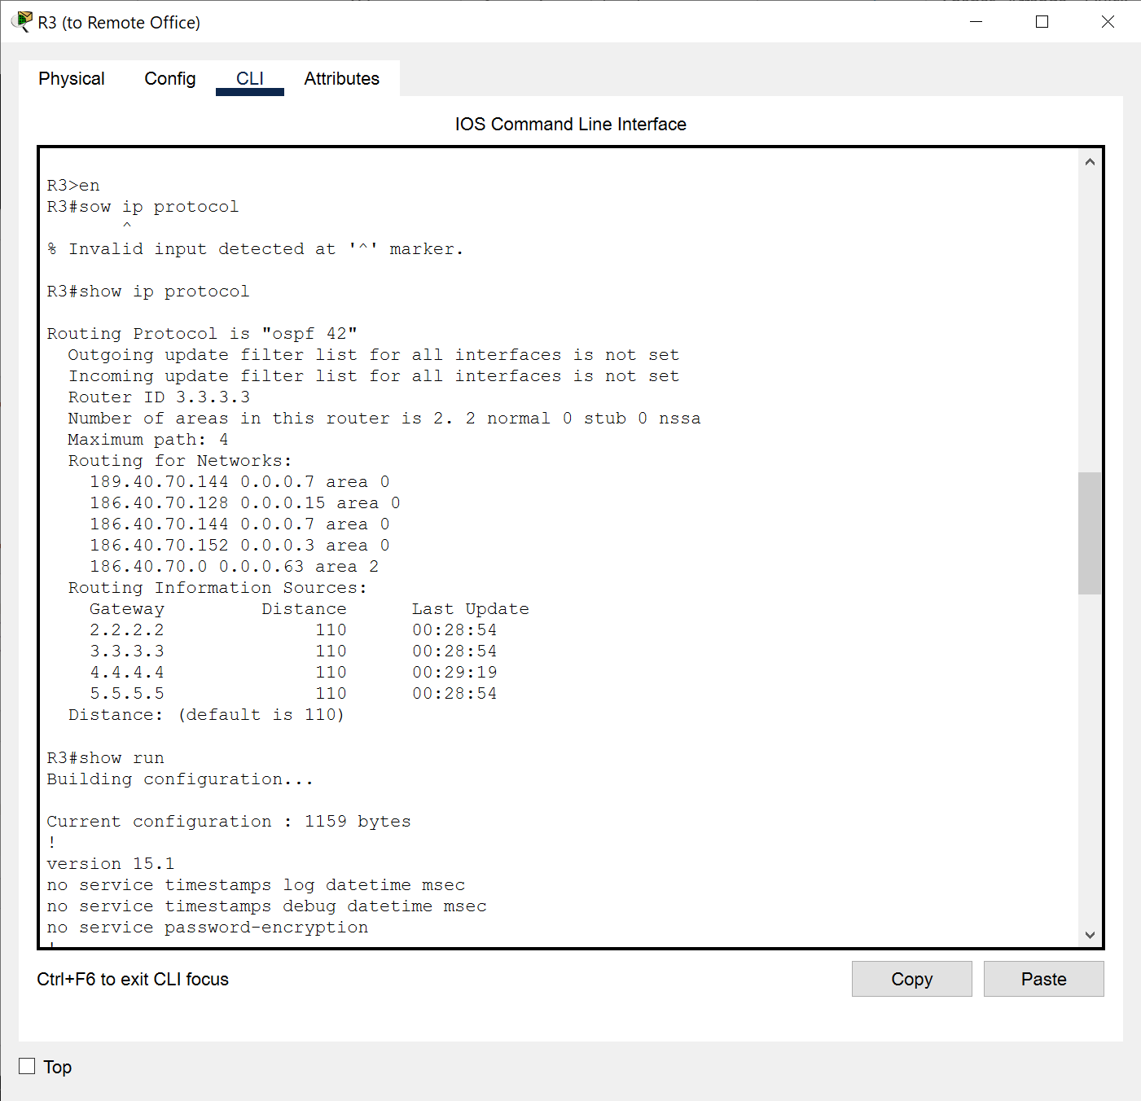
Main Office (BackBone Area) Router R3
Interface
Configuration
Password enable
Interface Serial 0/0/0 set to DCE with clock rate 6400.
Hello – dead interval 20-80
Default route 184.40.70.145 to R2
Int Port No | DTE/DCE | Network Name | Int Address | Subnet Mask
Fa0/0 | Na | Main Building | 186.40.70.148 | 255.255.255.248
Se0/0/0 | DCE |  | 186.40.70.153 | 255.255.255.252

Slide 9
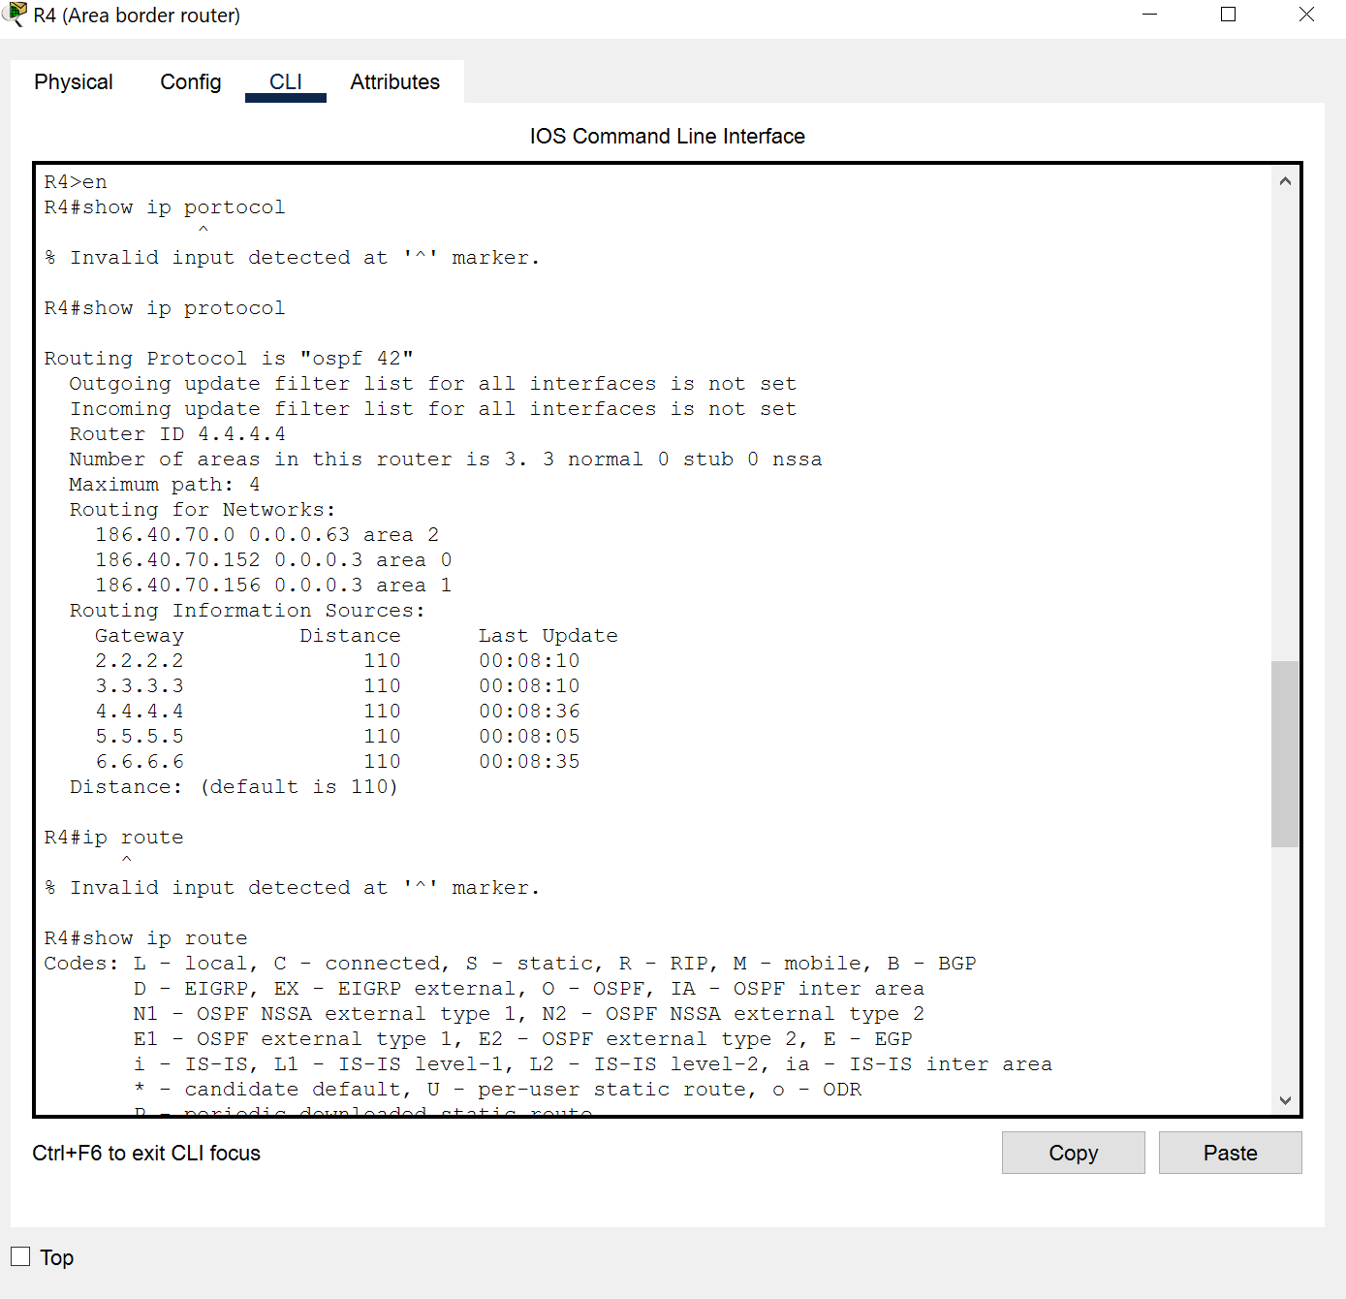
Main Office (BackBone Area) Router R4
Interface
Int Port No | DTE/DCE | Network Name | Int Address | Subnet Mask
Se0/0/0 | DTE | Main Building | 186.40.70.154 | 255.255.255.252
Se0/0/1 | DCE | Engineering Office | 186.40.70.157 | 255.255.255.252
Fa0/0 | NA | Sales Office | 186.40.70.1 | 255.255.255.192
Configuration
Password enable
Interface Serial 0/0/1 set to DCE with clock rate 64000
Hello – dead interval 20-80 set to both serial interface
Border router for Area 1, 2 & 0

Slide 10
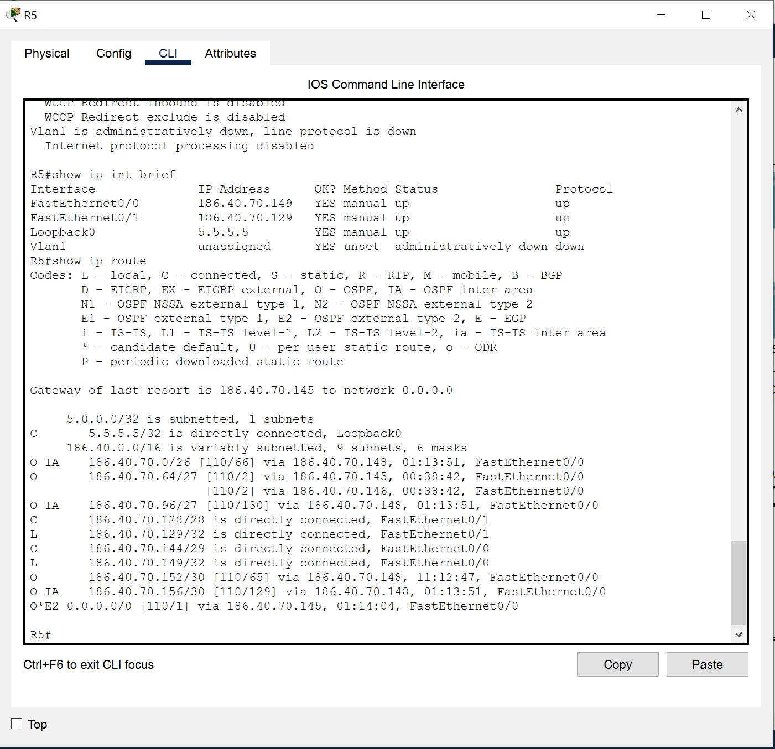
Main Office (BackBone Area) R5
Interface
Int Port No | DTE/DCE | Network Name | Int Address | Subnet Mask
Fa0/0 | NA | Admin Office | 186.40.70.146 | 255.255.255.149
Fa0/1 | NA |  | 186.40.70.129 | 255.255.255.240
Configuration
Password enable
Interface Serial 0/0/1 set to DCE with clock rate 64000
Hello – dead interval 20-80 set to both serial interface

Slide 11
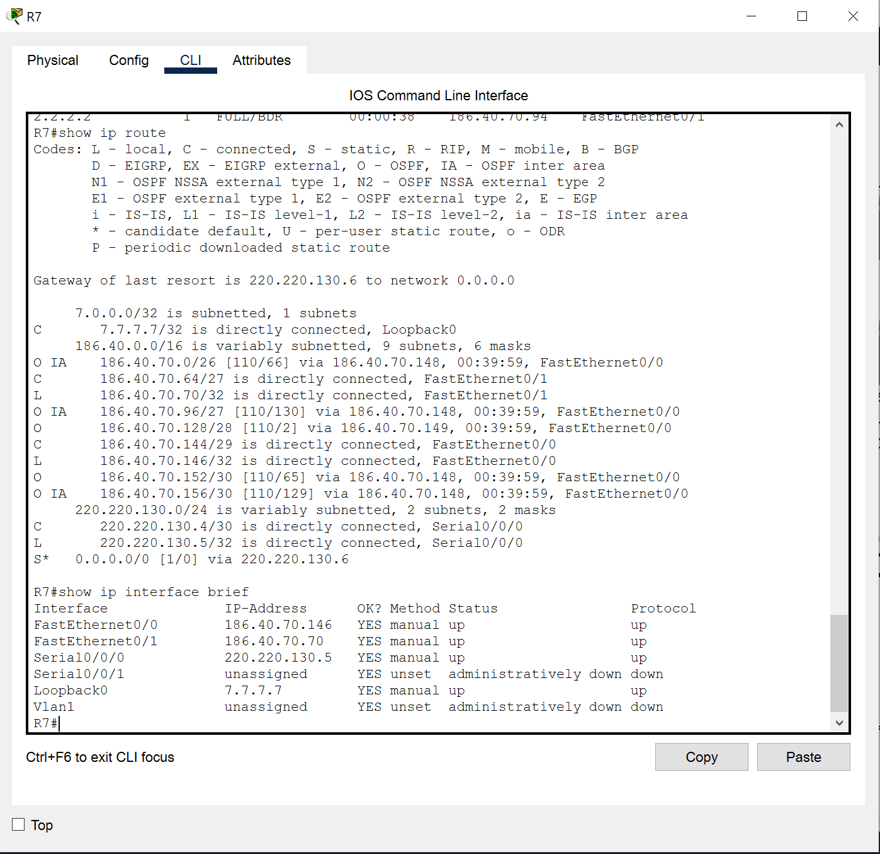
Main Office (BackBone Area) Router R7
Interface
Int Port No | DTE/DCE | Network Name | Int Address | Subnet Mask
Fa0/0 | NA | Main Building | 186.40.70.146 | 255.255.255.248
Fa0/1 | NA |  | 186.40.70.70 | 255.255.255.224
Se0/0/0 | DTE | ISP | 220.220.130.5 | 255.255.255.252
Configuration
Password enable
HSRP enable for R2 backup link to ISP
- Standby version 2
- Standby IP 180.40.70.150
- Standby priority 150

Slide 12
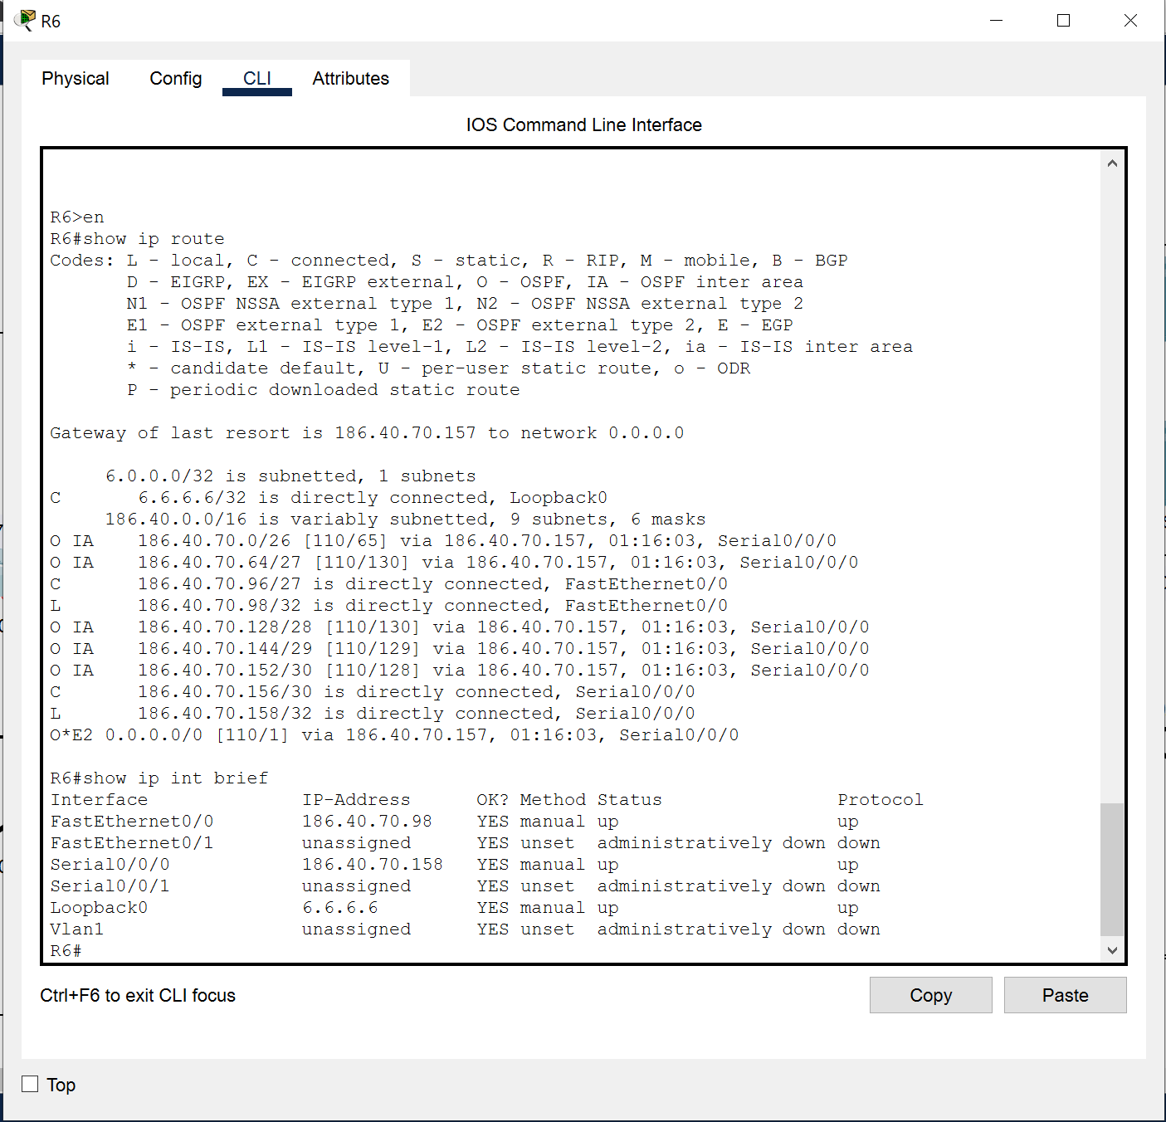
Area 1 (Branch office - engineering) R6
Interface
Int Port No | DTE/DCE | Network Name | Int Address | Subnet Mask
Fa0/0 | NA | Engineering Office | 186.40.70.98 | 255.255.255.224
Se0/0/0 | DTE |  | 186.40.70.158 | 255.255.255.252
Configuration
Password enable
Routing protocol Disable for Int Fa0/0
Hello-Dead Interval set to 20-80 for Se0/0/0

Slide 13
OSPF configuration
Implementation of OSPF in the network and configuration for each router in their area.
The OSPF ID is "42"
BD/BDR in the network will be R2 and R5 respectively
Backbone Area (area 0) will be R2, R3 & R5.
R4 is ABR for Area 0, 1 and 2.
R6 will be in area 1 (as shown in the diagram)
R7 is an additional router sole priority is to be the network redundancy in case R2 is shutdown. (refer to the diagram slide 4 for R7 location)

Slide 14
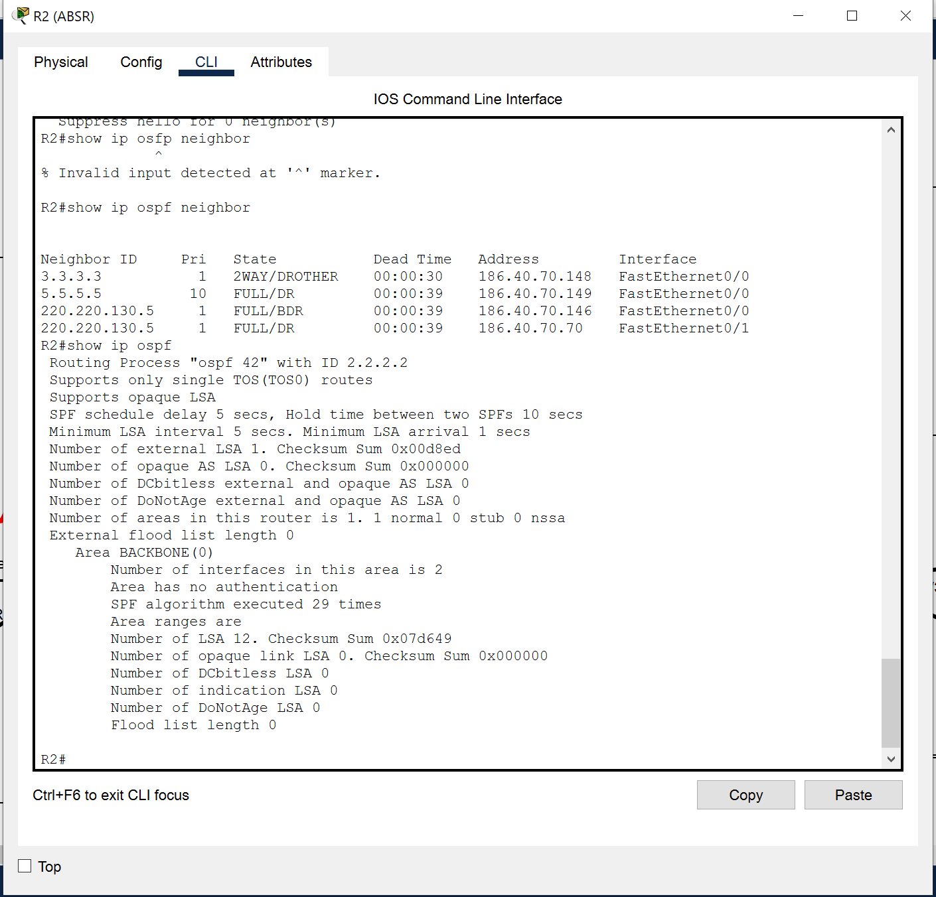
Main Office (BackBone Area) Router R2
OSPF Configuration
Configure iP Loopback address 2.2.2.2 255.255.255.255
Area border router for area 0
Designated router
Both interface is in Area 0

Slide 15
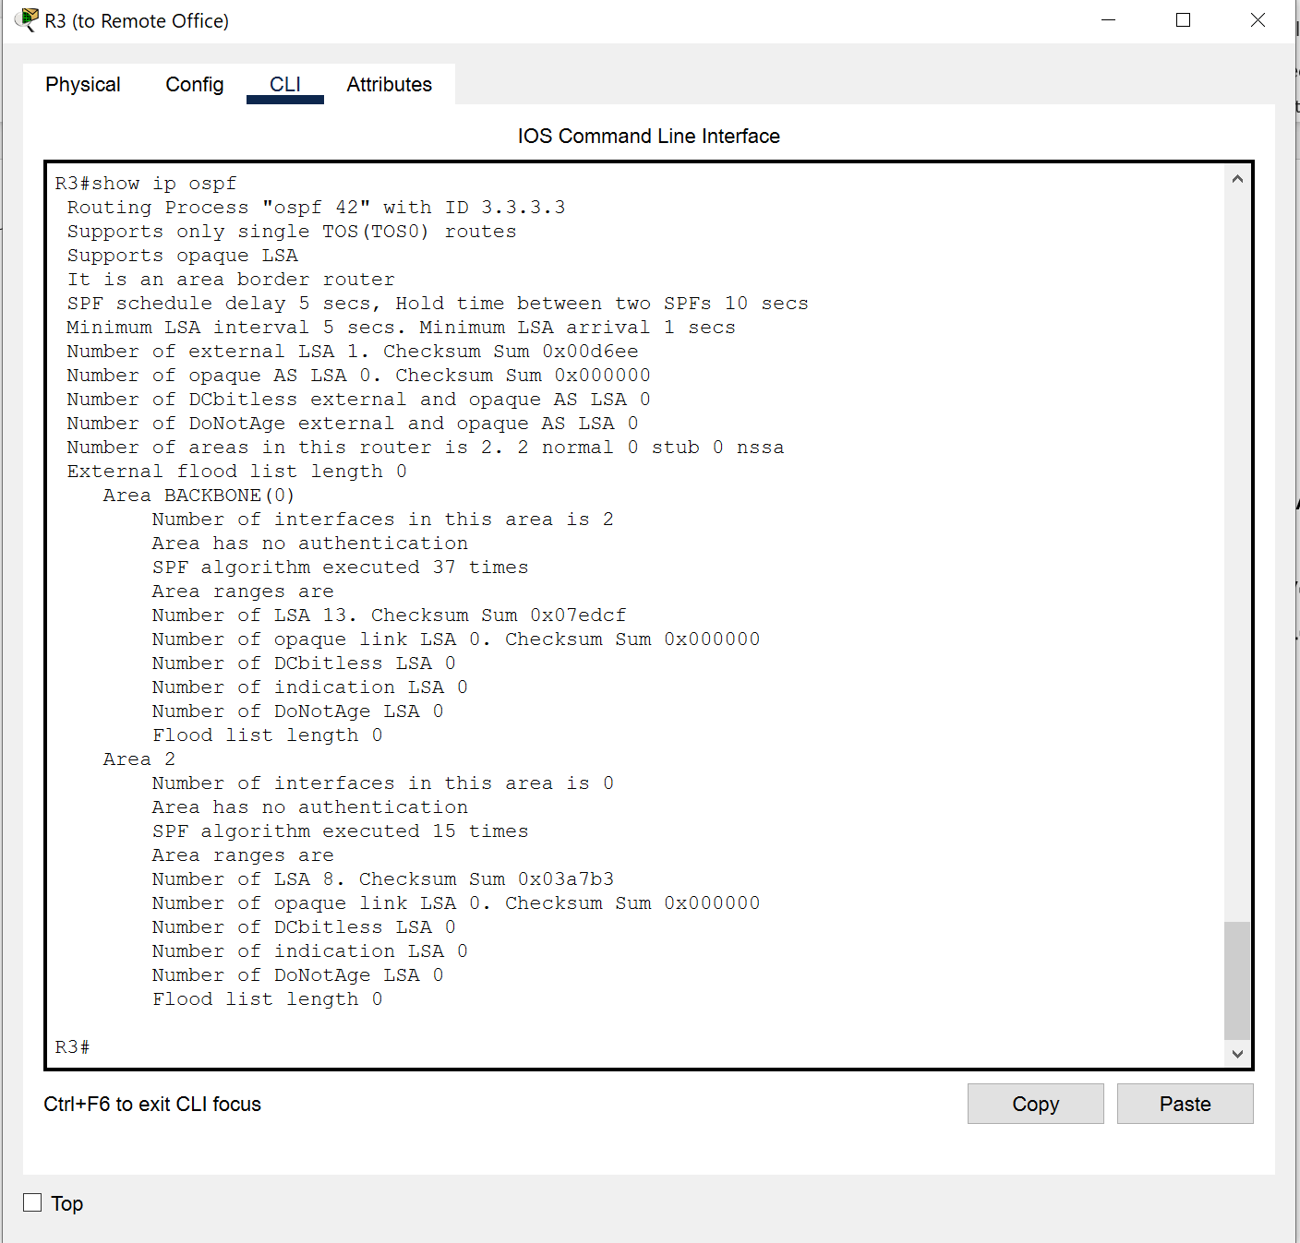
Main Office (BackBone Area) Router R3
OSPF Configuration
Router ID 3.3.3.3
Interface loopback configure
Router is in Backbone (area 0)
- Both interface is routed to area 0

Slide 16
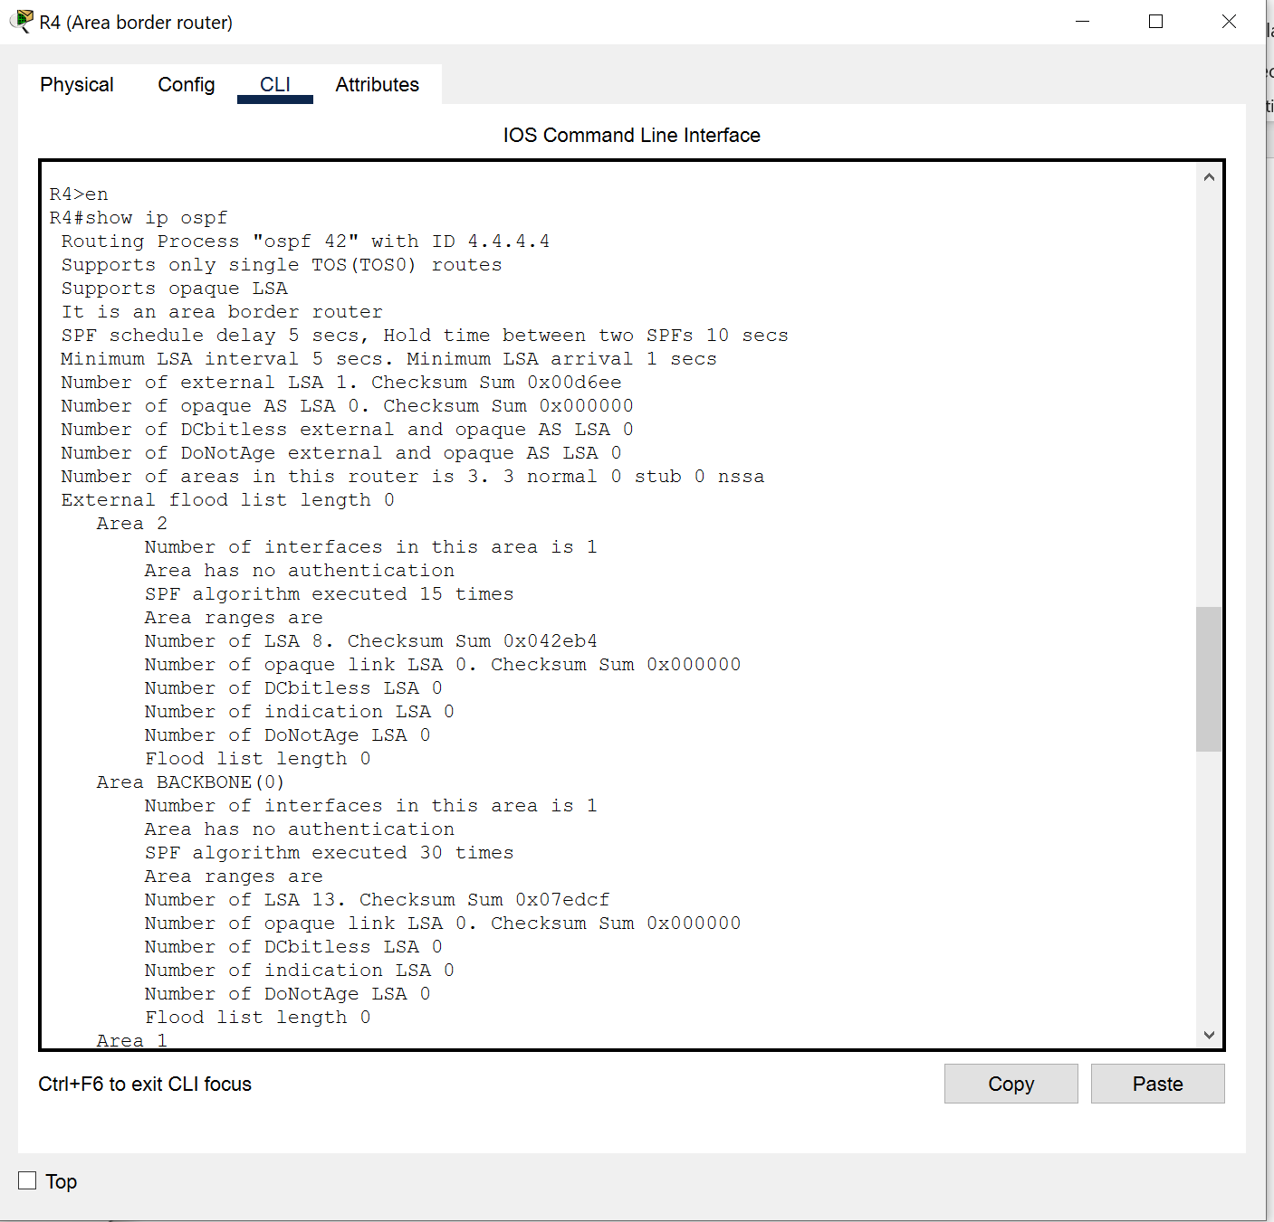
Main Office (BackBone Area) Router R4
OSPF Configuration
An Area Border router between Area 0, 1 & 2
Router ID 4.4.4.4
Loopback 0 interface configured
3 interface.
- Se0/0/0 connected to area 0
- Se0/0/1 connected to area 1
- Fe0/0 connected to area 2

Slide 17
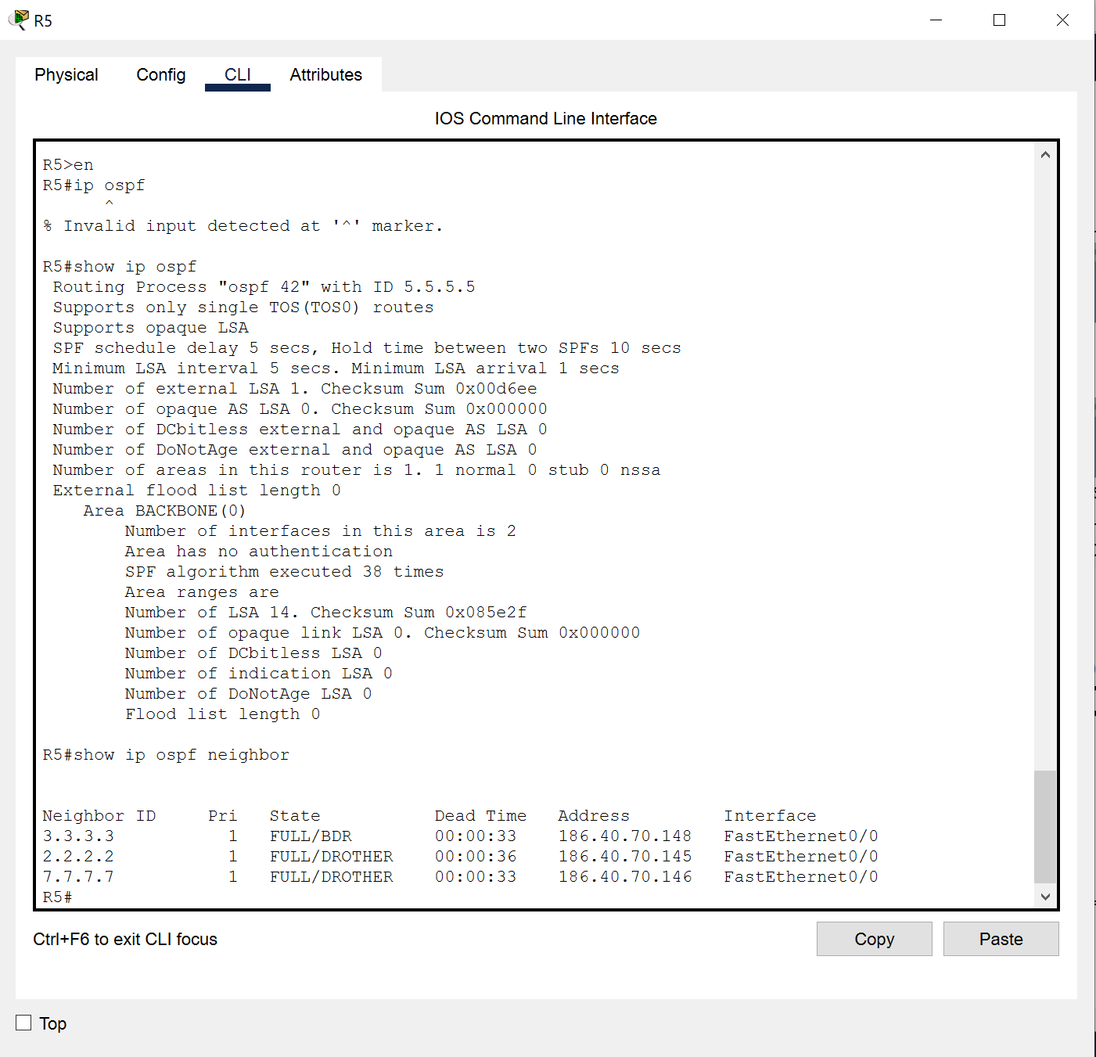
Main Office (BackBone Area) Router R5
OSPF Configuration
Router in area 0
Router ID 5.5.5.5
Loopback 0 interface configured
Both interface configure to area 0
A Backup designated router.
Passive interface configure on int Fa0/1

Slide 18
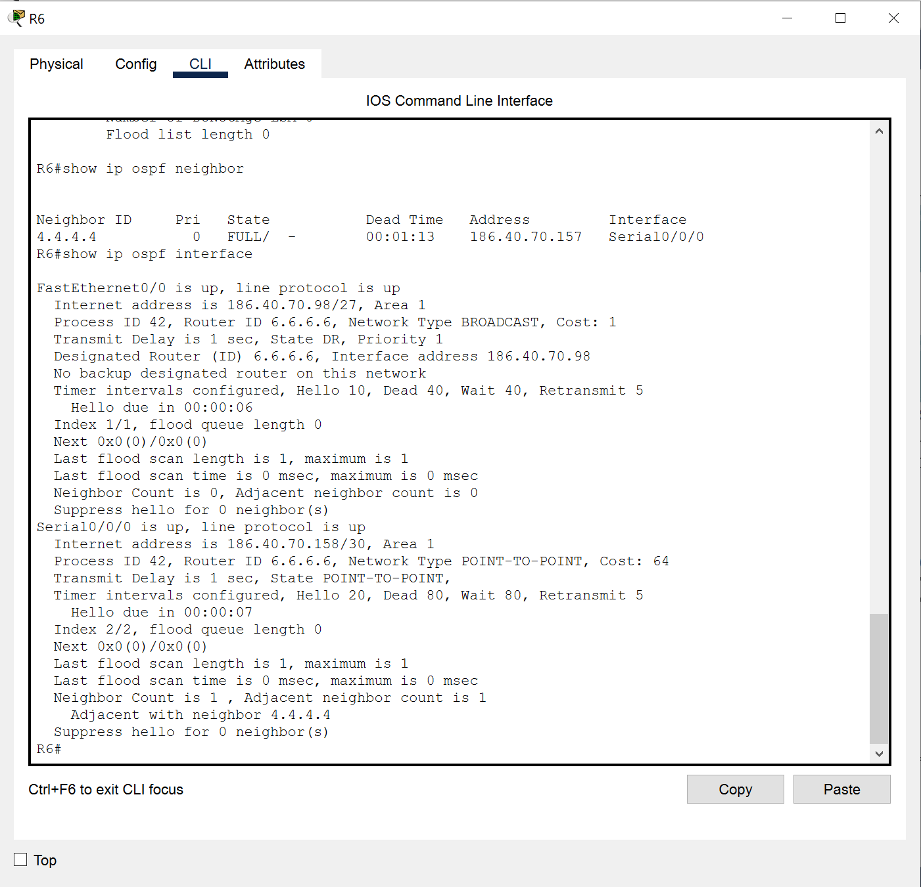
Branch Office - Engineering (Area 1) Router R6
OSPF Configuration
Router in area 1
Router ID 6.6.6.6
Loopback 0 interface configure
Network in interface Se0/0/0 is PTP.
Routing update disable in interface Fe0/0

Slide 19
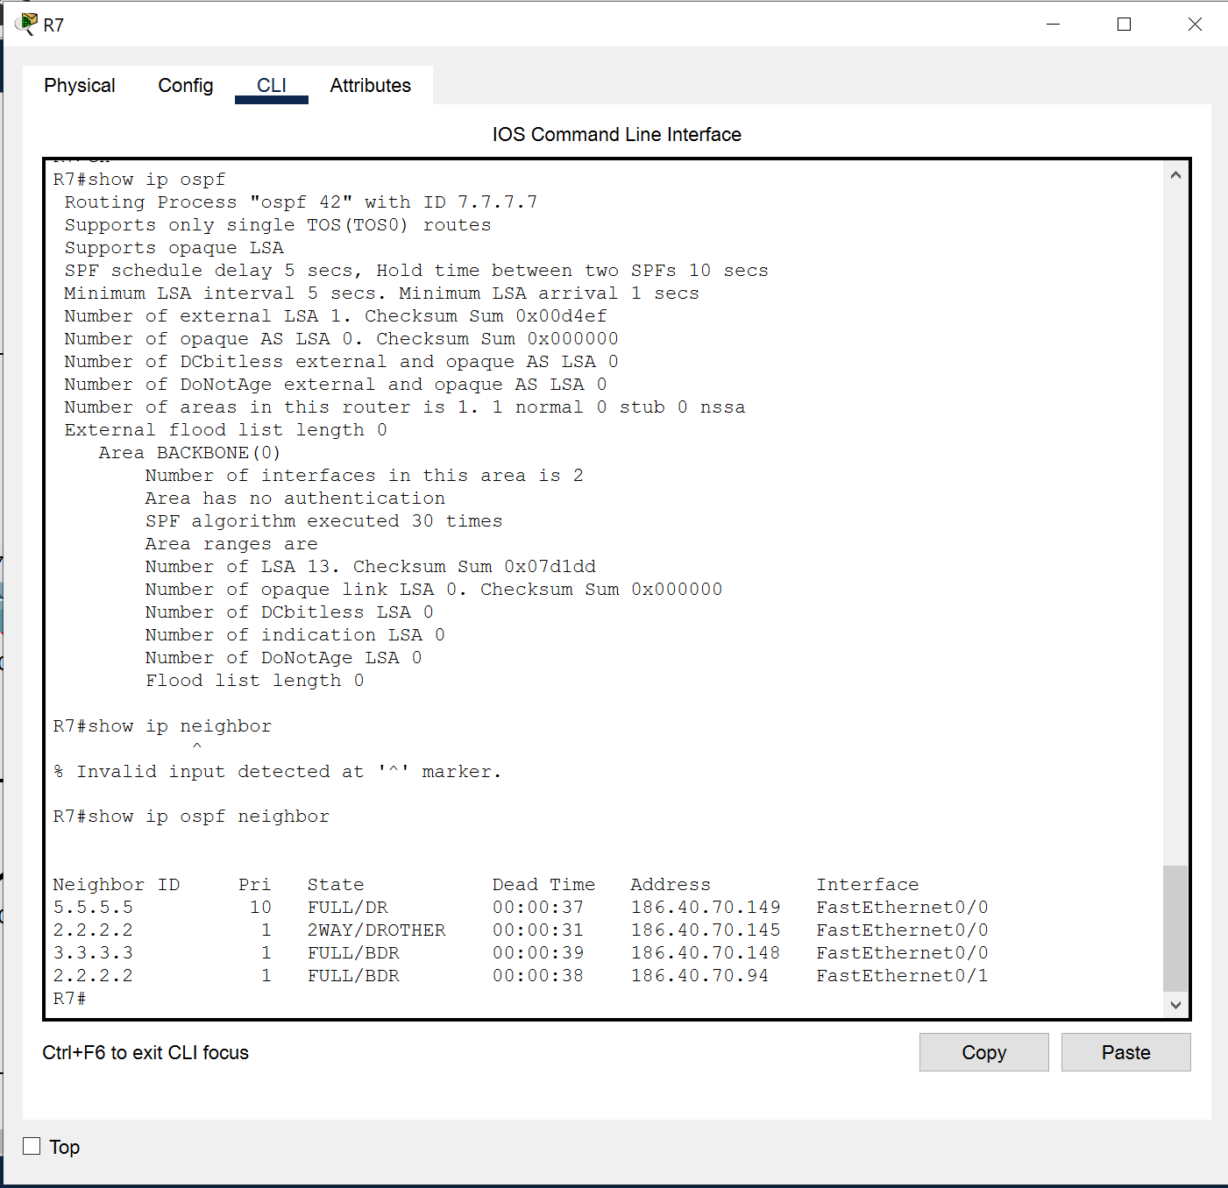
Main Office (backbone Area) Router R7
OSPF Configuration
Area border router in area 0
Router ID 7.7.7.7
Loopback 0 interface configure
Back up router for R2 to ISP. OSPF configuration is identical to R2

Slide 20


Routers configuration details
Links for each router IP configuration
Configuration of:
- Show Run
- IP Protocol
- IP Route
Note*: click on the link to redirect to the text file for the router configuration.
R3(Backbone Area)
R7
Reduncy router. Link to ISP
R2(Backbone Area)
ABR
ACL
R5(Backbone Area)
BDR
R6(Area 1)
Branch Office , Engineering
R4(Area 0, 1 & 2)
Border Router

Slide 21
Implantation Budget
PRODUCT | COST | UNIT | TOTAL | SPECIFICATION
ROUTER 2811 | $2,967 | 6 units | $17,802 | LINK
2690-24TT | $627 | 5 units | $3,135 | LINK
Server-PT | $3,350 | 2 unit | $6,700 | Link
Misc. e.g Cables, Server Rack. | $5,000 | (depend on requirement) | $5000
ITEM | COST
Total Products | $32,637
Manpower | $12,00
Total | $44,637

Slide 22



Future Recommendation
Security
To set up port security for each router and switch. Allowing access to only company personal
Firewall for each router.
ACL configuration for each routers offices to protect confidential files and traffics.
Enable different password for each routers
Enable MOTD to warn any unauthorized access
Cost
Setup Vlans for Routers. To reduce bandwiths
Use switches as Layer 3. Set up router on a stick. This reduce cost to purchase more router if there is a need to extend branches
Set up DHCP for each branches.
Sustainability
Set up Access points for each offices.
To use a latest Router which could be more expensive but would last longer and have better functionality. Also, the current router used is absolute.
-

Slide 23
THANK YOU
Shalihin Ahmaddullah
MUHAMMAD_SHALIHIN01.PT@ICHAT.SP.EDU.SG
P7474668

