Slide 1





Design, Development and Evaluation of a Specification-Driven, Reusable Alumni Management Platform for Resource-Constrained Institutions
Platform progress.
Focus: the election module and the data model
Md Habibur Rahman, EMIT, B7, 2512220
Under Supervision Of –
Professor Dr. Kazi Muheymin-Us-Sakib
Date: 31 Oct 2026

Slide 2
Where the project stands
What | Count
API controllers | 49
HTTP endpoints | 406
Entity types in the database | 83 (24 for elections and polls)
PostgreSQL migrations | 34
Commits | 378
Clients | Angular web, Flutter mobile
note: the count is of code, not of features used

Slide 3
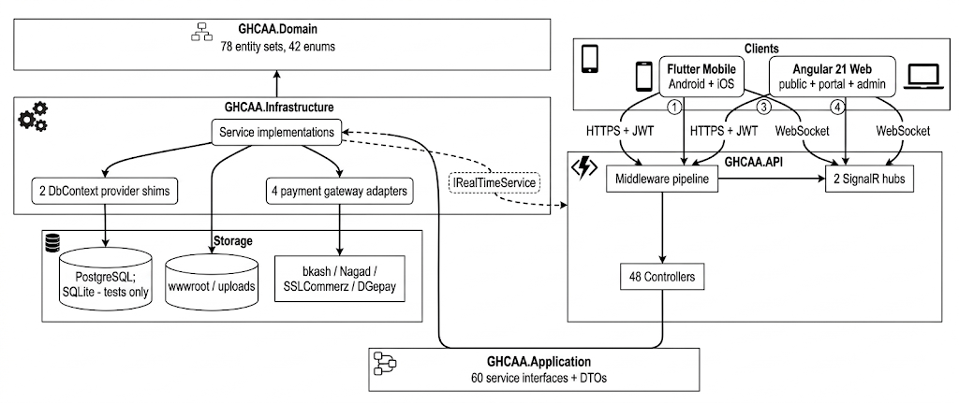
Architecture
Layers are API, Infrastructure, Application and Domain.
Single API serves for the web and mobile.

Slide 4
Election lifecycle
Announced
Nomination
Scrutiny
Withdrawal
CandidateList
Campaign
Polling
Counting
Declared
Archived
Needs a second official to approve
Publish
OpenPolling
ReplaceBallotKey
ClosePolling
Count
Declare
Archive
EmergencyRevoke
One official cannot move the election forward alone.
Notes:
Ten phases, in order. Polling is highlighted because that is where members vote. The eight actions below need two different officials: one requests, a second approves. So one official cannot move the election forward alone.

Slide 5
Data model
83 entity types, drawn as six ER sub-models. 24 serve elections and polls.
Identity and records
Figure 6.3
Standing and money
Figure 6.4
Events and participation
Figure 6.5
Governance
Figure 6.6
Election roll and nominations
Figure 6.7
Voting and the count
Figure 6.8
Why six: one diagram of all the tables cannot be printed legibly. The two shaded sub-models are the election.
Notes:
The book draws the database as six ER sub-models, Figures 6.3 to 6.8. One diagram of all 83 entity types cannot be read on a page. The next two slides are the election sub-models.

Slide 6
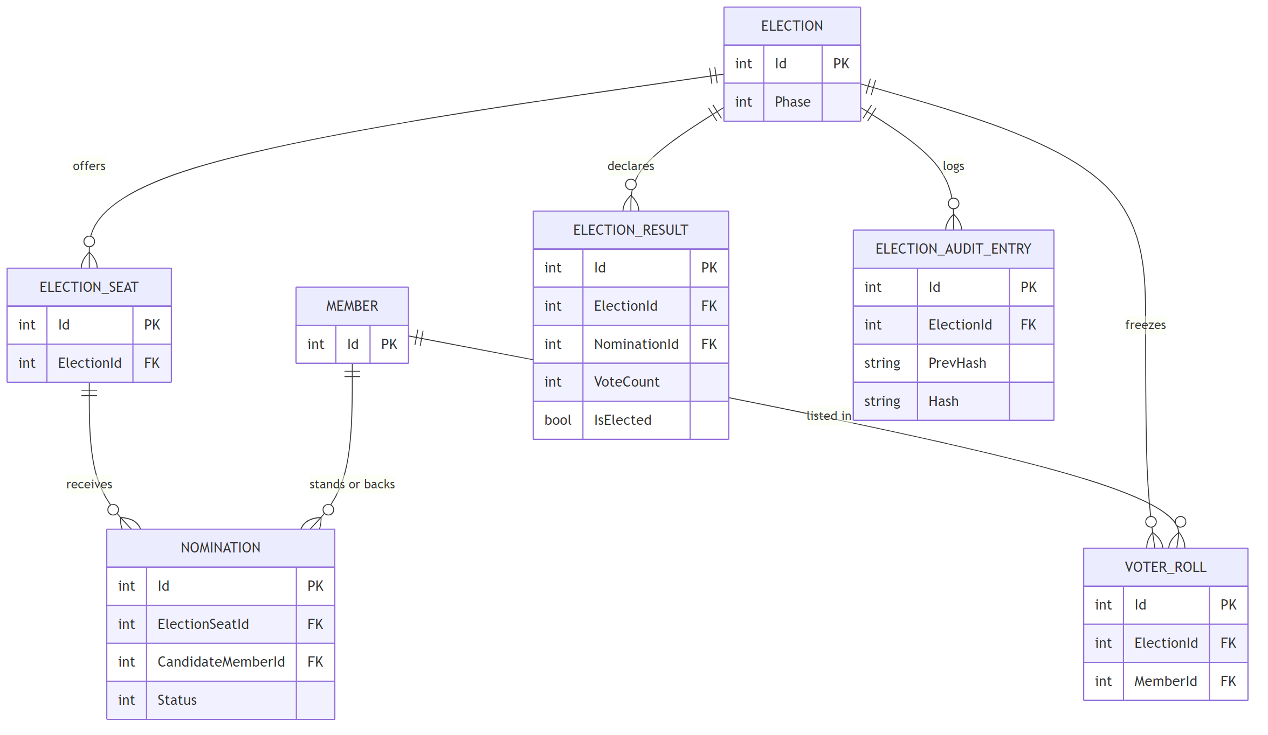
Election ERD: roll and nominations
Book Figure 6.7
Notes:
Election, its seats, the frozen voter roll, nominations, results and the audit log. A member stands for a seat or backs a candidate through Nomination. ElectionAuditEntry keeps PrevHash and Hash, so the log is a chain.

Slide 7
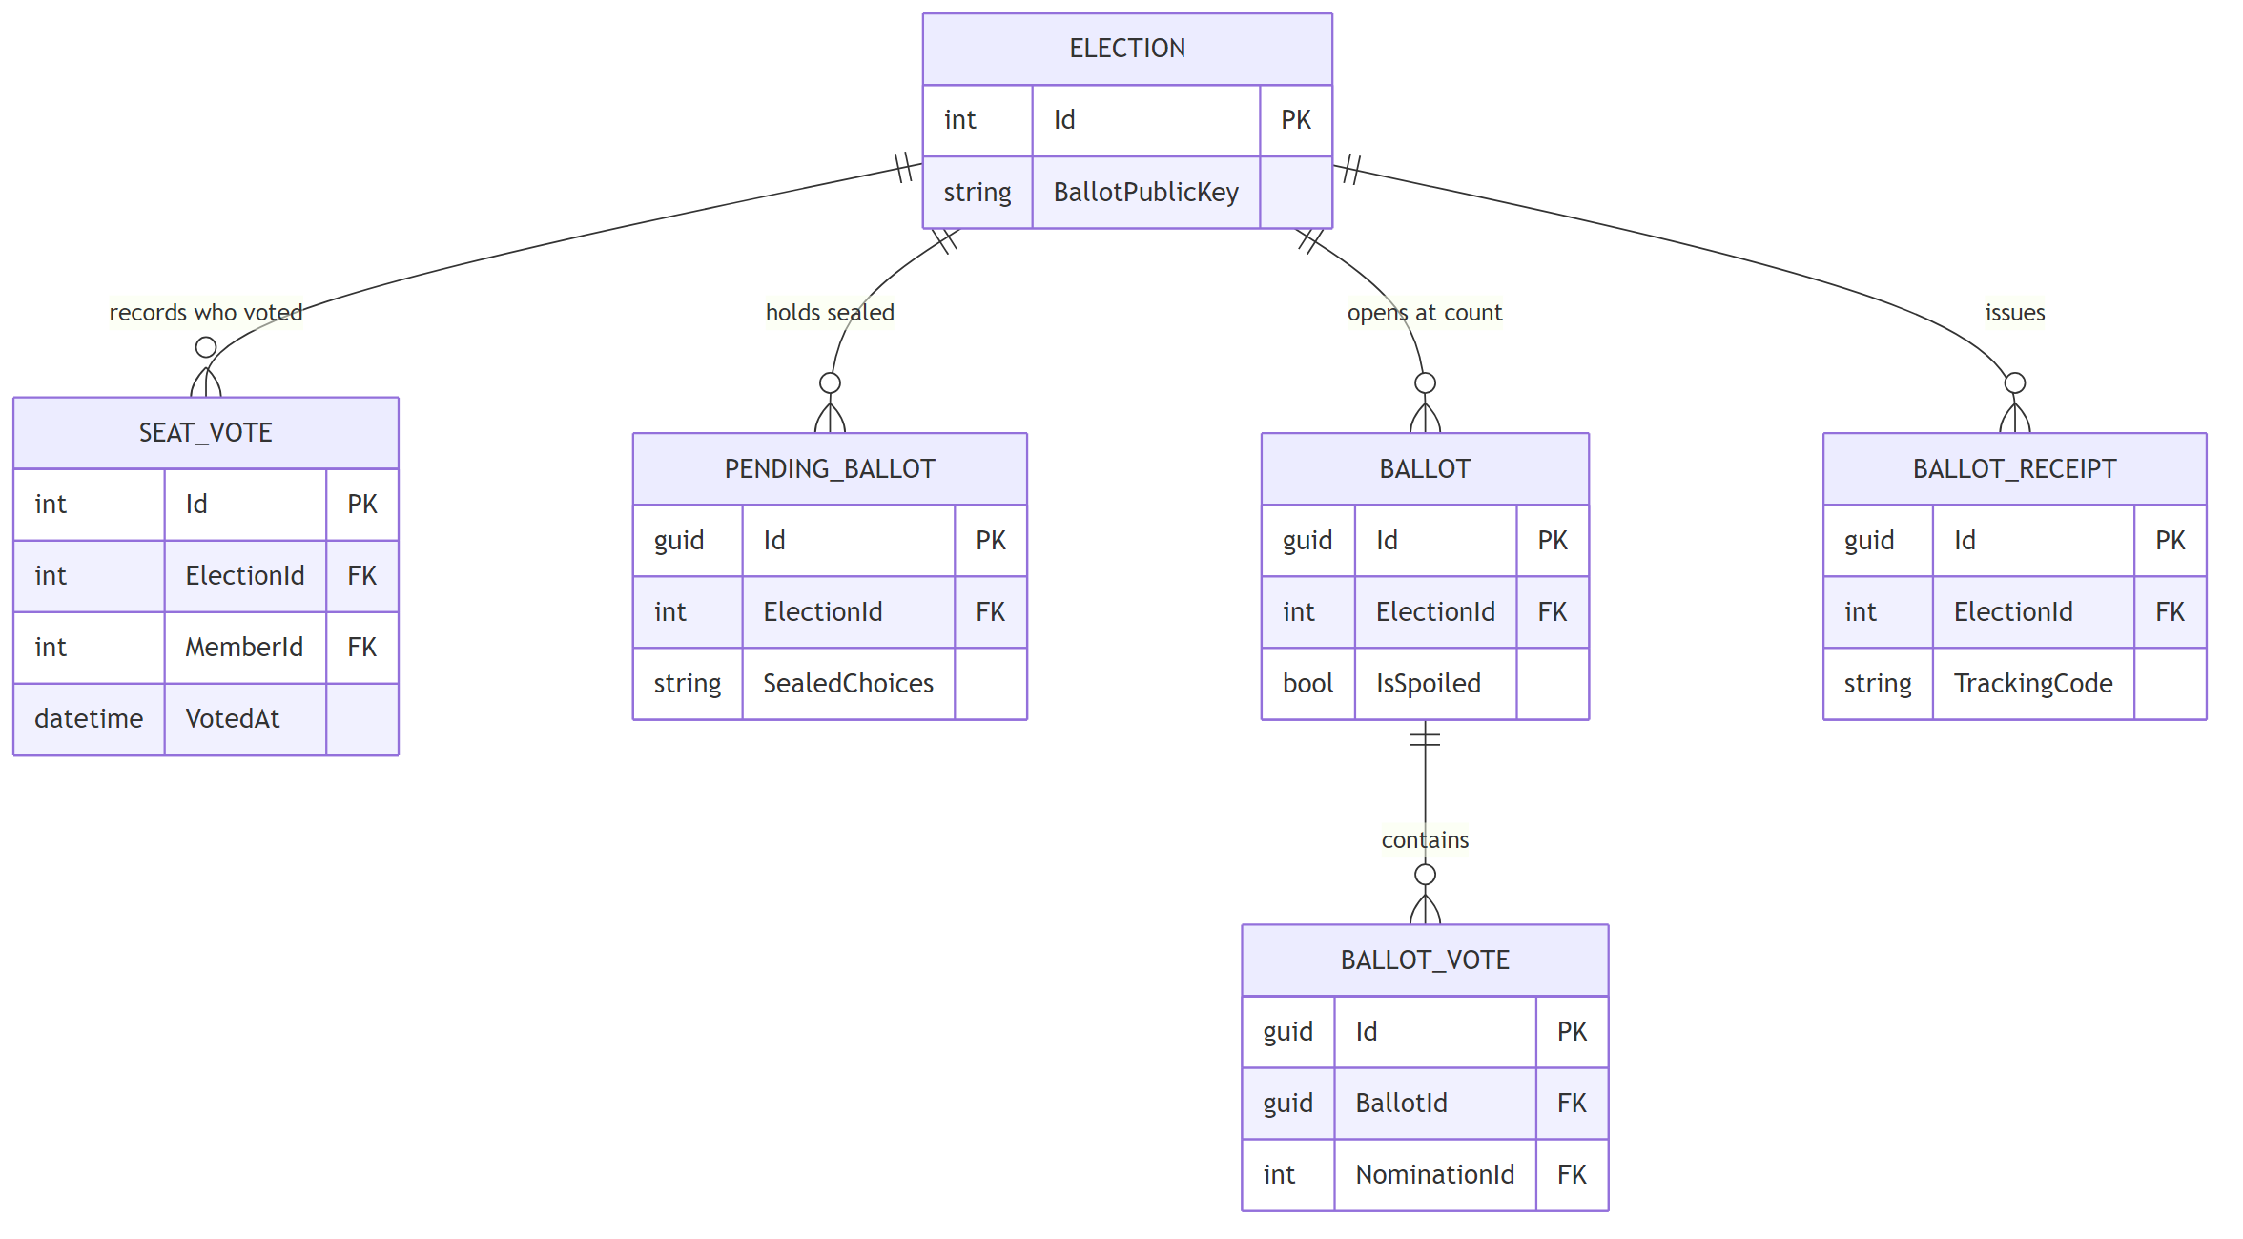
Election ERD: voting and the count
Book Figure 6.8
No key joins SeatVote to Ballot.
SeatVote knows who voted. Ballot knows what was chosen. Nothing links the two.
Notes:
SeatVote records who voted and when. PendingBallot holds the sealed choices. Ballot and BallotVote use random GUID keys. BallotReceipt holds a tracking code. Point to the gap: there is no foreign key from SeatVote to Ballot.

Slide 8
How ballot secrecy is kept
Who voted and what they chose are stored apart.
Voter side: who voted
Ballot side: what was chosen
1 The voter casts a ballot. SeatVote records the member and the time.
2 In the same transaction the choices go to PendingBallot, sealed with the election public key. No member, no time.
4 The voter gets a tracking code in BallotReceipt. It is not linked to the ballot.
3 At the count, the officer's private key opens the sealed rows. They are shuffled, written to Ballot and BallotVote under random GUIDs, then deleted.
5 ElectionAuditEntry chains each entry to the hash of the one before it, so an edit shows.
Notes:
Left side knows who voted. Right side knows what was chosen. The dashed line is the gap: no key crosses it. The arrow is a write in one transaction, not a stored link. The sealed rows have no member and no time, and the count shuffles them before writing Ballot rows under random keys.

Slide 9
Demo: a full local election
Run by the walkthrough script, step by step.
Setup
Polling
10 voters
Close
Count
Declare
Results
Commands, from the repo root, local machine only
scripts\run-election-walkthrough.bat setup before the talk, up to Campaign
scripts\run-election-walkthrough.bat resume slow in the talk, polling to results
scripts\run-election-walkthrough.bat full demo one go, polling dates moved to now
scripts\clean-election-test-data.bat afterwards, remove the test data
Notes:
Run setup before the talk. In the talk, run resume slow so each step shows, 400 ms apart. Step-up codes come by real email, so the machine needs network access. If the room setup is not reliable, show screenshots from a rehearsal run instead. Rehearse the full run the day before, and run the clean-up script afterwards.

Slide 10
Verification
Test declarations counted from source on 31 Oct 2026.
517
election-related backend test attributes, across 37 files
These count the tests that exist. They are not a pass rate. The design is checked by tests; it has not yet run a live election.
Notes:
These numbers count test declarations in the source. They are not a pass rate. Run the suites before the talk and quote the pass result separately.

Slide 11
What is left
Tracker on 31 Oct 2026: 86 TODO, 28 PARTIAL.
Tracker. 86 TODO and 28 PARTIAL. Finished items move to the archive file, so this list understates progress.
Waiting on the election calendar. Phone checks on a real device (84.50) and two follow-up fixes (B4, B5).
Next. The first live election, then a report on how it ran.
Notes:
Finished items are moved out of TODO.md, so 86 open items is not the whole history. The device checks and the two fixes need a real election to test against.

Slide 12
Github
https://github.com/shalin-rahman/GHCAA
Q & A
Thank you

