Slide 1





Design, Development and Evaluation of a Specification-Driven, Reusable Alumni Management Platform for Resource-Constrained Institutions
Platform progress.
Focus: the election module and the data model
Md Habibur Rahman, EMIT, B7, 2512220
Under Supervision Of –
Professor Dr. Kazi Muheymin-Us-Sakib
Date: 31 Oct 2026

Slide 2
Where the project stands
What | Count
API controllers | 49
HTTP endpoints | 406
Entity types in the database | 83 (24 for elections and polls)
PostgreSQL migrations | 34
Commits | 378
Clients | Angular web, Flutter mobile
note: the count is of code, not of features used

Slide 3
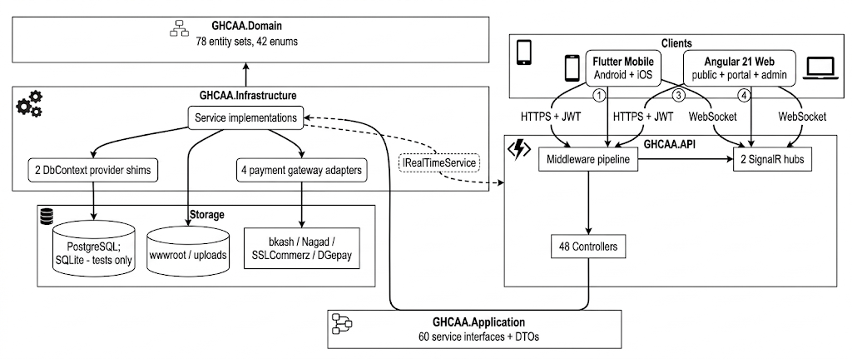
Architecture
Layers are API, Infrastructure, Application and Domain.
Single API serves for the web and mobile.

Slide 4
Election lifecycle

Slide 5
Github
https://github.com/shalin-rahman/GHCAA
Q & A
Thank you

