Slide 1
#32 Foodzie!
Jeet Baru
Shalin Shah
Vihanga Bare

Slide 2
Demo
Demo Video

Slide 3
Use Cases
Signup/Login
Add Review/Delete Review
Add Outlet/ Delete Outlet
Search/ Filter Restaurants
List all Outlets
List all Users

Slide 4
Design Patterns
DAO
Singleton
Model- Viewer- Controller
Builder

Slide 5
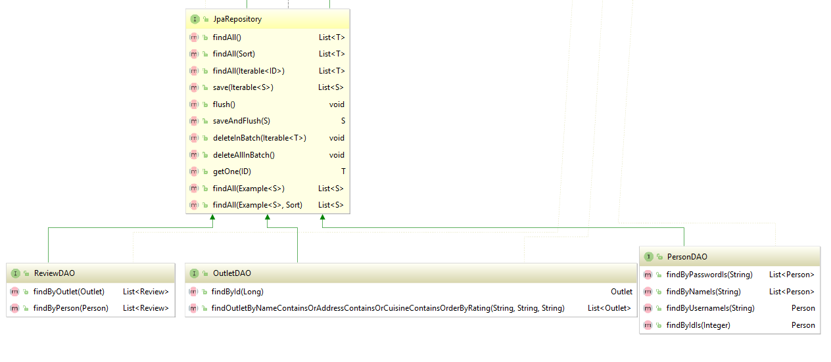
DAO

Slide 6
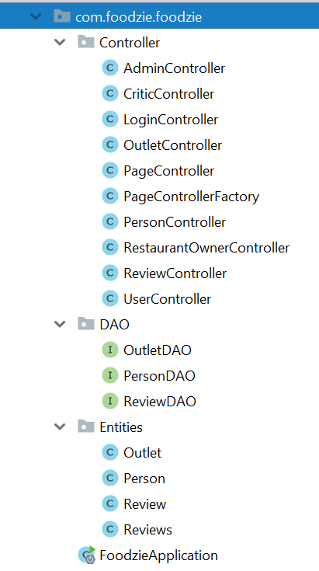
MVC

Slide 7
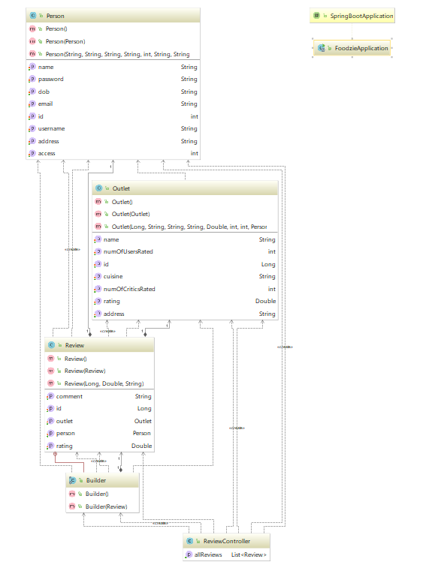
Builder

Slide 8
Improvements and Learning
Improvements…..
Improve the application GUI
Achieve Stretch goals related to add/delete images, place an order for delivery functionality.
Improve the application GUI
Achieve Stretch goals related to add/delete images, place an order for delivery functionality.
Learning…..
Hands-on experience of processes essential to the development of a production grade application
Learnt to use different Java Frameworks - Spring, Hibernate, ThymeLeaf, JPA

Slide 9
Improvements and Learning
Improvements…..
Improve the application GUI
Achieve Stretch goals related to add/delete images, place an order for delivery functionality.
Improve the application GUI
Achieve Stretch goals related to add/delete images, place an order for delivery functionality.
Learning…..
Hands-on experience of processes essential to the development of a production grade application
Learnt to use different Java Frameworks - Spring, Hibernate, ThymeLeaf, JPA

Slide 10
Thank you

