Slide 1
Shalini Priya
E‑commerce Analytics Data Pipeline on GCP
I designed an end‑to‑end pipeline that turns raw CSV exports into clean fact/dimension tables ready for dashboards
From raw Kaggle CSVs to BI‑ready facts & dimensions

Slide 2
Agenda
Business questions we’re solving
Tech stack
medallion architecture on GCS + BigQuery,
Deep Dive into each layer
Dimensional model
Airflow
Self service analytics
Demo

Slide 3
Business Questions & Requirements (Bottom Up Approach)
What stakeholders need ?
Which traffic sources generate the most engaged sessions?
Which browsers are mostly used?
How does engagement differ by gender?
What is the shipment status?

Slide 4
2. Why This Stack?
Why Airflow + GCS + BigQuery?
Airflow → Orchestrate daily ETL with clear dependencies and retries
GCS + BigQuery → Serverless, scalable storage and analytics with low operational overhead
BigQuery SQL → Familiar, high‑performance transformations without extra compute
Kaggle API (PythonOperator) → Simple, flexible way to ingest CSVs into the pipeline
Visualization → Metabase

Slide 5
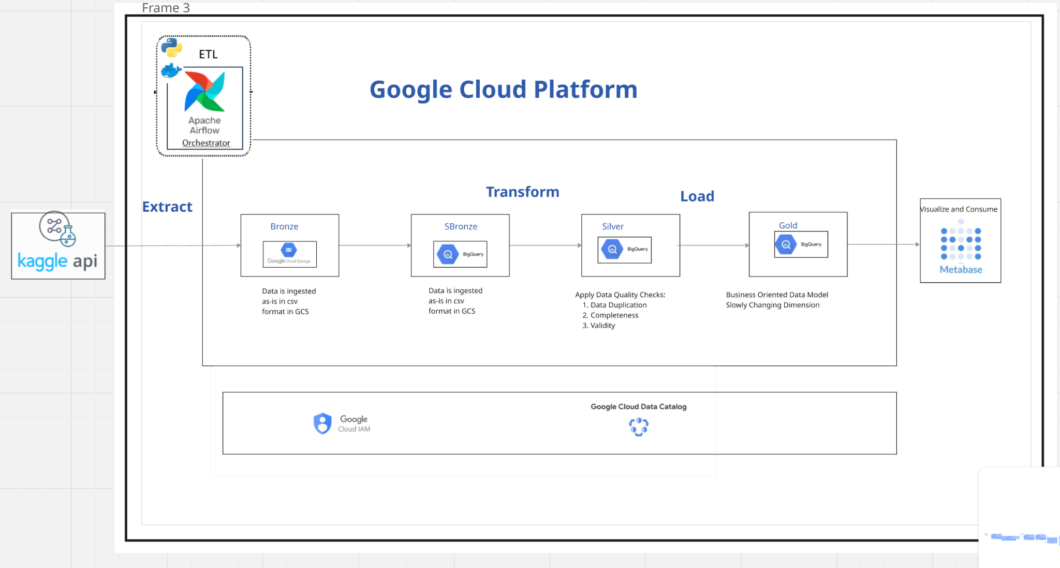
3. Architecture

Slide 6
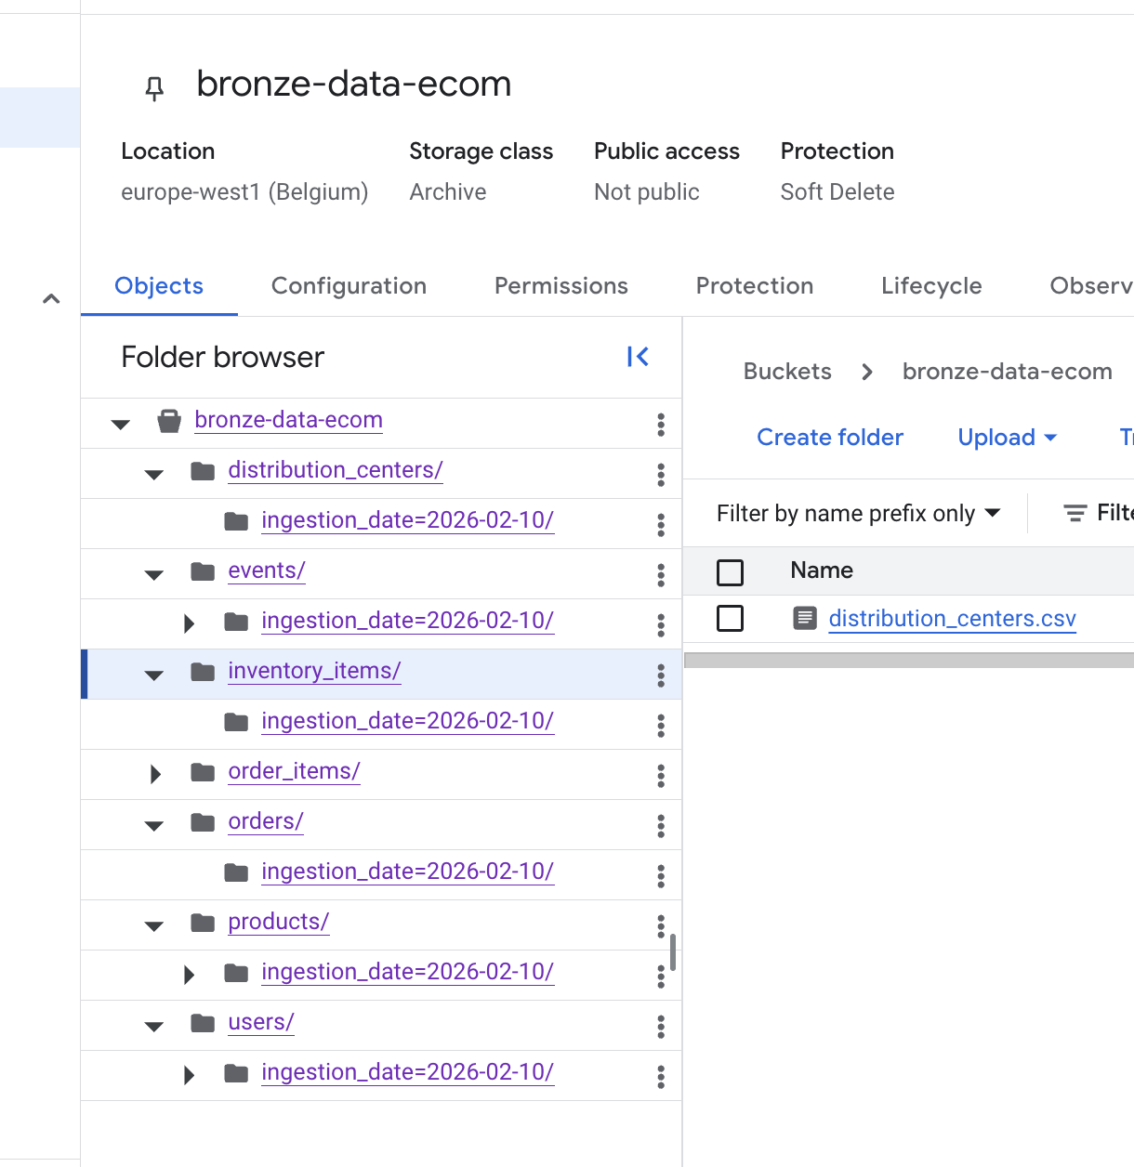
4.1 Bronze Layer (GCS + BigQuery - Raw Zone)
Goal: AS is data extraction
Ingestion (Airflow → GCS → BigQuery (temporary table) Fetch 7 Kaggle CSVs daily using an ingestion DAG
Store them as-is in: gs://bucket/raw/ingestion_date=YYYY-MM-DD/source=events/file.csv
Metadata Capture - source, ingestion_date
- Useful for audits
BigQuery GCS Folders

Slide 7
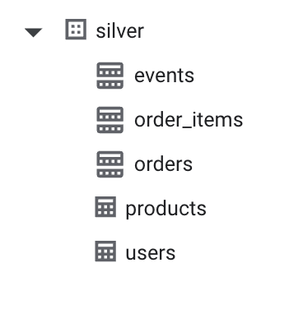
4.2 Silver Layer (Cleaned Dataset)
Goal: Standardized data model ready for dimensional modeling.
Process
Load bronze files into BigQuery silver tables: Partitioned by created_at date
Perform certain transformations:
Standardize datatypes (with respect to BigQuery)
Deduplicate

Slide 8
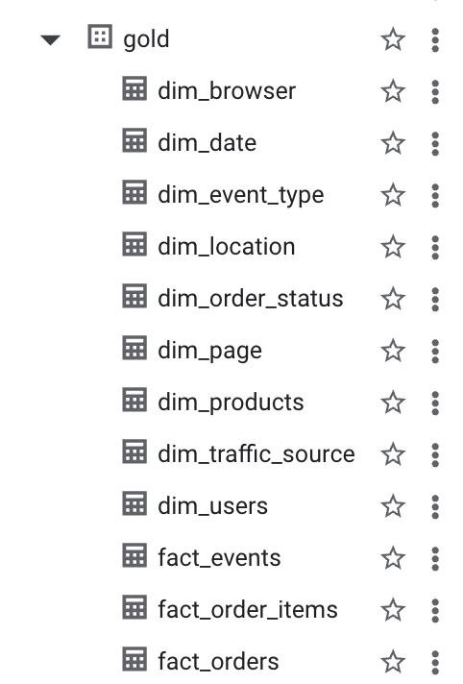
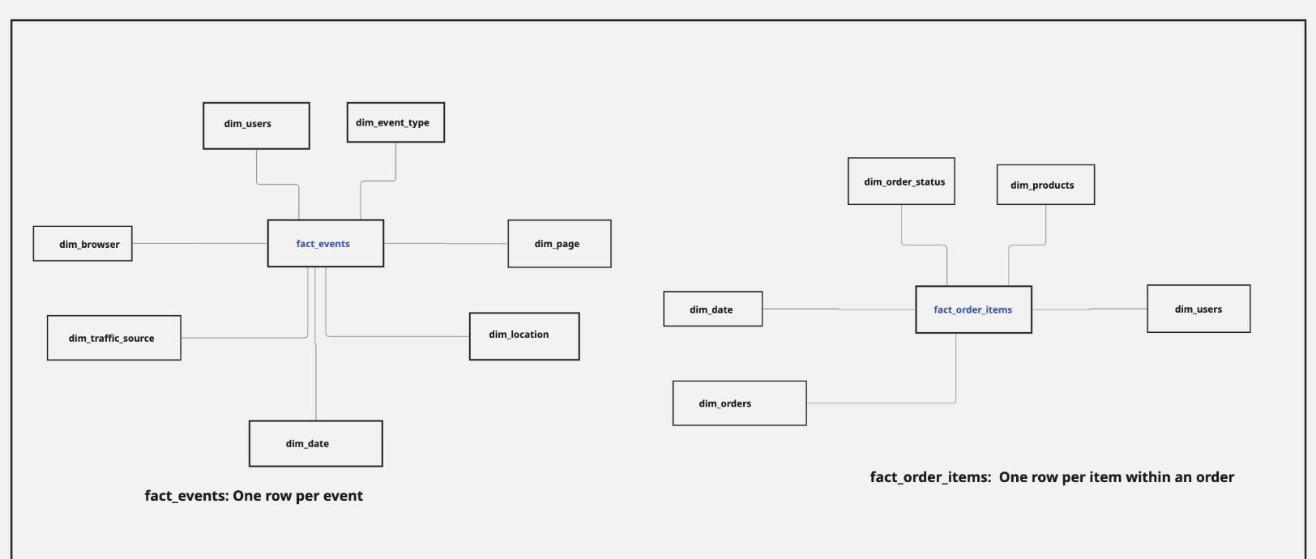
4.3 Gold Layer (Analytics Ready Dataset)
Goal: To build fact and dimension tables
fact_events – one row per user event.
fact_order_items – one row per order item.
dim_users, dim_products, dim_date, dim_browser, dim_traffic_source shared
across facts

Slide 9
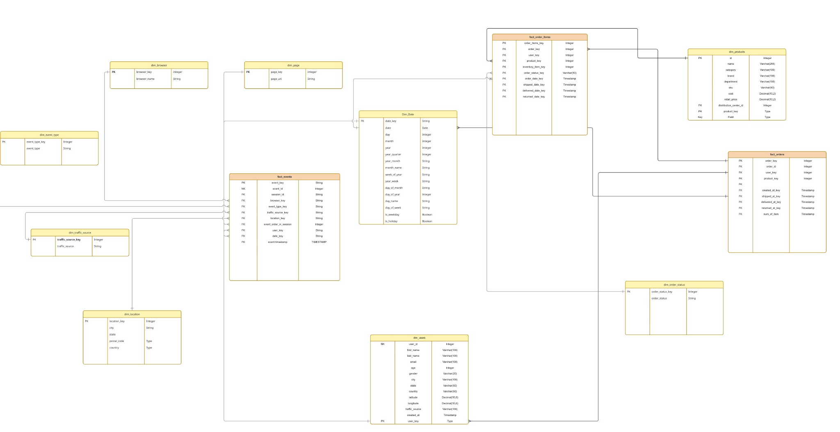
5. Dimensional Model (Kimball)

Slide 10
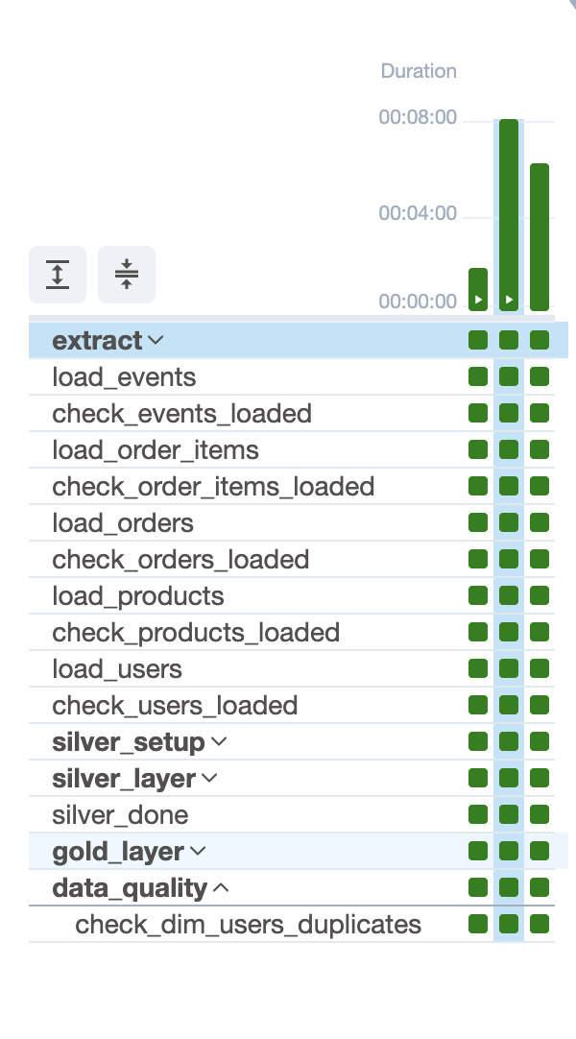
6. Airflow
Single DAG per pipeline, structured by medallion layer (extract → bronze → silver → gold → data quality)
TaskGroups for each layer to keep the DAG clean and maintainable
PythonOperator for Kaggle ingestion; BigQuery operators for SQL transforms
ShortCircuitOperator to skip runs when no new data arrives
Config‑driven tasks (YAML) so adding a new table is mostly configuration, not code changes.

Slide 11
7. Architectural Improvements
Data Quality checks (Integrate Great Expectations etc)
Schema registry
Partition & cluster strategy
Handle late arriving data

Slide 12
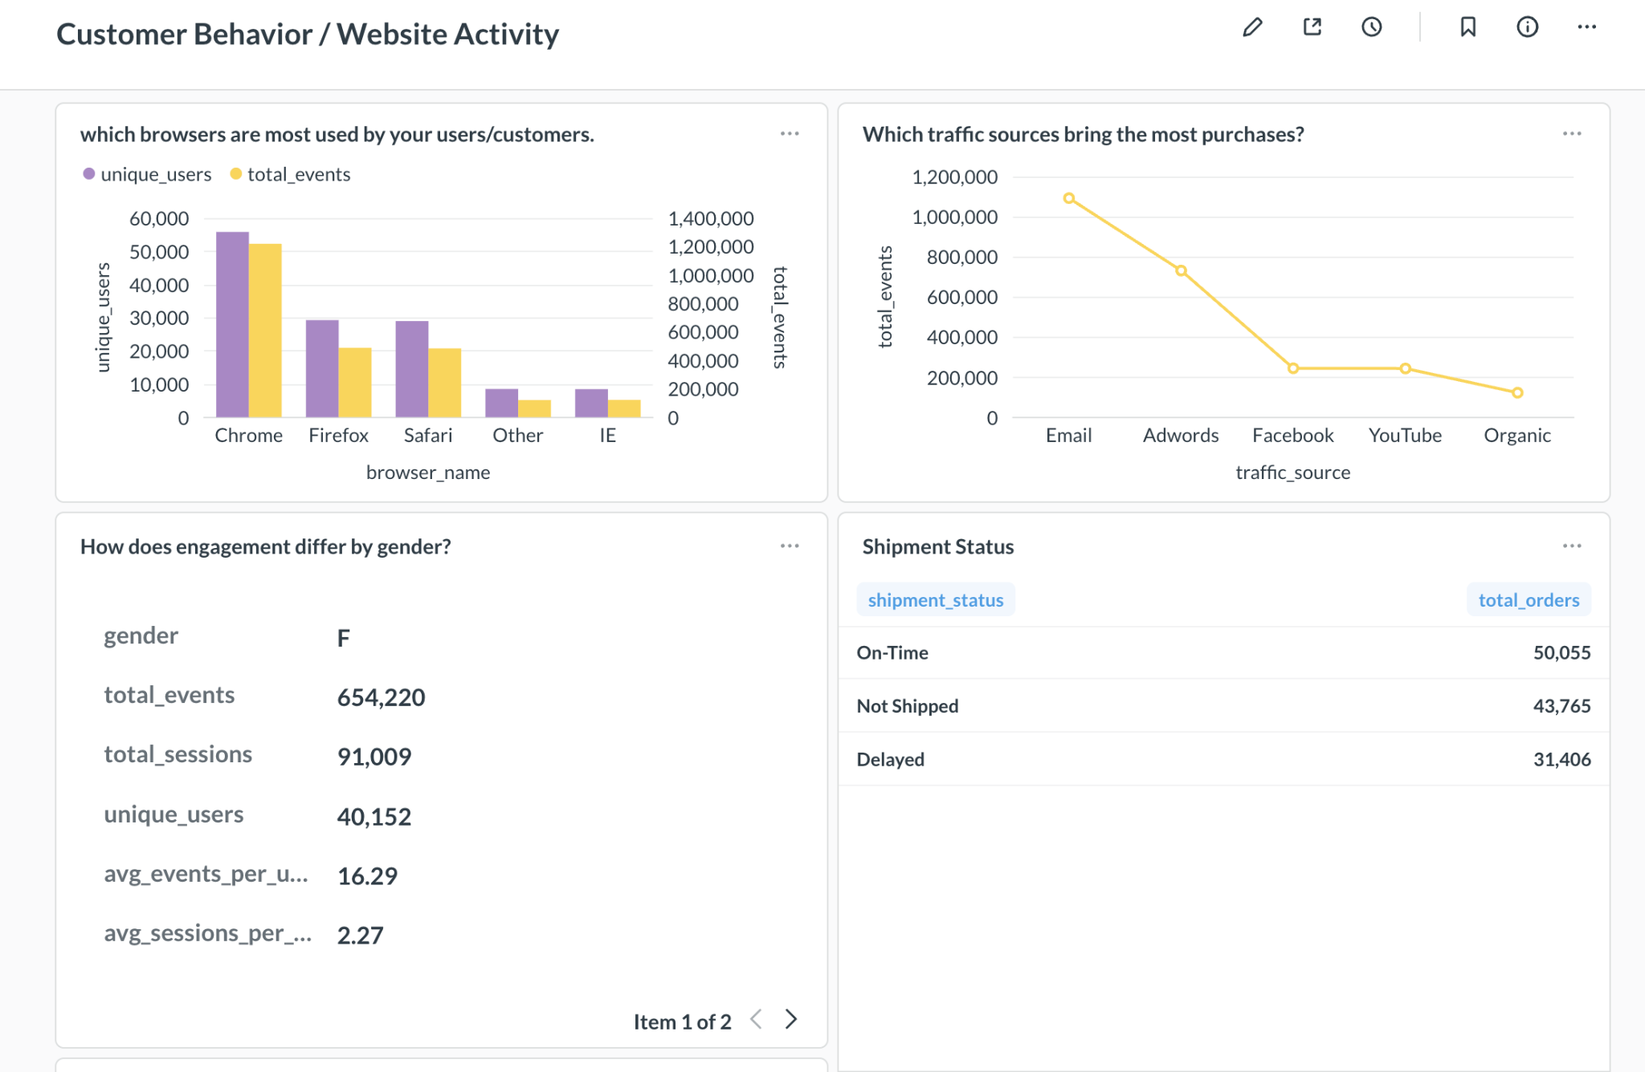
8. Example Insights / Dashboard

Slide 13
8. Demo

Slide 14
Thank You

