Slide 1


ONLINE BOOK REVIEW SYSTEM
GROUP NO- 07

Slide 2
TEAM MEMBERS
EMPLOYEE ID | EMPLOYEE NAME
EMPLOYEE ID EMPLOYEE NAME
2490195 Shalini kumari
2492109 Sonalika Samal
2492014 Snehal tekawade
2493123 Siddiq Ali
2492436 Shruti Dash
2492254 Snehal Asutaar
2489779 Snehal Jare
2492268 Shubham ku. Vivek
2492357 Sourla Madhavi
2492068 Sudeep Sen
FRONTEND
BACKEND

Slide 3
INDEX
Introduction
Project Scope
Tools & Technologies
Diagram
Data-Flow Diagram
Admin Module
User Module
Book
Review-category
Output
Conclusion
Future Enhancement

Slide 4
Introduction
Online book review System has been developed to override the problems of existing manual system.
Every organization ,whether it is big or small has challenges to overcome and managing the information of customer, book, review etc.
This website is supported to eliminate and in some cases reduce the hardships faced by this existing offline system. Moreover this system is designed to carry out the particular operations in a smooth manner.
No formal or prior knowledge is needed for the user to use this system .Thus by this all it provides it is user-friendly.
Book review System as described above can lead to error free, secure, reliable and fast management system .It can assist the user to concentrate on their other activities.
Thus it will help organization in better utilization of resources.

Slide 5
Project Scope
This project “Online book review system” makes the task faster and easy. This is used to manage records.
The system is used to keep the record of Login details, Logout details, Registration details.

Slide 6
PROPOSED SYSTEM
The online book review system will provide facility to check reviews of books in online.
A user can check books review anytime and anywhere as the system will be online based.
The online book review system will provide detailed information so that a customer can
know about the books and based on the information customer will know about books.
The user can search for the books which will be going to release in the future ,so they will
have an option to book in advance.
The online book review system will make the user experience much better than the present
system.

Slide 7




Technologies
Front end: Angular
Server Side: Spring Boot
Back-end: Hibernate, MYSQL
Server: Tomcat

Slide 8
PORTAL
User
Admin

Slide 9
DATA FLOW DIAGRAM
Spring Boot
Creation of Entities
Mapping of Entities
Creating Rest Controller
Frontend Angular using angular Framework
Implementation
Exception Handling
J unit Testing
Postman API Testing

Slide 10
REGISTRATION
LOGIN
USER
ADMIN
SEARCH BOOK
ADD/REMOVE BOOK
WISHLIST
ADD PRICE
CART
EDIT BOOK DETAIL
ORDER
VIEW BOOK/USER
REVIEW
RESET PASSWORD
LOGOUT
ADD NEW ADMIN ACCOUNT

Slide 11
ER-DIAGRAM
Entity relationship diagrams provide a visual starting point for database design that can also be used to help determine information system requirements throughout an organization
BOOK-NAME
USER-ID
NAME
BOOK-ID
PRICE
EMAIL
USER
REVIEW
BOOK
MO-NUMBER
RATING
AUTHOR-NAME

Slide 12
ANGULAR WITH BUILDING BLOCKS
MODULE
COMPONENT
DIRECTRIVES
SERVICES
ROUTING

Slide 13
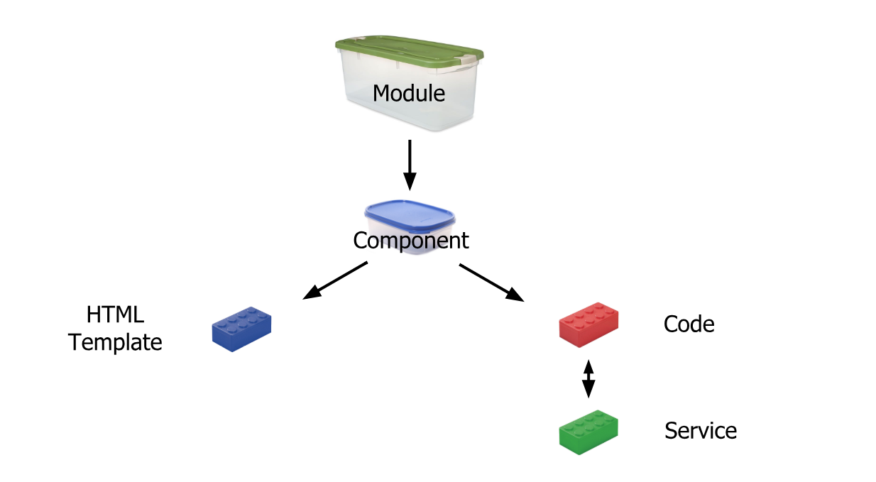
Angular refers to a place where you can group the components, directives, pipes, and services, which are related to the application. In case you are developing a website, the header, footer, left, center and the right section become part of a module. To define module, we can use the NgModule.

Slide 14
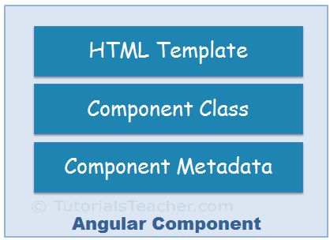
Components are the main building block for Angular applications. Each component consists of:
An HTML template that declares what renders on the page. A Type Script class that defines
behavior A CSS selector that defines how the component is used in a template.

Slide 15
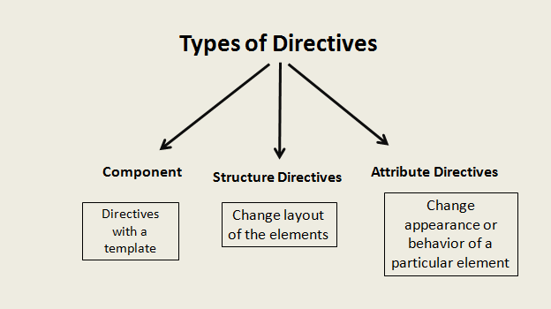
Directives are classes that add additional behavior to elements in your Angular applications. Use Angular's built-in directives to manage forms, lists

Slide 16
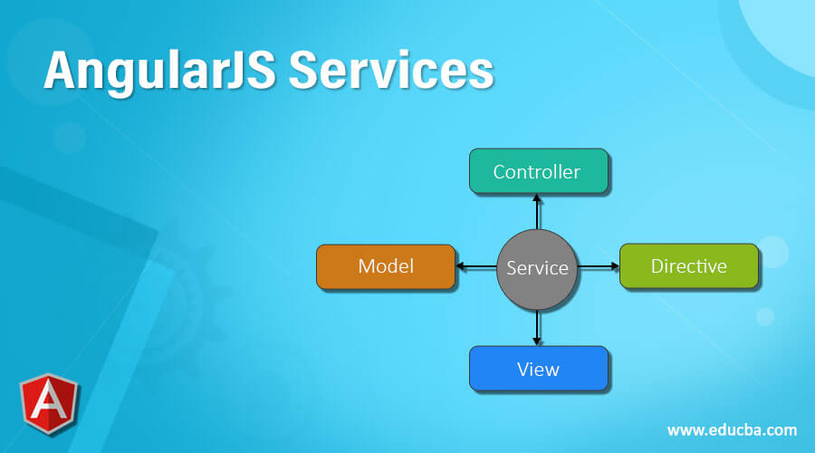
Services in Angular are simply typescript classes with the @injectible decorator. This decorator tells angular that the class is a service and can be injected into components that need that service. They can also inject other services as dependencies.

Slide 17
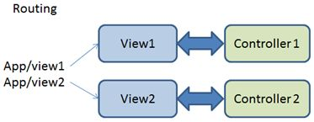
Angular CLI to generate a basic Angular application with an application routing module, called AppRoutingModule.

Slide 18
DIAGRAM
DIAGRAM FOR BACKEND
GET
POST
PUT
DELETE
API LAYER
BUSINESS
LOGIC
PERSISTENCE
LOGIC
POSTMAN CLIENT
CONTROLLER
SERVICE
DAO
Database

Slide 19
@Data : It is a convenient shortcut annotation that bundles the features of
@ToString, @EqualsAndHashCode, @Getter / @Setter and @RequiredArgsConstructor together.
@Bean - indicates that a method produces a bean to be managed by Spring.It use to create the object of the class.
@Service - indicates that an annotated class is a service class.A class that provides business services.
@Repository - indicates that an annotated class is a repository, which is an abstraction of data access and storage.
@Configuration - indicates that a class is a configuration class that may contain bean definitions.
@SpringBootApplication - enables Spring Boot autoconfiguration and component scanning.
There are also Hibernate @Entity, @Table, @Id, and @GeneratedValue annotations in the our project
annotation

Slide 20
Each entity must have at least two annotations defined: @Entity and @Id.
1)The @Entity annotation specifies that the class is an entity and is mapped to a database table.
2)The @Id annotation specifies the primary key of an entity
The @Table annotation specifies the name of the database table to be used for mapping.
the @GeneratedValue provides for the specification of generation strategies for the values of primary keys.
@RestController is used for making restful web services with the help of the @RestController annotation.
This annotation is used at the class level and allows the class to handle the requests made by the client.
The main difference between the @restcontroller and
the @controller is that the @restcontroller combination of the @controller and @ResponseBody annotation.
@RequestMapping - maps HTTP request with a path to a controller method.
@Autowired - marks a constructor, field, or setter method to be autowired by Spring dependency injection.

Slide 21
The schema is automatically created by Hibernate; later, the import.sql file is executed to fill the table with data.
@EnableSwagger2:It is use to enable the swagger.and it done by adding dependency in pom.xmlapis
it gives you a option to filter out the element which are required and which are not required for your swagger documention.
In controller part:i have added this annotation
@ApiOperation :we can add these annotations to any rest emthod in a controller to add basic information related to that method.With help of this annotation we can decide what it will take,produce,tags,response,object,check does any authorization available here for example in our project i have use @ApiOperation(value = "Write Review of the book") and value = "Write Review of the book" is description of my method.
@pathvariable:path variable annotation is used to bind method parameter to uri template variable
@PostMapping("books/{imageName}") in this {imageName} is my uri template variable

Slide 22
LOGIN MODULE
I have created a module name as login.
This module consist of user and the admin pannel.
any user can register himself as a admin or a user.
if a user register himaself as a admin then the user have all the right to make changes into the application like see the book,
update the deatils of the book, he can also see the rating and reviews of the book and make changes over there.
and if a person register himself as a user the he can see the book listed over there they can by the book and after that they can search the book,
and also give the reviews and rating to a particular book.
to explain this more, I have created a entity class of user and admin and also created the controller, service and the (DAO) class to perform all the operation of the login module
to understand more how its working I'll first explain the classes what they perform.

Slide 23
Data : purpose is to unify and ease the access to different kinds of
persistence stores, both relational database systems
and NoSQL data stores.
@Entity :The @Entity annotation specifies that the class is
an entity and is mapped to a database table. The @Table
annotation specifies
the name of the database table to be used for mapping
@ID : The @Id annotation specifies the primary key of an entity and the
@GeneratedValue provides for the specification of generation strategies for
the values of primary keys.
@OneToMany : one-to-many mapping means that one row in a table is mapped to multiple rows in another table.
@RestController: RestController is used for making restful web services with the help of the @RestController annotation.
@Autowired: The @Autowired annotation can be used to autowire bean on the setter method just like @Required annotation,
constructor, a property or methods with arbitrary names and/or multiple arguments

Slide 24
@PostMapping : @PostMapping annotation maps HTTP POST requests onto specific handler methods.
It is a composed annotation that acts as a shortcut for @RequestMapping(method = RequestMethod. POST)
@GetMapping : @GetMapping annotation maps HTTP GET requests onto specific handler methods.
It is a composed annotation that acts as a shortcut for @RequestMapping(method = RequestMethod. GET)
@putMApping :Annotation for mapping HTTP PUT requests onto specific handler methods. Specifically,
@PutMapping is a composed annotation that acts as a shortcut for @RequestMapping(method = RequestMethod. PUT)

Slide 25
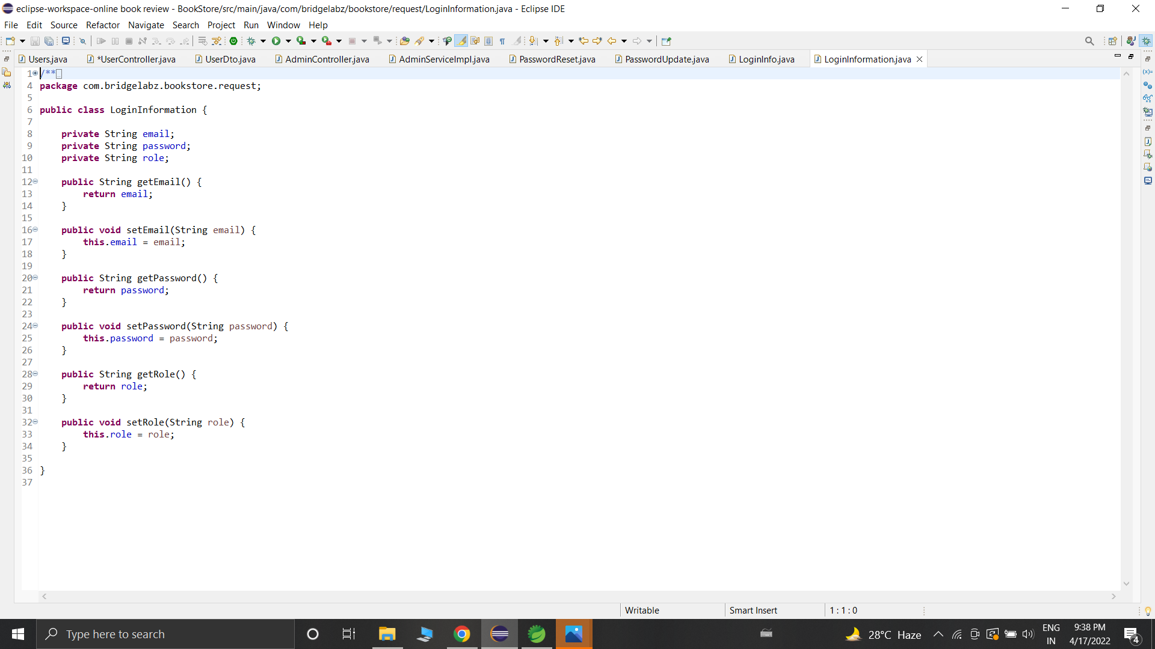

Slide 26
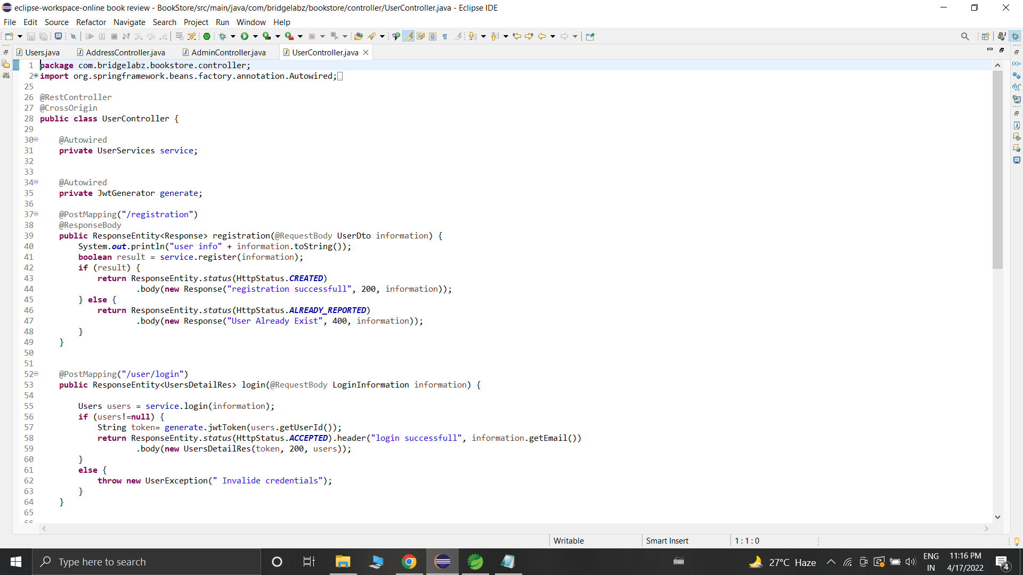

Slide 27
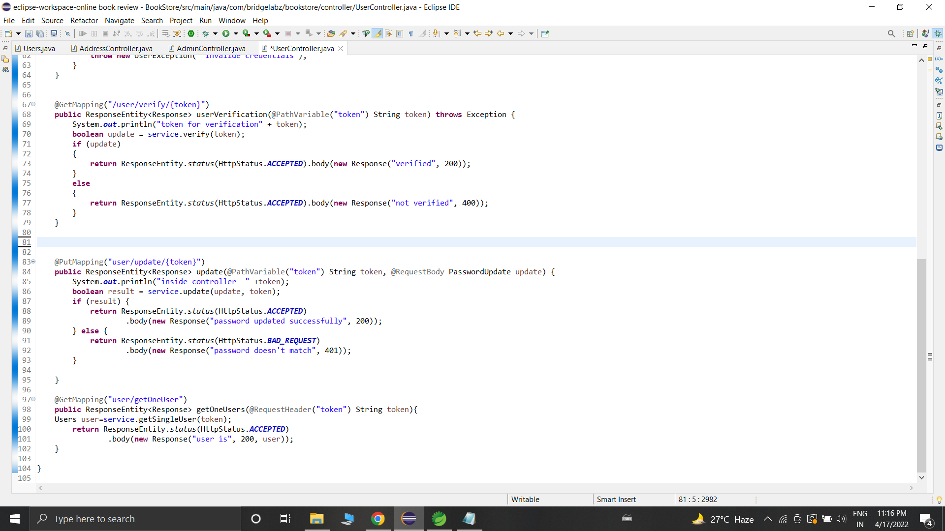

Slide 28
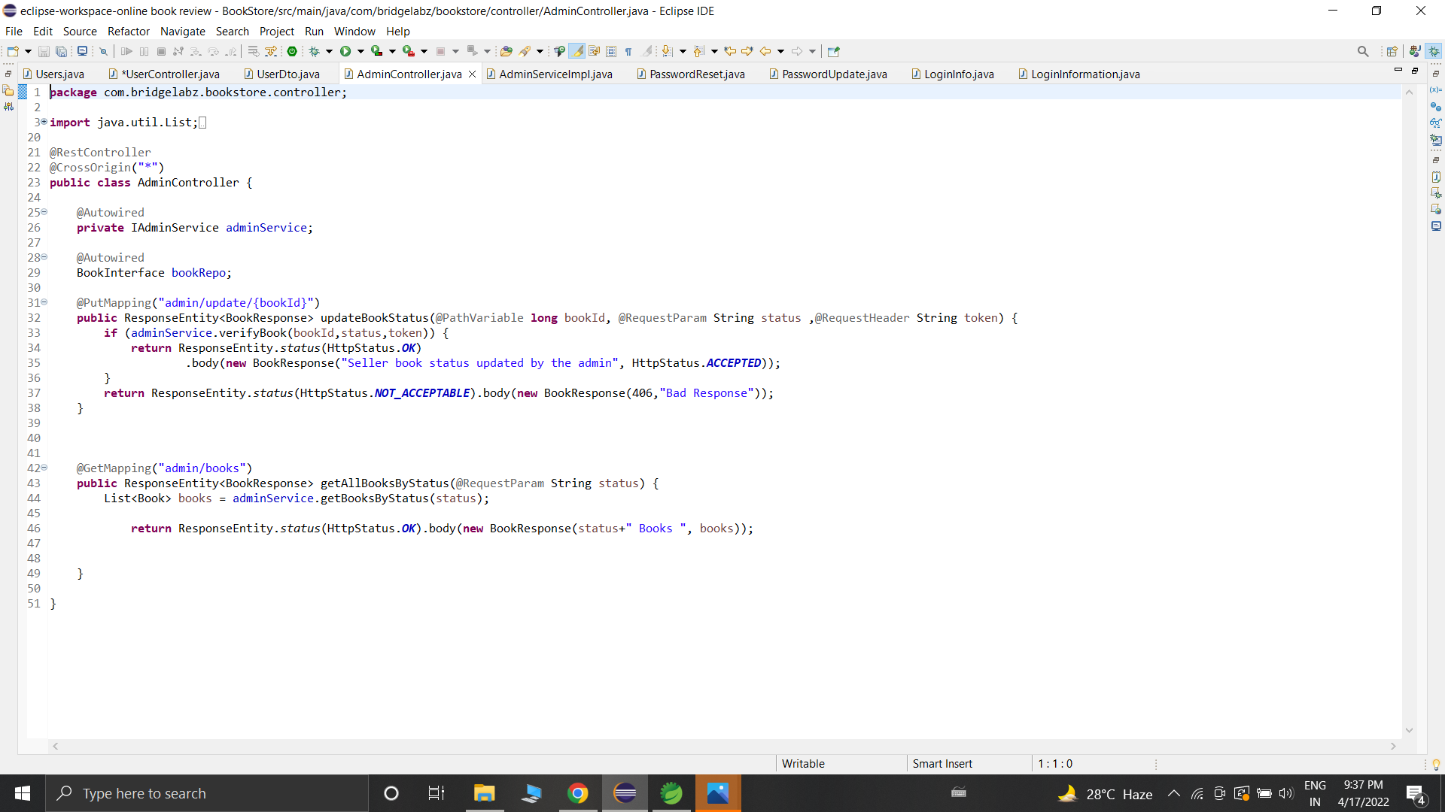

Slide 29
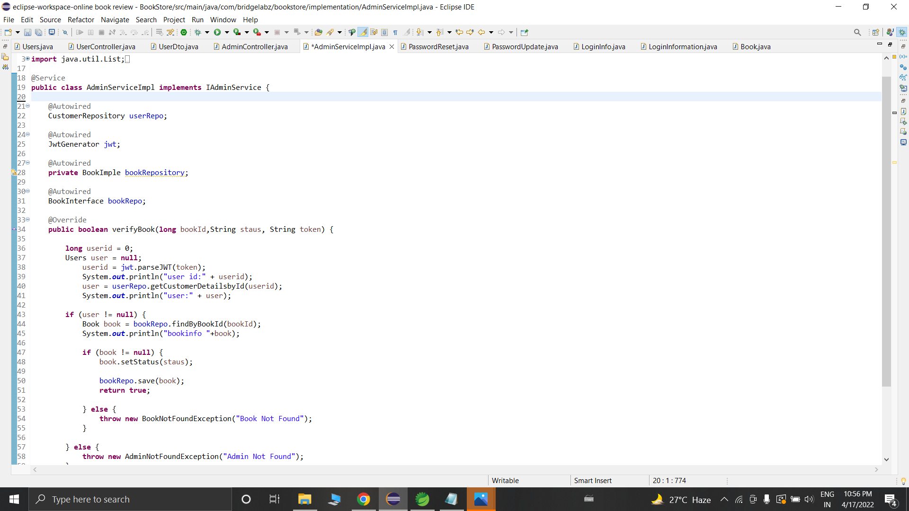

Slide 30
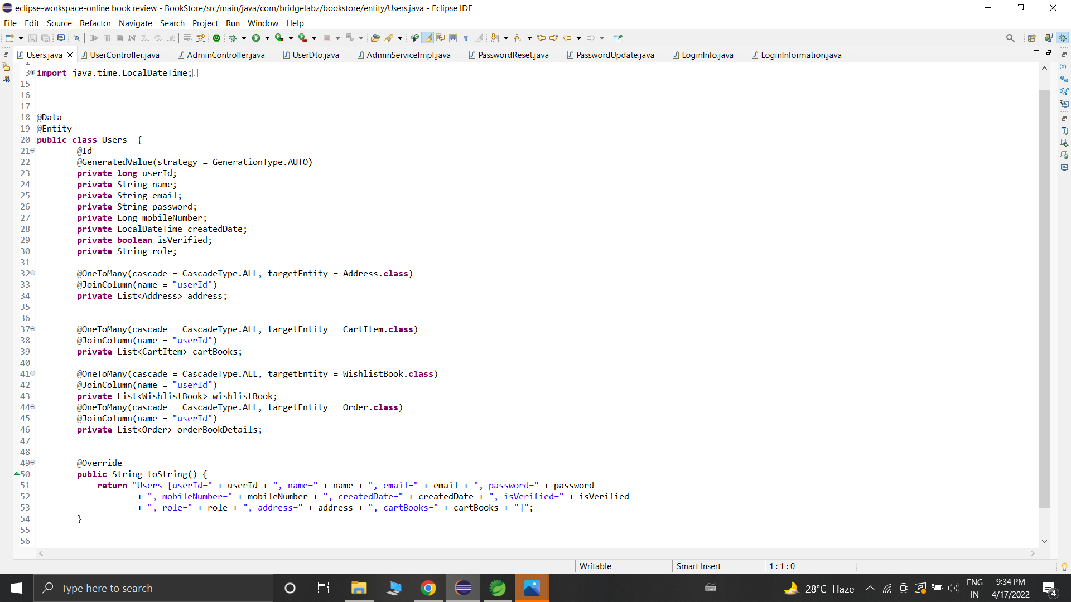

Slide 31
1.@GetMapping: To process get requests, the traditional RequestMapping should be @RequestMapping(value = “/get/{id}”,
method = RequestMethod.GET) The new method can be abbreviated as:
@GetMapping("/get/{id}")
2.@PostMapping: To process post requests, the traditional RequestMapping should be
@RequestMapping(value = “/get/{id}”, method = RequestMethod.POST) The new method can be abbreviated as:
@PostMapping("/get/{id}")
3@PutMapping: Same function as PostMapping, both are used to submit information to the server.
If you are adding information you tend to use @PostMapping, and if you are updating information,
you tend to use @PutMapping. The difference between the two is not very obvious.
4.@DeleteMapping annotation maps HTTP DELETE requests onto specific handler methods.
It is a composed annotation that acts as a shortcut for @RequestMapping(method = RequestMethod.DELETE).

Slide 32
5 CrossOrigen @CrossOrigin annotation enables cross-origin resource sharing only for this specific method. By default,
its allows all origins, all headers, and the HTTP methods specified in the @RequestMapping annotation
6 Configration. Spring @Configuration annotation is part of the spring core framework.
Spring Configuration annotation indicates that the class has
@Bean definition methods. So Spring container can process the class and
generate Spring Beans to be used in the application

Slide 33
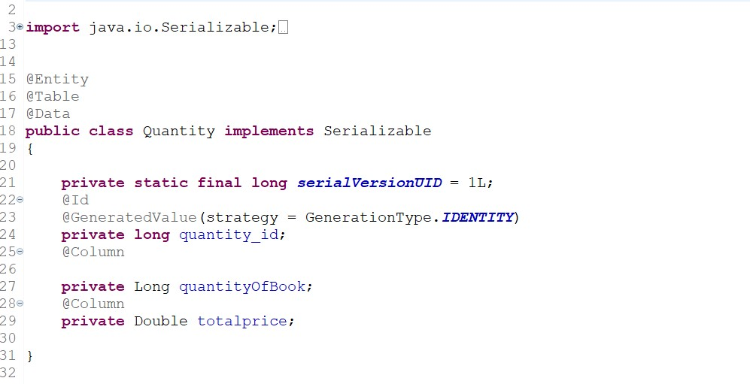

Slide 34
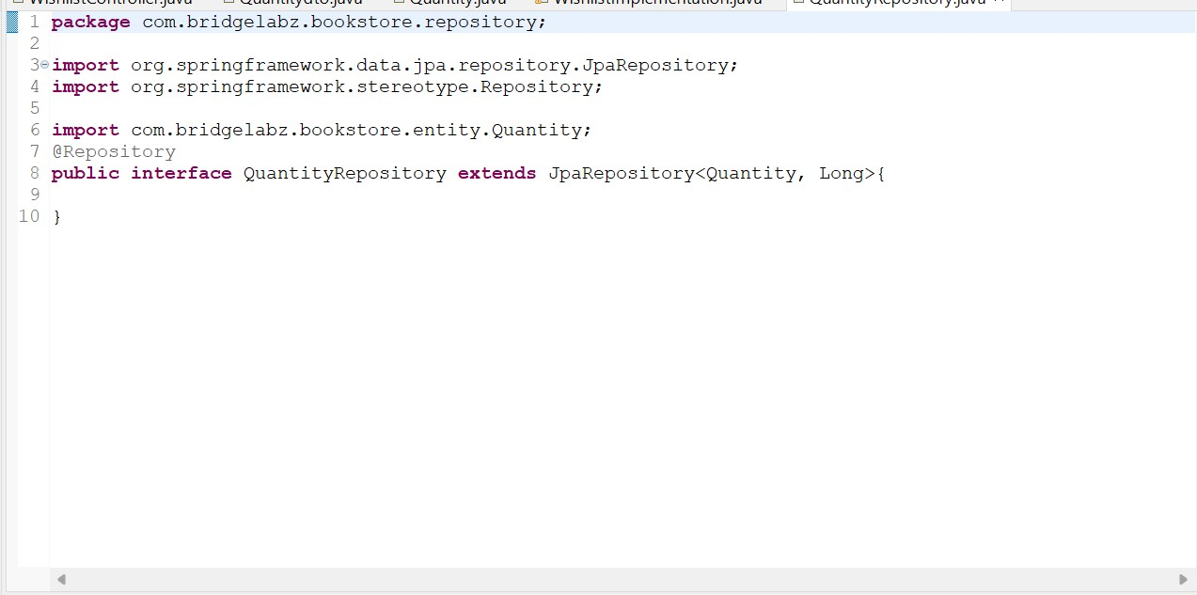

Slide 36
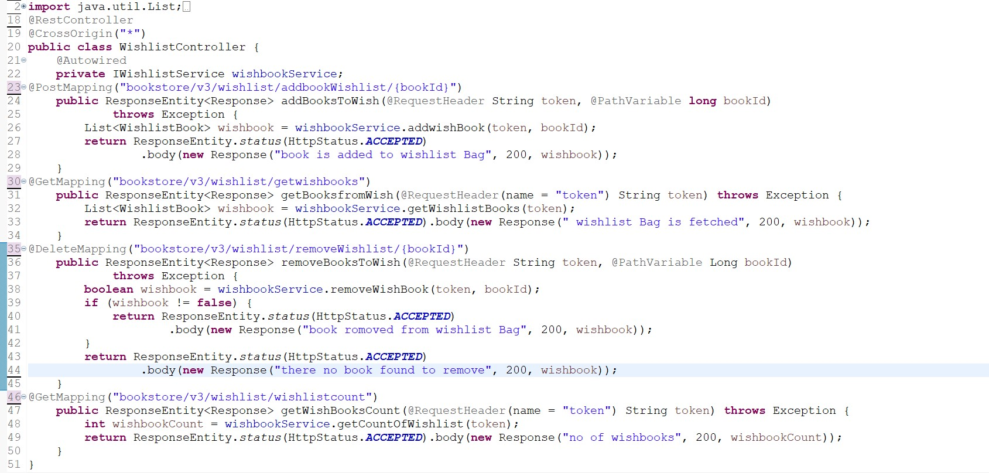

Slide 37
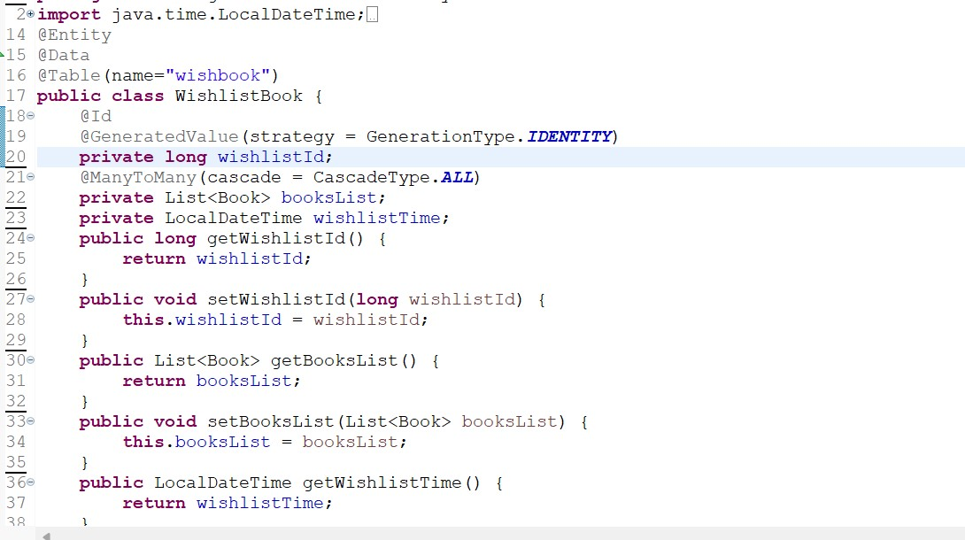

Slide 38
CART AND ADDRESS MODULE
I have created a module name as Cart and Address.This module consit of Cart and the Address pannel. any user can add book in cart .Basically cart is page in which user can store the books which they want to store .if they want to give reviwe on any book after long time then they can add that book into cart . it is easy method to find that book in this application. user can find his choice book in cart easily and also give the reviews and rating to a particular book. And address module is used to store tha address of user .user can add address in that page and they also want to add his user_-id for reference .user have to add full address in this page . because of this info we know that from which place users are giving review for our book application . after all this all data will store and admin can easily understood all info about users .to explain this more i have created a entity class of cart and address and also created the controller, service and the dao class to perform all the operation of the this modules.

Slide 39
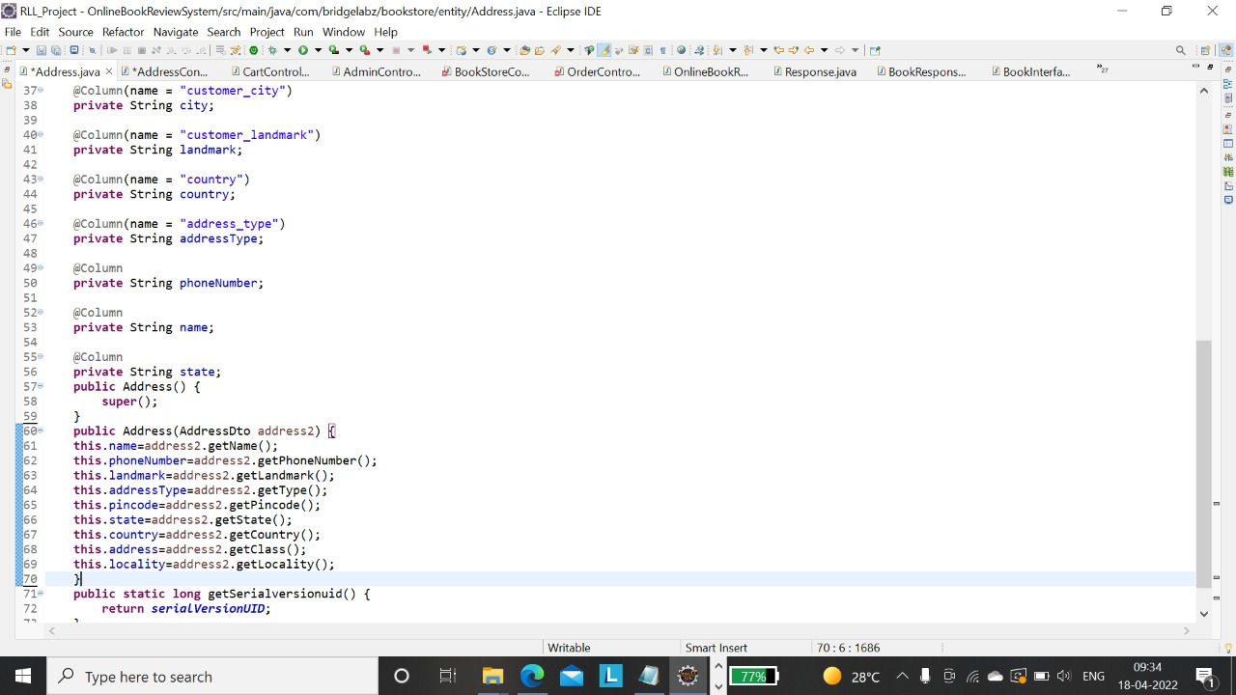

Slide 40
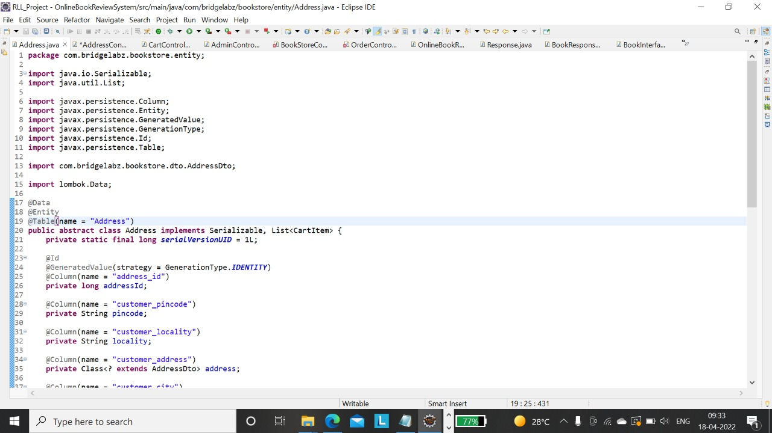

Slide 41
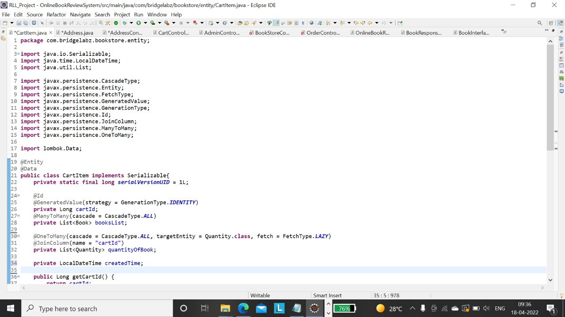

Slide 42
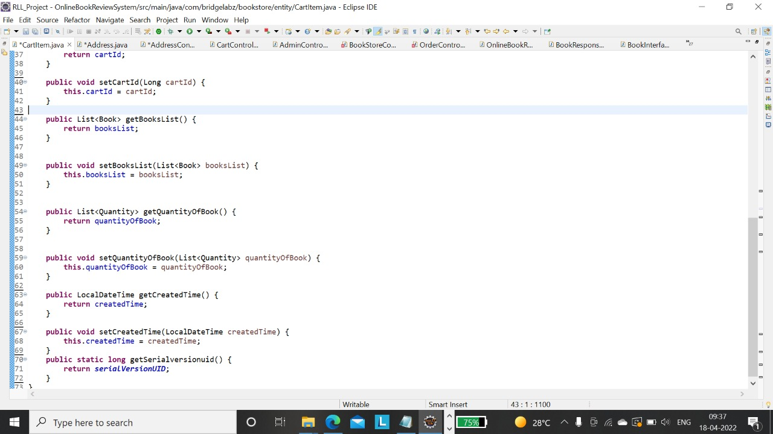

Slide 43
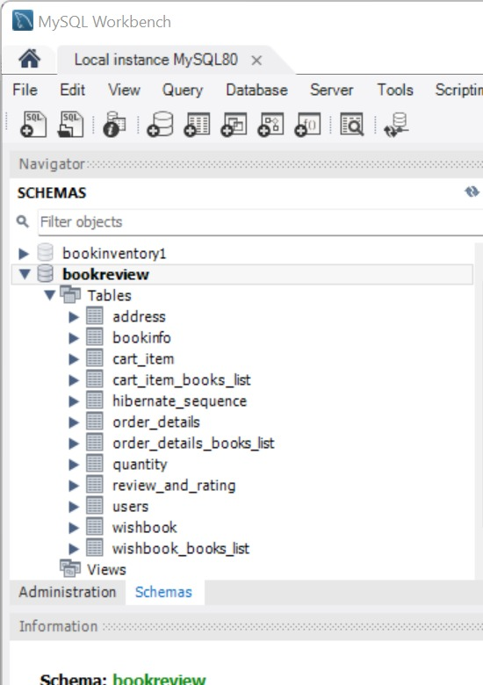

Slide 44
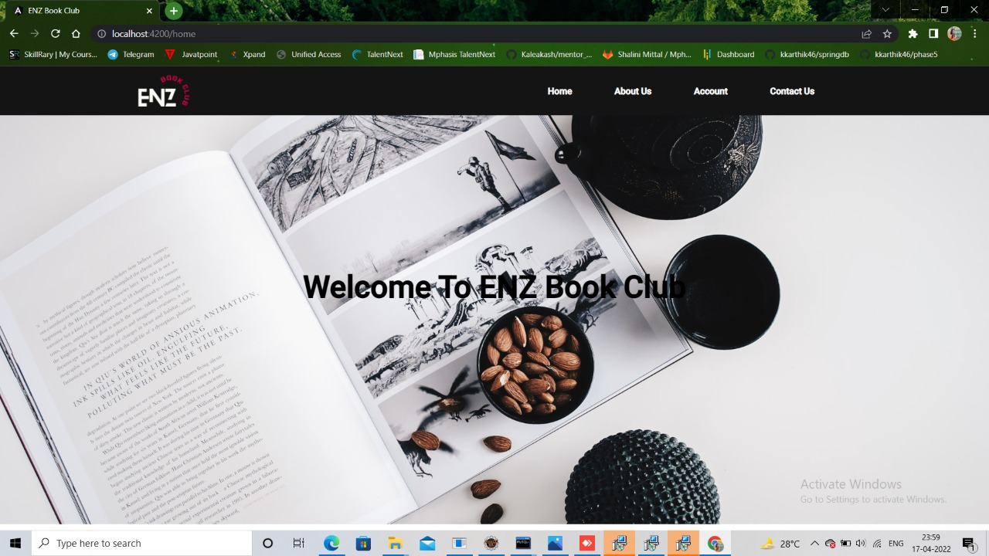

Slide 45
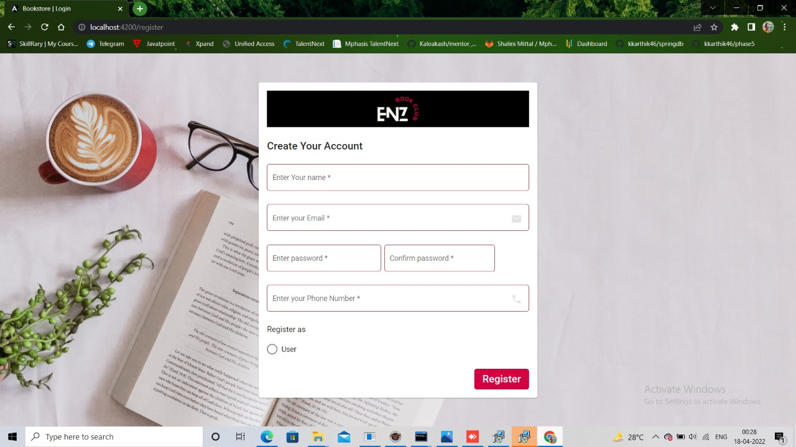

Slide 46
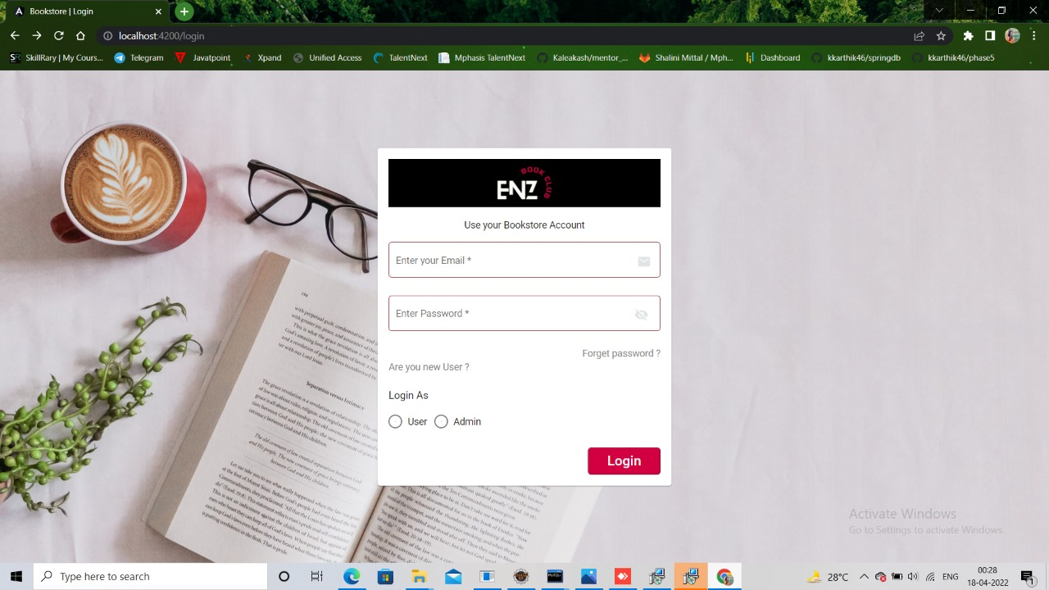

Slide 47
FUTURE ENHANCEMENT
To make that only authorized candidates taking the exam their fingerprints, can be taken and compared with stored ones, Examination centers can be set up at various places and candidates can be asked to take the exam in those centers only. Invigilators should be asked to invigilate at those centers. This eliminates copying and any malpractices by the candidates.

Slide 48
CONCLUSION
The Online Book Review Management System project has been successfully completed. The goal of the system is achieved and the problems are solved, This project is developed in this manner that is user-friendly and required help is provided at different levels, The primary objective is to provide the interactive service to all the students. Different types of services are provided to both the students and staff. The student can avail this service anytime,This system certainly doesn’t reduces the manpower but helps the development of the available manpower and optimizes the manpower.

