Slide 1
Customer Segmentation
BY:
Maknoor Shalini
Nishtha Varshney
Kara Akhila

Slide 2
Introduction
Contents
Approach - Proposed Soln
Result & Conclusion

Slide 3
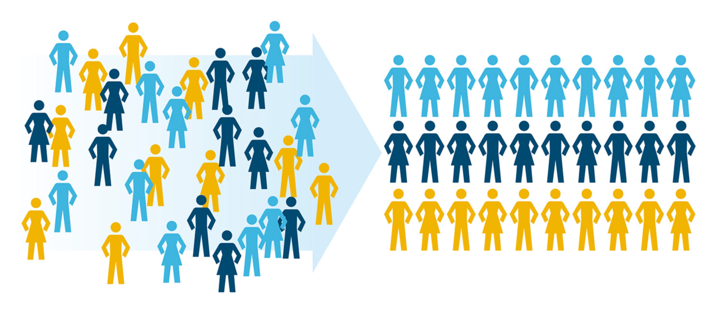
INTRODUCTION
Customer segmentation is the process of dividing customers into groups based on common characteristics so companies can market to each group effectively and appropriately.

Slide 4
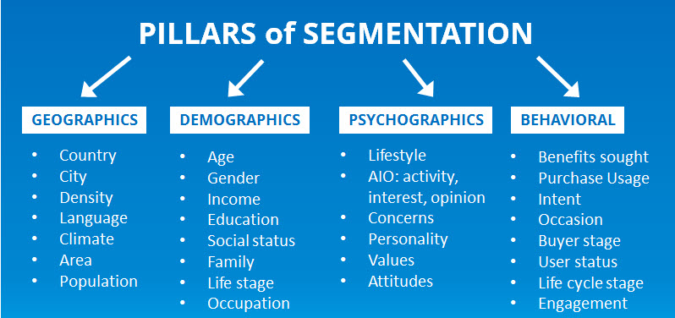
Different Approaches Of Segmentation

Slide 5
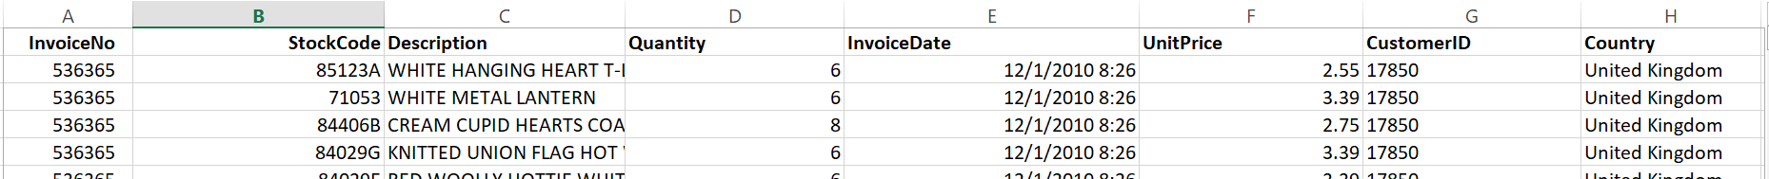
Data Preprocessing
The dataset we chose is transactional data-set which contains all the transactions occurring between 01/12/2010 and 09/12/2011 for a UK based and non-registered non-store online retail.
The data-set consists of 8 attributes - Invoice no, Stock Code, Description, Quantity, Invoice date, Unit price, Customer ID and the country
PRE-PROCESSING -
Removal of Missing Values
Removal of Duplicate Values
There were some negative values observed in the column ‘Quantity’, which could be due to any of
these reasons - it might be purchased and returned product , discount or error. The values which do
not have any previous purchase history nor have description as ‘Discount’ are error values and such
rows should be removed from the dataframe.

Slide 6
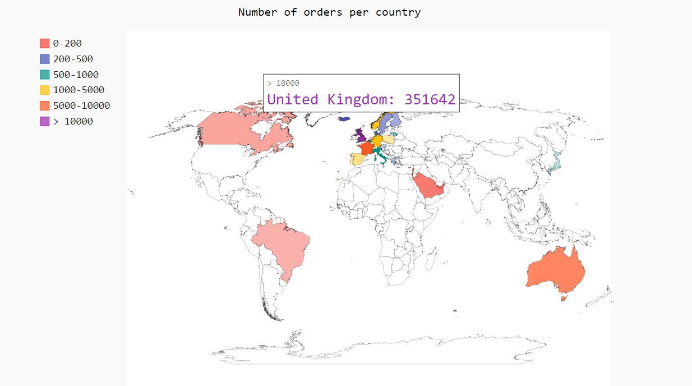
Data Visualisation
Dividing customers based on geographic information

Slide 7
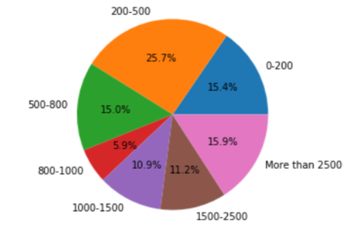
Data Visualisation
Dividing customers based on their purchase history

Slide 8
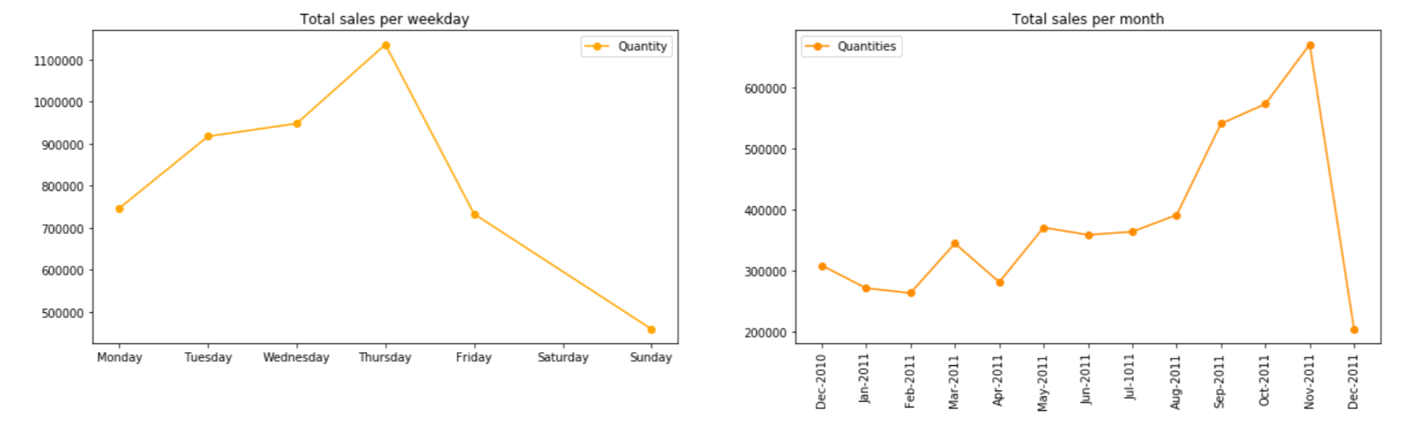
Data Visualisation
Sales(per weekday/per month)

Slide 9
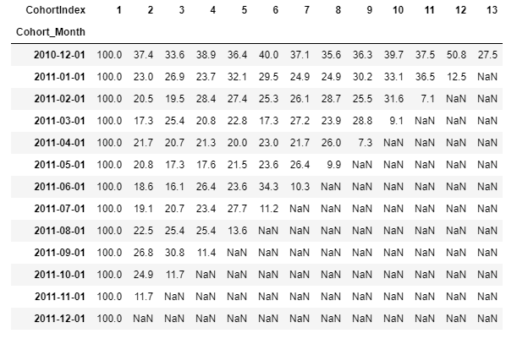
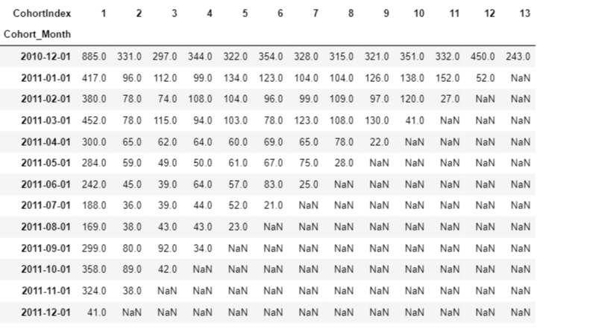
Approach and the Proposed Solution
1. Cohort Analysis - is a tool to quantify customer commitment after some time. It assists with knowing whether customer commitment is really improving after some time or is just seeming to improve as a result of development.

Slide 10
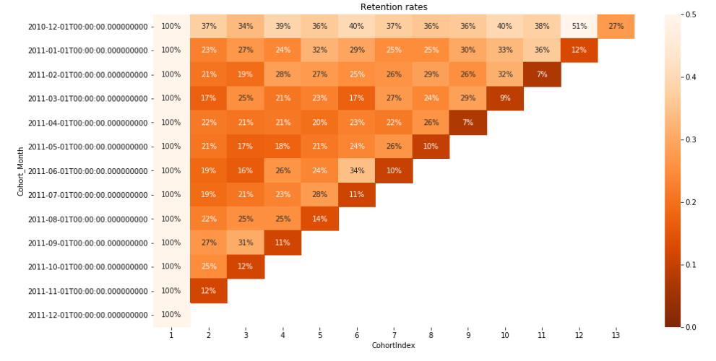
Approach and the Proposed Solution
Heat Map

Slide 11
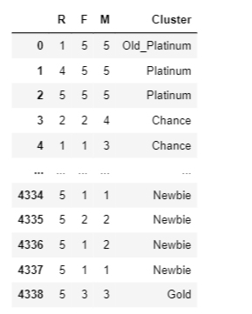
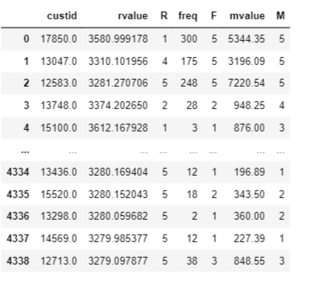
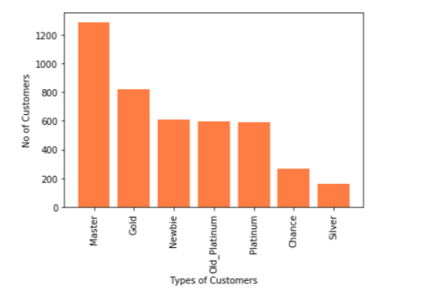
Approach and the Proposed Solution
2. Clustering Using RFM scores - Customers are grouped and analysed based on their RFM
scores. RFM scores are calculated for each customer based on their past purchases.

Slide 12
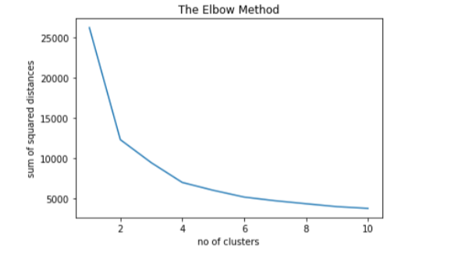
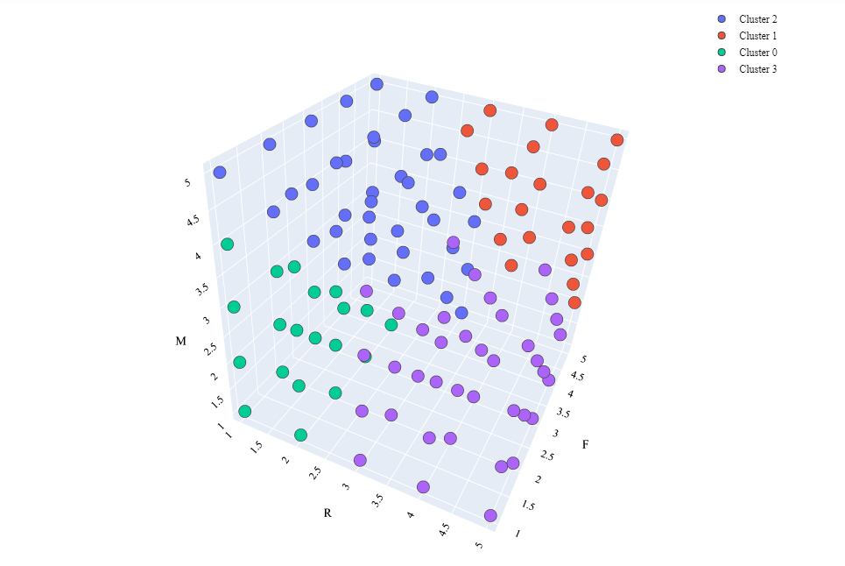
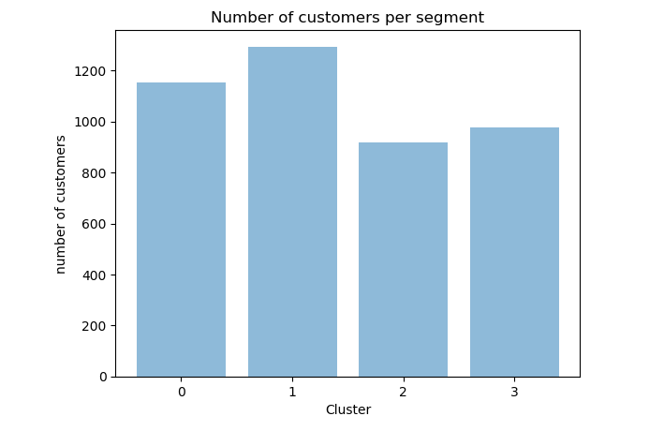
Approach and the Proposed Solution
K-MEANS

Slide 13
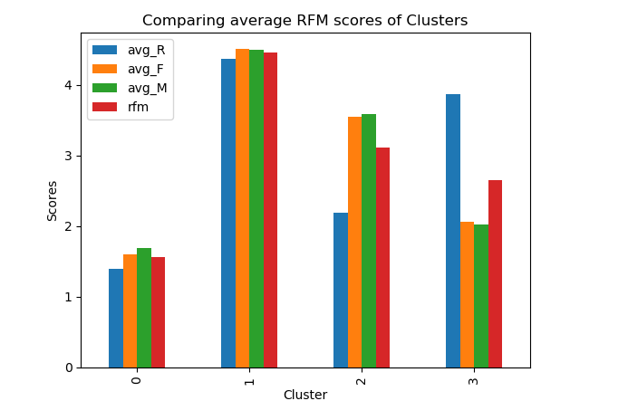
Approach and the Proposed Solution

Slide 14

Result and Conclusion

Slide 15
Thank you !!!

