Slide 1
SENTIMENT ANALYSIS
Phase 5 Project Documentation & Submission
SHALINI SIVAKUMAR S
B.E(CSE) 3RD YEAR
EMAIL ID: sshalini5404@gmail.com
NM ID: au513521104045

Slide 2
PROBLEM STATEMENT :
we define an abstraction of the sentiment analysis problem. This abstraction gives us a statement of the problem and enables us to see a rich set of interrelated subproblems.
It is often said that if we cannot structure a problem, we probably do not understand the problem.
The objective of the definitions is thus to abstract a structure from the complex and intimidating unstructured natural language text.
This structure serves as a common framework to unify various existing research directions and enable researchers to design more robust and accurate solution techniques by exploiting the interrelationships of the subproblems.
From a practical application point of view, the definitions let practitioners see which subproblems need to be solved in building a sentiment analysis system
how the subproblems are related, and what output should be produced.

Slide 3
PROJECT OVERVIEW :
Collecting your WhatsApp group chat data is not very difficult. You can either collect it yourself or use a sample dataset.
This dataset challenges you to perform sentiment analysis on individuals within the group or on the group as a whole.
If a group is dedicated to a wider perspective, try performing sentiment analysis on a specific topic that frequently arises.

Slide 4

DESIGN THINKING :
Machine learning is a method of data analysis.
Machine learning is a machine centered approach.
In machine learning, there are algorithms we can use to make machine learn through data iteratively
make it able to find hidden insights from the data.
So that, machine can itself take decisions without being explicitly programmed what to do in each case.

Slide 5

DATA PREPROCESSING :
study proposes an effective text data preprocessing technique and develop an algorithm to train the Support Vector Machine (SVM), Deep Learning (DL) and Naïve Bayes (NB) classifiers to process Twitter data.
We develop an algorithm that weights the sentiment score in terms of weight of hashtag and cleaned text. In this study, we
(i) compare different preprocessing techniques on the data collected from Twitter using various techniques such as (stemming, lemmatization and spelling correction) to obtain the efficient method
(ii) develop an algorithm to weight the scores of the hashtag and cleaned text to obtain the sentiment. We retrieved N=1,314,000 Twitter data, and we compared the popularity of two products, Google Now and Amazon Alexa.
Using our data preprocessing algorithm and sentiment weight score algorithm, we train SVM, DL, NB models. The results show that stemming technique performed best in terms of computational speed.

Slide 6
MODEL TRAINING
The problem of analyzing sentiments in human speech is the subject of
The study of
Natural language processing,
Cognitive sciences,
Affective psychology,
Computational linguistics, and communication studies.
Each of them adds their own individual perspective to the understanding of a phenomenon,
The relationship between language and human emotions, which is as frequently occurring as it’s mysterious.

Slide 7
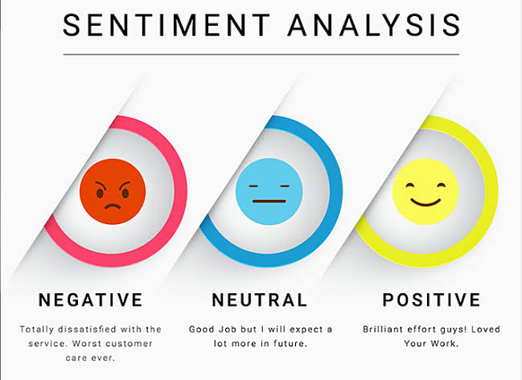
SENTIMENT ANNOTATION
The second step is to assign sentiment tags (positive, neutral, negative, etc.) to words and phrases. Attribute-based and fine-grained types of sentiment analysis will require more labels and more textual data to produce accurate results. Keep in mind that sentiment labeling is considered reliable if it’s made by more than one annotator.

Slide 8
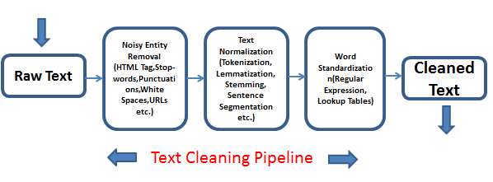
TEXT CLEANSING
Reviews and comments typically contain a lot of irrelevant and excessive information that can negatively affect a model’s precision. So, before feeding the dataset to an algorithm, you must get rid of noises, stop words (articles, pronouns, etc.), and variations of the same words, transforming them into canonical form.

Slide 9

MODEL TRAINING AND TESTING
Finally, your data science team proceeds to train an ML model and evaluate its results. For this, the prepared dataset is split into training and testing parts. Once the model achieves satisfactory predictions, it can be used for sentiment detection and classification in new, unlabeled reviews.

Slide 10
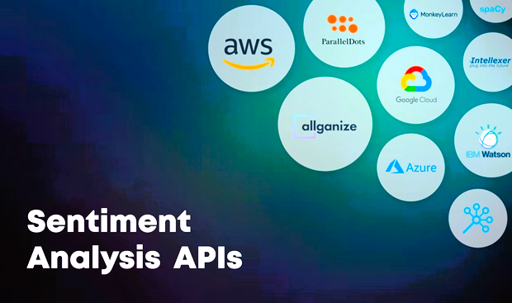
SENTIMENT ANALYSIS TOOLS AND APIS
Connexun
Emvista
AWS
Lettria
IBM Watson

Slide 11
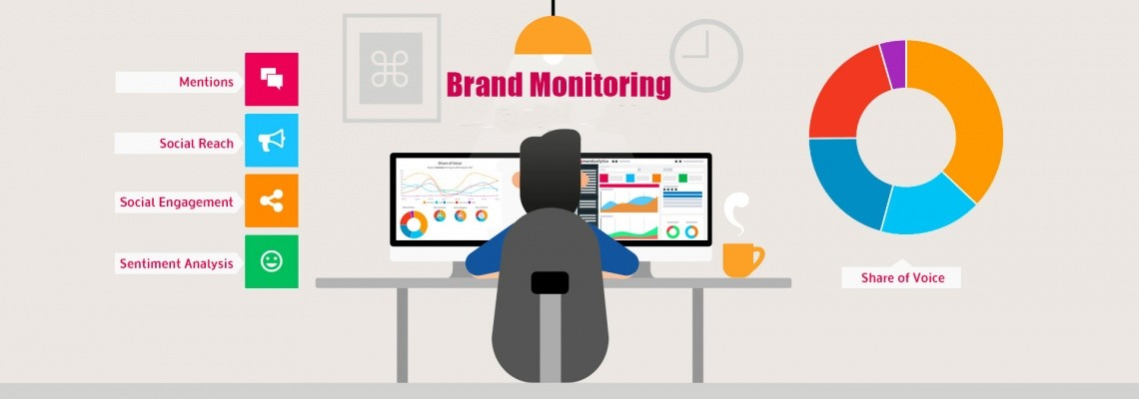
BRAND MONITORING
If the Internet was a mountain river, then analyzing user-generated content on social media and other platforms is like fishing during the trout-spawning season. People enjoy sharing their points of view regarding the latest news, local and global events, and their experience as customers. Twitter and Facebook are favorite places for daily comment wars and spirited (to put it mildly!) conversations. News about celebrities, entrepreneurs, and global companies draws thousands of people within a couple of hours after being published on Reddit. Media giants like Time, The Economist, and CNBC, as well as millions of blogs, forums, and review platforms, flourish with content on various topics.

Slide 12
SENTIMENT ANALYSIS MARKETING APPLICATIONS:
Below are some of the top applications to help increase customer acquisition, improve customer service, and keep your clientele happy:
Social media monitoring
Analyze marketing campaign success
Gauge consumer sentiment around a new product Launch.
Keep an eye on your competition
Prevent PR crisesng campaign success
Gauge consumer sentiment around a new product Launch.
Keep an eye on your competition
Prevent PR crises

Slide 13

EXPLORATORY ANALYSIS
To begin this exploratory analysis, first use matplotlib to import libraries and define functions for plotting the data. Depending on the data, not all plots will be made.

Slide 14
Distribution graphs (histogram/bar graph) of column data:
Def plotPerColumnDistribution(df, nGraphShown, nGraphPerRow ):
nunique = df.nunique()
df = df[[col for col in df if nunique[col] > 1 and nunique[col] < 50]] # For displaying purposes, pick columns that have between 1 and 50 unique values
nRow, nCol = df.shape columnNames = list(df)
nGraphRow = (nCol + nGraphPerRow – 1) / nGraphPerRow
plt.figure(num = None, figsize = (6 * nGraphPerRow, 8 * nGraphRow), dpi = 80, facecolor = ‘w’, edgecolor = ‘k’)
for I in range(min(nCol, nGraphShown)): plt.subplot(nGraphRow, nGraphPerRow, I + 1) columnDf = df.iloc[:, i]
if (not np.issubdtype(type(columnDf.iloc[0]), np.number)):
valueCounts = columnDf.value_counts() valueCounts.plot.bar()
else:
columnDf.hist() plt.ylabel(‘counts’) plt.xticks(rotation = 90)
plt.title(f’{columnNames[i]} (column {i})’) plt.tight_layout(pad = 1.0, w_pad = 1.0, h_pad =
plt.show()

Slide 15
Correlation matrix :
Def plotCorrelationMatrix(df, graphWidth):
filename = df.dataframeName
df = df.dropna(‘columns’) # drop columns with NaN
df = df[[col for col in df if df[col].nunique() > 1]] # keep columns where there are more than 1 unique v alues
if df.shape[1] < 2:
print(f’No correlation plots shown: The number of non-NaN or constant columns ({df.shape[1]}) is
less than 2’)
return
corr = df.corr()
plt.figure(num=None, figsize=(graphWidth, graphWidth), dpi=80, facecolor=‘w’, edgecolor=‘k’) corrMat = plt.matshow(corr, fignum = 1)
plt.xticks(range(len(corr.columns)), corr.columns, rotation=90) plt.yticks(range(len(corr.columns)), corr.columns)
plt.gca().xaxis.tick_bottom()
plt.colorbar(corrMat)
plt.title(f’Correlation Matrix for {filename}’, fontsize=15) plt.show()

Slide 16
Visualising and counting sentiments of tweets for each airline.
print("Total number of tweets for each airline \n ",df.groupby('airline')['airline_sentiment'].count().sort_values(ascending=False))
airlines= ['US Airways','United','American','Southwest','Delta','Virgin America']
plt.figure(1,figsize=(12,12))
for i in airlines:
indices= airlines.index(i)
plt.subplot(2,3,indices+1)
new_df=df[df['airline']==i]
count=new_df['airline_sentiment'].value_counts()
Index = [1,2,3]
plt.bar(Index,count, color=['blue', 'green', 'red'])
plt.xticks(Index,['negative','neutral','positive'])
plt.ylabel('Mood Count')
plt.xlabel('Mood')
plt.title('Count of Moods of '+i)
plt.show()

Slide 17
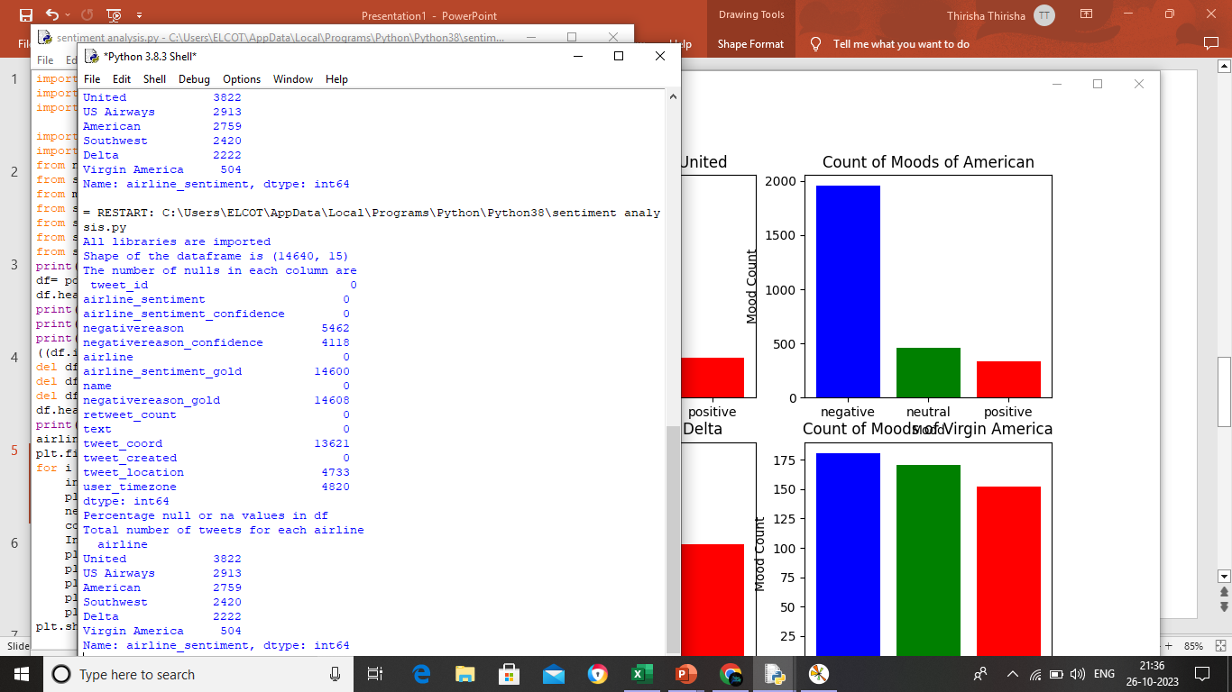
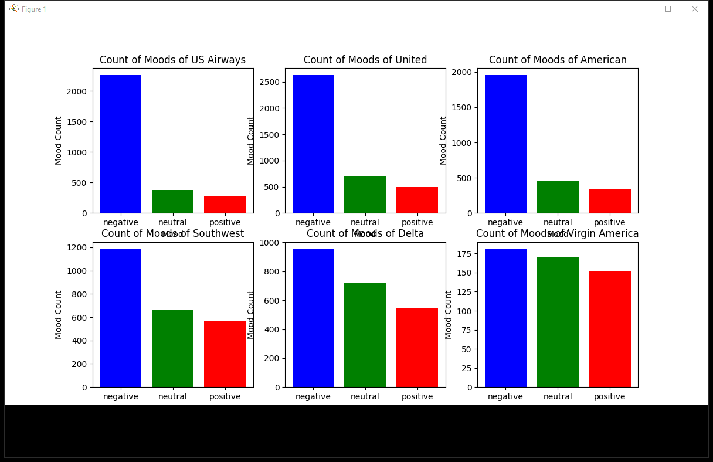
OUTPUT:

Slide 18
Wordcloud plots for positive tweets to visualise most frequent words for each
new_df=df[df['airline_sentiment']=='positive']
words = ' '.join(new_df['text'])
cleaned_word = " ".join([word for word in words.split()
if 'http' not in word
and not word.startswith('@')
and word != 'RT'
])
wordcloud = WordCloud(stopwords=STOPWORDS,
background_color='white',
width=3000,
height=2500
).generate(cleaned_word)
plt.figure(1,figsize=(15,15))
plt.imshow(wordcloud)
plt.axis('off')
plt.show()

Slide 19
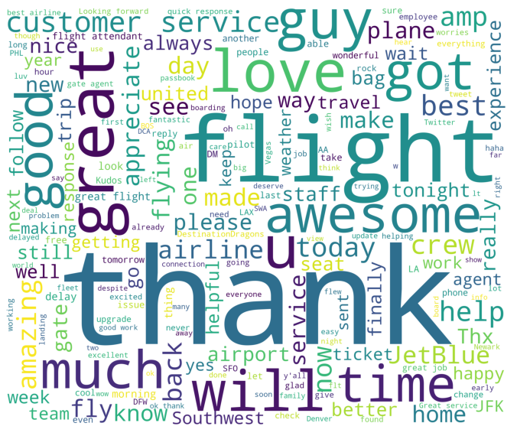
OUTPUT:

