Slide 1
DEEP LEARNING FUNDAMENTALS
Neural Networks
& Optimization
Basics & Perceptron
Activation Functions
Loss Functions
Optimization
A structured introduction to neural networks, loss functions, and modern optimization techniques

Slide 2
What is a Neural Network?
SECTION 1 — BASICS
Inspired by Biology
Network Architecture
Modeled after the human brain's network of neurons connected by synapses.
Layered Architecture
Organized into an Input Layer, one or more Hidden Layers, and an Output Layer.
Learning from Data
Adjusts internal parameters (weights & biases) through a training process.
Input
Hidden
Output
3 neurons
4 neurons
2 neurons
Universal Approximation
Weights (w) connect each neuron to the next layer. Each neuron computes: z = Σ(wᵢxᵢ) + b, then applies an activation function.
Can theoretically approximate any continuous function given sufficient neurons.

Slide 3
The Perceptron — Building Block of Neural Nets
x₁
w₁
Binary Classification
Original perceptron outputs 0 or 1 (step function).
Σ
f(z)
ŷ
x₂
z
Linearly Separable
w₂
Activation
A single perceptron can only solve linearly separable problems.
+b
(bias)
x₃
w₃
Multi-layer Extension
Stacking perceptrons into layers solves complex non-linear tasks.
Perceptron Formula: ŷ = f( w₁x₁ + w₂x₂ + w₃x₃ + b )
Weights & Bias
Learnable parameters updated during training via backpropagation.

Slide 4
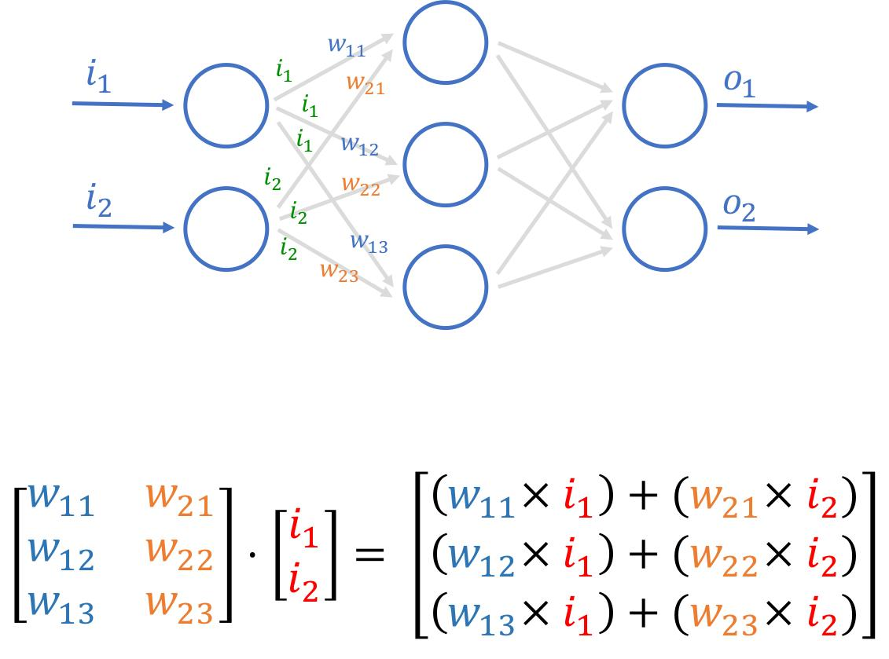
Multi Layer Network
I1 = 5
Neuron to Neuron
A
LUXURY
Each neuron has multiple weights
A neuron doesn’t send just one output with one weight
It sends its output to multiple neurons in the next layer
And each connection has its own weight
B
z
BUDGET
C
DENSITY
How it works
Suppose : One neuron output = 5
Next layer has 3 neurons:
Connection to | Weight | Output passed
Neuron A | 0.2 | 5 × 0.2 = 1
Neuron B | 0.8 | 5 × 0.8 = 4
Neuron C | -0.5 | 5 × (-0.5) = -2.5
Notes:
A neural network is NOT learning “the answer directly” It is learning different perspectives of the same data
Each neuron = a different lens / feature extractor
Think of a panel of judges 👇
Same candidate (input)
But:
Judge 1 cares about communication → high weight
Judge 2 cares about technical → medium weight
Judge 3 cares about attitude → negative/positive differently
👉 Same person 👉 Different importance → different weights

Slide 5
Activation Functions
SECTION 2
Step Function
Legacy
Sigmoid (σ)
Classic
Tanh
Common
f(z) = 1 if z≥0, else 0
f(z) = 1 / (1 + e⁻ᶻ)
f(z) = (eᶻ − e⁻ᶻ) / (eᶻ + e⁻ᶻ)
Original perceptron activation. Binary output only. Not differentiable — cannot use gradient descent.
Outputs 0–1. Useful for binary classification. Suffers from vanishing gradients in deep networks.
Zero-centered output (−1 to 1). Better than sigmoid for hidden layers but still has vanishing gradient.
Use: Historical only
Use: Output layer (binary) – Binary Cross-entropy
Use: Hidden layers (RNNs)
ReLU
Popular
Leaky ReLU
Better ReLU
Softmax
Multi-class
f(z) = max(0, z)
f(z) = max(αz, z) | α≈0.01
f(zᵢ) = eᶻⁱ / Σeᶻʲ
Most widely used. Computationally efficient. Can suffer 'dying ReLU' when neurons output 0 permanently.
Fixes dying ReLU by allowing small negative gradient. Better gradient flow than standard ReLU.
Converts raw scores to probability distribution summing to 1. Essential for multi-class classification.
Use: Hidden layers (CNNs, MLPs)
Use: Deep networks
Use: Output layer (multi-class) – categorical cross entropy

Slide 6
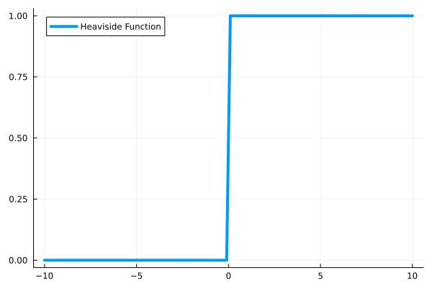
Step Function
Linear in Nature
Above threshold 1
Below threshold 0
No in-between : very strict
Perfect for:
yes/no problems
rule-based systems
NOT USED

Slide 7
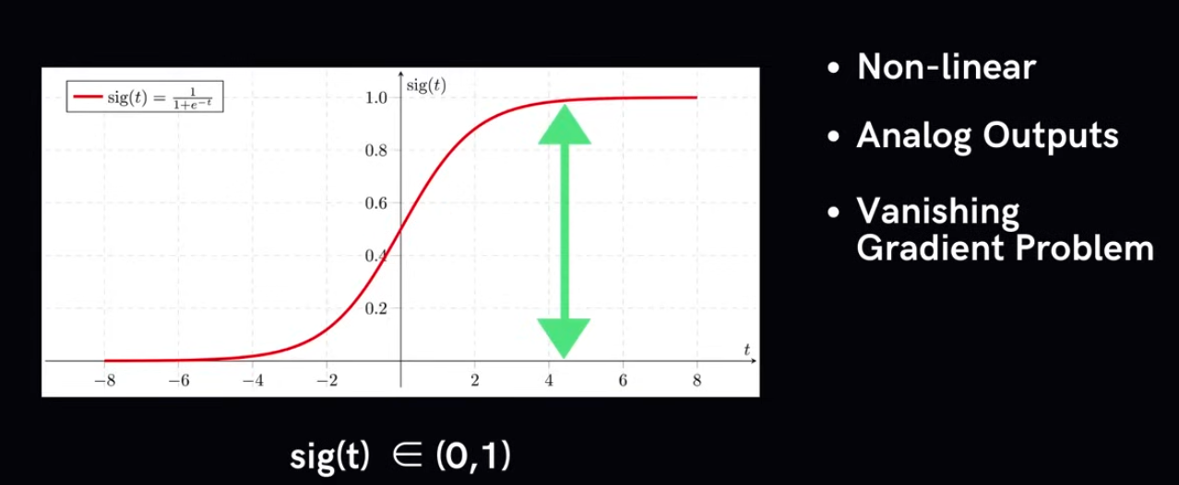
Sigmoid Function

Slide 8
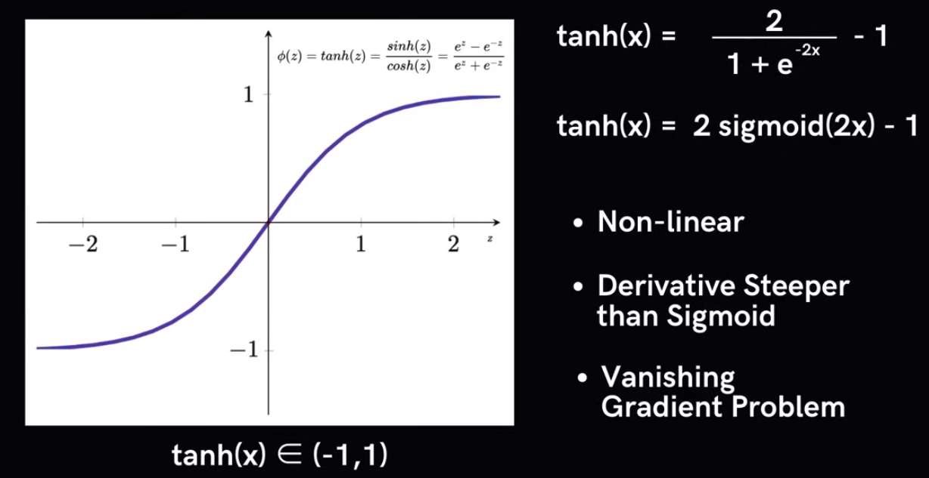
Tanh Function

Slide 9
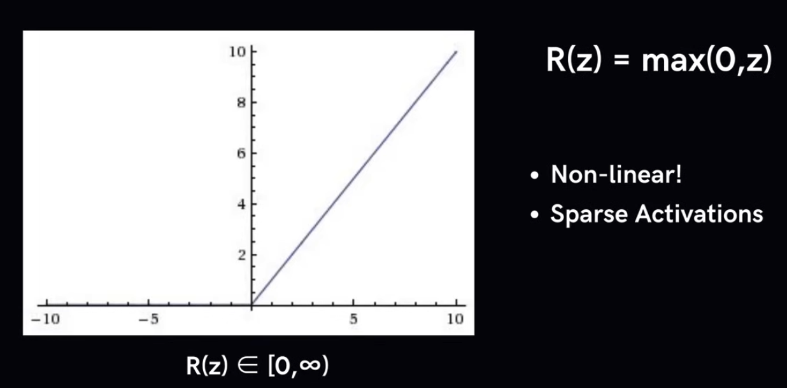
Relu Function

Slide 10
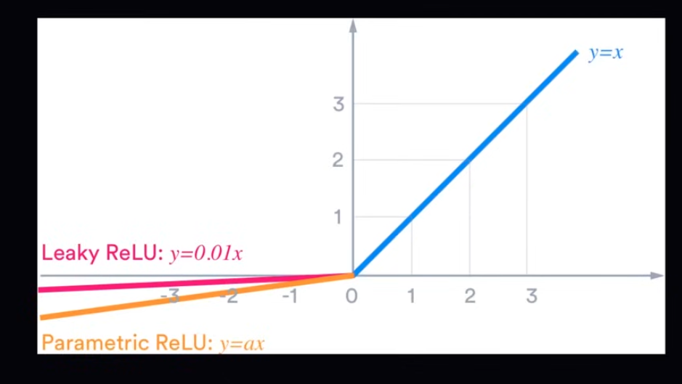
Leaky Relu Function

Slide 11
Loss Functions
SECTION 3
A Loss Function measures the gap between the model's prediction (ŷ) and the true label (y). Training minimizes this value.
REGRESSION LOSSES
CLASSIFICATION LOSSES
MSE — Mean Squared Error
Binary Cross-Entropy
L = (1/n) Σ(yᵢ − ŷᵢ)²
L = −[y·log(ŷ) + (1−y)·log(1−ŷ)]
Penalizes large errors heavily (squared). Sensitive to outliers. Most common for regression tasks.
Used with sigmoid output for binary classification. Penalizes confident wrong predictions heavily.
MAE — Mean Absolute Error
Categorical Cross-Entropy
L = (1/n) Σ|yᵢ − ŷᵢ|
L = −Σ yᵢ · log(ŷᵢ)
More robust to outliers than MSE. Less smooth gradient near zero.
Used with softmax for multi-class. Compares predicted probability distribution to one-hot labels.
Huber Loss
Hinge Loss
L = MSE if |e|≤δ, else MAE
L = max(0, 1 − y·ŷ)
Combines MSE (small errors) and MAE (large errors). Best of both worlds.
Used in SVMs and max-margin classifiers. Encourages correct classification by a margin.

Slide 12
Optimization Techniques
SECTION 4
Goal: Find weights W that minimize the loss function L(W). Gradient Descent is the core idea — move W in the direction opposite to the gradient ∇L.
SGD
Stochastic Gradient Descent
SGD + Momentum
Momentum Accelerated
W = W − η · ∇L(W; xᵢ)
v = βv − η·∇L; W = W + v
Updates weights using one sample (or mini-batch) at a time. Fast but noisy. η = learning rate.
Accumulates velocity in consistent gradient directions. Speeds up convergence and reduces oscillation.
✔ Simple, memory-efficient
✘ Noisy convergence, may oscillate
✔ Faster convergence
✘ Requires tuning β (typically 0.9)
RMSProp
Root Mean Square Propagation
Adam
Adaptive Moment Estimation
W = W − (η/√E[g²]+ε) · g
m̂=m/(1−β₁); v̂=v/(1−β₂)
Adapts learning rate per-parameter using running average of squared gradients. Good for RNNs.
Combines Momentum + RMSProp. Maintains first and second moment estimates. Default choice for most tasks.
✔ Handles non-stationary objectives
✘ No momentum by default
✔ Fast, robust — works out-of-the-box
✘ May generalize slightly worse than SGD

Slide 13
Summary & Key Takeaways
Neural Networks • Loss Functions • Optimization
01
Neural Network = Layers of Neurons
02
Perceptron is the Simplest Unit
Each neuron computes a weighted sum of inputs plus a bias, then applies an activation function to introduce non-linearity.
A single neuron that makes binary decisions. Multiple stacked perceptrons can solve complex, non-linearly separable problems.
03
Activation Functions Add Non-linearity
04
Loss Functions Measure Error
ReLU is the default for hidden layers; Sigmoid for binary outputs; Softmax for multi-class outputs. Choice impacts gradient flow.
MSE/MAE for regression; Cross-Entropy for classification. The loss guides training by quantifying how wrong the model's predictions are.
05
Optimizers Minimize Loss
Gradient Descent iteratively updates weights. Adam is the go-to modern optimizer — adaptive, fast, and robust across most architectures.

