Slide 1
Natural Language Processing
Understanding Human Language with AI

Slide 2
Introduction to NLP

Slide 3
What is Natural Language Processing?
NLP is a branch of artificial intelligence that helps computers understand, interpret, and manipulate human language
Combines computational linguistics with statistical, machine learning, and deep learning models
Enables computers to process human language in the form of text or voice data
Bridges the gap between human communication and computer understanding
Goal: Make human-computer interaction more natural and intuitive

Slide 4
Why is NLP Important?
Massive Growth of Unstructured Data: 80% of organizational data is unstructured text
Enhanced User Experience: Voice assistants, chatbots, and smart search
Business Intelligence: Extract insights from customer feedback, reviews, and social media
Automation: Automate repetitive tasks like email routing, document classification
Accessibility: Breaking language barriers with real-time translation

Slide 5
History of NLP

Slide 6
Early Days (1950s-1960s)
1950: Alan Turing's 'Computing Machinery and Intelligence' - Turing Test
1954: Georgetown-IBM experiment - First machine translation (Russian to English)
1960s: ELIZA chatbot by Joseph Weizenbaum - Pattern matching and substitution
Rule-based approach dominated this era
Limited by computational power and linguistic understanding

Slide 7
Symbolic Era (1970s-1980s)
Focus on hand-coded rules and symbolic representations
Development of parsers and grammar-based systems
Expert systems for specific domains
Challenges: Brittleness, couldn't handle ambiguity well
LUNAR system (1970s) - Natural language database interface for moon rocks

Slide 8
Statistical Revolution (1990s-2000s)
Shift from rule-based to data-driven approaches
Introduction of Hidden Markov Models (HMMs) for speech and POS tagging
Machine learning algorithms: Naive Bayes, Decision Trees, SVMs
Emergence of annotated corpora (Penn Treebank, Brown Corpus)
Improved accuracy but required large labeled datasets
Notes:
Corpus?
A large collection of text data
Annotated Corpus
Text labeled with useful information:
POS tags
Syntax trees
Named entities

Slide 9
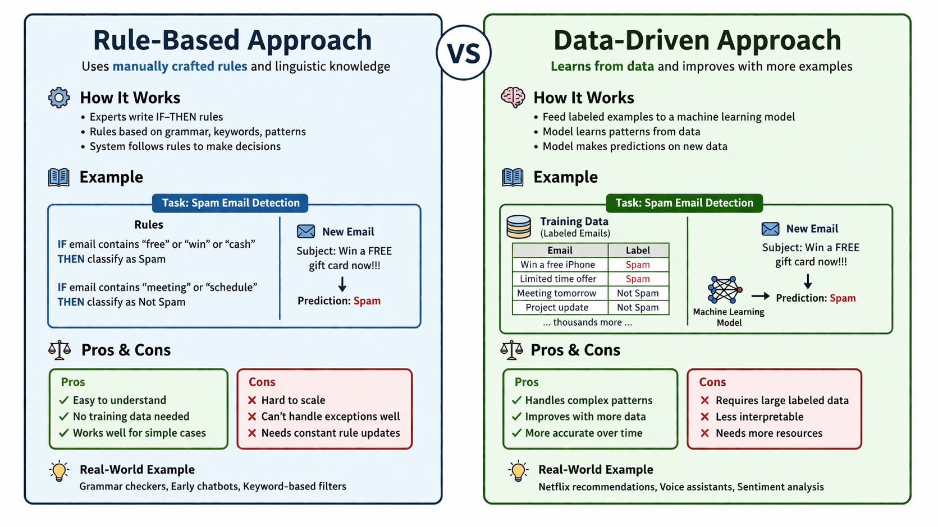
Rule Based vs Data Driven
Notes:
Rule-Based (Old Approach)
Humans manually wrote rules like:
“If word ends with -ing, it's probably a verb”
“If sentence starts with ‘Is’, it’s a question”
Based on linguistics + grammar rules
👉 Problem:
Too many exceptions in language
Hard to scale
Breaks with real-world messy text
Data-Driven (Modern Approach)
Instead of rules → learn from data
Feed thousands/millions of examples
Model learns patterns automatically
👉 Example: Instead of writing rules for spam detection:
Give model 10,000 emails labeled spam/not spam
It learns patterns like:
“Free”, “Win”, “Offer” → spam
✅ Why shift happened?
More data available
Better computing power
ML models outperform rigid rules

Slide 10
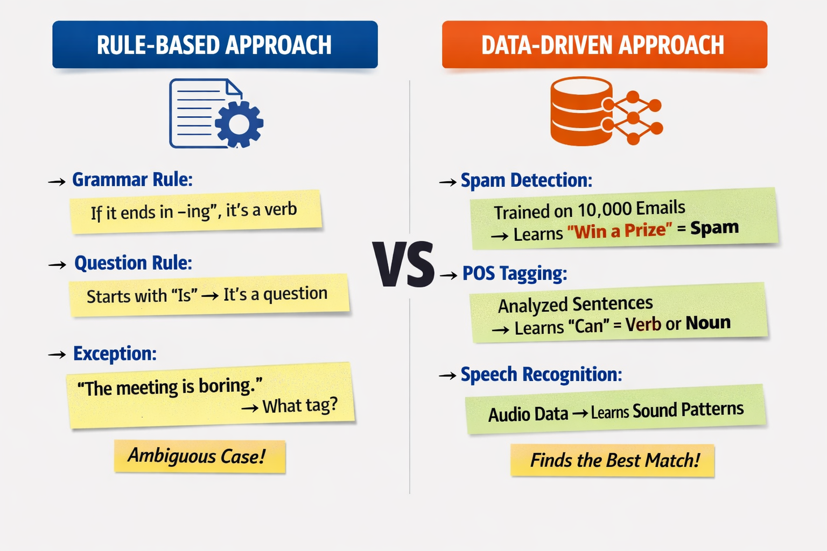
Rule Based vs Data Driven
Notes:
Use it if:
📉 Very little or no data available
🎯 Problem is simple & well-defined
📏 Rules are clear and stable
⚡ Need quick & predictable results
🔍 Need full control & explainability
Use it if:
📊 You have enough labeled data
🧠 Problem is complex or ambiguous
🔄 Patterns are not easily rule-defined
📈 You want high accuracy & scalability
🌍 System must adapt to real-world variation
💡 Examples:
Sentiment analysis
Machine translation
Chatbots (intent detection)
Email classification
🚫 Avoid if:
Very small dataset
Need strict, deterministic logic
High cost of labeling data
💡 Examples:
Keyword-based chatbot
Spam filter with fixed rules
Form validation (email, phone format)
Regex-based text extraction
🚫 Avoid if:
Language is ambiguous
Too many exceptions
Rules become hard to maintain

Slide 11
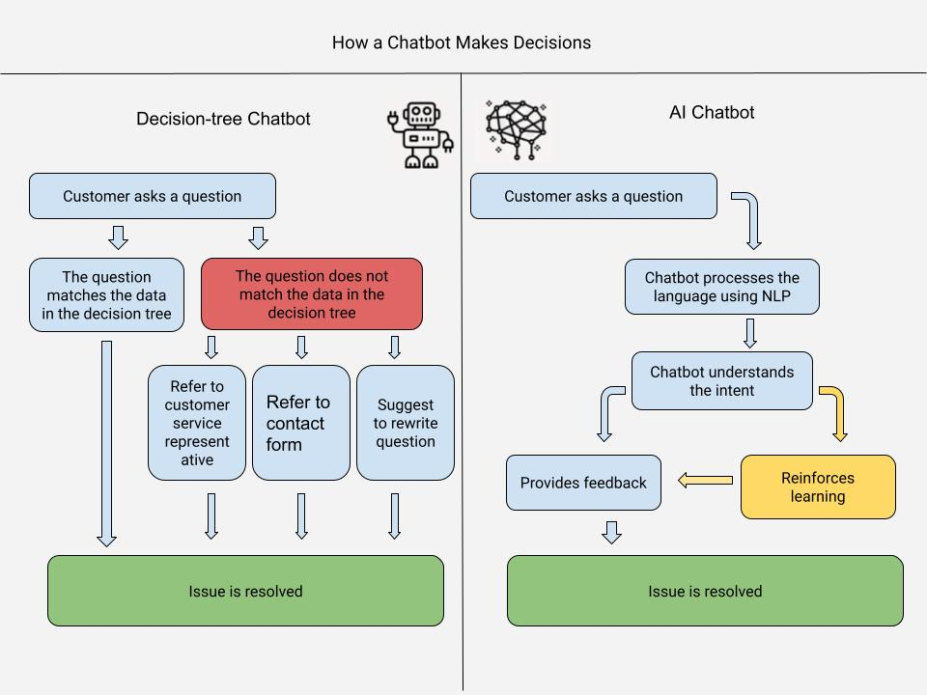
Rule Based vs Data Driven Example
Notes:
Use it if:
📉 Very little or no data available
🎯 Problem is simple & well-defined
📏 Rules are clear and stable
⚡ Need quick & predictable results
🔍 Need full control & explainability
Use it if:
📊 You have enough labeled data
🧠 Problem is complex or ambiguous
🔄 Patterns are not easily rule-defined
📈 You want high accuracy & scalability
🌍 System must adapt to real-world variation
💡 Examples:
Sentiment analysis
Machine translation
Chatbots (intent detection)
Email classification
🚫 Avoid if:
Very small dataset
Need strict, deterministic logic
High cost of labeling data
💡 Examples:
Keyword-based chatbot
Spam filter with fixed rules
Form validation (email, phone format)
Regex-based text extraction
🚫 Avoid if:
Language is ambiguous
Too many exceptions
Rules become hard to maintain

Slide 12
Hidden Markov Models
Probabilistic model in machine learning
Observed data = words (what you see)
Hidden states = POS tags or phonemes (what you infer)
Used in:
Speech recognition
POS tagging
Named entity recognition (early systems)
Key idea: context matters (sequence-based prediction)
Notes:
POS : Parts of speech

Slide 13
Deep Learning Era (2010s-Present)
2013: Word2Vec - Word embeddings revolutionize text representation
2014: Sequence-to-sequence models for translation
2017: Transformer architecture - 'Attention is All You Need'
2018: BERT, GPT - Pre-trained language models
2020s: Large Language Models (GPT-3, GPT-4, Claude, LLaMA) - Human-like text generation

Slide 14
Components of NLP

Slide 15
Components
Natural Language Understanding: Process where machines comprehend human language by breaking it down into structured components.
Natural Language Generation: Reverse process where machines convert structured data into human-readable text. It plans what content to include, structures it into proper sentences, and then realizes it as natural-sounding language output.
NLU takes human language as input and produces structured data (understanding)
NLG takes structured data as input and produces human language (generation)
Notes:
NLU It analyzes input text through multiple layers: tokenization splits the text, syntactic analysis understands the grammar, and semantic analysis extracts the actual meaning and intent

Slide 16
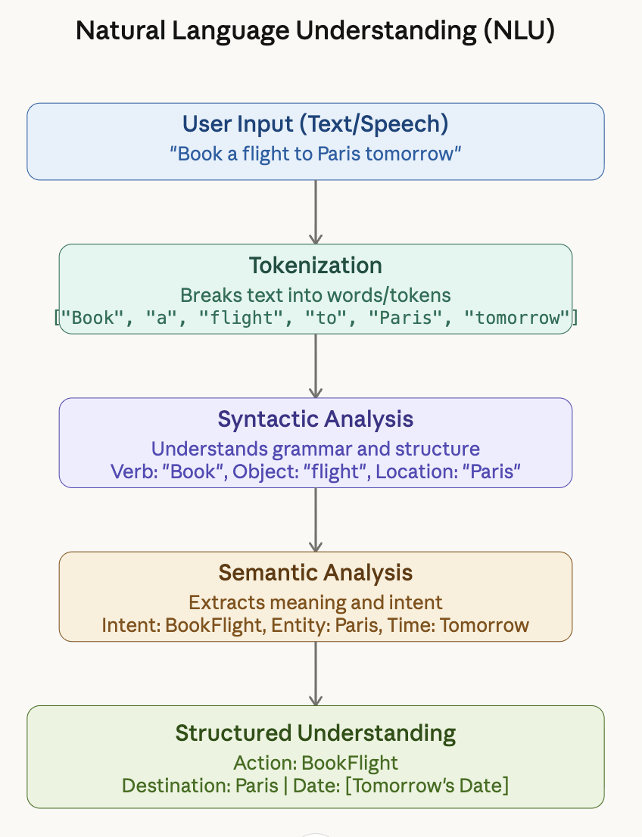
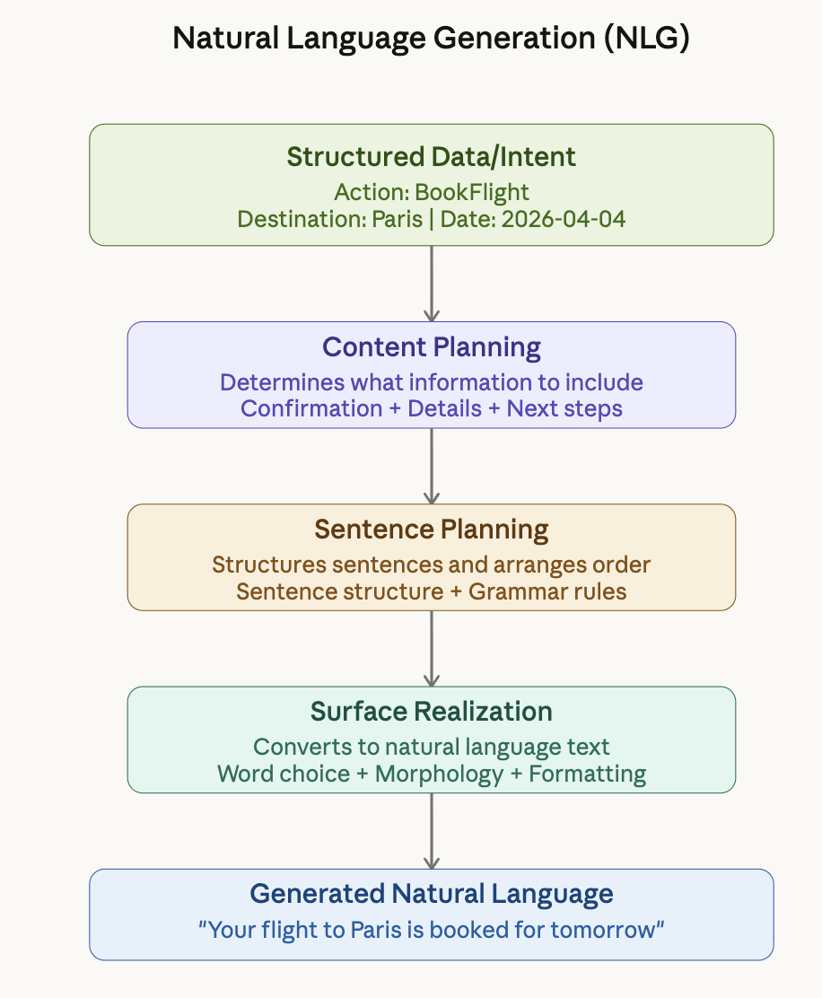
Example

Slide 17
1. Syntactic Analysis (Syntax)
Tokenization: Breaking text into words, phrases, symbols
Part-of-Speech (POS) Tagging: Identifying grammatical roles (noun, verb, adjective)
Parsing: Analyzing grammatical structure of sentences
Constituency Parsing: Breaking sentences into sub-phrases (noun phrases, verb phrases)
Dependency Parsing: Identifying relationships between words

Slide 18
2. Semantic Analysis (Meaning)
Word Sense Disambiguation: Determining correct meaning of ambiguous words
Named Entity Recognition (NER): Identifying persons, organizations, locations, dates
Semantic Role Labeling: Identifying 'who did what to whom, when, where, why'
Relationship Extraction: Finding relationships between entities
Understanding the actual meaning beyond grammatical structure

Slide 19
3. Pragmatic Analysis (Context)
Discourse Analysis: Understanding text beyond individual sentences
Coreference Resolution: Identifying when different words refer to the same entity
Sentiment Analysis: Determining emotional tone (positive, negative, neutral)
Intent Recognition: Understanding the speaker's goal or intention
Context-dependent interpretation of language
Notes:
focuses on real-world meaning using context
👉 It answers:
What does the speaker really mean?
What is the intent behind the sentence?
Key Aspects:
Context (who, where, situation)
Intent
Implied meaning
Sarcasm / tone
🔹 Example 1:
"Can you open the window?"
Lexical meaning: 👉 Asking about ability
Pragmatic meaning: 👉 It’s a request → "Please open the window"
🔹 Example 2:
"Wow, great job!"
Could be genuine praise
Could be sarcasm 😅
👉 Only context tells the real meaning

Slide 20
4. Lexical Analysis (Words)
Lemmatization: Reducing words to their base/dictionary form
Stemming: Removing suffixes to get root form
Stop Word Removal: Filtering common words (the, is, at)
N-grams: Analyzing sequences of N words together
Building vocabulary and understanding word patterns
Notes:
What are the words?
What type of word is it?

Slide 21
Applications of NLP

Slide 22
Text Processing & Analysis
Sentiment Analysis: Analyzing customer reviews, social media monitoring
Text Classification: Spam detection, news categorization, content moderation
Information Extraction: Resume parsing, invoice processing
Document Summarization: Generating concise summaries of long documents
Keyword Extraction: SEO optimization, content tagging

Slide 23
Conversational AI & Virtual Assistants
Chatbots: Customer service automation, FAQ handling
Voice Assistants: Siri, Alexa, Google Assistant
Question Answering Systems: IBM Watson, search engines
Dialogue Systems: Task-oriented (booking, orders) and open-domain conversations
24/7 customer support and engagement

Slide 24
Machine Translation & Language Tools
Neural Machine Translation: Google Translate, DeepL
Real-time Translation: Breaking language barriers in global communication
Grammar Checking: Grammarly, Microsoft Editor
Spell Checking and Auto-correction
Language Learning Applications

Slide 25
Healthcare & Legal Applications
Clinical Documentation: Automated medical record generation
Drug Discovery: Analyzing research papers and medical literature
Legal Document Analysis: Contract review, due diligence
Medical Coding: ICD-10 code assignment
Patient Interaction: Symptom checkers, health chatbots

Slide 26
Capstone Project Ideas

Slide 27
Capstone: Email Spam Classification System
Objective: Build a classifier to detect spam vs legitimate emails
Dataset: Use Enron email dataset or SpamAssassin corpus
Techniques: TF-IDF vectorization, Naive Bayes, Random Forest, or LSTM
Features: Email subject, body text, sender information, metadata
Deliverables: Trained model, web interface for testing, performance metrics (accuracy, precision, recall, F1-score)

Slide 28
Capstone: Sentiment Analysis Dashboard
Objective: Analyze sentiment of product reviews or social media posts
Dataset: Amazon reviews, Twitter API, or Yelp dataset
Techniques: VADER, TextBlob, or transformer-based models (BERT, RoBERTa)
Visualization: Real-time dashboard showing sentiment trends, word clouds
Deliverables: Interactive dashboard, sentiment classification model, insights report

Slide 29
Capstone: Chatbot for Customer Support
Objective: Build an intelligent chatbot to handle customer queries
Approach: Intent recognition + Entity extraction + Response generation
Techniques: Rasa, DialogFlow, or custom seq2seq model
Features: FAQ handling, order tracking, product recommendations
Deliverables: Deployed chatbot, conversation logs, performance analytics

Slide 30
Capstone: News Article Summarizer
Objective: Generate concise summaries of news articles
Dataset: CNN/DailyMail dataset or BBC News
Approaches: Extractive (select key sentences) vs Abstractive (generate new text)
Techniques: TextRank, BERT extractive summarization, or T5/BART for abstractive
Deliverables: Summarization tool, web app, comparison of extractive vs abstractive methods

Slide 31
Capstone: Resume Parser & Job Matcher
Objective: Extract information from resumes and match to job descriptions
NLP Tasks: NER for skills/education/experience, text similarity
Techniques: SpaCy for NER, sentence transformers for semantic matching
Features: Parse PDF/Word resumes, extract structured data, rank job matches
Deliverables: Resume parsing system, job matching algorithm, recommendation engine

Slide 32
Thank You!
Questions?

