Slide 1

Natural Language Processing
TASKS
Core concepts, techniques & real-world applications
Tokenization
NER
Sentiment
Translation
QA
Summarization
From foundational preprocessing to advanced generative AI

Slide 2
NLP TASK TAXONOMY
NLP tasks span a wide spectrum — from low-level text processing to high-level semantic understanding.
Text Preprocessing
Sequence Labeling
Text Classification
Tokenization, Lemmatization, Stopword Removal, POS Tagging
NER, Chunking, Slot Filling, Event Detection
Sentiment Analysis, Topic Modeling, Intent Detection, Spam
Text Generation
Semantic Tasks
Information Retrieval
Summarization, Translation, QA, Dialogue, Story Gen
Textual Entailment, Coreference, Semantic Similarity
Open-Domain QA, Document Retrieval, Knowledge Extraction

Slide 3

Key Preprocessing Tasks
Tokenization
Splitting text into words/subwords. BPE, WordPiece, SentencePiece used by modern LLMs.
Text
Preprocessing
POS Tagging
Assigning grammatical roles (Noun, Verb, Adj) to each token. Used in syntax analysis.
The foundation of
every NLP pipeline
Lemmatization / Stemming
Reducing words to base forms. 'running' → 'run'. Improves vocabulary consistency.
Raw Text
Sentence Split
Named Entity Recognition (NER)
Tokenize
Identifying structured info: names, dates, locations, organizations in text.
Lowercase
Remove Stopwords
Dependency Parsing
Lemmatize
Analysing grammatical structure — how words relate to each other in a sentence.
Vectorize

Slide 4
Sentiment Analysis & Text Classification
Automatically categorizing text into predefined labels — from polarity to intent to topic.
Very Negative
Negative
Neutral
Positive
Very Positive
Binary Classification
Multi-class Classification
Multi-label Classification
Spam / Not Spam
Topic categorization
Tag multiple topics
Positive / Negative
Language detection
Product attribute tagging
Relevant / Irrelevant
Intent classification
News category overlap
Fake / Real News
Emotion recognition
Medical coding (ICD)

Slide 5
Named Entity Recognition (NER)
Example Sentence:
Apple
Inc.
was
founded
in
Cupertino,
California
by
Steve Jobs
in
1976.
ORG
ORG
LOC
LOC
PER
DATE
Standard NER Entity Types
PER
Person
ORG
Organization
LOC
Location
DATE
Date/Time
MISC
Miscellaneous
Applications of NER
Resume Parsing
Medical Records
Financial Document Analysis
Legal Contract Mining
News Aggregation

Slide 6
Machine Translation
Automatically translating text across languages preserving meaning, tone, and context
Evolution of MT Approaches
1950s–80s
1990s–2000s
2014–2017
2017–Now
Rule-Based MT
Statistical MT
Neural MT (Seq2Seq)
Transformer MT
Hand-crafted linguistic rules. High linguistic cost, low scalability.
Corpus-based probabilities (IBM models, phrase tables, Moses).
Encoder-decoder with RNN/LSTM. Attention mechanism introduced.
Self-attention, BERT, GPT, mBART, NLLB-200 covering 200 languages.
Key Challenges in MT
Evaluation Metrics
▸ Ambiguity & polysemy
• BLEU — n-gram precision score
▸ Low-resource languages
• METEOR — alignment-based metric
▸ Domain-specific terminology
• chrF — character-level F-score
▸ Cultural nuance & idioms
• COMET — neural evaluation model

Slide 7
Question Answering (QA)
Extractive QA
Abstractive QA
Answer is a span from the context document.
Model: BERT, RoBERTa on SQuAD
Ex: 'When was X founded?' → extracts date.
Answer is generated, not extracted.
Model: T5, BART, GPT-4
Ex: 'Explain X in simple terms'
Open-Domain QA
Visual QA (VQA)
No context given; model retrieves + answers.
RAG (Retrieval-Augmented Generation)
Ex: Wikipedia-scale knowledge bases
Answer questions about an image.
Model: BLIP, LLaVA, GPT-4V
Ex: 'What color is the car in the image?'
📊 Key Benchmarks: SQuAD 2.0 · TriviaQA · Natural Questions · HotpotQA · MS MARCO

Slide 8
Text Summarization
Extractive Summarization
Abstractive Summarization
• Selects key sentences directly from source
• Generates new sentences to convey meaning
• No new words generated — verbatim
• More human-like, concise summaries
• Easier to implement, less hallucination
• Powered by Seq2Seq / Transformer models
VS
• Methods: TextRank, LexRank, SumBasic
• Models: BART, PEGASUS, T5, GPT-4
• Limitation: May be incoherent across sentences
• Evaluation: ROUGE-1/2/L, BERTScore

Slide 9

Language Models & LLMs
Pre-trained models that power nearly every modern NLP task
Model | Year | Params | Architecture | Best For
BERT | 2018 | 110M | Encoder-only | Classification, NER, QA
GPT-3 | 2020 | 175B | Decoder-only | Text generation, Completion
T5 | 2020 | 11B | Encoder-Decoder | Seq2Seq, Summarization, MT
LLaMA 3 | 2024 | 8–70B | Decoder-only | Open-source general purpose
GPT-4 | 2023 | ~1.8T | MoE Transformer | Reasoning, Code, Vision+Text
Claude 3.7 | 2025 | N/A | Transformer | Long context, reasoning, code
Paradigm Shift
Pre-train on massive corpora → Fine-tune on domain tasks → Prompt / RAG / Agent at inference time.

Slide 10
NLP in Financial Services & BFSI
Practical applications of NLP across banking, insurance, and capital markets:
Equity Research
Risk & Compliance
Earnings call summarization, broker note parsing, sentiment signals from news
Regulatory document analysis, KYC/AML document extraction, policy comparison
Customer Service
Credit Underwriting
Intent detection, FAQ bots, complaint categorization, claim automation
Bank statement parsing, financial report NER, covenant extraction from loan docs
Insurance Claims
Trade Finance
Medical records NER, claim narrative classification, fraud signal detection
Bill of lading parsing, invoice entity extraction, LC document QA

Slide 11
NLP Evaluation Metrics
Metric | Tasks | What It Measures | Range
Accuracy | Classification | % correctly classified samples | 0–1
F1-Score | NER, Classification | Harmonic mean of Precision & Recall | 0–1
BLEU | Translation | n-gram overlap with reference translations | 0–1
ROUGE-L | Summarization | Longest common subsequence overlap | 0–1
Perplexity | Language Models | How well model predicts a sample | 1–∞
BERTScore | Summarization, MT | Semantic similarity via BERT embeddings | 0–1
EM / F1 | Question Answering | Exact match and token-level F1 | 0–1
MCC | Imbalanced datasets | Matthews Correlation Coefficient | -1 to 1
Different NLP tasks require different evaluation metrics—no single metric fits all.
Notes:
Accuracy
Used in: Classification
Measures: % of correct predictions
Range: 0 to 1
👉 Best for balanced datasets
F1-Score
Used in: NER, Classification
Measures: Balance between Precision & Recall
Range: 0 to 1
👉 Useful when classes are imbalanced
BLEU (Bilingual Evaluation Understudy)
Used in: Machine Translation
Measures: Overlap of generated vs reference text (n-grams)
Range: 0 to 1
👉 Higher = closer to human translation
ROUGE-L
Used in: Text Summarization
Measures: Longest common subsequence similarity
Range: 0 to 1
👉 Focuses on recall (coverage of content)
Perplexity
Used in: Language Models
Measures: How well model predicts next word
Range: 1 to ∞
👉 Lower = better model
BERTScore
Used in: Summarization, Translation
Measures: Semantic similarity using embeddings (context-aware)
Range: 0 to 1
👉 Better than exact word matching
EM / F1 (QA Tasks)
Used in: Question Answering
EM: Exact match with correct answer
F1: Token-level overlap
Range: 0 to 1
MCC (Matthews Correlation Coefficient)
Used in: Imbalanced Classification
Measures: Quality of binary classification
Range: -1 to 1
👉 +1 = perfect, 0 = random, -1 = wrong

Slide 12
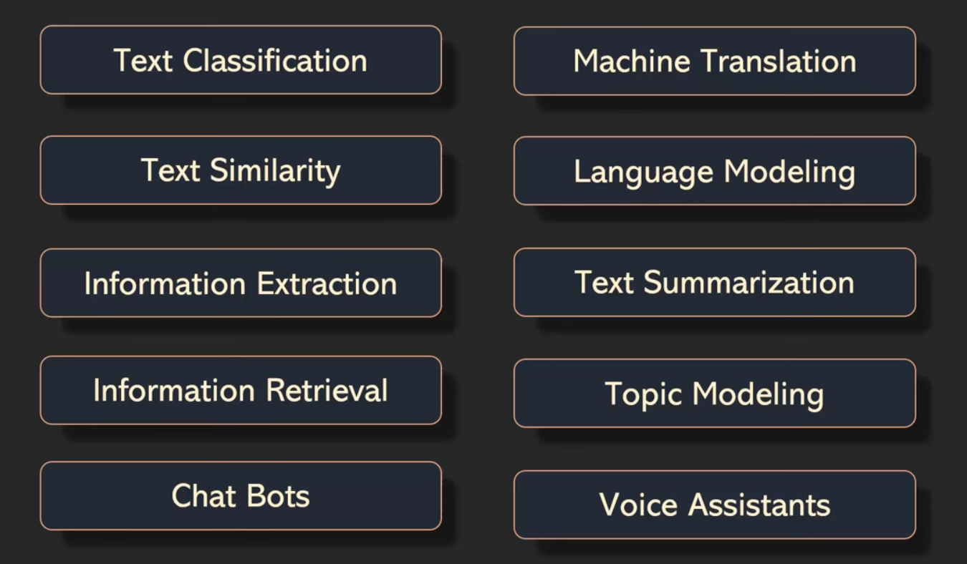
Some more
Notes:
Accuracy
Used in: Classification
Measures: % of correct predictions
Range: 0 to 1
👉 Best for balanced datasets
F1-Score
Used in: NER, Classification
Measures: Balance between Precision & Recall
Range: 0 to 1
👉 Useful when classes are imbalanced
BLEU (Bilingual Evaluation Understudy)
Used in: Machine Translation
Measures: Overlap of generated vs reference text (n-grams)
Range: 0 to 1
👉 Higher = closer to human translation
ROUGE-L
Used in: Text Summarization
Measures: Longest common subsequence similarity
Range: 0 to 1
👉 Focuses on recall (coverage of content)
Perplexity
Used in: Language Models
Measures: How well model predicts next word
Range: 1 to ∞
👉 Lower = better model
BERTScore
Used in: Summarization, Translation
Measures: Semantic similarity using embeddings (context-aware)
Range: 0 to 1
👉 Better than exact word matching
EM / F1 (QA Tasks)
Used in: Question Answering
EM: Exact match with correct answer
F1: Token-level overlap
Range: 0 to 1
MCC (Matthews Correlation Coefficient)
Used in: Imbalanced Classification
Measures: Quality of binary classification
Range: -1 to 1
👉 +1 = perfect, 0 = random, -1 = wrong

Slide 13
Key Takeaways
01
NLP tasks span preprocessing, classification, generation, and semantic reasoning — each needing different architectures.
02
Transformer-based models (BERT, T5, GPT-4) dominate modern NLP by leveraging attention and massive pre-training.
03
Evaluation must match the task: BLEU for MT, ROUGE for summarization, F1/EM for QA, and semantic metrics for generation.
04
BFSI applications are exploding — from earnings call summarization to KYC document NER and insurance claim automation.
05
RAG and agentic pipelines are the new frontier — combining retrieval with generation for grounded, up-to-date answers.
Natural Language Processing | Comprehensive Overview

