Slide 1
JUNIT 5.0
Shalini Mittal
Corporate Trainer

Slide 2
Course Objectives
By the end of this course, you will be able to:
Describe the need for JUNIT5.
Describe the test lifecycle.
JUNIT Essentials
JUNIT Features
JUNIT Fixtures
JUNIT Annotations
JUNIT Assertions

Slide 3
Unit Testing

Slide 4
Introduction To UnitTesting
Upon completion of this course, you will learn about:
JUnit essentials
Installation of Junit
JUnit and its purpose.
Concepts of testing.
Write a simple test case.
Execute a test case to check the results.
Creation of mocks
Testing the mock using the Mockito Framework
Notes:
https://zeroturnaround.com/rebellabs/why-your-next-cloud-app-will-probably-suck-without-unit-testing/

Slide 5
Overview of JUNIT
A unit testing framework that is extensively used to test the code written in Java.
Unit testing is a type of software testing.
Software testing: The process of examining whether the software and its components meet the specified requirements
Other types of software testing are as shown.
Beta Testing
Regression Testing
Acceptance Testing
Functional Testing
System Testing
Unit Testing
Integration Testing
Performance Testing
Usability Testing
http://junit.org/junit4/faq.html - FAQ
Notes:
PG Reference: Page 6-7
Explain to participants that JUnit is a unit testing framework, which is used to write repeatable tests.
Ask participants what do they know about unit testing.
Explain that unit testing is a type of software testing (process of examining whether the software and its components meet the specified requirements). After development, software is tested to evaluate it for aspects such as reliability, user-friendliness, functionality, effectiveness, and efficiency. In addition, testing helps to identify and fix errors or bugs in the software. Therefore, software testing is critical for the successful implementation of the software.
On the basis of the components or functions of the code being tested and the number of tests conducted on the same code, software testing is categorized into several types.
Show the different types of software testing on the slide. Ask participants if they can explain each type. Summarize the following for all participants:
Unit testing: Testing small bits or units of code for efficiency and workability
Integration testing: Testing groups of individual units of software to check whether they work well together
Functional testing: Is quality assurance testing, which checks the functionality of the software and compares the expected and actual output
System testing: Testing the complete system to verify its compliance with design specifications
Stress testing: Testing the software performance by deliberately placing it under stress
Performance testing: Testing the responsiveness and stability of a system in a particular condition
Usability testing: Testing the software on selected users to investigate its user-friendly features
Acceptance testing: Testing performed by selected users to check the functionality of the system
Regression testing: Testing software for bugs after changes or patches have been made
Beta testing: Testing the software on external users
Since the JUnit framework provides a platform for performing unit testing on Java-based applications, a better understanding of unit testing will help you use JUnit more effectively.

Slide 6
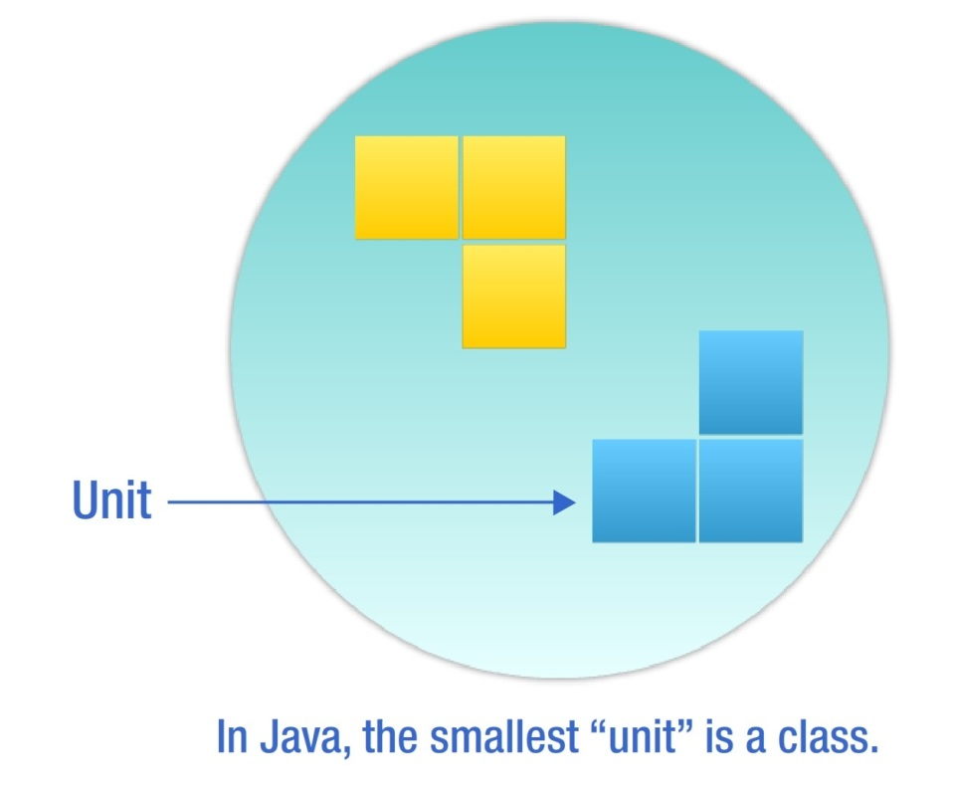
Unit Testing
Unit testing:
Is performed to validate the tester’s assumptions about the code design.
Is an effective method of testing. Each part of the program is isolated to determine which individual parts are correct
Involves testing the smallest unit of code under a variety of input conditions.
Notes:
PG Reference: Page 7-8
Ask participants to share what they know about unit testing.
Explain that unit testing is performed to validate the tester’s assumptions about the design of the code, which means that it helps to check whether the code is doing what it is designed to do.
Explain that unit testing is an effective method of testing since by isolating each part of the program, it helps to determine which individual parts are correct. During a unit test, when the code is executed but the desired task is not performed, errors are identified and subsequently fixed.
Unit testing requires you to test the smallest unit of code under a variety of input conditions. In Java, this smallest unit of code is a class. Ask participants to share some examples of a class.

Slide 7
Benefits of Unit Testing
The key benefits of unit testing are:
Ability to re-factor code with confidence
Proof that your code actually works
Availability of a regression-test suite
Demonstration of concrete progress
Developers use unit tests as an internal control on the functionality and compatibility of their applications when changes to features, code or the environment happen.
Notes:
PG Reference: Page 8 - 9
Discuss the benefits of unit testing.
Ability to re-factor code with confidence: JUnit enables developers to re-factor code with confidence and by running the existing test cases, it makes sure that no new bugs are introduced.
Proof that your code actually works: Results in fewer bugs and better code
Availability of a regression-test suite: JUnit provides a low-effort way to catch bugs before the build goes off to QA.
Demonstration of concrete progress: Unit tests help you to demonstrate progress in parts and not wait for the entire code to be ready before it can be tested.
Fowler draws a clean line between changes to code that do, and those that do not, affect its behavior. He calls those that do not, "refactoring". This is an important distinction, because if we divide our work into refactoring and non-refactoring code modification activities (Fowler calls it "wearing different hats"), we can apply different, goal-appropriate techniques.
If we are making a refactoring, or behavior-preserving code modification:
all our unit tests should pass before and after the modification
we should not need to modify any tests, or write any new ones
we expect cleaner code when we are done
we do not expect new behavior
If we are making a behavior-changing code modification:
we expect new behavior
we should write new tests
we may get dirtier code when we are done (and should then refactor it)

Slide 8
JUNIT Features
Asserts
Specify the expected output and compare it with the output received
Test setup and teardown
Sets up test data and tears down that data or context, before and after running the test, respectively
Exception testing
Tests and verifies whether an exception was thrown
Test suites
JUnit test cases are organized into test suites for better management
Parameterized testing
Creates tests that operate on sets of data that are fed into the tests
Rules
Extend the functionality of Junit by adding behaviors to tests
Integration with popular build systems
Integrates with most of the popular build systems for Java, including ANT and Maven
Notes:
. JUnit is packaged as a single jar file that is a library of functionality of unit testing code. For example, when you write unit testing code, you need a way to compare the output received with the output expected. JUnit provides you asserts and many ways of using them on common data types.

Slide 9
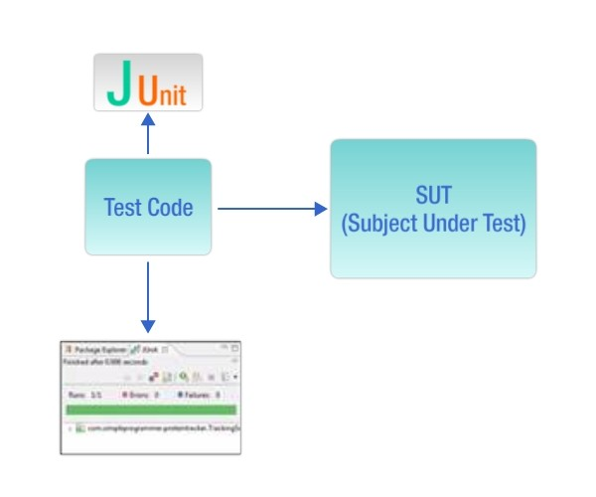
How JUNIT Works
To test using JUnit:
Create a separate project for writing tests that test an SUT.
Use a JUnit runner to execute the test code. The runner:
Determines the tests that exist in the test code
Executes the tests
Reports the results, including reporting to a graphical view
Writing JUnit tests in an IDE helps you to get quick feedback regarding a test passing or failing.
Notes:
It is entirely possible that a product passes when verified but fails when validated. This can happen when, say, a product is built as per the specifications but the specifications themselves fail to address the user’s needs.
Regulatory – lifts in the building, needs to have a certified note that its been verified

Slide 10
JUnit5
Unlike previous versions of JUnit, JUnit 5 is composed of several different modules from three different sub-projects. JUnit 5 = JUnit Platform + JUnit Jupiter + JUnit Vintage
JUnit 5 requires Java 8 (or higher) at runtime. However, you can still test code that has been compiled with previous versions of the JDK.
JUnit Platform To be able to launch junit tests, IDEs, build tools or plugins need to include and extend platform APIs. It defines the TestEngine API for developing new testing frameworks that runs on the platform. It also provides a Console Launcher to launch the platform from the command line and build plugins for Gradle and Maven.
JUnit Jupiter It includes new programming and extension models for writing tests. It has all new junit annotations and TestEngine implementation to run tests written with these annotations.
JUnit Vintage It primary purpose is to support running JUnit 3 and JUnit 4 written tests on the JUnit 5 platform. It’s there are backward compatibility.

Slide 11
JUnit5 Annotations – 1/3
Annotation | Description
@Test | Denotes that a method is a test method. Unlike JUnit 4’s @Test annotation, this annotation does not declare any attributes, since test extensions in JUnit Jupiter operate based on their own dedicated annotations.
@ParameterizedTest | Denotes that a method is a parameterized test.
@RepeatedTest | Denotes that a method is a test template for a repeated test.
@TestFactory | Denotes that a method is a test factory for dynamic tests.
@TestTemplate | Denotes that a method is a template for test cases designed to be invoked multiple times depending on the number of invocation contexts returned by the registered providers.
@TestMethodOrder | Used to configure the test method execution order for the annotated test class; similar to JUnit 4’s @FixMethodOrder.
@TestInstance | Used to configure the test instance lifecycle for the annotated test class.
@DisplayName | Declares a custom display name for the test class or test method.
@DisplayNameGeneration | Declares a custom display name generator for the test class. Such annotations are inherited.
@Tag | Used to declare tags for filtering tests, either at the class or method level.

Slide 12
JUnit5 Annotations – 2/3
Annotation | Description
@BeforeEach | Denotes that the annotated method should be executed before each @Test, @RepeatedTest, @ParameterizedTest, or @TestFactory method in the current class
@AfterEach | Denotes that the annotated method should be executed after each @Test, @RepeatedTest, @ParameterizedTest, or @TestFactory method in the current class
@BeforeAll | Denotes that the annotated method should be executed before all @Test, @RepeatedTest, @ParameterizedTest, and @TestFactory methods in the current class. Such methods must be static (unless the "per-class" test instance lifecycle is used).
@AfterAll | Denotes that the annotated method should be executed after all @Test, @RepeatedTest, @ParameterizedTest, and @TestFactory methods in the current class. Such methods must be static (unless the "per-class" test instance lifecycle is used).

Slide 13
JUnit5 Annotations – 3/3
Annotation | Description
@Nested | Denotes that the annotated class is a non-static nested test class. @BeforeAll and @AfterAll methods cannot be used directly in a @Nested test class unless the "per-class" test instance lifecycle is used.
@Disabled | Used to disable a test class or test method
@Timeout | Used to fail a test, test factory, test template, or lifecycle method if its execution exceeds a given duration.
@ExtendWith | Used to register extensions declaratively.
@RegisterExtension | Used to register extensions programmatically via fields.
@TempDir | Used to supply a temporary directory via field injection or parameter injection in a lifecycle method or test method; located in the org.junit.jupiter.api.io package.

Slide 14
Test in JUnit5
import static org.junit.jupiter.api.Assertions.fail;
import static org.junit.jupiter.api.Assumptions.assumeTrue;
import org.junit.jupiter.api.*;
class StandardTests {
@BeforeAll
static void initAll() { }
@BeforeEach void init() { }
@Test void succeedingTest() { }
@Test void failingTest() { fail("a failing test"); }
@Test
@Disabled("for demonstration purposes")
void skippedTest() { // not executed }
@Test
void abortedTest() { assumeTrue("abc".contains("Z"));
fail("test should have been aborted");
}
@AfterEach
void tearDown() { }
@AfterAll
static void tearDownAll()
{ }
}

Slide 15
Assertions
Assertions help in validating the expected output with actual output of a testcase.
To keep things simple, all JUnit Jupiter assertions are static methods in the org.junit.jupiter.Assertions class e.g. assertEquals(), assertNotEquals().
void testCase()
{
//Test will pass
Assertions.assertNotEquals(3, Calculator.add(2, 2));
//Test will fail
Assertions.assertNotEquals(4, Calculator.add(2, 2), "Calculator.add(2, 2) test failed");
//Test will fail
Supplier<String> messageSupplier = ()-> "Calculator.add(2, 2) test failed";
Assertions.assertNotEquals(4, Calculator.add(2, 2), messageSupplier);
}

Slide 16
Grouped Assertions
In a grouped assertion all assertions are executed, and all // failures will be reported together.
@Test
void groupedAssertions() {
assertAll("person", () -> assertEquals("Jane", person.getFirstName()),
() -> assertEquals("Doe", person.getLastName())
);
}

Slide 17
Assumptions
Assumptions class provides static methods to support conditional test execution based on assumptions.
A failed assumption results in a test being aborted. Assumptions are typically used whenever it does not make sense to continue execution of a given test method. In test report, these test will be marked as passed.
JUnit jupiter Assumptions class has two such methods: assumeFalse(), assumeTrue().
public class AppTest {
@Test
void testOnDev() {
System.setProperty("ENV", "DEV");
Assumptions.assumeTrue("DEV".equals(System.getProperty("ENV")), AppTest::message);
}
@Test
void testOnProd() {
System.setProperty("ENV", "PROD");
Assumptions.assumeFalse("DEV".equals(System.getProperty("ENV")));
}
private static String message () {
return "TEST Execution Failed :: ";
}
}

Slide 18
Display names
Test classes and test methods can declare custom display names via @DisplayName — with spaces, special characters, and even emojis — that will be displayed in test reports and by test runners and IDEs.
@DisplayName("A special test case")
class DisplayNameDemo {
@Test
@DisplayName("Custom test name containing spaces")
void testWithDisplayNameContainingSpaces() { }
@Test @DisplayName("╯°□°）╯")
void testWithDisplayNameContainingSpecialCharacters() { }
@Test
@DisplayName("😱")
void testWithDisplayNameContainingEmoji() { }
}

Slide 19
Expected Exception
In JUnit 5, to test methods which throws exceptions, we should use .assertThrows() method from org.junit.jupiter.api.Assertions class.
The assertThrows() method asserts that execution of the supplied executable block or lambda expression which throws an exception of the expectedType. public static <T extends Throwable> T assertThrows(Class<T> expectedType, Executable executable)
If no exception is thrown from the executable block, or if an exception of a different type is thrown, assertThrows() method will fail.
@Test
void testExpectedException() {
//First argument - specifies the expected exception.
//Here it expects that code block will throw NumberFormatException
//Second argument - is used to pass an executable code block or lambda expression
Assertions.assertThrows(NumberFormatException.class, () -> {
Integer.parseInt("One");
});
}
Notes:
Please note that if the code block throws an exception of a class that is a subtype of the expected exception type, then the assertion will pass.
For example, if we are expecting IllegalArgumentException and the test throws NumberFormatException then also the test will PASS because NumberFormatException extends IllegalArgumentException class.
This also means that if we pass Exception.class as the expected exception type, any exception thrown from the code block will make the assertion succeed since Exception is the super-type for all exceptions.

Slide 20
Timeout
The @Timeout annotation allows one to declare that a test, test factory, test template, or lifecycle method should fail if its execution time exceeds a given duration. The time unit for the duration defaults to seconds but is configurable.
@BeforeEach
@Timeout(5)
void setUp() {
// fails if execution time exceeds 5 seconds
}
@Test
@Timeout(value = 100, unit = TimeUnit.MILLISECONDS)
void failsIfExecutionTimeExceeds100Milliseconds() {
// fails if execution time exceeds 100 milliseconds }
Notes:
https://junit.org/junit5/docs/current/user-guide/#writing-tests-classes-and-methods

Slide 21
Test Execution Order
By default, test methods will be ordered using an algorithm that is deterministic but intentionally nonobvious. This ensures that subsequent runs of a test suite execute test methods in the same order, thereby allowing for repeatable builds.
Although true unit tests typically should not rely on the order in which they are executed, there are times when it is necessary to enforce a specific test method execution order — for example, when writing integration tests or functional tests where the sequence of the tests is important, especially in conjunction with @TestInstance(Lifecycle.PER_CLASS).
To control the order in which test methods are executed, annotate your test class or test interface with @TestMethodOrder and specify the desired MethodOrderer implementation
@Test
@Order(1)
void nullValues() { // perform assertions against null values }
@Test
@Order(2)
void emptyValues() { // perform assertions against empty values }
@Test
@Order(3)
void validValues() { // perform assertions against valid values }

Slide 22
Test Instance Lifecycle
In order to allow individual test methods to be executed in isolation and to avoid unexpected side effects due to mutable test instance state, JUnit creates a new instance of each test class before executing each test method
This "per-method" test instance lifecycle is the default behavior in JUnit Jupiter and is analogous to all previous versions of JUnit.
If you would prefer that JUnit Jupiter execute all test methods on the same test instance, annotate your test class with @TestInstance(Lifecycle.PER_CLASS).
When using this mode, a new test instance will be created once per test class.
Thus, if your test methods rely on state stored in instance variables, you may need to reset that state in @BeforeEach or @AfterEach methods.
Notes:
Please note that the test class will still be instantiated if a given test method is disabled via a condition (e.g., @Disabled, @DisabledOnOs, etc.) even when the "per-method" test instance lifecycle mode is active.s
https://junit.org/junit5/docs/current/user-guide/#writing-tests-tagging-and-filtering

Slide 23
Repeated Test
Unit 5 @RepeatedTest annotation enable to write repeatable test templates which could be run multiple times. The frequency can be configured as parameter to @RepeatedTest annotation.
Please note that each invocation of a repeated test behaves like the execution of a regular @Test method with full support for the same lifecycle callbacks and extensions.
It means that @BeforeEach and @AfterEach annotated methods will be invoked where they fit in test life cycle, for each individual invocation.
@DisplayName("Add operation test")
@RepeatedTest(5)
void addNumber(TestInfo testInfo) {
Calculator calculator = new Calculator();
Assertions.assertEquals(2, calculator.add(1, 1), "1 + 1 should equal 2");
}

Slide 24
Repetition Info
RepetitionInfo is used to inject information about the current repetition of a repeated test into @RepeatedTest, @BeforeEach, and @AfterEach methods.
@BeforeEach
public void initEach(RepetitionInfo info){
int currentRepetition = info.getCurrentRepetition();
int totalRepetitions = info.getTotalRepetitions();
//Use information as needed
}
@DisplayName("Add operation test")
@RepeatedTest(value = 5, name="{displayName} :: repetition {currentRepetition} of {totalRepetitions}")
void addNumber(TestInfo testInfo) {
Calculator calculator = new Calculator();
Assertions.assertEquals(2, calculator.add(1, 1), "1 + 1 should equal 2");
}
@AfterEach
public void cleanUpEach(RepetitionInfo info){
int currentRepetition = info.getCurrentRepetition();
int totalRepetitions = info.getTotalRepetitions();
//Use information as needed
}

Slide 25
Tags
JUnit 5 @Tag can be used to filter testcases from test plans.
It can help in create multiple different test plans for different environments, different use-cases or any specific requirement.
You can execute set of tests by including only those tagged tests in test plan OR by excluding other tests from test plan.
apply the @Tag annotation on test class or test method or both
apply multiple tags on single test case as well, so that you can include it in multiple test plans.
@Tag("development")
public class ClassATest{
@Test
@Tag("userManagement")
void testCaseA(TestInfo testInfo) {}
}
@Test
@Tag("development")
@Tag("production")
void testCaseA(TestInfo testInfo) {
}

Slide 26
Test Suites
Using JUnit 5 test suites, you can run tests spread into multiple test classes and different packages. JUnit 5 provides two annotations: @SelectPackages and @SelectClasses to create test suites.
To execute the suite, you will use @RunWith(JUnitPlatform.class).
@RunWith(JUnitPlatform.class)
@SelectPackages("com.demo.junit5.examples")
public class JUnit5TestSuiteExample
{
}

Slide 27
Filter packages
use following annotations for filtering test packages, classes or even test methods.
@IncludePackages and @ExcludePackages to filter packages
@IncludeClassNamePatterns and @ExcludeClassNamePatterns to filter test classes
@IncludeTags and @ExcludeTags to filter test methods
@RunWith(JUnitPlatform.class)
@SelectPackages("com.demo.junit5.examples")
@IncludePackages("com.demo.junit5.examples.packageC")
@ExcludeTags("PROD")
public class JUnit5TestSuiteExample
{
}

Slide 28
Conditional test
Allows developers to either enable or disable a container or test based on certain conditions programmatically.
Operating System Conditions A container or test may be enabled or disabled on a particular operating system via the @EnabledOnOs and @DisabledOnOs annotations.
Java Runtime Environment Conditions A container or test may be enabled or disabled on particular versions of the Java Runtime Environment (JRE) via the @EnabledOnJre and @DisabledOnJre annotations or on a particular range of versions of the JRE via the @EnabledForJreRange and @DisabledForJreRange annotations
System Property Conditions A container or test may be enabled or disabled based on the value of the named JVM system property via the @EnabledIfSystemProperty and @DisabledIfSystemProperty annotations.

Slide 29
Conditional test Example
@Test
@EnabledOnOs({ LINUX, MAC })
void onLinuxOrMac() { // ... }
@Test
@DisabledOnOs(WINDOWS)
void notOnWindows() { // ... }
@Test
@EnabledOnJre(JAVA_8)
void onlyOnJava8() { // ... }
@Test
@EnabledOnJre({ JAVA_9, JAVA_10 })
void onJava9Or10() { // ... }
@Test
@EnabledForJreRange(min = JAVA_9, max = JAVA_11)
void fromJava9to11() { // ... }
@Test
@EnabledIfSystemProperty(named = "os.arch", matches = ".*64.*")
void onlyOn64BitArchitectures() { // ... }
@Test
@DisabledIfSystemProperty(named = "ci-server", matches = "true") void notOnCiServer() { // ... }

Slide 30
Hamcrest

Slide 31
Overview of Hamcrest
Hamcrest is a framework for software tests.
Hamcrest allows checking for conditions in your code via existing matchers classes.
It also allows you to define your custom matcher implementations.
To use Hamcrest matchers in JUnit you use the assertThat statement followed by one or several matchers.
Hamcrest has the target to make tests as readable as possible
Below shows JUNIT and Hamcrest comparison
/ JUnit 4 for equals check
assertEquals(expected, actual);
// Hamcrest for equals check
assertThat(actual, is(equalTo(expected)));
// JUnit 4 for not equals check
assertFalse(expected.equals(actual));
// Hamcrest for not equals check
assertThat(actual, is(not(equalTo(expected))));
Notes:
Hamcrest is typically viewed as a third generation matcher framework. The first generation used assert(logical statement) but such tests were not easily readable. The second generation introduced special methods for assertions, e.g., assertEquals(). This approach leads to lots of assert methods. Hamcrest uses assertThat method with a matcher expression to determine if the test was succesful

Slide 32
Hamcrest – What Is It
Framework for creating matcher objects.
These matcher objects are predicates and are used to write rules which can be satisfied under certain conditions.
Hamcrest lets us step beyond simple JUnit asserts and enables us to craft very specific, readable verification code.
It makes liberal use of static methods to create an assertion grammar which is easy to write and to understand.
When used in conjunction with JUnit and Mockito it allows us to write clear, concise tests which satisfy the property of good unit testing which is to ‘test one thing’.

Slide 33
Using Hamcrest Matchers
To use the library for a Maven based project, the following dependency to your pom file. <dependency> <groupId>org.hamcrest</groupId> <artifactId>hamcrest-library</artifactId> <version>1.3</version> <scope>test</scope>
</dependency>
OR
The JUnit distribution included in Eclipse only contain the core Hamcrest matcher. To use all available matchers, download the latest hamcrest-all-*.jar from https://code.google.com/p/hamcrest/downloads/list and add it to your projects classpath.
Notes:
If you get the following exception "java.lang.SecurityException: class "org.hamcrest.Matchers"'s signer information does not match signer information of other classes in the same package", ensure that the hamcrest jar is before the Junit library in the build path. You an configure the order in the project properties in the Eclipse IDE under Java Build Path on the Order and Export tab.

Slide 34
Tour Of Hamcrest Matchers 1/2
Core
anything - always matches, useful if you don't care what the object under test is
describedAs - decorator to adding custom failure description
is – decorator to improve readability
Logical
allOf - matches if all matchers match, short circuits (like Java &&)
anyOf - matches if any matchers match, short circuits (like Java ||)
not - matches if the wrapped matcher doesn't match and vice versa
Object
equalTo - test object equality using Object.equals
hasToString - test Object.toString
instanceOf, isCompatibleType - test type
notNullValue, nullValue - test for null
sameInstance - test object identity
Beans
hasProperty - test JavaBeans properties
Notes:
Theories are similar but different in concept. The idea behind them is to create test cases that test on assumptions rather than static values. So if my supplied test data is true according to some assumptions, the resulting assertion is always deterministic. One of the driving ideas behind this is that you would be able to supply an infinite number of test data and your test case would still be true; also, often you need to test an universe of possibilities within a test input data, like negative numbers. If you test that statically, that is, supply a few negative numbers, it is not guaranteed that your component will work against all negative numbers, even if it is highly probable to do so.
https://github.com/junit-team/junit4/wiki/Theories
if we have more then one theory about our test subject we only have to declare the data points once. So let’s add the following theory, which should be true for addition: a + b = b + a So we add the following theory to our class @Theory public void addition_is_commutative(Integer a, Integer b) { assertTrue(a + b == b + a); }

Slide 35
Tour Of Hamcrest Matchers 2/2
Collections
array - test an array's elements against an array of matchers
hasEntry, hasKey, hasValue - test a map contains an entry, key or value
hasItem, hasItems - test a collection contains elements
hasItemInArray - test an array contains an element
Number
closeTo - test floating point values are close to a given value
greaterThan, greaterThanOrEqualTo, lessThan, lessThanOrEqualTo - test ordering
Text
equalToIgnoringCase - test string equality ignoring case
equalToIgnoringWhiteSpace - test string equality ignoring differences in runs of whitespace
containsString, endsWith, startsWith - test string matching
Notes:
Theories are similar but different in concept. The idea behind them is to create test cases that test on assumptions rather than static values. So if my supplied test data is true according to some assumptions, the resulting assertion is always deterministic. One of the driving ideas behind this is that you would be able to supply an infinite number of test data and your test case would still be true; also, often you need to test an universe of possibilities within a test input data, like negative numbers. If you test that statically, that is, supply a few negative numbers, it is not guaranteed that your component will work against all negative numbers, even if it is highly probable to do so.
https://github.com/junit-team/junit4/wiki/Theories
if we have more then one theory about our test subject we only have to declare the data points once. So let’s add the following theory, which should be true for addition: a + b = b + a So we add the following theory to our class @Theory public void addition_is_commutative(Integer a, Integer b) { assertTrue(a + b == b + a); }

Slide 36
Hamcrest Matchers
The following are the most important Hamcrest matchers:
allOf - matches if all matchers match (short circuits)
anyOf - matches if any matchers match (short circuits)
not - matches if the wrapped matcher doesn’t match and vice
equalTo - test object equality using the equals method
is - decorator for equalTo to improve readability
hasToString - test Object.toString
instanceOf, isCompatibleType - test type
notNullValue, nullValue - test for null
sameInstance - test object identity
Notes:
https://www.javacodegeeks.com/2015/11/hamcrest-matchers-tutorial.html
https://code.tutsplus.com/tutorials/expressive-tests-with-hamcrest--net-28308

Slide 37
Hamcrest Matchers Contd…
The following are the most important Hamcrest matchers:
hasEntry, hasKey, hasValue - test a map contains an entry, key or value
hasItem, hasItems - test a collection contains elements
hasItemInArray - test an array contains an element
closeTo - test floating point values are close to a given value
greaterThan, greaterThanOrEqualTo, lessThan, lessThanOrEqualTo
equalToIgnoringCase - test string equality ignoring case
equalToIgnoringWhiteSpace - test string equality ignoring differences in runs of whitespace
containsString, endsWith, startsWith - test string matching

Slide 38
Custom Matchers
We may run up against the limits of the Hamcrest library of Matchers.
Either we need new matcher functionality on standard classes such as Strings, Integers or Lists, or we need to create matchers which match with highly customized classes which we have created.
There are basically 4 parts to a Hamcrest Matcher:
a static factory method -the visible part of the Matcher.
an assertion - done with the matches() method. This is the real work of a Matcher, running the actual check. Notice that it’s not meant to throw the AssertionError; that’s the job of the assertThat() method. This method simply returns a boolean stating whether the input matches the idea the Matcher tests for. The input into this method comes from the first argument in the assertThat() method.
a description of a passed assertion - used to describe what is expected by the Matcher [ describeTo() ]
and a description of a failed assertion - for describing the actual result, usually just just outputting the given object. [describeMismatch() ]
Notes:
https://programmingideaswithjake.wordpress.com/2014/11/01/how-to-make-your-own-hamcrest-matchers/
http://www.planetgeek.ch/2012/03/07/create-your-own-matcher/
https://www.javacodegeeks.com/2015/11/custom-hamcrest-matchers.html
<user-provided reason>
Expected: <result of describeTo>
but: <result of describeMismatch>

Slide 39
JUNIT Mocking

Slide 40
Need Of Mocking
Order
- Product - filled
+ Order(Product) + getter/setters + void fill(Warehouse) + boolean isFilled() + setMailService(MailService)
Product
- name - quantity
+ getter/setters + Product()
<<interface>> Message
Stubs - State Verificaition
Mocks – Behaviour verification
<<interface>> Warehouse
+ void add(Product product); +int getInventory(Product product); + boolean hasInventory(Product product); +void remove(Product product);
<<interface>> MailService
+ void send(Message
Notes:
Difference between stubs and mocks
Mailservice you need a stub as it is state verification as how the mail will be send is unknown, The behaviour of protocol used is unknown and if the mails were really send to customers cannot be checked as mailservice itself is dependent on other service. Hence we can only check for the state of message sent or not
Warehouse you create mock as you can have behavior verification for warehouse if order was filled by verifying that hasInventory() and remove() method were called and returned value as expected.

Slide 41
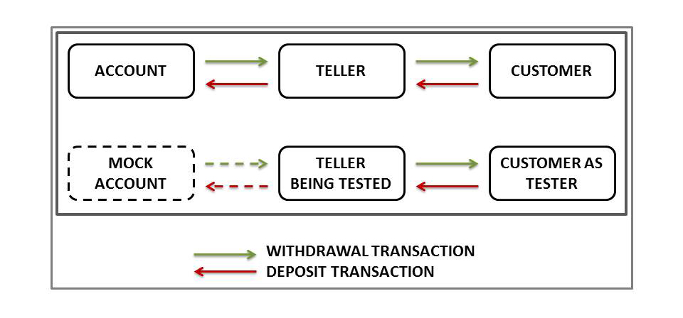
Concept Of Mocking
Mocking:
Is based on the concept that the mock object replaces the real object
Fakes dependencies
Tests objects and interactions with dependencies
Example of mocking: In a bank, there is an account, a teller (SUT), and a customer, as shown.
Notes:
If you have a class Calculator, that needs a dao (Data Access Object) object to load the data it needs from a database, then the dao object is a "real object". In order to test the Calculator class you will have to provide it with a dao object that has a valid connection to the database. In addition you have to insert the data needed for the test into the database.
Setting up the connection and inserting the data in the database can be a lot of work. Instead you can provide the Calculator instance with a fake dao class which just returns the data you need for the test. The fake dao class will not actually read the data from the database. The fake dao class is a mock object. A replacement for a real object which makes it easier to test the Calculator class. Purist mock testers would call such a fake dao for a stub. I will get to that distinction later.
https://www.martinfowler.com/articles/mocksArentStubs.html

Slide 42
Key Phases Of Mocking
Phase – I: Stubbing
Specify how your mock object must behave when involved in an interaction
Phase – II: Setting Expectations
Set a mock object such that it tells what to expect when a test is run
Phase – III: Verification
Verify that the expectations have been met.
It is done before invoking a function of the SUT
It is done after invoking a function of the SUT.

Slide 43
Benefits Of Mocking
In unit testing, mock objects can simulate the behavior of complex, real objects and are especially useful when a real object is impractical.
Benefits
Helps to create tests in advance
Enables working with multiple teams (write test code for source not yet written)
Provides proof of concepts or demos
Interact with customers while ensuring confidentiality
Isolate systems where dependencies exist
Simulate complex, real objects
Notes:
PG Reference: Page 19
Explain that in unit testing as Mock objects can simulate the behavior of complex, real objects and are especially useful when a real object is impractical. Key benefits of mocking are that it enables you to:
Create tests in advance: Using Mock, you can create service tests even before the services are written. As a result, you can add service tests to the test automation environment during the development process. Therefore, with service mocking, you can use TDD in JUnit.
Work with multiple teams: Test code can be created for source that has not yet been written. This means that the QA team can write mocks and test them even before the source code is ready. Therefore, mocking eliminates the need for testing to wait until the development team finishes writing the source code. This saves time and is also a huge financial advantage.
Provide proof of concepts or demos: Creating mocks is cost efficient, which means that you can use mocks to create a proof of concept or demonstrate a concept. You can, therefore, examine the concept beforehand, which gives you the advantage of creating multiple code to arrive on the best code before these are demonstrated.
Interact with customers: Many companies do not allow their clients or customers to access their source code because of security restrictions or inaccessibility of the test environment. In such scenarios, a mock of the system can be developed and provided to the customer for inspection and approval.
Isolate systems: In some scenarios, as a tester you may want to test only one part of a system without interference from the system’s dependencies. Mock is used to remove these dependencies so that the functionality of the system can be tested to identify errors or bugs. For example, an Internet provider has many systems, such as product management, product development and testing, database management, and customer service systems, that help to connect numerous clients to the web. There may be an underlying system that connects all these systems to a single platform. If this platform needs to be tested, obviously all other systems are affected. Creating a mock of the platform isolates it for testing without harming or changing the other systems.
Simulate real objects: Mock objects used in writing mock tests can mimic the behaviors of complex, real objects. Therefore, when creating a real object is not feasible, using mock objects is useful.

Slide 44
When Use Mocking
Use mocking when the class you want to unit test communicates with other classes that have side effects which should only be called in the real production system. Some random examples of such side effects I thought of are:
Charging a credit card or bank account
Printing medical records, invoices, personal documents, etc
Sending an overdue bill notification to a client via email
Sending a request to an external system
Launching weapons into a neighboring enemy solar system
Flooding the reactor core
Shutting down life support
Notes:
https://zeroturnaround.com/rebellabs/how-to-mock-up-your-unit-test-environment-to-create-alternate-realities/
Example :
Create a new business rule regarding the mailing of invoices. Some customers get invoices by email, but others want a physically printed copy of the invoice instead
If you do not mock the printerservice and emailservice, chances are:
An email has reached the test inbox he has created for the imaginary user (not so bad)
A test invoice has been printed to the company printer (very bad!)
He forgot to add any ASSERT code at the end of the tests (DUDE!!!)

Slide 45
Mocking Frameworks
JMOck
EasyMock
Jmockit
Mockachino
Unitils
PowerMock – extends Easymock and Mockito with the ability to mock static, final and private methods

Slide 46
Mockito
Open Source Mocking Framework
Uses the mock testing strategy (called mocking); uses substitutes of objects to validate code
Has a simple coding language
Has a simple coding language
Can mock classes and interfaces, resulting in better coding
Is used to write clean and simple Application Programming Interface, enabling creation and modification of test code
Is user friendly (tests are readable and verification of errors is clean)
Notes:
https://zeroturnaround.com/rebellabs/how-to-mock-up-your-unit-test-environment-to-create-alternate-realities/
Full Mockito package
https://static.javadoc.io/org.mockito/mockito-core/2.2.29/org/mockito/Mockito.html#21

Slide 47
Mockito Implementation
To create JUnit test cases using Mockito:
1. Creating Mock Objects
2. Using Stubs to Set Expectations
3. Verifying Using Mockito

Slide 48
Create Mock Objects
1. Creating Mock Objects
Create mock objects in JUnit by using:
Static mock() method call
@Mock annotation
Mock object is created and used to test the service.
Use the verify () method to ensure that a method is called in a JUnit mock test.
Use the when() thenReturn() syntax to set condition and return a value if true.
If several return values are specified, these will be returned in sequence until the last specified value is returned.
Notes:
PG Reference: Page 20-21
Explain that you can create mock objects in JUnit by using the static mock() method call or the @Mock annotation. If you use annotations, you must initialize the mock objects. The MockitoRule allows this. It invokes the static method MockitoAnnotations.initMocks(this) to initialize the mock objects. Code Segment 3.7 in the PG is an example that shows the use of Mockito.
Alternatively you can use @RunWith(MockitoJUnitRunner.class).
Example: Suppose you have a class named LoginService in your application, which uses a Data Access Object (DAO) to authenticate a user. Code Segment 3.7 in the PG shows how to mock the interaction of LoginService with DAO.
Ask the participants to note how the mock DAO object (implementing the DAO interface) is created and used to test the service. The verify () method is used to make sure that a method is called in a JUnit mock test. You can use the when(…..) thenReturn(….) syntax to set a condition and return a specified value if this condition is found to be true. If you specify more than one return values, these will be returned in sequence until the last specified value is returned. To have a method return the same value always, just specify it once.

Slide 49
Stubs to set expectations
2. Using Stubs to Set Expectations
Create a stub and pass an argument to the method as a mock.
Use the anyInt() method when you cannot predict arguments.
For stubbing void method calls:
The when() method cannot be used.
Use doReturn(result).when(mock_object).void_method_call()
Returns a specific value for the void method
Exceptions using thenThrow() or doThrow()
Notes:
PG Reference: Page 19
Explain that in unit testing as Mock objects can simulate the behavior of complex, real objects and are especially useful when a real object is impractical. Key benefits of mocking are that it enables you to:
Create tests in advance: Using Mock, you can create service tests even before the services are written. As a result, you can add service tests to the test automation environment during the development process. Therefore, with service mocking, you can use TDD in JUnit.
Work with multiple teams: Test code can be created for source that has not yet been written. This means that the QA team can write mocks and test them even before the source code is ready. Therefore, mocking eliminates the need for testing to wait until the development team finishes writing the source code. This saves time and is also a huge financial advantage.
Provide proof of concepts or demos: Creating mocks is cost efficient, which means that you can use mocks to create a proof of concept or demonstrate a concept. You can, therefore, examine the concept beforehand, which gives you the advantage of creating multiple code to arrive on the best code before these are demonstrated.
Interact with customers: Many companies do not allow their clients or customers to access their source code because of security restrictions or inaccessibility of the test environment. In such scenarios, a mock of the system can be developed and provided to the customer for inspection and approval.
Isolate systems: In some scenarios, as a tester you may want to test only one part of a system without interference from the system’s dependencies. Mock is used to remove these dependencies so that the functionality of the system can be tested to identify errors or bugs. For example, an Internet provider has many systems, such as product management, product development and testing, database management, and customer service systems, that help to connect numerous clients to the web. There may be an underlying system that connects all these systems to a single platform. If this platform needs to be tested, obviously all other systems are affected. Creating a mock of the platform isolates it for testing without harming or changing the other systems.
Simulate real objects: Mock objects used in writing mock tests can mimic the behaviors of complex, real objects. Therefore, when creating a real object is not feasible, using mock objects is useful.

Slide 50
Verify
3. Verifying Using Mockito
Use the verify() method to verify whether the set expectations are met.
The verify() method can check whether a behavior happened:
Once or twice
Multiple times
Never
By verifying the set expectations, errors in the code being detected can be determined.
Debug code if the expectations are not met.
Notes:
PG Reference: Page 19
Explain that in unit testing as Mock objects can simulate the behavior of complex, real objects and are especially useful when a real object is impractical. Key benefits of mocking are that it enables you to:
Create tests in advance: Using Mock, you can create service tests even before the services are written. As a result, you can add service tests to the test automation environment during the development process. Therefore, with service mocking, you can use TDD in JUnit.
Work with multiple teams: Test code can be created for source that has not yet been written. This means that the QA team can write mocks and test them even before the source code is ready. Therefore, mocking eliminates the need for testing to wait until the development team finishes writing the source code. This saves time and is also a huge financial advantage.
Provide proof of concepts or demos: Creating mocks is cost efficient, which means that you can use mocks to create a proof of concept or demonstrate a concept. You can, therefore, examine the concept beforehand, which gives you the advantage of creating multiple code to arrive on the best code before these are demonstrated.
Interact with customers: Many companies do not allow their clients or customers to access their source code because of security restrictions or inaccessibility of the test environment. In such scenarios, a mock of the system can be developed and provided to the customer for inspection and approval.
Isolate systems: In some scenarios, as a tester you may want to test only one part of a system without interference from the system’s dependencies. Mock is used to remove these dependencies so that the functionality of the system can be tested to identify errors or bugs. For example, an Internet provider has many systems, such as product management, product development and testing, database management, and customer service systems, that help to connect numerous clients to the web. There may be an underlying system that connects all these systems to a single platform. If this platform needs to be tested, obviously all other systems are affected. Creating a mock of the platform isolates it for testing without harming or changing the other systems.
Simulate real objects: Mock objects used in writing mock tests can mimic the behaviors of complex, real objects. Therefore, when creating a real object is not feasible, using mock objects is useful.

Slide 51
@InjectMocks
Use the verify() method to verify whether the set expectations are met.
The verify() method can check whether a behavior happened:
Once or twice
Multiple times
Never
By verifying the set expectations, errors in the code being detected can be determined.
Debug code if the expectations are not met.
Notes:
https://tedvinke.wordpress.com/2014/02/13/mockito-why-you-should-not-use-injectmocks-annotation-to-autowire-fields/

Slide 52
Best Practices

Slide 53
What You Should Not Test
Other framework libraries (you should assume they work correctly)
The database (you should assume it works correctly when it is available)
Other external resources (again you assume they work correctly when available)
Really trivial code (like getters and setters for example)
Code that has non deterministic results (Think Thread order or random numbers)
Code that deals only with UI (e.g. Swing toolkit, Wicket)
Notes:
https://zeroturnaround.com/rebellabs/dont-test-blindly-the-right-methods-for-unit-testing-your-java-apps/
Funny story: When I was just starting to get into code and learned about unit tests, the first thing I did was write a test that saved an Entity on the database using Hibernate, read it back and then verified that it is the same. Turns out that writing unit tests against your own database or Hibernate is not very productive. Awesome :-/

Slide 54
What You Should Focus on
Notes:
the highlighted part in gold is where you should focus your testing efforts. This is the part of the code where usually most bugs manifest. It is also the part that changes a lot as user requirements change since it is specific to your application.

Slide 55
Prioritize Things
Write tests for the following:
Core code that is accessed by a lot of other modules
Code that seems to gather a lot of bugs
Code that changes by multiple different developers (often to accommodate new requirements)

Slide 56
Code Coverage
Write tests for the following:
Part of your code “touched” by unit tests is Code Coverage.
Code coverage is the percentage that shows to what depth your internal checks affect your Java classes. To obtain this metric, you can run one of multiple tools available for this purpose.
Jcov
JaCoCo
CloverSerenity
TestWell
Eclemma – Eclipse Plugin
Cobertura
EMMA
JUNIT5 CHEATSHEET

Slide 57
Assignments

Slide 58
Assignment 1
Implement a class Car with the following properties. A car has a certain fuel efficiency (measured in miles gallon or liters km—pick one) and a certain amount of fuel in the gas tank. The efficiency is specified in the constructor, and the initial fuel level is 0.
Supply a method drive that simulates driving the car for a certain distance, reducing the amount of gasoline in the fuel tank. Also supply methods getGasInTank, returning the current amount of gasoline in the fuel tank, and addGas, to add gasoline to the fuel tank. Sample usage:
Car myHybrid = new Car(50); // 50 miles per gallon myHybrid.addGas(20); // Tank 20 gallons myHybrid.drive(100); // Drive 100 miles double gasLeft = myHybrid.getGasInTank(); // Get gas remaining in tank
You may assume that the drive method is never called with a distance that consumes more than the available gas. Supply a CarTester class that tests all methods.

Slide 59
Assignment 1
Write a tester class that tests a scenario in which gas is added to the car, the car is driven, more gas is added, and the car is driven again. Print the actual and expected amount of gas in the tank.

Slide 60
Assignment 2
Implement a class Employee. An employee has a name (a string) and a salary (adouble). Provide a constructor with two arguments
public Employee(String employeeName, double currentSalary)
and methods
public String getName() public double getSalary() public void raiseSalary(double byPercent)
These methods return the name and salary, and raise the employee’s salary by a certain percentage.
Sample usage:
Employee harry = new Employee("Hacker, Harry", 50000); harry.raiseSalary(10); // Harry gets a 10 percent raise
Supply an EmployeeTester class that tests all methods.

Slide 61
Assignment 2
Class person
Total = 0
Calcalories(weight)
If(weight <0)
wieght = 0
Total = total + weight
Client – change reqt ( weight cannot be –ve)
-

