Slide 1
Docker Compose
Shalini Mittal
Corporate Trainer

Slide 2
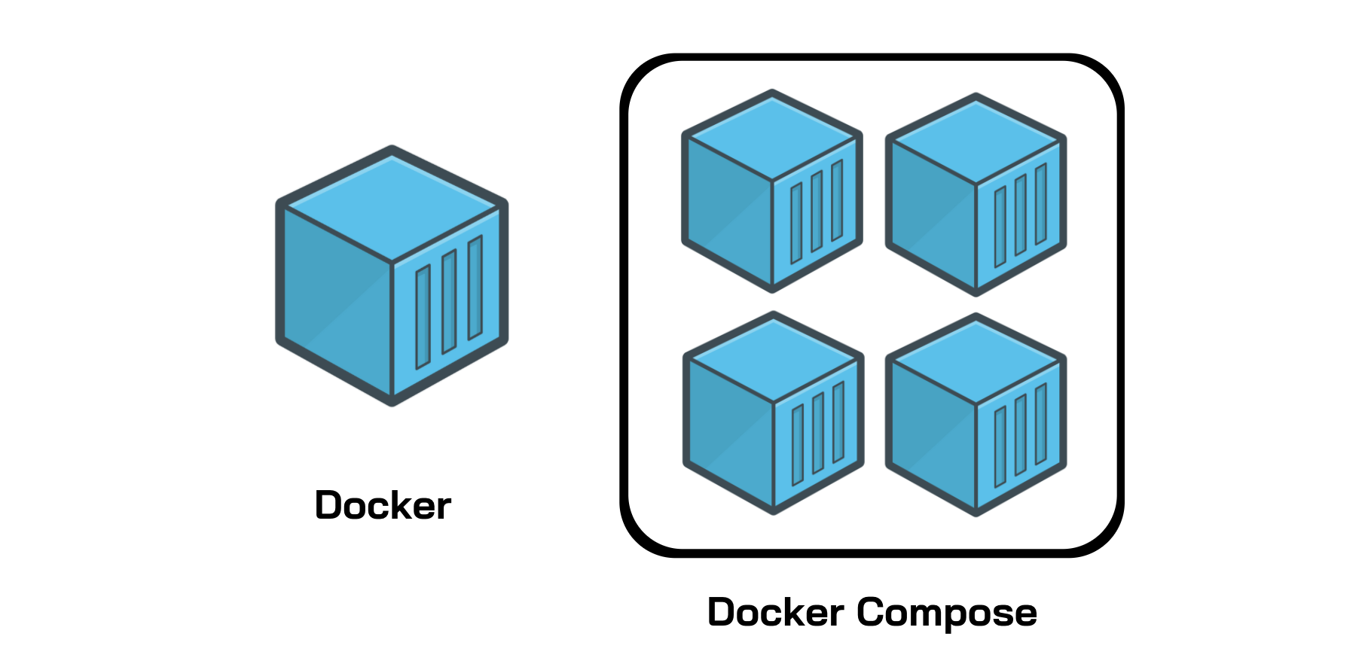
Docker Compose ?
Docker tool used to define and run multi-container applications.
With Compose, use a YAML file to configure your application’s services and create all the app’s services from that configuration.
Think of docker-compose as an automated multi-container workflow.
Compose is an excellent tool for development, testing, CI workflows, and staging environments.
According to the Docker documentation, the most popular features of Docker Compose are:
Multiple isolated environments on a single host
Preserve volume data when containers are created
Only recreate containers that have changed
Variables and moving a composition between environments
Orchestrate multiple containers that work together

Slide 3
Steps to use compose
Once you have Docker Compose downloaded and running properly, you can start using it with your Dockerfiles. This process requires three basic steps:
Define your app’s environment using a Dockerfile. This way, it can be reproduced.
Define the services for your app in a docker-compose.yml file. This way, they can run in an isolated environment.
Run docker-compose to start your app.

Slide 4
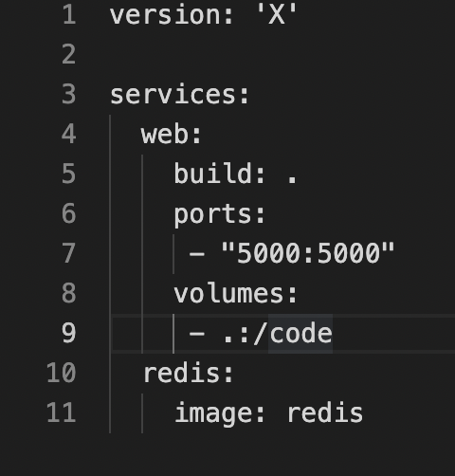
Docker compose file structure
Docker Compose files work by applying multiple commands that are declared within a single docker-compose.yml configuration file.
The basic structure of a Docker Compose YAML file looks like this:

Slide 5
Compose file parts
version ‘3’: denotes that we are using version 3 of Docker Compose, and Docker will provide the appropriate features.
services: defines all the different containers we will create.
web: name of our Flask app service. Docker Compose will create containers with the name we provide.
build: specifies the location of Dockerfile, and . represents the directory where the docker-compose.yml file is located.
ports: This is used to map the container’s ports to the host machine.
volumes: This is just like the -v option for mounting disks in Docker.
links: This will link one service to another. For the bridge network, we must specify which container should be accessible to which container using links.
image: If we don’t have a Dockerfile and want to run a service using a pre-built image, we specify the image location using the image clause. Compose will fork a container from that image.
environment: The clause allows us to set up an environment variable in the container. This is the same as the -e argument in Docker when running a container.

Slide 6
Compose commands – 1/2
docker-compose: Every Compose command starts with this command. You can also use docker-compose <command> --help to provide additional information about arguments and implementation details. docker-compose --help
docker-compose build: This command builds images in the docker-compose.yml file. The job of the build command is to get the images ready to create containers, so if a service is using the prebuilt image, it will skip this service
docker-compose images: This command will list the images you’ve built using the current docker-compose file.
docker-compose stop: This command stops the running containers of specified services.
docker-compose run: This is similar to the docker run command. It will create containers from images built for the services mentioned in the compose file

Slide 7
Compose Commands – 2/2
docker-compose up: This command does the work of the docker-compose build and docker-compose run commands. It builds the images if they are not located locally and starts the containers. If images are already built, it will fork the container directly
docker-compose ps: This command list all the containers in the current docker-compose file. They can then either be running or stopped.
docker-compose down: This command is similar to the docker system prune command. However, in Compose, it stops all the services and cleans up the containers, networks, and images.
Notes:
AWS services are region scoped, hence a service in 1 region is not available in other region

Slide 8
Spring Boot compose
Update the SpringBootDockerDemo project created earlier
Add the following in properties file : spring.data.mongodb.host=mongo_db # this is name of service spring.data.mongodb.port=27017 spring.data.mongodb.database=test
Update the Dockerfile as follows : FROM openjdk:11 EXPOSE 8081 WORKDIR /app # Copy maven executable to the image COPY mvnw . COPY .mvn .mvn # Copy the pom.xml file COPY pom.xml . # Copy the project source COPY ./src ./src COPY ./pom.xml ./pom.xml RUN chmod 755 /app/mvnw RUN ./mvnw clean package –DskipTests ENTRYPOINT ["java","-jar","target/spring-mongo.jar"]

Slide 9
Docker-compose.yml
version: "3" services:
mongo_db:
image: mongo
container_name: mongo
restart: always
ports:
- 27017:27017
userservice: #it is just a name , which will be used only in this file.
image: user-service #name of the image after dockerfile executes
container_name: user-service-app #name of the container created from docker image
build:
context: . #docker file path (. means root directory)
dockerfile: Dockerfile #docker file name
ports:
- "8080:8080" #docker containter port with your os port
restart: always
depends_on: #define dependencies of this app
- mongo_db #dependency name (which is defined with this name 'db' in this file earlier)
Notes:
example.
Suppose, you have five test cases, one method is written for each test case (Assume that the program is written using the main method without using testNG). When you run this program first, three methods are executed successfully, and the fourth method is failed. Then correct the errors present in the fourth method, now you want to run only fourth method because first three methods are anyway executed successfully. This is not possible without using TestNG

Slide 10
Deploy Spring boot on container
Execute below command from the root folder of docker-compose.yml file: docker-compose up
Notes:
example.
Suppose, you have five test cases, one method is written for each test case (Assume that the program is written using the main method without using testNG). When you run this program first, three methods are executed successfully, and the fourth method is failed. Then correct the errors present in the fourth method, now you want to run only fourth method because first three methods are anyway executed successfully. This is not possible without using TestNG

Slide 11
References
https://takacsmark.com/docker-compose-tutorial-beginners-by-example-basics/#what-is-docker-compose
https://spring.io/guides/topicals/spring-boot-docker/#a-better-dockerfile
Notes:
example.
Suppose, you have five test cases, one method is written for each test case (Assume that the program is written using the main method without using testNG). When you run this program first, three methods are executed successfully, and the fourth method is failed. Then correct the errors present in the fourth method, now you want to run only fourth method because first three methods are anyway executed successfully. This is not possible without using TestNG

Slide 12

Any Question ?

Slide 13


7738460004 shalini06mittal@gmail.com
Thank you !

