Slide 1
Spring Framework
Shalini Mittal
Corporate Trainer

Slide 2
What we will Cover?
Life without Spring!!!
Need for Spring
Introduction to Spring.
Spring Architecture
Spring Framework
Spring Container
Spring Installation
Spring Configuration
Spring IOC, Beans and ApplicationContext
Notes:
https://springframework.guru/spring-framework-annotations/

Slide 3
The Spring Triangle
Simple
Object
Dependency Injection
Aspect Oriented Programming
Enterprise Service Abstractions
JMS
JCA
JDBC
EJB

Slide 4
Goal of Spring framework
Provide comprehensive infrastructural support for developing enterprise Java applications
      Spring deals with the plumbing
      So you can focus on solving the domain problem
  The essence of Spring is in providing enterprise services to Plain Old
  Java Objects (POJOs).
  This is particularly valuable in a J2EE environment, but application code
  delivered as POJOs is naturally reusable in a variety of runtime
  environments.
Notes:
http://www.wrox.com/WileyCDA/Section/Why-Use-the-Spring-Framework-.id-130098.html

Slide 5
Spring advantage
Make a Java method execute in a database transaction without having to deal with the transaction APIs
Make a local Java method a remote procedure without having to deal with remote APIs
Make a local Java method a management operation without having to deal with JMX APIs
Make a local Java method a message handler without having to deal with JMS APIs

Slide 6
What is Dependency Injection?
A typical application system consists of several parts working together to carry out a use case
Component A
Component B
Component C
Component D
DataSource

Slide 7
Before Spring…
public class HelloWorld {
public static void main(String[] args) {
System.out.println("Hello World");}}
Any Problem with this program?
How to change the message or source of message.
How to change the output channel, maybe stderr or text in html.
Not very Extensible…
Notes:
/**
* As far as examples go, this one is pretty simple—it does the job, but it is not very extensible. What if
we want to change the message? What if we want to output the message differently, maybe to stderr
instead of stdout or enclosed in HTML tags rather than as plain text?
*/

Slide 8
Alternative…
if(args.length > 0) {
System.out.println(args[0]);
} else {
System.out.println("Hello World!");
}
The renderer and message provider are tightly coupled.
Not cohesive
Cannot change the source of message and the renderer easily.

Slide 9
Better Solution
Refactor the rendering and message retrieval logic into separate components.
Let these components implement interfaces and define the interdependencies between the components and the launcher using these interfaces.
public interface MessageRenderer {
public void render();
public void setMessageProvider(MessageProvider provider);
public MessageProvider getMessageProvider();}
public interface MessageProvider {
public String getMessage();}

Slide 10
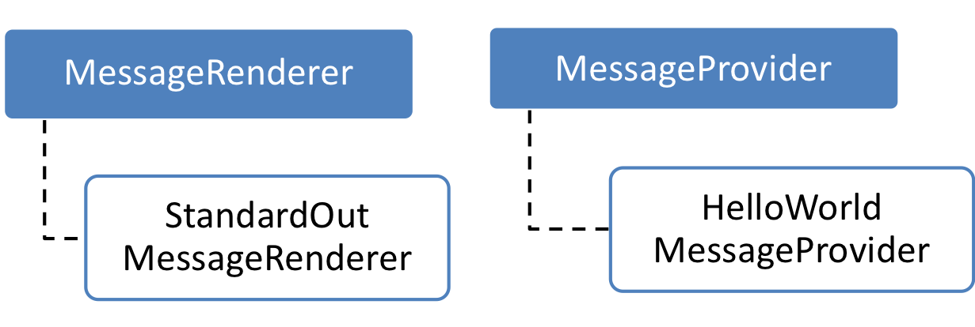
Let’s Understand the solution…
<<depends>>
public static void main(String[] args) {
MessageRenderer mr = new StandardOutMessageRenderer();
MessageProvider mp = new HelloWorldMessageProvider();
mr.setMessageProvider(mp);
mr.render();
}
Implementation class names are hardcoded.

Slide 11
Enhancing The Solution…
Create a simple factory class that reads the implementation class names from a properties file and instantiates them on behalf of the application
private static MessageSupportFactory instance = null;
private Properties props = null;
private MessageRenderer renderer = null;
private MessageProvider provider = null;
private MessageSupportFactory() {
  props = new Properties();
  props.load(new FileInputStream("msf.properties"));
  // get the implementation classes
  String rendererClass = props.getProperty("renderer.class");
  String providerClass = props.getProperty("provider.class");
  renderer = (MessageRenderer)
  Class.forName(rendererClass).newInstance();
  provider = (MessageProvider)
  Class.forName(providerClass).newInstance();
  }

Slide 12
What we want?
public static void main(String[] args) {
MessageRenderer mr = //get StandardOutMessageRenderer instance
mr.render();
}

Slide 13
But how?
To achieve this, we need someone who can manage the components and it’s dependencies
The term Container which is commonly used in EE, is also used by Spring and is referred to as an IoC (Inversion of Control) Container
Spring provides a Container/Factory/Context which manages
    Component instantiation and initialization
    Component dependencies
    Services wrapped around those Components

Slide 14
Advantages of DI
Reduce glue code.
Externalize dependencies.
Manage dependencies in a single place.
Improve testability.
Foster good application design.
Notes:
https://martinfowler.com/articles/injection.html

Slide 15
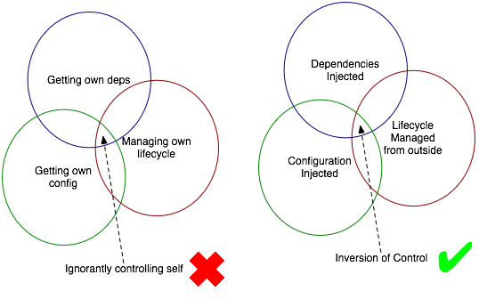
loC Concepts
Notes:
Understanding inversion of control: Inversion of control is at the heart of the Spring framework. As seen earlier, any non-trivial application is made up of two or more classes that collaborate with each other to perform some business logic. Traditionally, each object is responsible for obtaining its own references to the objects it collaborates with (its dependencies). This can lead to a highly coupled and hard-to-test code.
Applying IoC, objects are given their dependencies at creation time by some external entity that coordinates each object in the system ie dependencies are injected into objects. So, IoC means an inversion of responsibility with regard to how an object obtains references to collaborating objects.
Dependency injection is kind of an Inversion of Control pattern. The term dependency injection describes the process of providing (or injecting) a component with the dependencies it needs, in an IoC fashion. Dependency Injection proposes separating the implementation of an object and the construction of objects that depend on them.
Dependency injection is a form of PUSH configuration; the container pushes dependencies into application objects at runtime. This is opposite to the traditional PULL configuration in which the app object pulls dependencies from its environment.
In the figure, we have application objects offering external services. The application components depend on these external services. The job of coordinating the implementation and construction is left to the assembler code, which In this case would be the spring IoC framework.

Slide 16
What is Spring Framework?
An open source framework created by Rod Johnson, Juergen Hoeller et all
Lightweight container in terms of size and overhead.
Promotes loose coupling through DI and IOC
Creates the Java Components for your application and manages their life-cycle.
Supports AOP which enables development by separating business logic from system services (such as logging or transaction management).
Data access support
MVC support
Transaction Management
Integration with other framework
Authentication and authorization framework
Unit Testing made simple with use of POJO’s and mocking interfaces.
Notes:
Spring is non-intrusive; objects in a Spring-enabled application typically have no dependencies on Spring-specific classes.
2 mb size min

Slide 17
Why Spring Framework?
Simplifies complexity of application.
Takes Care of dependencies by autowiring java objects
Lifecycle managed by spring container
Secure way to handle forms and logins
Comes with various design patterns
Leverages existing frameworks and technologies
Convention over configuration provides Rapid Application development.
Spring uses callback interfaces to allow clean acquisition and release of resources such as JDBC Connections.
There's little or no lock-in to a particular framework, or proprietary code, for configuration management.
Writes boiler plate code that reduces development time and hence developers focus on WHAT rather than HOW.
Notes:
Spring is non-intrusive; objects in a Spring-enabled application typically have no dependencies on Spring-specific classes.
2 mb size min

Slide 18
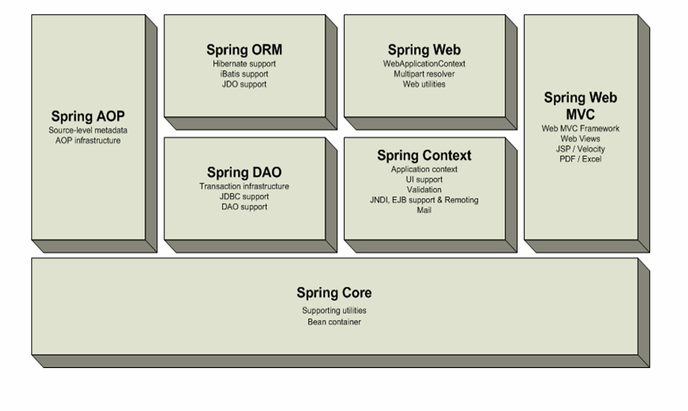
Spring Core Modules
Notes:
.

Slide 19
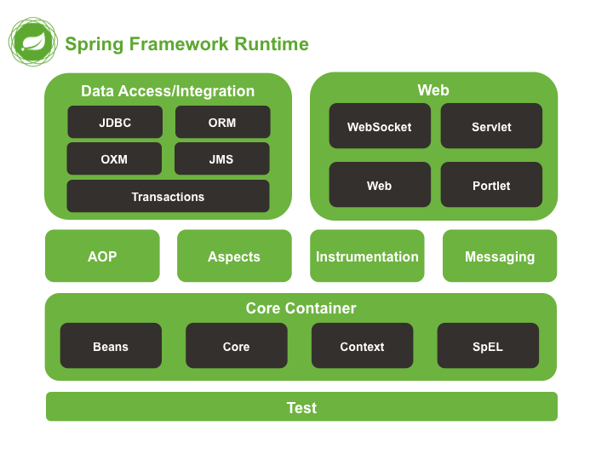
Cont’d…

Slide 20
Spring Framework – Core Modules
The core container
  Provides the fundamental functionality of the Spring Framework containing the BeanFactory, which is the fundamental Spring container and the basis on which Spring’s DI is based.
Application context module
  Built on the core container making Spring a Framework.
  Provides support for i18n, application life cycle events and validation.
  Provides enterprise services such as email, JNDI access, EJB integration etc.
Notes:
The core module’s BeanFactory makes Spring a container, but the context module is what makes it a framework.

Slide 21
Spring Framework – Core Modules
AOP module
  This module serves as the basis for developing your own aspects for your Spring enabled application. With AOP, application wide concerns (such as transactions and auditing) are decoupled from the objects to which they are applied.
JDBC abstraction and the DAO module
  It abstracts away the common code like opening and closing connections, so that you can keep your database code clean and simple.

Slide 22
Spring Framework – Core Modules
Object-relational mapping (ORM) integration module.
  Built on top of DAO module
    Spring doesn’t attempt to implement its own ORM solution, but does provide hooks into several popular ORM frameworks, including Hibernate, JPA and iBATIS.
The Spring MVC framework
  Spring comes with its own MVC framework and even it can integrated with existing popular MVC frameworks like Struts, JSF, and Tapestry.

Slide 23
Java EE Vs Spring
Heavyweight application server having server centric architecture.
Components inside container must implement specific interfaces and mandates inheritance hierarchy.
Components must be tested within container only, thus testing can be difficult.
The cycle of “build, unit-test, deploy, integration-test” can be time taking.
Lightweight framework WITHOUT server centric architecture.
Components are simple POJO objects which can be reused outside Spring framework as well.
POJOs created can be easily unit tested outside any complex container.
The build-and-unit-test cycle can be decoupled from container and integration cycle is improved because of POJO centric design of beans.

Slide 24
Typical JEE Applications
Application Server
Web/Presentation Layer
Business Layer
Persistent Layer
?
?
?

Slide 25
Where does Spring fits?
Application Server
Web/Presentation Layer
Business Layer
Persistent Layer
Spring MVC, Struts, JSF
Spring, EJB, WebServices, Scheduled Tasks
Hibernate, JPA, Spring Templates, Spring Data

Slide 26
Spring Installation
Eclipse mars or up
JDK7 or up
Spring Core Jars
Notes:
Spring is non-intrusive; objects in a Spring-enabled application typically have no dependencies on Spring-specific classes.
2 mb size min

Slide 27
Spring Beans and Configuration Metadata
In Spring, the term “bean” is used to refer to any component managed by the container.
Spring meta-data configuration can be …
  XML based
  Java based : Annotations
Java based configurations are recommended practice since inclusion of Spring JavaConfig project
Spring Beans and Configuration Metadata is combined and the Spring Framework’s IoC container is created & initialized
Spring IoC container is decoupled from configuration metadata format
Notes:
Spring is non-intrusive; objects in a Spring-enabled application typically have no dependencies on Spring-specific classes.
2 mb size min

Slide 28
Spring Beans Maven Project
Add following dependencies:
  <dependency>
  <groupId>org.springframework</groupId>
  <artifactId>spring-context</artifactId>
  <version>5.0.1.RELEASE</version>
  </dependency>
  <dependency>
  <groupId>org.springframework</groupId>
  <artifactId>spring-core</artifactId>
  <version>5.0.1.RELEASE</version>
  </dependency>
Notes:
Spring is non-intrusive; objects in a Spring-enabled application typically have no dependencies on Spring-specific classes.
2 mb size min

Slide 29
Spring Beans Gradle Project
plugins{
id 'java'
}
group 'org.example'
version '1.0-SNAPSHOT'
repositories {
mavenCentral()
}
dependencies {
testCompile group: 'junit', name: 'junit', version: '4.12'
compile 'org.springframework:spring-context:5.3.3'
}
Notes:
Spring is non-intrusive; objects in a Spring-enabled application typically have no dependencies on Spring-specific classes.
2 mb size min

Slide 30

Spring IOC Container
The IoC container is an implementation of BeanFactory interface
Then we have ApplicationContext and WebApplicationContext derived from it for adding additional capabilities
The most commonly used form of IoC container is the ApplicationContext implementation
Notes:
Spring is non-intrusive; objects in a Spring-enabled application typically have no dependencies on Spring-specific classes.
2 mb size min

Slide 31
Contd…
When the container is loaded, it gets its instructions on what objects to instantiate, configure, and assemble by reading configuration metadata.
It composes the application and interdependencies between the objects
At this stage, the application is fully configured and ready to use
The Spring IOC Container manages the entire lifecycle of the Spring Beans

Slide 32
Spring Configuration
A typical Spring configuration will have, at minimum, the following structure:
Within the <beans> element, you'll place bean declarations and other elements that configure your application's context.
<?xml version="1.0" encoding="UTF-8"?>
<beans xmlns="http://www.springframework.org/schema/beans"
xmlns:xsi="http://www.w3.org/2001/XMLSchema-instance"
xsi:schemaLocation=" http://www.springframework.org/schema/beans http://www.springframework.org/schema/beans/spring-beans-3.0.xsd">
<!-- <bean/> definitions here -->
</beans>
Add <bean> tags here

Slide 33
Example :
Lets take the sample code of message provider and renderer.
Create a configuration file spring-context.xml in the project classpath.
In the configuration file add the following :
Create a class with main method and write the following code :
<bean id="provider" class="decoupled.HelloWorldMessageProvider" />
<bean id="renderer" class="decoupled.StandardOutMessageRenderer”/>
ApplicationContext ctx = new ClassPathXmlApplicationContext(”spring-context.xml");
MessageRenderer mr = (MessageRenderer) ctx.getBean("renderer");
MessageProvider mp = (MessageProvider) ctx.getBean("provider");
mr.setMessageProvider(mp);
mr.render();
Notes:
ApplicationContext: It loads spring beans configured in spring configuration file,and manages the life cycle of the spring bean as and WHEN CONTAINER STARTS.It won't wait until getBean("springbeanref") is called.
BeanFactory It loads spring beans configured in spring configuration file,manages the life cycle of the spring bean when we call the getBean("springbeanref").So when we call the getBean("springbeanref") at the time of spring bean life cycle starts.

Slide 34
Bean Container concept:
The container or bean factory is at the core of the Spring framework and uses IoC to manage components.
Bean factory is responsible to create and dispense beans.
It takes part in the life cycle of a bean, making calls to custom initialization and destruction methods, if those methods are defined.
Spring has two types of containers:
  Bean factories that are the simplest, providing basic support for dependency injection
  Application contexts that build on bean factory by providing application framework services
Notes:
https://docs.spring.io/spring/docs/1.2.x/reference/beans.html

Slide 35
ApplicationContext
Provides application framework services such as :
  Resolving text messages, including support for internationalization of these messages
  Load file resources, such as images
  Publish events to beans that are registered as listeners
Many implementations of application context exist:
  AnnotationConfigApplicationContext
  AnnotationConfigWebApplicationContext
  ClassPathXmlApplicationContext
  FileSystemApplicationContext
  XmlWebApplicationContext
Notes:
https://docs.spring.io/spring/docs/3.2.x/spring-framework-reference/html/beans.html

Slide 36
ApplicationContext Implementations
ClassPathXmlApplicationContext : It Loads context definition from an XML file located in the classpath, treating context definitions as classpath resources. The application context is loaded from the application’s classpath by using the code .
ApplicationContext ctx = new ClassPathXmlApplicationContext(“bean.xml”);
FileSystemXmlApplicationContext : It loads context definition from an XML file in the filesystem. The application context is loaded from the file system by using the code .
ApplicationContext context = new FileSystemXmlApplicationContext(“bean.xml”);
XmlWebApplicationContext : It loads context definition from an XML file contained within a web application.
AnnotationConfig and AnnotationConfigWeb ApplicationContext are used to load beans created in java file.

Slide 37
ThankYou

