Slide 1
JUNIT 5.0
Shalini Mittal
Corporate Trainer

Slide 2
Course Objectives
By the end of this course, you will be able to:
Describe the need for JUNIT5.
Describe the test lifecycle.
JUNIT Essentials
JUNIT Features
JUNIT Fixtures
JUNIT Annotations
JUNIT Assertions

Slide 3
Unit Testing

Slide 4
Introduction To UnitTesting
Upon completion of this course, you will learn about:
JUnit essentials
Installation of Junit
JUnit and its purpose.
Concepts of testing.
Write a simple test case.
Execute a test case to check the results.
Creation of mocks
Testing the mock using the Mockito Framework
Notes:
https://zeroturnaround.com/rebellabs/why-your-next-cloud-app-will-probably-suck-without-unit-testing/

Slide 5
Overview of JUNIT
A unit testing framework that is extensively used to test the code written in Java.
Unit testing is a type of software testing.
Software testing: The process of examining whether the software and its components meet the specified requirements
Other types of software testing are as shown.
Beta Testing
Regression Testing
Acceptance Testing
Functional Testing
System Testing
Unit Testing
Integration Testing
Performance Testing
Usability Testing
http://junit.org/junit4/faq.html - FAQ
Notes:
PG Reference: Page 6-7
Explain to participants that JUnit is a unit testing framework, which is used to write repeatable tests.
Ask participants what do they know about unit testing.
Explain that unit testing is a type of software testing (process of examining whether the software and its components meet the specified requirements). After development, software is tested to evaluate it for aspects such as reliability, user-friendliness, functionality, effectiveness, and efficiency. In addition, testing helps to identify and fix errors or bugs in the software. Therefore, software testing is critical for the successful implementation of the software.
On the basis of the components or functions of the code being tested and the number of tests conducted on the same code, software testing is categorized into several types.
Show the different types of software testing on the slide. Ask participants if they can explain each type. Summarize the following for all participants:
Unit testing: Testing small bits or units of code for efficiency and workability
Integration testing: Testing groups of individual units of software to check whether they work well together
Functional testing: Is quality assurance testing, which checks the functionality of the software and compares the expected and actual output
System testing: Testing the complete system to verify its compliance with design specifications
Stress testing: Testing the software performance by deliberately placing it under stress
Performance testing: Testing the responsiveness and stability of a system in a particular condition
Usability testing: Testing the software on selected users to investigate its user-friendly features
Acceptance testing: Testing performed by selected users to check the functionality of the system
Regression testing: Testing software for bugs after changes or patches have been made
Beta testing: Testing the software on external users
Since the JUnit framework provides a platform for performing unit testing on Java-based applications, a better understanding of unit testing will help you use JUnit more effectively.

Slide 6
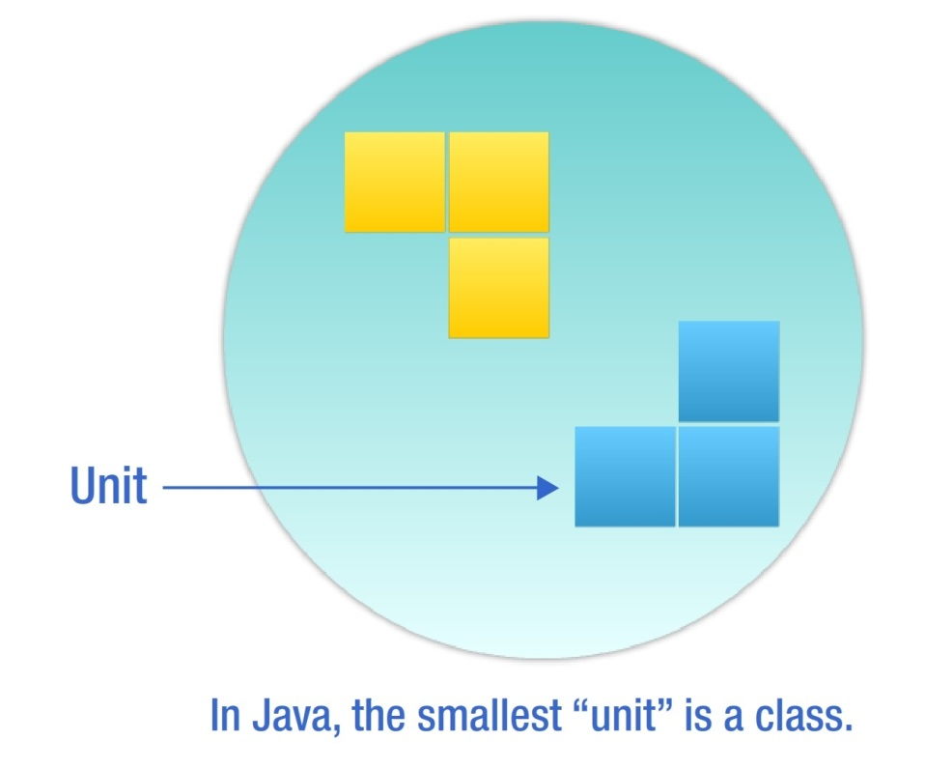
Unit Testing
Unit testing:
Is performed to validate the tester’s assumptions about the code design.
Is an effective method of testing. Each part of the program is isolated to determine which individual parts are correct
Involves testing the smallest unit of code under a variety of input conditions.
Notes:
PG Reference: Page 7-8
Ask participants to share what they know about unit testing.
Explain that unit testing is performed to validate the tester’s assumptions about the design of the code, which means that it helps to check whether the code is doing what it is designed to do.
Explain that unit testing is an effective method of testing since by isolating each part of the program, it helps to determine which individual parts are correct. During a unit test, when the code is executed but the desired task is not performed, errors are identified and subsequently fixed.
Unit testing requires you to test the smallest unit of code under a variety of input conditions. In Java, this smallest unit of code is a class. Ask participants to share some examples of a class.

Slide 7
Benefits of Unit Testing
The key benefits of unit testing are:
Ability to re-factor code with confidence
Proof that your code actually works
Availability of a regression-test suite
Demonstration of concrete progress
Developers use unit tests as an internal control on the functionality and compatibility of their applications when changes to features, code or the environment happen.
Notes:
PG Reference: Page 8 - 9
Discuss the benefits of unit testing.
Ability to re-factor code with confidence: JUnit enables developers to re-factor code with confidence and by running the existing test cases, it makes sure that no new bugs are introduced.
Proof that your code actually works: Results in fewer bugs and better code
Availability of a regression-test suite: JUnit provides a low-effort way to catch bugs before the build goes off to QA.
Demonstration of concrete progress: Unit tests help you to demonstrate progress in parts and not wait for the entire code to be ready before it can be tested.
Fowler draws a clean line between changes to code that do, and those that do not, affect its behavior. He calls those that do not, "refactoring". This is an important distinction, because if we divide our work into refactoring and non-refactoring code modification activities (Fowler calls it "wearing different hats"), we can apply different, goal-appropriate techniques.
If we are making a refactoring, or behavior-preserving code modification:
all our unit tests should pass before and after the modification
we should not need to modify any tests, or write any new ones
we expect cleaner code when we are done
we do not expect new behavior
If we are making a behavior-changing code modification:
we expect new behavior
we should write new tests
we may get dirtier code when we are done (and should then refactor it)

Slide 8
JUNIT Features
Asserts
Specify the expected output and compare it with the output received
Test setup and teardown
Sets up test data and tears down that data or context, before and after running the test, respectively
Exception testing
Tests and verifies whether an exception was thrown
Test suites
JUnit test cases are organized into test suites for better management
Parameterized testing
Creates tests that operate on sets of data that are fed into the tests
Rules
Extend the functionality of Junit by adding behaviors to tests
Integration with popular build systems
Integrates with most of the popular build systems for Java, including ANT and Maven
Notes:
. JUnit is packaged as a single jar file that is a library of functionality of unit testing code. For example, when you write unit testing code, you need a way to compare the output received with the output expected. JUnit provides you asserts and many ways of using them on common data types.

Slide 9
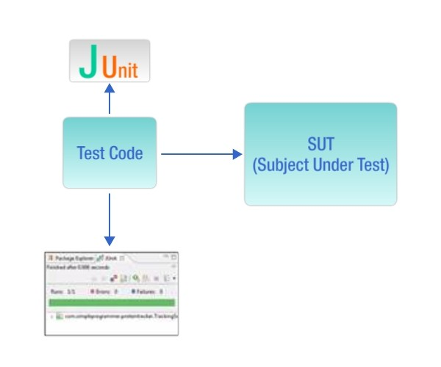
How JUNIT Works
To test using JUnit:
Create a separate project for writing tests that test an SUT.
Use a JUnit runner to execute the test code. The runner:
Determines the tests that exist in the test code
Executes the tests
Reports the results, including reporting to a graphical view
Writing JUnit tests in an IDE helps you to get quick feedback regarding a test passing or failing.
Notes:
It is entirely possible that a product passes when verified but fails when validated. This can happen when, say, a product is built as per the specifications but the specifications themselves fail to address the user’s needs.
Regulatory – lifts in the building, needs to have a certified note that its been verified

Slide 10
JUnit5
Unlike previous versions of JUnit, JUnit 5 is composed of several different modules from three different sub-projects. JUnit 5 = JUnit Platform + JUnit Jupiter + JUnit Vintage
JUnit 5 requires Java 8 (or higher) at runtime. However, you can still test code that has been compiled with previous versions of the JDK.
JUnit Platform To be able to launch junit tests, IDEs, build tools or plugins need to include and extend platform APIs. It defines the TestEngine API for developing new testing frameworks that runs on the platform. It also provides a Console Launcher to launch the platform from the command line and build plugins for Gradle and Maven.
JUnit Jupiter It includes new programming and extension models for writing tests. It has all new junit annotations and TestEngine implementation to run tests written with these annotations.
JUnit Vintage It primary purpose is to support running JUnit 3 and JUnit 4 written tests on the JUnit 5 platform. It’s there are backward compatibility.

Slide 11
JUnit5 Annotations – 1/3
Annotation | Description
@Test | Denotes that a method is a test method. Unlike JUnit 4’s @Test annotation, this annotation does not declare any attributes, since test extensions in JUnit Jupiter operate based on their own dedicated annotations.
@ParameterizedTest | Denotes that a method is a parameterized test.
@RepeatedTest | Denotes that a method is a test template for a repeated test.
@TestFactory | Denotes that a method is a test factory for dynamic tests.
@TestTemplate | Denotes that a method is a template for test cases designed to be invoked multiple times depending on the number of invocation contexts returned by the registered providers.
@TestMethodOrder | Used to configure the test method execution order for the annotated test class; similar to JUnit 4’s @FixMethodOrder.
@TestInstance | Used to configure the test instance lifecycle for the annotated test class.
@DisplayName | Declares a custom display name for the test class or test method.
@DisplayNameGeneration | Declares a custom display name generator for the test class. Such annotations are inherited.
@Tag | Used to declare tags for filtering tests, either at the class or method level.

Slide 12
JUnit5 Annotations – 2/3
Annotation | Description
@BeforeEach | Denotes that the annotated method should be executed before each @Test, @RepeatedTest, @ParameterizedTest, or @TestFactory method in the current class
@AfterEach | Denotes that the annotated method should be executed after each @Test, @RepeatedTest, @ParameterizedTest, or @TestFactory method in the current class
@BeforeAll | Denotes that the annotated method should be executed before all @Test, @RepeatedTest, @ParameterizedTest, and @TestFactory methods in the current class. Such methods must be static (unless the "per-class" test instance lifecycle is used).
@AfterAll | Denotes that the annotated method should be executed after all @Test, @RepeatedTest, @ParameterizedTest, and @TestFactory methods in the current class. Such methods must be static (unless the "per-class" test instance lifecycle is used).

Slide 13
JUnit5 Annotations – 3/3
Annotation | Description
@Nested | Denotes that the annotated class is a non-static nested test class. @BeforeAll and @AfterAll methods cannot be used directly in a @Nested test class unless the "per-class" test instance lifecycle is used.
@Disabled | Used to disable a test class or test method
@Timeout | Used to fail a test, test factory, test template, or lifecycle method if its execution exceeds a given duration.
@ExtendWith | Used to register extensions declaratively.
@RegisterExtension | Used to register extensions programmatically via fields.
@TempDir | Used to supply a temporary directory via field injection or parameter injection in a lifecycle method or test method; located in the org.junit.jupiter.api.io package.

Slide 14
Test in JUnit5
import static org.junit.jupiter.api.Assertions.fail;
import static org.junit.jupiter.api.Assumptions.assumeTrue;
import org.junit.jupiter.api.*;
class StandardTests {
@BeforeAll
static void initAll() { }
@BeforeEach void init() { }
@Test void succeedingTest() { }
@Test void failingTest() { fail("a failing test"); }
@Test
@Disabled("for demonstration purposes")
void skippedTest() { // not executed }
@Test
void abortedTest() { assumeTrue("abc".contains("Z"));
fail("test should have been aborted");
}
@AfterEach
void tearDown() { }
@AfterAll
static void tearDownAll()
{ }
}

Slide 15
Assertions
Assertions help in validating the expected output with actual output of a testcase.
To keep things simple, all JUnit Jupiter assertions are static methods in the org.junit.jupiter.Assertions class e.g. assertEquals(), assertNotEquals().
void testCase()
{
//Test will pass
Assertions.assertNotEquals(3, Calculator.add(2, 2));
//Test will fail
Assertions.assertNotEquals(4, Calculator.add(2, 2), "Calculator.add(2, 2) test failed");
//Test will fail
Supplier<String> messageSupplier = ()-> "Calculator.add(2, 2) test failed";
Assertions.assertNotEquals(4, Calculator.add(2, 2), messageSupplier);
}

Slide 16
Grouped Assertions
In a grouped assertion all assertions are executed, and all // failures will be reported together.
@Test
void groupedAssertions() {
assertAll("person", () -> assertEquals("Jane", person.getFirstName()),
() -> assertEquals("Doe", person.getLastName())
);
}

Slide 17
Assumptions
Assumptions class provides static methods to support conditional test execution based on assumptions.
A failed assumption results in a test being aborted. Assumptions are typically used whenever it does not make sense to continue execution of a given test method. In test report, these test will be marked as passed.
JUnit jupiter Assumptions class has two such methods: assumeFalse(), assumeTrue().
public class AppTest {
@Test
void testOnDev() {
System.setProperty("ENV", "DEV");
Assumptions.assumeTrue("DEV".equals(System.getProperty("ENV")), AppTest::message);
}
@Test
void testOnProd() {
System.setProperty("ENV", "PROD");
Assumptions.assumeFalse("DEV".equals(System.getProperty("ENV")));
}
private static String message () {
return "TEST Execution Failed :: ";
}
}

Slide 18
Display names
Test classes and test methods can declare custom display names via @DisplayName — with spaces, special characters, and even emojis — that will be displayed in test reports and by test runners and IDEs.
@DisplayName("A special test case")
class DisplayNameDemo {
@Test
@DisplayName("Custom test name containing spaces")
void testWithDisplayNameContainingSpaces() { }
@Test @DisplayName("╯°□°）╯")
void testWithDisplayNameContainingSpecialCharacters() { }
@Test
@DisplayName("😱")
void testWithDisplayNameContainingEmoji() { }
}

Slide 19
Expected Exception
In JUnit 5, to test methods which throws exceptions, we should use .assertThrows() method from org.junit.jupiter.api.Assertions class.
The assertThrows() method asserts that execution of the supplied executable block or lambda expression which throws an exception of the expectedType. public static <T extends Throwable> T assertThrows(Class<T> expectedType, Executable executable)
If no exception is thrown from the executable block, or if an exception of a different type is thrown, assertThrows() method will fail.
@Test
void testExpectedException() {
//First argument - specifies the expected exception.
//Here it expects that code block will throw NumberFormatException
//Second argument - is used to pass an executable code block or lambda expression
Assertions.assertThrows(NumberFormatException.class, () -> {
Integer.parseInt("One");
});
}
Notes:
Please note that if the code block throws an exception of a class that is a subtype of the expected exception type, then the assertion will pass.
For example, if we are expecting IllegalArgumentException and the test throws NumberFormatException then also the test will PASS because NumberFormatException extends IllegalArgumentException class.
This also means that if we pass Exception.class as the expected exception type, any exception thrown from the code block will make the assertion succeed since Exception is the super-type for all exceptions.

Slide 20
Timeout
The @Timeout annotation allows one to declare that a test, test factory, test template, or lifecycle method should fail if its execution time exceeds a given duration. The time unit for the duration defaults to seconds but is configurable.
@BeforeEach
@Timeout(5)
void setUp() {
// fails if execution time exceeds 5 seconds
}
@Test
@Timeout(value = 100, unit = TimeUnit.MILLISECONDS)
void failsIfExecutionTimeExceeds100Milliseconds() {
// fails if execution time exceeds 100 milliseconds }
Notes:
https://junit.org/junit5/docs/current/user-guide/#writing-tests-classes-and-methods

Slide 21
Test Execution Order
By default, test methods will be ordered using an algorithm that is deterministic but intentionally nonobvious. This ensures that subsequent runs of a test suite execute test methods in the same order, thereby allowing for repeatable builds.
Although true unit tests typically should not rely on the order in which they are executed, there are times when it is necessary to enforce a specific test method execution order — for example, when writing integration tests or functional tests where the sequence of the tests is important, especially in conjunction with @TestInstance(Lifecycle.PER_CLASS).
To control the order in which test methods are executed, annotate your test class or test interface with @TestMethodOrder and specify the desired MethodOrderer implementation
@Test
@Order(1)
void nullValues() { // perform assertions against null values }
@Test
@Order(2)
void emptyValues() { // perform assertions against empty values }
@Test
@Order(3)
void validValues() { // perform assertions against valid values }

Slide 22
Test Instance Lifecycle
In order to allow individual test methods to be executed in isolation and to avoid unexpected side effects due to mutable test instance state, JUnit creates a new instance of each test class before executing each test method
This "per-method" test instance lifecycle is the default behavior in JUnit Jupiter and is analogous to all previous versions of JUnit.
If you would prefer that JUnit Jupiter execute all test methods on the same test instance, annotate your test class with @TestInstance(Lifecycle.PER_CLASS).
When using this mode, a new test instance will be created once per test class.
Thus, if your test methods rely on state stored in instance variables, you may need to reset that state in @BeforeEach or @AfterEach methods.
Notes:
Please note that the test class will still be instantiated if a given test method is disabled via a condition (e.g., @Disabled, @DisabledOnOs, etc.) even when the "per-method" test instance lifecycle mode is active.s
https://junit.org/junit5/docs/current/user-guide/#writing-tests-tagging-and-filtering

Slide 23
Repeated Test
Unit 5 @RepeatedTest annotation enable to write repeatable test templates which could be run multiple times. The frequency can be configured as parameter to @RepeatedTest annotation.
Please note that each invocation of a repeated test behaves like the execution of a regular @Test method with full support for the same lifecycle callbacks and extensions.
It means that @BeforeEach and @AfterEach annotated methods will be invoked where they fit in test life cycle, for each individual invocation.
@DisplayName("Add operation test")
@RepeatedTest(5)
void addNumber(TestInfo testInfo) {
Calculator calculator = new Calculator();
Assertions.assertEquals(2, calculator.add(1, 1), "1 + 1 should equal 2");
}

Slide 24
Repetition Info
RepetitionInfo is used to inject information about the current repetition of a repeated test into @RepeatedTest, @BeforeEach, and @AfterEach methods.
@BeforeEach
public void initEach(RepetitionInfo info){
int currentRepetition = info.getCurrentRepetition();
int totalRepetitions = info.getTotalRepetitions();
//Use information as needed
}
@DisplayName("Add operation test")
@RepeatedTest(value = 5, name="{displayName} :: repetition {currentRepetition} of {totalRepetitions}")
void addNumber(TestInfo testInfo) {
Calculator calculator = new Calculator();
Assertions.assertEquals(2, calculator.add(1, 1), "1 + 1 should equal 2");
}
@AfterEach
public void cleanUpEach(RepetitionInfo info){
int currentRepetition = info.getCurrentRepetition();
int totalRepetitions = info.getTotalRepetitions();
//Use information as needed
}

Slide 25
Tags
JUnit 5 @Tag can be used to filter testcases from test plans.
It can help in create multiple different test plans for different environments, different use-cases or any specific requirement.
You can execute set of tests by including only those tagged tests in test plan OR by excluding other tests from test plan.
apply the @Tag annotation on test class or test method or both
apply multiple tags on single test case as well, so that you can include it in multiple test plans.
@Tag("development")
public class ClassATest{
@Test
@Tag("userManagement")
void testCaseA(TestInfo testInfo) {}
}
@Test
@Tag("development")
@Tag("production")
void testCaseA(TestInfo testInfo) {
}

Slide 26
Test Suites
Using JUnit 5 test suites, you can run tests spread into multiple test classes and different packages. JUnit 5 provides two annotations: @SelectPackages and @SelectClasses to create test suites.
To execute the suite, you will use @RunWith(JUnitPlatform.class).
@RunWith(JUnitPlatform.class)
@SelectPackages("com.demo.junit5.examples")
public class JUnit5TestSuiteExample
{
}

Slide 27
Filter packages
use following annotations for filtering test packages, classes or even test methods.
@IncludePackages and @ExcludePackages to filter packages
@IncludeClassNamePatterns and @ExcludeClassNamePatterns to filter test classes
@IncludeTags and @ExcludeTags to filter test methods
@RunWith(JUnitPlatform.class)
@SelectPackages("com.demo.junit5.examples")
@IncludePackages("com.demo.junit5.examples.packageC")
@ExcludeTags("PROD")
public class JUnit5TestSuiteExample
{
}

Slide 28
Conditional test
Allows developers to either enable or disable a container or test based on certain conditions programmatically.
Operating System Conditions A container or test may be enabled or disabled on a particular operating system via the @EnabledOnOs and @DisabledOnOs annotations.
Java Runtime Environment Conditions A container or test may be enabled or disabled on particular versions of the Java Runtime Environment (JRE) via the @EnabledOnJre and @DisabledOnJre annotations or on a particular range of versions of the JRE via the @EnabledForJreRange and @DisabledForJreRange annotations
System Property Conditions A container or test may be enabled or disabled based on the value of the named JVM system property via the @EnabledIfSystemProperty and @DisabledIfSystemProperty annotations.

Slide 29
Conditional test Example
@Test
@EnabledOnOs({ LINUX, MAC })
void onLinuxOrMac() { // ... }
@Test
@DisabledOnOs(WINDOWS)
void notOnWindows() { // ... }
@Test
@EnabledOnJre(JAVA_8)
void onlyOnJava8() { // ... }
@Test
@EnabledOnJre({ JAVA_9, JAVA_10 })
void onJava9Or10() { // ... }
@Test
@EnabledForJreRange(min = JAVA_9, max = JAVA_11)
void fromJava9to11() { // ... }
@Test
@EnabledIfSystemProperty(named = "os.arch", matches = ".*64.*")
void onlyOn64BitArchitectures() { // ... }
@Test
@DisabledIfSystemProperty(named = "ci-server", matches = "true") void notOnCiServer() { // ... }

