Slide 1
HTML5
Shalini Mittal
Notes:
http://miageprojet2.unice.fr/Intranet_de_Michel_Buffa/HTML5_Tutorial/HTML5_discovery_tutorial#Basic_usage
http://www.w3.org/html/wg/drafts/2dcontext/html5_canvas/
http://www.videojs.com/docs/api/
https://rawgithub.com/whatwg/html-differences/master/Overview.html
http://www.htmlgoodies.com/html5/other/html5-canvas-vs.-svg-choose-the-best-tool-for-the-job.html#fbid=-sbiXy4MS6D

Slide 2
HTML5
Valid Document Structure
Semantic Elements
New Input Types
New Form Elements
New Form Attributes
Canvas
SVG
Video & Audio
Drag & Drop
Web Sockets
Web Storage
Web Workers
Geolocation
Notes:
http://miageprojet2.unice.fr/Intranet_de_Michel_Buffa/HTML5_Tutorial/HTML5_discovery_tutorial#Basic_usage

Slide 3
Valid Document Structure
The HTML5 <!DOCTYPE>
In HTML5 there is only one <!doctype> declaration, and it is very simple:
<!DOCTYPE html>
HTML5 Document
<!DOCTYPE html>
<html>
<head>
<title>Title of the document</title>
<meta charset=“utf-8">
<link rel=“stylesheet" href=“lounge.css">
<script src=“lounge.js"></script>
</head>
<body>
The content of the document......
</body> </html>
The smallest/minimal, valid HTML5 document (31 bytes):
<!DOCTYPE html><title>x</title>
Notes:
http://miageprojet2.unice.fr/Intranet_de_Michel_Buffa/HTML5_Tutorial
http://mathiasbynens.be/notes/minimal-html
http://webdesign.about.com/od/beginningtutorials/qt/html-quick-and-dirty.htm
HTML5: 15 bytes
<!DOCTYPE html>That’s right — there’s no <title> element! When a higher-level protocol provides title information, e.g. in the Subject line of an email or when HTML is used as an e-mail authoring format, the <title> element may be omitted.
In all other situations, this is the smallest possible HTML5 document (31 bytes):
<!DOCTYPE html><title>x</title>Sadly, the SGML trick we used before (<title//) is not allowed in HTML5 anymore. Even if it was, we still couldn’t use it, because HTML5 requires a non-empty content value for the <title> element if it is used. The reasoning behind this is obvious: if you leave the <title> element empty, it means the document doesn’t need a title, in which case you should simply omit the <title> element entirely (as explained above).
Note that body content is not required.

Slide 4
HTML5 Semantic Elements
What are Semantic Elements?
  A semantic element clearly describes its meaning to both the browser and the developer.
Examples of non-semantic elements: <div> and <span> - Tells nothing about its content.
Examples of semantic elements: <form>, <table>, and <img> - Clearly defines its content.
Recommended using lowercase for tag and attributing names in HTML, since by doing this you can make your document more compliant for future upgrades.

Slide 5
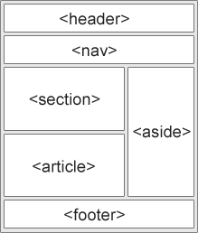
New Semantic Elements in HTML5
Many of existing web sites today contains HTML code like this: <div id="nav">, <div class="header">, or <div id="footer">, to indicate navigation links, header, and footer.
HTML5 offers new semantic elements to clearly define different parts of a web page:
Notes:
I’m not marking this up for me, but for everyone who can benefit from the enhanced meaning. Whether it’s the browser, a search engine spider, an accessibility tool, the person you pass the project on to, or even future you returning to the project in six months time, the markup indicates how the content should be interpreted.
http://html5doctor.com/lets-talk-about-semantics/

Slide 6
New Semantic Elements in HTML5
HTML5 <section> Element
The <section> element defines a section in a document.
According to W3C's HTML5 documentation: "A section is a thematic grouping of content, typically with a heading.“
HTML5 <article> Element
The <article> element specifies independent, self-contained content.
An article should make sense on its own and it should be possible to distribute it independently from the rest of the web site.
Examples of where an <article> element can be used:
  Forum post
  Blog post
  News story
  Comment
HTML5 <nav> Element
The <nav> element defines a set of navigation links.
The <nav> element is intended for large blocks of navigation links. However, not all links in a document should be inside a <nav> element!
Notes:
http://www.webdesignerdepot.com/2013/01/the-harsh-truth-about-html5s-structural-semantics-part-3/
http://html5doctor.com/microdata/#syntax
http://webdesignernotebook.com/css/how-to-use-modernizr/

Slide 7
New Semantic Elements in HTML5
HTML5 <aside> Element
The <aside> element defines some content aside from the content it is placed in (like a sidebar).
The aside content should be related to the surrounding content.
HTML5 <header> Element
The <header> element specifies a header for a document or section.
The <header> element should be used as a container for introductory content.
You can have several <header> elements in one document.
HTML5 <footer> Element
The <footer> element specifies a footer for a document or section.
A <footer> element should contain information about its containing element.
A footer typically contains the author of the document, copyright information, links to terms of use, contact information, etc.
You can have several <footer> elements in one document.

Slide 8
New Semantic Elements in HTML5
HTML5 <figure> and <figcaption> Elements
The <figure> tag specifies self-contained content, like illustrations, diagrams, photos, code listings, etc.
While the content of the <figure> element is related to the main flow, its position is independent of the main flow, and if removed it should not affect the flow of the document.
The <figcaption> tag defines a caption for a <figure> element.
The <figcaption> element can be placed as the first or last child of the <figure> element.

Slide 9
New Semantic Elements in HTML5
HTML5 <hgroup> Element
The <hgroup> tag is used to group heading elements.
The <hgroup> element is used to group a set of <h1> to <h6> elements, when a heading has multiple levels (subheadings).
Notes:
http://www.w3schools.com/tags/tag_time.asp

Slide 10
New Semantic Elements in HTML5
Can We Start Using These Semantic Elements?
The elements explained above are all block elements (except <figcaption>).
To get these elements to work properly in all (older) major browsers, set the display property to block in your style sheet (this causes older browsers to render these elements correctly):
header, section, footer, aside, nav, article, figure
{
display: block;
}

Slide 11
New Semantic Elements in HTML5
Problem With Internet Explorer 8 And Earlier
IE8 and earlier does not know how to render CSS on elements that it doesn’t recognize. You cannot style <header>, <section>, <footer>, <aside>, <nav>, <article>, <figure>, or other new HTML5 elements.
Thankfully, Sjoerd Visscher has discovered a JavaScript workaround called HTML5 Shiv; to enable styling of HTML5 elements in versions of Internet Explorer prior to version 9.
You can download and read more about the HTML5 Shiv at: http://code.google.com/p/html5shiv/
To enable the HTML5 Shiv (after downloading), insert the following code into the <head> element:
  <!--[if lt IE 9]>
  <script src="html5shiv.js"></script>
  <![endif]-->
That code above is a comment that only IE reads, for versions earlier than IE9.
It must be placed in the <head> element because Internet Explorer needs to know about the elements before it renders them.
Notes:
http://en.wikipedia.org/wiki/HTML5_Shiv
http://ejohn.org/blog/html5-shiv/
http://net.tutsplus.com/tutorials/html-css-techniques/html5-and-css3-without-guilt/

Slide 12
Before HTML5
<body>
<h1>Using Divs</h1>
<div class="container">
<div class="header">
<h1>Welcome to Samparkk</h1>
</div>
<div class="wrapper">
<div class="sidebar">
<div class="nav">
<ul>
<li><a href="#">Home</a></li>
<li><a href="#">About</a></li>
<li><a href="#">Contact</a></li>
</ul>
</div>
</div>
<div class="content">
<div class="section">
<h2>Welcome to our site</h2>
<p>Here you will learn to create websites...</p>
</div>
</div>
<div class="clearfix"></div>
</div>
<div class="footer">
<p>copyright &copy; samparkk.com</p>
</div>
</div>
</body>

Slide 13
Before HTML5 - CSS
.sidebar .nav{
padding: 10px;
}
.nav ul{
list-style: none;
padding: 0px;
margin: 0px;
}
.nav ul li{
margin-bottom: 5px;
}
.nav ul li a{
color: #3d677e;
}
.nav ul li a:hover{
text-decoration: none;
}
.content{
float: left;
width: 80%;
min-height: 170px;
}
.content .section{
padding: 10px;
}
.content h2{
font-size: 16px;
margin: 0px;
}
.clearfix{
clear: both;
}
.footer{
background-color: #679BB7;
padding: 10px 0;
}
.footer p{
text-align: center;
margin: 5px;
}
</style>
<style type="text/css">
body{
font: 12px verdana, sans-serif;
margin: 0px;
}
.header{
padding: 10px 0;
background-color: #679BB7;
}
.header h1{
font-size: 18px;
margin: 10px;
}
.container{
width: 100%;
background-color: #f0f0f0;
}
.sidebar{
float: left;
width: 20%;
min-height: 170px;
background-color: #bbd2df;
}

Slide 14
Assignments
Rewrite previous code using semantic elements

Slide 15
Resources (minimal html5, semantic elements)
http://miageprojet2.unice.fr/Intranet_de_Michel_Buffa/HTML5_Tutorial/HTML5_discovery_tutorial#Basic_usage
http://miageprojet2.unice.fr/Intranet_de_Michel_Buffa/HTML5_Tutorial
http://mathiasbynens.be/notes/minimal-html
http://webdesign.about.com/od/beginningtutorials/qt/html-quick-and-dirty.htm
http://html5doctor.com/lets-talk-about-semantics/
http://en.wikipedia.org/wiki/HTML5_Shiv
http://ejohn.org/blog/html5-shiv/
http://net.tutsplus.com/tutorials/html-css-techniques/html5-and-css3-without-guilt/
http://www.webdesignerdepot.com/2013/01/the-harsh-truth-about-html5s-structural-semantics-part-3/
http://html5doctor.com/microdata/#syntax
http://webdesignernotebook.com/css/how-to-use-modernizr/
http://html5doctor.com/lets-talk-about-semantics/

Slide 16
HTML5 New Input Types
HTML5 has several new input types for forms. These new features allow better input control and validation.
    color
    date
    datetime
    datetime-local
    email
    month
    number
    range
    search
    tel
    time
    url
    week
Note: Not all major browsers support all the new input types. However, you can already start using them; If they are not supported, they will behave as regular text fields.
Notes:
http://html5doctor.com/the-time-element/

Slide 17
Assignments:- HTML5 New Input Types
color type is used for input fields that should contain a color.(ch,O)
The date type allows the user to select a date.(ch,O,S)
The datetime type allows the user to select a date and time (with time zone).(S,O)
The datetime-local type allows the user to select a date and time (no time zone). (ch,O,S)
The time type allows the user to select a time.
function change(color){
document.body.style.backgroundColor=color; }
</script>
<form>
<input type='text' value="Shalini" name="acadgild"/>
    Select your favorite color:
    <input type="color" id="favcolor" onchange="change(this.value)" name='mycolor‘ value="#ff0000"><br> <input type="submit">
</form>
<form action="demo_form.asp">
Birthday: <input type="date" name="bday"></br>
<!-- datetime supported only in opera and safari -->
Birthday (date and time): <input type="datetime" name="bdaytime"></br>
Birthday (date and time): <input type="datetime-local" name="bdaytime"></br>
Select a time: <input type="time" name="usr_time"><br>
Select a week: <input type="week" name="week_year"><br>
<input type="submit"></form>
Notes:
https://stackoverflow.com/questions/14946091/are-there-any-style-options-for-the-html5-date-picker
https://stackoverflow.com/questions/18326982/open-html5-date-picker-on-icon-click
Awesome tutorial for different browser support
https://developer.mozilla.org/en-US/docs/Web/HTML/Element/input/date

Slide 18
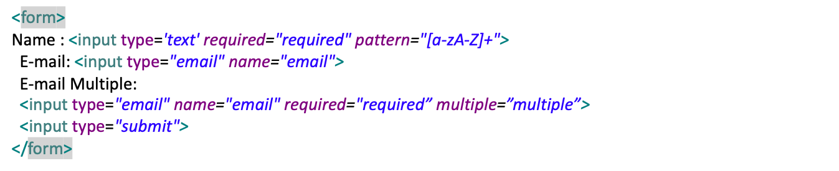
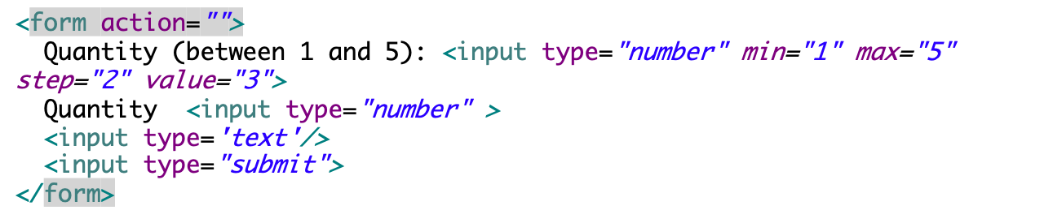
Assignments:- HTML5 New Input Types
The email type is used for input fields that should contain an e-mail address. A field for an e-mail address will be automatically validated when submitted.
The month type allows the user to select a month and year.
The number type is used for input fields that should contain a numeric value. You can also set restrictions on what numbers are accepted.
<form action="demo_form.asp">
Birthday (month and year): <input type="month" name="bdaymonth">
<input type="submit">
</form>
Notes:
https://stackoverflow.com/questions/14946091/are-there-any-style-options-for-the-html5-date-picker
https://stackoverflow.com/questions/18326982/open-html5-date-picker-on-icon-click
Awesome tutorial for different browser support
https://developer.mozilla.org/en-US/docs/Web/HTML/Element/input/date

Slide 19
Assignments:- HTML5 New Input Types
The range type is used for input fields that should contain a value from a range of numbers. You can also set restrictions on what numbers are accepted. A control for entering a number whose exact value is not important (like a slider control)
<script type="text/javascript">
function showVal(newVal){
document.getElementById("valBox").innerHTML=newVal;
}
</script>
<form action="demo_form.asp" method="get">
Points: <input type="range" id="points" min="1" max="10" onchange="showVal(this.value)"><br> <span id="valBox"></span><br>
points1:<input id="slider2" type ="range" min ="100" max="500" step ="50" value ="150" onchange="showVal(this.value)"/><br>
<input type="submit">
</form>
Notes:
https://stackoverflow.com/questions/14946091/are-there-any-style-options-for-the-html5-date-picker
https://stackoverflow.com/questions/18326982/open-html5-date-picker-on-icon-click
Awesome tutorial for different browser support
https://developer.mozilla.org/en-US/docs/Web/HTML/Element/input/date

Slide 20
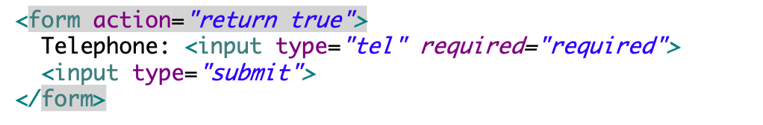
Assignments:- HTML5 New Input Types
The search input type can be used for creating search fields.
A search field typically behaves like a regular text field, but in some browser like Google Chrome and Apple Safari as soon as you start typing in a search box a small cross appears on the right side of the field that lets you quickly clear the search field.
<form action="demo_form.asp">
Search Google: <input type="search" name="googlesearch” placeholder = "Enter item”>
<input type="submit">
</form>
The validation for the input type="tel" is currently not supported by any browser, but it is still useful. The iPhone and some Android devices using the input type="tel" to change the virtual keyboard with a numeric keypad.
Notes:
https://stackoverflow.com/questions/14946091/are-there-any-style-options-for-the-html5-date-picker
https://stackoverflow.com/questions/18326982/open-html5-date-picker-on-icon-click
Awesome tutorial for different browser support
https://developer.mozilla.org/en-US/docs/Web/HTML/Element/input/date

Slide 21
Resources
http://www.sagarganatra.com/2011/07/custom-validation-messages-for-html5.html
http://html5doctor.com/the-progress-element/
http://miteshmaheta.blogspot.in/2012/08/html5-progress-bar-runs-in-all-browser.html
http://jsbin.com/ifamoq/3/edit
Html5 email validation-http://www.sagarganatra.com/2011/07/custom-validation-messages-for-html5.html
http://html5doctor.com/the-time-element/
http://html5doctor.com/the-progress-element/
http://miteshmaheta.blogspot.in/2012/08/html5-progress-bar-runs-in-all-browser.html
http://jsbin.com/ifamoq/3/edit

Slide 22
HTML5 New Form Elements
HTML5 has the following new form elements:
  <datalist>
  <output>
Note: Not all major browsers support all the new form elements. However, you can already start using them; If they are not supported, they will behave as regular text fields.

Slide 23
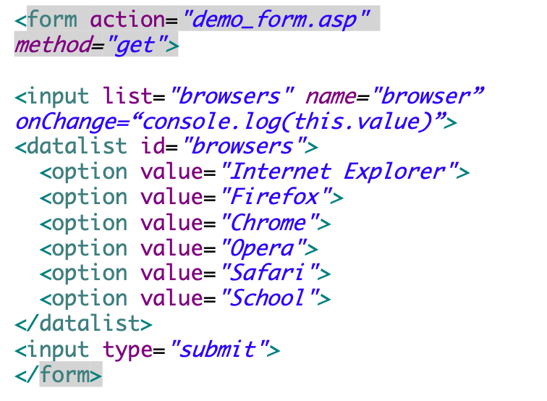
HTML5 New Form Elements
datalist:
The <datalist> element specifies a list of pre-defined options for an <input> element.
The <datalist> element is used to provide an "autocomplete" feature on <input> elements. Users will see a drop-down list of pre-defined options as they input data.
Use the <input> element's list attribute to bind it together with a <datalist> element.
Notes:
Examples in ‘form_elements’ folder
Progress bar demo: http://jsfiddle.net/wmichaelgreen/Gj6Pv/
Output ex: http://jsbin.com/evecux/11/edit

Slide 24
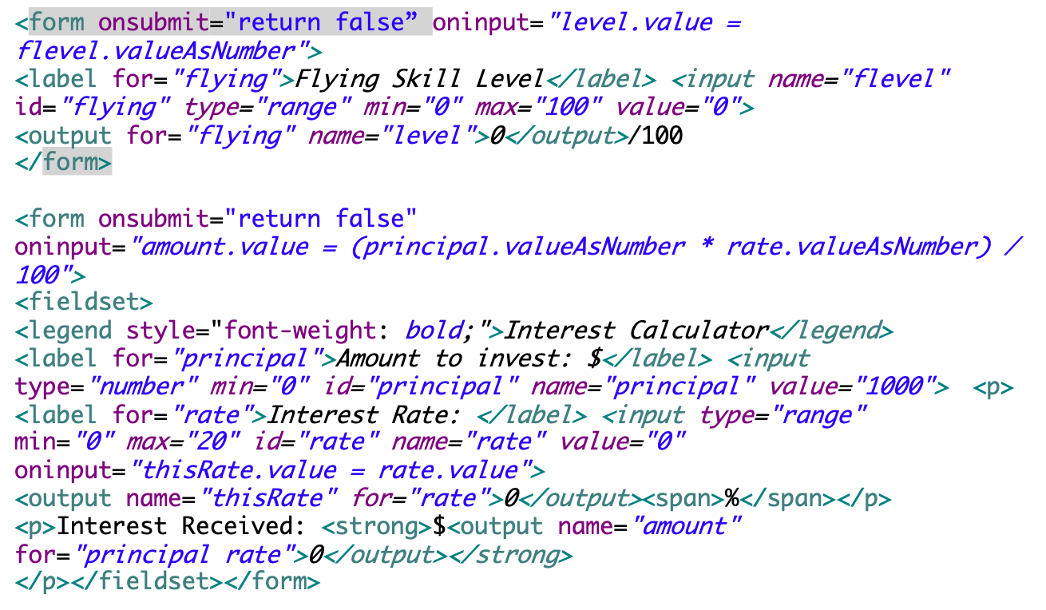
HTML5 New Form Elements
output:
The <output> element represents the result of a calculation (like one performed by a script).
Notes:
Examples in ‘form_elements’ folder
Progress bar demo: http://jsfiddle.net/wmichaelgreen/Gj6Pv/
Output ex: http://jsbin.com/evecux/11/edit
http://html5doctor.com/the-output-element/

Slide 25
Resources: HTML5 New Form Elements
Progress bar demo: http://jsfiddle.net/wmichaelgreen/Gj6Pv/
Output ex: http://jsbin.com/evecux/11/edit

Slide 26
HTML5 New Form Attributes
<form> novalidate
The novalidate attribute is a boolean attribute.
When present, it specifies that the form-data (input) should not be validated when submitted. <input> autofocus Attribute
The autofocus attribute is a boolean attribute.
When present, it specifies that an <input> element should automatically get focus when the page loads.
<form action="demo_form.asp" novalidate>
E-mail: <input type="email" name="user_email">
<input type="submit">
</form>

Slide 27
HTML5 New Form Attributes
<input> pattern Attribute
The pattern attribute specifies a regular expression that the <input> element's value is checked against.
The pattern attribute works with the following input types: text, search, url, tel, email, and password.
Use the global title attribute to describe the pattern to help the user.
<form action="demo_form.asp">
Country code: <input type="text" name="country_code" pattern="[A-Za-z]{3}" title="Three letter country code">
<input type="submit">
</form>
Notes:
http://html5doctor.com/the-output-element/
http://html5doctor.com/the-time-element/
http://www.html5tutorial.info/html5-time.php

Slide 28
HTML5 New Form Attributes
<input> placeholder Attribute
The placeholder attribute specifies a short hint that describes the expected value of an input field (e.g. a sample value or a short description of the expected format).
The short hint is displayed in the input field before the user enters a value.
Note: The placeholder attribute works with the following input types: text, search, url, tel, email, and password.
<form action="demo_form.asp">
<input type="text" name="fname" placeholder="First name"><br>
<input type="text" name="lname" placeholder="Last name"><br>
<input type="submit" value="Submit">
</form>

Slide 29
Resources – html5 new form attributes
http://html5doctor.com/the-output-element/
http://html5doctor.com/the-time-element/
http://www.html5tutorial.info/html5-time.php

Slide 30
Html5 Canvas
The HTML5 <canvas> element is used to draw graphics, on the fly, on a web page via scripting (usually JavaScript).
The <canvas> element is only a container for graphics. You must use a script to actually draw the graphics.
Canvas has several methods for drawing paths, boxes, circles, characters, and adding images.
<canvas id="myCanvas" width="200" height="100"></canvas>
Notes:
https://developer.mozilla.org/en-US/docs/Web/API/CanvasRenderingContext2D
http://joshondesign.com/p/books/canvasdeepdive/chapter01.html
http://stackoverflow.com/questions/1332501/how-can-i-use-the-html5-canvas-element-in-ie

Slide 31
Canvas
<script>
var c=document.getElementById("myCanvas");
var ctx=c.getContext("2d");
ctx.fillStyle="#FF0000";
ctx.fillRect(0,0,150,75);
</script>
First, find the <canvas> element: var c=document.getElementById("myCanvas");
Then, call its getContext() method (you must pass the string "2d" to the getContext() method): var ctx=c.getContext("2d");
The Context("2d") object is a built-in HTML5 object, with many properties and methods for drawing paths, boxes, circles, text, images, and more.
The next two lines draw a red rectangle: ctx.fillStyle="#FF0000";
ctx.fillRect(0,0,150,75);
The fillStyle property can be a CSS color, a gradient, or a pattern. The default fillStyle is #000000 (black).
The fillRect(x,y,width,height) method draws a rectangle filled with the current fill style.

Slide 32
Canvas – Paths, Arcs
To draw straight lines on a canvas, we will use the following two methods:
  moveTo(x,y) defines the starting point of the line
  lineTo(x,y) defines the ending point of the line
To draw a circle on a canvas, we will use the following method:
  arc(x,y,r,start,stop)
To actually draw the line or circle, we must use stroke() or fill().
var c=document.getElementById("myCanvas");
var ctx=c.getContext("2d");
ctx.beginPath();
ctx.arc(95,50,40,0,2*Math.PI);
ctx.stroke();
Notes:
Show arc example with 0.5 * Math.PI,1*Math.PI,1.5*Math.PI and last arg as true (anticlockwise drawing)

Slide 33
Canvas - Text
To draw text on a canvas, the most important property and methods are:
  font - defines the font properties for text
  fillText(text,x,y) - Draws "filled" text on the canvas
  strokeText(text,x,y) - Draws text on the canvas (no fill)
  var c=document.getElementById("myCanvas");
  var ctx=c.getContext("2d");
  ctx.font="30px Arial";
  ctx.fillText("Hello World",10,50);
  ctx.strokeText("Hello World",10,80);

Slide 34
Canvas - Gradients
Gradients can be used to fill rectangles, circles, lines, text, etc. Shapes on the canvas are not limited to solid colors.
There are two different types of gradients:
  createLinearGradient(x,y,x1,y1) - Creates a linear gradient
  createRadialGradient(x,y,r,x1,y1,r1) - Creates a radial/circular gradient
Once we have a gradient object, we must add two or more color stops.
The addColorStop() method specifies the color stops, and its position along the gradient.
Gradient positions can be anywhere between 0 to 1.
To use the gradient, set the fillStyle or strokeStyle property to the gradient, and then draw the shape, like a rectangle, text, or a line.

Slide 35
Canvas – Gradients Example
var c=document.getElementById("myCanvas");
var ctx=c.getContext("2d");
// Create gradient
var grd=ctx.createRadialGradient(75,50,5,90,60,100);
grd.addColorStop(0,"red");
grd.addColorStop(1,"white");
// Fill with gradient
ctx.fillStyle=grd;
ctx.fillRect(10,10,150,80);
var c=document.getElementById("myCanvas");
var ctx=c.getContext("2d");
// Create gradient
var grd=ctx.createLinearGradient(0,0,200,0);
grd.addColorStop(0,"red");
grd.addColorStop(1,"white");
// Fill with gradient
ctx.fillStyle=grd;
ctx.fillRect(10,10,150,80);

Slide 36
Canvas
<body>
<canvas id="myCanvas" width="300" height="300" style="border:1px solid #d3d3d3;">
Your browser does not support the HTML5 canvas tag.</canvas>
<script>
var c=document.getElementById("myCanvas");
var ctx=c.getContext("2d");
ctx.beginPath();
ctx.moveTo(0,0);
ctx.lineTo(50,50);
ctx.lineTo(100,50);
ctx.stroke();
ctx.beginPath();
ctx.arc(100,150,40,0,2*Math.PI);
ctx.fillStyle = "rgb(0, 173, 239)";
//ctx.fillStyle = "lightblue";
ctx.fill();
//ctx.stroke();
</script></body>
Notes:
http://www.w3schools.com/tags/ref_canvas.asp
basic_canvas.html
Chapter7/index.html
http://tutorials.jenkov.com/html5-canvas/todataurl.html
canvas shadow: http://jsbin.com/oqeyip/2/edit
Canvas apis:
http://www.w3.org/html/wg/drafts/2dcontext/html5_canvas/
toDataURL
window.location = canvas.toDataURL('image/png');

Slide 37

Assignments: Canvas
Draw a circle as shown below

Slide 38
Resources : canvas
http://www.html5canvastutorials.com/tutorials/html5-canvas-arcs/
http://joshondesign.com/p/books/canvasdeepdive/chapter01.html
http://www.w3.org/html/wg/drafts/2dcontext/html5_canvas/
https://developer.mozilla.org/en-US/docs/Web/API/CanvasRenderingContext2D
http://tutorials.jenkov.com/html5-canvas/todataurl.html
http://stackoverflow.com/questions/1332501/how-can-i-use-the-html5-canvas-element-in-ie
http://www.htmlgoodies.com/html5/other/html5-canvas-vs.-svg-choose-the-best-tool-for-the-job.html#fbid=-sbiXy4MS6D

Slide 39
Extra Assignment - Canvas
Create a smiley face on canvas using canvas JavaScript API.
Create a new T-shirt design for upcoming event in your organization

Slide 40
SVG – Scalable Vector Graphics
SVG: SVG is a vector API that draws shapes. Each shape has an object that you can attach event handlers to. If you zoom in the shape stays smooth, whereas Canvas would become pixelated.
Differences Between SVG and Canvas
SVG is a language for describing 2D graphics in XML.
Canvas draws 2D graphics, on the fly (with a JavaScript).
SVG is XML based, which means that every element is available within the SVG DOM. You can attach JavaScript event handlers for an element.
In SVG, each drawn shape is remembered as an object. If attributes of an SVG object are changed, the browser can automatically re-render the shape.
Canvas is rendered pixel by pixel. In canvas, once the graphic is drawn, it is forgotten by the browser. If its position should be changed, the entire scene needs to be redrawn, including any objects that might have been covered by the graphic.

Slide 41
Comparison of Canvas and SVG
The table below shows some important differences between Canvas and SVG:
Canvas | SVG
Resolution dependent No support for event handlers Poor text rendering capabilities You can save the resulting image as .png or .jpg Well suited for graphic-intensive games | Resolution independent Support for event handlers Best suited for applications with large rendering areas (Google Maps) Slow rendering if complex (anything that uses the DOM a lot will be slow) Not suited for game applications

Slide 42
SVG
<!DOCTYPE html>
<html>
<body>
<svg xmlns="http://www.w3.org/2000/svg" version="1.1">
<rect x="50" y="20" width="150" height="150" style="fill:blue;stroke:pink;stroke-width:5;opacity:0.4" />
</svg>
</body>
</html>

Slide 43
SVG
SVG Relies on Files, Canvas Uses Pure Scripting
SVG images are defined in XML. As a result, every SVG element is appended to the Document Object Model (DOM) and can be manipulated using a combination of JavaScript and CSS. Moreover, you can attach an event handlers to a SVG element or update its properties based on another document event. Canvas, on the other hand, is a simple graphics API. It draws pixels (extremely well I might add) and nothing more. Hence, there's no way to alter existing drawings or react to events. If you want to update the Canvas image, you have to redraw it.
Consider that SVG will result in slower rendering as document complexity increases due to SVG's integration into the DOM. Hence, SVG would probably not be best for dynamic applications like games.
Notes:
http://edutechwiki.unige.ch/en/Static_SVG_tutorial
http://edutechwiki.unige.ch/en/Using_SVG_with_HTML5_tutorial

Slide 44
Assignments: SVG
Svg_ex1
Svg_ex2
Rect_svg
Circle_scale

Slide 45
Resources: SVG
http://www.htmlgoodies.com/html5/other/html5-canvas-vs.-svg-choose-the-best-tool-for-the-job.html#fbid=-sbiXy4MS6D
http://edutechwiki.unige.ch/en/Static_SVG_tutorial
http://edutechwiki.unige.ch/en/Using_SVG_with_HTML5_tutorial

Slide 46
Video on the web
Until now, there has not been a standard for showing a video/movie on a web page.
Today, most videos are shown through a plug-in (like flash). However, different browsers may have different plug-ins.
HTML5 defines a new element which specifies a standard way to embed a video/movie on a web page: the <video> element.
Notes:
http://miageprojet2.unice.fr/Intranet_de_Michel_Buffa/HTML5_Tutorial/HTML5_discovery_tutorial#Basic_usage
http://www.longtailvideo.com/html5/track/
http://www.html5rocks.com/en/tutorials/track/basics/
https://developer.mozilla.org/en-US/docs/Web/HTML/Element/video

Slide 47
Video on the Web
<video controls
autoplay
src=" http://content.bitsontherun.com/videos/q1fx20VZ-kNspJqnJ.mp4 "
width="480" height="360"
poster="images/prerollposter.jpg"
id="video">
</video>
<video width="320" height="240" controls>
<source src="movie.mp4" type="video/mp4">
<source src="movie.ogg" type="video/ogg">
Your browser does not support the video tag.
</video>
The HTML5 specification allows for any video format. It is the browser implementation that determines what formats are actually supported.
<video poster="video.jpg" controls>
<source src="video.mp4">
<source src="video.webm">
<source src="video.ogv">
<object>...</object>
</video>
Insert your <object> element inside the
<video> element. If the browser doesn't
know about the <video> element, the
<object> will be used.
Notes:
http://jsbin.com/irofib/6/edit
http://miageprojet2.unice.fr/Intranet_de_Michel_Buffa/HTML5_Tutorial/HTML5_discovery_tutorial
http://miageprojet2.unice.fr/Intranet_de_Michel_Buffa/HTML5_Tutorial
http://mainline.essi.fr/HTML5slides/index.html#1
http://www.w3.org/2013/05/w3c-track.html#tutorials
http://miageprojet2.unice.fr/Intranet_de_Michel_Buffa/HTML5_tutorial_for_WWW_2013#Slides_from_the_presentation
http://www.w3.org/TR/html5/embedded-content-0.html#the-video-element
http://nitross.x10.mx/w3c-html5-course/index.html

Slide 48
Video Attributes
autoPlayA Boolean attribute; if specified, the video automatically begins to play back as soon as it can do so without stopping to finish loading the data.
bufferedAn attribute you can read to determine the time ranges of the buffered media. This attribute contains a TimeRanges object.
controlsIf this attribute is present, the browser will offer controls to allow the user to control video playback
heightThe height of the video's display area, in CSS pixels (absolute values only; no percentages.)
loopA Boolean attribute; if specified, the browser will automatically seek back to the start upon reaching the end of the video.
mutedA Boolean attribute that indicates the default setting of the audio contained in the video. If set, the audio will be initially silenced. Its default value is false, meaning that the audio will be played when the video is played.
https://developer.mozilla.org/en-US/docs/Web/HTML/Element/video
Notes:
http://miageprojet2.unice.fr/Intranet_de_Michel_Buffa/HTML5_Tutorial/HTML5_discovery_tutorial#Basic_usage
http://www.longtailvideo.com/html5/track/
http://www.html5rocks.com/en/tutorials/track/basics/
https://developer.mozilla.org/en-US/docs/Web/HTML/Element/video

Slide 49
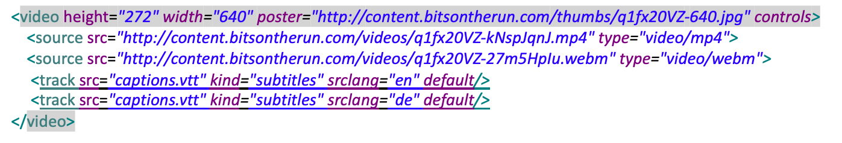
Track Tag
The track element provides a simple, standardized way to add subtitles, captions, screen reader descriptions and chapters to video and audio.
The track element is currently available in Internet Explorer 10 and Google Chrome. Firefox support is not yet implemented.
The video element would display a selector giving the user a choice of subtitle languages
Note that the track element cannot be used from a file:// URL. To see tracks in action, put files on a web server.
Each track element has an attribute for kind, which can be subtitles, captions, descriptions, chapters or metadata.
The track element src attribute points to a text file that holds data for timed track cues, which can potentially be in any format a browser can parse. Chrome supports WebVTT
https://developer.mozilla.org/en-US/docs/Web/HTML/Element/video
Notes:
https://www.html5rocks.com/en/tutorials/track/basics/

Slide 50
Track VTT File
Each item in a track file is called a cue. Each cue has a start time and end time separated by an arrow, with cue text in the line below.
Cues are separated by an empty line. Captions.vtt
﻿WEBVTT
00:00:01.000 --> 00:00:02.042
(drumbeat)
00:00:07.167 --> 00:00:12.025
(plaintive violin solo playing)
00:00:15.000 --> 00:00:18.183
(wind whistling)
00:00:24.167 --> 00:00:27.025
(orchestra music swells)
00:00:43.033 --> 00:00:43.192
(weapons clash)
00:00:44.000 --> 00:00:44.175
(gasps)
00:00:44.183 --> 00:00:45.158
(grunts)
00:00:45.167 --> 00:00:47.058
(groaning)
00:00:54.192 --> 00:00:55.150
(blade rings)
Notes:
https://www.html5rocks.com/en/tutorials/track/basics/
Cue times are in hours:minutes:seconds:milliseconds format! Parsing is strict. Numbers must be zero padded if necessary: hours, minutes and seconds must have two digits (00 for a zero value) and milliseconds must have three digits (000 for zero). There is an excellent WebVTT validator at quuz.org/webvtt, which checks for errors in time formatting, and problems such as non-sequential times.

Slide 51
Video Formats and Browser Support
Browser | MP4 | WebM | Ogg
Internet Explorer 9+ | YES | NO | NO
Chrome 6+ | YES | YES | YES
Firefox 3.6+ | NO | YES | YES
Safari 5+ | YES | NO | NO
Opera 10.6+ | NO | YES | YES
MP4 = MPEG 4 files with H264 video codec and AAC audio codec
WebM = WebM files with VP8 video codec and Vorbis audio codec
Ogg = Ogg files with Theora video codec and Vorbis audio codec
Notes:
1. The container is the file format that’s used to package up the video, audio
and metadata information. Common container formats include: MP4,
WebM, Ogg and Flash Video.
2. The codec is the software used to encode and decode a specific encoding
of video or audio. Popular web codecs include: H.264, VP8, Theora, AAC,
and Vorbis.
http://www.w3schools.com/tags/ref_av_dom.asp
3. The browser decides what video it can decode and not all browser makers
agree, so if you want to support everyone, you need multiple encodings.

Slide 52
Video Formats and Browser Support
1. The container is the file format that’s used to package up the video, audio
and metadata information. Common container formats include: MP4,
WebM, Ogg and Flash Video.
2. The codec is the software used to encode and decode a specific encoding
of video or audio. Popular web codecs include: H.264, VP8, Theora, AAC,
and Vorbis.
3. The browser decides what video it can decode and not all browser makers
agree, so if you want to support everyone, you need multiple encodings.

Slide 53
HTML5 <video> - DOM Methods and Properties
HTML5 has DOM methods, properties, and events for the <video> and <audio> elements.
These methods, properties, and events allow you to manipulate <video> and <audio> elements using JavaScript.
There are methods for playing, pausing, and loading and there are properties (like duration and volume).
There are also DOM events that can notify you when the <video> element begins to play, is paused, is ended, etc.

Slide 54
Video with track
Example of movie with captions/subtitles
Several tracks may be included, in different languages:
<video src="brave.webm">
<track kind=subtitles src=brave.en.vtt srclang=en label="English">
<track kind=captions src=brave.en.hoh.vtt srclang=en label="English for the Hard of Hearing">
<track kind=subtitles src=brave.fr.vtt srclang=fr lang=fr label="Français">
<track kind=subtitles src=brave.de.vtt srclang=de lang=de label="Deutsch">
</video>
Notes:
http://mainline.essi.fr/HTML5slides/chapter2.html#9

Slide 55
Video
<video> tag is a pure DOM element, can apply CSS3 transitions...
<style>
video
{ width: 100px; transition: all 0.5s ease-in-out; }
video:hover, video:focus
{ width: 600px; transform: rotate(45deg); }
</style>

Slide 56
Assignments: video
Video_track.html
http://www.html5rocks.com/en/tutorials/track/basics/
basicvideoex
canplayvideotype

Slide 57
Resources: video
http://www.html5rocks.com/en/tutorials/track/basics/
http://www.w3schools.com/tags/ref_av_dom.asp
http://www.videojs.com/docs/api/
http://miageprojet2.unice.fr/Intranet_de_Michel_Buffa/HTML5_Tutorial/HTML5_discovery_tutorial#Basic_usage
http://www.longtailvideo.com/html5/track/
http://jsbin.com/irofib/6/edit
http://miageprojet2.unice.fr/Intranet_de_Michel_Buffa/HTML5_Tutorial
http://mainline.essi.fr/HTML5slides/index.html#1
http://www.w3.org/2013/05/w3c-track.html#tutorials
http://miageprojet2.unice.fr/Intranet_de_Michel_Buffa/HTML5_tutorial_for_WWW_2013#Slides_from_the_presentation
http://nitross.x10.mx/w3c-html5-course/index.html
http://www.w3.org/TR/html5/embedded-content-0.html#the-video-element

Slide 58
HTML5 <audio>
In order to make your web page plays music, the html code can be as simple as
<audio controls>
<source src="vincent.mp3" type="audio/mpeg"/>
<source src="vincent.ogg" type="audio/ogg"/> </audio>
Browser | .mp3 | .wav | .ogg
Mozzila Firefox 3.6 |  | ✓ | ✓
Opera 10.63 |  | ✓ | ✓
Google Chrome 8.0 | ✓ | ✓ | ✓
Apple Safari 5.0.3 (with QuickTime) | ✓ | ✓
Microsoft IE 9 Beta | ✓ | ✓

Slide 59
HTML5 <audio> attributes
Attribute | Value | Description
controls | *Boolean attribute | You need this to make the native audio player appear. Otherwise, you would have to use DOM to control the audio element to play your music.
autoplay | *Boolean attribute | If this guy exists, the browser will just play your song or your speech without asking permission from your visitor.
loop | *Boolean attribute | Keep repeating your music
src | url | The URL of your audio file
preload | none | metadata | auto | This attribute was formerly known as "autobuffer" and it was an boolean attribute as "controls". none - do not buffer audio file automatically. metadata - only buffer the metadata of audio file. auto - buffer audio file before it gets played.
<audio controls> <source src="vincent.mp3" type="audio/mpeg"/> <source src="vincent.ogg" type="audio/ogg"/> <object type="application/x-shockwave-flash" data="media/OriginalMusicPlayer.swf" width="225" height="86"> <param name="movie" value="media/OriginalMusicPlayer.swf"/> <param name="FlashVars" value="mediaPath=vincent.mp3" /> </object> </audio>
Notes:
Boolean attribute is an attribute that either present in the tag or not present. A Boolean attribute has just its name and no value. You can put it this way too, whatever value you assign to a boolean attribute means only one thing - TRUE.

Slide 60
HTML5 <audio> support
If your browser doesn't suppport HTML5 but you have got flash plug-in, you probably don't want to miss the fun. Here you go ..
If the web browser support neither HTML5 nor Flash, you might as well let the user download the audio file and wish them luck on getting a player to play it.
<audio controls>
<source src="vincent.mp3" type="audio/mpeg"/>
<source src="vincent.ogg" type="audio/ogg"/>
<object type="application/x-shockwave-flash" data="media/OriginalMusicPlayer.swf" width="225" height="86">
<param name="movie" value="media/OriginalMusicPlayer.swf"/>
<param name="FlashVars" value="mediaPath=vincent.mp3" />
</object>
<a href="vincent.mp3">Download this lovely song and wish you all the best!</a>
</audio>
Notes:
Boolean attribute is an attribute that either present in the tag or not present. A Boolean attribute has just its name and no value. You can put it this way too, whatever value you assign to a boolean attribute means only one thing - TRUE.

Slide 61
Resources: Canvas and Video
Canvas_video_magic_demo
http://html5doctor.com/video-canvas-magic/
http://html5doctor.com/demos/video-canvas-magic/demo2.html
http://www.wickedlysmart.com/hfhtml5/
Notes:
http://www.wickedlysmart.com/hfhtml5/

Slide 62
Assignment - video
Play a video on a webpage and display it in parallel in black and white in canvas adjoining video
http://html5doctor.com/demos/video-canvas-magic/demo2.html

Slide 63
What are WebSockets?
WebSockets is a technique for two-way communication over one (TCP) socket, a type of PUSH technology.
With WebSockets, writing highly interactive real-time web applications becomes a simple task.
Websockets can replace long-polling used to simulate Push technology
In contrast to Server-Sent Events, the WebSocket protocol is not build on top of HTTP. However, the WebSocket protocol defines the HTTP handshake behaviour to switch an existing HTTP connection to a lower level WebSocket connection using websocket protocol.
WebSockets does not try to simulate a server push channel over HTTP. It just defines a framing protocol on top of TCP.
Once a websocket connection is established only WebSocket frames will be transferred over the wire avoiding overhead of HTTP headers
Notes:
http://cjihrig.com/blog/how-to-use-websockets/
http://net.tutsplus.com/tutorials/javascript-ajax/start-using-html5-websockets-today/
https://today.java.net/article/2010/04/26/html5-server-push-technologies-part-2
WebSockets also provide an elegant implementation of push technology. Push technology refers to communication that is initiated by the server. This contrasts the typical Web communication model of client initiated communication (also known as pull technology). Prior to HTML5, push technology was implemented through a number of hacks such as long polling. In long polling, the client makes an AJAX request to the server. If the server doesn’t have any data to return, it simply leaves the connection open. Once data becomes available, the server sends it back to the client. The client then immediately makes another request, ensuring that an open connection is always available for push data. WebSockets make these techniques obsolete by providing true push technology. The additional overhead of repeatedly polling the server is also mitigated by using WebSockets.
Server-sent events
http://www.nczonline.net/blog/2010/10/19/introduction-to-server-sent-events/
http://html5hacks.com/blog/2013/04/21/push-notifications-to-the-browser-with-server-sent-events/

Slide 64
The HTML5 WebSockets
The HTML5 WebSockets specification defines an API that enables web pages to use the WebSockets protocol for two-way communication with a remote host.
It introduces the WebSocket interface and defines a full-duplex communication channel that operates through a single TCP socket over the Web.
It provide an enormous reduction in unnecessary network traffic and latency compared to the unscalable polling and long-polling solutions that were used to simulate a full-duplex connection by maintaining two connections.
http://www.websocket.org/quantum.html
WebSockets account for network hazards such as proxies and firewalls, making streaming possible over any connection, and with the ability to support upstream and downstream communications over a single connection.
WebSockets-based applications place less burden on servers, allowing existing machines to support more concurrent connections
Notes:
http://www.websocket.org/quantum.html
http://www.websocket.org/echo.html
However, in case of long-polling, streaming is still encapsulated in HTTP, intervening firewalls and proxy servers may choose to buffer the response, increasing the latency of the message delivery.

Slide 65
The HTML5 WebSockets
var myWebSocket = new WebSocket("ws://www.websockets.org");
var myWebSocket = new WebSocket("wss://www.websockets.org"); ( wss: is for secure websocket)
Before connecting to an end-point and sending a message, you can associate a series of event listeners to handle each phase of the connection life-cycle as shown in the following example.
  myWebSocket.onopen = function(evt) { alert("Connection open ..."); };
  myWebSocket.onmessage = function(evt) { alert( "Received Message: " + evt.data); };
  myWebSocket.onclose = function(evt) { alert("Connection closed."); };
To send a message to the server, simply call "send" and provide the content you wish to deliver.
After sending the message, call "close" to terminate the connection.
  myWebSocket.send("Hello WebSockets!");
  myWebSocket.close();
Notes:
Note that a ws:// and wss:// prefix are proposed to indicate a WebSocket and a secure WebSocket connection, respectively.
A WebSocket connection is established by upgrading from the HTTP protocol to the WebSockets protocol during the initial handshake between the client and the server. The connection itself is exposed via the "onmessage" and "send" functions defined by the WebSocket interface.

Slide 66
Assignment: web sockets
Websocketex
Push_technology
Jwebsocketserver_startup.txt
Jwebsocketserver
Jwebsocketclient

Slide 67
Resources: websocket
http://www.websocket.org/quantum.html
http://www.websocket.org/echo.html
http://cjihrig.com/blog/how-to-use-websockets/
http://net.tutsplus.com/tutorials/javascript-ajax/start-using-html5-websockets-today/
https://today.java.net/article/2010/04/26/html5-server-push-technologies-part-2

Slide 68
Drag and Drop
It is when you "grab" an object and drag it to a different location.
In HTML5, drag and drop is part of the standard, and any element can be draggable.
  function allowDrop(ev){
  ev.preventDefault();
  }
  function drag(ev){
  ev.dataTransfer.setData("Text",ev.target.id);
  }
  function drop(ev){
  ev.preventDefault();
  var data=ev.dataTransfer.getData("Text");
  ev.target.appendChild(document.getElementById(data));
  }
  </script></head>
  <body>
  <div id="div1" ondrop="drop(event)"
  ondragover="allowDrop(event)"></div>
  <img id="drag1" src="img_logo.gif" draggable="true"
  ondragstart="drag(event)" width="336" height="69">
  </body>

Slide 69
Drag and Drop
Make an element draggable
To make an element draggable, set the draggable attribute to true: <img draggable="true">
What to Drag - ondragstart and setData()
<img id="drag1" src="img_logo.gif" draggable="true"
ondragstart="drag(event)" width="336" height="69">
Then, specify what should happen when the element is dragged.
In the example above, the ondragstart attribute calls a function, drag(event), that specifies what data to be dragged.
The dataTransfer.setData() method sets the data type and the value of the dragged data:
function drag(ev)
{
ev.dataTransfer.setData("Text",ev.target.id);
}
In this case, the data type is "Text" and the value is the id of the draggable element ("drag1").
Notes:
http://html5demos.com/

Slide 70
Drag and Drop
Where to Drop - ondragover
The ondragover event specifies where the dragged data can be dropped.
By default, data/elements cannot be dropped in other elements. To allow a drop, we must prevent the default handling of the element.
This is done by calling the event.preventDefault() method for the ondragover event: event.preventDefault()
Do the Drop - ondrop
When the dragged data is dropped, a drop event occurs.
In the example above, the ondrop attribute calls a function, drop(event):
function drop(ev)
{ ev.preventDefault();
var data=ev.dataTransfer.getData("Text");
ev.target.appendChild(document.getElementById(data));
}
Call preventDefault() to prevent the browser default handling of the data (default is open as link on drop)
Get the dragged data with the dataTransfer.getData("Text") method. This method will return any data that was set to the same type in the setData() method
e.dataTransfer.setData(mimeType, dataPayload)
The dragged data is the id of the dragged element ("drag1")
Append the dragged element into the drop element
Notes:
What is microdata-
http://www.htmlgoodies.com/html5/Web-Developer-Tutorial-HTML5-Microdata-3920016.htm#fbid=-sbiXy4MS6D

Slide 71
Assignments – Drag and drop
dragdropimgcopy
dragdrop
dragdrop

Slide 72
Extra Assignment – Drag and drop
http://html5demos.com/drag
drag a copy of an image into adjoining location

Slide 73
Resources – Drag and Drop
http://html5demos.com/
https://www.tutorialrepublic.com/html-tutorial/html5-drag-and-drop.php
Detailed
https://web.dev/drag-and-drop/

Slide 74
Web Storage
Some ways cookies could be improved on.
There’s only 4k to work with, my app needs more storage than that.
Sending the cookie back and forth every time seems really inefficient, especially if I’m on a mobile device with not a lot of bandwidth.
They sound like a good way to transmit viruses and other malware to my browser.
The way the key/value pairs are done as part of the HTTP request is a pain to deal with in code.
HTML5 provides a
simple, client-side API to storage that is
persistent, stored on the browser, offers
more storage capacity, and is transmitted
to a server only if I want it to be.

Slide 75
Web Storage
HTML5 web storage, a better local storage than cookies.
Web pages can store data locally within the user's browser.
Web Storage is more secure and faster than cookies
The data is not included with every server request, but used ONLY when asked for.
It is also possible to store large amounts of data, without affecting the website's performance. (5 to 10 megabytes per domain)
The data is stored in key/value pairs, and web pages belonging to same domain can only access data stored among themselves.
Notes:
five megabytes is allocated to all the pages from the same domain for storage. Pet-R-Us.com gets five, PetEmporium.com gets five more, and so on, all on your machines.
Every page on wickedlysmart.com can see the items stored by other pages on that site, but code from other sites, say, google.com, can’t access
that storage (they can access only their own local storage items).
loading a page from my computer, origin is known as the “Local Files” origin, which is great to use for testing.

Slide 76
Web Storage
localStorage and sessionStorage
There are two new objects for storing data on the client:
  localStorage - stores data with no expiration date
  sessionStorage - stores data for one session

Slide 77
Web Storage
Before using web storage, check browser support for localStorage and sessionStorage:
if(typeof(Storage)!=="undefined")
{
// Yes! localStorage and sessionStorage support!
// Some code.....
}
else
{
// Sorry! No web storage support..
}

Slide 78
Web Storage
The localStorage data will not be deleted when the browser is closed, and will be available the next day, week, or year.
The sessionStorage object supports exactly the same API as localStorage, so you already know everything about it you need to.
The keys for each localStorage item must be unique. If you use the same key as an existing item, you’ll overwrite the value of that item.
One way to generate a unique key is to use the current time in milliseconds since 1970, using the Date object’s getTime() method.
It is important to create a naming scheme for your web app that will still work if items are removed from the store, or if another app creates items in the store.
Local storage may be particularly useful on mobile devices to reduce bandwidth requirements.
Not all browsers are currently throwing the QUOTA_EXCEEDED_ERR exception. But they still throw a exception when you exceed your limit, so you may want to handle the general case of an exception occurring when you set an item.

Slide 79
Web Storage – Imp API
localStorage.setItem("price", 9.99); //implicit conversion to string
var price = parseFloat(localStorage.getItem("price"));
localStorage.removeItem(key);
for (var i = 0; i < localStorage.length; i++)
{
var key = localStorage.key(i);
var value = localStorage[key];
alert(value);
}
try { localStorage.setItem(mykey, myvalue);} catch(e) { if (e == QUOTa_ExCEEDED_ERR) { alert("Out of storage!"); } }
If you need to store arrays or objects in localStorage, use JSON.stringify to create the value to store, and JSON.parse after you retrieve it.
JSON.stringify(stickiesArray);
JSON.parse(stickiesArray);
localStorage.clear();
Notes:
for (var key in localStorage) {
var value = localStorage[key];
}
localStorage["sticky_0"] = "Pick up dry cleaning";
stickiesarray.splice(i,1);
splice removes elements from an array starting at the location given by the first argument (i), for as many elements as are specified in the second argument (1).

Slide 80
Many ways to make use of localStorage…
This gives me a new way to store user state. I used to need some kind of server-side based session and backend storage. Now I can just store my users’ state locally, and bring in the server-side code only when I have to.
I’m storing lots of local data to make my clients’ apps fast on their mobile devices. Having a large store on the client side is a huge win for me.
I’ve got a really cool game that works in two different browser windows, and I’m using localStorage to synchronize state.
I’m going to store playlists with metadata for my users. They’ll be able to store their favourite clips along with the time code where they left off viewing.
In my new Twitter client, I’m going to cache Twitter search results for efficiency with localStorage. When my users search, I'm going to check the local results first. That could really help my mobile users.
Notes:
I’m using sessionStorage for my new ecommerce library’s shopping cart. If the user closes the browser, I want the shopping
cart to go away.

Slide 81
Assignment – local storage
Create a login webpage with username stored in local storage so that when user revisits the login webpage it greets user with its name.
Sticky application : stickapp

Slide 82
Assignment – web storage
webstorageex
webstorageex1
Sticky application : stickapp

Slide 83
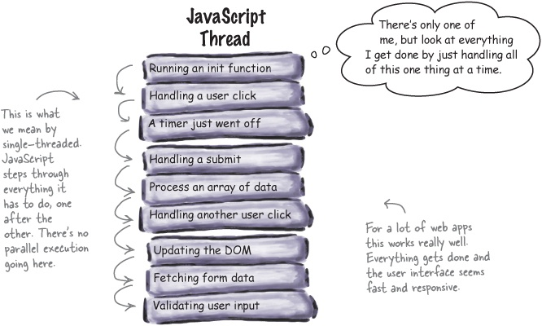
Web worker
JS without web worker

Slide 84
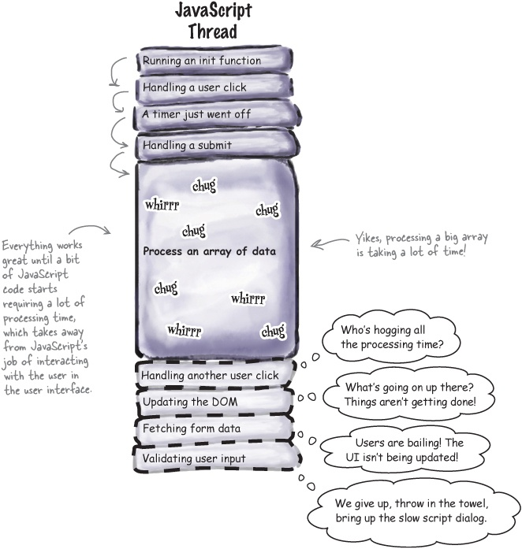
Web worker
need for web worker

Slide 85
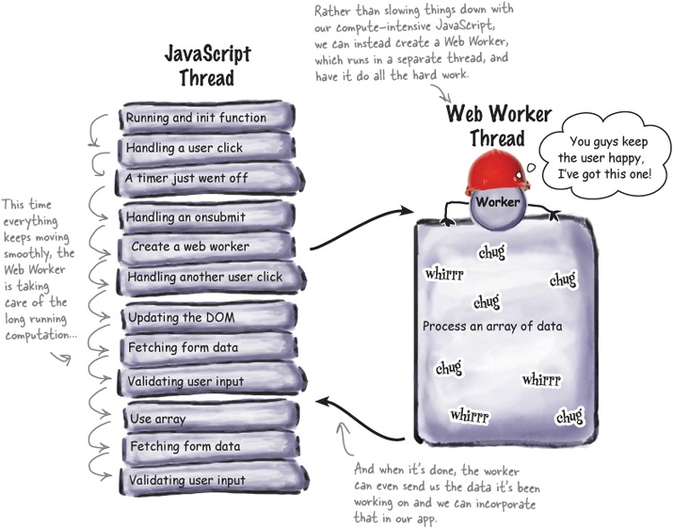
Web worker
need for web worker
Notes:
A web worker is a JavaScript running in the background, without affecting the performance of the page.

Slide 86
Web worker
Web Workers will allow to design more responsive web applications then otherwise possible in the past.
Web Workers ensure that the user can continue to interact with the page while your JavaScript code runs in the background.
Notes:
http://www.itgeared.com/articles/1474-html5-web-workers-introduction-tutorial/

Slide 87
Web Workers and the DOM
Web workers do not have access to the following JavaScript objects:
The window object
The document object
The parent object
Notes:
http://www.interactivebusinessautomation.com/html5/

Slide 88
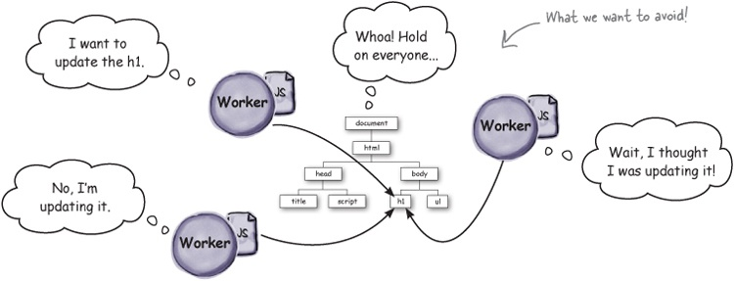
Web Workers and DOM
Why not allow workers to access the DOM?
Allowing a bunch of changes to the DOM at the same time FROM MULTIPLE THREADS can easily lead to situations where the DOM is in an inconsistent state.

Slide 89
Web Workers
Posting messages to web worker:
Depending on your browser/version, postMessage() can accept either a string or JSON object as its single argument.
The latest versions of the modern browsers support passing a JSON object.
You can send a string...
worker.postMessage("ping");
... an array...
worker.postMessage([1, 2, 3, 5, 11]);
... or even a JSON object.
worker.postMessage({"message": "ping", "count": 5});
You can’t send functions:
worker.postMessage(updateTheDOM);
Guess Why?
Notes:
As it might contain a reference to the DOM allowing the worker to change the DOM

Slide 90
Web Workers
worker.onmessage = function (event) {
var message = event.data;
var worker = event.target;
};
event.data - This is the object that is sent from the worker to the code in your page when the worker posts a message. The data property contains the message the worker sent (e.g., a string, like “pong”).
event.target - The target is a reference to the worker that sent the message. This can come in handy if you need to know which worker it’s from.

Slide 91
Web Workers
worker.js:
onmessage = pingPong;
function pingPong(event) {
if (event.data == "ping") {
postMessage("pong");
}
}
The worker uses postMessage to send messages, too.
When the worker receives a message from the main code, the pingPong function (worker’s message handler) will be called, and the message will be passed in.
This way main thread and worker thread can communicate with one another.

Slide 92
Web workers
Q: When I send a worker an object in a message, does it become a shared object between my main page and the worker?
A: No, when you send an object the worker gets a copy of it. Any changes the worker makes will not affect the object in your main page. The worker is executing in a different environment than your main page, so you have no access to objects there. The same is true of objects the worker sends you: you get a copy of them.
Q: Can workers access localStorage or make XMLHttpRequests?
A: Yes, workers can access localStorage and make XMLHttpRequests.
Q: Can I have as many workers as I want?
A: Web Workers aren’t intended to be used in large numbers—while creating a worker looks simple in code, it requires extra memory and an operating system thread, which can be costly in start-up time and resources.

Slide 93
Web workers
Web Workers have a global function named importScripts that you can use to import one or more JavaScript files or URLs into your worker.
importScripts("http://bigscience.org/nuclear.js", "http://nasa.gov/rocket.js",
"mylibs/atomsmasher.js");
if (taskType == "songdetection") {
importScripts("audio.js");
}

Slide 94
Assignment - Web workers
Create a textbox to take the input for how many Fibonacci numbers to be generated
If the number value is >0, then pass this value to web worker.
Web worker generates Fibonacci series and passes the result back to main file.

Slide 95
Server Side Events
HTML5 server-sent event is a new way for the web pages to communicating with the web server.
It is also possible with the XMLHttpRequest object that lets your JavaScript code make a request to the web server, but it's a one-for-one exchange — that means once the web server provides its response, the communication is over. XMLHttpRequest object is the core of all Ajax operations.
However, there are some situations where web pages require a longer-term connection to the web server. A typical example is stock quotes on finance websites where price updated automatically. Another example is a news ticker running on various media websites.
You can create such things with the HTML5 server-sent events. It allows a web page to hold an open connection to a web server so that the web server can send a new response automatically at any time, there's no need to reconnect, and run the same server script from scratch over and over again
Notes:
Note: Server-Sent Events (SSE) are unidirectional that means data are delivered in one direction from the server to client. A client typically is a web browser.
Tip: The HTML5's server-sent events feature is supported in all major modern web browsers like Firefox, Chrome, Safari and Opera except Internet Explorer.

Slide 96
Server Side Code
The first two line of the PHP script sets two important headers. First, it sets the MIME type to text/event-stream, which is required by the server-side event standard. The second line tells the web server to turn off caching otherwise the output of your script may be cached.
Every message send through HTML5 server-sent events must start with the text data: followed by the actual message text and the new line character sequence (\n\n).
And finally, we have used the PHP flush() function to make sure that the data is sent right away, rather than buffered until the PHP code is complete.
<?php header("Content-Type: text/event-stream"); header("Cache-Control: no-cache"); // Get the current time on server $currentTime = date("h:i:s", time()); // Send it in a message echo "data: " . $currentTime . "\n\n"; flush(); ?>
Notes:
Note: Server-Sent Events (SSE) are unidirectional that means data are delivered in one direction from the server to client. A client typically is a web browser.
Tip: The HTML5's server-sent events feature is supported in all major modern web browsers like Firefox, Chrome, Safari and Opera except Internet Explorer.

Slide 97
Client Side Code
The EventSource object is used to receive server-sent event messages.
var url ="https://techgatha.com/servertime.php"
window.onload = function() {
var source = new EventSource(url);
source.onmessage = function(event) {
document.getElementById("result").innerHTML += "New time received from web server: " + event.data + "<br>";
};
};
Notes:
Note: Server-Sent Events (SSE) are unidirectional that means data are delivered in one direction from the server to client. A client typically is a web browser.
Tip: The HTML5's server-sent events feature is supported in all major modern web browsers like Firefox, Chrome, Safari and Opera except Internet Explorer.

Slide 98
Geolocation
The HTML5 Geolocation API is used to get the geographical position of a user.
Since this can compromise user privacy, the position is not available unless the user approves it.
Your users are now on the move with mobile devices that are location aware.
The best apps are going to be the ones that can enhance users’ experiences using their location.
Knowing where your users are can add a lot to a web experience
Notes:
you can give them directions, make suggestions about where they might go, you can know
it’s raining and suggest indoor activities, you can let your users know who else in their area might be interested in
some activity.

Slide 99
Geolocation
<script>
var x=document.getElementById("demo");
function getLocation()
{
if (navigator.geolocation)
{
navigator.geolocation.getCurrentPosition(showPosition);
}
else{x.innerHTML="Geolocation is not supported by this browser.";}
}
function showPosition(position)
{
x.innerHTML="Latitude: " + position.coords.latitude +
"<br>Longitude: " + position.coords.longitude;
}
</script>
How the Geolocation API determines your location?
Notes:
You’ve probably seen latitude and longitude specified in both degrees/minutes/seconds, such as (47˚38’34’’, 122˚32’32’’), and in decimal values, such as (47.64, -122.54).
With the Geolocation API we always use decimal values. If you need to convert degrees/minutes/seconds to decimal, you can use this function:
function degreesToDecimal(degrees, minutes, seconds) {
return degrees + (minutes / 60.0) + (seconds / 3600.0);
}
Also notice that longitude West and latitude South are represented by negative values.

Slide 100
Geolocation
Many times latitude and longitude are specified in both degrees/minutes/seconds, such as (47˚38’34’’, 122˚32’32’’), and in decimal values, such as (47.64, -122.54).
With the Geolocation API we always use decimal values.
If you need to convert degrees/minutes/seconds to decimal, you can use this function:
  function degreesToDecimal(degrees, minutes, seconds) {
  return degrees + (minutes / 60.0) + (seconds / 3600.0);
  }
Notice that longitude West and latitude South are represented by negative values.

Slide 101
Geolocation object - Other interesting Methods
The getCurrentPosition() method returns an object if it is successful. The latitude, longitude and accuracy properties are always returned. The other properties below are returned if available.
Property Description
coords.latitude The latitude as a decimal number
coords.longitude The longitude as a decimal number
coords.accuracy The accuracy of position
coords.altitude The altitude in meters above the mean sea level
coords.altitudeAccuracy The altitude accuracy of position
coords.heading The heading as degrees clockwise from North
coords.speed The speed in meters per second
timestamp The date/time of the response
watchPosition() - Returns the current position of the user and continues to return updated position as the user moves (like the GPS in a car).
clearWatch() - Stops the watchPosition() method.
Notes:
http://www.tutorialspoint.com/html5/geolocation_getcurrentposition.htm
http://dev.w3.org/geo/api/spec-source.html#accuracy
file:///D:/html5/hfhtml5_noVideo/chapter5/myLoc.html
http://stackoverflow.com/questions/8720334/geolocation-watchposition-breaks-geolocation-getcurrentposition

Slide 102
Assignments: Geolocation
watchPosition()
googlemaploc
Googlemaplocwithmarker
Geolocation basic example
Geolocation example using error handling

Slide 103
Resources: Geolocation
http://www.tutorialspoint.com/html5/geolocation_getcurrentposition.htm
http://dev.w3.org/geo/api/spec-source.html#accuracy
file:///D:/html5/hfhtml5_noVideo/chapter5/myLoc.html
http://stackoverflow.com/questions/8720334/geolocation-watchposition-breaks-geolocation-getcurrentposition

Slide 104
Extra Assignment - Geolocation
Show your current location in a Google map with a marker.

Slide 105
Resources
http://html5demos.com/
http://dev.opera.com/articles/view/drag-and-drop/
http://slides.html5rocks.com/#drag-and-drop
https://developer.mozilla.org/en/docs/DragDrop/Drag_Operations
http://www.marcofolio.net/webdesign/html5_microdata_what_is_it_and_why_should_you_care_.html
http://www.interactivebusinessautomation.com/html5/
http://www.interactivebusinessautomation.com/html5/w3schools/
http://jsfiddle.net/ult_combo/tbXvC/1/
http://blogs.msdn.com/b/cdndevs/archive/2011/05/26/console-log-say-goodbye-to-javascript-alerts-for-debugging.aspx
http://www.html5tutorial4u.com/html5-input-types.htm
Notes:
https://github.com/remy/html5demos

