Slide 1
Kubernetes
Shalini Mittal
Corporate Trainer
Notes:
minikube start

Slide 2
Installation
Need following softwares:
Docker-Desktop or any virtual machine
Minikube https://minikube.sigs.k8s.io/docs/start/
Kubectl https://kubernetes.io/docs/tasks/tools/#install-on-windows-using-chocolatey-or-scoop
When you install Kubernetes, choose an installation type based on: ease of maintenance, security, control, available resources, and expertise required to operate and manage a cluster.
You can download Kubernetes to deploy a Kubernetes cluster on a local machine, into the cloud, or for your own datacenter. https://kubernetes.io/releases/download/
If you don't want to manage a Kubernetes cluster yourself, you could pick a managed service, including certified platforms. There are also other standardized and custom solutions across a wide range of cloud and bare metal environments.
Notes:
https://computingforgeeks.com/how-to-install-minikube-on-ubuntu-debian-linux/

Slide 3
What is kubectl
The Kubernetes command-line tool, kubectl, allows you to run commands against Kubernetes clusters.
You can use kubectl to deploy applications, inspect and manage cluster resources, and view logs.
kubectl is installable on a variety of Linux platforms, macOS and Windows
To run Kubernetes any of the following can be used:
Kind
Minikube
kubeadm
Notes:
https://www.edureka.co/blog/kubernetes-tutorial/

Slide 4
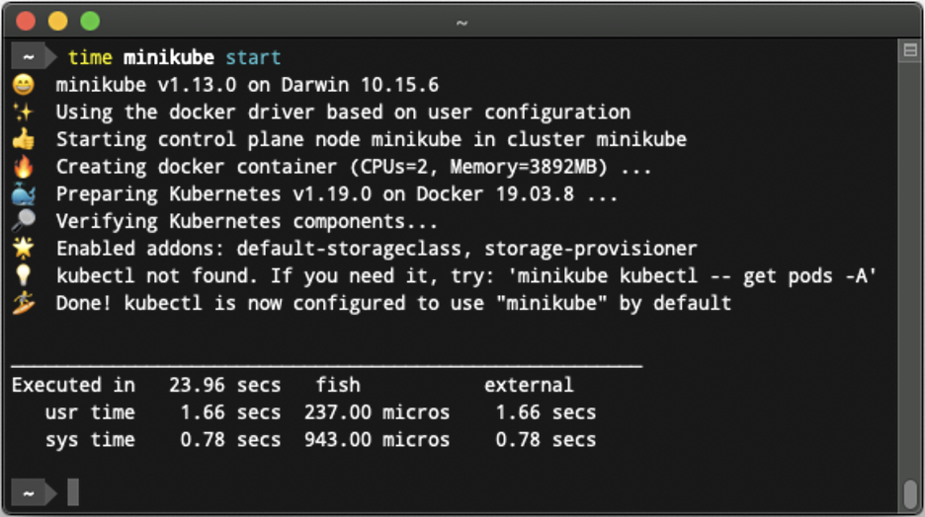
Minikube
Minikube is a utility you can use to run Kubernetes (k8s) on your local machine. It creates a single node cluster contained in a virtual machine (VM). This cluster lets you demo Kubernetes operations without requiring the time and resource-consuming installation of full-blown K8s.
Notes:
https://sensu.io/blog/minikube-tutorial

Slide 5
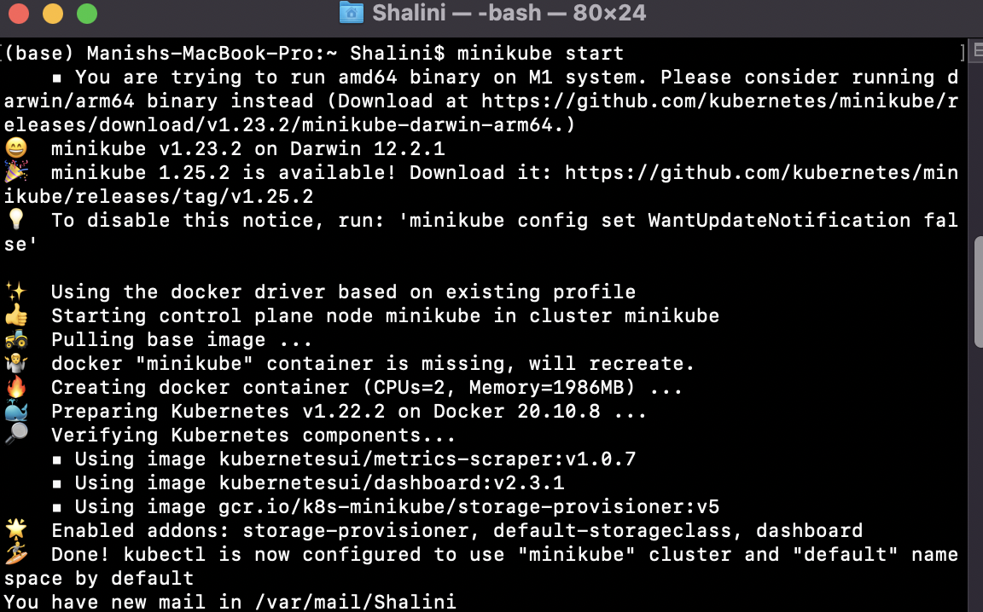
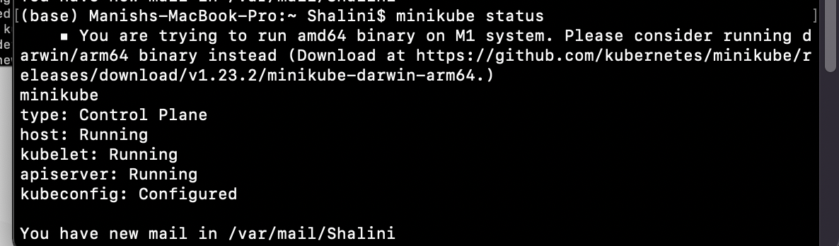
Check if minikube installed
minikube start
minikube status

Slide 6
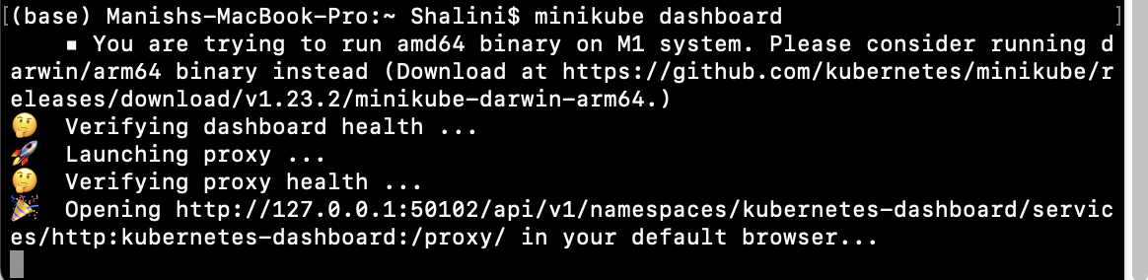
Dashboard
minikube dashboard – should open a dashboard on the browser

Slide 7
Tools to interact
kubeadm: the command to bootstrap the cluster.
kubelet: the component that runs on all of the machines in your cluster and does things like starting PODs and containers.
kubectl: the command line util to talk to your cluster.
Notes:
kubeadm will not install or manage kubelet or kubectl for you, so you will need to ensure they match the version of the Kubernetes control plane you want kubeadm to install for you.

Slide 8
Kubeadm
Kubeadm is a tool to set up a minimum viable Kubernetes cluster without much complex configuration.
Also, Kubeadm makes the whole process easy by running a series of prechecks to ensure that the server has all the essential components and configs to run Kubernetes.
It is developer and maintained by the official Kubernetes community.
https://devopscube.com/setup-kubernetes-cluster-kubeadm/

Slide 9
Kubelet
The kubelet is the primary "node agent" that runs on each node. It can register the node with the apiserver using one of: the hostname; a flag to override the hostname; or specific logic for a cloud provider
The kubelet is another Kubernetes controller. In general terms, it provides an interface between the Kubernetes control plane and the container runtime on each server in the cluster.

Slide 10
kubectl
kubectl is the command-line interface (CLI) tool for working with a Kubernetes cluster.
is the primary means by which a developer can interact with a Kubernetes cluster. For example, if you want to get the basic information about the nodes in a cluster, you’d type the command:
kubectl get nodes

Slide 11
kubectl
kubectl is the command-line interface (CLI) tool for working with a Kubernetes cluster.
is the primary means by which a developer can interact with a Kubernetes cluster. For example, if you want to get the basic information about the nodes in a cluster, you’d type the command:
kubectl get nodes

Slide 12
References
https://kubernetes.io/docs/concepts/overview/components/
https://www.edureka.co/blog/kubernetes-architecture/
https://www.edureka.co/blog/kubernetes-tutorial/
https://www.bmc.com/blogs/it-orchestration-vs-automation-whats-the-difference/
https://www.edureka.co/blog/amazon-eks/
https://birthday.play-with-docker.com/kubernetes-docker-desktop/
https://www.section.io/engineering-education/deploy-docker-container-to-kubernetes-cluster/

Slide 13

Any Question ?

Slide 14


7738460004 shalini06mittal@gmail.com
Thank you !

