Slide 1
Kafka Streams
Shalini Mittal
Corporate Trainer

Slide 2
What we will Cover?
Console Commands

Slide 3
Kafka Topics Console?
To get list of help commands
bin/kafka-topics
Create a topic => partitions and replication-factor are important
bin/kafka-topics --bootstrap-server localhost:9092 --create --topic t1 --partitions 2 --replication-factor 1
See list of topics:
bin/kafka-topics --bootstrap-server localhost:9092 --list
Describe a topic
bin/kafka-topics --bootstrap-server localhost:9092 --topic t1 --describe
Delete a topic
bin/kafka-topics --bootstrap-server localhost:9092 --topic t1 --delete
For deletion in latest version of kafka, delete.topic.enable is set to true by default.
To disable this, add following within etc/kafka/server.properties
delete.topic.enable = false
Notes:
https://docs.confluent.io/platform/current/kafka/post-deployment.html#:~:text=Increasing%20the%20replication%20factor%20can,factor%20of%20the%20specified%20partitions.

Slide 4
Kafka Producer Console?
To get list of help commands
bin/kafka-console-producer
To start a producer
bin/kafka-console-producer --broker-list localhost:9092 --topic t1
If command executed successfully, the producer shell starts and we can start producing messages
Add producer properties :
bin/kafka-console-producer--broker-list localhost:9092 --topic t1 --producer-property acks=all
If producer produces on a topic say t2 that doesn’t exist, we get warning but topic gets created. [Now default it sets partition and replication factor as 1. These can be configured in server.properties
num.partitions
]
bin/kafka-console-producer--broker-list localhost:9092 --topic t2
Notes:
Apache kafka – no support and u on your alone
Commercial – bunch of tools and utilities to manage . Comes with cost but most popular. Offers community edition as well
Managed Service – on the cloud.

Slide 5
Kafka Consumer Console?
To get list of help commands
bin/kafka-console-consumer
To start a consumer
bin/kafka-console-consumer --bootstrap-server localhost:9092 --topic t2
The consumer will by default start reading from the messages arrived after consumer is up and running.
If consumer needs previous messages add from beginning flag as follows:
bin/kafka-console-consumer --bootstrap-server localhost:9092 --topic t2 --from-beginning
Message ordering recieved by consumer is not guaranteed across partitions. Order is only guarantee at partition level
Notes:
Apache kafka – no support and u on your alone
Commercial – bunch of tools and utilities to manage . Comes with cost but most popular. Offers community edition as well
Managed Service – on the cloud.

Slide 6
Kafka Consumer Groups?
To create consumers in group use –group flag
bin/kafka-console-consumer --bootstrap-server localhost:9092 --topic t2 --group first-group
2 consumers in same group will never read same message
But if another consumer in another group created and set –from-beginning flag it receives all the messages on that topic. But if consumer in this second group started again even with –from-beginning flag set , it wont receive the previous messages as it already consumed. Now if we stop the consumer and send messages from producer, and restart this consumer it receives only latest messages produced by the producer.
Start zookeeper, 1 broker, producer, 2 consumers [ same group ]
Notes:
Apache kafka – no support and u on your alone
Commercial – bunch of tools and utilities to manage . Comes with cost but most popular. Offers community edition as well
Managed Service – on the cloud.

Slide 7
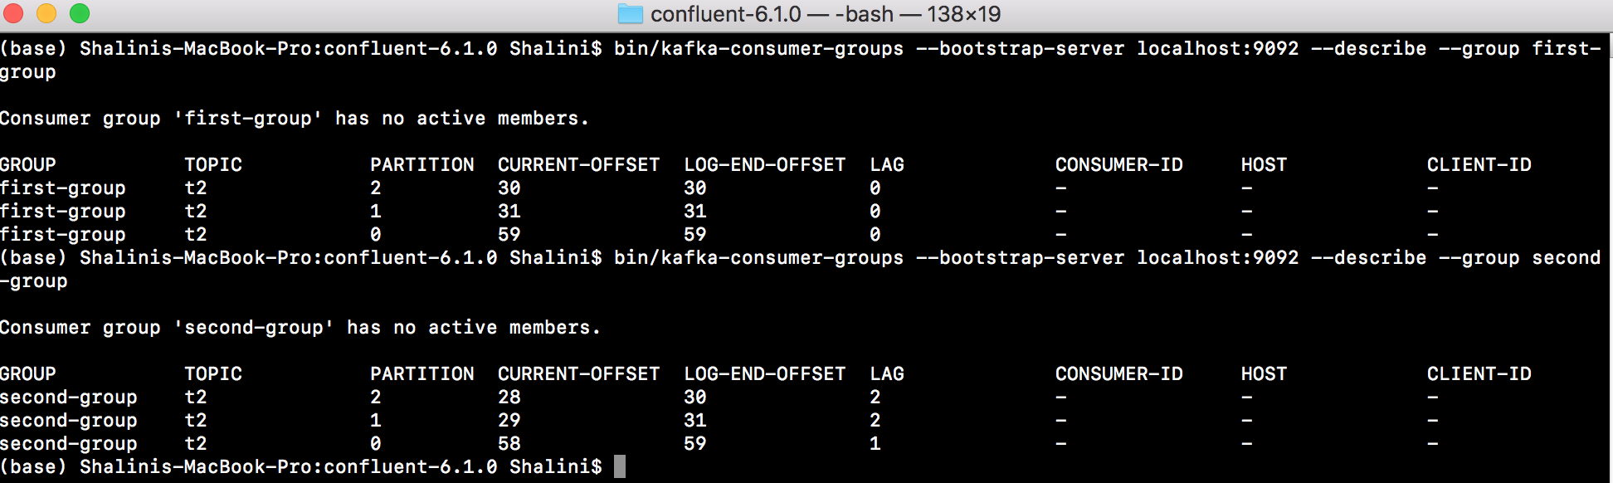
Kafka Consumer Groups CLI – 1/2
To get list of help commands: bin/kafka-consumer-groups
To see list of groups:
bin/kafka-consumer-groups --bootstrap-server localhost:9092 --list
If consumers created before without –group, then kafka internally assigns them a group id.
To describe the consumer groups:
bin/kafka-consumer-groups --bootstrap-server localhost:9092 --describe --group first-group
If some messages were not consumed it shows the lag for the messages
G1 and g2
Notes:
Apache kafka – no support and u on your alone
Commercial – bunch of tools and utilities to manage . Comes with cost but most popular. Offers community edition as well
Managed Service – on the cloud.

Slide 8
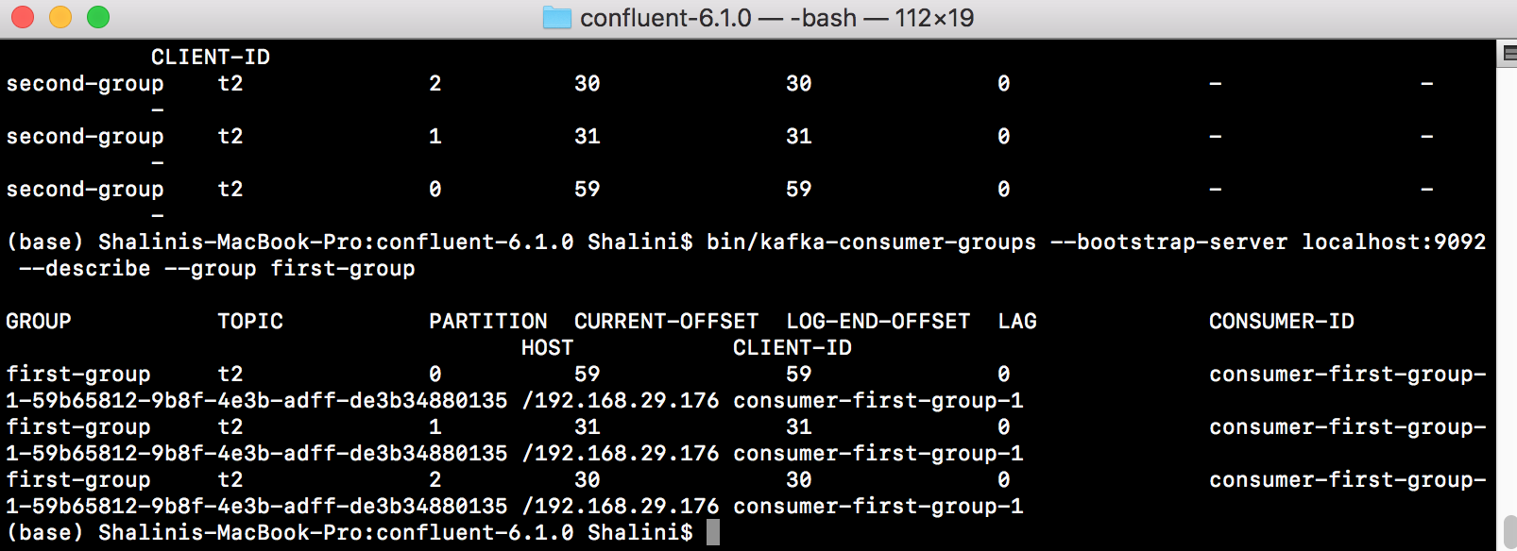
Kafka Consumer Groups CLI – 2/2
If consumer running and execute the command to describe a certain group we get following screen
Notes:
Apache kafka – no support and u on your alone
Commercial – bunch of tools and utilities to manage . Comes with cost but most popular. Offers community edition as well
Managed Service – on the cloud.

Slide 9
Reset Offsets?
By default when the consumer starts it reads messages from the default offset that’s set.
Consumer groups command provides with --reset-offsets that takes following options:
You must choose one of the following reset specifications:
--to-datetime,
--by-period,
--to-earliest,
--to-latest,
--shift-by,
--from-file,
--to-current.
To use the above flag:
bin/kafka-consumer-groups --bootstrap-server localhost:9092 --group first-group --reset-offsets --to-earliest
This gives an error saying –execute is missing:
bin/kafka-consumer-groups --bootstrap-server localhost:9092 --group first-group --reset-offsets --to-earliest –execute
One of the reset scopes should be defined: --all-topics, --topic.
Notes:
Apache kafka – no support and u on your alone
Commercial – bunch of tools and utilities to manage . Comes with cost but most popular. Offers community edition as well
Managed Service – on the cloud.

Slide 10
Reset Offsets commands
To use the previous flag:
bin/kafka-consumer-groups --bootstrap-server localhost:9092 --group first-group --reset-offsets --to-earliest
This gives an error saying –execute is missing:
bin/kafka-consumer-groups --bootstrap-server localhost:9092 --group first-group --reset-offsets --to-earliest –execute
Again it gies an error => One of the reset scopes should be defined: --all-topics, --topic.
If needs to shift offset by a certain value
bin/kafka-consumer-groups --bootstrap-server localhost:9092 --group first-group --reset-offsets --shift-by -2 --execute --topic t2
Notes:
Apache kafka – no support and u on your alone
Commercial – bunch of tools and utilities to manage . Comes with cost but most popular. Offers community edition as well
Managed Service – on the cloud.

Slide 11
ThankYou

