Slide 1
Normalization

Slide 2
Data Integrity
Refers to the accuracy and consistency of data
Making sure the data remains intact and unchanged throughout its entire life cycle.
This includes the capture of the data, storage, updates, transfers, backups, etc..
Every time data is processed there’s a risk that it could get corrupted (whether accidentally or maliciously).
SQL injection
Notes:
https://database.guide/what-is-data-integrity/

Slide 3
Risks to Data Integrity
A user tries to enter a date outside an acceptable range.
A user tries to enter a phone number in the wrong format.
A bug in an application attempts to delete the wrong record.
While transferring data between two databases, the developer accidentally tries to insert the data into the wrong table.
While transferring data between two databases, the network went down.
A user tries to delete a record in a table, but another table is referencing that record as part of a relationship.
A user tries to update a primary key value when there’s already a foreign key in a related table pointing to that value.
A developer forgets that he’s on a production system and starts entering test data directly into the database.
A hacker manages to steal all user passwords from the database.
A hacker hacks into the network and drops the database (i.e. deletes it and all its data).
A fires sweeps through the building, burning the database computer to a cinder.
The regular backups of the database has been failing for the past two months…

Slide 4
Handle Data Integrity
risks can be addressed from within the database itself (through the use of data types and constraints against each column for example, encryption, etc)
Others can be addressed through other features of the DBMS (such as regular backups – and testing that the backups do actually restore the database as expected).
Some of these require other (non-database related) factors to be present, such as an offsite backup location, a properly functioning IT network, proper training, security policies, etc.

Slide 5
Types of Integrity
Entity integrity : defines each row to be unique within its table. No two rows can be the same. A primary key can be defined
Referential integrity : concerned with relationships. When two or more tables have a relationship, we have to ensure that the foreign key value matches the primary key value at all time
Domain integrity : Concerns the validity of entries for a given column. Selecting the appropriate data type for a column is the first step in maintaining domain integrity.
User-defined integrity: allows the user to apply business rules to the database that aren’t covered by any of the other three data integrity types.

Slide 6
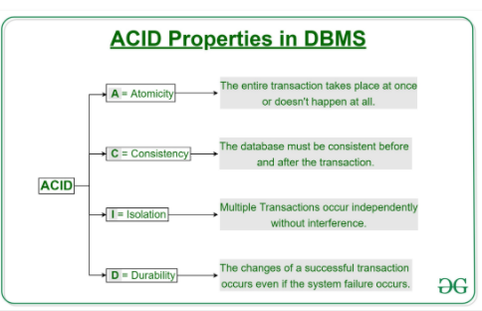
ACID
Transaction is a single unit of work which access and modifies data
Transaction access data through read and write operations
To maintain consistency in database, before and after transaction, certain properties are to be followed. These are called ACID properties.
Notes:
https://www.educative.io/edpresso/what-are-acid-properties-in-a-database?aid=5082902844932096&utm_source=google&utm_medium=cpc&utm_campaign=edpresso-dynamic&gclid=Cj0KCQiA1pyCBhCtARIsAHaY_5c-Fonh1jA3YyMUKR-m_NeNTnPOQcUaWOtbqZmlzhmU-MoNJp3q-foaAsmTEALw_wcB

Slide 7
Atomicity
Transaction takes place together or does not happen
Involves following operations –
Abort – Nothing is saved
Commit – Data is visible
Also knows as All or nothing rule
Transfer of Rs 1000 from account of Paul to Smith.
Read Balance from Paul’s Account
Deduct Rs 1000 from Paul’s account
Read Balance from Smith’s account
Add Rs 1000 to Smith’s Account
X
Transaction fails after deduction resulting in inconsistent data

Slide 8
Consistency
Integrity constrained must be maintained
In short correctness of data
Read Balance from Paul’s Account which is Rs 1500
Deduct Rs 1000 from Paul’s account. New Balance is Rs 500
Read Balance from Smith’s account which is Rs 500
Add Rs 1000 to Smith’s Account and new Balance is Rs 1500
Total of both account, before and after transaction, Rs 2000

Slide 9
Isolation
Multiple transactions are executed concurrently without leading to database inconsistency
Changes from a transaction are not visible to others till they are committed
Timeline
Read Balance from Paul’s Account which is Rs 1500
Deduct Rs 1000 from Paul’s account. New Balance is Rs 500
Read Balance from Smith’s account which is Rs 500
Add Rs 1000 to Smith’s Account and new Balance is Rs 1500
Transaction T1
Read Balance from Smith’s Account which is Rs 500
Deduct Rs 300 from Smith’s account. New Balance is Rs 200
Read Balance from Paul’s account which is Rs 500
Add Rs 300 to Pauls’s Account and new Balance is Rs 800
Transaction T2
Result incorrect calculation

Slide 10
Durability
Once the transaction are completed, the updates are written to the disk
They should persist even if there is a system failure
The updates are permanent and are stored in non volatile memory

Slide 11
Normalization
Process of organizing data in database
Helps in minimizing redundancy
Divides larger table into smaller tables
Links them using relationships
Improves data integrity.
Normal Form | Description
1NF | A relation is in 1NF if it contains an atomic value.
2NF | A relation will be in 2NF if it is in 1NF and all non-key attributes are fully functional dependent on the primary key.
3NF | A relation will be in 3NF if it is in 2NF and no transition dependency exists.
4NF | A relation will be in 4NF if it is in Boyce Codd normal form and has no multi-valued dependency.
5NF | A relation is in 5NF if it is in 4NF and not contains any join dependency and joining should be lossless.
Notes:
https://database.guide/what-is-normalization/#more-1203

Slide 12
Benefits of Normalization
Minimizes data redundancy (duplicate data).
Minimizes null values.
Results in a more compact database (due to less data redundancy/null values).
Minimizes/avoids data modification issues.
Simplifies queries.
The database structure is cleaner and easier to understand. You can learn a lot about a relational database just by looking at its schema.
You can extend the database without necessarily impacting the existing data.
Searching, sorting, and creating indexes can be faster, since tables are narrower, and more rows fit on a data page.
Notes:
https://database.guide/what-is-normalization/#more-1203

Slide 13
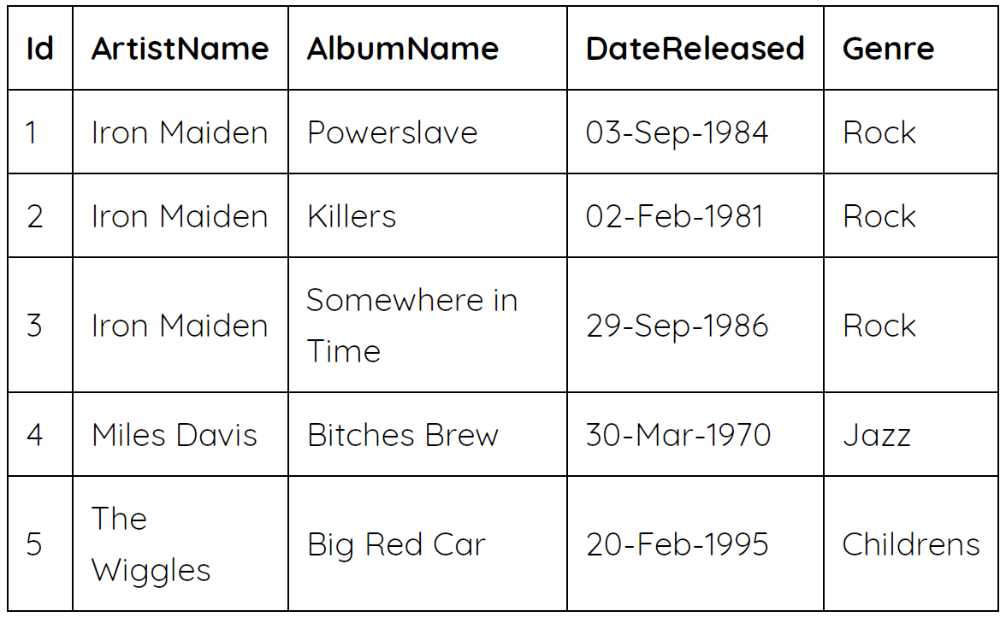
Example
Normalized
Denormalize
Notes:
This schema separates the data into three different tables. Each table is quite specific in the data that it stores – there’s one table for albums, one for artists, and another that holds data that’s specific to genre. However, because the relational model allows us to create a relationship between these tables, we can still find out which albums belong to which artist, and in which genre they belong.
IdArtistNameAlbumNameDateReleasedGenre1Iron MaidenPowerslave03-Sep-1984Rock2Iron MaidenKillers02-Feb-1981Rock3Iron MaidenSomewhere in Time29-Sep-1986Rock4Miles DavisBitches Brew30-Mar-1970Jazz5The WigglesBig Red Car20-Feb-1995Childrens

Slide 14
Denormalized Anamoly
Update anomaly : update an artist’s name, we’ll need to update multiple rows. Same with genre. If we update some rows, but not others, we’ll end up with inaccurate data. This is known as an update anomaly.
Insertion anomaly: To add an artists, haven’t released any albums yet, need to set other fields to null This is known as an insertion anomaly.
Deletion anomaly: If we need to delete an album, we can’t do that without also deleting the artist. If an artist only has one album, and we delete that album, we’ll end up deleting the artist from our database. This is known as a deletion anomaly.
Notes:
Update anomalyIf we need to update an artist’s name, we’ll need to update multiple rows. Same with genre. This could result in errors. If we update some rows, but not others, we’ll end up with inaccurate data. This is known as an update anomaly

Slide 15
Normalization Types
1NF
2NF
3NF
BCNF
https://www.studytonight.com/dbms/third-normal-form.php
Notes:
Update anomalyIf we need to update an artist’s name, we’ll need to update multiple rows. Same with genre. This could result in errors. If we update some rows, but not others, we’ll end up with inaccurate data. This is known as an update anomaly

Slide 16
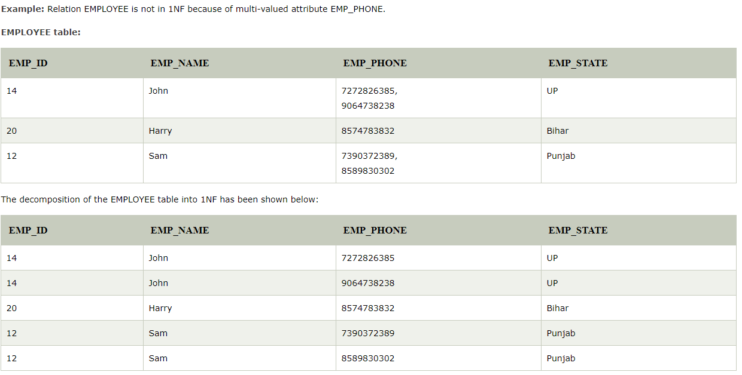
First Normal form
A relation will be 1NF if it contains an atomic values
It states that an attribute of a table cannot hold multiple values. It must hold only single-valued attribute.
First normal form disallows the multi-valued attribute, composite attribute, and their combinations.

Slide 17
Second Normal form
In the 2NF, relational must be in 1NF.
A relation is in 2NF if it has No Partial Dependency, i.e., no non-prime attribute (attributes which are not part of any candidate key) is dependent on any proper subset of any candidate key of the table.
Partial Dependency – If the proper subset of candidate key determines non-prime attribute, it is called partial dependency.

Slide 18
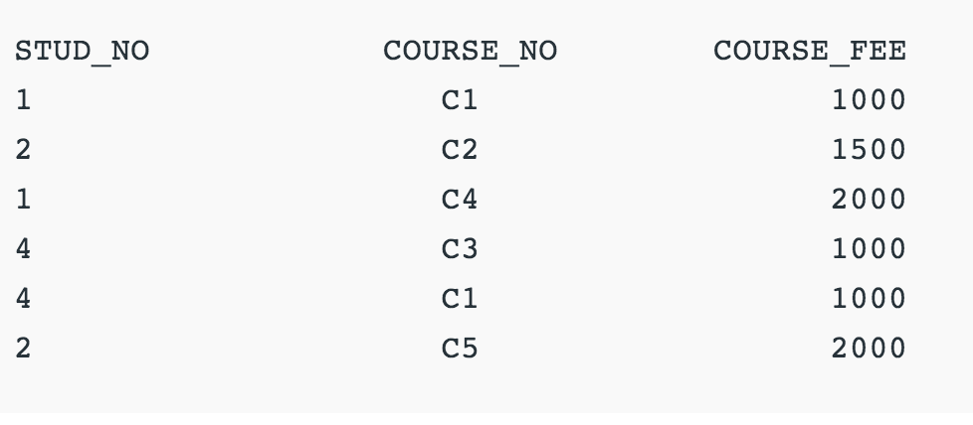
Example:
COURSE_FEE cannot alone decide the value of COURSE_NO or STUD_NO;
COURSE_FEE together with STUD_NO cannot decide the value of COURSE_NO;
COURSE_FEE together with COURSE_NO cannot decide the value of STUD_NO;
COURSE_FEE would be a non-prime attribute, as it does not belong to the one only candidate key {STUD_NO, COURSE_NO} ;
But, COURSE_NO -> COURSE_FEE , i.e., COURSE_FEE is dependent on COURSE_NO, which is a proper subset of the candidate key.
Non-prime attribute COURSE_FEE is dependent on a proper subset of the candidate key, which is a partial dependency and so this relation is not in 2NF.

Slide 19
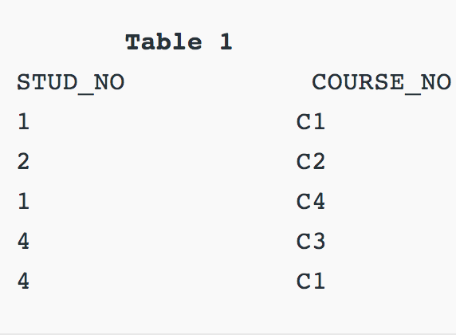
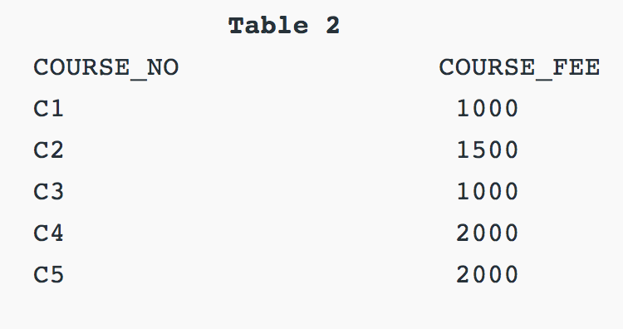
2NF Example:
To convert the above relation to 2NF,we need to split the table into two.
2NF tries to reduce the redundant data getting stored in memory.
For instance, if there are 100 students taking C1 course, we dont need to store its Fee as 1000 for all the 100 records, instead once we can store it in the second table as the course fee for C1 is 1000.

Slide 20
Third Normal form
A relation will be in 3NF if it is in 2NF and not contain any transitive partial dependency.
3NF is used to reduce the data duplication. It is also used to achieve the data integrity.
If there is no transitive dependency for non-prime attributes, then the relation must be in third normal form.
Transitive dependency – If A->B and B->C are two FDs then A->C is called transitive dependency
A relation is in third normal form if it holds atleast one of the following conditions for every non-trivial function dependency X → Y.
X is a super key.
Y is a prime attribute, i.e., each element of Y is part of some candidate key.

Slide 21
Third Normal form continued
{STUD_NO -> STUD_NAME, STUD_NO -> STUD_STATE, STUD_STATE -> STUD_COUNTRY, STUD_NO -> STUD_AGE} Candidate Key: {STUD_NO}
STUD_NO -> STUD_STATE and STUD_STATE -> STUD_COUNTRY are true.
So STUD_COUNTRY is transitively dependent on STUD_NO and violates the third normal form. To convert it in third normal form, we will decompose the relation
STUDENT (STUD_NO, STUD_NAME, STUD_PHONE, STUD_STATE, STUD_COUNTRY_STUD_AGE) as:
STUDENT (STUD_NO, STUD_NAME, STUD_PHONE, STUD_STATE, STUD_AGE)
STATE_COUNTRY (STATE, COUNTRY)

Slide 22
BCNF
BCNF is the advance version of 3NF. It is stricter than 3NF.
A table is in BCNF if every functional dependency X → Y, X is the super key of the table.
For BCNF, the table should be in 3NF, and for every FD, LHS is super key.
Notes:
https://www.ques10.com/p/17052/explain-bcnf-with-example/
https://hackr.io/blog/dbms-normalization
https://www.studytonight.com/dbms/boyce-codd-normal-form.php

Slide 23
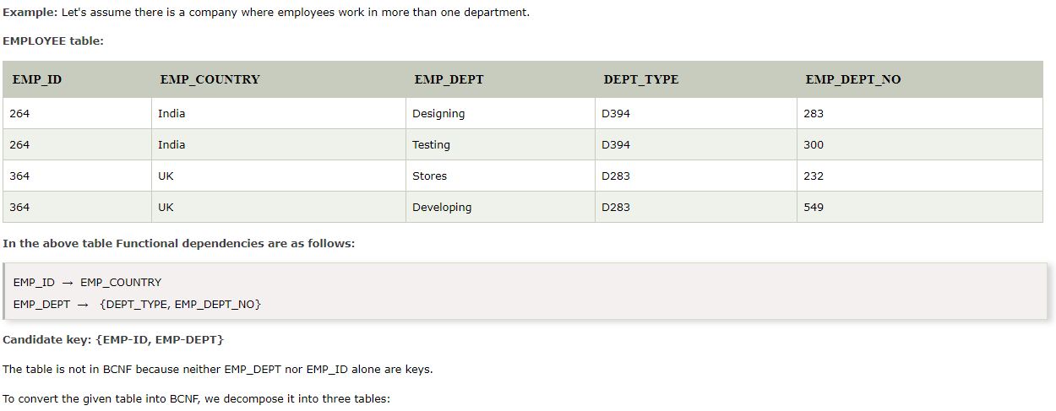
BCNF
Notes:
https://www.ques10.com/p/17052/explain-bcnf-with-example/

Slide 24
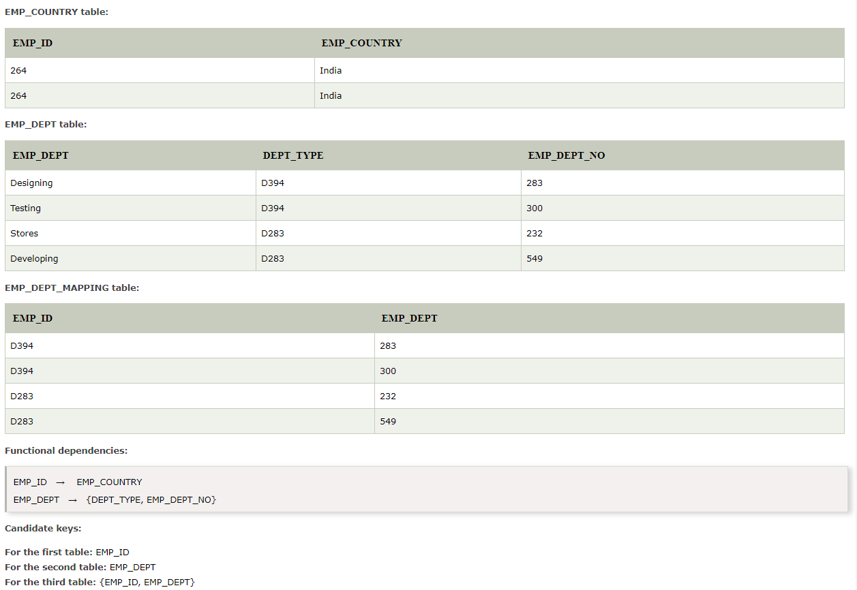
BCNF continued

