Slide 1
Performance

Slide 2
Optimization
Every MySQL backed application can benefit from a finely tuned database server
Database performance tuning should occur regularly and before productivity is affected.
The most obvious symptoms of performance problems are:
Queries stack up and never completing in the MySQL process table.
Applications or websites using the database become sluggish.
Connection timeouts errors, especially during peak hours.
https://dev.mysql.com/doc/refman/8.0/en/optimization.html
Notes:
It is best practice behavior to conduct weekly or monthly audits of database performance to prevent issues from adversely affecting applications.
While it is normal for there to be several concurrent queries running at once on a busy system, it becomes a problem when these queries are taking too long to finish regularly. Although the specific threshold varies per system and per application, average query times exceeding several seconds will manifest as a slowdown within attached websites and applications. These slowdowns can sometimes start out small and go unnoticed until a large traffic surge hits a particular bottleneck.

Slide 3
MyISAm vs InnoDb
A major factor in database performance is the storage engine used by the database, and more specifically, its tables.
Different storage engines provide better performance in one situation over another.
For general use, there are two contenders to be considered. These are MyISAM or InnoDB
Before we can understand the difference between the two storage engines, we need to understand the term “locking.”

Slide 4
Locking
To protect the integrity of the data stored within databases, MySQL employs locking.
Locking, simply put, means protecting data from being accessed.
When a lock is applied, the data cannot be modified except by the query that initiated the lock.
Locking is a necessary component to ensure the accuracy of the stored information.
Each storage engine has a different method of locking used.
Depending on your data and query practices, one engine can outperform another.

Slide 5
Table Locking
The technique of locking an entire table when one or more cells within the table need to be updated or deleted. Table locking is the default method employed by the default storage engine, MyISAM.
Example: MyISAM Table Locking |  | Column A | Column B | Column C
Query 1 UPDATE | Row 1 | Writing | data | data
Query 2 SELECT (Wait) | Row 2 | data | data | data
Query 3 UPDATE (Wait) | Row 3 | data | data | data
Query 4 SELECT (Wait) | Row 4 | data | data | data
Query 5 SELECT (Wait) | Row 5 | data | data | data

Slide 6
Row Locking
The act of locking an effective range of rows in a table while one or more cells within the range are modified or deleted. Row-level locking is the method used by the InnoDB storage engine and is intended for high-performance databases.
Example: InnoDB Row-Level Locking |  | Column A | Column A | Column A
Query 1 UPDATE | Row 1 | Writing | data | data
Query 2 SELECT | Row 2 | Reading | data | data
Query 3 UPDATE | Row 3 | data | Writing | data
Query 4 SELECT | Row 4 | Reading | Reading | Reading
Query 5 SELECT | Row 5 | Reading | data | Reading
The example shows how using row-level locking allows for multiple queries to run on individual rows by locking only the rows being updated instead of the entire table.

Slide 7
Which to use?
If your application relies on huge tables that do not change data frequently, then MyISAM will out-perform InnoDB.
Conversely, InnoDB outperforms MyISAM when data within the table changes frequently.
Table changes write data more than reading data per second. In these situations, InnoDB can keep up with large amounts of requests easier than locking the entire table for each one.
Notes:
https://www.liquidweb.com/kb/mysql-performance-myisam-vs-innodb/

Slide 8
Index Concepts
Imagine phone_book table containing roughly 35 million entries. Consider a query like this one:
SELECT * FROM phone_book WHERE last_name = 'Zawodny’
Without any sort of index to consult, MySQL must read all the records in the phone_book table and compare the last_name field with the string “Zawodny” to see whether they match.
As the number of records increases, so does the effort necessary to find a given record. In computer science, we call that an O(n) problem.
But given a real phone book, we all know how to quickly locate anyone named Zawodny:
Notes:
But given a real phone book, we all know how to quickly locate anyone named Zawodny: flip to the Zs at the back of book and start there. Since the second letter is “a,” we know that any matches will be at or near the front of the list of all names starting
Most technical books (like this one) provide an index at the back. It allows you to find the location of important terms and concepts quickly because they’re listed in sorted order along with the corresponding page numbers. Need to know where mysqlhotcopy is discussed? Just look up the page number in the index.with Z. The method used is based on knowledge of the data and how it is sorted.
https://www.oreilly.com/library/view/high-performance-mysql/0596003064/ch04.html

Slide 9
Index Concepts
Database indexes are similar and we choose to create an index on a particular column of a database table ALTER TABLE phone_book ADD INDEX (last_name)
asking MySQL to create an ordered list of all the last names in the phone_book table. Along with each name, it notes the positions of the matching records—just as the index at the back of this book lists page numbers for each entry
From the database server’s point of view, indexes exist so that the database can quickly eliminate possible rows from the result set when executing a query.
Without any indexes, MySQL (like any database server) must examine every row in a table. Not only is that time consuming, it uses a lot of disk I/O and can effectively pollute the disk cache.

Slide 10
Indexes
Helps in finding rows with specified column values quickly
If no index is present it will read all rows making finding of relevant rows slow
When index is created it is stored in a new structure. Pointers to the values are also stored
Compares row values in tree structure for faster location of data
Primary key and unique key are some of the examples of Indexes
primary key is automatically indexed in MySQL because primary key, index, etc gets stored into B-trees.
All engines including InnoDB as well as MyISAM automatically supports the primary key to be indexed.
Notes:
https://dev.mysql.com/doc/refman/5.6/en/mysql-indexes.html

Slide 11
What is Indexing?
is a powerful structure in MySQL which can be leveraged to get the fastest response times from common queries.
MySQL queries achieve efficiency by generating a smaller table, called an index, from a specified column or set of columns.
These columns, called a key, can be used to enforce uniqueness
Queries utilize indexes to identify and retrieve the targeted data, even if they are a combination of keys.
Without an index, running that same query results in an inspection of every row for the needed data.
Indexing produces a shortcut, with much faster query times on expansive tables
Notes:
Queries utilize indexes to identify and retrieve the targeted data, even if they are a combination of keys. Without an index, running that same query results in an inspection of every row for the needed data. Indexing produces a shortcut, with much faster query times on expansive tables

Slide 12
When to use Indexing?
Indexing is only advantageous for huge tables with regularly accessed information.
Without indexes, when tables grow to enormous proportions, response times suffer from queries targeting those obtuse tables.
Inefficient queries manifest into latency within application or website performance

Slide 13
Cons of Indexing?
MySQL needs to maintain a separate list of indexes’ values and keep them updated as your data changes, you really don’t want to index every column in a table.
Indexes are a trade-off between space and time.
You’re sacrificing some extra disk space and a bit of CPU overhead on each INSERT, UPDATE, and DELETE query to make most (if not all) your queries much faster.

Slide 14
WHAT TO INDEX
Indexing works best on those columns that are the subject of the WHERE clauses in commonly executed queries.
Consider the following simplified table:
ID, TITLE, LAST_NAME, FIRST_NAME, MAIDEN_NAME, DOB, GENDER, AGE, DESCRIPTION, HISTORY, ETC...
If your queries rely on testing the WHERE clause using LAST_NAME and FIRST_NAME then indexing by these two columns would significantly increase query response times.
Alternately, if your queries rely on a simple ID lookup, indexing by ID would be the better choice.
Notes:
Selecting what to index is probably the most challenging part to indexing your databases. Determining what is important enough to index and what is benign enough to not index.

Slide 15
WHAT is unique INDEX
Setting the UNIQUE constraint will enforce uniqueness based on the configured indexing key.
As with any key, this can be a single column or a concatenation of multiple columns.
The function of this constraint ensures that there are no duplicate entries in the table based on the configured key.

Slide 16
WHAT is primary INDEX
PRIMARY KEY is used to optimize indexes.
This constraint ensures that the designated PRIMARY KEY cannot be of a null value.
As a result, a performance boost occurs when running on an InnoDB storage engine for the table in question.
This boost is due to how InnoDB physically stores data, placing null valued rows in the key out of contiguous sequence with rows that have values.
Enabling this constraint ensures the rows of the table are kept in contiguous order for quicker response
When using large databases always set a primary key. If cannot determine which column should be a primary key add an int column with auto increment as primary key.

Slide 17
Partial Index
Indexes trade space for performance.
Maybe you have a phone_book table with 2 billion rows in it.
Adding an index on last_name will require a lot of space considering an average last name of 8 bytes
Instead of indexing the entire last name, you might index only the first 4 bytes:
ALTER TABLE phone_book ADD INDEX (last_name(4))
In doing so, you’ve reduced the space requirements for the data portion of the index by roughly half.
Notes:
If the average last_name is 8 bytes long, you’re looking at roughly 16 GB of space for the data portion of the index; the row pointers are there no matter what you do, and they add another 4-8 bytes per record.[

Slide 18
Multicolumn Index
Like many relational database engines, MySQL allows you to create indexes that are composed of multiple columns: ALTER TABLE phone_book ADD INDEX (last_name, first_name)
Such indexes can improve the query speed if you often query all columns together in the WHERE clause or if a single column doesn’t have sufficient variety.
Of course, you can use partial indexes to reduce the space required:
ALTER TABLE phone_book ADD INDEX (last_name(4), first_name(4))
In either case, a query to find Josh Woodward executes quickly: SELECT * FROM phone_book WHERE last_name = 'Woodward' AND first_name = 'Josh'
Notes:
Having the last name and first name indexed together means that MySQL can eliminate rows based on both fields, thereby greatly reducing the number of rows it must consider. After all, there are a lot more people in the phone book whose last name starts with “Wood” than there are folks whose last name starts with “Wood” and whose first name also starts with “Josh.”
So why not just create two indexes, one on last_name and one on first_name? You could do that, but MySQL won’t use them both at the same time. In fact, MySQL will only ever use one index per table per query—except for UNIONs.^{[3]} This fact is important enough to say again: MySQL will only ever use one index per table per query.
With separate indexes on first_name and last_name, MySQL will choose one or the other. It does so by making an educated guess about which index allows it to match fewer rows. We call it an educated guess because MySQL keeps track of some index statistics that allow it to infer what the data looks like. The statistics, of course, are generalizations. While they often let MySQL make smart decisions, if you have very clumpy data, MySQL may make suboptimal choices about index use. We call data clumpy if the key being indexed is sparse in some areas (such as names beginning with X) and highly concentrated in others (such as the name Smith in English-speaking countries). This is an important topic that we’ll revisit later in this book.

Slide 19
Index Order
How does MySQL order values in the index?
If you’ve used another RDBMS, you might expect MySQL to have syntax for specifying that an index be sorted in ascending, descending, or some other order.
MySQL gives you no control over its internal sorting of index values.
For example, some database products may execute this query quickly: SELECT * FROM phone_book WHERE last_name = 'Zawodny' ORDER BY first_name DESC
And this query slowly: SELECT * FROM phone_book WHERE last_name = 'Zawodny' ORDER BY first_name ASC
Notes:
Why? Because some databases store the indexes in descending order and are optimized for reading them in that order. In the first case, the database uses the multicolumn index to locate all the matching records. Since the records are already stored in descending order, there’s no need to sort them. But in the second case, the server finds all matching records and then performs a second pass over those rows to sort them.

Slide 20
Listing Indexes
Tables can have multiple indexes.
Managing indexes will inevitably require being able to list the existing indexes on a table.
The syntax for viewing an index is below.
SHOW INDEX FROM tableName;

Slide 21
Creating Indexes
Multiple indexing is useful for creating indexes attuned to the queries required by your application or website.
The default settings allow for up to 16 indexes per table
Indexes can be created during a table’s creation or added on to the table as additional indexes later on.

Slide 22
Creating Indexes Examples
Create Table with
Standard Index
Create a Table with
Unique Index & Primary Key
Add an Index
to Existing Table
CREATE TABLE tableName ( ID int, LName varchar(255), FName varchar(255), DOB varchar(255), LOC varchar(255), INDEX ( ID ) );
CREATE TABLE tableName ( ID int, LName varchar(255), FName varchar(255), DOB varchar(255), PRIMARY KEY (ID), UNIQUE INDEX ( ID ) );
CREATE INDEX indexName ON tableName (ID, LName, FName, LOC);

Slide 23
Delete Indexes Examples
DROP INDEX indexName ON tableName;

Slide 24
Index Structures
There are various types (or structures) of indexes in databases.
B-Tree Indexes
Hash Indexes
R-Tree Indexes

Slide 25
B-Tree?
The B-tree, or balanced tree, is the most common types of index.
Virtually all database servers and embedded database libraries offer B-tree indexes, often as the default index type because of their unique combination of flexibility, size, and overall good performance.

Slide 26
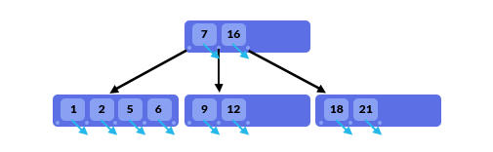
B-Tree features
A tree data structure
Sorted at all times based on key values
Organized like binary tree structure where smaller values are stored on left and bigger values on right.
B Tree nodes can have many children
Can quickly find values near to root
B-trees offer O(log n) performance for single-record lookups
Range-base queries such as the following can be resolved very quickly:
Example – Primary Key and Unique Key
SELECT * FROM phone_book WHERE last_name BETWEEN 'Marten' and 'Mason'

Slide 27
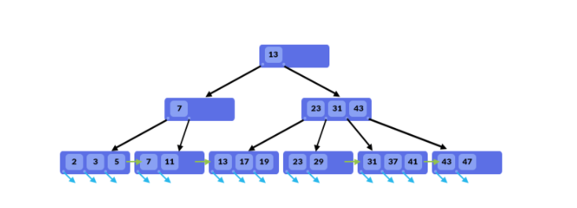
B+-Tree
Similar to B Tree structure
Difference are –
Internal nodes store only values and not pointers to rows reducing internal node size and reducing disk I/O
Leaf nodes are linked and can conduct full scan with one pass
Delete operation is much easier since it does not require to remove values from internal nodes

Slide 28
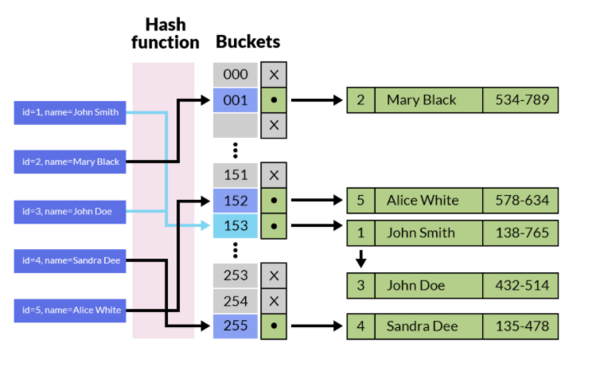
Hash Indexes
Related to hashing techniques
Hash function is used to calculate the address where actual value is stored
Values are stored in bucket based on value of hash functions
Very fast when checking for equality
Will not help in case of range.
hash tables are always governed by the available storage space.
Notes:
While hash-based indexes generally provide some of the fastest key lookups, they are also less flexible and less predictable than other indexes. They’re less flexible because range-based queries can’t use the index. Good hash functions generate very different values for similar values, so the server can’t make any assumptions about the ordering of the data within the index structure. Records that are near each other in the hash table are rarely similar. Hash indexes are less predictable because the wrong combination of data and hash function can result in a hash table in which most of the records are clumped into just a few buckets. When that happens, performance suffers quite a bit. Rather than sifting through a relatively small list of keys that share the same hash value, the computer must examine a large list.
Hash indexes work relatively well for most text and numeric data types. Because hash functions effectively reduce arbitrarily sized keys to a small hash value, they tend not to use as much space as many tree-based indexes.
R-Tree Indexes

