Slide 1
JEST - Mocking
Shalini Mittal
Corporate Trainer

Slide 2
Agenda
Different ways to mock
JSDom
Need of mocking
Mock dependency injection
What is mocking

Slide 3
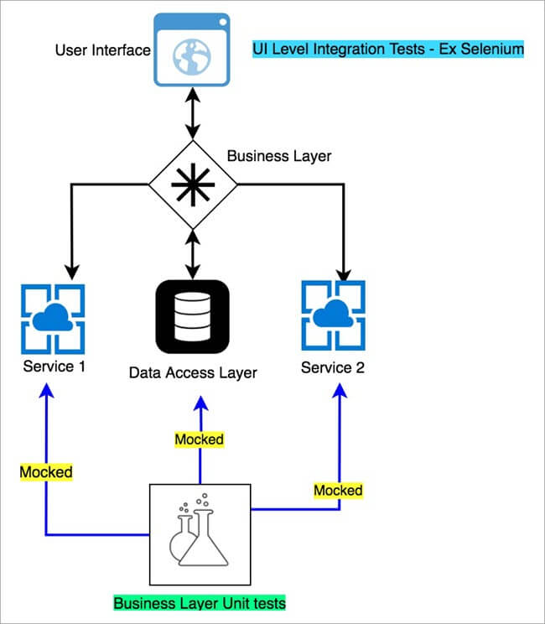
Mocking
a controlled instance or implementation of dependency that the code under test depends on in order to test its core logic.
Notes:
et’s take an example of any Business or Ecommerce Application. Almost every such type of application primarily has 3 layers i.e. User Interface, Business Layer & Data Access layer (which talks to the underlying data store)
Look at it this way – An app like google maps can have dependencies on an
Actual data stores like MySQL or any other no SQL database which stores Map data.
An external service like CoordinateService which provides latitudes and longitudes of a location.
An external service like traffic service which provides real-time traffic information for a given Coordinate pair.
So, if someone is trying to validate the core business logic using unit test, until and unless they have working implementations of these dependencies, the tests could not be run.
Mocks come to rescue in these situations, where no matter your dependency is up and running or not, you are always guaranteed to run your business logic with a programmed response for the dependency that’s being getting called from the code under test.

Slide 4
Need for mocking
Tests, and the software components we want to test, most of the times have dependencies. A typical dependency might be an external data source for example.
It would be impractical to call the real API in a testing environment, or in development. There are a number of reasons for not doing this.
First, tests must not depend on external services. A test using a real API could fail if:
the API has intermittent or permanent network issues
the API gets rate-limited
the API is slow
On the other hand, you don't want to use the actual RESTFUL API in development neither because:
the API could be a paid service, you'll incur in high costs
you're behind a firewall which blocks outbound connections
the API is slow
Also, more often than not, frontend developers need, and want, to develop in isolation long before the RESTFUL API is 100% ready.
It's here that mocking and stubbing come into play.

Slide 5
Mocking and stubbing
In the context of a typical frontend application, mocking and stubbing help to "fake" the real API, by replacing it with a fabricated service, or with a "surgical" swap of a single function.
This is particularly useful when working on decoupled frontend architectures, which more often than not talk to remote APIs, not always under our direct control.
What's the difference between mocking and stubbing?
Mocking means replacing one or more function in testing with a fake copy
Stubbing means replacing some external service , or a network response, with a fake version
Mocking is also when you assert on the mocked function to see:
if it has been called by another piece of code
how many times has been called
how many parameters has been called with
Notes:
Stub: a dummy piece of code that lets the test run, but you don't care what happens to it.
Mock: a dummy piece of code, that you VERIFY is called correctly as part of the test.
Spy: a dummy piece of code, that intercepts some calls to a real piece of code, allowing you to verify calls without replacing the entire original object.

Slide 6
Mock Function
The goal for mocking is to replace something we don’t control with something we do, so it’s important that what we replace it with has all the features we need.
The Mock Function provides features to:
Capture calls
Set return values
Change the implementation
The simplest way to create a Mock Function instance is with jest.fn().
test("returns undefined by default", () => {
const mock = jest.fn();
let result = mock("foo");
expect(result).toBeUndefined();
expect(mock).toHaveBeenCalled();
expect(mock).toHaveBeenCalledTimes(1);
expect(mock).toHaveBeenCalledWith("foo");
});

Slide 7
Dependency Injection
One of the common ways to use the Mock Function is by passing it directly as an argument to the function you are testing.
This allows you to run your test subject, then assert how the mock was called and with what arguments:
This strategy is solid, but it requires that your code supports dependency injection. Often that is not the case, so we will need tools to mock existing modules and functions instead.
const doAdd = (a, b, callback) => {
callback(a + b);
};
test("calls callback with arguments added", () => {
const mockCallback = jest.fn();
doAdd(1, 2, mockCallback);
expect(mockCallback).toHaveBeenCalledWith(3);
});

Slide 8
Mock Modules and Functions
There are three main types of module and function mocking in Jest:
jest.fn: Mock a function
jest.mock: Mock a module
jest.spyOn: Spy or mock a function
Notes:
Mockexample fodler

Slide 9
Sample Modules
math.js
const add = (a, b) => a + b;
const subtract = (a, b) => b - a;
const multiply = (a, b) => a * b;
const divide = (a, b) => b / a;
module.exports = {add,subtract,multiply,divide}
app.js
const math = require('./math');
const doAdd = (a, b) => math.add(a, b);
const doSubtract = (a, b) => math.subtract(a, b);
const doMultiply = (a, b) => math.multiply(a, b);
const doDivide = (a, b) => math.divide(a, b);
module.exports = {doAdd, doSubtract, doMultiply, doDivide}
Notes:
Mockexample fodler

Slide 10
Mock a function with jest.fn
The most basic strategy for mocking is to reassign a function to the Mock Function. Then, anywhere the reassigned functions are used, the mock will be called instead of the original function
See the mockexample folder
This type of mocking is less common for a couple reasons:
jest.mock does this automatically for all functions in a module
jest.spyOn does the same thing but allows restoring the original function
const app = require("./app");
const math = require("./math");
math.add = jest.fn();
math.subtract = jest.fn(()=>8);
//math.subtract = jest.fn();
test("calls math.add", () => {
app.doAdd(1, 2);
expect(math.add).toHaveBeenCalledWith(1, 2);
//expect(math.add(1,2)).toBe(3)
});
test("calls math.subtract", () => {
app.doSubtract(10, 2);
expect(math.subtract).toHaveBeenCalledWith(10, 2);
expect(math.subtract(10,2)).toBe(8);
});
Notes:
Mockexample fodler

Slide 11
Mock a module with jest.mock
A more common approach is to use jest.mock to automatically set all exports of a module to the Mock Function.
To mock all the functions in the module use jest.mock("./math");
So, calling jest.mock('./math'); essentially sets math.js to:
This is the easiest and most common form of mocking (and is the type of mocking Jest does for you with automock: true).
The only disadvantage of this strategy is that it’s difficult to access the original implementation of the module. For those use cases, you can use spyOn.
export const add = jest.fn();
export const subtract = jest.fn();
export const multiply = jest.fn();
export const divide = jest.fn();
const app = require("./app");
const math = require("./math"); // Set all module functions to jest.fn
jest.mock("./math");
test("calls math.add", () => {
app.doAdd(1, 2);
expect(math.add).toHaveBeenCalledWith(1, 2);
});
Notes:
Mockexample fodler

Slide 12
Mock a module with jest.spyOn
Sometimes you only want to watch a method be called, but keep the original implementation. Other times you may want to mock the implementation, but restore the original later in the suite.
In these cases, you can use jest.spyOn.
Here we simply “spy” calls to the math function, but leave the original implementation in place:
This is useful in a number of scenarios where you want to assert that certain side-effects happen without actually replacing them.
In other cases, you may want to mock a function, but then restore the original implementation: addMock.mockRestore(); This is useful for tests within the same file, but unnecessary to do in an afterAll hook since each test file in Jest is sandboxed.
test("calls math.add", () => {
const addMock = jest.spyOn(math, "add");
// calls the original implementation
expect(app.doAdd(1, 2)).toEqual(3);
// and the spy stores the calls to add
expect(addMock).toHaveBeenCalledWith(1, 2);
});
Notes:
Mockexample fodler

Slide 13
jest.spyOn implementation
The key thing to remember about jest.spyOn is that it is just sugar for the basic jest.fn() usage.
We can achieve the same goal by storing the original implementation, setting the mock implementation to to original, and re-assigning the original later:
Notes:
Mockexample fodler

Slide 14
Timer mocks
The native timer functions (i.e., setTimeout(), setInterval(), clearTimeout(), clearInterval()) are less than ideal for a testing environment since they depend on real time to elapse.
Jest can swap out timers with functions that allow you to control the passage of time.
Enable fake timers by calling jest.useFakeTimers(). This is replacing the original implementation of setTimeout() and other timer functions. Timers can be restored to their normal behavior with jest.useRealTimers()
jest.useFakeTimers();
jest.spyOn(global, 'setTimeout');
test('waits 1 second before ending the game', () => {
const timerGame = require('../js/timerGame');
timerGame();
expect(setTimeout).toHaveBeenCalledTimes(1);
expect(setTimeout).toHaveBeenLastCalledWith(expect.any(Function), 1000);
});
function timerGame(callback) {
console.log('Ready....go!');
setTimeout(() => {
console.log("Time's up -- stop!");
callback && callback();
}, 1000);
}
module.exports = timerGame;
Notes:
Mockexample fodler

Slide 15
DOM Manipulation
Another class of functions that is often considered difficult to test is code that directly manipulates the DOM.
npm i –save-dev jest-environment-jsdom
Add following in the test spec /**
* @jest-environment jsdom
*/
Notes:
Mockexample fodler

Slide 16
https://www.valentinog.com/blog/fake/
https://www.valentinog.com/blog/cypress/
https://jestjs.io/docs/mock-function-api#mockfnmockimplementationfn
https://medium.com/@rickhanlonii/understanding-jest-mocks-f0046c68e53c
https://www.pluralsight.com/guides/how-does-jest.fn()-work
https://jestjs.io/docs/timer-mocks#enable-fake-timers
https://betterprogramming.pub/test-and-mock-asynchronous-calls-with-the-jest-testing-framework-c0efbbbde2c3

Slide 17

Any Question ?

Slide 18


7738460004 shalini06mittal@gmail.com
Thank you !

