Slide 1
JEST - Cypress
Shalini Mittal
Corporate Trainer

Slide 2
Agenda
Configure project for jest
First test
Jest Matchers
Mock axios
Advantages
What is cypress

Slide 3
Cypress
End to End Testing, or UI testing is one the many approaches for testing a web application.
An end to end test checks whether a web application works as expected or not, by testing the so called user flow.
a NodeJS-based modern automation tool that supports JavaScript/Typescript as the programing language.
It supports different types of testing like:
End to End Testing
Unit Testing
Integration Testing
API Testing
Along with the test script runner, Cypress provides you a visual interface to indicate what all tests and which all commands are running, passed, or failed.
It allows us to test highly interactive applications and carry out different tests such as manipulating the DOM, asserting that if some element is available or present on the screen, reading or writing data into/from fields, submitting forms and even redirecting to a different page without actually making direct modifications to your code.

Slide 4
Installation
Cypress is a desktop application that users need to install in their systems. It supports the following operating systems:
MacOS 10.9 and above (64-bit only)
Windows 7 and above
Linux Ubuntu 12.04 and above, Fedora 21, and Debian.
mkdir CypressDemos && cd $_
npm init -y
npm i cypress --save-dev
Once cypress is installed to run there are 2 ways
MAC node_modules/.bin/cypress open
Windows node_modules\.bin\cypress open
npx cypress open
Create html file and install the serve as follows: npm i –g serve
Then start the server at a port no which will serve the html file serve –p 3000
Notes:
https://medium.com/@neeldeep/npm-serve-c0914240001c

Slide 5
Cypress Features
There is multiple uniqueness, which makes Cypress one of the quickly adaptable choices for Web automation. Few of them are:
It delivers fast, consistent, and reliable test execution compared to other automation tools because of its architectural design.
Flake Resistant - Cypress automatically waits for commands and assertions before moving on. No more async issues.
Ability to test edge test cases by mocking the server response. (Network Requests)
Debuggability - It takes snapshots as your tests run. We can hover over each command in the Command Log to accurately see what happened at each step.
View videos of the execution of your entire tests when running from the Cypress Dashboard.

Slide 6
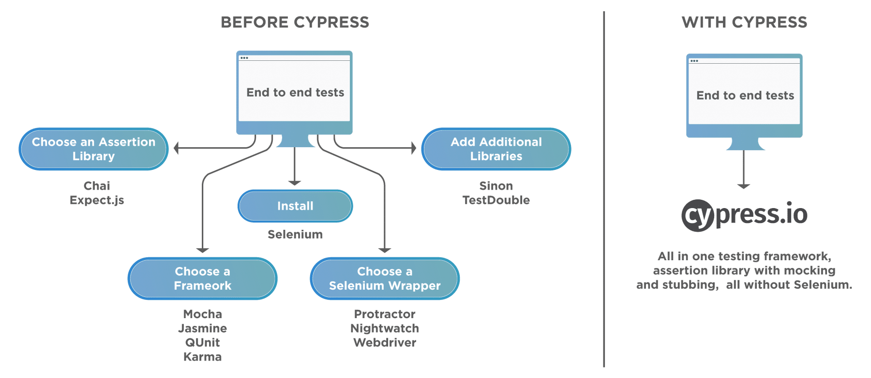
Before and After

Slide 7
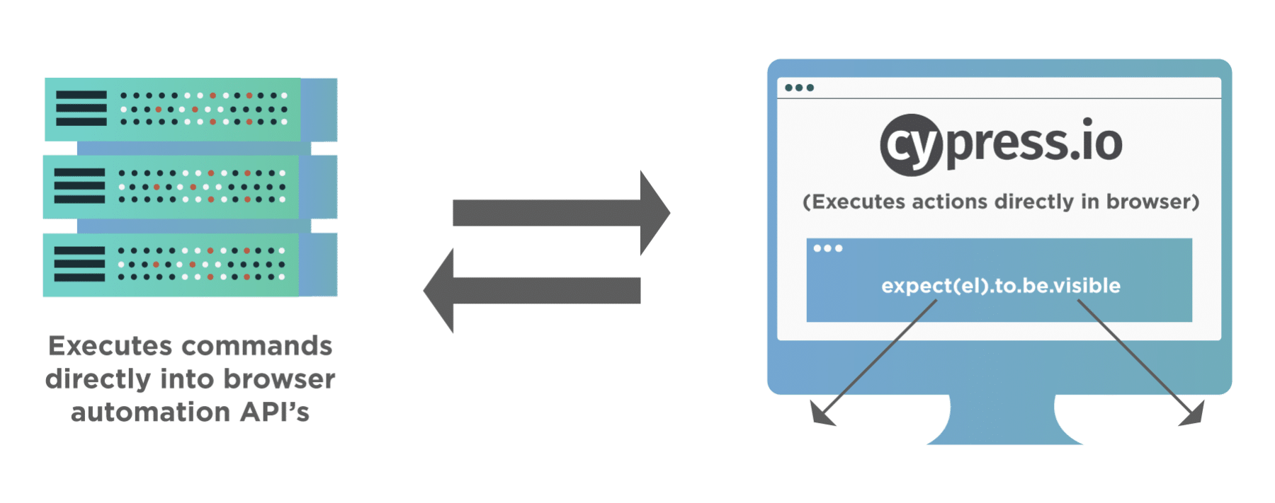
Cypress Architecture
Cypress engine directly operates inside the browser. In other words, it is the browser that is executing your test code.
It enables Cypress to listen and modify the browser behavior at run time by manipulating DOM and altering Network requests and responses on the fly.
Cypress Browser Support: Canary, Chrome, Electron(Default), Chromium, Mozilla Firefox browsers (beta support) and Microsoft Edge (Chromium-based) browsers
With Cypress, you can do Unit, Functional, Integration, End to End Testing. It fits every need of a Test Pyramid.

Slide 8
Cypress Components
It has two main components that come by default in its installation -
Cypress Test Runner
Cypress Dashboard.
One of them is used as a runner to run our Cypress test cases on the local machine, and the other tracks our runs and status from our Automation Suite.

Slide 9
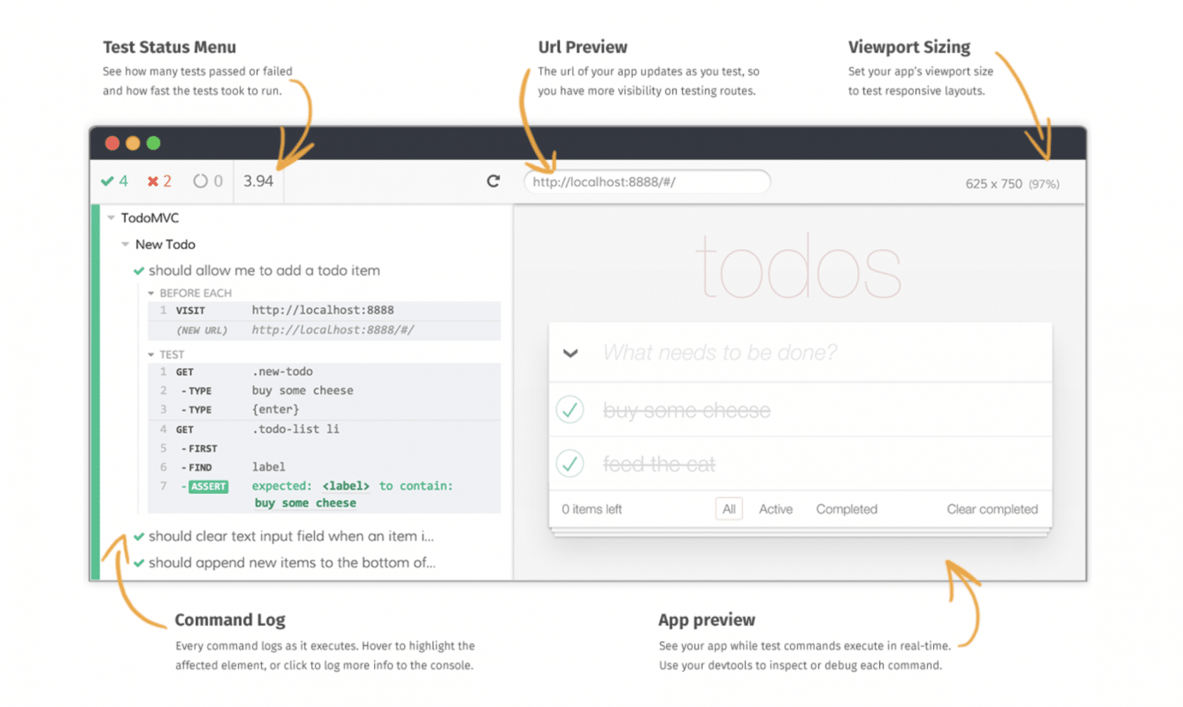
Test Runner
It runs tests in a unique interactive runner that allows you to see commands as they execute while also viewing the application under test.

Slide 10
Test Runner Components
Test Status: Menu shows you a summary of how many tests passed, failed, or in progress and time took for the test.
Url Preview: shows you the URL of your test and helps you track any URL route.
Viewport Sizing: set your app viewport size to test responsive layouts.
Command Log: It shows you the command logs as it executes for all the tests that execute.
App Preview: you can see the test while commands execute.

Slide 11
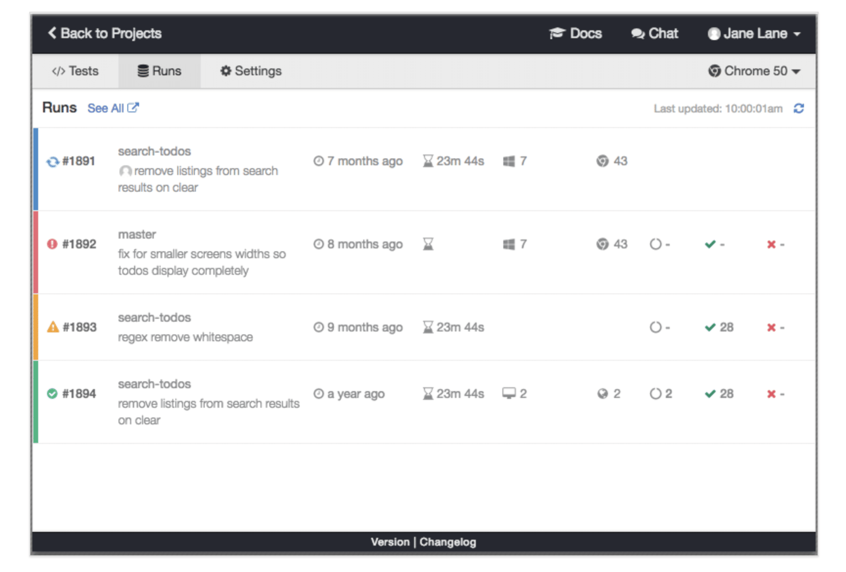
DashBoard Service
The Cypress Dashboard is a service that provides you access to recorded tests - typically when running Cypress tests from your CI provider. The Dashboard provides you with insight into what happened when your tests ran.

Slide 12
Cypress Folder
By default, Cypress comes with a folder structure. The main folder is cypress, within which there are subfolders.
Integration: This folder contains the actual test scripts.
Fixtures: If you are using external data inside your tests, your data can be organized inside the Fixtures folder.
Plugins: The Plugins folder contains the special files which can be used to execute the code before the project loads. If your project needs any pre-processors, include them in this folder and configure them accordingly. By default, the plugins folder contains the index.js file, which can be customized to create your own tasks.
Support: The Support folder contains utilities, global commands, frequently used codes etc. By default, this folder comes with two files – commands.js and index.js. Additional files and folders can be added as required.
Assets: A folder called downloads will be created after the test run which includes screenshots, videos, etc
https://applitools.com/blog/whats-new-cypress-10/

Slide 13
Cypress Constructs
describe(): It is is simply a way to group our tests. It takes two arguments, the first is the name of the test group, and the second is a callback function.
context(): It is is just an alias for describe().
it(): We use it for an individual test case. It takes two arguments, a string explaining what the test should do, and a callback function which contains our actual test.
before(): It runs once before all tests in the block.
after(): It runs once after all tests in the block.
beforeEach(): It runs before each test in the block.
afterEach(): It runs after each test in the block.
.only(): To run a specified suite or test, append ".only" to the function.
.skip(): To skip a specified suite or test, append ".skip()" to the function.

Slide 14
Cypress test Case
Each test generally consists of three steps:
Prerequisite: You have a given state of the application.
Action: You perform some action on the elements of the application.
Expectations: Then, you assert/validate the changed state of the application.
On the same lines, let's consider we have the following scenario that we need to automate using Cypress:
We visit the home page of “https://demoqa.com/”.
Click on the widget menu item.
Validate the search results.
Notes:
Mockexample fodler

Slide 15
Steps Implement
Cypress provides a visit() method which accepts a URL of the page which needs to open in the browser
The values in get() methods are the CSS selectors of the HTML elements on which actions need to perform.
describe('My First Cypress Test', function() {
it('Visits the ToolsQA Demo Page and check the menu items’,()=> {
//Visit the Demo QA Website
cy.visit("https://demoqa.com/");
// Clicking on Widget Menu Item
cy.get(':nth-child(4) > :nth-child(1) > .avatar > svg').click();
//Verify number of items present under the Widget Tab
cy.get(':nth-child(4) > .element-list > .menu-list > li').should('have.length',9);
})
})
Notes:
Mockexample fodler

Slide 16
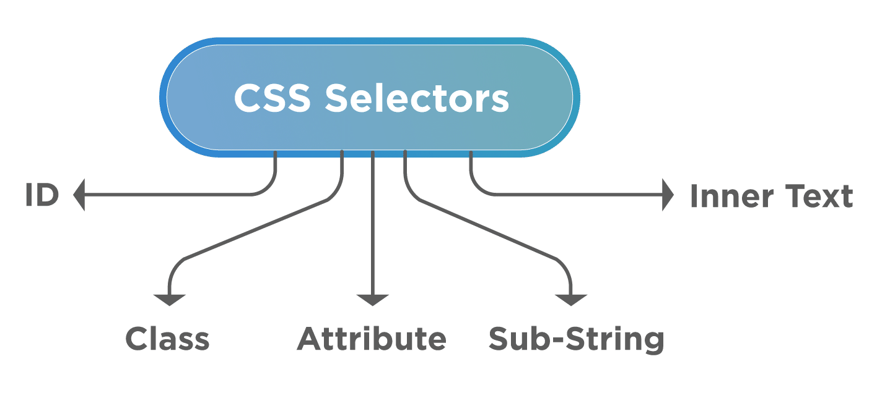
Locators
input#userid where "userid" is the id of the tag input.
input.login where login is the class name of the tag input.
input[name=username] where "username" is the value of attribute "name".
input[class=login], where, "login" is the value of the attribute "class”
input#userid[name^=user].
Where input denotes an HTML tag-name. Which, in turn, has an "id" value as 'userid' and from the attribute, and the 'name' attribute should have a value which starts with 'user’.
nput#userid[name$=name].
Where input denotes an HTML tag-name that has an id value as 'userid' and the attribute' name' should have a value which ends with 'user'.
input#userid[name=erna].*
Where input denotes an HTML tag-name that has an id value as 'userid' and the attribute 'name' should have a value which contains a substring 'erna'.
Notes:
Mockexample fodler

Slide 17
Get() command
The get() method gets one or more elements based on the selector passed as a parameter. Additionally, it can return a web element or a list of web elements. After that, appropriate action can be performed on that.
Syntax:
cy.get(selector) cy.get(selector, options)
Options as seen in table
Option | Default | Description
log | true | Toggle which enables whether the command should log on the console or not.
timeout | defaultCommandTimeout | Time for which get() should wait before raising timeout error.
withinSubject | null | Specifies from where element search should start. Additionally, null specifies that Cypress will start searching element from the root element.
Notes:
Mockexample fodler

Slide 18
Examples
Get an element of type input cy.get('input’)
Specify logging as false. Moreover, it will skip the command output printing on the Cypress Test runners console. cy.get('input',{ log: false })
Wait for an explicit timeout cy.get('input',{ timeout: 1000 }) // It will wait for 1000ms before timing out
Notes:
Mockexample fodler

Slide 19
Access Multiple Values
To pick certain elements and do our operations or assertions. Therefore, for handling such situations, we can use the "eq" method.
Additionally, the Eq method helps us in getting a DOM element at a specific index in an array of elements. cy.get('input').eq(1).should('contain', 'Cucumber’)
The index value in eq starts from 0, the same as arrays in other programming languages. That is to say, the first element will be accessed using eq(0), the second element using eq(1), and so on.
<ul>
<input>Cypress</input> <input>Cucumber</input> <input>Gherkin</input> <input>JBehave</input>
<input>BDD</input>
</ul>
Notes:
Mockexample fodler

Slide 20
Chain commands
"get" command can be chain to do respective actions on a particular web element as it returns an object of the "Chainable" interface, which enables other Cypress commands to invoke on that object.
Find link with "href" attribute containing word “demoqa” and click it. cy.get('a[href*="demoqa"]').click()
Find the web element with class name as 'mobile-nav' and pass the timeout as options and then chain commands having different assertions for visibility and containing 'Home' keyword. cy.get('.mobile-nav', { timeout: 10000 }) .should('be.visible') .and('contain', 'Home')
Notes:
Cypress manages a Promise chain on your behalf, with each command returning a ‘subject’ to the next command until the chain ends or an error encounters. So, all the commands returning a chainable interface allows invoking any other Cypress command without explicitly using the "cy" object. Let's understand this behavior with the help of the following examples:

Slide 21
Within() block
Used to search a web element inside a parent web element. So for doing that, we use "within" block chained with "cy.get" command to search for a particular parent element.
cy.get() always looks for the element within the whole document, with an exception that when its used inside the .within() code block. Its syntax will look like below: within(callbackFn) within(options, callbackFn)
Where callbackFn will be any function that will invoke after the parent function

Slide 22
Within() block Example
cy.get('#searchBox').within(() => { cy.get('input').type('Cucumber') // Only searches inputs within searchBox })
it will first get the "searchBox" element, and inside that searchBox element, it will search for input tags and will ignore other input tags that are not inside this.
There can be a situation where we have five input tags, but we want to work on one input tag, which is under the "searchBox" element so that the situation can resolve using the ".within" block.

Slide 23
find()
The find() method returns one or more DOM elements based on the selector that's passed as a parameter.
However, the only difference being is that the find() method always chains with other methods that return DOM elements, such as the get() method.
Moreover, you can never chain/invoke the find() method on the "cy" object, as we did with the "get()" method in the previous section.
Syntax: .find(selector) .find(selector, options) cy.get(parentSelector).find(childSelector)
Option | Default | Description
log | true | Toggle which enables whether the command should log on the console or not.
timeout | defaultCommandTimeout | Time for which get() should wait before raising timeout error.

Slide 24
find() Example
We have to find all the <li> elements which have the #id as "parent", then the same can be achieved using the following command:
cy.get('#parent').find('li')
<ul id="parent">
<li class="child"></li>
<li class="child"></li>
</ul>

Slide 25
Cypress Assertions – 1/3
Length cy.get('li.selected').should('have.length', 3)
Class cy.get('form').find('input').should('not.have.class', 'disabled’)
Value cy.get('textarea').should('have.value', 'foo bar baz’)
Text Content
// assert the element's text content is exactly the given text cy.get('[data-testid="user-name"]').should('have.text', 'Joe Smith’)
// assert the element's text includes the given substring cy.get('[data-testid="address"]').should('include.text', 'Atlanta’)
// retry until this span does not contain 'click me’ cy.get('a').parent('span.help').should('not.contain', 'click me’)
// the element's text should start with "Hello" cy.get('[data-testid="greeting"]') .invoke('text') .should('match', /^Hello/)
// use cy.contains to find an element with its text // matching the given regular expression cy.contains('[data-testid="greeting"]', /^Hello/)

Slide 26
Cypress Assertions – 2/3
Visibility cy.get('[data-testid="form-submit"]').should('be.visible’) cy.contains('[data-testid="todo"] li', 'write tests').should('be.visible’) https://www.youtube.com/watch?v=LxkrhUEE2Qk
Existence // retry until loading spinner no longer exists cy.get('[data-testid="loading"]').should('not.exist’)
State // retry until our radio is checked cy.get(':radio').should('be.checked')
CSS // retry until element has matching css cy.get('[data-testid="completed"]').should( 'have.css', 'text-decoration', 'line-through’ ) // retry while accordion css has the // "display: none" property cy.get('[data-testid="accordion"]').should('not.have.css', 'display', 'none’)

Slide 27
Cypress Assertions – 3/3
Disabled property
<input type="text" data-testid="example-input" disabled />
cy.get('[data-testid="example-input"]’) .should('be.disabled’) // let's enable this element from the test .invoke('prop', 'disabled', false) cy.get('[data-testid="example-input"]’) // we can use "enabled" assertion .should('be.enabled’) // or negate the "disabled" assertion .and('not.be.disabled')
https://docs.cypress.io/guides/references/assertions#Negative-assertions

Slide 28
UI Interactions
UI interaction commands
Click Command
Double Command
Right Click Command
Type Command
Clear Command
Check/UnCheck Command
Select Command
Trigger Command
https://www.toolsqa.com/cypress/cypress-commands-ui-interaction-commands/

Slide 29
References
https://www.valentinog.com/blog/cypress/
https://www.toolsqa.com/cypress/what-is-cypress/
https://mindmajix.com/cypress-alternatives

Slide 30

Any Question ?

Slide 31


7738460004 shalini06mittal@gmail.com
Thank you !

