Slide 1
TestNG
Shalini Mittal
Corporate Trainer

Slide 2
3-As [Arrange Act and Assert ]?
a unit test is a method that instantiates a small portion of our application and verifies its behavior independently from other parts
The AAA suggests that you should divide your test method into three sections
ARRANGE : section you only have code required to setup that specific test. Here objects would be created, mocks setup (if you are using one) and potentially expectations would be set
ACT: Then there is the Act, which should be the invocation of the method being tested
ASSERT: And on Assert you would simply check whether the expectations were met
Example : // arrange var repository = Substitute.For<IClientRepository>(); var client = new Client(repository); // act client.Save(); // assert mock.Received.SomeMethod();
Notes:
example.
Suppose, you have five test cases, one method is written for each test case (Assume that the program is written using the main method without using testNG). When you run this program first, three methods are executed successfully, and the fourth method is failed. Then correct the errors present in the fourth method, now you want to run only fourth method because first three methods are anyway executed successfully. This is not possible without using TestNG

Slide 3
FIRST Principle
[F]ast Unit tests should be fast otherwise they will slow down development/deployment time and will take longer time to pass or fail. Dependencies should be mocked.
[I]solated Never ever write tests which depend on other test cases. If one of your test methods can break for more than one reason, consider splitting it into separate tests.
[R]epeatable A repeatable test is one that produces the same results each time you run it.
[S]elf-validating each test must be able to determine that the output is expected or not. It must determine it is failed or pass. There must be no manual interpretation of results.
[T]imely Can use review process or automated tools to reject code without sufficient tests.
Notes:
Fast
Unit tests should be fast otherwise they will slow down your development/deployment time and will take longer time to pass or fail. Typically on a sufficient large system, there will be few thousand unit tests – let’s say 2000 unit tests. If average unit test take 200 milliseconds to run (which shall be considered fast), then it will take 6.5 minutes to run complete suite.
6.5 minutes doesn’t seem long at this stage, but imagine if you run them on your development machine multiple times a day which will eat up your good amount of productive time. And imagine when the count of these tests increase when new functionalities are added to application, it will further increase the test execution time.
The value of your suite of unit tests diminishes as their ability to provide continual, comprehensive, and fast feedback about the health of your system also diminishes.
One of the major cause of slow tests – is dependency that must handle external evil necessities such as databases, files, and network calls. They take thousands of milliseconds. So to make suite fast, you must avoid creating these dependencies by using mock testing.
Isolated
Never ever write tests which depend on other test cases. No matter how carefully you design them, there will always be possibilities of false alarms. To make situation worse, you may end up spending more time in figuring out which test in the chain has caused the failure.
In best case scenario, you should be able to run any one test at any time, in any order.
By making independent tests, it’s easy to keep your tests focused only on a small amount of behavior. When this test fail, you know exactly what has gone wrong and where. No need to debug the code itself.
The Single Responsibility Principle (SRP) of SOLID Class-Design Principles​ says that classes should be small and single-purpose. This can be applied to your tests as well. If one of your test methods can break for more than one reason, consider splitting it into separate tests.
Repeatable
A repeatable test is one that produces the same results each time you run it. To accomplish repeatable tests, you must isolate them from anything in the external environment not under your direct control. In these cases, feel free to use mock objects. They have been designed for this very purpose.
On occasion, you’ll need to interact directly with an external environmental influence such as a database. You’ll want to set up a private sandbox to avoid conflicts with other developers whose tests concurrently alter the database. In this situation, you may use in-memory databases.
If tests are not repeatable then you will surely get some bogus test results and you can’t afford to waste time chasing down phantom problems.
Self-validating
Tests must be self-validating means – each test must be able to determine that the output is expected or not. It must determine it is failed or pass. There must be no manual interpretation of results.
Manually verifying the results of tests is a time-consuming process that can also introduce more risk.
Make sure you don’t do anything silly, such as designing a test to require manual arrange steps before you can run it. You must automate any setup your test requires – even do not rely on existence of database and pre-cooked data.
Create in-memory database, create schema and put dummy data and then test the code. In this way, you can run this test N number of times without fearing any external factor which can affect test execution and it’s result.
Timely
Practically, You can write unit tests at any time. You can wait upto code is production ready or you’re better off focusing on writing unit tests in a timely fashion.
As a suggestion, you should have guidelines or strict rules around unit testing. You can use review processes or even automated tools to reject code without sufficient tests.
The more you unit-test, the more you’ll find that it pays to write smaller chunks of code before tackling a corresponding unit test. First, it’ll be easier to write the test, and second, the test will pay off immediately as you flesh out the rest of the behaviors in the surrounding code
If you use Eclipse or IntelliJ IDEA, consider incorporating a tool like Infinitest. As you make changes to your system, Infinitest identifies and runs (in the background) any tests that are potentially impacted.
On an even larger scale, you can use a continuous integration (CI) tool such as Jenkins or TeamCity. A CI tool watches your source repository and kicks off a build/test process when it recognizes changes.

Slide 4
SRP – Single Responsibility Principle
Helps to modularize code.
A class should only have one responsibility.
Example :- OrderController class Take the order Create order form request Process the request Send email
Controller class is doing too many things. Instead have separate classed for every common functionality.
Creating separate classes for different functionality offers reusabililty, modularity and easy maintenance
Dependency Injection is the key to implement SRP.
Notes:
SOLID principles: single responsibility, open-closed, liskov substitution, interface segregation and dependency inversion

Slide 5
What TestNG?
An automation testing framework in which NG stands for "Next Generation".
Inspired from JUnit which uses the annotations (@).
Can generate proper report, including number of test cases runs, the number of test cases passed, the number of test cases failed, and the number of test cases skipped.
Multiple test cases can be grouped by converting them into testng.xml file and set priorities which test case should be executed first.
The same test case can be executed multiple times without loops just by using keyword called 'invocation count.'
Can execute multiple test cases on multiple browsers, i.e., cross browser testing.
Can be easily integrated with tools like Maven, Jenkins, etc.
Annotations used in the testing are very easy to understand ex: @BeforeMethod, @AfterMethod, @BeforeTest, @AfterTest
WebDriver has no native mechanism for generating report
No need for a static main method. The sequence of actions is regulated by easy-to-understand annotations that do not require methods to be static.
Uncaught exceptions are automatically handled by TestNG without terminating the test prematurely. These exceptions are reported as failed steps in the report.
The TestNG provides an option, i.e., testng-failed.xml file in test-output folder and run only failed test cases in this XML file.
Notes:
example.
Suppose, you have five test cases, one method is written for each test case (Assume that the program is written using the main method without using testNG). When you run this program first, three methods are executed successfully, and the fourth method is failed. Then correct the errors present in the fourth method, now you want to run only fourth method because first three methods are anyway executed successfully. This is not possible without using TestNG

Slide 6
INstall TestNG?
Launch Eclipse.
On the menu bar, click Help.
Choose the "Install New Software…" option.
Enter "http://dl.bintray.com/testng-team/testng-eclipse-release/" in the Work with box https://testng.org/testng-eclipse-update-site/
Click the Add button.
Notes:
example.
Suppose, you have five test cases, one method is written for each test case (Assume that the program is written using the main method without using testNG). When you run this program first, three methods are executed successfully, and the fourth method is failed. Then correct the errors present in the fourth method, now you want to run only fourth method because first three methods are anyway executed successfully. This is not possible without using TestNG

Slide 7
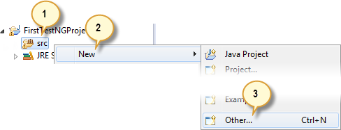
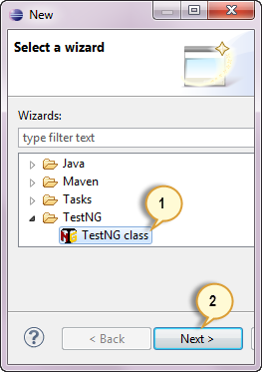
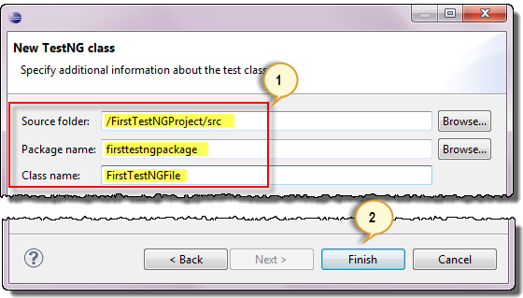
First Test Case
Create a new Java Project and add Library -> TestNG as dependency in the project
Add Selenium jars in the above project.
Create a new TestNG class =>
Give name to the class FirstTectNgClass

Slide 8
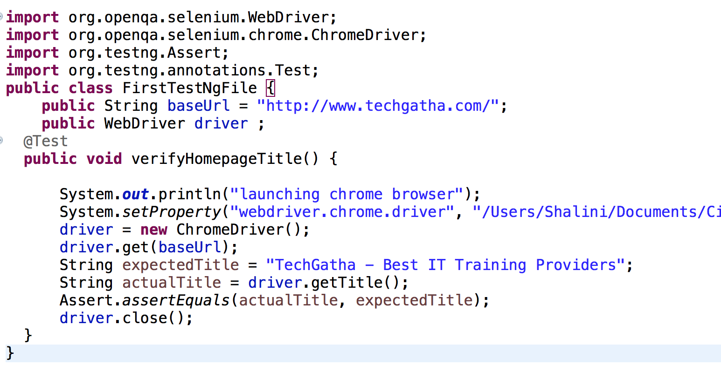
Lets code…
Provide your driver location

Slide 9
Assertions

Slide 10
Methods | Description
1- assertEquals(String actual, String expected); | 1- It accepts two string arguments. 2- It’ll check whether both are equal, if not it’ll fail the test.
2- assertEquals(String actual, String expected, String message); | 1- It accepts three string arguments. 2- It’ll test whether both are same, if not it’ll fail the test. 3- Also, it’ll throw a message that we provide.
3- assertEquals(boolean actual, boolean expected); | 1- It assumes two boolean arguments. 2- It tests them for equality, if not it’ll fail the test.
4- assertEquals( java.util.Collection actual, java.util.Collection expected, java.lang.String message); | 1- It accepts two collection type objects. 2- It checks whether they hold same elements and with the same order. 3- It’ll fail the test if the above condition doesn’t meet. 4- Also, you’ll see the message appear in the report.
5- assertTrue(<condition>); | 1- It accepts one boolean argument. 2- It tests that the given condition is true. 3- If it fails, then an <AssertionError> would occur.
6- assertTrue( <condition>, message); | 1- It assumes one boolean argument and a message. 2- It asserts that the given condition is true. 3- If it fails, then an <AssertionError> would occur with the message you passed.
7- assertFalse( <condition>); | 1- It accepts one boolean argument. 2- It checks that the given condition is false. 3- If it doesn’t pass, then an <AssertionError> would occur.
8- assertFalse( <condition>, message); | 1- It assumes one boolean argument and a message. 2- It asserts that the given condition is false. 3- If it fails, then an <AssertionError> would occur with the message you passed.

Slide 11
Generate HTML Reports
TestNG has the ability to generate reports in HTML format.
After running our FirstTestNGFile that we created in the previous section, right-click the project name in the Project Explorer window then click on the "Refresh" option.
Notice that a "test-output" folder was created. Expand it and look for an index.html file. This HTML file is a report of the results of the most recent test run.

Slide 12
TestNG Annotations – 1/2
@BeforeSuite: The annotated method will be run before all tests in this suite have run.
@AfterSuite: The annotated method will be run after all tests in this suite have run.
@BeforeTest: The annotated method will be run before any test method belonging to the classes inside the tag is run.
@AfterTest: The annotated method will be run after all the test methods belonging to the classes inside the tag have run.
@Test: The annotated method is a part of a test case. By default, methods annotated by @Test are executed alphabetically
@Parameters : use this annotation for passing the parameters to the test methods
@DataProvider : It marks a method as a data source for the test. Every @DataProvider annotated method must always return the value as <Object[ ][ ]>. You can use it in any of the @Test annotated methods.
@Listeners : use them with the test classes for the logging function

Slide 13
TestNG Annotations – 2/2
@BeforeGroups: The list of groups that this configuration method will run before. This method is guaranteed to run shortly before the first test method that belongs to any of these groups is invoked.
@AfterGroups: The list of groups that this configuration method will run after. This method is guaranteed to run shortly after the last test method that belongs to any of these groups is invoked.
@BeforeClass: The annotated method will be run before the first test method in the current class is invoked.
@AfterClass: The annotated method will be run after all the test methods in the current class have been run.
@BeforeMethod: The annotated method will be run before each test method.
@AfterMethod: The annotated method will be run after each test method.
@Factory : use it to execute any specific group of test cases with different values. It returns an array of test class objects as the <Object[ ]>.

Slide 14
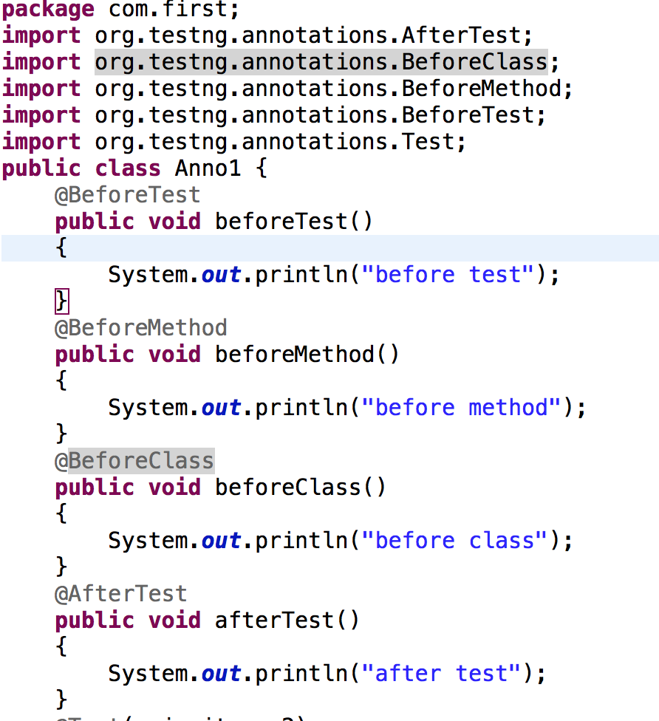
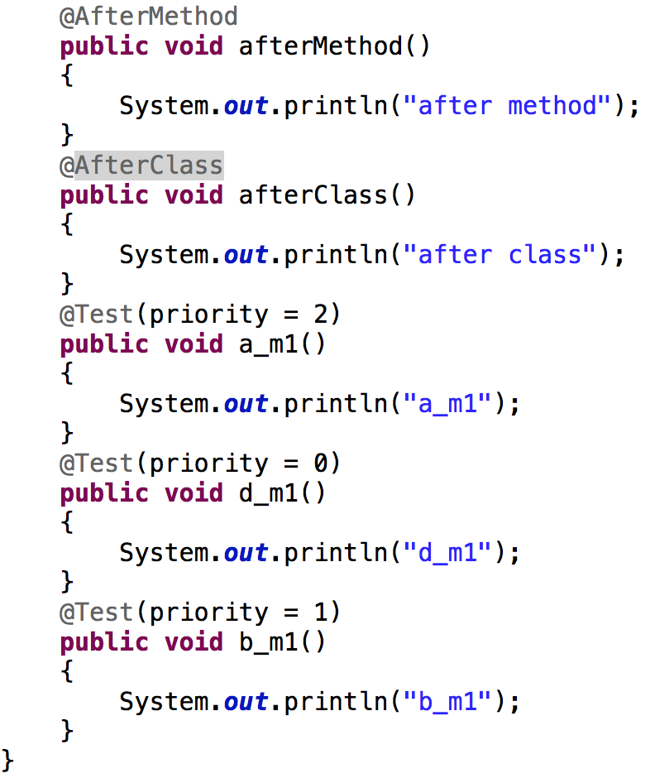
@Test, @BeforeTest, @BeforeMethod, @AfterTest, @AfterMethod
Notes:
EXAMPLE could be: =>
Go to the homepage and verify its title. => beforemethod
Click REGISTER and verify the title of its target page. => test
Go back to the homepage and verify if it still has the correct title. => aftermethod and then beforemethod again
Click SUPPORT and verify the title of its target page. => test
Go back to the homepage and verify if it still has the correct title. => aftermethod
Beforetest => launch the driver
Aftertest => close the driver

Slide 15
Assignment
Load the driver
Open the browser => techgatha.com
Verify the title of the homepage
Click on Kids Section / Services
Verify the heading is Students Creations / IT Corporate Training
Go back to homepage
Verify the title
Close the browser
Using selenium and testng

Slide 16
Assignment Solution
public String baseUrl = "http://techgatha.com";
String driverPath = "/Users/Shalini/Documents/Citius_backup/selenium/chromedriver";
public WebDriver driver;
public String expected = null;
public String actual = null;
@BeforeTest
public void launchBrowser() {
System.out.println("launching chrome browser");
System.setProperty("webdriver.chrome.driver", driverPath);
driver= new ChromeDriver();
driver.get(baseUrl);
}
@BeforeMethod
public void verifyHomepageTitle() {
String expectedTitle = "TechGatha - Best IT Training Providers";
String actualTitle = driver.getTitle();
Assert.assertEquals(actualTitle, expectedTitle);
}
@Test(priority = 0)
public void kidsClick(){
driver.findElement(By.linkText("KIDS SECTION")).click() ;
expected = "STUDENT'S CREATIONS";
WebElement element= driver.findElement(By.tagName("h2"));
Assert.assertEquals(element.getText(), expected);
}
@AfterMethod
public void goBackToHomepage ( ) {
driver.findElement(By.xpath("//a[@href ='index.html']")).click() ;
}
@AfterTest
public void terminateBrowser(){
driver.close();
}

Slide 17
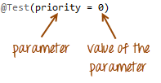
@Test Parameters
To execute methods in a different order, use the parameter "priority".
Parameters are keywords that modify the annotation's function.
Parameters require you to assign a value to them. You do.this by placing a "=" next to them, and then followed by the value.
Parameters are enclosed in a pair of parentheses which are placed right after the annotation like the code snippet shown below.
TestNG will execute the @Test annotation with the lowest priority value up to the largest. There is no need for your priority values to be consecutive
Methods are executed based on the ascending value of priority.
Enabled : If the enabled=true then the test will execute and if enabled=false then the test will NOT execute @Test(priority = 0, enabled = false)

Slide 18
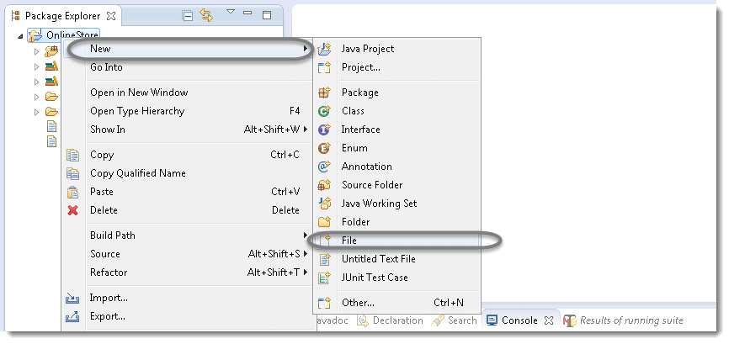
TestNg Suite
Create testng.xml file to create and handle multiple test classes. This is the xml file where you will configure your test run, set test dependency, include or exclude any test, method, class or package and set priority etc.
Create a testng.xml file .

Slide 19
TestNg.xml
<?xml version="1.0" encoding="UTF-8" ?>
<suite name="Suite">
<test name="Suite Demo">
<classes>
<class name="com.first.Anno1" />
<class name="com.first.FirstTestNgFile" />
</classes>
</test>
</suite>
Run the test by right click on the testng.xml file and select Run As > TestNG Suite
The above test will execute only those tests, which are mentioned in the testng.xml. The rest of the test cases under ‘automationFramework’ package will remain untouched.

Slide 20
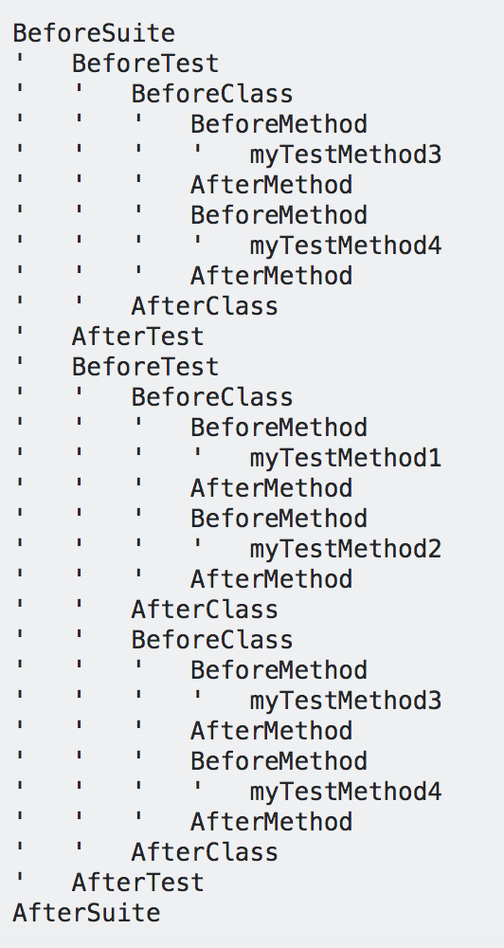
Difference
<suite name="Suite">
<test name="Test1" >
<classes>
<class name="com.before.anno.MyTestClass2" />
</classes>
</test>
<test name="Test2">
<classes>
<class name="com.before.anno.MyTestClass1"/>
<class name="com.before.anno.MyTestClass2"/>
</classes>
</test>
</suite>
Class1 -> myTestMethod1 and 2
Class2 -> myTestMethod3 and 4
SeleniumAbstractTest -> has all before and after methods
extends
SeleniumAbstractTest

Slide 21
TestNg Groups
We use groups in Testng when,
We don't want to define test methods separately in different classes (depending upon functionality) and
At the same time want to ignore (not to execute) some test cases as if they does not exist in the code.
This is done by using "include" and "exclude" mechanism supported in testNG.
Example : @Test (groups = { "bonding", "strong_ties" }) <groups> <run> <include name="bonding" /> </run> </groups>

Slide 22
Groups Example
package com.group;
import org.testng.annotations.Test;
public class GroupDemo {
@Test (groups = { "Car" })
public void Car1() {
System.out.println("Batch Car - Test car 1");
}
@Test (groups = { "Car" })
public void Car2() {
System.out.println("Batch Car - Test car 2");
}
@Test (groups = { "Scooter" })
public void Scooter1() {
System.out.println("Batch Scooter - Test scooter 1");
}
@Test (groups = { "Scooter" })
public void Scooter2() {
System.out.println("Batch Scooter - Test scooter 2");
}
@Test (groups = { "Car", "Sedan Car" })
public void Sedan1() {
System.out.println("Batch Sedan Car - Test sedan 1");
}
}
<suite name="Suite Group">
<test name="Practice Grouping">
<groups>
<run>
<include name="Car" />
</run>
</groups>
<classes>
<class name="com.group.GroupDemo" />
</classes>
</test>
</suite>

Slide 23
Parameterization
Two ways by which parameterization can be achieved.
With the help of Parameters annotation and TestNG XML file. @Parameters({“name”,”sample”})
Parameters can be defined at 2 levels
Suite level – The parameters inside the <suite> tag of TestNG XML file will be a suite level parameter.
Test Level -- The parameters inside the <Test> tag of testing XML file will be a Test level parameter.
With the help of DataProvider annotation. @DataProvider(name=“searchmethod”)

Slide 24
Pass Parameters
Benefit of the data-driven/parametric testing
Process the large data set as per business requirement.
Run the same test over and over again with different values.
@Parameters Annotation: Pass single or multiple parameter values to the test methods.
Example :Create a class ParametersTesting.java
@Parameters({ "BrowserName" })
@Test public void OpenBrowser(String BrowserName) { System.out.println("browser passed as :- " + BrowserName); }
@Parameters({ "UserName", "Passcode" })
@Test public void FillLoginForm(String UserName, String Passcode) {
System.out.println("Parameter for User Name passed as :- " + UserName); System.out.println("Parameter for Passcode passed as :- " + Passcode); }
<suite name="Parameters Testing Test Suite">
<test name="Parameters Testing">
<parameter name="BrowserName" value="Firefox"/>
<parameter name="UserName" value="demo"/>
<parameter name="Passcode" value="PASSWORD"/>
<classes>
<class name="com.parameters.ParametersTesting" />
</classes>
</test>
</suite>
Notes:
https://www.techbeamers.com/testng-parameters-and-dataprovider-annotations/

Slide 25
@Optional
use it to specify an optional value for a parameter which is not available in the TestNG.XML file
@Parameters({ "optional-value" })
@Test
public void optionCheck(@Optional("Optional Value") String value)
{ System.out.println("This is: " + value); }
<suite name="Optional Testing Test Suite" verbose="1">
<test name="Optional Testing Part1">
<classes>
<class name="com.parameters.OptionalTesting" /> </classes>
</test>
<test name="Optional Testing Part2">
<parameter name="optional-value" value=”From XML" />
<classes>
<class name="com.parameters.OptionalTesting" /> </classes>
</test>
</suite>
Notes:
https://www.techbeamers.com/testng-parameters-and-dataprovider-annotations/

Slide 26
Data Providers
@Parameters annotation is easy but to test with multiple sets of data use Data Provider.
Data provider returns a two-dimensional JAVA object to the test method and the test method, will invoke M times in a M*N type of object array.
For example, if the DataProvider returns an array of 2*3 objects, the corresponding testcase will be invoked 2 times with 3 parameters each time.
@DataProvider
public Object[][] provideData()
{return new Object[][]{
{"u1","p1"},
{"u2","p2"},
{"u3","p3"},
{"u4","p4"},};
}
@Test(dataProvider = "provideData")
public void FillLoginForm(String UserName, String Passcode) {
System.out.println("Parameter for User Name passed as :- " + UserName);
System.out.println("Parameter for Passcode passed as :- " + Passcode);
}

Slide 27
Data Providers Pass Parameter
Two types of parameters supported by dataProvider method
Method
@DataProvider(name = "squares")
public Object[][] provideValues(Method m)
{
if(m.getName().equalsIgnoreCase("testforsquares"))
return new Object[][] {
{1,1},{2,4},{3,9}};
else
return new Object[][] {
{1,1},{2,8},{3,27}
};}
@Test(dataProvider = "squares",
dataProviderClass = DataProviderClass.class)
public void testForSquares(int no, int sq) {
System.out.println("test squares");
assertEquals(no*no, sq);
}
@Test(dataProvider = "squares",
dataProviderClass = DataProviderClass.class)
public void testForCubes(int no, int cube) {
System.out.println("test cubes");
assertEquals(no*no*no, cube);
}

Slide 28
Data Driven Apache POI
Selenium does not provides support to read data from excel files and pass that data to test case.
Apache POI (Poor Obfuscation Implementation) is an API written in Java to support read and write operations – modifying office files
Developing Data Driven framework in Selenium using POI helps reduce maintenance, improve test coverage thus providing a good return on investment.
Download jar files for Apache POI : https://poi.apache.org/download.html
Unzip the jar file, and add the following jars to your project and congure them.
dom4j-1.6.1.jar
poi-3.10-FINAL-20140208.jar
poi-ooxml-3.10-FINAL-20140208.jar
poi-ooxml-schemas-3.10-FINAL-20140208.jar
xmlbeans-2.3.0.jar

Slide 29
Interface in POI
Below mentioned are some of the interfaces of POI.
XSSFWorkbook: Represents workbook in xlsx
HSSFWorkbook: Represents workbook in xls
XSSFSheet: Represents a sheet in XLSX
HSSFSheet: Represents a sheet in XLS
XSSFRow: Represents a row in a sheet of XLSX
HSSFRow: Represents a row in a sheet of XLS
XSSFCell: Represents a cell in a row of XLSX
HSSFCell: Represents a cell in a row of XLS le.
Fields available in a cell:
CELL_TYPE_BLANK: Represents a blank cell.
CELL_TYPE_BOOLEAN: Represents a Boolean cell (true or false).
CELL_TYPE_ERROR: Represents an error value in a cell.
CELL_TYPE_FORMULA: Represents a formula result on a cell.
CELL_TYPE_NUMERIC: Represents numeric data in a cell.
CELL_TYPE_STRING: Represents string in a cell.

Slide 30
Create a .xlsx file with 4 columns and sample data
Test Case ID | Username | Passwod | Result
TC_Login_01 | u1 | p1
TC_Login_02 | u2 | p2
TC_Login_03 | u3 | p3
TC_Login_04 | u4 | p4
Sampledata.xlsx
Row 0, cell 0 -> Test Case ID

Slide 31
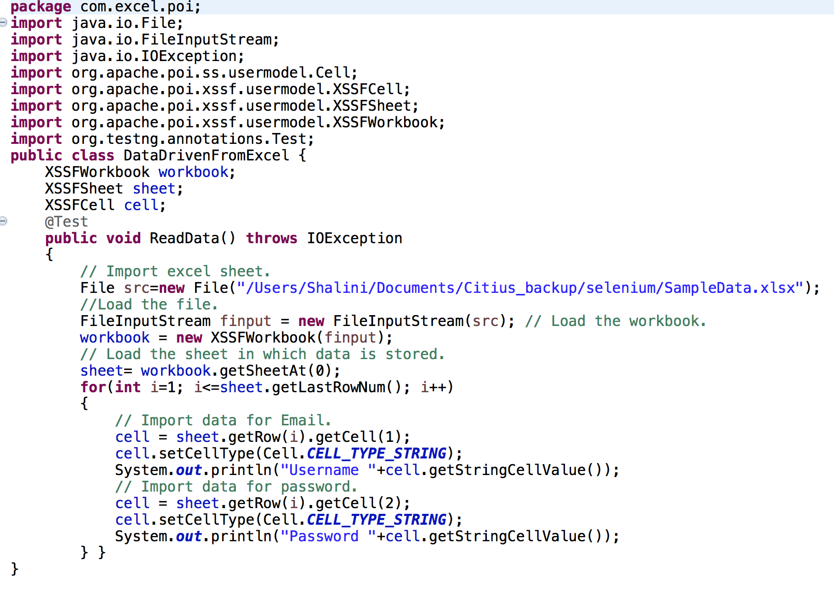
EXAMPLE – Read Data
Please change with your path

Slide 32
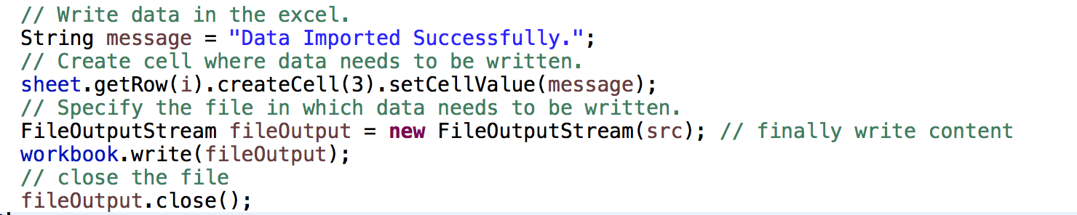
EXAMPLE – Write Data
Add the following code in the previous Test method to write data for tests executed successfully.

Slide 33
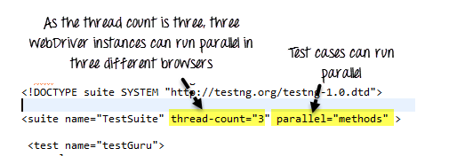
Parallel Execution
to run multiple tests at the same time use "parallel" attribute
The parallel attribute of suite tag can accept four values:
tests | All the test cases inside <test> tag of Testing xml file will run parallel.
classes | All the test cases inside a Java class will run parallel
methods | All the methods with @Test annotation will execute parallel.
instances | Test cases in same instance will execute parallel but two methods of two different instances will run in different thread.

Slide 34
Parallel Execution Example
<?xml version="1.0" encoding="UTF-8" ?>
<!DOCTYPE suite SYSTEM "http://testng.org/testng-1.0.dtd">
<suite name="TestSuite" thread-count="3" parallel="methods" >
<test name="testGuru">
<classes>
<class name="com.parallel.ParallelDemo">
</class>
</classes>
</test>
</suite>
@Test
public void executSessionOne(){
//First session of WebDriver
System.setProperty("webdriver.chrome.driver", "/Users/Shalini/Documents/Citius_backup/selenium/chromedriver");
WebDriver driver = new ChromeDriver();
driver.get("http://techgatha.com/contact.html");
driver.findElement(By.id(”name")).sendKeys("Driver 1"); }
@Test
public void executeSessionTwo(){
// same code as One, only change the uid value
}
@Test
public void executSessionThree(){
// same code as One, only change the uid value
}
}

Slide 35
Listeners
Listener is defined as interface that modifies the default TestNG's behavior.
Listeners "listen" to the event defined in the selenium script and behave accordingly.
It is used in selenium by implementing Listeners Interface.
It allows customizing TestNG reports or logs
Types :
IAnnotationTransformer
IAnnotationTransformer2
Iconfigurable
IConfigurationListener
IExecutionListener
Ihookable
IInvokedMethodListener
IInvokedMethodListener2
IMethodInterceptor
IReporter
ISuiteListener
ITestListener .

Slide 36
ITestListener
ITestListener has following methods
OnStart- OnStart method is called when any Test starts.
onTestSuccess- onTestSuccess method is called on the success of any Test.
onTestFailure- onTestFailure method is called on the failure of any Test.
onTestSkipped- onTestSkipped method is called on skipped of any Test.
onTestFailedButWithinSuccessPercentage- method is called each time Test fails but is within success percentage.
onFinish- onFinish method is called after all Tests are executed.

Slide 37
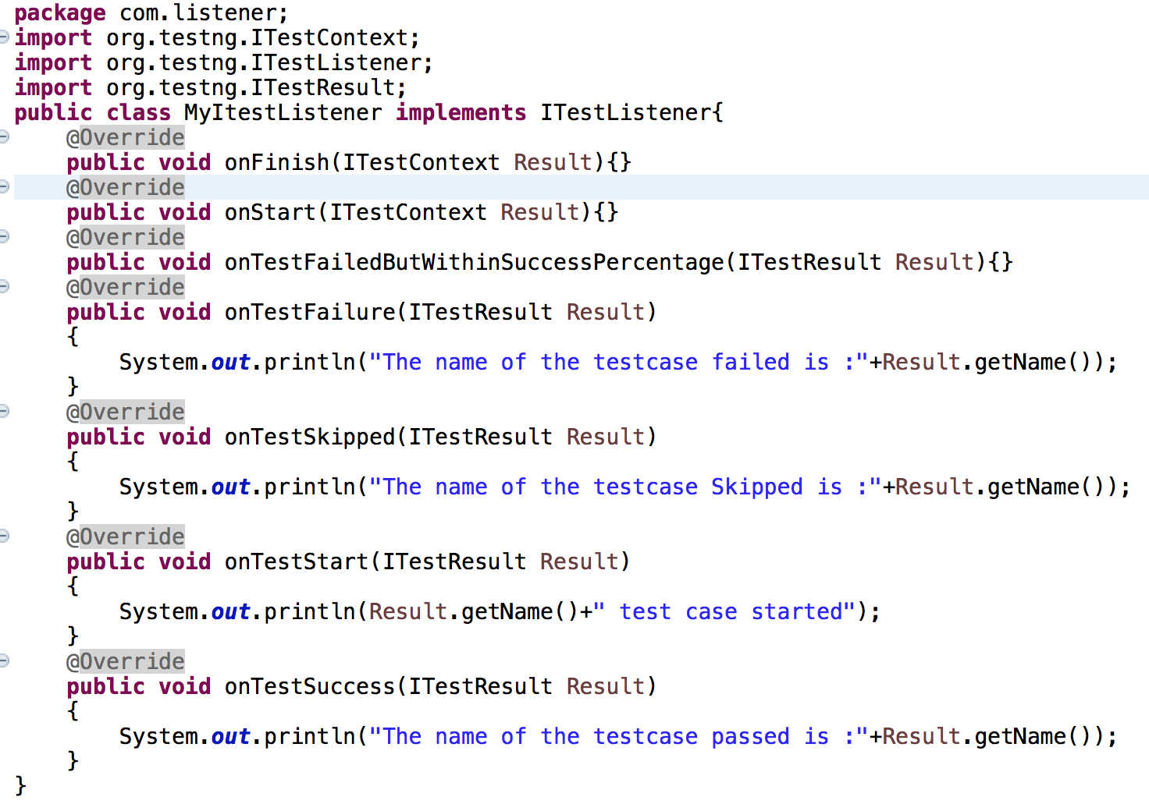
Create a Listener class

Slide 38
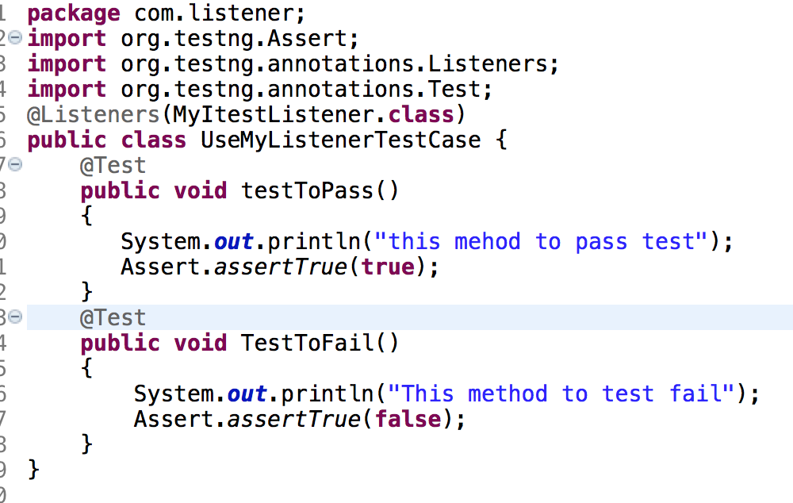
Register Listener for single class
@Listeners(Listener_Demo.ListenerTest.class)

Slide 39
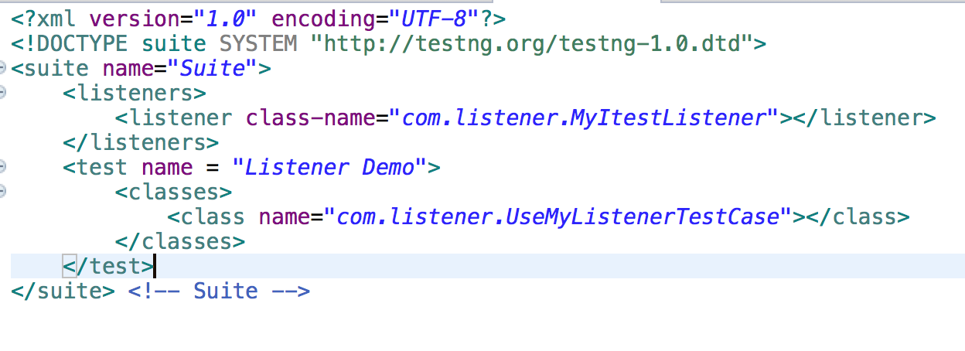
Register Listener for multiple classes
If project has multiple classes adding Listeners to each one of them could be cumbersome and error prone.
In such cases, we can create a testng.xml and add listeners tag in XML.

Slide 40
Reporter class
Reporter is a class present in TestNG. It provides 4 different methods to store log information they are:
Reporter.log(String s);
Reporter.log(String s, Boolean logToStandardOut);
Reporter.log(String s, int level);
Reporter.log(String s, int level, Boolean logToStandardOut);
Create 2 classes DemoA and DemoB with the following code. Select these 2 classes, right click and TestNG -> Convert to TestNG.
It generates testng.xml. Run this xml and see the Reported logs added in the reports.
@Test
public void run() throws InterruptedException
{ //set the driver
Reporter.log("The browser is opened now");
driver.manage().window().maximize();
Reporter.log("The browser is maximized");
driver.get("http://www.google.com");
Reporter.log("The browser opens the google url");
Thread.sleep(1000);
Reporter.log("Web Driver waits for 1 sec before closing the browser");
driver.close();
Reporter.log("The browser is closed now");
}

Slide 41
ReportNG
ReportNG is a simple plug-in for the TestNG unit-testing framework to generate HTML reports as a replacement for the default TestNG HTML reports
To use ReportNG reports we need to follow the below three steps:
Step 1: Add the below Jars Files to your project.
reportng-1.1.4.jar velocity-dep-1.4.jar guice-3.0.jar
Step 2: The Most important step, to make sure reportNG reports, we need to disable the default TestNG Listeners.
It can be done by following the below steps:
Right Click on Properties 2. Click on TestNG 3. You will find an option as "Disable default listeners", check the checbox 4. Click on "Apply" button, it will show as message as "Project preferences are saved". 5. Now Click on "OK" button.
Step 3: We need to add the below two listeners to testng.xml file.
<listeners> <listener class-name="org.uncommons.reportng.HTMLReporter"/>
<listener class-name="org.uncommons.reportng.JUnitXMLReporter"/> </listeners>
Notes:
http://www.software-testing-tutorials-automation.com/2014/07/selenium-webdriver-frameworks-required.html

Slide 42
ReportNG Example
<!DOCTYPE suite SYSTEM "http://testng.org/testng-1.0.dtd" >
<suite name="Suite ReportNG" verbose="1" >
<listeners>
<listener class-name="org.uncommons.reportng.HTMLReporter"/>
<listener class-name="org.uncommons.reportng.JUnitXMLReporter"/>
</listeners>
<test name="Test for ReportNg Reporting" >
<packages>
<package name="com.reporter" />
<package name="com.parameters" />
</packages>
</test>
</suite>
Notes:
http://www.software-testing-tutorials-automation.com/2014/07/selenium-webdriver-frameworks-required.html

Slide 43
Assignment
Automate all the Menu links of techlistic.com Steps to Automate: 1. Launch browser of your choice say., firefox, chrome etc. 2. Open this URL - https://www.techlistic.com/ 3. Maximize or set size of browser window.
4. Click on 'Java Tutorial' link and validate page title.
5. Navigate back to Home Page.
6. Click on 'Selenium Tutorial' link and validate page title.
7. Navigate back to Home Page.
8. Click on 'Selenium Blogs' link and validate page title.
9. Navigate back to Home Page.
10. Click on 'TestNG Blogs' link and validate page title.
11. Close the browser.
Notes:
http://www.software-testing-tutorials-automation.com/2014/07/selenium-webdriver-frameworks-required.html

Slide 44
Reference Links
https://howtodoinjava.com/best-practices/first-principles-for-good-tests/
https://www.toolsqa.com/selenium-webdriver/testng-testsuite/
https://www.techbeamers.com/testng-tutorials/
https://howtodoinjava.com/best-practices/first-principles-for-good-tests/
http://www.software-testing-tutorials-automation.com/2015/02/how-to-wait-for-page-to-loadready-in.html
https://www.techlistic.com/p/selenium-assignments.html
Notes:
Assgn -> http://demo.guru99.com/test/delete_customer.php

Slide 45

Any Question ?

Slide 46


7738460004 shalini06mittal@gmail.com
Thank you !

