Slide 1
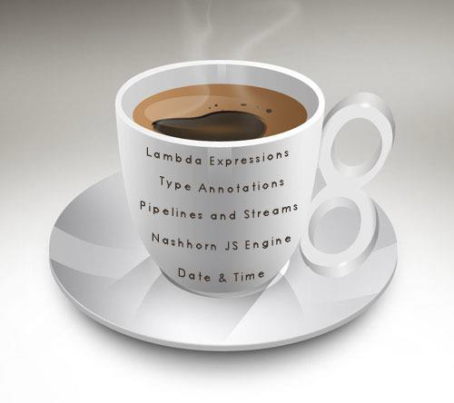
Day 2
Java 8
By
Shalini Mittal

Slide 2
Journey Continued……
Stream API
Create streams
Intermediate operations
Terminal operations

Slide 3
Streams In A NutShell
More convenient methods than collections – forEach,map,filter,reduce
Cool Properties that Lists lack –
Lazy evaluation
Automatic Parallelization
Infinite(unbound) streams
Do not store data
Programmatic wrappers around existing data sources
No relation with IO streams

Slide 4
Stream Characteristics
No Data Structures
Streams have no storage.
Values carried from a source through a pipeline of operations.
Underlying data structure (e.g., the List or array that the Stream wraps) never modified
Designed for lambdas
All Stream operations take lambdas as arguments
Do not support indexed access
First element access only
But can easily be output as arrays or Lists
Simple syntax to build an array or List from a Stream
Streams are consumable
Cannot reuse same stream multiple times
Supports sequential and parallel processing
Notes:
Streams are consumable, so there is no way to create a reference to stream for future usage. Since the data is on-demand, it’s not possible to reuse the same stream multiple times

Slide 5
Stream Operations
Intermediate Operations
Return the stream itself
Always lazy
Traversal of the pipeline source does not begin
Map,flatMap, filter
Terminal Operations
Return a result of a certain type
Traverses the stream to produce a result
Stream pipeline is consumed after this operation
forEach

Slide 6
Ways to create streams
From individual values
Stream.of(val1, val2, …)
From array
Stream.of(someArray), Arrays.stream(someArray)
From List (and other collections)
someList.stream(), someOtherCollection.stream()
From a “function”
Stream.generate, Stream.iterate
From a StreamBuilder
someBuilder.build()
From String
String.chars, Stream.of(someString.split(...))
From another Stream
distinct, filter, limit, map, sorted, skip
Notes:
Marker Interface

Slide 7
Core Operations - Intermediate
filter()
Filter accepts a predicate to filter all elements of the stream.
This operation is intermediate which enables us to call another stream operation
map()
Converts each element into another object via the given function.
sorted()
Returns a sorted view of the stream.
The elements are sorted in natural order unless you pass a custom Comparator.
flatMap()
used to flatten a Stream of collections to a Stream of objects.
Used to convert the 2 levels Stream into one Stream level or a 2d array into a 1d array.
Stream<Collection<Item>> —-> flatMap() —-> Stream<Item>

Slide 8
Core Operations - Terminal
forEach()
Helps in iterating over all elements of a stream and perform some operation on each of them.
The operation is passed as lambda expression parameter.
collect()
Recieve elements from a stream and store them in a collection
count()Returns
the number of elements in the stream as a long.
reduce()
Performs a reduction on the elements of the stream with the given function.
The result is an Optional holding the reduced value.

Slide 9
collect
Stream.collect() using Supplier, Accumulator and Combiner
supplier : It creates a new result container which will be populated by accumulator and combiner and finally it will be returned by collect() method. In parallel processing the Supplier function will be called multiple times that will return fresh value each time.
accumulator : It incorporates additional element into the result.
combiner : It combines two values that must be compatible with accumulator. Combiner works in parallel processing.

Slide 10
Parallel Stream
Operatiosn are indepent and associative. a op ( b op c) = (a op b) op c
Either lots of data, or long processing per elements N * Q > 10000 N – no of elements and Q – amout of time taken
Data easy to partition Array are good ,linked lists are bad.
Notes:
Multiplying and adding elements is not something go for parallel
http://openjdk.java.net/projects/code-tools/jmh/

Slide 11

Any Question ?

Slide 12

Thank you !

