Slide 1
Spring Boot Testing
Shalini Mittal
Corporate Trainer

Slide 2
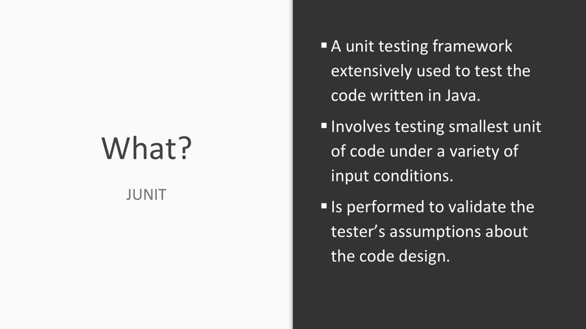
Spring Boot does not compete with Spring or Spring MVC.
At core spring Framework , DI is the core and helps build complex applications.
Spring uses programming configurations
It handes all the common concerns like : handling requests, JDBC connections etc.
Spring MVC provides a decoupled way of developing web applications. With simple concepts like Dispatcher Servlet, ModelAndView, and View Resolver, it makes it easy to develop web applications.

Slide 3
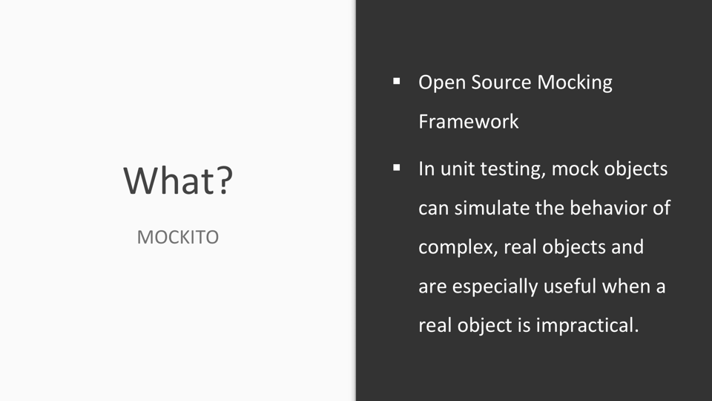

Slide 4
Test Dependency
The spring-boot-starter-test “Starter” (in the test scope) contains the following provided libraries:
  JUnit 4: The de-facto standard for unit testing Java applications.
  Spring Test & Spring Boot Test: Utilities and integration test support for Spring Boot applications.
  AssertJ: A fluent assertion library.
  Hamcrest: A library of matcher objects (also known as constraints or predicates).
  Mockito: A Java mocking framework.
  JSONassert: An assertion library for JSON.
  JsonPath: XPath for JSON.

Slide 5
Test Simple Controller
@Controller
public class HomeController {
@RequestMapping("/")
public @ResponseBody String greeting() {
return "Hello World";
}
}
The @SpringBootTest annotation tells Spring Boot to go and look for a main configuration class (one with @SpringBootApplication for instance), and use that to start a Spring application context.
You can run this test in your IDE or on the command line (mvn test or gradle test) and it should pass.
To convince yourself that the context is creating your controller you could add an assertion
The @Autowired annotation is interpreted by the Spring and the controller is injected before the test methods are run.
@Autowired
HomeController controller;
@Test
public void contextLoads() {
assertThat(controller).isNotNull();
}
Notes:
import static org.assertj.core.api.Assertions.assertThat;

Slide 6
Test Controller Behavior
Lets write some tests that assert the behaviour of our application.
To do that we could start the application up and listen for a connection like it would do in production, and then send an HTTP request and assert the response.
@RunWith(SpringRunner.class)
@SpringBootTest(webEnvironment = WebEnvironment.RANDOM_PORT)
public class SpringBootTestDemoApplicationTests {
@LocalServerPort
private int port;
@Autowired
private TestRestTemplate restTemplate;
@Test
public void greetingShouldReturnDefaultMessage() throws Exception {
assertThat(this.restTemplate.getForObject("http://localhost:" + port + "/",
String.class)).contains("Hello World");
}
}
Notes:
import static org.assertj.core.api.Assertions.assertThat;

Slide 7
Test Controller Behavior
Lets write some tests that assert the behaviour of our application.
To do that we could start the application up and listen for a connection like it would do in production, and then send an HTTP request and assert the response.
@SpringBootTest(webEnvironment = WebEnvironment.RANDOM_PORT)
public class SpringBootTestDemoApplicationTests {
@LocalServerPort private int port;
@Autowired private TestRestTemplate restTemplate;
@Test
public void greetingShouldReturnDefaultMessage() throws Exception {
assertThat(this.restTemplate.getForObject("http://localhost:" + port + "/",
String.class)).contains("Hello World");}
}
webEnvironment=RANDOM_PORT to start the server with a random port (useful to avoid conflicts in test environments), and the injection of the port with @LocalServerPort.
A TestRestTemplate class to do integration tests, that can make a request.
Notes:
import static org.assertj.core.api.Assertions.assertThat;

Slide 8
Test Controller MockMvc
Not start the server at all, but test only the layer below that, where Spring handles the incoming HTTP request and hands it off to your controller.
Use Spring’s MockMvc, and we can ask for that to be injected for us by using the @AutoConfigureMockMvc annotation on the test case:
import static org.hamcrest.Matchers.containsString;
import static org.springframework.test.web.servlet.request.MockMvcRequestBuilders.get;
import static org.springframework.test.web.servlet.result.MockMvcResultHandlers.print;
import static org.springframework.test.web.servlet.result.MockMvcResultMatchers.content;
import static org.springframework.test.web.servlet.result.MockMvcResultMatchers.status;
@SpringBootTest
@AutoConfigureMockMvc
public class SpringBootTestDemoApplicationTestsMockMvc {
@Autowired
private MockMvc mockMvc;
@Test
public void shouldReturnDefaultMessage() throws Exception {
this.mockMvc.perform(get("/")).andDo(print()).andExpect(status().isOk())
.andExpect(content().string(containsString("Hello World")));
}
}
Notes:
That way, almost the full stack is used, and your code will be called exactly the same way as if it was processing a real HTTP request, but without the cost of starting the server.
In this test, the full Spring application context is started, but without the server.

Slide 9
Test Controller WebMvcTest
Narrow down the tests to just the web layer by using @WebMvcTest
Spring Boot is only instantiating the web layer, not the whole context.
In an application with multiple controllers, use this :
@WebMvcTest(HomeController.class)
import static org.hamcrest.Matchers.containsString;
import static org.springframework.test.web.servlet.request.MockMvcRequestBuilders.get;
import static org.springframework.test.web.servlet.result.MockMvcResultHandlers.print;
import static org.springframework.test.web.servlet.result.MockMvcResultMatchers.content;
import static org.springframework.test.web.servlet.result.MockMvcResultMatchers.status;
@WebMvcTest
public class SpringBootTestDemoApplicationTestsMockMvc {
@Autowired
private MockMvc mockMvc;
@Test
public void shouldReturnDefaultMessage() throws Exception {
this.mockMvc.perform(get("/")).andDo(print()).andExpect(status().isOk())
.andExpect(content().string(containsString("Hello World")));
}
}
Notes:
That way, almost the full stack is used, and your code will be called exactly the same way as if it was processing a real HTTP request, but without the cost of starting the server.
In this test, the full Spring application context is started, but without the server.

Slide 10
Test Controller With Service Dependency
The service dependency will be automatically injected by Spring into the controller
@Service
public class HomeService {
public String greet() {
return "Hello World";
}
}
@WebMvcTest(HomeController.class)
public class WebMockMvcTest {
@Autowired
private MockMvc mockMvc;
@MockBean
private HomeService service;
@Test
public void shouldReturnDefaultMessage() throws Exception {
when(service.greet()).thenReturn("Hello Mock"); this.mockMvc.perform(get("/")).andExpect(status().isOk()) .andExpect(content().string(containsString("Hello Mock")));
}
}
@Controller
public class HomeController {
@Autowired
HomeService service;
@RequestMapping("/")
public @ResponseBody String greeting() {
return service.greet();
}
}
Notes:
That way, almost the full stack is used, and your code will be called exactly the same way as if it was processing a real HTTP request, but without the cost of starting the server.
In this test, the full Spring application context is started, but without the server.

Slide 11
Test DAO layer
To test Spring Data JPA repositories, or any other JPA-related components for that matter, Spring Boot provides the @DataJpaTest annotation
TestEntityManager is designed for tests, provides an alternative to the JPA standard EntityManager
Inject the JPA Repository you want to test
@RunWith(SpringRunner.class)
@DataJpaTest
public class TicketBookingDAOTest {
@Autowired
private TestEntityManager entityManager;
@Autowired
private TicketBookingDao bookingDao;
@Test
public void testSaveTicket()
{
Ticket ticket = getTicket();
Ticket savedindb = entityManager.persist(ticket);
Ticket getfromdb = bookingDao.findById(savedindb.getTicketId()).get();
assertThat(getfromdb).isEqualTo(savedindb);
}
private Ticket getTicket() {
Ticket ticket = new Ticket();
ticket.setPassengerName("Shalini");
ticket.setSourceStation("Delhi");
ticket.setDestStation("Mumbai");
ticket.setEmail("shalini@gmail.com");
ticket.setBookingDate("5/20/2018");
return ticket;
}
}
Notes:
That way, almost the full stack is used, and your code will be called exactly the same way as if it was processing a real HTTP request, but without the cost of starting the server.
In this test, the full Spring application context is started, but without the server.

Slide 12
Test Service layer - MockBean
Our Service layer code is dependent on our Repository. However, to test the Service layer, we do not need to know or care about how the persistence layer is implemented, so use the mocking support provided by Spring Boot Test
@RunWith(SpringRunner.class)
@SpringBootTest
public class TicketBookingServiceTest {
@Autowired
private TicketBookingService ticketBookingService;
@MockBean
private TicketBookingDao ticketBookingDao;
@Test
public void testCreateTicket(){
Ticket ticket = new Ticket();
ticket.setTicketId(1);
ticket.setPassengerName("Martin Bingel");
ticket.setSourceStation("Kolkata");
ticket.setDestStation("Delhi");
ticket.setBookingDate("12/5/2018");
ticket.setEmail("martin.s2017@gmail.com");
Mockito.when(ticketBookingDao.save(ticket)).thenReturn(ticket);
assertThat(ticketBookingService.createTicket(ticket)).isEqualTo(ticket);
}
Notes:
That way, almost the full stack is used, and your code will be called exactly the same way as if it was processing a real HTTP request, but without the cost of starting the server.
In this test, the full Spring application context is started, but without the server.

Slide 13
Test Service layer MockitoJunitRunner– Mock and InjectMock
MockitoJUnitRunner class automatically initialize all the objects annotated with @Mock and @InjectMocks annotations.
The @Mock annotation creates a mock implementation for the class it is annotated with.
@InjectMocks also creates the mock implementation, additionally injects the dependent mocks that are marked with the annotations @Mock into it.
@RunWith(MockitoJUnitRunner.class)
public class TicketBookingServiceTestMockitoRunner {
@InjectMocks
private TicketBookingService ticketBookingService;
@Mock
private TicketBookingDao ticketBookingDao;
@Test
public void testCreateTicket(){
Ticket ticket = new Ticket();
ticket.setTicketId(1);
ticket.setPassengerName("Martin Bingel");
ticket.setSourceStation("Kolkata");
ticket.setDestStation("Delhi");
ticket.setBookingDate("12/5/2018");
ticket.setEmail("martin.s2017@gmail.com");
Mockito.when(ticketBookingDao.save(ticket)).thenReturn(ticket);
assertThat(ticketBookingService.createTicket(ticket)).isEqualTo(ticket);}
Notes:
import org.mockito.junit.MockitoJUnitRunner;

Slide 14
Test Service layer – MockitoAnnotations
If we are not using the MockitoJUnitRunner class approach, then we can use the static method MockitoAnnotations.initMocks(). This method also, upon initialization of junit tests, initializes the mock objects.
@RunWith(MockitoJUnitRunner.class)
public class TicketBookingServiceTestMockitoRunner {
@InjectMocks
private TicketBookingService ticketBookingService;
@Mock
private TicketBookingDao ticketBookingDao;
@Before
public void init() {
MockitoAnnotations.initMocks(this);
}
//tests
}
Notes:
That way, almost the full stack is used, and your code will be called exactly the same way as if it was processing a real HTTP request, but without the cost of starting the server.
In this test, the full Spring application context is started, but without the server.

Slide 15
Test Rest Controller
When we are unit testing a rest service, we would want to launch only the specific controller and the related MVC Components.
@RunWith(SpringRunner.class) : provides functionality to launch a Spring TestContext Framework.
@WebMvcTest(value = TicketController.class, secure = false): Used for unit testing Spring MVC application. Used when a test focuses only Spring MVC components. Launch only one Controller. All other controllers and mappings will not be launched when this unit test is executed.
@Autowired private MockMvc mockMvc: Allows to execute requests against the test context.
@MockBean private TicketService ticketService: MockBean is used to add mocks to a Spring ApplicationContext.
Mockito.when(ticketBookingService.createTicket(Mockito.any(Ticket.class))).thenReturn(mockTicket);): Mocking the method createTicket to return the created mockTicket when invoked.
Notes:
WebMvcTest annotation is used for unit testing Spring MVC application. This can be used when a test focuses only Spring MVC components. Using this annotation will disable full auto-configuration and only apply configuration relevant to MVC tests.

Slide 16
Test Rest Controller – Build request
String inputInJson = this.mapToJson(mockTicket);
String URI = "/api/tickets/create";
MockMvcRequestBuilders.post(URI).accept(MediaType.APPLICATION_JSON).content(inputInJson).contentType(MediaType.APPLICATION_JSON);: Creating a Request builder to be able to execute a get request to uri with accept header as “application/json”
MvcResult result = mockMvc.perform(requestBuilder).andReturn(): mockMvc is used to perform the request and return the response back.
MockHttpServletResponse response = result.getResponse();
String outputInJson = response.getContentAsString();
assertThat(outputInJson).isEqualTo(inputInJson);
assertEquals(HttpStatus.OK.value(), response.getStatus());
private String mapToJson(Object object) throws JsonProcessingException {
ObjectMapper objectMapper = new ObjectMapper();
return objectMapper.writeValueAsString(object);
}
Notes:
Ticket mockTicket = new Ticket();
mockTicket.setTicketId(1);
mockTicket.setPassengerName("Martin Bingel");
mockTicket.setSourceStation("Kolkata");
mockTicket.setDestStation("Delhi");
mockTicket.setBookingDate("17/7/2019");
mockTicket.setEmail("martin.s2017@gmail.com");

Slide 17
JUNIT Mocking

Slide 18
Need Of Mocking
Order
- Product - filled
+ Order(Product) + getter/setters + void fill(Warehouse) + boolean isFilled() + setMailService(MailService)
Product
- name - quantity
+ getter/setters + Product()
<<interface>> Message
Stubs - State Verificaition
Mocks – Behaviour verification
<<interface>> Warehouse
+ void add(Product product); +int getInventory(Product product); + boolean hasInventory(Product product); +void remove(Product product);
<<interface>> MailService
+ void send(Message
Notes:
Difference between stubs and mocks
Mailservice you need a stub as it is state verification as how the mail will be send is unknown, The behaviour of protocol used is unknown and if the mails were really send to customers cannot be checked as mailservice itself is dependent on other service. Hence we can only check for the state of message sent or not
Warehouse you create mock as you can have behavior verification for warehouse if order was filled by verifying that hasInventory() and remove() method were called and returned value as expected.

Slide 19
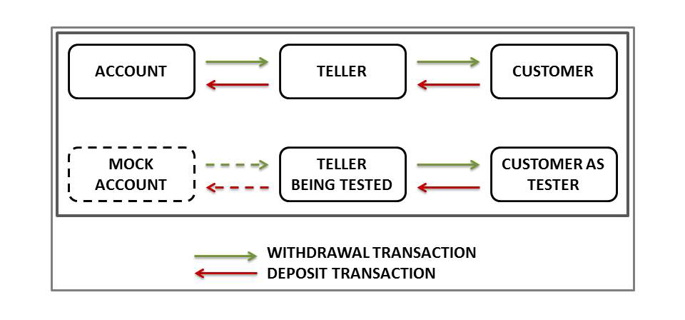
Concept Of Mocking
Mocking:
Is based on the concept that the mock object replaces the real object
Fakes dependencies
Tests objects and interactions with dependencies
Example of mocking: In a bank, there is an account, a teller (SUT), and a customer, as shown.
Notes:
If you have a class Calculator, that needs a dao (Data Access Object) object to load the data it needs from a database, then the dao object is a "real object". In order to test the Calculator class you will have to provide it with a dao object that has a valid connection to the database. In addition you have to insert the data needed for the test into the database.
Setting up the connection and inserting the data in the database can be a lot of work. Instead you can provide the Calculator instance with a fake dao class which just returns the data you need for the test. The fake dao class will not actually read the data from the database. The fake dao class is a mock object. A replacement for a real object which makes it easier to test the Calculator class. Purist mock testers would call such a fake dao for a stub. I will get to that distinction later.
https://www.martinfowler.com/articles/mocksArentStubs.html

Slide 20
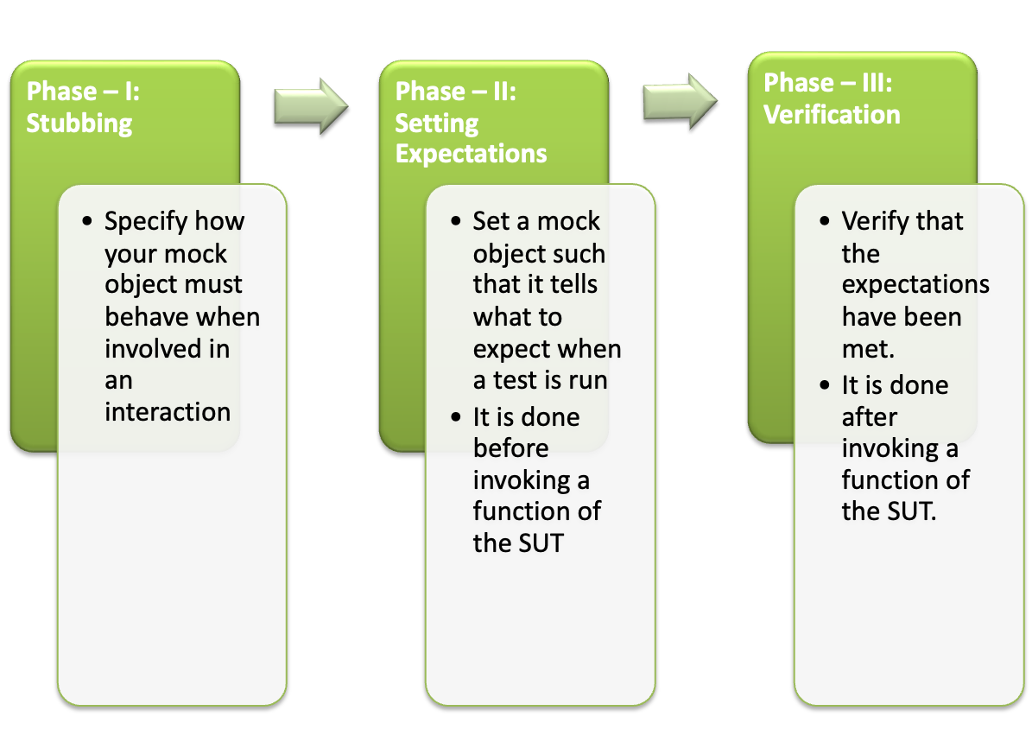
Key Phases Of Mocking

Slide 21
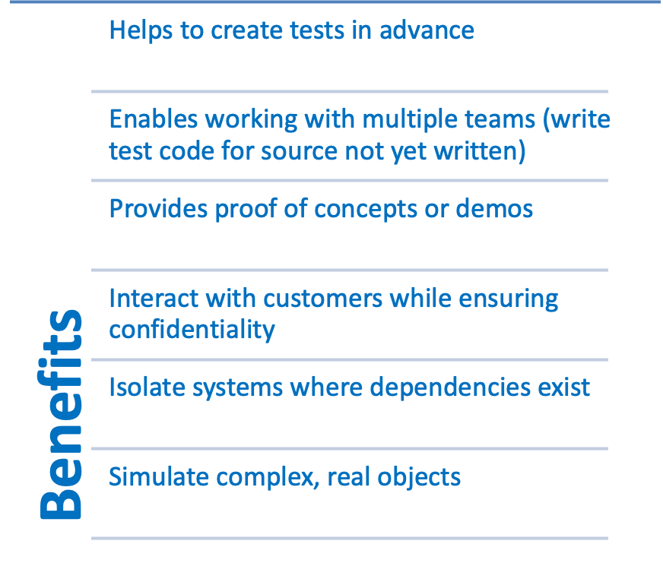
Benefits Of Mocking
In unit testing, mock objects can simulate the behavior of complex, real objects and are especially useful when a real object is impractical.
Notes:
PG Reference: Page 19
Explain that in unit testing as Mock objects can simulate the behavior of complex, real objects and are especially useful when a real object is impractical. Key benefits of mocking are that it enables you to:
Create tests in advance: Using Mock, you can create service tests even before the services are written. As a result, you can add service tests to the test automation environment during the development process. Therefore, with service mocking, you can use TDD in JUnit.
Work with multiple teams: Test code can be created for source that has not yet been written. This means that the QA team can write mocks and test them even before the source code is ready. Therefore, mocking eliminates the need for testing to wait until the development team finishes writing the source code. This saves time and is also a huge financial advantage.
Provide proof of concepts or demos: Creating mocks is cost efficient, which means that you can use mocks to create a proof of concept or demonstrate a concept. You can, therefore, examine the concept beforehand, which gives you the advantage of creating multiple code to arrive on the best code before these are demonstrated.
Interact with customers: Many companies do not allow their clients or customers to access their source code because of security restrictions or inaccessibility of the test environment. In such scenarios, a mock of the system can be developed and provided to the customer for inspection and approval.
Isolate systems: In some scenarios, as a tester you may want to test only one part of a system without interference from the system’s dependencies. Mock is used to remove these dependencies so that the functionality of the system can be tested to identify errors or bugs. For example, an Internet provider has many systems, such as product management, product development and testing, database management, and customer service systems, that help to connect numerous clients to the web. There may be an underlying system that connects all these systems to a single platform. If this platform needs to be tested, obviously all other systems are affected. Creating a mock of the platform isolates it for testing without harming or changing the other systems.
Simulate real objects: Mock objects used in writing mock tests can mimic the behaviors of complex, real objects. Therefore, when creating a real object is not feasible, using mock objects is useful.

Slide 22
When Use Mocking
Use mocking when the class you want to unit test communicates with other classes that have side effects which should only be called in the real production system.
Some random examples of such side effects I thought of are:
Charging a credit card or bank account
Printing medical records, invoices, personal documents, etc
Sending an overdue bill notification to a client via email
Sending a request to an external system
Launching weapons into a neighboring enemy solar system
Flooding the reactor core
Shutting down life support
Notes:
https://zeroturnaround.com/rebellabs/how-to-mock-up-your-unit-test-environment-to-create-alternate-realities/
Example :
Create a new business rule regarding the mailing of invoices. Some customers get invoices by email, but others want a physically printed copy of the invoice instead
If you do not mock the printerservice and emailservice, chances are:
An email has reached the test inbox he has created for the imaginary user (not so bad)
A test invoice has been printed to the company printer (very bad!)
He forgot to add any ASSERT code at the end of the tests (DUDE!!!)

Slide 23
Mocking Frameworks
JMOck
EasyMock
Jmockit
Mockachino
Unitils
PowerMock – extends Easymock and Mockito with the ability to mock static, final and private methods

Slide 24
Mockito
Open Source Mocking Framework
Uses the mock testing strategy (called mocking); uses substitutes of objects to validate code
Has a simple coding language
Has a simple coding language
Can mock classes and interfaces, resulting in better coding
Is used to write clean and simple Application Programming Interface, enabling creation and modification of test code
Is user friendly (tests are readable and verification of errors is clean)
Notes:
https://zeroturnaround.com/rebellabs/how-to-mock-up-your-unit-test-environment-to-create-alternate-realities/
Full Mockito package
https://static.javadoc.io/org.mockito/mockito-core/2.2.29/org/mockito/Mockito.html#21

Slide 25
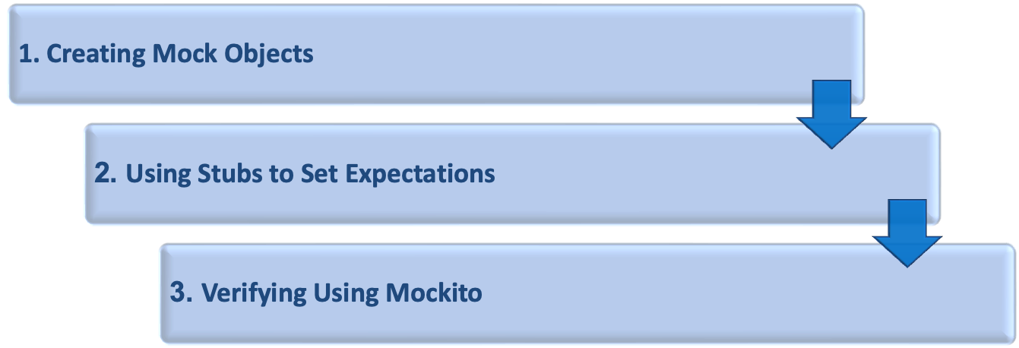
Mockito Implementation
To create JUnit test cases using Mockito:

Slide 26
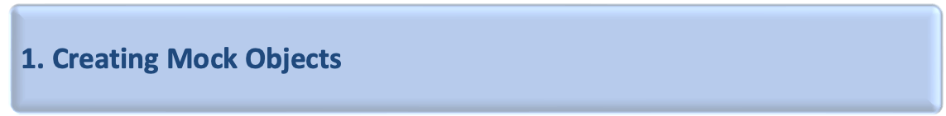
Create Mock Objects
Create mock objects in JUnit by using:
  Static mock() method call
  @Mock annotation
Mock object is created and used to test the service.
Use the verify () method to ensure that a method is called in a JUnit mock test.
Use the when() thenReturn() syntax to set condition and return a value if true.
If several return values are specified, these will be returned in sequence until the last specified value is returned.
Notes:
PG Reference: Page 20-21
Explain that you can create mock objects in JUnit by using the static mock() method call or the @Mock annotation. If you use annotations, you must initialize the mock objects. The MockitoRule allows this. It invokes the static method MockitoAnnotations.initMocks(this) to initialize the mock objects. Code Segment 3.7 in the PG is an example that shows the use of Mockito.
Alternatively you can use @RunWith(MockitoJUnitRunner.class).
Example: Suppose you have a class named LoginService in your application, which uses a Data Access Object (DAO) to authenticate a user. Code Segment 3.7 in the PG shows how to mock the interaction of LoginService with DAO.
Ask the participants to note how the mock DAO object (implementing the DAO interface) is created and used to test the service. The verify () method is used to make sure that a method is called in a JUnit mock test. You can use the when(…..) thenReturn(….) syntax to set a condition and return a specified value if this condition is found to be true. If you specify more than one return values, these will be returned in sequence until the last specified value is returned. To have a method return the same value always, just specify it once.

Slide 27
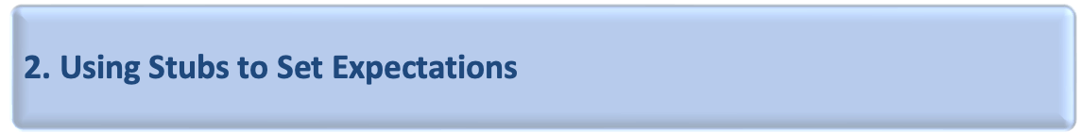
Stubs to set expectations
Create a stub and pass an argument to the method as a mock.
Use the anyInt() method when you cannot predict arguments.
For stubbing void method calls:
  The when() method cannot be used.
  Use doReturn(result).when(mock_object).void_method_call()
  Returns a specific value for the void method
Exceptions using thenThrow() or doThrow()
Notes:
PG Reference: Page 19
Explain that in unit testing as Mock objects can simulate the behavior of complex, real objects and are especially useful when a real object is impractical. Key benefits of mocking are that it enables you to:
Create tests in advance: Using Mock, you can create service tests even before the services are written. As a result, you can add service tests to the test automation environment during the development process. Therefore, with service mocking, you can use TDD in JUnit.
Work with multiple teams: Test code can be created for source that has not yet been written. This means that the QA team can write mocks and test them even before the source code is ready. Therefore, mocking eliminates the need for testing to wait until the development team finishes writing the source code. This saves time and is also a huge financial advantage.
Provide proof of concepts or demos: Creating mocks is cost efficient, which means that you can use mocks to create a proof of concept or demonstrate a concept. You can, therefore, examine the concept beforehand, which gives you the advantage of creating multiple code to arrive on the best code before these are demonstrated.
Interact with customers: Many companies do not allow their clients or customers to access their source code because of security restrictions or inaccessibility of the test environment. In such scenarios, a mock of the system can be developed and provided to the customer for inspection and approval.
Isolate systems: In some scenarios, as a tester you may want to test only one part of a system without interference from the system’s dependencies. Mock is used to remove these dependencies so that the functionality of the system can be tested to identify errors or bugs. For example, an Internet provider has many systems, such as product management, product development and testing, database management, and customer service systems, that help to connect numerous clients to the web. There may be an underlying system that connects all these systems to a single platform. If this platform needs to be tested, obviously all other systems are affected. Creating a mock of the platform isolates it for testing without harming or changing the other systems.
Simulate real objects: Mock objects used in writing mock tests can mimic the behaviors of complex, real objects. Therefore, when creating a real object is not feasible, using mock objects is useful.

Slide 28
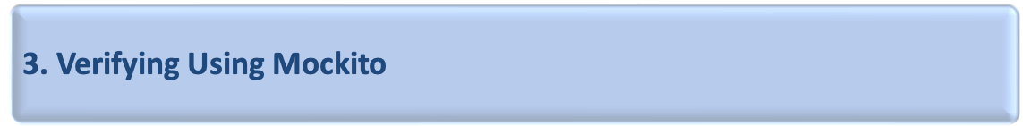
Verify
Use the verify() method to verify whether the set expectations are met.
The verify() method can check whether a behavior happened:
  Once or twice
  Multiple times
  Never
By verifying the set expectations, errors in the code being detected can be determined.
Debug code if the expectations are not met.
Notes:
PG Reference: Page 19
Explain that in unit testing as Mock objects can simulate the behavior of complex, real objects and are especially useful when a real object is impractical. Key benefits of mocking are that it enables you to:
Create tests in advance: Using Mock, you can create service tests even before the services are written. As a result, you can add service tests to the test automation environment during the development process. Therefore, with service mocking, you can use TDD in JUnit.
Work with multiple teams: Test code can be created for source that has not yet been written. This means that the QA team can write mocks and test them even before the source code is ready. Therefore, mocking eliminates the need for testing to wait until the development team finishes writing the source code. This saves time and is also a huge financial advantage.
Provide proof of concepts or demos: Creating mocks is cost efficient, which means that you can use mocks to create a proof of concept or demonstrate a concept. You can, therefore, examine the concept beforehand, which gives you the advantage of creating multiple code to arrive on the best code before these are demonstrated.
Interact with customers: Many companies do not allow their clients or customers to access their source code because of security restrictions or inaccessibility of the test environment. In such scenarios, a mock of the system can be developed and provided to the customer for inspection and approval.
Isolate systems: In some scenarios, as a tester you may want to test only one part of a system without interference from the system’s dependencies. Mock is used to remove these dependencies so that the functionality of the system can be tested to identify errors or bugs. For example, an Internet provider has many systems, such as product management, product development and testing, database management, and customer service systems, that help to connect numerous clients to the web. There may be an underlying system that connects all these systems to a single platform. If this platform needs to be tested, obviously all other systems are affected. Creating a mock of the platform isolates it for testing without harming or changing the other systems.
Simulate real objects: Mock objects used in writing mock tests can mimic the behaviors of complex, real objects. Therefore, when creating a real object is not feasible, using mock objects is useful.

Slide 29
@InjectMocks
Use the verify() method to verify whether the set expectations are met.
The verify() method can check whether a behavior happened:
  Once or twice
  Multiple times
  Never
By verifying the set expectations, errors in the code being detected can be determined.
Debug code if the expectations are not met.
Notes:
https://tedvinke.wordpress.com/2014/02/13/mockito-why-you-should-not-use-injectmocks-annotation-to-autowire-fields/

Slide 30
Assignments

Slide 31
Assignment 1
Implement a class Car with the following properties. A car has a certain fuel efficiency (measured in miles gallon or liters km—pick one) and a certain amount of fuel in the gas tank. The efficiency is specified in the constructor, and the initial fuel level is 0.
Supply a method drive that simulates driving the car for a certain distance, reducing the amount of gasoline in the fuel tank. Also supply methods getGasInTank, returning the current amount of gasoline in the fuel tank, and addGas, to add gasoline to the fuel tank. Sample usage:
Car myHybrid = new Car(50); // 50 miles per gallon myHybrid.addGas(20); // Tank 20 gallons
myHybrid.drive(100); // Drive 100 miles
double gasLeft = myHybrid.getGasInTank(); // Get gas remaining in tank
You may assume that the drive method is never called with a distance that consumes more than the available gas. Supply a CarTester class that tests all methods.

Slide 32
Assignment 1
Write a tester class that tests a scenario in which gas is added to the car, the car is driven, more gas is added, and the car is driven again. Print the actual and expected amount of gas in the tank.

Slide 33
Assignment 2
Implement a class Employee. An employee has a name (a string) and a salary (adouble). Provide a constructor with two arguments
public Employee(String employeeName, double currentSalary)
and methods
public String getName()
public double getSalary()
public void raiseSalary(double byPercent)
These methods return the name and salary, and raise the employee’s salary by a certain percentage.
Sample usage:
Employee harry = new Employee("Hacker, Harry", 50000); harry.raiseSalary(10); // Harry gets a 10 percent raise
Supply an EmployeeTester class that tests all methods.

Slide 34
Assignment 2
Class person
Total = 0
Calcalories(weight)
If(weight <0)
wieght = 0
Total = total + weight
Client – change reqt ( weight cannot be –ve)
-

Slide 35
ThankYou
shalini06mittal@gmail.com
7738460004

