Slide 1
Spring Framework
Shalini Mittal
Corporate Trainer

Slide 2
What we will Cover?
Setter Injection
Constructor Injection
Autowiring
Collection Iinjection
Bean Scope
Bean LifeCycle
Java based Configuration

Slide 3
Dependency Injection
We will explore different types of DI
  Setter injection
  Constructor injection
  Field injection
    only possible using annotations approach
  Method injection
    Using Spring API
Notes:
http://www.wrox.com/WileyCDA/Section/Why-Use-the-Spring-Framework-.id-130098.html

Slide 4
Setter Injection
public void setBookId(int bookid) {
this.bookid = bookid;
}
We need a MessageProvider object to be injected

Slide 5
XML Configuration
<bean id="book2” class="entity.Book">
<property name="bookid" value="102"></property>
<property name="title" value="Midnight"></property>
<property name="price" value="1345.90"></property>
<property name="price" ref=”a1"></property>
</bean>
That’s the setter method of the bean class we are referring to

Slide 6
Annotation Style Configuration
@Autowired
public void setAuthor(Author) {
this.author = author;
}
Here we are injecting a MessageProvider using annotations. To activate use of annotations for DI, we need to inform the container about the same
<context:annotation-config />
Notes:
Annotation injection is performed before XML injection, thus the latter configuration will override the former for properties wired through both approaches.

Slide 7
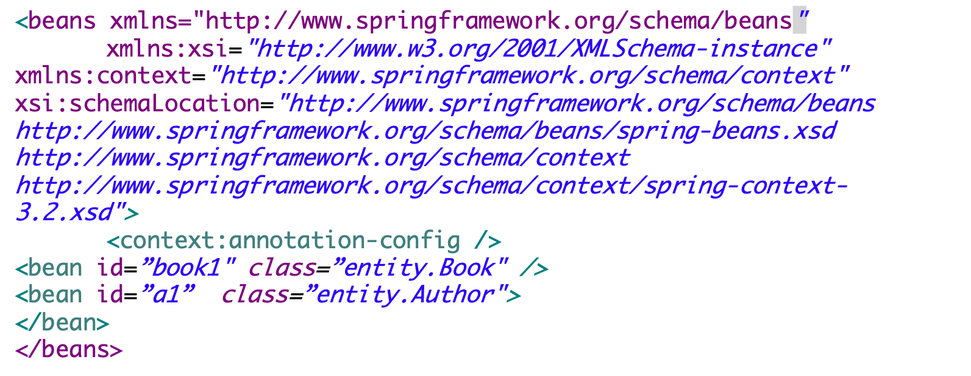
Annotation XML Configuration

Slide 8
@Autowired
@Autowired applies to fields, constructors, and multi-argument methods, allowing for narrowing through qualifier annotations at the parameter level.
@Autowired annotation can be applied on variables and methods for autowiring byType.
We can also use @Autowired annotation on constructor for constructor based spring autowiring.
By default, the autowiring fails whenever zero candidate beans are available; the default behavior is to treat annotated methods, constructors, and fields as indicating required dependencies
@Autowired(required=false)
Notes:
https://stackoverflow.com/questions/4093504/resource-vs-autowired
@Autowired + @Qualifier will work only with spring DI, if you want to use some other DI in future @Resource is good option.
other difference which I found very significant is @Qualifier does not support dynamic bean wiring, as @Qualifier does not support placeholder, while @Resource does it very well.
For example: if you have an interface with multiple implementations like this
interface parent { } @Service("actualService") class ActualService implements parent{ } @Service("stubbedService") class SubbedService implements parent{ }with @Autowired & @Qualifier you need to set specific child implementation like
@Autowired @Qualifier("actualService") or @Qualifier("stubbedService") Parent object;which does not provide placeholder while with @Resource you can put placeholder and use property file to inject specific child implementation like
@Resource(name="${service.name}") Parent object; where service.name is set in property file as
#service.name=actualService service.name=stubbedService

Slide 9
@Component
To avoid using the <bean> tag in the xml file, we need to use @Component annotation
Any bean marked as @Component can be scanned by the IoC container on startup and will be loaded dynamically
To make it more clear as to what type of components are we building, Spring introduced @Service, @Repository, @Controller and many other stereotypes to distinguish between the same
Alternatively @Named CDI annotation be used instead of @Component
@CDI (Context & Dependency Injection) is a JSR standard for DI in Java. Spring framework supports CDI. Benefit of using CDI will be our code will remain the same if we shift from one DI Container to another in future

Slide 10
@Component Type
@Component
public class Book {
}
Needed in the xml file to tell the container about fully annotated components. To provide an id the bean, it can be done somewhat like this @Component

Slide 11
Constructor Injection
public Book(int bookid, String title, double price, Author author) {
this.bookid = bookid;
this.title = title;
this.price = price;
this.author = author;
}
This time the dependencies are bound to a constructor
Informing the container to invoke a parameterized constructor
<bean id="book1" class="entity.Book">
<constructor-arg name="bookid" value="101"></constructor-arg>
<constructor-arg name="title" value="Core Java"></constructor-arg>
<constructor-arg name="price" value="345.90"></constructor-arg>
<constructor-arg name="author" ref="a1"></constructor-arg>
</bean>
Notes:
https://docs.spring.io/spring/docs/3.0.0.M3/reference/html/ch04s11.html

Slide 12
Constructor Annotation Configuration
@Autowired
public Book(Author author) {
this.author =author;
}
Informing the container that we need to inject a DataSource by calling this constructor

Slide 13
@Qualifier
This annotation is used to avoid conflicts in bean mapping and we need to provide the bean name that will be used for autowiring.
This way we can avoid issues where multiple beans are defined for same type.
This annotation usually works with the @Autowired annotation.
For constructors with multiple arguments, we can use this annotation with the argument names in the method.
Notes:
https://martinfowler.com/articles/injection.html

Slide 14
Collection Injection
4 major collection types are supported :
  List – <list/>
  Set – <set/>
  Map – <map/>
  Properties – <props/>

Slide 15
Sample Code for Collection
public class Employee
{
  private List<Object> lists; private Set<Object> sets; private Map<Object, Object> maps; private Properties pros;
//... }

Slide 16
List Injection
<property name="lists">
<list>
<value>1</value>
<ref bean=”address" />
</list>
</property>
<bean id=“address” class=”com.collection.Address">
<property name=”city" value=”Mumbai" />
<property name=”state" value=”Mah" />
<property name=”country" value=”India" />
</bean>
Notes:
Spring is non-intrusive; objects in a Spring-enabled application typically have no dependencies on Spring-specific classes.
2 mb size min

Slide 17
Set Injection
<property name="sets">
<set>
<value>1</value>
<ref bean=”address" />
</set>
</property>
<bean id=“address” class=”com.collection.Address">
<property name=”city" value=”Mumbai" />
<property name=”state" value=”Mah" />
<property name=”country" value=”India" />
</bean>
Notes:
Spring is non-intrusive; objects in a Spring-enabled application typically have no dependencies on Spring-specific classes.
2 mb size min

Slide 18
Map Injection
<property name="maps">
<map>
<entry key="Key 1" value="1" />
<entry key="Key 2" value-ref=”address" />
</map>
</property>
<bean id=“address” class=”com.collection.Address">
<property name=”city" value=”Mumbai" />
<property name=”state" value=”Mah" />
<property name=”country" value=”India" />
</bean>
Notes:
Spring is non-intrusive; objects in a Spring-enabled application typically have no dependencies on Spring-specific classes.
2 mb size min

Slide 19
Java Based Configuration
Spring 3.0 provides XMLess approach for the first time. New set of annotations have been introduced to eliminate xml completely
With the introduction of @Component family of annotations in 2.5, we were able to remove bean definitions from the xml and using @Resource and @Autowired, even the dependencies could be managed from the code itself. But we still needed an XML file for registering non-annotated beans
In 2.0, annotation support was introduced primarily for Transaction management and AOP
Prior to 2.0, everything had to be in XML files
Notes:
Spring is non-intrusive; objects in a Spring-enabled application typically have no dependencies on Spring-specific classes.
2 mb size min

Slide 20
@Configuration
@Configuration DIConfiguration.java
@ComponentScan(basePackages={"decoupled"})
public class DIConfiguration {
}
So what we were doing in xml files for all these years, now the same configuration will be provided through Java code
Notes:
Spring is non-intrusive; objects in a Spring-enabled application typically have no dependencies on Spring-specific classes.
2 mb size min

Slide 21
Loading the container
public static void main(String[] args) {
AnnotationConfigApplicationContext context = new AnnotationConfigApplicationContext(DIConfiguration.class);
Book b1 = (Book)context.getBean(”book1");
}
This time we are launching the Spring IoC container with the help of a Java based configuration class. Alternatively to avoid changing the bootstrap process, you can still have an xml file containing
<context:component-scan base-package=”com.package.beans" /> ,
so that the container will automatically load the Java based configuration class like any other bean but with those additional configurational capabilities
Best of both the worlds!
Notes:
Spring is non-intrusive; objects in a Spring-enabled application typically have no dependencies on Spring-specific classes.
2 mb size min

Slide 22
Collection Injection using java based configuration
@Bean
public List<String> namesList() {
List names = new ArrayList<String>();
names.add("Salman Khan");
names.add("Hrithik Roshan");
return names;
}
@Bean
public Set<Long> numbersBean() {
Set<Long> numbers = new HashSet<>();
numbers.add(2222222222L);
numbers.add(1212121212L);
return numbers;
}
@Bean
public Map<Long, String> phoneNameMapBean() {
Map<Long, String> phoneNames = new HashMap<>();
phoneNames.put(888888888888L, "Ram");
phoneNames.put(777777777777L, "Bhim");
return phoneNames;
}
Notes:
if key and value both are Strings, go for Properties as follows

Slide 23
Bean Scope
singleton (default) - Scopes a single bean definition to a single object instance per Spring IoC container.
prototype (non singleton) - Scopes a single bean definition to any number of object instances.
Request - Scopes a single bean definition to the lifecycle of a single HTTP request; that is, each HTTP request has its own instance of a bean created off the back of a single bean definition. Only valid in the context of a web-aware Spring ApplicationContext.
Session - Scopes a single bean definition to the lifecycle of an HTTP Session. Only valid in the context of a web-aware Spring ApplicationContext.
Global session -Scopes a single bean definition to the lifecycle of a global HTTP Session. Typically only valid when used in a portlet context. Only valid in the context of a web-aware Spring ApplicationContext.
Notes:
Spring is non-intrusive; objects in a Spring-enabled application typically have no dependencies on Spring-specific classes.
2 mb size min

Slide 24
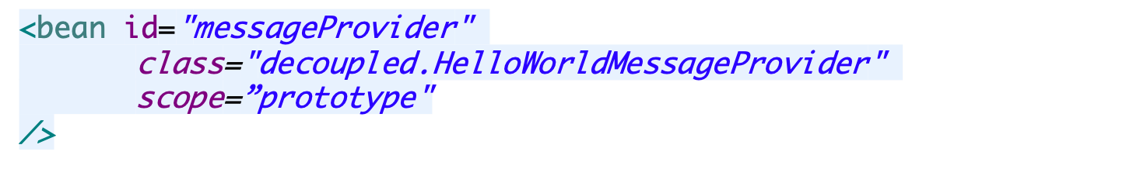

Change the scope
We use the scope attribute in the xml to change the scope of a bean
We use @Scope annotation as an alternative to xml approach
Notes:
Spring's concept of a singleton bean differs from the Singleton pattern as defined in the Gang of Four (GoF) patterns book. The GoF Singleton hard-codes the scope of an object such that one and only one instance of a particular class is created per ClassLoader. The scope of the Spring singleton is best described as per container and per bean. This means that if you define one bean for a particular class in a single Spring container, then the Spring container creates one and only one instance of the class defined by that bean definition.

Slide 25
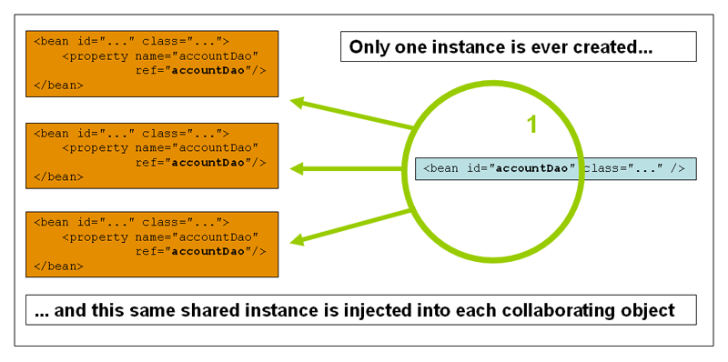
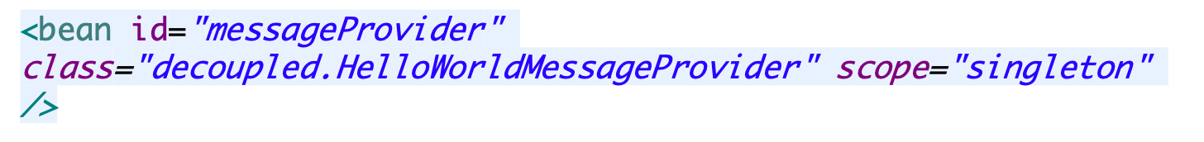
Singleton
Notes:
Spring's concept of a singleton bean differs from the Singleton pattern as defined in the Gang of Four (GoF) patterns book. The GoF Singleton hard-codes the scope of an object such that one and only one instance of a particular class is created per ClassLoader. The scope of the Spring singleton is best described as per container and per bean. This means that if you define one bean for a particular class in a single Spring container, then the Spring container creates one and only one instance of the class defined by that bean definition.

Slide 26
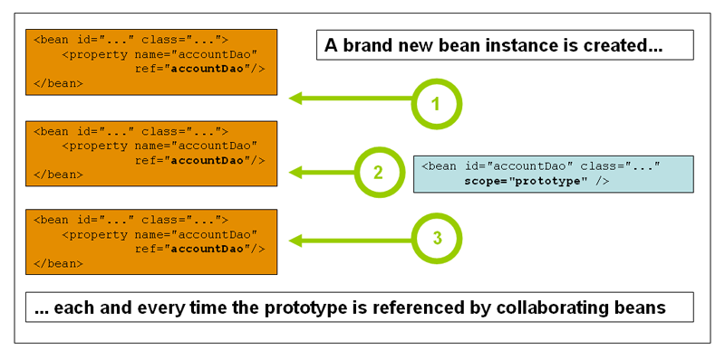
Prototype
Notes:
In contrast to the other scopes, Spring does not manage the complete lifecycle of a prototype bean: the container instantiates, configures, and otherwise assembles a prototype object, and hands it to the client, with no further record of that prototype instance. Thus, although initialization lifecycle callback methods are called on all objects regardless of scope, in the case of prototypes, configured destruction lifecycle callbacks are not called. The client code must clean up prototype-scoped objects and release expensive resources that the prototype bean(s) are holding. To get the Spring container to release resources held by prototype-scoped beans, try using a custom bean post-processor, which holds a reference to beans that need to be cleaned up.

Slide 27
Lazy bean Initialization
By default, Spring “application context” eagerly creates and initializes all ‘singleton scoped‘ beans during application startup itself.
It helps in detecting the bean configuration issues at early stage, in most of the cases. But sometimes, you may need to mark some or all beans to be lazy initialized due to different project requirements.
  Lazy initialized beans in Java configuration
  @Lazy
  Lazy initialized beans in XML configuration
  lazy-init=“true”
Notes:
https://howtodoinjava.com/spring5/core/spring-bean-eager-vs-lazy-init/

Slide 28
Namespaces in Spring
By now you must be familiar with the xml file which we have been writing every time.
Older versions of Spring configuration relied on dtd based validation.
From version 2.0, xml schemas (xsd) were introduced making the configuration of different resources in spring much easier
Also we can create custom schemas of our own and use that in the configuration file of Spring
Notes:
https://docs.spring.io/spring/docs/3.2.x/spring-framework-reference/html/beans.html

Slide 29
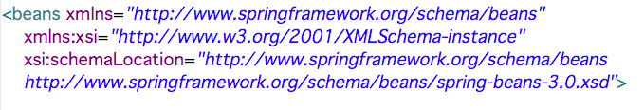
Default Namespace
We use the beans namespace as the default one. So most of the tags we have seen so far in the xml was defined in this namespace

Slide 30
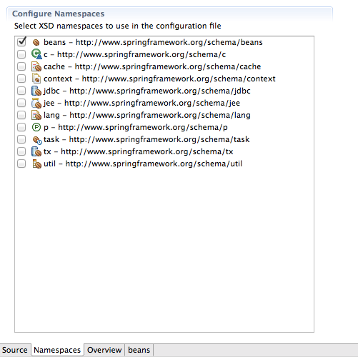
Some of the Namespace

Slide 31
Why so many Namespace
Since in Spring any resource is configured as a bean in the xml file, whether it is a DataSource or JNDI resource or user defined beans. Sometimes this leads to confusions since the xml file is less verbose
With namespaces it becomes easy to identify what type of bean have we configured in the xml file
We will see some examples to understand the difference and discuss about the best option

Slide 32
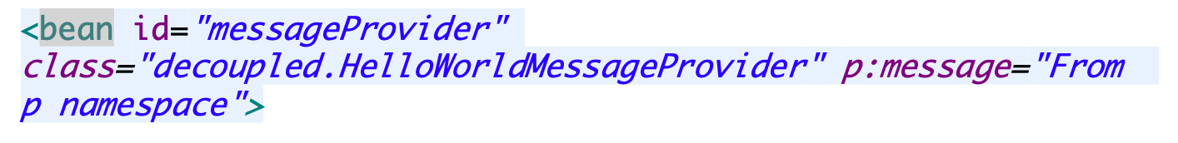
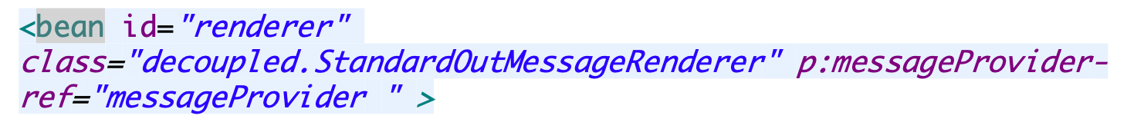
P Namespace
The p-namespace enables you to use the bean element's attributes, instead of nested <property/> elements, to describe your property values and/or collaborating beans.
public class HelloWorldMessageProvider implements MessageProvider {
String message;
public void setMessage(String message) {
this.message = message;
}
public String getMessage() {
return this.message;
}
}
xmlns:p="http://www.springframework.org/schema/p"
Use the property name as
Attribute name for p:
<property name=“message” value=“”/>
For bean reference

Slide 33
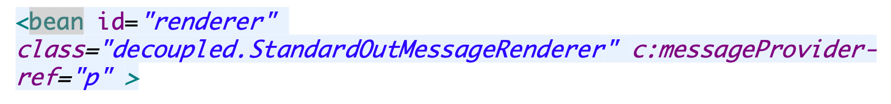
C Namespace
Configuring the constructor arguments rather then nested constructor-arg elements.
public StandardOutMessageRenderer(MessageProvider messageProvider) {
this.messageProvider =messageProvider;
}
xmlns:c="http://www.springframework.org/schema/c
Use the argument name as
Attribute name for c:

Slide 34
ThankYou

