Slide 1
Spring Framework
Shalini Mittal
Corporate Trainer

Slide 2
What we will Cover?
Introduction to AOP
What is an Aspect?
Spring’s support for AOP
  Proxy based
  Weaving
Spring and AspectJ relationship
Pointcuts, Joinpoints and other terminologies
Different types of Aspects
Before, After, AfterReturning, AfterThrowing, Around
Notes:
https://www.javachinna.com/spring-aop-application-with-real-time-examples/
https://www.javachinna.com/logging-performance-monitoring-security-and-transaction-management-with-spring-aop/
https://spring.io/blog/2007/07/19/debunking-myths-proxies-impact-performance/
https://stackify.com/spring-aop-tutorial-with-examples/

Slide 3
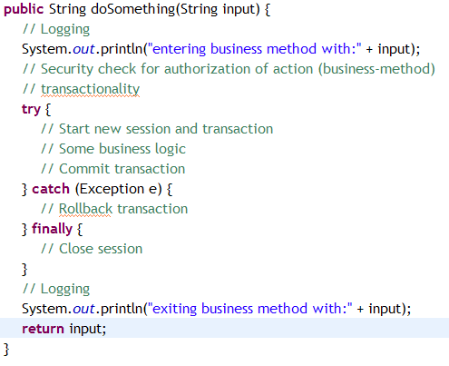
The problem

Slide 4
IOC Example, where is AOP then!
public class BankAccount {
public void transfer(BigDecimal amount, BankAccount recipient) {
SecurityManager.hasPermission(this, Permission.TRANSFER,
SecurityContext.getCurrentUser());
recipient.deposit(this.withdraw(amount));
}
public void closeOut() {
SecurityManager.hasPermission(this, Permission.CLOSE_OUT,
SecurityContext.getCurrentUser());
this.open = false;
}
public void changeRates(BigDecimal newRate) {
SecurityManager.hasPermission(this, Permission.CHANGE_RATES,
SecurityContext.getCurrentUser());
this.rate = newRate;
}
}

Slide 5
Identifying repetitive code
public class BankAccount {
public void transfer(BigDecimal amount, BankAccount recipient) {
recipient.deposit(this.withdraw(amount));
}
public void closeOut() {
this.open = false;
}
public void changeRates(BigDecimal newRate) {
this.rate = newRate;
}
}
As you can see AOP has freed the object from the cross-cutting constraint of security authorization. The end result is a removal of duplicate code and a simplified class that is focused on its core business logic.
This is how the BankAccount class will look like after applying AOP

Slide 6
Cont’d…
So how do we get the security checks back into the system? You can add the authorization mechanism into the execution path called aspect-oriented programming (AOP)
Aspects are concerns of the application that apply themselves across the entire system. The SecurityManager is one example of a system-wide aspect, as its hasPermission methods are used by many methods. Other typical aspects include logging, auditing, exception handling, performance monitoring and transaction management
These types of concerns are best left to the framework hosting the application, allowing developers to focus more on business logic

Slide 7
Cont’d…
An AOP framework, such as Spring AOP, will interject (also called weaving) aspect code transparently into your domain model at runtime or compile time. This means that while we may have removed calls to the SecurityManager from the BankAccount class, the deleted code will still be executed in the AOP framework
The beauty of this technique is that both the domain model (the BankAccount) and any client of the code are unaware of this enhancement to the code

Slide 8


Proxy approach
AOP Proxy
target
BankAccount
invokes
Client
interceptors
SecurityManager
Aspect/Interceptor
Since the client code should be unaware that he is talking to different class, the Proxy generated by Spring would either be a subclass of BankAccount or implement interfaces exposed by BankAccount class so that the client code remains transparent to the changes in the configuration.
Client invokes methods exposed by the proxy, which in turn will execute interceptors configured for the target bean

Slide 9
Types of Advice
While writing an aspect, we need to also decide when will this aspect/advice run:
  Before
  After
  AfterReturning
  AfterThrowing
  Around

Slide 10
Before Advice
Interceptor
2
Proxy
3
Target Bean
1
Client calls some method of the proxy class
The proxy executes the interceptor first
If the interceptor executes without any error, then finally invokes the real method of the bean class

Slide 11
After Advice
Interceptor
3
Proxy
2
Target Bean
1
Client calls some method of the proxy class
The proxy executes real method first.
The interceptor is executed irrespective of the target bean method fails or succeeds. Logically acts like the finally block!

Slide 12
AfterReturning Advice
Interceptor
3
Proxy
2
Target Bean
1
Client calls some method of the proxy class
The proxy executes real method first.
The interceptor is executed only if the target method returns successfully.

Slide 13
AfterThrowing Advice
Interceptor
3
Proxy
2
Target Bean
1
Client calls some method of the proxy class
The proxy executes real method first.
The interceptor is executed only if the target method fails by throwing an exception.

Slide 14
Around Advice
Interceptor
Proxy
2
Target Bean
1
3
4
Client calls some method of the proxy class
The proxy executes the interceptor first.
The interceptor is now responsible for proceeding to the target method of the bean class.
After the target method completes, the interceptor is again executed. So basically Around advice is like perfoming pre and post processing both.

Slide 15
AOP terminologies
Aspect – A modularization of a concern for which the implementation might otherwise cut across multiple objects. Transaction management is an example of crosscutting concern in J2EE applications. Aspects are implemented using Spring as Advisors or interceptors
Joinpoint – Point during the execution of a program, such as a method invocation or a particular exception being thrown. In Spring AOP, a joinpoint is always a method invocation
Advice – Advice specifies what to do at a join point. In Spring, this is the additional behavior that Spring will inject around a method invocation
Pointcuts – Pointcuts are expressions which identify where an advice should apply

Slide 16
Example
Log a message everytime, before a method is called..
Steps to be followed:
1. Write a class which will contain the common logging code. This called will be called as Aspect.
2. Either in xml or annotations, we will have to configure a pointcut, to specify when(before) and where(for all the beans or only a few or only for a particular method pattern) this aspect will apply.

Slide 17
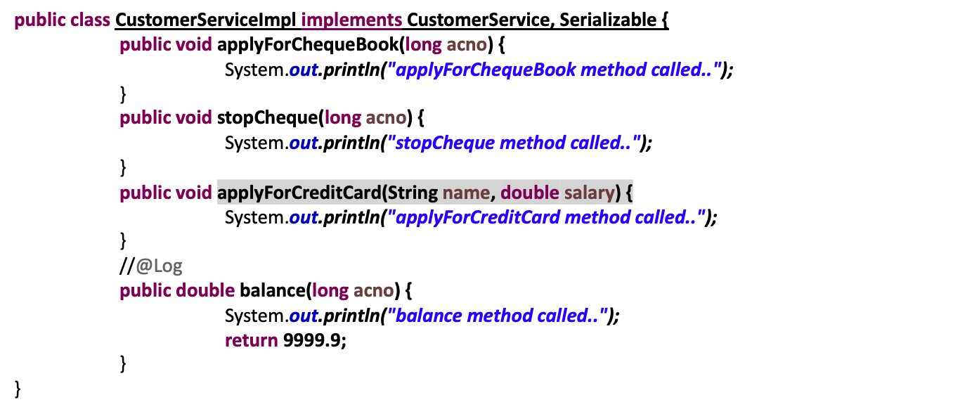
The Sample Customer bean
@Retention(RetentionPolicy.RUNTIME)
public @interface Log {
}
package service;
public interface CustomerService {
public void applyForChequeBook(long acno);
public void stopCheque(long acno);
public void applyForCreditCard(String name, double salary);
public double balance(long acno);
}

Slide 18
The Sample Order bean
package service;
public interface OrderService {
public void placeOrder(Order order);
}
package service;
public class Order {
}
public class OrderServiceImpl implements OrderService {
public void placeOrder(Order order) {
//some order processing logic here
}
}

Slide 19
The Aspect class
//This is an Aspect class
public class LoggingAspect {
//This is an advice.
//Pointcut means where will this advice be applied.
public void log(JoinPoint joinPoint) {
System.out.println("common logging code executed for : "+joinPoint);
}
}
Context about the intercepted point
Methods of the Aspect class can logically be called as advices. Since we are not using annotations, the pointcut configuration will be done in an xml file

Slide 20
The configuration
We need to use the AOP namespace in the xml to configure aspects and pointcuts
xmlns:aop="http://www.springframework.org/schema/aop"
xsi:schemaLocation="http://www.springframework.org/schema/aop http://www.springframework.org/schema/aop/spring-aop.xsd
http://www.springframework.org/schema/beans http://www.springframework.org/schema/beans/spring-beans.xsd">
<aop:aspectj-autoproxy />
<bean id="customerService" class="service.CustomerServiceImpl" />
<bean id="loggingAspect" class="ex1.LoggingAspect" />
<aop:config>
<aop:pointcut id="pointcut1" expression="execution(public * apply*(..))” />
<aop:aspect ref="loggingAspect">
<aop:before method="log" pointcut-ref="pointcut1" />
</aop:aspect>
</aop:config>
ApplicationContext context = new ClassPathXmlApplicationContext("ex1/ex1-config.xml");
CustomerService customerService = (CustomerService)context.getBean(CustomerService.class);
//getClass will confirm that a proxy was created dynamically
System.out.println(customerService.getClass());
//calling the method of the bean class. Client has no idea that
customerService.applyForChequeBook(12345);

Slide 21
Annotation style configuration
@Aspect
public class LoggingAspect {
@Before("execution(public * apply*(..))")
public void log(JoinPoint joinPoint) {
System.out.println("common logging code executed for : "+joinPoint);
}
}
This is the annotated version of the same aspect as before. As you can see the instruction about when and where will the log method execute is configured using relevant annotations. You decide which approach is better!
@EnableAspectJAutoProxy(proxyTargetClass = true) => Add this annotation on the configuration class. Use proxyTargetClass = treue if you need spring to use cglib proxy instead of jdk dynamic proxy
Notes:
https://stackoverflow.com/questions/51795511/when-is-cglib-proxy-used-by-spring-aop

Slide 22
About JoinPoint object
@Aspect
public class LoggingAspect2 {
@Before("execution(public * apply*(..))")
public void log(JoinPoint joinPoint) {
Object proxyObject = joinPoint.getThis();
Object targetBean = joinPoint.getTarget();
Object[] args = joinPoint.getArgs();
Signature signature = joinPoint.getSignature();
//some logging code here
}
}
The JoinPoint object provides the runtime information about the current point of invocation

Slide 23
Useful JoinPoint context
this
  The currently executing object that been intercepted (a proxy in Spring AOP)
target
  The target of the execution (typically your object)
args
  The method arguments passed to the join point
signature
  The method signature of the join point

Slide 24
Pointcuts
One of the reason why AspectJ was adopted by Spring was because of a very powerful and easy to learn pointcut expressions
This is the most important thing in our configuration, because a pointcut identifies the places where our aspects will execute

Slide 25
Pointcut expressions
Spring AOP supports the following AspectJ pointcut designators (PCD) for use in pointcut expressions:
  execution, within, this, target, args
Spring AOP also supports an additional PCD named as:
  bean(id or name)
The execution expression is the most commonly used PCD used in our Spring applications

Slide 26
execution expression
The syntax of execution expression is:
  execution(modifiers-pattern? ret-type-pattern declaring-type-pattern? name-pattern(param-pattern) throws-pattern?)
Can chain together to create composite pointcuts
  &&(and), ||(or), !(not)

Slide 27
Example
execution(public * apply*(..))
Public method returning anything and the method name begins with apply taking any number of arguments
execution(public * com.package.service.*. *(..))
Any public method, return type anything, belonging to any class from the service package any number of arguments
execution(public * apply*(java.lang.String,*))
Any void method of any class taking a String as the first argument and the second argument can be anything
Notes:
https://www.baeldung.com/spring-aop-pointcut-tutorial

Slide 28
Example
@Before("execution(* EmpService.setCname(..)) && args(name)")
public void generateLogsBefore(JoinPoint jp, String name)
Any method that needs to access the arguments being passed to target method
execution(public * com.package.service..*.*(..))
Any method within the whole service package including subpackages taking any number of arguments
execution(@Log * *(..))
Only those methods which are annotated with @Log annotation taking any number of arguments and returning anything
execution(public * apply*(..)throws CustomException)
Only those methods whose signature contains the following throws clause returning anything taking any number of arguments

Slide 29
Example on other expressions
within(com.package.service.*)
For any class within the service package. When using within expression we cannot specify the method name or argument bindings
within(com.package.service..*)
Within the service package and any of it’s sub packages and any class
within(com.package.service.CustomerService+)
Withing the service package and for any bean of type CustomerService. The + operator over here indicates, any bean of that type

Slide 30
Cont’d…
@annotation(com.package.Log)
Only those methods which are annotated with @Log annotation
@target(com.package.Log)
Only those bean classes which are annotated with @Log annotation
bean(*Service)
Only those beans whose id/name matches the expression

Slide 31
Passing parameters to advice
As we seen, a JoinPoint object provides all the details required by the advice to perform any kind of operation
Another way of achieving the same is by using target, args and this expressions in the Pointcut declaration

Slide 32
Example
@Aspect
public class OrderValidator {
@Before("execution(* placeOrder(..)) && args(order)")
public void validateOrder(Order order) {
//some order validation logic here
}
}
Over here, we are telling the container to pass the Order object passed as a parameter to the placeOrder method to the validateOrder advice for validation purpose

Slide 33
Named Pointcut
This is another very important feature of Spring AOP. Since pointcut expressions are lengthy and if you need to use the same pointcut in multiple places, then instead of repeating the expression we can give a logical name to that pointcut and refer to it by that name
It will be more clear with the help of an example!

Slide 34
Example
@Aspect
public class PointcutConfig {
@Pointcut("execution(public * com.package.service.*.*(..))")
public void serviceComponents() {}
@Pointcut("execution(* apply*(..))")
public void applyMethods() {}
}
Basically we are creating aliases for the pointcuts so that we can refer to the same easily now.

Slide 35
Cont’d…
Instead of writing the actual expression, we are referring to the pointcut aliases
@Aspect
public class LoggingAspect {
@Before(”com.package.PointcutConfig.applyMethods()")
public void log(JoinPoint joinPoint) {
System.out.println("log advice executed for method : "+
joinPoint.getSignature().getName());
}
@Before(”com.package.PointcutConfig.serviceComponents()")
public void timeLog(JoinPoint joinPoint) {
System.out.println("request for method : "+
joinPoint.getSignature().getName()+
" occurred at "+new Date());
}
}

Slide 36
After and AfterReturning advice
@Aspect
public class LoggingAspect {
@After("bean(*Service)")
public void log(JoinPoint joinPoint) {
System.out.println("log advice got executed after call to method : "+
joinPoint.getSignature().getName());
}
@AfterReturning(pointcut="execution(* balance(..)) && args(acno)",
returning="balance")
public void validate(JoinPoint joinPoint, long acno, double balance) {
System.out.println("validate advice called after successful return”);
System.out.println("acno passed "+acno+" and the balance returned "+balance);
}
}
In AfterReturning advice, we can even process the return value of the target method which was called.

Slide 37
Exception handling using AOP
Exception handling is one more important aspect of our application development
In many cases exception handling is merely catching system exceptions, wrapping it up as user defined exceptions and throwing it to the caller
This means we end up writing duplicate try/catch blocks in many places, which can easily be eliminated using AOP

Slide 38

Example
public class BusinessException extends Exception {
public BusinessException() {super();}
public BusinessException(String message, Throwable cause)
{super(message, cause);}
public BusinessException(String message)
{super(message); }
public BusinessException(Throwable cause) {super(cause);}
}
<aop:aspectj-autoproxy />
<bean id="messageSource" class="org.springframework.context.support.ResourceBundleMessageSource">
<property name="basename" value="ex6/messages" />
</bean>
<bean id="exceptionHandler" class="ex6.ExceptionHandler" />
<bean id="businessComponent" class="ex6.BusinessComponent" />
public class BusinessComponent implements BusinessInterface {
public void someBusinessMethod() throws BusinessException {
//we are raising a different exception to see the aspect //coming into action
//assume that you are connecting to the database and //something goes wrong
throw new RuntimeException();
}
}
We are trying to create a scenario where the code is raising a system exception and the exception handling code has been into a common place, i.e. Aspects

Slide 39
AfterThrowing Advice
@Aspect
public class ExceptionHandler implements MessageSourceAware {
private MessageSource messageSource;
…
@AfterThrowing(pointcut="execution(* businessMethod(..))”,
throwing="ex")
public void handleException(JoinPoint jp, RuntimeException ex) throws Throwable {
System.out.println("Routine exception handling code here.");
…
throw new BusinessException(
messageSource.getMessage(jp.getSignature().getName(),
null, null));
}
}

Slide 40
Around Advice
If we need to do both pre and post processing, i.e. we need to excute some code before and after the method is called
Also we might want to handle exceptions, return values all in one place
So basically, Around advice combines the capability of Before, After, AfterReturning and AfterThrowing advice in one place

Slide 41
Example
@Aspect
public class ProfilingAspect {
@Around("execution(* *(..))")
public Object profile(ProceedingJoinPoint joinPoint) throws Throwable {
StopWatch watch = new StopWatch();
watch.start(joinPoint.getSignature().getName());
try {
return joinPoint.proceed(); //calling the target method
}
catch(Exception e) {
throw e;
}
finally {
watch.stop();
System.out.println(watch.prettyPrint());
}
}
}

Slide 42
ThankYou

