Slide 1
Spring Framework
Shalini Mittal
Corporate Trainer

Slide 2
What we will Cover?
Spring JDBC
Spring Hibernate

Slide 3
Role of Spring while accessing data
Provide comprehensive data access support
  To make data access easier to do it effectively
Enable a layed application architecture
  To isolate an application’s business logic from the complexity of data access
Spring manages resources for you
  Eliminates boilerplate code
  Reduces likelihood of bugs
Notes:
https://stackoverflow.com/questions/5117191/spring-jdbc-connection-pool-best-practices

Slide 4
Cont’d…
Declarative transaction management
  Transaction boundaries declared via configuration
  Enforced by a Spring transaction manager
Automatic connection management
  Connections acquired/released automatically
Intelligent exception handling
  Root cause failures always reported
  Resources always released properly

Slide 5
Layered Architecture
Service Layer
Data Access Layer
Infrastructure Layer

Slide 6
The Service Layer
Defines the public functions of the application
  Clients call into the application through this layer
Encapsulates the logic to carry out each application function
  Delegates to the infrastructure layer to manage transactions
  Delegates to the data access layer to map persisent data into a form needed to execute the business logic

Slide 7
The Data Access Layer
Used by the service layer to access data needed by the business logic
Encapsulates the complexity of data access
  The use of data access API
    JDBC, Hibernate, etc
  The mapping of data into a form suitable for business logic
    A JDBC ResultSet to a domain object graph

Slide 8
The Infrastructure Layer
Exposes low-level services needed by other layers
  Infrastructure services are provided by Spring
  Developers typically do not write them
Likely to vary between environments
  Production vs. test

Slide 9
Layers working together
Client calls a function of the service layer
A service initiates a function of the application
  By delegating to the transaction manager to begin a transaction
  By delegating to repositories to load data for processing
    All data access calls participate in a transaction
    Repositories oftern return domain objects that encapsulate domain behaviors
A service continues processing
  By executing business logic
  Often by coordinating between domain objects loaded by repositories
And finally, completes processing
  By updating changed data and committing the transaction

Slide 10
Introducing Spring JDBC Support
Introduction to Spring JDBC
  Problems with traditional JDBC
    Results in reduntant, error prone code
    Leads to poor exception handling
  Spring’s JdbcTemplate API
    Configuration
    Query execution
    Working with result sets
    Exception handling

Slide 11
Redundant, error prone code
public List<Flight> getAvailableFlights() {
Connection conn = null;
PreparedStatement pst = null;
ResultSet rs = null;
try {
conn = dataSource.getConnection();
pst = conn.prepareStatement("select * from flights_test");
rs = pst.executeQuery();
List<Flight> rows = new ArrayList<Flight>();
while(rs.next()) {
Flight f = new Flight();
f.setFlightNo(rs.getString(1));
f.setCarrier(rs.getString(2));
f.setFrom(rs.getString(3));
f.setTo(rs.getString(4));
rows.add(f);
}
return rows;
}
catch(SQLException e) {
throw new RuntimeException(e);
}
finally {
try { rs.close(); pst.close(); conn.close(); } catch(Exception e) { }
}
}

Slide 12
Spring’s JdbcTemplate
Greatly simplifies use of the JDBC API
  Eliminates repetitive boilerplate code
  Alleviates common causes of bugs
  Handles SQLExceptions properly
Without sacrificing power
  Provides full access to the standard JDBC constructs

Slide 13
Introduction to JdbcTemplate API
public int getTotalFlights() {
return jdbcTemplate.queryForObject(
"select count(*) from flights_test”, Integer.class);
}
Acquisition of the connection
Participation in the transaction
Execution of the statement
Processing of the result set
Handling any exceptions
Release of the connection
All the steps managed by the Template class

Slide 14
Spring JDBC – Who does what?
Action | Spring | You
Define the connection parameters |  | X
Open the connection | X
Specify the SQL statement |  | X
Declare parameters and provide parameter values |  | X
Prepare and execute the statement | X
Setup the loop to iterate through the results (if any) | X
Do the work for each iteration |  | X
Process any exception | X
Handle transactions | X
Close the connection, statement and resultset | X

Slide 15
Java Based Configuration
@Configuration
@ComponentScan
public class AppConfig {
@Bean public DataSource getMySQLDataSource(){
DriverManagerDataSource dataSource = new DriverManagerDataSource();
dataSource.setDriverClassName("com.mysql.jdbc.Driver");
dataSource.setUrl("jdbc:mysql://localhost:8889/java");
dataSource.setUsername("root");
dataSource.setPassword("root");
System.out.println("Data source created");
return dataSource;
}
//@Bean
public DataSource getDataSource(){
EmbeddedDatabaseBuilder builder = new EmbeddedDatabaseBuilder();
EmbeddedDatabase db = builder
.setType(EmbeddedDatabaseType.H2)
.addScript("createtable.sql")
.addScript("insertdata.sql")
.build();
System.out.println("Database created "+db);
return db;
}
@Bean
public JdbcTemplate getTemplate(){
return new JdbcTemplate(getMySQLDataSource());
}
}
Notes:
// ?useUnicode=true&useJDBCCompliantTimezoneShift=true&useLegacyDatetimeCode=false&serverTimezone=UT

Slide 16
Maven dependency
<dependency>
<groupId>org.springframework</groupId>
<artifactId>spring-context</artifactId>
<version>${spring.version}</version>
</dependency>
<dependency>
<groupId>org.springframework</groupId>
<artifactId>spring-jdbc</artifactId>
<version>${spring.version}</version>
</dependency>
<!-- https://mvnrepository.com/artifact/com.h2database/h2 -->
<!-- <dependency>
<groupId>com.h2database</groupId>
<artifactId>h2</artifactId>
<version>1.4.199</version>
</dependency> -->
<dependency>
<groupId>mysql</groupId>
<artifactId>mysql-connector-java</artifactId>
<version>5.1.23</version>
</dependency>

Slide 17
Creating a JdbcTemplate
JdbcTemplate class requires a DataSource to be supplied for successful creation.
NamedParameterJdbcTemplate class allows the usage of named parameters ‘:name’ rather than traditional ‘?’ similar to Hibernate
jdbcTemplate = new JdbcTemplate(dataSource);
jdbcTemplate = new NamedParameterJdbcTemplate(dataSource);

Slide 18
Example
public class FlightRepositoryImpl implements FlightRepository {
@Autowired
private JdbcTemplate jdbcTemplate;
}

Slide 19
Using JdbcTemplate class methods
Simple select query
public int getTotalFlights() {
return jdbcTemplate.queryForObject(
"select count(*) from flights_test”, Integer.class);
}
Query with bind parameters
public int getTotalFlights(String carrier) {
return jdbcTemplate.queryForObject(
"select count(*) from flights_test where carrier =?",
new Object[]{carrier}, Integer.class);
}
Notes:
https://docs.spring.io/spring/docs/4.0.x/spring-framework-reference/html/jdbc.html
https://www.dineshonjava.com/using-jdbctemplate-in-spring-chapter-33/

Slide 20
Cont’d…
JdbcTemplate class supports varargs
Query for a single row
public int getTotalFlights(String carrier) {
return jdbcTemplate.queryForObject(
"select count(*) from flights_test where carrier =?",
Integer.class, carrier);
}
public Map getFlightInfo(String flightNo) {
return jdbcTemplate.queryForMap(
"select * from flights_test where flightno= ? ",
flightNo);
}

Slide 21
Cont’d…
Query for multiple rows
returns a List where each element of the List contains a Map object holding column name, column value pair data
pubic List getFlights(String carrier) {
return jdbcTemplate.queryForList(
"select * from flights_test where carrier = ?", carrier);
}

Slide 22
Cont’d…
Query for single domain objects
public Flight getFlight(String flightno)
{
class FlightMapper implements RowMapper<Flight> {
@Override
public Flight mapRow(ResultSet rs, int index) throws SQLException {
Flight flight = new Flight();
flight.setFlightNo(rs.getString(1));
flight.setCarrier(rs.getString(2));
flight.setFrom(rs.getString(3));
flight.setTo(rs.getString(4));
return flight;
}
}
Flight flight = jdbcTemplate.queryForObject("select * from flights_test where flightno=? ", new Object[]{flightno}, new FlightMapper());
return flight;
}

Slide 23
Cont’d…
Query for domain objects
public List<Flight> getAvailableFlights(String carrier) {
class FlightMapper implements RowMapper<Flight> {
@Override
public Flight mapRow(ResultSet rs, int index) throws SQLException {
Flight flight = new Flight();
flight.setFlightNo(rs.getString(1));
flight.setCarrier(rs.getString(2));
flight.setFrom(rs.getString(3));
flight.setTo(rs.getString(4));
return flight;
}
}
return jdbcTemplate.query(
"select * from flights_test where carrier = ?", new FlightMapper(), carrier);
}

Slide 24
Cont’d…
For all other DML operations
public void newFlight(Flight flight) {
jdbcTemplate.update(
"insert into flights_test values(?, ?, ?, ?)",
flight.getFlightNo(), flight.getCarrier(), flight.getFrom(), flight.getTo());
}
Please check the reference and API documentation for further usages of JdbcTemplate API

Slide 25
@Configuration
@EnableTransactionManagement
@ComponentScan(basePackages= {"jdbc"})
public class JavabasedConfiguration {
@Bean
public DataSource getDataSource()
{
DriverManagerDataSource dataSource = new DriverManagerDataSource();
dataSource.setDriverClassName("com.mysql.jdbc.Driver");
dataSource.setUrl("jdbc:mysql://localhost:8889/java");
dataSource.setUsername("root");
dataSource.setPassword("root");
System.out.println("Data source created");
return dataSource;
}
@Bean
public LocalSessionFactoryBean getSessionFactory()
{
LocalSessionFactoryBean sessionFactoryBean = new LocalSessionFactoryBean();
sessionFactoryBean.setDataSource(getDataSource());
sessionFactoryBean.setPackagesToScan("jdbc");
sessionFactoryBean.setHibernateProperties(hibernateProperties());
System.out.println("session factory created");
return sessionFactoryBean;
}
@Bean
public PlatformTransactionManager hibernateTransactionManager() {
System.out.println("tx manager");
HibernateTransactionManager transactionManager
= new HibernateTransactionManager();
transactionManager.setSessionFactory(getSessionFactory().getObject());
System.out.println(transactionManager);
return transactionManager;
}
private final Properties hibernateProperties() {
Properties hibernateProperties = new Properties();
hibernateProperties.setProperty(
"hibernate.dialect", "org.hibernate.dialect.MySQLDialect");
hibernateProperties.setProperty("hibernate.show_sql", "true");
return hibernateProperties;
}
}

Slide 26
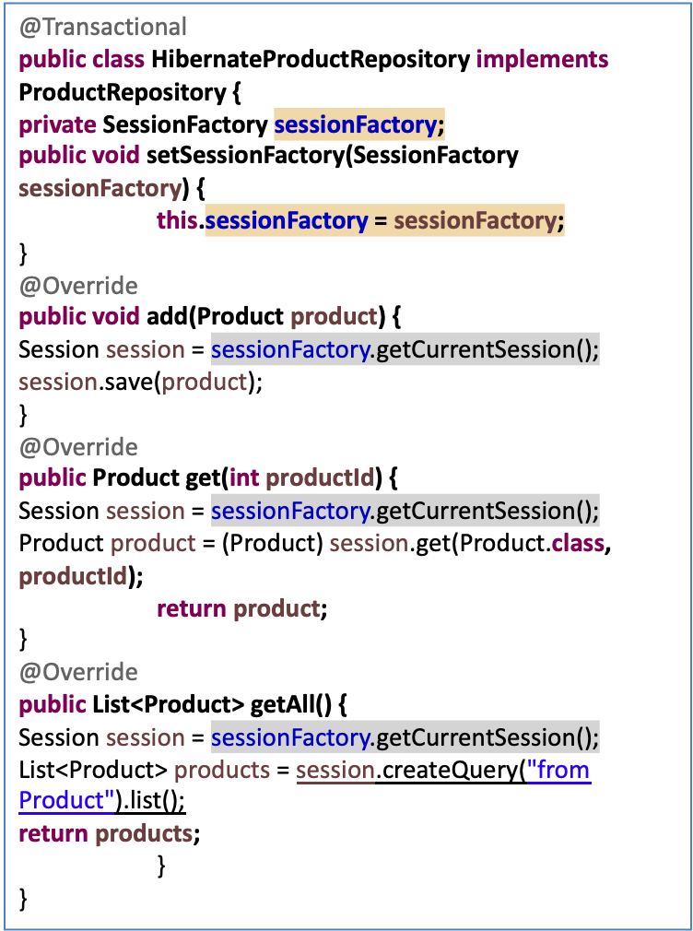
Sample Code
public interface ProductRepository {
public void add(Product product);
public Product get(int productId);
public List<Product> getAll();
}
ApplicationContext context = new ClassPathXmlApplicationContext("ex1/ex1-config.xml");
ProductRepository productRepository = (ProductRepository)context.getBean("productRepository");
Product p = new Product();
p.setName("Majrul's Hackbook");
p.setDescription("Hackintosh is fun!");
p.setPrice(20000.0);
p.setQuantity(99); productRepository.add(p);

Slide 27
Sample Code
List<LinkedCaseInsensitiveMap<String>> l_lstResult = (List) out.get("CUSTOMERRESULTSET");
ArrayList<Customer> l_lstCityTownList = new ArrayList<>(l_lstResult.size());
for (int i = 0; i < l_lstResult.size(); i++) {
Customer c1 = new Customer();
LinkedCaseInsensitiveMap<String> l_hmColmnData = l_lstResult.get(i);
c1.setEmail(l_hmColmnData.get("EMAIL"));
c1.setCity(l_hmColmnData.get("CITY"));
c1.setCustname(l_hmColmnData.get("CUSTNAME"));
c1.setPhone(l_hmColmnData.get("PHONE"));
l_lstCityTownList.add(c1);
}
System.out.println(l_lstCityTownList);
return l_lstCityTownList;
CUSTOMERRESULTSET => name of out parameter in oracle

Slide 28
ThankYou

