Slide 1
Microservice – 02
Shalini Mittal
Corporate Trainer

Slide 2
Topics
Circuit Breakers
Resilience4j
Hystrix
Config Server and Client

Slide 3
Circuit Breakers

Slide 4
Introduction
A typical distributed system consists of many services collaborating together.
These services are prone to failure or delayed responses.
If a service fails it may impact on other services affecting performance and possibly making other parts of application inaccessible or in the worst case bring down the whole application.
When a microservice encounters an error, it will have an impact on other microservices that call it, and will also have a domino effect
A fallback is require for the service that fails.
Possible solutions:
Throw an error
Return fallback default response
Cache previous responses and use that as fallback response

Slide 5
Fallback pattern
Each service that’s wrapped by a circuit breaker can implements a fallback using one of the following three approaches:
Custom fallback: In some cases a service’s client library provides a fallback method we can invoke, or in other cases we can use locally available data on an API server (eg, a cookie or local JVM cache) to generate a fallback response
Fail silent: In this case the fallback method simply returns a null value, which is useful if the data provided by the service being invoked is optional for the response that will be sent back to the requesting client
Fail fast: Used in cases where the data is required or there’s no good fallback and results in a client getting a 5xx response. This can negatively affect the device UX, which is not ideal, but it keeps API servers healthy and allows the system to recover quickly when the failing service becomes available again.

Slide 6
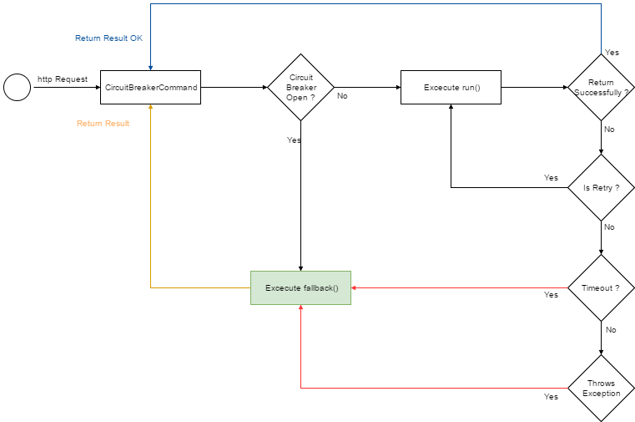
Pattern Integration

Slide 7
What is Circuit Breaker
The concept of a circuit breaker is to prevent calls to microservice when it’s known the call may fail or time out.
This is done so that clients don’t waste their valuable resources handling requests that are likely to fail.
Using this concept, you can give the server some spare time to recover.
To know if a request is likely to fail record the results of several previous requests sent to other microservices. For example, 4 out of 5 requests sent failed or timeout, then most likely the next request will also encounter the same thing.

Slide 8
Resilience4J
A lightweight, easy-to-use fault tolerance library inspired by Netflix Hystrix, but designed for Java 8 and functional programming.
Provides higher-order functions (decorators) to enhance any functional interface, lambda expression or method reference with a Circuit Breaker, Rate Limiter, Retry or Bulkhead.
You can stack more than one decorator on any functional interface, lambda expression or method reference. The advantage is that you have the choice to select the decorators you need and nothing else.
https://resilience4j.readme.io/docs/getting-started
Notes:
Lightweight, because the library only uses Vavr, which does not have any other external library dependencies.
Netflix Hystrix, in contrast, has a compile dependency to Archaius which has many more external library dependencies such as Guava and Apache Commons Configuration
https://www.baeldung.com/spring-boot-resilience4j
spring-boot-resilience4j-retry-main
https://resilience4j.readme.io/docs/circuitbreaker#create-and-configure-a-circuitbreaker
https://jsession4d.com/a-quick-guide-to-resilience4j-with-spring-boot/
https://resilience4j.readme.io/docs/getting-started-3

Slide 9
Resilience4J Modules
Module | Purpose
Retry | Automatically retry a failed remote operation
RateLimiter | Limit how many times we call a remote operation in a certain period
TimeLimiter | Set a time limit when calling remote operation
Circuit Breaker | Fail fast or perform default actions when a remote operation is continuously failing
Bulkhead | Limit the number of concurrent remote operations
Cache | Store results of costly remote operations
Notes:
https://reflectoring.io/retry-with-resilience4j/
https://reflectoring.io/
https://reflectoring.io/rate-limiting-with-springboot-resilience4j/
https://reflectoring.io/retry-with-springboot-resilience4j/
https://reflectoring.io/circuitbreaker-with-resilience4j/
https://reflectoring.io/bulkhead-with-resilience4j/
https://reflectoring.io/time-limiting-with-resilience4j/
https://reflectoring.io/rate-limiting-with-resilience4j/
https://bootcamptoprod.com/spring-boot-resilience4j-retry/
3
The default Resilience4j aspect order is
Retry( CircuitBreaker( RateLimiter( TimeLimiter( Bulkhead( function)))))

Slide 10
Resilience4J Project
Create a spring boot project ResilienceSpringBootWebDemo
Add below dependencies
Web
Circuit breaker
Actuator
Aop
For Reactor programming ResilienceSpringBootReactorDemo
Add below dependencies
Webflux
Circuit breaker
Actuator
Aop
Notes:
Lightweight, because the library only uses Vavr, which does not have any other external library dependencies.
Netflix Hystrix, in contrast, has a compile dependency to Archaius which has many more external library dependencies such as Guava and Apache Commons Configuration
spring-boot-resilience4j-retry-main
https://resilience4j.readme.io/docs/circuitbreaker#create-and-configure-a-circuitbreaker
https://jsession4d.com/a-quick-guide-to-resilience4j-with-spring-boot/
https://resilience4j.readme.io/docs/getting-started-3

Slide 11
Dependency starter
Add the following dependency for resilience4j : <dependency> <groupId>org.springframework.cloud</groupId> <artifactId>spring-cloud-starter-circuitbreaker-resilience4j</artifactId> </dependency> <dependency> <groupId>org.springframework.boot</groupId> <artifactId>spring-boot-starter-aop</artifactId> </dependency>

Slide 12
Dependency without starter
Add the following dependency for resilience4j : <dependency> <groupId>org.springframework.boot</groupId> <artifactId>spring-boot-starter-actuator</artifactId> </dependency> <dependency> <groupId>io.github.resilience4j</groupId> <artifactId>resilience4j-spring-boot2</artifactId> <version>1.1.0</version> </dependency> <dependency> <groupId>org.springframework.boot</groupId> <artifactId>spring-boot-starter-aop</artifactId> </dependency>

Slide 13
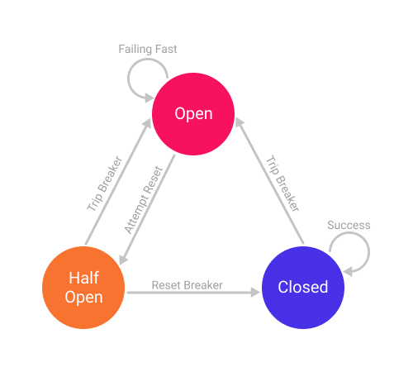
Circuit breaker States and Settings
A CircuitBreaker can be in one of the three states:
CLOSED – everything is fine, no short-circuiting involved
OPEN – remote server is down, all requests to it are short-circuited
HALF_OPEN – a configured amount of time since entering OPEN state has elapsed and CircuitBreaker allows requests to check if the remote service is back online

Slide 14
Circuit breaker States and Settings
A CircuitBreaker can be in one of the three states:
CLOSED – everything is fine, no short-circuiting involved
OPEN – remote server is down, all requests to it are short-circuited
HALF_OPEN – a configured amount of time since entering OPEN state has elapsed and CircuitBreaker allows requests to check if the remote service is back online
We can configure the following settings:
the failure rate threshold above which the CircuitBreaker opens and starts short-circuiting calls
the wait duration which defines how long the CircuitBreaker should stay open before it switches to half open
the size of the ring buffer when the CircuitBreaker is half open or closed
a custom CircuitBreakerEventListener which handles CircuitBreaker events
a custom Predicate which evaluates if an exception should count as a failure and thus increase the failure rate

Slide 15
Circuit breaker Types
Circuit Breaker Type
There are 2 types of circuit breaker patterns, Count-based and Time-based.
Count-based: the circuit breaker switches from a closed state to an open state when the last N requests have failed or timeout.
Time-based: the circuit breaker switches from a closed state to an open state when the last N time unit has failed or timeout
In both types of circuit breakers, we can determine what the threshold for failure or timeout is. Suppose we specify that the circuit breaker will trip and go to the open state when 50% of the last 20 requests took more than 2s, or for a time-based, we can specify that 50% of the last 60 seconds of requests took more than 5s.

Slide 16
Circuit breaker Configuration(yml)
resilience4j:
circuitbreaker:
instances:
example:
failureRateThreshold: 50
waitDurationInOpenState: 5s
permittedNumberOfCallsInHalfOpenState: 3
minimumNumberOfCalls: 5
slidingWindowType: COUNT_BASED
slidingWindowSize: 10
eventConsumerBufferSize: 10
registerHealthIndicator: true
maxWaitDurationInHalfOpenState: 6s

Slide 17
Circuit breaker Configuration(yml) shared
resilience4j.circuitbreaker:
configs:
default:
slidingWindowSize: 100 permittedNumberOfCallsInHalfOpenState: 10
waitDurationInOpenState: 10000
failureRateThreshold: 60
eventConsumerBufferSize: 10
registerHealthIndicator: true
someShared:
slidingWindowSize: 50
permittedNumberOfCallsInHalfOpenState: 10
instances:
example:
baseConfig: default
waitDurationInOpenState: 5000
backendB:
baseConfig: someShared

Slide 18
Circuit breaker Configuration(properties)
Can create a shared config then apply to specific instance
resilience4j.circuitbreaker.configs.shared.register-health-indicator=true resilience4j.circuitbreaker.configs.shared.sliding-window-type=count_based resilience4j.circuitbreaker.configs.shared.sliding-window-size=3 resilience4j.circuitbreaker.configs.shared.failure-rate-threshold=40 resilience4j.circuitbreaker.configs.shared.slow-call-rate-threshold=40 resilience4j.circuitbreaker.configs.shared.permitted-number-of-calls-in-half-open-state=1 resilience4j.circuitbreaker.configs.shared.max-wait-duration-in-half-open-state=10s resilience4j.circuitbreaker.configs.shared.wait-duration-in-open-state=10s resilience4j.circuitbreaker.configs.shared.slow-call-duration-threshold=2s resilience4j.circuitbreaker.configs.shared.writable-stack-trace-enabled=true resilience4j.circuitbreaker.configs.shared.automatic-transition-from-open-to-half-open-enabled=true
Below uses shared config for circuit breaker name “example”
resilience4j.circuitbreaker.instances.example.base-config=shared
Can override the shared config properties as follows:
#resilience4j.circuitbreaker.instances.example.slow-call-duration-threshold=1s

Slide 19
Expose actuator endpoints
management.endpoints.web.exposure.include=* management.endpoint.health.show-details=always management.health.circuitbreakers.enabled=true
management.health.ratelimiters.enabled=true resilience4j.retry.metrics.legacy.enabled=true resilience4j.retry.metrics.enabled=true

Slide 20
Circuit breaker Properties
Sliding-window-type: specify count-based or time-based circuit breaker type. If count-based, the circuit will trip or move to an open state based on each incoming request.
Sliding-window-size: use this parameter to record the last N requests to make the circuit breaker trip or open. Ex : 5 requests
Failure-rate-threshold: it shows the percentage of the total sliding-window-size that fails and will cause the circuit breaker trips to open state. This means, with a configuration of 40%, 2 out of 5 failed requests will cause the circuit breaker trips to open state.
Slow-call-rate-threshold: it shows the percentage of the total sliding-window-size that fails which will cause the circuit breaker trips to open state. From the configuration above, it can be seen that 2 out of 5 failed requests will cause the circuit breaker trips to open state.
Slow-call-duration-threshold: is the time taken to indicate the received response exceeds this configuration time will be recorded as an error count.

Slide 21
Failure rate and slow call rate thresholds
The state of the CircuitBreaker changes from CLOSED to OPEN when the failure rate is equal or greater than a configurable threshold. For example when more than 50% of the recorded calls have failed.
By default all exceptions count as a failure
failure-rate-threshold only counts for an exception that happened. For example runtime exception, business exception, etc.
The CircuitBreaker also changes from CLOSED to OPEN when the percentage of slow calls is equal or greater than a configurable threshold. For example when more than 50% of the recorded calls took longer than 5 seconds. This helps to reduce the load on an external system before it is actually unresponsive.
slow-call-rate threshold only count for the "process" that exceeds the limit. For example you set the boundary process to 2s, and the process took more than 2s.
Notes:
You can define a list of exceptions which should count as a failure. All other exceptions are then counted as a success, unless they are ignored. Exceptions can also be ignored so that they neither count as a failure nor success.
The failure rate and slow call rate can only be calculated, if a minimum number of calls were recorded. For example, if the minimum number of required calls is 10, then at least 10 calls must be recorded, before the failure rate can be calculated. If only 9 calls have been evaluated the CircuitBreaker will not trip open even if all 9 calls have failed.

Slide 22
URL To Test
Normal http://localhost:8080/api/circuit-breaker
Sliding window http://localhost:8080/api/circuit-breaker/id/10 http://localhost:8080/api/circuit-breaker/id/1
Slow Rate http://localhost:8080/api/circuit-breaker/10

Slide 23
Time Limiter
It's possible to limit the amount of time spent calling a remote service using the TimeLimiter.
Set a threshold timeout value for async calls made to external systems.
Timelimiter aspect is only applicable for reactive methods or Completable futures
resilience4j.timelimiter.configs.shared.timeout-duration=2s resilience4j.timelimiter.configs.shared.cancel-running-future=true
resilience4j.timelimiter.instances.example.base-config=shared

Slide 24
Retry
We can automatically retry a failed call using the Retry API:
We can also configure the following:
the max attempts number
the wait duration before retries
a custom function to modify the waiting interval after a failure
a custom Predicate which evaluates if an exception should result in retrying the call
resilience4j: retry: instances: retryApi: maxAttempts: 3 waitDuration: 1s metrics: enabled: true legacy: enabled: true
Notes:
https://betterjavacode.com/programming/spring-retry-vs-resilience4j-retry

Slide 25
Rate Limiter
this functionality allows limiting access to some service.
Its API is very similar to CircuitBreaker's – there are Registry, Config and Limiter classes.
We can configure parameters like:
the period of the limit refresh
the permissions limit for the refresh period
the default wait for permission duration

Slide 26
BulkHead
It's possible to limit the number of concurrent calls to a particular service.
We can configure the following settings:
the max amount of parallel executions allowed by the bulkhead
the max amount of time a thread will wait for when attempting to enter a saturated bulkhead

Slide 27
Hystrix
Uses Circuit-Breaker pattern
When to break circuit
What to do when circuit breaks
When to resume requests
When we apply a circuit breaker to a method, Hystrix watches for failing calls to that method, and if failures build up to a threshold, Hystrix opens the circuit so that subsequent calls automatically fail.
While the circuit is open, Hystrix redirects calls to the method, and they’re passed on to our specified fallback method.
Looks for any method annotated with the @HystrixCommand annotation, and wraps that method in a proxy connected to a circuit breaker so that Hystrix can monitor it
Notes:
https://www.cars24.com/blog/hystrix-how-to-handle-cascading-failures-in-microservices/

Slide 28
Hystrix Example
Add hystrix dependency
Add @EnableCircuitBreaker to class with main()
Feign.hystrix.enabled=true => to use feign with hystrix and create a class that implements the interface and overrides the method to provide the fallback
Create a service class as follows:
@Service
public class GetEmployeeService {
@Autowired
private RestTemplate restTemplate;
@HystrixCommand(fallbackMethod = "consumeEmployeeFallback")
public Employee consumeEmployee() {
throw new RuntimeException();
}
public Employee consumeEmployeeFallback(){
return new Employee(0, "", "");
}
}
@Autowired
private GetEmployeeService empservice;
@RequestMapping("/")
public Employee consumeEmployee(){
return empservice.consumeEmployee();
}
Update
EmployeeConsumerResource

Slide 29
Hystrix Properties
default timeout set to 500ms
This timeout can be increased by adding custom commandProperties.
@HystrixCommand(fallbackMethod = "failed", commandProperties = { @HystrixProperty(name = "execution.isolation.thread.timeoutInMilliseconds", value = "2000") })
configure our Hystrix not to invoke the fallback method for some custom exceptions which needs to be propagated to the client. @HystrixCommand(fallbackMethod = "failed", commandProperties = { @HystrixProperty(name = "execution.isolation.thread.timeoutInMilliseconds", value = "3000") }, ignoreExceptions = {CustomException.class})
https://github.com/Netflix/Hystrix/wiki/Configuration
https://github.com/Netflix/Hystrix/tree/master/hystrix-contrib/hystrix-javanica#configuration
Notes:
https://www.devglan.com/spring-cloud/spring-cloud-hystrix
https://dzone.com/articles/microservices-part-4-spring-cloud-circuit-breaker
commandProperties = { @HystrixProperty(name = "execution.isolation.thread.timeoutInMilliseconds", value = "30000"), @HystrixProperty(name = "circuitBreaker.requestVolumeThreshold", value = "2"), @HystrixProperty(name = "circuitBreaker.sleepWindowInMilliseconds", value = "500"), @HystrixProperty(name = "metrics.rollingStats.timeInMilliseconds", value = "180000") }, threadPoolProperties = { @HystrixProperty(name = "coreSize", value = "30"), @HystrixProperty(name = "metrics.rollingStats.timeInMilliseconds", value = "180000") })
Where mykey is set @HystrixCommand(fallbackMethod = "defaultDoSomething", commandKey = "mykey")
#hystrix.command.mykey.circuitBreaker.requestVolumeThreshold=20 #hystrix.command.mykey.metrics.rollingStats.timeInMilliseconds=5000 #hystrix.command.default.circuitBreaker.errorThresholdPercentage=50 #hystrix.command.default.circuitBreaker.sleepWindowInMilliseconds=1000

Slide 30
Hystrix Dashboard
Hystrix provides with hystrix streams and hystrix dashboard
Add hystrix-dashboard and actuator dependency
It provides a web application that displays different circuit breakers, circuits open/closed, number of requests coming, timeouts ets.
To enable dashboard, add @EnableHystrixDashboard on the clas with main()
Under application.properties add : management.endpoints.web.exposure.include=* hystrix.dashboard.proxyStreamAllowList=*
Run the application and access the dashboard at http://localhost:8080/hystrix
Provide the link to hystrix stream to this dashboard http://localhost:8080/actuator/hystrix.stream

Slide 31
Hystrix Timeout Example
@HystrixCommand(fallbackMethod = "defaultDoSomething") public void doSomething(int input) { System.out.println("input: " + input); //in case of exception fallbackMethod is called System.out.println("output: " + 10 / input); } public void defaultDoSomething(int input) { System.out.println("in default method, the input number: " + input); } @HystrixCommand(fallbackMethod = "defaultDoSomething") public void doSomething2(int input) { try { TimeUnit.MILLISECONDS.sleep(1500);// timeout scenario } catch (InterruptedException e) { return; } System.out.println("input: " + input); System.out.println("output: " + 10 / input); }
MyService myService = ctx.getBean(MyService.class); System.out.println("-- calling doSomething(1) 40 times --"); int n = 40; for (int i = 0; i < n; i++) { System.out.println("******* "+i +" **************"); myService.doSomething(i < (n * 0.6) ? 0 : 2); TimeUnit.MILLISECONDS.sleep(100); } TimeUnit.SECONDS.sleep(6); System.out.println("-- final call --"); myService.doSomething(2);
Notes:
the fallback method in the beginning is called because of the exception, but when more than 20 such calls made within 10 seconds and more than 50% calls failed during that time then the circuit breaker trips (opens) and further calls to the method is not made but instead the fallback method is called directly. After a time specified by circuitBreaker.sleepWindowInMilliseconds (default 5 seconds), circuit is reset (closed) automatically and the service method is called again.
Service A calls Service B which waits for 2000 ms (thread.sleep(2000). Here we used execution.isolation.thread.timeoutInMilliseconds attribute with value 1000 means the RestTemplate will wait for 1000 ms and once this time is over than it perform fallback logic, where it executes the fallback method - "getFallBackData".

Slide 32
Turbine
It aggregates multiple Hystrix Metrics Streams into one, so that it could be displayed into a single dashboard view.
Turbine is an open-source tool from Netflix for aggregating multiple streams into a single stream. Spring provided a nice wrapper around it to be easily used in the Spring ecosystem.
Add turbine , actuator and hystrix dependency
Update properties file as follows: management.endpoints.web.exposure.include=* hystrix.dashboard.proxyStreamAllowList=* server.port=9090 spring.application.name=TURBINE turbine.appConfig= book-catalog-service, circuit-breaker turbine.clusterNameExpression= new String("default")
Add following annotations: @EnableEurekaClient @EnableTurbine @EnableHystrixDashboard
On hystrix stream monitor http://localhost:9090/turbine.stream?cluster=default
Notes:
https://stackabuse.com/spring-cloud-turbine/
Here, we are telling Turbine the Eureka server location, applications whose /hystrix.stream it needs to fetch and turbine.clusterNameExpression as new String("default"), which gives the cluster name of "default".
We can open up http://localhost:9090/turbine.stream?cluster=default to see the aggregate stream of both user-service and recommendation-service:

Slide 33
Cloud Config
Notes:
https://medium.com/cloud-native-daily/spring-cloud-config-externalizing-the-configurations-from-your-microservice-284e319f7056
https://docs.spring.io/spring-cloud-config/docs/current/reference/html/
https://www.baeldung.com/spring-cloud-bus

Slide 34
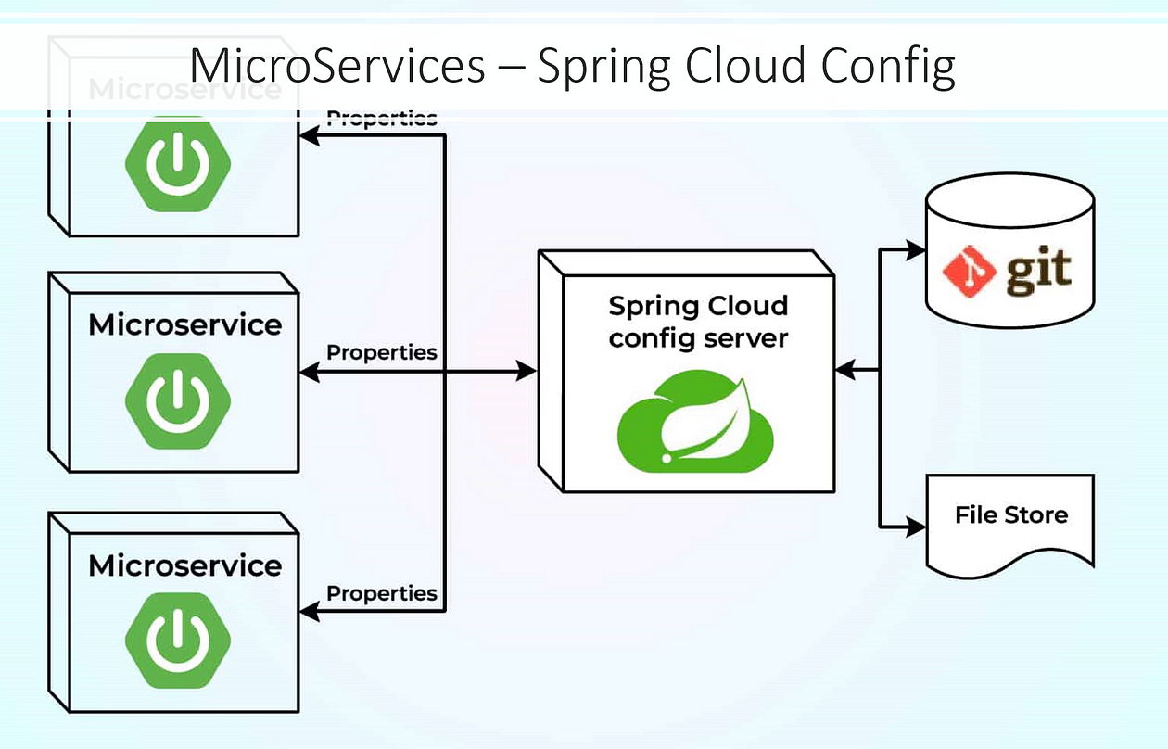
Notes:
https://mvnrepository.com/artifact/io.zipkin.java/zipkin-server/2.12.9
notification-service
rapid-api-service
registation-service
spring-observability

Slide 35
Cloud Config
A configuration is anything that varies between multiple environments, like the DEV, TEST, UAT, and PROD environments. This includes your database credentials, external API URLs, and app-specific configurations.
Spring Cloud Config
Spring Cloud Config enables you to externalize the configurations of your application in a distributed ecosystem.
It has server and client modules.
With the Config server, you have a central place to manage all your application configurations across multiple environments.
Spring cloud config supports file systems, git, AWS CodeCommit, and Google Cloud Store
Spring Cloud Config server also supports Vault
Spring Cloud Config also supports JDBC compatible database, Subversion, Hashicorp Vault, Credhub and local filesystems, REDIS, and AWS Buckets as backends to store the configurations.
Notes:
https://mvnrepository.com/artifact/io.zipkin.java/zipkin-server/2.12.9
notification-service
rapid-api-service
registation-service
spring-observability

Slide 36
Config Server Application
Create a Spring starter project ConfigServerDemo. Add below dependency config-server and actuator as a dependency
Add @EnableConfigServer on class with main() method
Add the following in application.properties of ConfigServerDemo
spring.application.name=ConfigServerDemo spring.profiles.active=native spring.cloud.config.server.native.search-locations= classpath:/config
server.port=8888 management.endpoints.web.exposure.include=*
If yml spring: application: name: ConfigServerDemo cloud: config: server: native: search-locations: "classpath:/config" profiles: active: native server: port: 8888
Notes:
Here we are maintaining same property name for different environment, as we generally maintain properties for different environments like urls, credentials, database details etc. Here the most important point is that we need to append hyphen (-) with the environment name in each property so that config server understands it. Also, we need to name the properties file with the config client service name that we will create after this.
spring.cloud.config.server.git.uri will bind the git location to look for the configuration. Here we are using local git repo but can be switched to remote got location by just changing this location.

Slide 37
Config ClassPath SetUp -1/2
Create a folder config within resources folder and craete 3 files as follows:
config-server-client.properties => add following in this file msg=hello from default
config-server-client-prod.properties => add following in this file msg=hello from production
config-server-client-dev.properties => add following in this file msg=hello from development
Start the application and test with following url: http://localhost:8888/config-server-client/prod http://localhost:8888/config-server-client/dev http://localhost:8888/config-server-client/default
Notes:
Here we are maintaining same property name for different environment, as we generally maintain properties for different environments like urls, credentials, database details etc. Here the most important point is that we need to append hyphen (-) with the environment name in each property so that config server understands it. Also, we need to name the properties file with the config client service name that we will create after this.
spring.cloud.config.server.git.uri will bind the git location to look for the configuration. Here we are using local git repo but can be switched to remote got location by just changing this location.

Slide 38
Config ClassPath SetUp -2/2
Within config folder also create 2 files as follows:
accounts.yml account-prod.yml
Test on browser as follows: http://localhost:8888/accounts/prod http://localhost:8888/accounts/default
build: version: "3.0" accounts: message: "Welcome to EazyBank accounts related local APIs " contactDetails: name: "John Doe - Developer" email: "john@eazybank.com" onCallSupport: - (555) 555-1234 - (555) 523-1345
build: version: "1.0" accounts: message: "Welcome to EazyBank accounts related prod APIs " contactDetails: name: "Reine Aishwarya - Product Owner" email: "aishwarya@eazybank.com" onCallSupport: - (453) 392-4829 - (236) 203-0384 msg:
Notes:
Here we are maintaining same property name for different environment, as we generally maintain properties for different environments like urls, credentials, database details etc. Here the most important point is that we need to append hyphen (-) with the environment name in each property so that config server understands it. Also, we need to name the properties file with the config client service name that we will create after this.
spring.cloud.config.server.git.uri will bind the git location to look for the configuration. Here we are using local git repo but can be switched to remote got location by just changing this location.

Slide 39
Config Server Client
Create a new project ConfigServerClient with following dependencies: Actuator Config Client Web and Rest Repositories as dependencies
To bind with config server add the following in properties file: spring.application.name=config-server-client management.endpoints.web.exposure.include=*
Create a Rest Resource as follows:
@RestController
@RefreshScope
class MessageRestController {
@Value("${msg: - Config Server is not working..please check}")
private String msg;
@RequestMapping("/msg")
String getMsg() {
return this.msg; }
}
Notes:
java -jar -Dspring.profiles.active=dev XXX.jar
https://soshace.com/spring-cloud-config-refresh-strategies/
https://medium.com/analytics-vidhya/spring-cloud-config-server-and-good-practice-of-refresh-scope-usage-ef65d0fee379

Slide 40
Config Server Client Properties
#Active Profile - will relate to development properties file in the server. spring.profiles.active=dev
Add below spring.config.import=optional:configserver:http://localhost:8888/
Open the bowser and test http://localhost:8080/msg
Changing the active profile should read from corresponding properties file
Notes:
spring.cloud.config.uri=http://localhost:8888. OR

Slide 41
Configure for Accounts yml
Add below in the ConfigServerClient project
Also add below on the class with main : @EnableConfigurationProperties(value = {AccountsContactInfoDto.class})
Also add below in the controller: @Autowired private AccountsContactInfoDto accountsContactInfoDto; @GetMapping("/contact") public ResponseEntity<AccountsContactInfoDto> getContactInfo() { return ResponseEntity .status(HttpStatus.OK) .body(accountsContactInfoDto); }
@ConfigurationProperties(prefix = "accounts") public class AccountsContactInfoDto{ private String message; private Map<String, String> contactDetails; private List<String> onCallSupport; // getters and setters}
Notes:
spring.cloud.config.uri=http://localhost:8888. OR

Slide 42
Read from Accounts yml
Since the properties file name is accounts and application name is config-server-client, it will not read by default
To test from accounts yml, add below in properties file spring.cloud.config.name=accounts
Open the bowser and test http://localhost:8080/contact
Changing the active profile should read from corresponding properties file
Notes:
spring.cloud.config.uri=http://localhost:8888. OR

Slide 43
Config File SetUp
Copy the config folder and paste within any directory of your OS
Update the config server properties file to locate for file system: search-locations: file:///Users/Shalini/Desktop/SynechronMSAug2024Workshop/config
Make some changes in the account-prod.yml to see the changes reflected.
Restart the config server and config client and it should be working.
Notes:
Here we are maintaining same property name for different environment, as we generally maintain properties for different environments like urls, credentials, database details etc. Here the most important point is that we need to append hyphen (-) with the environment name in each property so that config server understands it. Also, we need to name the properties file with the config client service name that we will create after this.
spring.cloud.config.server.git.uri will bind the git location to look for the configuration. Here we are using local git repo but can be switched to remote got location by just changing this location.

Slide 44
Refresh Properties
Once the client and server are running, update any property within account-prod.yml file
Without restarting, go to the browser and refresh the url: http://lolcahost:8888/accounts/prod The changes should be reflected
Do the same for the below url: http://localhost:8888/contact The details will not be refreshed automatically.
Make a POST request to http://localhost:8080/actuator/refresh and add @RefreshScope annotation on the controller class of config client.
Now refreshing the /contact url should reflect the changes
Notes:
Here we are maintaining same property name for different environment, as we generally maintain properties for different environments like urls, credentials, database details etc. Here the most important point is that we need to append hyphen (-) with the environment name in each property so that config server understands it. Also, we need to name the properties file with the config client service name that we will create after this.
spring.cloud.config.server.git.uri will bind the git location to look for the configuration. Here we are using local git repo but can be switched to remote got location by just changing this location.

Slide 45
Config Server Application. GIT
Add the following in application.properties of ConfigServerDemo
Remote Repo
Spring.profile.active=git spring.cloud.config.server.git.uri=https://github.com/shalini06mittal/CloudConfigRepo.git
spring.cloud.config.server.git.default-label=main spring.cloud.config.server.git.timeout= 5
spring.cloud.config.server.clone-on-start= true
The config server does not complain to start if you configure wrong Git uri. The clients will fail when they try to fetch the configuration. To avoid this, always enable clone-on-start property, so that you will realize the mistakes before it’s too late. spring.cloud.config.server.force-pull= true
Also, make force-pull value to true to make sure the server fetches the configuration when the local repository is corrupted.
Notes:
https://medium.com/@pravinbabu4u/spring-cloud-config-best-practices-19c51a71687d
Local Repo spring.cloud.config.server.git.uri= WINDOW USERS => ${USERPROFILE}\\Desktop\\config-server-repo
D:\\MS\\cloud-config-repo
#Disable security of the Management endpoint management.security.enabled=false

Slide 46
Verify Config Client
Run the application and test on browser: http://localhost:8080/msg
If it does not displays the development profile just refresh by making a POST request on the following url: http://localhost:8080/actuator/refresh
Change the profile in properties file, refresh and test it again
@RefreshScope is required on the controller
Notes:
https://www.journaldev.com/8195/spring-boot-cli-setup-and-helloworld-example
https://reflectoring.io/spring-boot-s3/
https://cloud.spring.io/spring-cloud-config/multi/multi__spring_cloud_config_client.html
https://docs.pivotal.io/spring-cloud-services/2-0/common/config-server/writing-client-applications.html
https://medium.com/swlh/spring-cloud-config-server-composite-configuration-jdbc-redis-awss3-d849c4d94383
https://medium.com/swlh/spring-cloud-config-bus-auto-refresh-properties-for-clients-d18fa4c036cb#:~:text=Every%20Config%20Client%20(application%20service,properties%20will%20be%20re%2Dfetched.
https://www.appsdeveloperblog.com/spring-cloud-bus-refreshing-config-changes/

Slide 47
Encrypt properties
Add below in config server properties file:
Now open postman and POST request with raw data in body as plain text to http://localhost:8888/encrypt aishwarya@eazybank.com
You should get the encrypted value. Copy and paste that in github repo for accounts prod yml file email adding a prefix {cipher}<the encrypted key>
Now make a refresh post request to config client and it should be able to read the data as plain text
management: endpoints: web: exposure: include: "*" encrypt: key: "45D81EC1EF61DF9AD8D3E5BB397F9"
Notes:
https://www.journaldev.com/8195/spring-boot-cli-setup-and-helloworld-example
https://reflectoring.io/spring-boot-s3/
https://cloud.spring.io/spring-cloud-config/multi/multi__spring_cloud_config_client.html
https://docs.pivotal.io/spring-cloud-services/2-0/common/config-server/writing-client-applications.html
https://medium.com/swlh/spring-cloud-config-server-composite-configuration-jdbc-redis-awss3-d849c4d94383
https://medium.com/swlh/spring-cloud-config-bus-auto-refresh-properties-for-clients-d18fa4c036cb#:~:text=Every%20Config%20Client%20(application%20service,properties%20will%20be%20re%2Dfetched.
https://www.appsdeveloperblog.com/spring-cloud-bus-refreshing-config-changes/

Slide 48
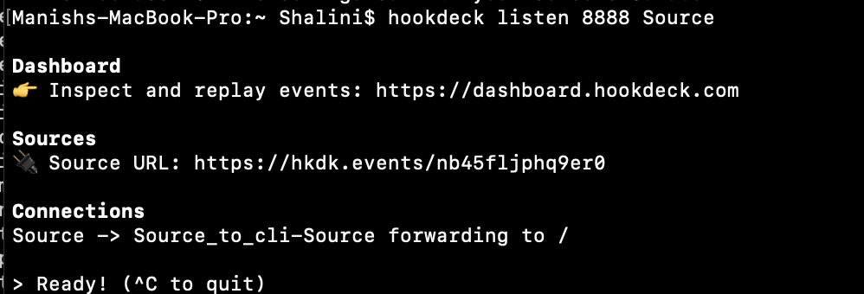
Configure for Broker – Local Setup
Spring Cloud Bus uses lightweight message broker to link distributed system nodes. The primary usage is to broadcast configuration changes or other management information.
You will need rabbitmq for the same up and running
https://console.hookdeck.com/
On the right there are steps to install hookdeck for different OS.
Once installation is done, for Step 2 after login when running the below command add the path /monitor and port is where the config server is running, as follows: hookdeck listen 8888 Source --cli-path /monitor
Once done copy the Source Url and add a webhook on github webhook shown in next slide
Notes:
brew install hookdeck/hookdeck/hookdeck
hookdeck login --cli-key 3kwqgkbhpt8uq1io7y3d52rwmho9ytpib327ekobe38yvcsej5
hookdeck listen 8888 Source --cli-path /monitor
hookdeck listen [port] Source

Slide 49
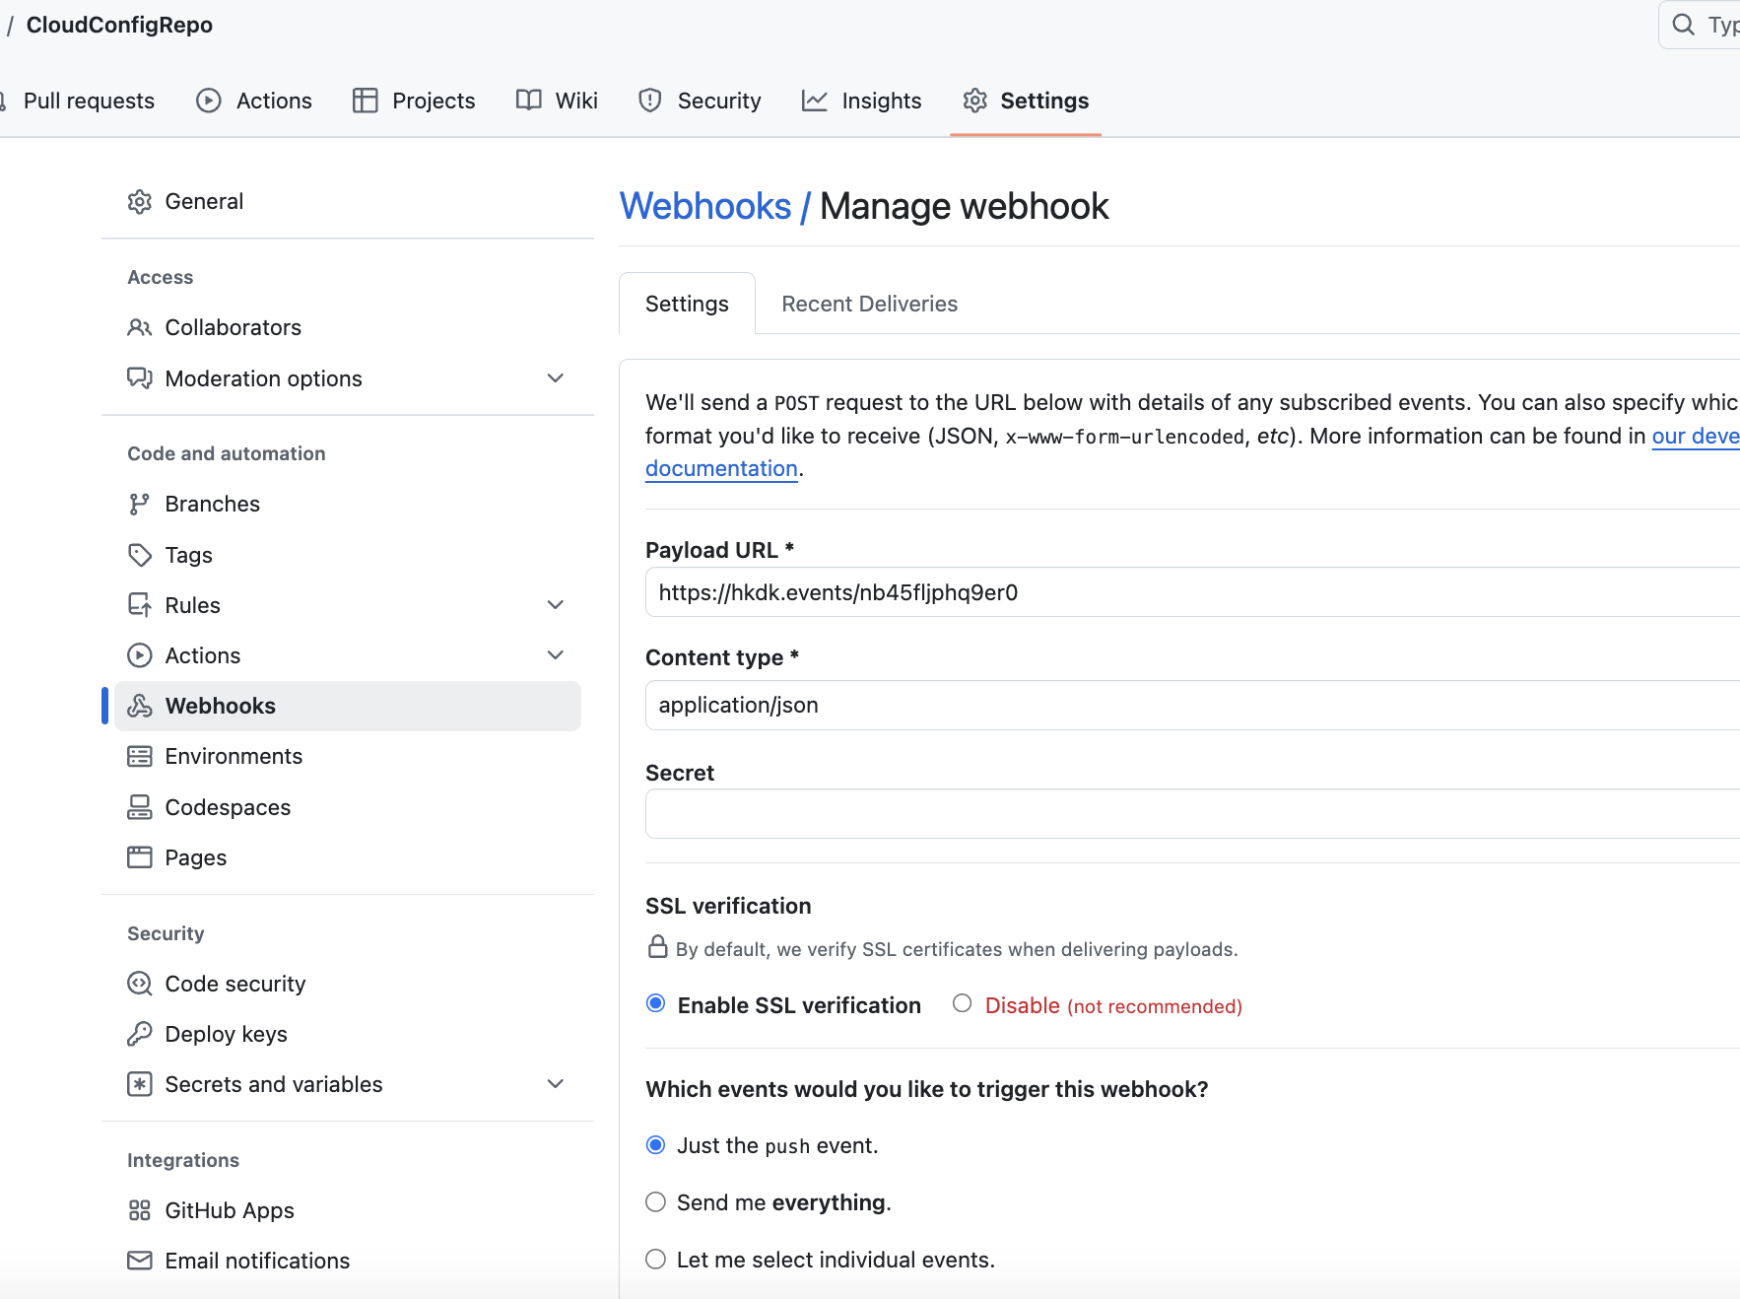
WebHook Github
Notes:
To know the linux version on AWS
cat /etc/os-release
cat /etc/system-release
https://cloudkatha.com/how-to-deploy-spring-boot-application-on-aws-ec2/#google_vignette
https://www.baeldung.com/spring-cloud-bus

Slide 50
Configure Cloud Config Client for Broker
Add below dependency in ConfigServerCLient
Add below in config server <dependency>
<groupId>org.springframework.cloud</groupId>
<artifactId>spring-cloud-starter-bus-amqp</artifactId>
</dependency>
<dependency>
<groupId>org.springframework.cloud</groupId>
<artifactId>spring-cloud-config-monitor</artifactId>
</dependency>
<dependency> <groupId>org.springframework.cloud</groupId> <artifactId>spring-cloud-starter-bus-amqp</artifactId> <version>4.1.2</version> </dependency>
Notes:
To know the linux version on AWS
cat /etc/os-release
cat /etc/system-release
https://cloudkatha.com/how-to-deploy-spring-boot-application-on-aws-ec2/#google_vignette
https://www.baeldung.com/spring-cloud-bus

Slide 51
Broker Properties
Configure properties file as follows:
Then do Maven install to create the jar file
spring.rabbitmq.host=localhost spring.rabbitmq.port=5672 spring.rabbitmq.username=guest spring.rabbitmq.password=guest spring.cloud.bus.enabled=true spring.cloud.bus.refresh.enabled=true
Notes:
To know the linux version on AWS
cat /etc/os-release
cat /etc/system-release
https://cloudkatha.com/how-to-deploy-spring-boot-application-on-aws-ec2/#google_vignette
https://www.baeldung.com/spring-cloud-bus

Slide 52
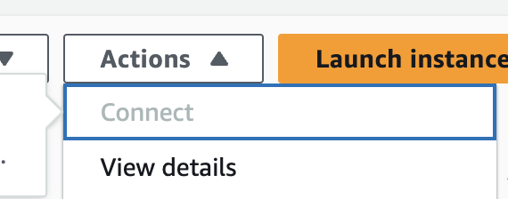
AWS
Create t2.micro Ec2 instance with the defaults.
DO NOT FORGET THE pem file ( key-value pair)
Once EC2 instance created, click on Actions -> Connect and open the EC2 shell
Run below commands on AWS Shell
sudo yum install java-17-amazon-corretto-devel
sudo yum update -y
sudo yum install -y docker
sudo service docker start
sudo docker ps
sudo docker pull rabbitmq:3-management
sudo docker run -d --hostname my-rabbit --name some-rabbit -p 15672:15672 -p 5672:5672 rabbitmq:3-management
sudo docker ps : should see rabbitmq running
Notes:
To know the linux version on AWS
cat /etc/os-release
cat /etc/system-release
https://cloudkatha.com/how-to-deploy-spring-boot-application-on-aws-ec2/#google_vignette
https://www.baeldung.com/spring-cloud-bus

Slide 53
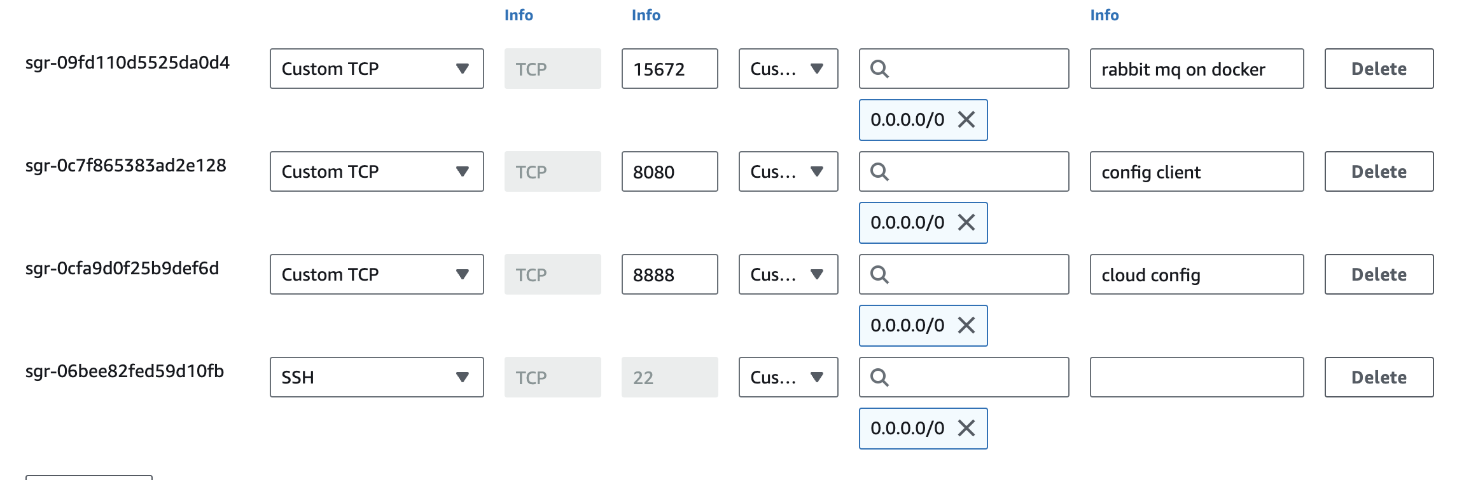
AWS Security
Inbound security rule -
Notes:
To know the linux version on AWS
cat /etc/os-release
cat /etc/system-release
https://cloudkatha.com/how-to-deploy-spring-boot-application-on-aws-ec2/#google_vignette
https://www.baeldung.com/spring-cloud-bus

Slide 54
Deploy applications on remote
Open terminal or command prompt and execute below command for both server and client to deploy on AWS EC2 scp -i config.pem ./ConfigServerClient-0.0.1-SNAPSHOT.jar ec2-user@ec2-3-82-117-12.compute-1.amazonaws.com:~ scp -i config.pem ./ConfigServerDemo-0.0.1-SNAPSHOT.jar ec2-user@ec2-3-82-117-12.compute-1.amazonaws.com:~ DO NOT FORGET :~ at the end
Go to EC2 shell and type ls, you should see the 2 jar files
Notes:
http://ec2-3-82-117-12.compute-1.amazonaws.com:15672/

Slide 55
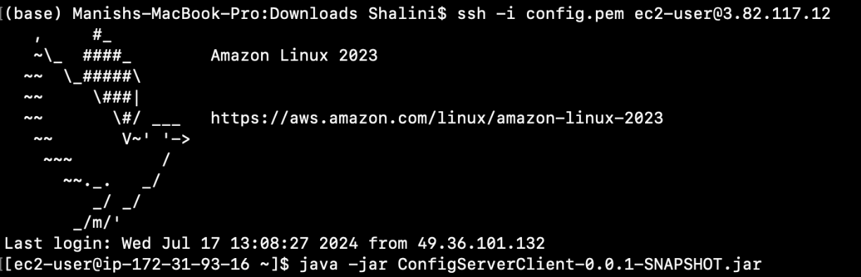
Start services
On EC2 shell on browser run jar command for starting config server java –jar ConfigServerDemo-0.0.1-SNAPSHOT.jar
Open terminal or command prompt and execute below command to go within AWS EC2 shell ssh -i config.pem ec2-user@3.82.117.12
Then run the jar file once inside the shell java –jar ConfigServerClient-0.0.1-SNAPSHOT.jar
Notes:
http://ec2-3-82-117-12.compute-1.amazonaws.com:15672/

Slide 56
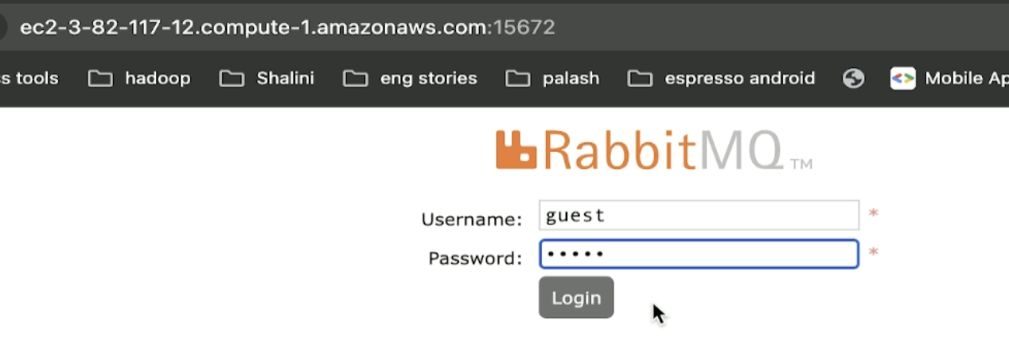
View services
RabbitMq: http://ec2-3-82-117-12.compute-1.amazonaws.com:15672/ username : guest, password : guest
Config Server http://ec2-3-82-117-12.compute-1.amazonaws.com:8888/config-server-client/production
Config Client http://ec2-3-82-117-12.compute-1.amazonaws.com:8080/greet
Notes:
http://ec2-3-82-117-12.compute-1.amazonaws.com:15672/

Slide 57
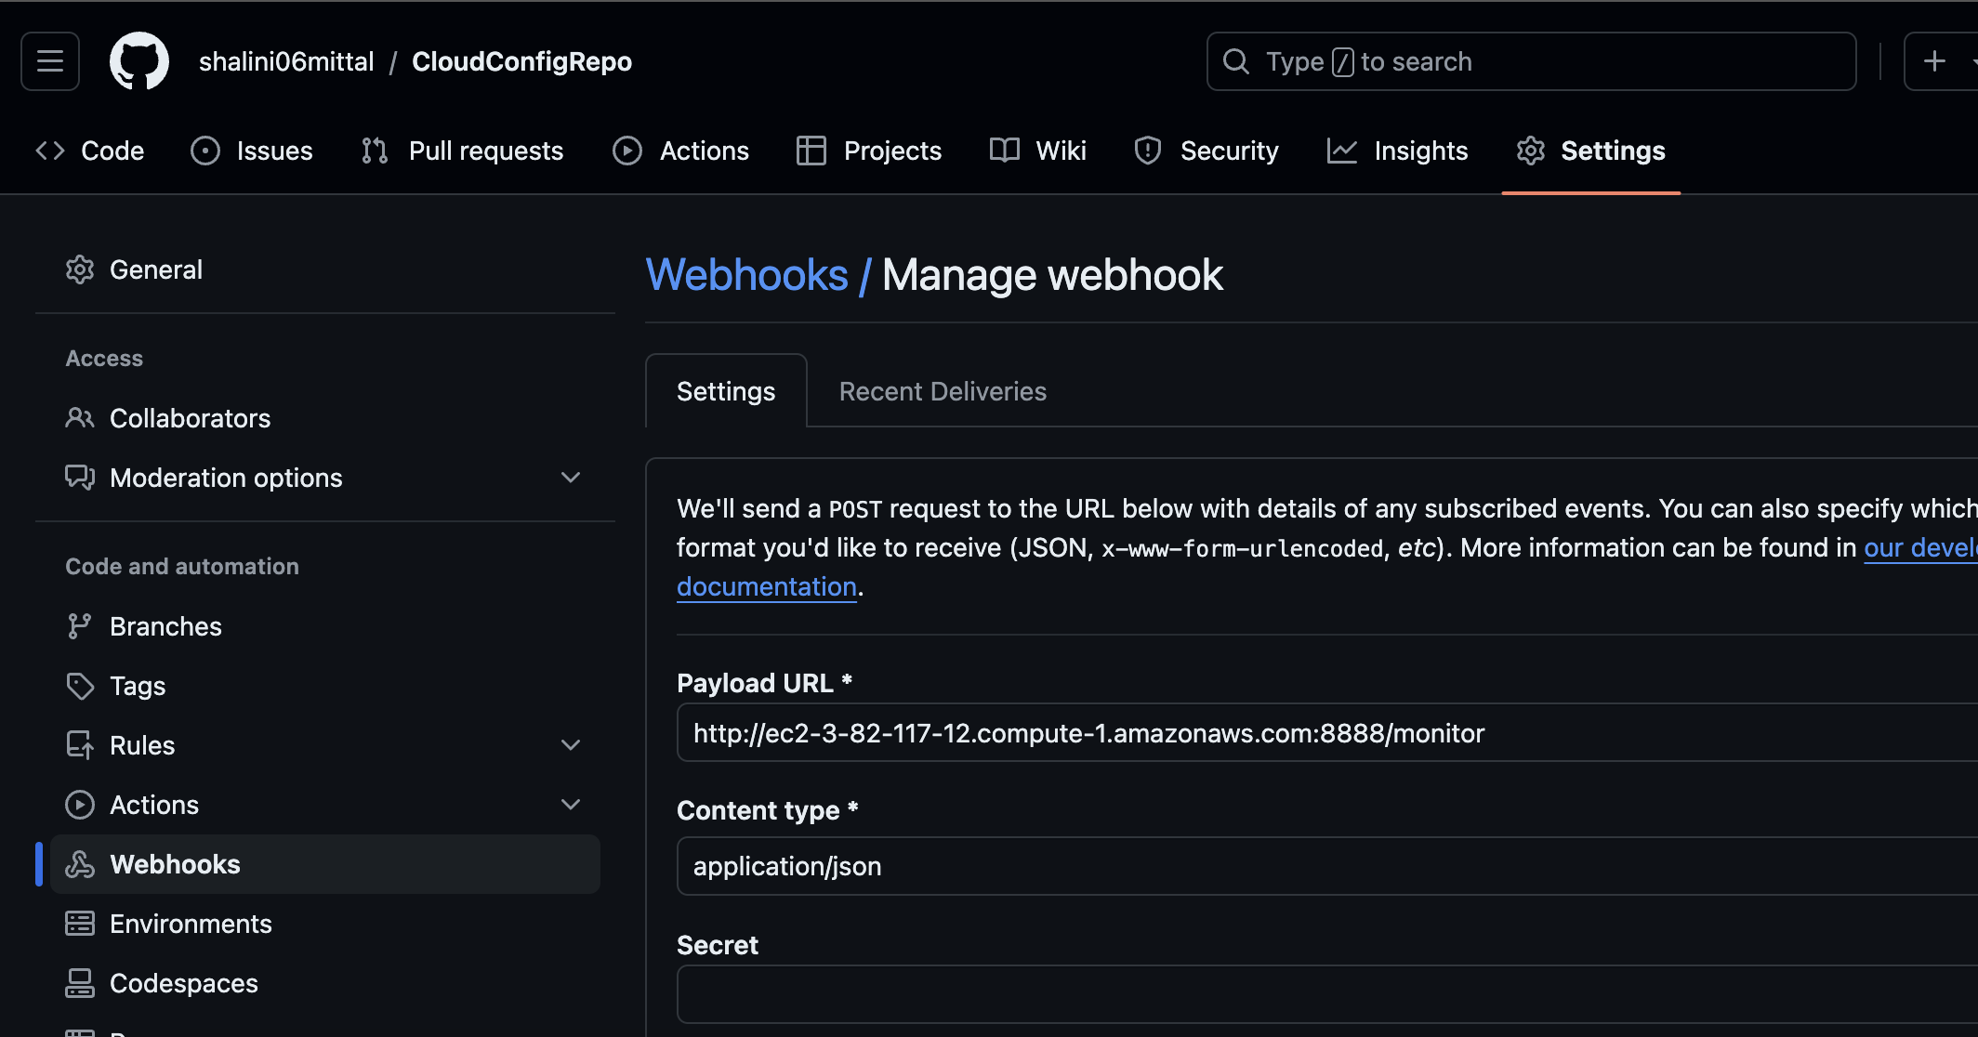
Git Webhook
Go to your git repo, click on Settings and Webhook on the left
Update as shown below
Notes:
http://ec2-3-82-117-12.compute-1.amazonaws.com:15672/

Slide 58
View the changes
Once all services up and running, change msg property in the git repo and refresh the client.
Client is able to see the changes
Notes:
http://ec2-3-82-117-12.compute-1.amazonaws.com:15672/

