Slide 1
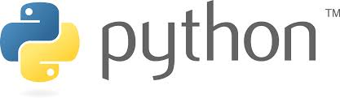
Shalini Mittal

Slide 2
Trainer’s Introduction
TOC
Participant’s Introduction

Slide 3
Day 1
Introduction To Python Fundamentals
History of python
What is Python
Python Installation
Python Interpreter
Running first hello world program
Output with print
Indentation
Input via keyboard
Data Types, Variables and Operators
Numbers
Strings
Variable declaration
Operators
Conditional statements/Control Structures
if Statements
while construct
for Statements
Break and continue
clauses on Loops
Pass Statements
Basic Data Structures
Lists
Tuples
Set
Dictionaries
Operations on data structures

Slide 4
Day 2
Functions
Local variables
Parameter passsing
Default Argument Values
Returning Values
Keyword & Positional
Arguments
Arbitrary Argument Lists
Documentation Strings
Lambda Operator
Introduction to OOP
OOP features : Abstraction, Encapsulation, Polymorphism, Inheritance
Class Definition Syntax
Class Objects, Instance
Constructor
Inheritance
Method overriding
File handling
Opening a File
Reading from a file, writing to a file
Closing a File
Handling Exceptions
try-except
else clause
finally clause

Slide 5
Day 3
Regular expressions
What is regular expression?
Writing simple regex
Search, match and findall functions
NumPy
Introduction
NdArray
Data Tyoes
Array attributes
Array Creation
Indexing and Slicing
Array Manipulation
Statistical Functions
Matplotlib
Pandas
Introduction
Data Structures
Series
Data Frames
Visualization
Load Data
CSV
EXCEL
Database

Slide 6
What we will cover today?
Introduction
What is Python
Python Features
Python Success
Python Limitations
Python SetUp
Python IDE
A simple program in Python

Slide 7
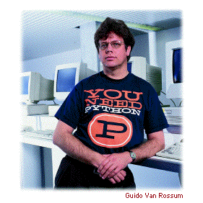
Introduction
Brief History of Python :
Invented by Guido Van Rossum (CWI,Amsterdam,1991)
Named after “Monty Python’s Flying Circus “ 1969-1974
Now owned by the Python Software Foundation (PSF)
Derived from ABC, Modula-3, Lisp and “C” languages

Slide 8

Here’s the confusion - Scripting vs Programming
Scripting Language
"normal users" can write short programs in that language to automate certain tasks in a defined environment
It is an interpreted language
Eg : Javascript / perl
Programming Language
used to write complex software that is not changed often
It is a compiled and interpreted language
Eg : Java
Python - A scripting language which takes on the advantages of programming too

Slide 9
Python Success
System Utilities
GUIs (Tkinter, gtk, Qt, Windows)
Internet Scripting
Embedded Scripting
Database Programming
Artificial Intelligence
Image Processing
CGI Programming
High-level logic glue
Simple tools
Rapid Prototyping
Please visit the following link for details
https://www.python.org/about/success

Slide 10
Python Users
Google
ILM
Astra Zeneca
SMHI
YouTube

Slide 11

So Python Features are…?
Scripting language
Interpreted ,Interactive
Elegant Syntax and dynamic typing
Rapid Application Development
Object Oriented
Portable
Powerful
Cross platform
Easy to Learn and Use

Slide 12

How to start with Python…
Python install
https://www.python.org/downloads/
Set the PATH environment variable
On Power Shell –
[Environment]::SetEnvironment Variable(“Path”,”$env:Path;C:\Python34”,”User”)
Then restart powershell. If needed restart the PC
Or directly go to Control Panel\All Control Panel Items\System
Set the PATH environment variable

Slide 13
Hey you need an IDE
Install PyCharm IDE
https://www.jetbrains.com/pycharm/download/#section=windows/
Install PyCharm

Slide 14
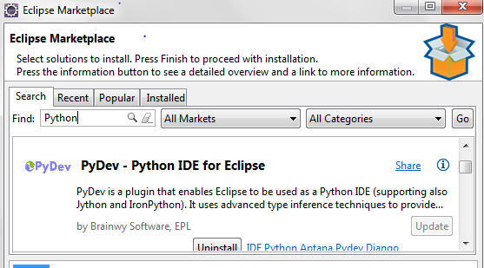
Hey you need an IDE
Install Eclipse IDE
https://eclipse.org/downloads/
Then in Eclipse go to Help->Eclipse MarketPlace and Type Python
Install PyDev

Slide 15
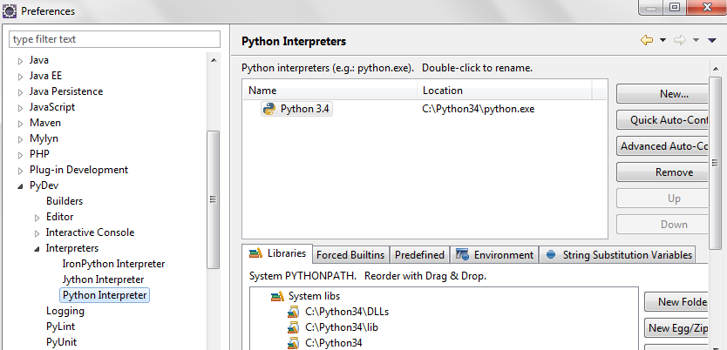
Set Eclipse for Python
Go to Windows->Preferences->PyDev->Interpreter->Python
Click on New
Add the path to your python interpreter installed

Slide 16
Before We Start – A small comparison
Example : “Hello World “
JRE
// Hello World in Java
class HelloWorld {
static public void main(String args[]) {
System.out.println(“Hello World!”);} }
JAVA
// Hello World in C++
#include <iostream.h>
Main() {
cout << “Hello World!” << endl;
return 0;
}
C++
PYTHON
# Hello World in Python
print ‘Hello World!’

Slide 17
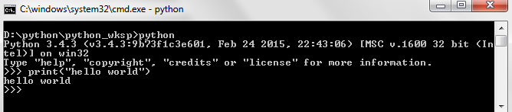
Few things to know before we begin ☺
Python programming can be done using a shell like Power Shell or command Prompt
The various IDE’s are also available for Python Programming
Eclipse
PyCharm
Boa Constructot
PythonWin
IDLE
etc

Slide 18
A simple Hello World
Writing a program in python is as simple as this :
print (“hello World”) #python 3
Print “hello World” #python2 – () are optional
Either you type this on a shell
Or code in a source file using Notepad or any IDE
Save your file with the extension .py
Eg: Hello.py
On Command prompt : type
python Hello.py

Slide 19
Python Calculator
Python 2
Python 3
17 / 3 # int / int -> int
17/3.0#int/float->float
17 // 3.0 # explicit floor division discards the fractional part
17 % 3 # the % operator returns the remainder of the division
5 * 3 + 2 # result * divisor + remainder
5 ** 2 # 5 squared
17 / 3 #classic division returns float
17 // 3.0 # explicit floor division discards the fractional part
17 % 3 # the % operator returns the remainder of the division
5 * 3 + 2 # result * divisor + remainder
5 ** 2 # 5 squared
Notes:
https://medium.com/@tyastropheus/tricky-python-i-memory-management-for-mutable-immutable-objects-21507d1e5b95

Slide 20

Any Question ?

Slide 21
Thank you !

