Slide 1

Python 3.4
Shalini Mittal

Slide 2
What we will cover today?
Python Syntax
Comments
Naming Rules
Whitespace
Data Types
Variables
Operators
Conditional/ Looping Constructs

Slide 3
Syntax
Spaces/Indentation marks the block
Traditional 4 spaces
No curly braces
No ; as terminator
Blocks are followed by :
No Type declararion for data
No new keyword
.py file acts as a module

Slide 4
Comments
Comments starts with ‘#’
Example :
# This is My Sample Program... # Comment line
Can include a “documentation string” as the first line of any new function or class that you define
It is good style of including one.The development environment, debugger, and other tools use it
Example :
def my_function(x, y):
“““This is the docstring. This function does …...””” # Documentation String

Slide 5
Naming Rules
Names are case sensitive and cannot start with a number. They can contain
Letters
Numbers
Underscores
Example :
bob, Bob, _bob, _2_bob_ , bob_2 , BoB
Keywords / Reserved words cannot be used as names

Slide 6
Whitespace
Whitespace is having significance in Python: especially indentation and placement of newlines
Use a newline to end a line of code
Not a semicolon like in C++ or Java
Use ‘\’ when must go to next line prematurely
No braces { } to mark blocks of code in Python
Use consistent indentation instead
The first line with a new indentation is considered outside of the block

Slide 7
Indenting Code
Blocks of code are defined by indentation
Indenting starts a block and unindenting ends it
No need for explicit braces, brackets or keywords
Whitespace is significant
Code blocks are started by a ‘:’
def fib(n):
print 'n =', n
if n > 1:
return n * fib(n - 1)
else:
print 'end of the line'
return 1

Slide 8
Data Types
Scalars:
Integer -> 2323, 3234L
Float -> 32.3, 3.1E2
Boolean -> True, False
Aggregate Types
Complex -> 3 + 2j, 1j
String -> “abc” , ‘abc’
List -> l = [ 1,2,3]
Dictionaries -> d = {‘hello’ : ‘there’, 2 : 15}
Tuple -> t = (1,2,3)
File
Set

Slide 9
Variables
No need to declare variables as specific type ( ex: integer, float, string )
Example:
A, B = 3, ‘cat’
Need to assign /initialize variables
Use of uninitialized variable raises exception
Variables are not strongly typed. A variable’s type is dynamic, and will changed whenever it is reassigned
if friendly:
greeting = "hello world"
else:
greeting = 12**2
print greeting
Variables are reference to Objects
Everything in Python is a object
Functions, Classes, Modules

Slide 10
Operators
Arithmetic/Logical :
Assignment : =
Comparison : ==
Logical : and, or, not ( no symbols &&,|| ,!)
Others : +,-,*,/,%, < ,<=, >= ,> ==, !=
Identity : is, is not
Membership : in, not in
Bitwise : | ^ & ~
Boolean : true, false
‘0’ and ‘None’ are false
It is true other than ‘0’ and ‘None’
True and False are aliases for 1 and 0 respectively
You can also assign to multiple names at the same time
>>> x, y = 2, 3
>>> x
2
>>> y
3

Slide 11
Control Structures
While Loop -
while condition:
statements
for Loop -
for var in sequence:
statements
If Block -
if condition:
statements
[elif condition:
statements] ...
else:
statements
Loop Control Statements –
break - Jumps out of the closest enclosing loop
continue - Jumps to the top of the closest enclosing loop
pass - Does nothing, empty statement placeholder

Slide 12
IF Else - ASSIGNMENT
Write a Python program to calculate the sum of three given numbers, if the values are equal then return thrice of their sum
A certain grade of steel is graded according to the following conditions:
Hardness must be > 50
Carbon content must be < 0.7
Tensile strength must be > 5600
The grades are as follows :
Grade is 10 if all 3 conditions are met
Grade is 9 if 1 & 2 conditions are met
Grade is 8 if 2 & 3 conditions are met
Grade is 7 if 1 & 3 conditions are met
Grade is 6 if only 1 condition is met
Grade is 5 if none of the conditions are met
WAP to find whether a year entered is leap year or not Note : A leap year is the one that if divisible by 4 should not be divisible by 100. But if divisible by 100 should also be divisible by 400 else its not a leap year. Ex: 2000 -> Divisibe by 4, 100 and 400 – leap year 1996 -> Divisible by 4 not 100 – leap year 1900 -> Divisible by 4 and 100 but not 400 – not a leap year
Notes:
https://www.codesdope.com/practice/python-decide-ifelse/

Slide 13
IF Else – ASSIGNMENT SOLUTION
h = int(input("Enter hardness")) c = int(input("Enter carbon content")) t = int(input("Enter tensile strength")) if h>50 and c<0.7 and t > 5600: print("Grade 10") elif h > 50 and c < 0.7: print("Grade 9") elif c < 0.7 and t > 5600: print("Grade 8") elif h > 50 and t > 5600: print("Grade 7") elif h > 50 or c < 0.7 or t > 5600: print("Grade 6") else: print("Grade 5")
year = int(input("Enter a year")) if year%4 == 0: if year%100 != 0: print("Leap year") else: if year%400 == 0: print("Leap year") else: print("not Leap year") else: print("not Leap year")

Slide 14
Range() function
If you do need to iterate over a sequence of numbers, the built-in function range() comes in handy.
It generates arithmetic progressions:
for i in range(5):
print(i)
Produces ... 0 1 2 3 4
The given end point is never part of the generated sequence
range(10) generates 10 values, the legal indices for items of a sequence of length 10.
It is possible to let the range start at another number, or to specify a different increment (even negative; sometimes this is called the ‘step’):
range(5, 10) produces 5 through 9
range(0, 10, 3) produces 0, 3, 6, 9
range(-10, -100, -30) produces -10, -40, -70
A strange thing happens : print(range(10)) → range(0, 10)
It is an object which returns the successive items of the desired sequence when you iterate over it, but it doesn’t really make the list, thus saving space.

Slide 15
Loop Structures Rules
Loop structures are delimitated by indentation (no endif, or {})
For loops iterate over the elements of a list
For Loop :
x = range(3)
for n in x:
print n
While Loop :
a = 0
while a < 3:
a = a + 1
print a
print ‘All Done’

Slide 16
For Loop Structures - ASSIGNMENT
Write a program to enter any number and print all factors of the number.
Write program to enter number and check whether it is Armstrong number or not. Eg: An Armstrong number of three digits is an integer such that the sum of the cubes of its digits is equal to the number itself. For example, 371 is an Armstrong number since 3**3 + 7**3 + 1**3 = 371
WAP for a booking system of the adventurous park. Take input as customer phone number, count of people and age of every count (<=5 - 70/-, >5 and <18 – 120/-, above 18 – 150/-) visiting. Calculate the phone total amount that customer has to pay along with the phone number.
Luhn Algorithm – credit card number **
Notes:
Write a program to enter 10 numbers and display list of Perfect number Eg: In number theory, a perfect number is a positive integer that is equal to the sum of its proper positive divisors, that is, the sum of its positive divisors excluding the number itself (also known as its aliquot sum).
Write a program to enter 10 numbers and display list of Strong numbers. Eg: Strong numbers are the numbers whose sum of factorial of digits is equal to the original number. Example: 145 is a strong number.

Slide 17
FOR– ASSIGNMENT SOLUTION
no = int(input('Enter a no to calculate factor')) for i in range(1, no+1): if no % i == 0: print(i)
str = input('Enter a string') print(str[0],end='.') for s in range(len(str)): if str[s] == ' ': print(str[s+1],end = '.')
no = int(input('Enter a no to find if its armstrong')) t = no sum = 0 while t!= 0: r = t % 10 sum = sum + r*r*r t = t//10 if sum == no: print("Armstrong") else: print("Not armstrong")

Slide 18
While Loop Structures - ASSIGNMENT
An electric mountain railway makes a return trips every day. In a trip the train goes up the mountain and back down. The train leaves from the foot of the mountain at 09:00, 11:00, 13:00 and 15:00. The train returns from the top of the mountain at 10:00, 12:00, 14:00 and 16:00. Train can accomodate 200 passengers.
Passengers can only purchase a return ticket; all tickets must be purchased on the day of travel. The cost is $25 for the journey up and $25 for the journey down.
Passengers must book their return train journey, as well as the departure train journey, when they purchase their ticket. Passengers can return on the next train down the mountain or a later train. Task: Purchasing tickets.
1. Ask for number of tickets to purchase and if available go ahead asking time slots to book.
2. Ask user to enter departure time until they enter the right time as the time slots available
3. Ask user to enter return time until they enter the right time as the time slots available and it should be
after the departure time.
4. Calculate total and print for return journey for 1 passenger
Notes:
Write a program to enter 10 numbers and display list of Perfect number Eg: In number theory, a perfect number is a positive integer that is equal to the sum of its proper positive divisors, that is, the sum of its positive divisors excluding the number itself (also known as its aliquot sum).
Write a program to enter 10 numbers and display list of Strong numbers. Eg: Strong numbers are the numbers whose sum of factorial of digits is equal to the original number. Example: 145 is a strong number.

Slide 19
While Loop Structures - Solution
Ask = int(input("How many tickets you want"))#201
while Ask > 200:
Ask = int(input("Error, Please enter below 200")) time_up = int(input("What time would you like to buy for 9 11 13 15?: "))
while time_up != 9 and time_up != 11 and time_up != 13 and time_up != 15 :
print("Error! please select the appropraite time from the available.")
time_up = int(input("What time would you like buy for 9 11 13 15?: "))
time_down = int(input("What time would you like to return 10 12 14 16?: "))
while time_up > time_down or ( time_down != 10 and time_down != 12 and time_down != 14 and time_down != 16) :
print("Error! please select the appropraite time (you must not select the time below the departure)." )
time_down = int(input("What time would you like to return 10 12 14 16?: "))
cost = Ask * 2 * 25
print('totol',cost)
Notes:
Write a program to enter 10 numbers and display list of Perfect number Eg: In number theory, a perfect number is a positive integer that is equal to the sum of its proper positive divisors, that is, the sum of its positive divisors excluding the number itself (also known as its aliquot sum).
Write a program to enter 10 numbers and display list of Strong numbers. Eg: Strong numbers are the numbers whose sum of factorial of digits is equal to the original number. Example: 145 is a strong number.

Slide 20
Nested Loop
A nested loop is a loop inside the body of the outer loop. The inner or outer loop can be any type, such as a while loop or for loop. For example, the outer for loop can contain a while loop and vice versa.
Syntax: # outer for loop for element in sequence # inner for loop for element in sequence: body of inner for loop body of outer for loop
Notes:
Write a program to enter 10 numbers and display list of Perfect number Eg: In number theory, a perfect number is a positive integer that is equal to the sum of its proper positive divisors, that is, the sum of its positive divisors excluding the number itself (also known as its aliquot sum).
Write a program to enter 10 numbers and display list of Strong numbers. Eg: Strong numbers are the numbers whose sum of factorial of digits is equal to the original number. Example: 145 is a strong number.

Slide 21
Nested Loop Structures - ASSIGNMENT
Write a program to take 5 numbers and print factors of 5 numbers. Ex: Input 10 Factors of 10 - 1 2 5 10 12 Factors of 12 - 1 2 3 4 6 12 .. So on for 5 numbers
Assume for that day park admits only 50 customers. Modify the below code to provide for booking until the tickets are exhausted. WAP for a booking system of the adventurous park. Take input as customer phone number, count of people and age of every count (<=5 - 70/-, >5 and <18 – 120/-, above 18 – 150/-) visiting. Calculate the phone total amount that customer has to pay along with the phone number.
Notes:
Write a program to enter 10 numbers and display list of Perfect number Eg: In number theory, a perfect number is a positive integer that is equal to the sum of its proper positive divisors, that is, the sum of its positive divisors excluding the number itself (also known as its aliquot sum).
Write a program to enter 10 numbers and display list of Strong numbers. Eg: Strong numbers are the numbers whose sum of factorial of digits is equal to the original number. Example: 145 is a strong number.

Slide 22
Nested Loop Structures – Solution 1
for i in range(5):
no = int(input('enter a no'))
print('factors of',no,'-',end=' ')
for j in range(1,no+1):
if no%j==0:
print(j, end=' ')
print()
Notes:
Write a program to enter 10 numbers and display list of Perfect number Eg: In number theory, a perfect number is a positive integer that is equal to the sum of its proper positive divisors, that is, the sum of its positive divisors excluding the number itself (also known as its aliquot sum).
Write a program to enter 10 numbers and display list of Strong numbers. Eg: Strong numbers are the numbers whose sum of factorial of digits is equal to the original number. Example: 145 is a strong number.

Slide 23
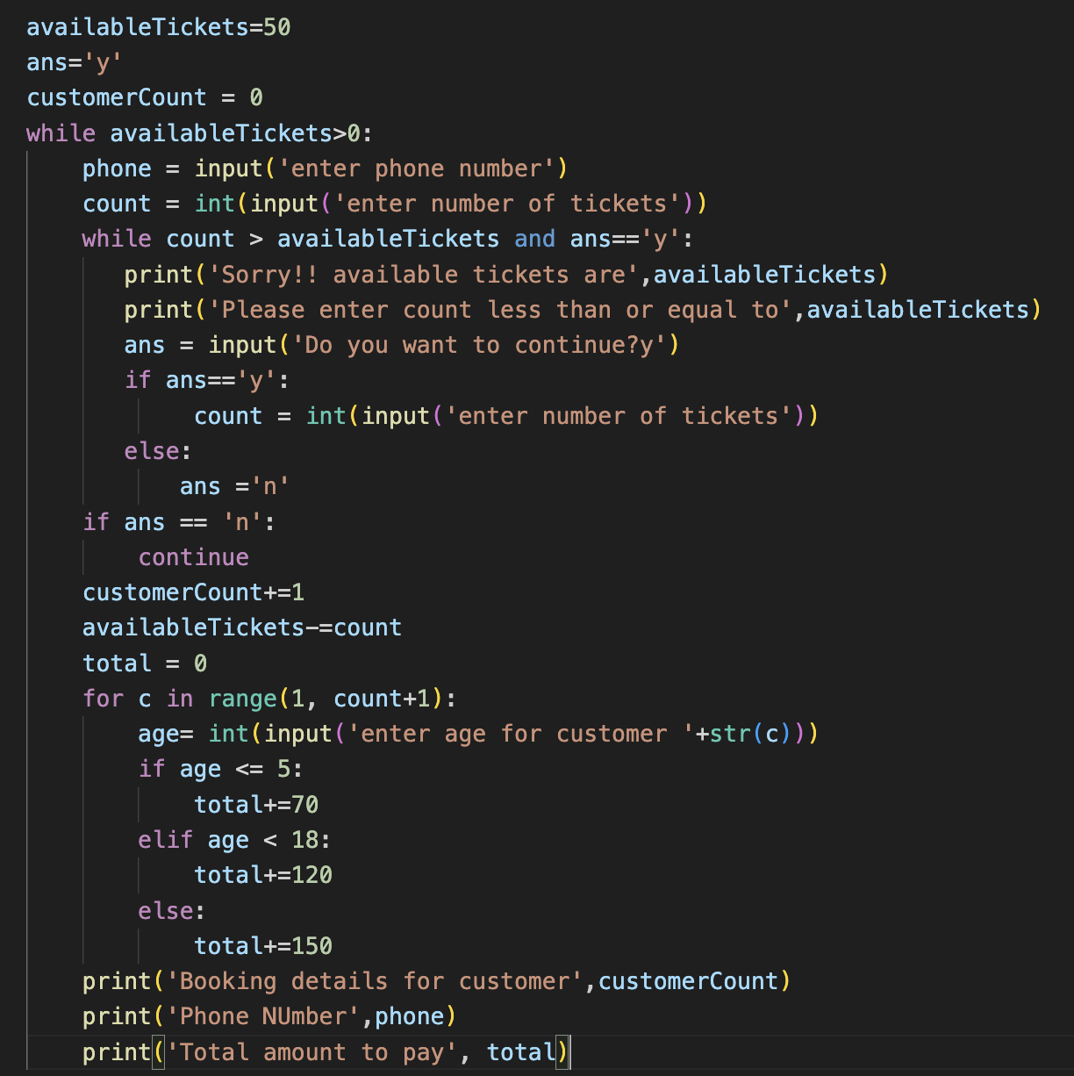
Nested Loop Structures – Solution 2
Notes:
Write a program to enter 10 numbers and display list of Perfect number Eg: In number theory, a perfect number is a positive integer that is equal to the sum of its proper positive divisors, that is, the sum of its positive divisors excluding the number itself (also known as its aliquot sum).
Write a program to enter 10 numbers and display list of Strong numbers. Eg: Strong numbers are the numbers whose sum of factorial of digits is equal to the original number. Example: 145 is a strong number.

Slide 24

Any Question ?

Slide 25
Thank you !

