Slide 1

Python 3.4
Shalini Mittal

Slide 2
What we will cover today?
OOPS
Class
Objects
Constructors
Types of Objects
Properties

Slide 3
OOPS
Python is an object oriented programming language.
Unlike procedure oriented programming, in which the main emphasis is on functions, object oriented programming stress on objects.
Object is simply a collection of data (variables) and methods (functions) that act on those data.
Four major principles of object-orientation
Encapsulation
Data Abstraction
Polymorphism
Inheritance
Notes:
http://www.programiz.com/python-programming/tuple

Slide 4
Class
Class is a blueprint for the object.
We can create many objects from a class.
An object is also called an instance of a class and the process of creating this object is called instantiation.
Syntax
Define a class using the keyword class.
class Duck:
pass
Creating object of a class Book
donald = Duck()
Notes:
We can think of class like a sketch (prototype) of a house. It contains all the details about the floors, doors, windows etc. Based on these descriptions we build the house. House is the object. As, many houses can be made from a description, we can create many objects from a class

Slide 5
Defining function in a class
class Duck:
def quack(self):
print("duck quacks")
def walk(self):
print("duck walks")
Notice the self parameter in function definition inside the class.
Whenever an object calls its method, the object itself is pass as the first argument. So, donald.quack() translates into Duck.quack(donald)
Accessing function of a class
First create object of the class
donald = Duck()
Then use dot . Operator to access the member methods of the class
donald.quack()
Notes:
http://www.programiz.com/python-programming/tuple

Slide 6
Constructor in a class
Class functions that begins with double underscore (__) are called special functions as they have special meaning.
The __init__() function gets called whenever a new object of that class is instantiated.
This type of function is also called constructors in Object Oriented Programming
We normally use it to initialize all the variables.
The self parameter is passed to the constructor by default.
Constructor can consist of other parameters to in initialize the instance variables of a class.
Notes:
http://www.programiz.com/python-programming/tuple

Slide 7
Instance Variables
Instance variables are for data unique to each instance
When you assign a value to a variable using self the instance variable get created
def __init__(self,name):
self.name = name
Class Variables
Class variables are for attributes and methods shared by all instances of the class:
class Dog:
kind = 'canine' # class variable shared by all instances
def __init__(self, name):
self.name = name #instance variable unique to each instance
Access class variables as : Dog.kind
Access instance variables as : d1 = Dog()
d1.name
Notes:
http://www.python-course.eu/python3_object_oriented_programming.php

Slide 8
Private, public and protected members
Naming | Type | Meaning
name | Public | These attributes can be freely used inside or outside of a class definition.
_name | Protected | Protected attributes should not be used outside of the class definition, unless inside of a subclass definition.
__name | Private | This kind of attribute is inaccessible and invisible. It's neither possible to read nor write to those attributes, except inside of the class definition itself.

Slide 9
Getter and Setters
Getters and setters are used in many object oriented programming languages to ensure the principle of data encapsulation.
They are known as mutator methods as well.
Getter for retrieving the data and the setter for changing the data.
According to this principle, the attributes of a class are made private to hide and protect them from other code.
For every private attribute of our class a getter and a setter can be defined
def setColor(self,color):
self.__color =color
def getColor(self):
return self.__color

Slide 10
Destructors
The method __del__ is used as a destructor.
It is called when the instance is about to be destroyed and if there is no other reference to this instance.
If a base class has a __del__() method, the derived class's __del__() method, if any, must explicitly call it to ensure proper deletion of the base class part of the instance.
Syntax to create a destructor is as follows:
def __del__(self):
print (“Object has been destroyed")

Slide 11
Class Assignment
Create a class Account with aid , name , balance as data members. Initialize the data members using init() and create methods for withdrawal and deposit. If withdrawal, deduct the amount from balance and update it If deposit, add the amount in balance and update it
Create an account object and test the methods.
IF YOU CAN => Create a list of account objects and call the withdrawal and deposit methods
Notes:
https://docs.python.org/3/tutorial/controlflow.html#break-and-continue-statements-and-else-clauses-on-loops

Slide 12
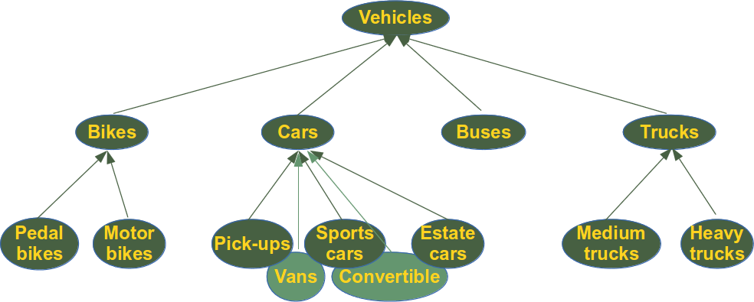
Inheritance
It refers to defining a new class with little or no modification to an existing class.
The new class is called derived (or child) class and the one from which it inherits is called the base (or parent) class.
Derived class inherits features from the base class, adding new features to it.
This results into re-usability of code.
Syntax:
class DerivedClass(BaseClass):
body_of_derived_class
Notes:
A particular item can be removed from set using methods like discard() and remove(). The only difference between the two is that, while using discard() if the item does not exist in the set, it remains unchanged. But remove() will raise an error in such condition. The following example will illustrate this.
http://www.programiz.com/python-programming/set

Slide 13
Inheritance Example
class Person: def __init__(self, name='guest', city='unknown'): print('init called') self.__name = name self.city = city def __eq__(self, other): if self.__name == other.__name: return True else: return False def __str__(self): return '{} lives in a beautiful {}'.format(self.__name, self.city)
class Employee(Person): def __init__(self, name , city, country='India'): Person.__init__(self, name, city) print('emp init called') e1 = Employee('pqr', 'chennai') print(e1)
Notes:
A particular item can be removed from set using methods like discard() and remove(). The only difference between the two is that, while using discard() if the item does not exist in the set, it remains unchanged. But remove() will raise an error in such condition. The following example will illustrate this.
http://www.programiz.com/python-programming/set

Slide 14
Method Overriding and Overloading
Overriding
Method overriding is an object-oriented programming feature that allows a subclass to provide a different implementation of a method that is already defined by its superclass or by one of its superclasses.
The implementation in the subclass overrides the implementation of the superclass by providing a method with the :-
same name,
same parameters or signature
and same return type as the method of the parent class.
Overloading
Overloading is the ability to define the same method, with the same name but with a different number of arguments and types.
It's the ability of one function to perform different tasks, depending on the number of parameters or the types of the parameters.
In python, If we need such a behaviour, we can simulate it with default parameters:
Notes:
https://docs.python.org/3/tutorial/controlflow.html#break-and-continue-statements-and-else-clauses-on-loops

Slide 15
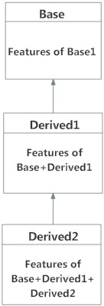
Multilevel Inheritance
We can inherit form a derived class.
This is called multilevel inheritance.
Multilevel inheritance can be of any depth in Python.
An example with corresponding visualization is given below.
class Base:
pass
class Derived1(Base):
pass
class Derived2(Derived1):
pass
Notes:
https://docs.python.org/3/tutorial/controlflow.html#break-and-continue-statements-and-else-clauses-on-loops

Slide 16
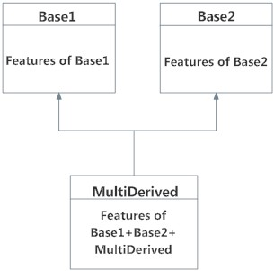
Multiple Inheritance
Multiple inheritance is possible in Python unlike other programming languages.
Every class in Python is derived from the class object. It is the most base type in Python
A class can be derived from more than one base classes.
The syntax for multiple inheritance is similar to single inheritance.
Python Multiple Inheritance Example
class Base1:
pass
class Base2:
pass
class MultiDerived(Base1, Base2):
pass
Notes:
https://docs.python.org/3/tutorial/controlflow.html#break-and-continue-statements-and-else-clauses-on-loops

Slide 17
Magic Methods
They are the methods with this clumsy syntax, i.e. the double underscores at the beginning and the end.
So what's magic about the __init__ method?
The answer is, you don't have to invoke it directly.
The invocation is realized behind the scenes.
When you create an instance x of a class A with the statement "x = A()", Python will do the necessary calls to __new__ and __init__.
Notes:
http://www.python-course.eu/python3_magic_methods.php

Slide 18
Overview of magic methods
Operator | Method
+ | object.__add__(self, other)
- | object.__sub__(self, other)
* | object.__mul__(self, other)
// | object.__floordiv__(self, other)
/ | object.__div__(self, other)
% | object.__mod__(self, other)
** | object.__pow__(self, other[, modulo])
<< | object.__lshift__(self, other)
>> | object.__rshift__(self, other)
& | object.__and__(self, other)
^ | object.__xor__(self, other)
| | object.__or__(self, other)
Notes:
https://docs.python.org/3/tutorial/controlflow.html#break-and-continue-statements-and-else-clauses-on-loops

Slide 19

Any Question ?

Slide 20
Thank you !

