Slide 1
Cloud Computing
Shalini Mittal
Corporate Trainer

Slide 2
Introduction
A term referred to storing and accessing data over the internet.
It doesn't store any data on the hard disk of your personal computer.
In cloud computing, you can access data from a remote server.
It is the use of remote servers on the internet to store, manage and process data rather than a local server or personal computer.
On-demand delivery of IT resources over the Internet with pay-as-you-go pricing.
Instead of buying, owning, and maintaining physical data centers and servers, you can access technology services, such as computing power, storage, and databases, on an as-needed basis from a cloud provider
Gartner says, By 2020,
a Corporate “No-Cloud” Policy Will Be as Rare as a “No-Internet” Policy Today
https://aws.amazon.com/what-is-cloud-computing/
Notes:
Back in 2006-2007, companies were using their own private servers to create services like for storage, computing, etc. But now with internet speeds becoming better, companies big or small have started understanding the power of the cloud, therefore they are shifting their data to the cloud for improved performance, so that they can focus on core-competency
For example, Netflix is a popular video streaming service which the whole world uses today, back in 2008 Netflix suffered a major database corruption, and for three days there operations were halted. The problem was scaling, that is when they realized the need for a highly reliable, horizontally scalable, distributed systems in the cloud. Came in AWS, and since then their growth has been off the charts.
Gartner says, By 2020, a Corporate “No-Cloud” Policy Will Be as Rare as a “No-Internet” Policy Today. Interesting, isn’t it?

Slide 3
Different cloud providers
Amazon Web Services. Highly scalable, complete cloud platform.
Microsoft Azure. IaaS and PaaS computing for development, deployment, and management. ...
Google Cloud Platform. Developer products and cloud technologies hosted by Google. ...
IBM Cloud. ...
Rackspace. ...
GoDaddy. ...
Verizon Cloud. ...

Slide 4
Categories Of Cloud Computing
SaaS (Software as a Service)
It allows companies to use software without having to purchase them, which reduces the expenditure of the company drastically, since they are already installed on the cloud server they can be quickly deployed and therefore saves time. [Gmail, google apps ]
PaaS (Platform as a Service)
It allows developers to build applications, collaborate on projects without having to purchase or maintain infrastructure. [Heroku ]
IaaS (Infrastructure as a Service)
It allows companies to rent servers, storage space, etc. from a cloud provider. [ AWS, Digital Ocean ]
Notes:
AWS services are region scoped, hence a service in 1 region is not available in other region

Slide 5
AWS History
2002- AWS services launched
2006- Launched its cloud products
2012- Holds first customer event
2015- Reveals revenues achieved of $4.6 billion
2016- Surpassed $10 billon revenue target
2016- Release snowball and snowmobile
2019- Offers nearly 100 cloud services

Slide 6
AWS Services Overview
Notes:
Compute It is used to process data on the cloud by making use of powerful processors which serve multiple instances at a time.
Storage and Content Delivery The storage as the name suggests, is used to store data in the cloud, this data can be stored anywhere but content delivery on the other hand is used to cache data nearer to the user so as to provide low latency.
Database The database domain is used to provide reliable relational and non relational database instances managed by AWS.
Networking It includes services which provide a variety of networking features such as security, faster access etc.
Management Tools It includes services which can be used to manage and monitor your AWS instances.
Security and Identity It includes services for user authentication or limiting access to a certain set of audience on your AWS resources.
Application Services It includes simple services like notifications, emailing and queuing.

Slide 7



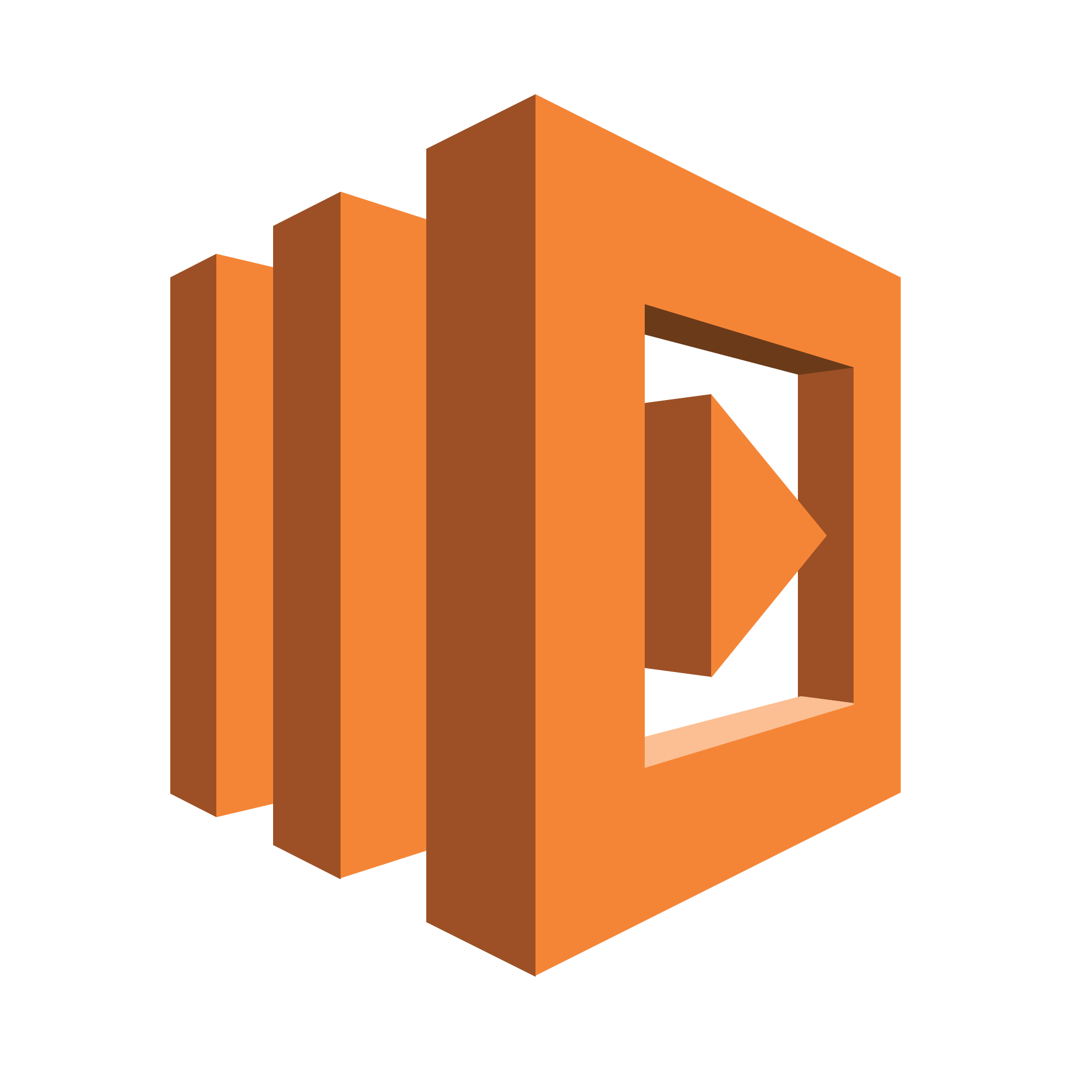

Compute
AWS EC2 A web service which provides re-sizable compute capacity in the cloud. Designed to make the web scale computing easier for developers.
AWS Elastic Beanstalk Elastic Beanstalk lets you quickly deploy and manage applications in AWS without worrying about the underlying infrastructure.
AWS Elastic Load Balancing ELB automatically manages the workload on your instances and distributes them to other instances in case of an instance failure.
AWS Lambda AWS Lambda is used to execute backend code without worrying about the underlying architecture, you just upload the code and it runs, it’s that simple!
AWS Autoscaling The Autoscaling feature is used to scale up and down automatically as and when required.

Slide 8

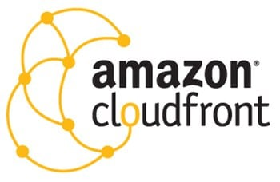


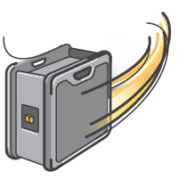

Storage and Content Delivery
S3 AWS: S3 stands for simple storage service, it is used for storing data in the form of objects in the AWS Cloud.
Amazon CloudFront CloudFront is a content delivery network which is used to cache data to an edge location which reduces latency.
Amazon EBS Amazon Elastic Block Storage is a storage service wherein each block of storage acts like a separate hard drive.
Amazon Glacier Glacier is an archiving service offered by Amazon, which offers low cost data archiving.
AWS Import/Export Snowball It offers physical transfer of data between user’s location and AWS data centers, the device which is used to transfer the data is called Snowball.
AWS Storage Gateway It is used to provide seamless integration with data security features between your on premise software appliance and AWS Cloud.

Slide 9
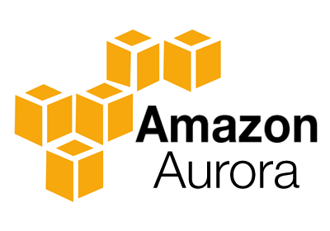


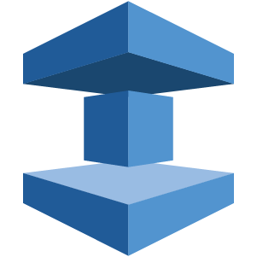

Database
Amazon Aurora It is a relational database engine that combines the speed and reliability of high-end commercial databases and the cost effectiveness and simplicity of open-source databases.
Amazon RDS Amazon RDS is a managed relational database service which does routine database tasks in 6 familiar databases like Amazon Aurora, MySQL, MariaDB, Oracle, Microsoft SQL Server, and PostgreSQL.
Amazon DynamoDB It is a fully managed No-SQL database service. It is known for extremely low latencies and scalability.
Amazon ElastiCache It is a web service that makes it easy to set up, manage and scale a distributed cache-in environment in the cloud.
Amazon Redshift Amazon Redshift is a fully managed petabyte-scale data warehouse service in the cloud.

Slide 10
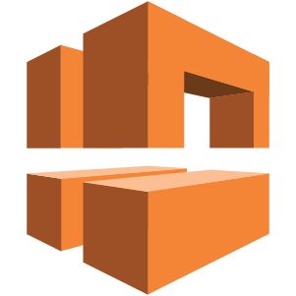


Networking
VPC AWS Amazon VPC lets you launch AWS resources in a virtual network that you define. It closely resembles a traditional network that you’d operate in your data center.
AWS Direct Connect It helps you establish a private connection between your premises and AWS, therefore giving better network performance and throughput than an Internet based connection.
Amazon Route 53 Route 53 is a highly scalable and highly available Domain Name System by Amazon AWS. The name is in reference to the TCP and UDP’s port 53 where DNS requests are addressed.

Slide 11


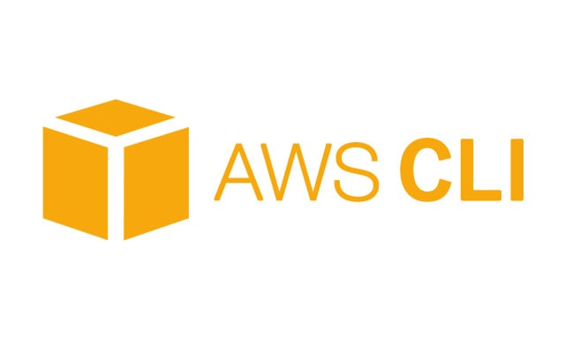


Management Tools
Amazon CloudWatch It is a monitoring tool by AWS which is used to keep a track on the AWS resources and the applications you run on Amazon AWS.
AWS CloudFormation It is a service which helps you setup and model your Amazon AWS resources so that you can spend less time managing these resources and more time focusing on the development.
AWS CloudTrail AWS CloudTrail is a logging service which records the API calls to your Amazon AWS account and delivers them to you.
AWS Command Line Tool It is an all in one tool to manage all your AWS services, by downloading and configuring only one tool you can manage all the AWS services through the command line.
AWS OpsWorks It is a configuration management tool that helps configure and operate applications of all size and shapes using Chef.
Trusted Advisor Trusted Advisor is a customized cloud monitoring tool, that analyzes your AWS environment and gives insights on the expense, performance improvement, security gaps and reliability.

Slide 12


Security And Identity
AWS Identity and Access Management(IAM) It is an AWS service that helps you control access to your AWS resources for your users.
AWS Key Management Service It is a managed service that helps you create and control encryption keys which is used to encrypt your data, and uses Hardware Security Modules to protect the security of your keys.

Slide 13



Application Services
Amazon SES It is a cost effective emailing service which is built on the scalable and reliable infrastructure of Amazon.com
Amazon SNS It is a web service offered by AWS that manages the delivery of messages to subscribed endpoints or clients.
Amazon SQS It is a fast, reliable and scalable message queuing service, it can be used to transmit any volume of data at any level of throughput, without losing any messages or without the use of any other service.

Slide 14
AWS Pricing
AWS follows a pay per use model, meaning you only pay for what you use.
For example, if you are using 10GB of space on S3 on AWS, you would be paying only for that 10GB, traditionally you have to buy an ‘x’ amount of storage say 20GB in advance, and even if you are using 10GB in the purchased space, you will be billed for the whole 20GB.
You can get started with AWS for free, AWS runs a free usage tier in which you can use the AWS services in a very basic manner for free

Slide 15

Any Question ?

Slide 16


7738460004 shalini06mittal@gmail.com
Thank you !

