Slide 1
AWS - IAM
Shalini Mittal
Corporate Trainer

Slide 2
Create an account
https://portal.aws.amazon.com/billing/signup#/start
To learn about free offers : https://aws.amazon.com/free/?all-free-tier.sort-by=item.additionalFields.SortRank&all-free-tier.sort-order=asc
Select Free Plan
To set the budget =>
AWS Management Console => ID [ My Billing Dashboard ] shows 0$
Left side => Budgets
Create Budget => Select Cost Budget :
Name : Learning AWS => Leave defaults
Budget Amount ; 0.01
Click Configure Alerts => Actual Cost => threshold 100% => Confirm Budget => Create Budget

Slide 3
Read AWS Bill
AWS management Console
Find Services
Billing
Left side => Bills
You get detailed overview of the bills

Slide 4
AWS Fundamentals

Slide 5
AWS Regions
These are data centers around the world
Names of regions are as follows:
Us-east-1
Eu-west-3
A region is a cluster of data centers
AWS services are region scoped
Notes:
AWS services are region scoped, hence a service in 1 region is not available in other region

Slide 6
AWS Availability Zones(AZ)
Each region has AZ => 3, min 2 and max 6
Each AZ is one or more discrete data centers with redundant power, networking and connectivity
They are separated form each other to isolate from disasters
Connected with high bandwidth, ultra low latency networking
To learn about AWS global infrastructure : https://aws.amazon.com/about-aws/global-infrastructure/

Slide 7
IAM – Identity and Access Management

Slide 8
IAM
Whole AWS security is in IAM
Users
Groups
Roles
Root Account : never to be used and shared
It is at the center of AWS
Policies in IAM are written in JSON
Root account created by default, shouldn’t be used or shared
Users are people within your organization, and can be grouped
Groups only contain users, not other groups
Users don’t have to belong to a group, and user can belong to multiple groups
Notes:
example.
Suppose, you have five test cases, one method is written for each test case (Assume that the program is written using the main method without using testNG). When you run this program first, three methods are executed successfully, and the fourth method is failed. Then correct the errors present in the fourth method, now you want to run only fourth method because first three methods are anyway executed successfully. This is not possible without using TestNG

Slide 9
IAM Security
Users
A physical person having an IAM account
Groups
Functions [ admins, devops ]
Teams [ engineering, design ]
Contains Users
Roles
Internal Usage within AWS resources
[ For machines ]
Policies defines what all these can do in json format

Slide 10
Introduction
It has a global view
Permission governed by policies
Multi Factor Authentication can be setup
Has predefined management policies
Give users minimal priviliges to perform their jobs

Slide 11
IAM Permissions
{
"Version": "2012-10-17",
"Statement": [
{
"Effect": "Allow",
"Action": "ec2:Describe*",
"Resource": "*"
},
{
"Effect": "Allow",
"Action": "elasticloadbalancing:Describe*",
"Resource": "*"
},
{
"Effect": "Allow",
"Action": [
"cloudwatch:ListMetrics",
"cloudwatch:GetMetricStatistics",
"cloudwatch:Describe*"
],
"Resource": "*"
}
]
}
Users or Groups can be assigned JSON documents called policies
These policies define the permissions of the users
In AWS you apply the least privilege principle: don’t give more permissions than a user needs

Slide 12
IAM Policy Structure
Consists of
Version: policy language version, always include “2012-10-
17”
Id: an identifier for the policy (optional)
Statement: one or more individual statements (required)
Statements consists of
Sid: an identifier for the statement (optional)
Effect: whether the statement allows or denies access (Allow, Deny)
Principal: account/user/role to which this policy applied to
Action: list of actions this policy allows or denies
Resource: list of resources to which the actions applied to
Condition: conditions for when this policy is in effect (optional)

Slide 13
IAM Federations
Big enterprises integrate their own repository of users with IAM
This way one can login into AWS using company credentials
Uses SAML standard [ Active Directory ]
IAM Points
One IAM User per physical person
One IAM Role per application
IAM credentials should never be shared
Never write IAM credentials in code
Never use ROOT account except for initial setup

Slide 14
IAM Hands-on
Search for IAM services in AWS Management console
Complete the steps for security and create a IAM user, group

Slide 15
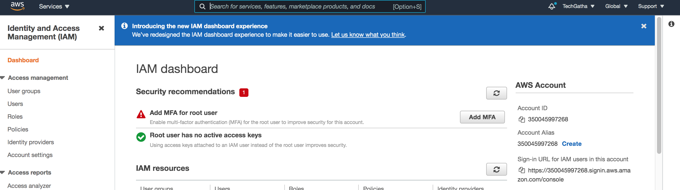
IAM User
Search IAM in services
Click Users on left panel and AddUsers.
Add username and select Password credential. Add a custom password and deselect password reset
Click Next: Permissions
Then Create Group with name admin and add AdministratorAccess policy
Then Next: Tags , add a tag department : engg
Review and user created. DOWNLOAD THE CSV FILE VVIMP
Notes:
Alias ; Shalini-alias-va
Name : Shalini
password : <common>

Slide 16
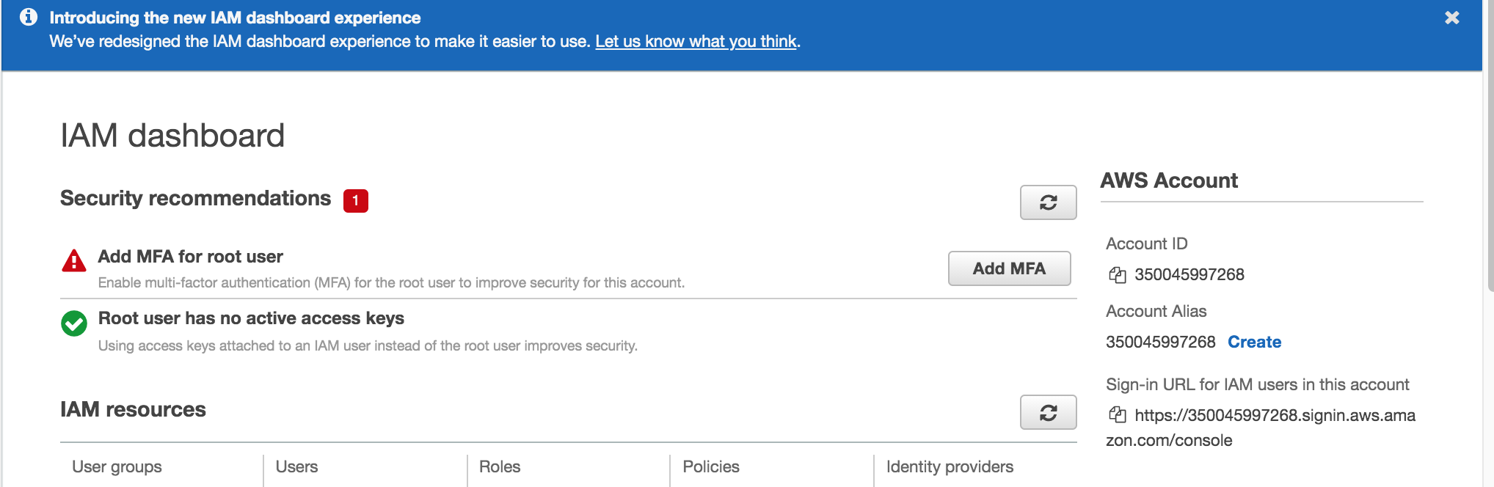
IAM User Alias
Go to IAM Dashboard and on rt side click Create , to create an alias “shalini-alias-v1”
Once an alias is created the Sign-in url is updated.
Copy this sig-in url and open in another browser. Login using username and password of IAM user just created.

Slide 17
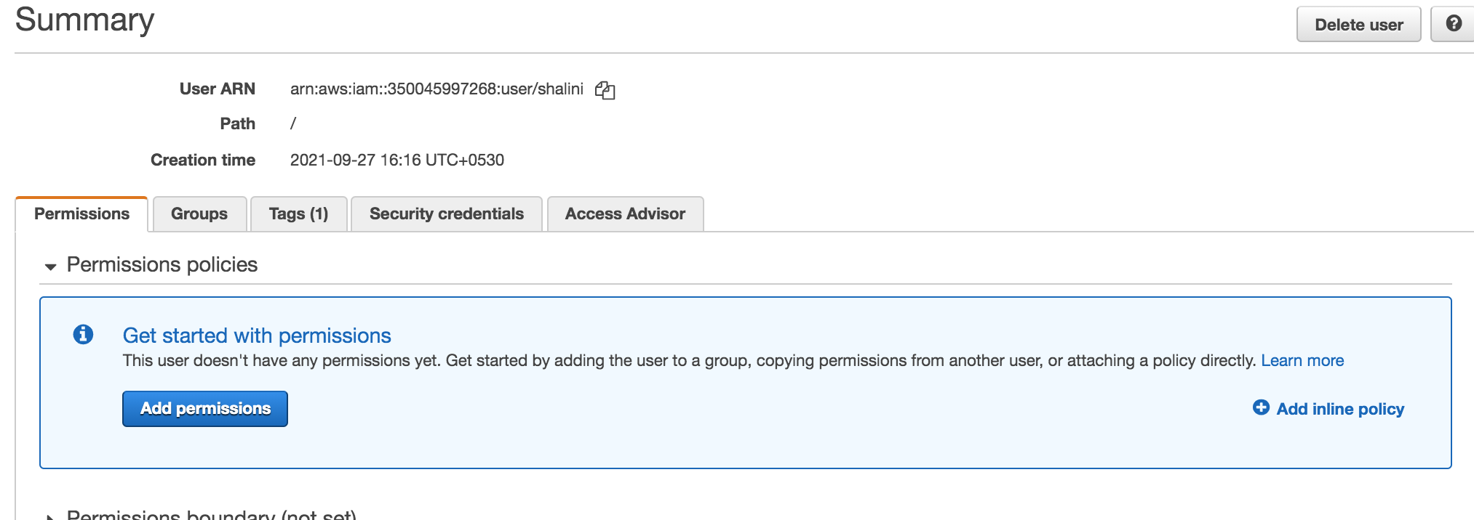
IAM Add Permission
Can remove user Shalini from group admin from within the root account.
Now if you tried to access in the IAM user logged in page we will have permission denied for Shalini
Now go to root account and select users and Shalini [username] .
Go to Permissions tab => Add Permissions => Attach existing policies directly => IAMReadOnlyAccess policy.
This policy will allow user logged in as IAM user to view but not create groups

Slide 18
IAM Create Policy
Go to policies under IAM dashboard and Create Policy.
Service : IAM
Actions: ListUsers
Resources : All
Now view the json generated.

Slide 19
IAM Password Policy
Go to Account Settings under IAM dashboard and Change Password Policy.
Choose the rules you need to set for a password
Then account name on the right corner drop down and Your Security Credentials for setting MFA
Set any of the options available to authenticate
Users have access to your account and can possibly change
configurations or delete resources in your AWS account
• You want to protect your Root Accounts and IAM users
• MFA = password you know + security device you own
• Main benefit of MFA:
if a password is stolen or hacked, the account is not compromised

Slide 20
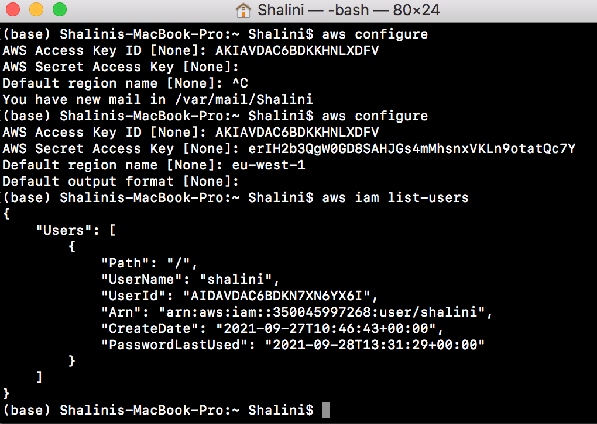
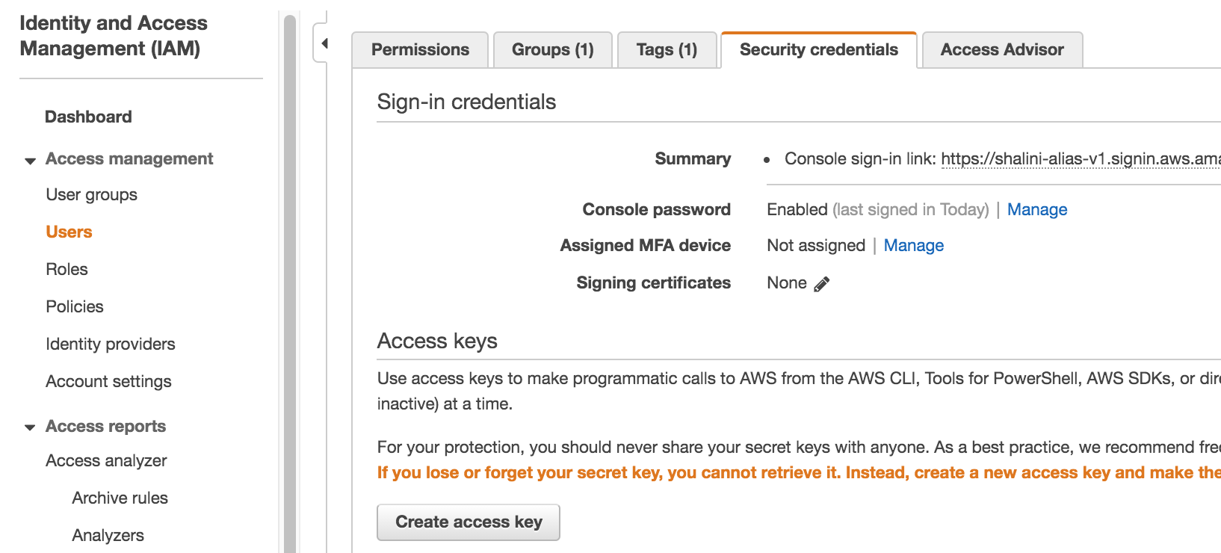
AWS CLI
Download AWS CLI : https://docs.aws.amazon.com/cli/latest/userguide/install-cliv2-mac.html
Then login as IAM user on aws console and click on IAM dashboard.
Click Users => Security Credentials => Create Access Key
Then on terminal /cmd type aws configure and paste the access key and id
Then aws iam list-users , will display the users info

Slide 21
Best Practices
Don’t use the root account except for AWS account setup
• One physical user = One AWS user
• Assign users to groups and assign permissions to groups
• Create a strong password policy
• Use and enforce the use of Multi Factor Authentication (MFA)
• Create and use Roles for giving permissions to AWS services
• Use Access Keys for Programmatic Access (CLI / SDK)
• Audit permissions of your account with the IAM Credentials Report
• Never share IAM users & Access Keys

Slide 22

Any Question ?

Slide 23


7738460004 shalini06mittal@gmail.com
Thank you !

