Slide 1
ELB and ASG
Shalini Mittal
Corporate Trainer
Notes:
https://aws.amazon.com/pricing/

Slide 2
Scalability and High availability
Scalability means that an application / system can handle greater loads by adapting.
There are two kinds of scalability:
Vertical Scalability
Horizontal Scalability (= elasticity)
Scalability is linked but different to High Availability

Slide 3
Vertical Scalability
Vertical Scalability means increasing the size of the instance
For example, your application runs on a t2.micro
Scaling that application vertically means running it on a t2.large
Vertical scalability is very common for non distributed systems, such as a database.
There’s usually a limit to how much you can vertically scale (hardware limit)

Slide 4
Horizontal Scalability
Horizontal Scalability means increasing the number of instances / systems for your application
Horizontal scaling implies distributed systems.
This is very common for web applications / modern applications
It’s easy to horizontally scale thanks the cloud offerings such as Amazon EC2
High Availability usually goes hand in hand with horizontal scaling
High availability means running your application / system in at least 2 Availability Zones
The goal of high availability is to survive a data center loss (disaster)

Slide 5
High Availability and Scalability
Vertical Scaling: Increase instance size (= scale up / down)
From: t2.nano - 0.5G of RAM, 1 vCPU
To: u-12tb1.metal – 12.3 TB of RAM, 448 vCPUs
Horizontal Scaling: Increase number of instances (= scale out / in)
Auto Scaling Group
Load Balancer
High Availability: Run instances for the same application across multi AZ
Auto Scaling Group multi AZ
Load Balancer multi AZ

Slide 6
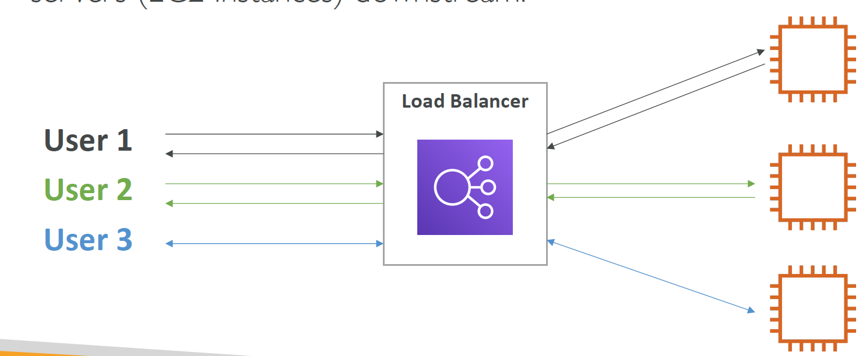
What is Load Balancer
Load balancers are servers that forward internet traffic to multiple servers (EC2 Instances) downstream.

Slide 7
Why Load Balancer
Spread load across multiple downstream instances
Expose a single point of access (DNS) to your application
Seamlessly handle failures of downstream instances
Do regular health checks to your instances
Provide SSL termination (HTTPS) for your websites
High availability across zones

Slide 8
Why use ELB
An ELB (Elastic Load Balancer) is a managed load balancer
• AWS guarantees that it will be working
• AWS takes care of upgrades, maintenance, high availability
• AWS provides only a few configuration knobs
• It costs less to setup your own load balancer but it will be a lot more
effort on your end (maintenance, integrations)
• 3 kinds of load balancers offered by AWS:
• Application Load Balancer (HTTP / HTTPS only) – Layer 7
• Network Load Balancer (ultra-high performance, allow

Slide 9
Load Balancer
AWS Amanagement Console => EC2
Make sure the region is selected appropriately
Launch Instance
Choose AMI => Amazon Linux 2 AMI [ Free Tier ]
Instance Type : t2.micro
Configure Instance Details : Leave defaults
Storage : It’s a disk. Leave defaults
Add Tags : Add Name : MyFirstInstance [ This name tag is important as it appears on the UI when the instance is created ]. Can add other tags
Create Security Group : Create new group :
Name : my-first-security
Description : Create with EC2 instance
SSH – TCP – 22 - 0.0.0.0/0 [ for any IP address to access ] => This is public address and anyone can access
Review and launch

Slide 10

Any Question ?

Slide 11


7738460004 shalini06mittal@gmail.com
Thank you !

