Slide 1
Selenium
Shalini Mittal
Corporate Trainer

Slide 2
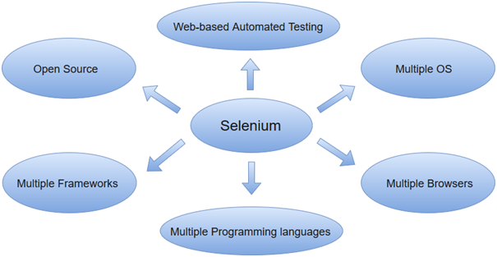
What?
Selenium Core Created by Jason Huggins in 2004, an engineer at ThoughtWorks.
Languages supported by Selenium include C#, Java, Perl, PHP, Python and Ruby.
Currently, Selenium Web driver is most popular with Java and C#.
Browsers supported by Selenium include Internet Explorer, Mozilla Firefox, Google Chrome and Safari.
Used to automate functional tests and can be integrated with automation test tools such as Maven, Jenkins, & Docker to achieve continuous testing. It can also be integrated with tools such as TestNG, & JUnit for managing test cases and generating reports.
Notes:
Having realized that the repetitious Manual Testing of their application was becoming more and more inefficient, he created a JavaScript program that would automatically control the browser's actions. He named this program as the "JavaScriptTestRunner."

Slide 3
Automation Testing
Increases the effectiveness, efficiency and coverage of software testing
Uses specialized tools to automate test cases without human intervention
Can access the test data, controls the execution of tests and compares the actual result against the expected result
Covers both functional and performance test on an application.
Testing tools used for functional automation:
Quick Test Professional, provided by HP.
Rational Robot, provided by IBM.
Coded UI, provided by Microsoft.
Selenium, open source.
Auto It, open Source.
Testing tools used for non-functional automation:
Load Runner, provided by HP.
JMeter, provided by Apache.
Burp Suite, provided by PortSwigger.
Acunetix, provided by Acunetix
Notes:
Functional automation is used for automation of functional test cases. For example, regression tests, which are repetitive in nature, are automated.
Performance automation is used for automation of non-functional performance test cases. For example, measuring the response time of the application under considerable (say 100 users) load.

Slide 4
Why Automation Testing
Considered beneficial for big software organizations. Although, it is often thought to be too expensive or difficult for smaller companies to implement.
Can be programmed to build and execute test scripts at a specific time without involving any human intervention. For instance, automated test can be automatically kicked off overnight, and the testers can analyze the results of the automated the next morning.
Able to playback pre-recorded and pre-defined actions.
Supports frequent regression testing.
Rapid feedback to developers.
Unlimited iterations of test case execution.
Provides disciplined documentation of test cases.
Generates customized defect reports.
Less error prone as compared to manual testing.
Notes:
Functional automation is used for automation of functional test cases. For example, regression tests, which are repetitive in nature, are automated.
Performance automation is used for automation of non-functional performance test cases. For example, measuring the response time of the application under considerable (say 100 users) load.

Slide 5
Selenium Limitations
Does not support automation testing for desktop applications.
Requires high skill sets in order to automate tests more effectively.
Since Selenium is open source software, you have to rely on community forums to get your technical issues resolved.
Web services like SOAP or REST cant be tested using Selenium.
Learning atleast one of the supported programming languages to create tests scripts in Selenium WebDriver.
It does not have built-in Object Repository like UTF/QTP to maintain objects/elements in centralized location. However, we can overcome this limitation using Page Object Model.
Does not have any inbuilt reporting capability; you have to rely on plug-ins like Unit and TestNG for test reports.
It is not possible to perform testing on images. We need to integrate Selenium with Sikuli for image based testing.
Creating test environment in Selenium takes more time as compared to vendor tools like UFT, RFT, Silk test, etc.
No one is responsible for new features usage; they may or may not work properly.
Selenium does not provide any test tool integration for Test Management.
Notes:
Functional automation is used for automation of functional test cases. For example, regression tests, which are repetitive in nature, are automated.
Performance automation is used for automation of non-functional performance test cases. For example, measuring the response time of the application under considerable (say 100 users) load.

Slide 6
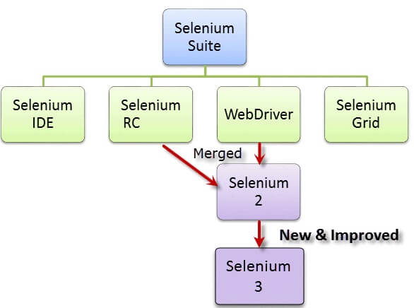
Selenium Suite
Selenium is not just a single tool but a suite of software's, each catering to different testing needs of an organization. It has four components.
Notes:
Selenium Integrated Development Environment (IDE)
Selenium Remote Control (RC)
WebDriver
Selenium Grid
Selenium RC and WebDriver are merged into a single framework to form Selenium 2. Selenium 1, by the way, refers to Selenium RC

Slide 7
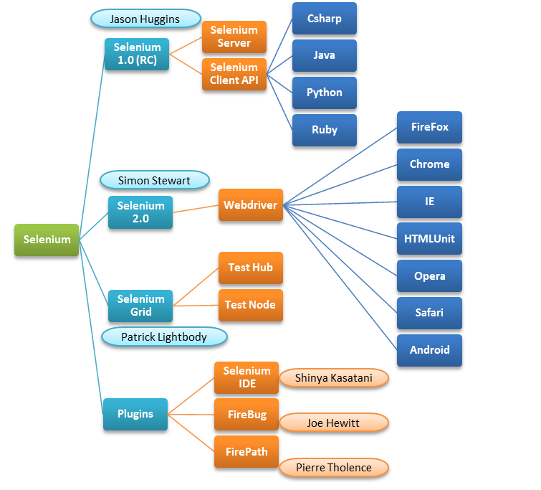
Selenium Components
Notes:
Selenium Integrated Development Environment (IDE)
Selenium Remote Control (RC)
WebDriver
Selenium Grid
Selenium RC and WebDriver are merged into a single framework to form Selenium 2. Selenium 1, by the way, refers to Selenium RC

Slide 8
Selenium Core
To help automate other web applications, JavaScriptRunner open-source was later re-named as Selenium Core.
Same origin policy Issue : prohibits JavaScript code from accessing elements from a domain that is different from where it was launched.
Due to this policy, testers needed to install local copies of both Selenium Core (a JavaScript program) and the web server containing the web application being tested so they would belong to the same domain.
Notes:
https://www.techbeamers.com/selenium-components-web-test-automation/#SeleniumWebdriverArchitecure
– Selenium 1.0 (RC)
Selenium RC was one of the core Selenium components for a long time. Though, it is still active but in maintenance only mode.
It has a few features that aren’t available or deprecated in the later versions of Selenium. It is made up of two subparts.
Selenium RC components are as follows:
-The Selenium Server
It starts and terminates the browser, translates and processes the Selenium commands sent from the test app. It behaves like an HTTP proxy, controls and verifies the HTTP messages exchanged between the client and the application under test.
-Client Libraries
This module is the interface between the programming language and the Selenium Server. Selenium supports many programming languages, so their client libraries. The most common of them are Java, CSharp, Python, and Ruby.
-When Should You Use Selenium RC?
You decide to choose it in the following scenario.
While writing a test case using a more expressive language than Selenium.
The need for cross-browser and cross-platform testing.
Need to deploy tests in a distributed infra using Selenium Grid.
Testing of an application in a new browser having JavaScript support.
For testing the web applications that support AJAX.
– Selenium IDE
Selenium IDE is a fully featured development environment (IDE) for composing the Selenium tests. It comes in the form of a Firefox Add-On. You can use it to record, edit, and for the debugging purpose. Initially, its creator used to call it as Selenium Recorder. He was Shinya Kasatani, who developed the tool and submitted to the Selenium community in 2006. It has recently got an upgrade and now it supports the Webdriver and more languages.
The beauty of this tool is that you can record a test script, customize it or write a new test from scratch all by yourself. It does have autocompletion support for the Selenium commands, so you don’t need to remember their exact syntax. Like every software has limitations, so the IDE has one. It doesn’t have the ability for the iterative and parameterization testing. Though you can fix this limitation by using the Webdriver.
There are few Selenium terms that you need to know for getting a start with the Selenium IDE.
Selenese commands such as type, open, clickAndWait, assert, verify, etc.
Locators such as ID, Name, XPath, CSS selector, etc.
-What Can You Do With Selenium IDE?
Run a customized JavaScript using the runScript command.
Export test cases in various supported formats.
Compose tests with limited programming skills.
Group test cases into test suites which you can convert into Selenium RC or Webdriver format.
Test a web application only with Firefox.
– Selenium WebDriver
Selenium WebDriver is the superlative form of Selenium RC. It can process multilingual commands (sent via Selenese or the Client API) and forwards them directly to the web browser. Webdriver has a built-in implementation of the Firefox driver. For other browsers, you need to plug-in their browser specific drivers to communicate and run the tests. There is also a browser free solution known as HtmlUnit webdriver. It is the fastest and the lightest driver and famously known as the <headless driver>. Unlike the other drivers, it does not launch any browser for executing the tests.
-What Can You Do With Selenium Webdriver?
There is no second thought that it is one of the most important Selenium components.
Choose from a variety of programming languages to write your test cases.
Test web applications which provide rich AJAX-based support.
Run test cases using the HtmlUnit headless browser.
Easily migrate Selenium RC tests using the “WebDriverBackedSelenium” wrapper.
– Selenium Grid
Selenium Grid is a dynamic tool that can distribute and run the Selenium tests across many physical/virtual machines in a concurrent order. It can significantly expedite the testing process across different browsers and reduce the testing cycle by giving quick and accurate results.
Selenium Components for Web Test Automation
Selenium Tutorial | By Harsh S.
Nowadays, Selenium is apparently the best choice for doing automated testing of Websites. Not only test engineers, but the developers also use it for the unit testing of their projects. In this post, we’ll exclusively talk about the various Selenium components.
Let’s take a glimpse of Selenium history. It was Jason Hugginsin 2004 who first created the Selenium while working at ThoughtWorks. He was the engineer who conceived the idea of browser automation to ease the repetitive tasks of manual testing. He gave this component its first name as the “JavaScriptTestRunner”. Then there was another bright engineer working at the same office, Paul Hammant, who extended its functionality and described it as Selenium RC. Afterward, there came many innovators who made it simpler, faster and more efficient.
While you start learning Selenium, you must know that it is a collection of tools that make it a perfect fit for Web UI automation. At the core, it has Selenium RC and Webdriver interfaces where you can plug-in different browser drivers like the Internet Explorer and Chrome to support cross-browser testing. However, some external tools like the Eclipse and Selenium IDE help you creating/writing automation scripts. Moreover, there are a bunch of supporting browser add-ons like the FireBug and FirePath that further eases up the UI automation process.
Selenium Components
Contents [hide]
1 – Selenium 1.0 (RC)
1.1 -The Selenium Server
1.2 -Client libraries
1.3 -When should you use Selenium RC?
2 – Selenium IDE
2.1 -What can you do with Selenium IDE?
3 – Selenium WebDriver
3.1 -What can you do with Selenium Webdriver?
4 – Selenium Grid
4.1 -Hub
4.2 -Node
4.3 -What can you do with Selenium Grid?
If you stare at the below snapshot, you will have a fair understanding of the Selenium components, both internal and the external ones. In this picture, we’ve depicted the entire hierarchy of the Selenium framework.
Selenium Components for Test Automation
Let’s now have a brief overview of some of the key Selenium components.
– Selenium 1.0 (RC)
Selenium RC was one of the core Selenium components for a long time. Though, it is still active but in maintenance only mode.
It has a few features that aren’t available or deprecated in the later versions of Selenium. It is made up of two subparts.
Selenium RC components are as follows:
-The Selenium Server
It starts and terminates the browser, translates and processes the Selenium commands sent from the test app. It behaves like an HTTP proxy, controls and verifies the HTTP messages exchanged between the client and the application under test.
-Client Libraries
This module is the interface between the programming language and the Selenium Server. Selenium supports many programming languages, so their client libraries. The most common of them are Java, CSharp, Python, and Ruby.
-When Should You Use Selenium RC?
You decide to choose it in the following scenario.
While writing a test case using a more expressive language than Selenium.
The need for cross-browser and cross-platform testing.
Need to deploy tests in a distributed infra using Selenium Grid.
Testing of an application in a new browser having JavaScript support.
For testing the web applications that support AJAX.
– Selenium IDE
Selenium IDE is a fully featured development environment (IDE) for composing the Selenium tests. It comes in the form of a Firefox Add-On. You can use it to record, edit, and for the debugging purpose. Initially, its creator used to call it as Selenium Recorder. He was Shinya Kasatani, who developed the tool and submitted to the Selenium community in 2006. It has recently got an upgrade and now it supports the Webdriver and more languages.
The beauty of this tool is that you can record a test script, customize it or write a new test from scratch all by yourself. It does have autocompletion support for the Selenium commands, so you don’t need to remember their exact syntax. Like every software has limitations, so the IDE has one. It doesn’t have the ability for the iterative and parameterization testing. Though you can fix this limitation by using the Webdriver.
There are few Selenium terms that you need to know for getting a start with the Selenium IDE.
Selenese commands such as type, open, clickAndWait, assert, verify, etc.
Locators such as ID, Name, XPath, CSS selector, etc.
-What Can You Do With Selenium IDE?
Run a customized JavaScript using the runScript command.
Export test cases in various supported formats.
Compose tests with limited programming skills.
Group test cases into test suites which you can convert into Selenium RC or Webdriver format.
Test a web application only with Firefox.
– Selenium WebDriver
Selenium WebDriver is the superlative form of Selenium RC. It can process multilingual commands (sent via Selenese or the Client API) and forwards them directly to the web browser. Webdriver has a built-in implementation of the Firefox driver. For other browsers, you need to plug-in their browser specific drivers to communicate and run the tests. There is also a browser free solution known as HtmlUnit webdriver. It is the fastest and the lightest driver and famously known as the <headless driver>. Unlike the other drivers, it does not launch any browser for executing the tests.
-What Can You Do With Selenium Webdriver?
There is no second thought that it is one of the most important Selenium components.
Choose from a variety of programming languages to write your test cases.
Test web applications which provide rich AJAX-based support.
Run test cases using the HtmlUnit headless browser.
Easily migrate Selenium RC tests using the “WebDriverBackedSelenium” wrapper.
– Selenium Grid
Selenium Grid is a dynamic tool that can distribute and run the Selenium tests across many physical/virtual machines in a concurrent order. It can significantly expedite the testing process across different browsers and reduce the testing cycle by giving quick and accurate results.
Selenium Grid can simultaneously invoke the multiple instances of WebDriver (or Selenium RC) tests using the same test code. You just have to make the test code is available on every node running the tests.
Selenium Grid architecture consists of a Hub and a Node.
-Hub
You can imagine it as a server component which pipelines and triggers the tests. A Selenium Grid has a single dedicated Hub, which runs when the test starts and shuts down after finishing up executing all the tests.
-Node
Nodes are meant to run the Selenium instances which the Hub uses to launch the tests. The grid can have many nodes running on a similar or distinct OS. You need to make sure that each node has access to the Selenium supported browsers.
-What Can You Do With Selenium Grid?
Simultaneous execution of Selenium RC/Webdriver tests in different browsers and on a variety of the operating systems.
Run a large Selenium test suite and to finish it in the shortest possible timeframe.

Slide 9
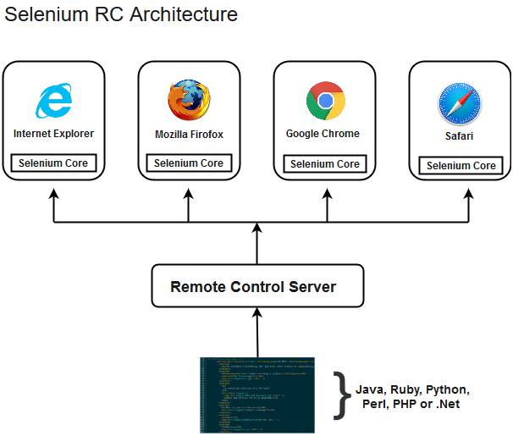
Selenium RC
Paul Hammant, created a server that acts as an HTTP proxy to "trick" the browser into believing that Selenium Core and the web application being tested come from the same domain.
This system became known as the Selenium Remote Control or Selenium 1.
Selenium RC comes with two components.
Selenium RC Server (acts as a HTTP proxy for web requests).
Selenium RC Client (library containing your programming language code).
Notes:
developed by Eliot Horowitz and Dwight Merriman in the year 2007, when they experienced some scalability issues with the relational database while developing enterprise web applications at their company DoubleClick. According to Dwight Merriman, one of the developers of MongoDB, this name of the database was derived from the word humongous to support the idea of processing large amount of data.
In 2009, MongoDB was made as an open source project, while the company offered commercial support services. Many companies started using MongoDB for its amazing features. The New York Times newspaper used MongoDB to build a web based application to submit the photos. In 2013, the company was officially named to MongoDB Inc.

Slide 10
Selenium Web Driver
Created by Simon Stewart WebDriver in 2006 when browsers and web applications were becoming more powerful and more restrictive with JavaScript programs like Selenium Core.
Successor to Selenium RC, most important component of Selenium Suite.
First cross-platform testing framework that controls browser from OS level.
A programming interface to create and execute test cases that can identify web elements on web pages desired actions performed on those elements.
Since, WebDriver directly calls the methods of different browsers hence we have separate driver for each browser.
Mozilla Firefox Driver (Gecko Driver)
Google Chrome Driver
Internet Explorer Driver
Opera Driver
Safari Driver
HTML Unit Driver (a special headless driver)
Notes:
Selenium WebDriver performs much faster as compared to Selenium RC
because it makes direct calls to the web browsers. RC on the other hand needs an RC server to interact with the web browser.

Slide 11
Selenium Grid
Developed by Patrick Lightbody to address the need of minimizing test execution times as much as possible
Allows to run our tests on different machines against different browsers in parallel. In simple words, we can run our tests simultaneously on different machines running different browsers and operating systems.
Selenium Grid follows the Hub-Node Architecture to achieve parallel execution of test scripts.
The Hub is considered as master of the network and the other will be the nodes. Hub controls the execution of test scripts on various nodes of the network.
Notes:
When we say schemaless, we actually mean dynamically typed schema, as opposed to statically typed schemas as available in RDBMS(SQL) databases.
JSON is a completely schema free data structure, as opposed to XML which allows you to specify XSD if you need.

Slide 12
Selenium IDE
Shinya Kasatani of Japan created Selenium IDE, a Firefox or Chrome extension that can automate the browser through a record-and-playback feature.
Simplest framework and easiest to learn, use only as a prototyping tool.
To install IDE as an extension type the following browser on the firefox url and add it as an extension: https://addons.mozilla.org/en-US/firefox/addon/selenium-ide/
Go to the top right corner on your Firefox browser and look for the Selenium IDE icon.
Click on that icon to launch Selenium IDE.
Notes:
Selenium WebDriver performs much faster as compared to Selenium RC
because it makes direct calls to the web browsers. RC on the other hand needs an RC server to interact with the web browser.

Slide 13
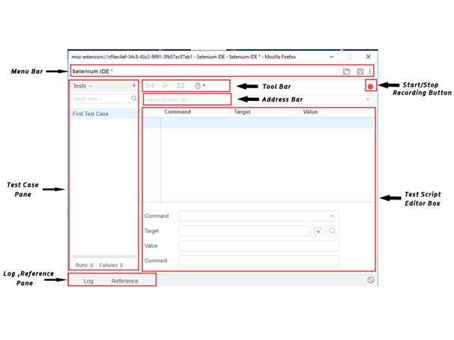
Selenium IDE Features
Notes:
https://www.javatpoint.com/selenium-ide-features

Slide 14
IDE First Test Case
The entire test script creation process in Selenium IDE can be classified into three steps:
Recording (recording user interactions with the browser)
Playing back (executing the recorded script)
Saving the test suite
Type url (google.com) in the address bar and click on rec button on the rightmost corner
Once the webpage opens, perform actions and IDE will record.
Notes:
When we say schemaless, we actually mean dynamically typed schema, as opposed to statically typed schemas as available in RDBMS(SQL) databases.
JSON is a completely schema free data structure, as opposed to XML which allows you to specify XSD if you need.

Slide 15
Selenium Web Driver & RC
They both allow to use a programming language in designing your test scripts.
They both allow to run tests against different browsers
They differ in following ways :
Architecture
Speed
Real Life Interaction
API
Browser Support
Notes:
When we say schemaless, we actually mean dynamically typed schema, as opposed to statically typed schemas as available in RDBMS(SQL) databases.
JSON is a completely schema free data structure, as opposed to XML which allows you to specify XSD if you need.

Slide 16
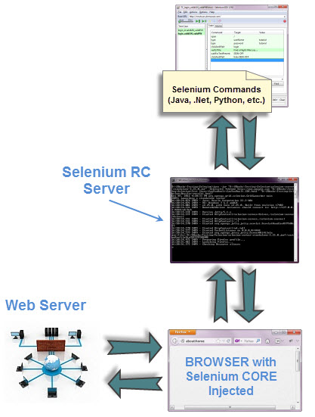
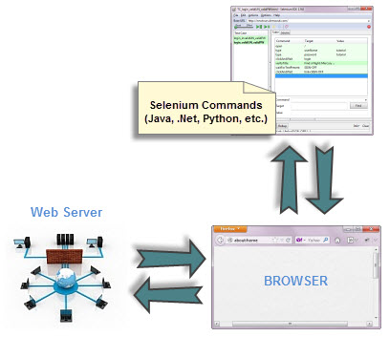
Architecture
Web Driver
RC
Notes:
WebDriver's architecture is simpler than Selenium RC's.
It controls the browser from the OS level
All you need are your programming language's IDE (which contains your Selenium commands) and a browser.
Selenium RC's architecture is way more complicated.
You first need to launch a separate application called Selenium Remote Control (RC) Server before you can start testing
The Selenium RC Server acts as a "middleman" between your Selenium commands and your browser
When you begin testing, Selenium RC Server "injects" a Javascript program called Selenium Core into the browser.
Once injected, Selenium Core will start receiving instructions relayed by the RC Server from your test program.
When the instructions are received, Selenium Core will execute them as Javascript commands.
The browser will obey the instructions of Selenium Core and will relay its response to the RC Server.
The RC Server will receive the response of the browser and then display the results to you.
RC Server will fetch the next instruction from your test script to repeat the whole cycle

Slide 17
Speed
WebDriver is faster than Selenium RC since it speaks directly to the browser, uses the browser's own engine to control it.
Selenium RC is slower since it uses a Javascript program called Selenium Core. This Selenium Core is the one that directly controls the browser, not you.

Slide 18
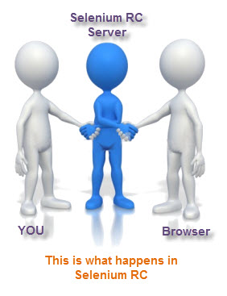

Real Life Interaction
Web Driver
RC
Notes:
WebDriver interacts with page elements in a more realistic way. For example, if you have a disabled text box on a page you were testing, WebDriver really cannot enter any value in it just as how a real person cannot.
Selenium Core, just like other JavaScript codes, can access disabled elements. In the past, Selenium testers complain that Selenium Core was able to enter values to a disabled text box in their tests. Differences in API

Slide 19
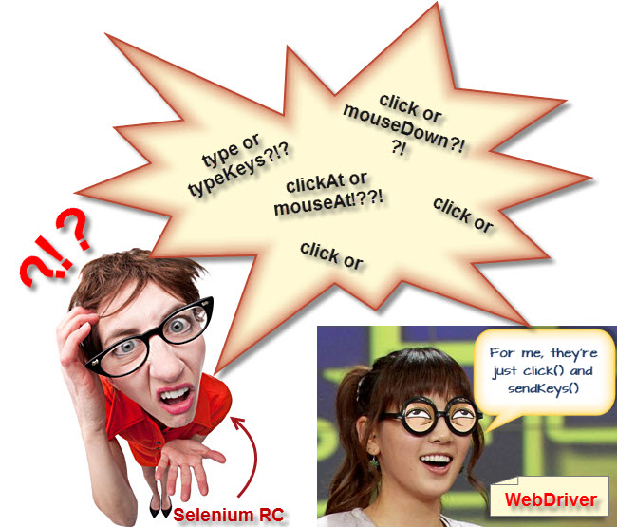
API
Notes:
Selenium RC's API is more matured but contains redundancies and often confusing commands. For example, most of the time, testers are confused whether to use type or typeKeys; or whether to use click, mouseDown, or mouseDownAt. Worse, different browsers interpret each of these commands in different ways too!
WebDriver's API is simpler than Selenium RC's. It does not contain redundant and confusing commands.

Slide 20

Browser Support
WebDriver can support the headless HtmlUnit browser
HtmlUnit is termed as "headless" because it is an invisible browser - it is GUI-less.
It is a very fast browser because no time is spent in waiting for page elements to load. This accelerates your test execution cycles.
Since it is invisible to the user, it can only be controlled through automated means.
Selenium RC cannot support the headless HtmlUnit browser. It needs a real, visible browser to operate on.
Notes:
Selenium RC's API is more matured but contains redundancies and often confusing commands. For example, most of the time, testers are confused whether to use type or typeKeys; or whether to use click, mouseDown, or mouseDownAt. Worse, different browsers interpret each of these commands in different ways too!
WebDriver's API is simpler than Selenium RC's. It does not contain redundant and confusing commands.

Slide 21
Web Driver Limitations
Web Driver cannot readily support new browsers
Selenium RC Has Built-In Test Result Generator
WebDriver has no built-in command that automatically generates a Test Results File.
You would have to rely on your IDE's output window, or design the report yourself using the capabilities of your programming language and store it as text, HTML, etc.
Notes:
Remember that WebDriver operates on the OS level. Also, remember that different browsers communicate with the OS in different ways. If a new browser comes out, it may have a different process of communicating with the OS as compared to other browsers. So, you have to give the WebDriver team quite some time to figure that new process out before they can implement it on the next WebDriver release.
However, it is up to the WebDriver's team of developers to decide if they should support the new browser or not.
Selenium RC automatically generates an HTML file of test results. The format of the report was pre-set by RC itself

Slide 22
Web Driver Installation
Install jdk8
Install Eclipse
Selenium Client java driver :- https://www.seleniumhq.org/download/
Chrome Driver :- https://sites.google.com/chromium.org/driver/downloads?authuser=0 https://sites.google.com/chromium.org/driver/ Download based on your OS
Mozilla Gecko Driver : https://github.com/mozilla/geckodriver/releases
Download based on your OS
Internet Explorer Driver : https://developer.microsoft.com/en-us/microsoft-edge/tools/webdriver/ [Release 17134]
Notes:
To invoke a browser in Selenium, we have to download an executable file specific to that browser. For example, Chrome browser implements the WebDriver protocol using an executable called ChromeDriver.exe. These executable files start a server on your system which in turn is responsible for running your test scripts in Selenium.
Selenium developers have defined properties for each browser that needs the location of the respective executable files to be parsed in order to invoke a browser. For example, the property defined for Chrome browser - webdriver.chrome.driver, needs the path of its executable file - D:\ChromeDriver\chromedriver.exe in order to launch chrome browser.

Slide 23
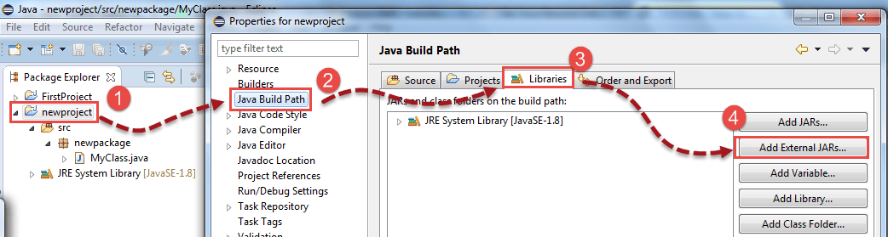
Configure Eclipse
Open Eclipse and create a core java project -> SeleniumWebDriverDemo
Right-click on "SeleniumWebDriverDemo" and select Properties.
On the Properties dialog, click on "Java Build Path".
Click on the Libraries tab, and then
Click on Add External Jars

Slide 24
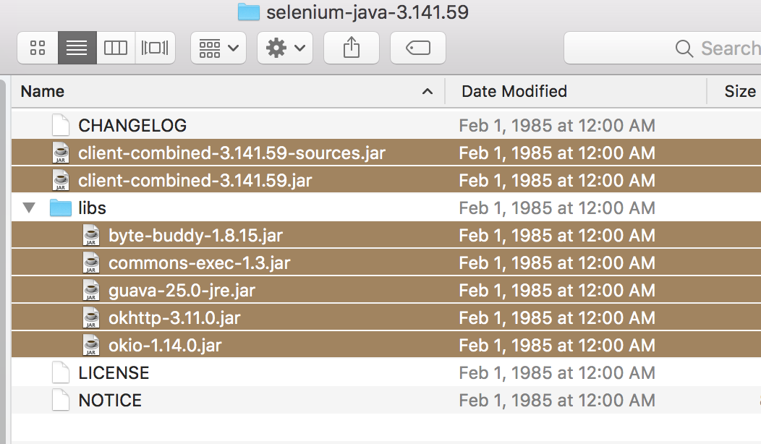
Add Jars
Then add all the jar files in the lib folder and outside the lib folder in the build path.

Slide 25
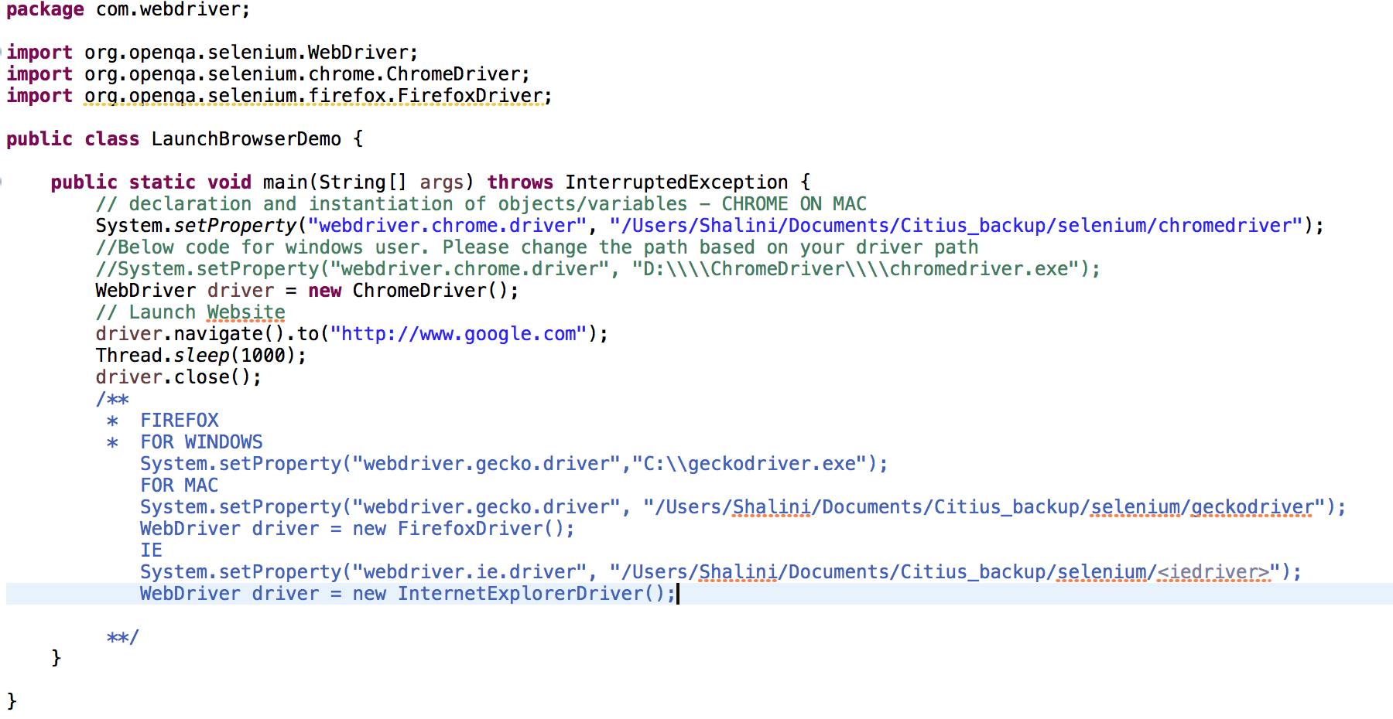
Time To Code : Phewwww
Create a java class as follows and execute the main method
Change the path to your driver path
Notes:
/**
* navigate().to() and get() do exactly the same thing. One's just a lot easier to type than the other!
The navigate interface also exposes the ability to move backwards and forwards in your browser’s history:
navigate().to() navigates to the page by changing the URL like doing forward/backward navigation.
Whereas, get() refreshes the page to changing the URL.
So, in cases where application domain changes, both the method behaves similarly.
That is, page is refreshed in both the cases.
But, in single-page applications,
while navigate().to() do not refreshes the page, get() do.
Moreover, this is the reason browser history is getting lost when get() is used due to application being refreshed.
*/

Slide 26
Reference Links
https://www.techbeamers.com/selenium-webdriver-tutorial/
https://www.toolsqa.com/selenium-tutorial/
https://www.swtestacademy.com/install-chrome-driver-on-mac/

Slide 27

Any Question ?

Slide 28


7738460004 shalini06mittal@gmail.com
Thank you !

