Slide 1
Selenium Driver Commands
Shalini Mittal
Corporate Trainer

Slide 2
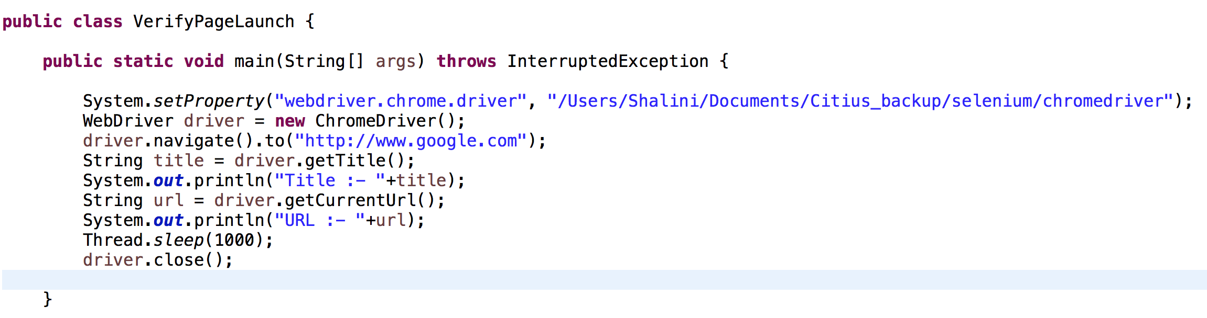
Verify Page Launched?
Get title of the page using getTitle()
Verify the url navigated using getCurrentUrl()

Slide 3
Get Commands
get() | It automatically opens a new browser window and fetches the page that you specify inside its parentheses. The parameter must be a String object.
getTitle() | Needs no parameters Fetches the title of the current page Leading and trailing white spaces are trimmed Returns a null string if the page has no title
getPageSource() | Needs no parameters Returns the source code of the page as a String value
getCurrentUrl() | Needs no parameters Fetches the string representing the current URL that the browser is looking at
getText() | Fetches the inner text of the element that you specify

Slide 4
Navigate Commands
These commands allow you to refresh,go-into and switch back and forth between different web pages.
navigate().to() | It automatically opens a new browser window and fetches the page that you specify inside its parentheses. It does exactly the same thing as the get() method.
navigate().refresh() | Needs no parameters. It refreshes the current page.
navigate().back() | Needs no parameters Takes you back by one page on the browser's history.
navigate().forward() | Needs no parameters Takes you forward by one page on the browser's history

Slide 5
Close and Quit Browser
These commands allow you to refresh,go-into and switch back and forth between different web pages. driver.get("http://www.popuptest.com/popuptest2.html");
driver.quit(); // using QUIT all windows will close
close() | Needs no parameters It closes only the browser window that WebDriver is currently controlling.
quit() | Needs no parameters It closes all windows that WebDriver has opened.

Slide 6
Find Element/s
Find Element command uniquely identifies a web element within the web page.
Find Elements command uniquely identifies list of web elements within the web page
findElement() -> takes in the By object as the parameter and returns an object of type WebElement. By object in turn can be used with various locator strategies such as ID, Name, Class Name, XPATH etc. Below is the syntax of FindElement command in Selenium web driver. WebElement elementName = driver.findElement(By.LocatorStrategy ("LocatorValue”));
Locator Strategy can by any of the following values.
ID
Name
Class Name
Tag Name
Link Text
Partial Link Text
XPATH
Locator Value is the unique value using which a web element can be identified WebElement loginLink = driver.findElement(By.linkText("Login"));
findElements : takes in By object as the parameter and returns a list of web elements. List<WebElement> listOfElements = driver.findElements(By.Id(”main"));
Notes:
Identification of correct GUI elements is a prerequisite to creating an automation script. But accurate identification of GUI elements is more difficult than it sounds. Sometimes, you end up working with incorrect GUI elements or no elements at all! Hence,
It returns an empty list if there are no elements found using the given locator strategy and locator value.

Slide 7
By.Locator() – Locate GUI Elements
Variation | Description | Sample
By.className | finds elements based on the value of the "class" attribute | findElement(By.className("someClassName"))
By.cssSelector | finds elements based on the driver's underlying CSS Selector engine | findElement(By.cssSelector("input#email"))
By.id | locates elements by the value of their "id" attribute | findElement(By.id("someId"))
By.linkText | finds a link element by the exact text it displays | findElement(By.linkText("REGISTRATION"))
By.name | locates elements by the value of the "name" attribute | findElement(By.name("someName"))
By.partialLinkText | locates elements that contain the given link text | findElement(By.partialLinkText("REG"))
By.tagName | locates elements by their tag name | findElement(By.tagName("div"))
By.xpath | locates elements via XPath | findElement(By.xpath("//html/body/div/table/tbody/tr/td[2]/table/ tbody/tr[4]/td/table/tbody/tr/td[2]/table/tbody/tr[2]/td[3]/ form/table/tbody/tr[5]"))

Slide 8
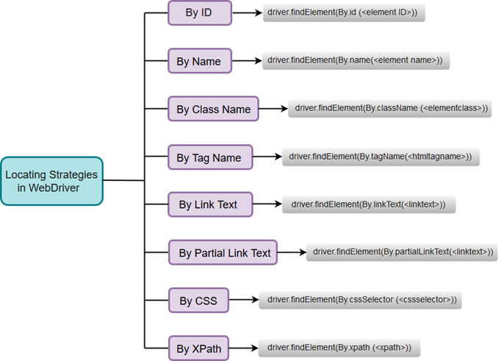

Slide 9
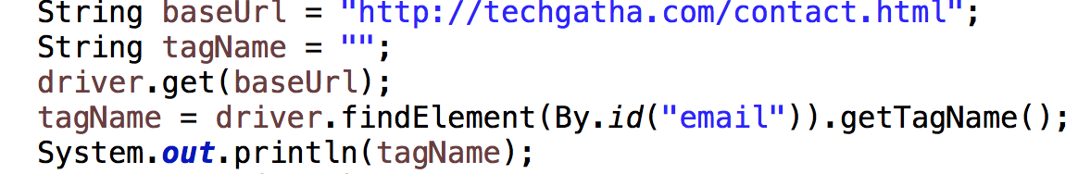
By Id
Code locates an element by its id.
getTagName() method to extract the tag name of that particular element whose id is "email".
Can also instantiate a WebElement object for findElement(). WebElement emailelement = driver.findElement(By.id("email")); tagName = emailelement.getTagName();
Notes:
https://www.testandquiz.com/selenium/testing.html

Slide 10
Web Element Commands
clear() -> clears the text WebElement element = driver.findElement(By.id("UserName")); element.clear();
sendKeys(CharSequence ) -> to send text driver.findElement(By.id("UserName")).sendKeys("JavaTpoint");
click() -> To click a particular element driver.findElement(By.linkText("javaTpoint")).click();
submit() -> To submit driver.findElement(By.id("SubmitButton")).submit();
getText() : String -> returns the text within an element WebElement element = driver.findElement(By.xpath("anyLink")); String linkText = element.getText();
getTagName() : String -> returns the tag name String tagName = driver.findElement(By.id("SubmitButton")).getTagName();
getCssvalue() : String
getAttribute(String Name) : String
getSize() : Dimension
getLocation() : Point
Notes:
When submit() is used, WebDriver will look up the DOM to know which form the element belongs to, and then trigger its submit function.

Slide 11
Clicking on an Element
Clicking is perhaps the most common way of interacting with web elements.
The click() method is used to simulate the clicking of any element
It does not take any parameter/argument.
The method automatically waits for a new page to load if applicable.
The element to be clicked-on, must be visible (height and width must not be equal to zero). driver.findElement(By.name("q")).sendKeys("java tutorials"); driver.findElement(By.name("btnK")).click();

Slide 12
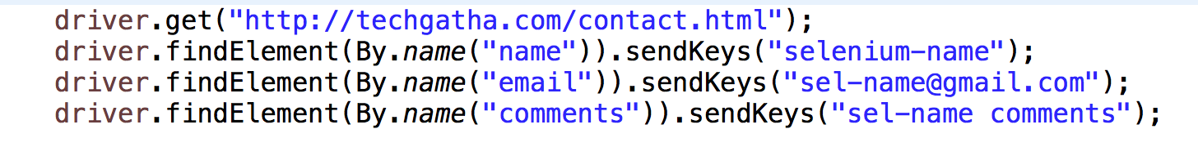
By Name
Code locates an element by its name.

Slide 13
By Class Name
// Launch Website
driver.navigate().to("https://www.testandquiz.com/selenium/testing.html");
//Locate the checkbox by Class Name and check it using click() function
driver.findElement(By.className("Automation")).click();

Slide 14
By Tag Name
// Launch Website
driver.navigate().to("https://www.testandquiz.com/selenium/testing.html");
//Locate the checkbox by Class Name and check it using click() function
driver.findElement(By.tagName(”input")).sendKeys(“Shalini”);

Slide 15
By Link Text
// Launch Website
driver.navigate().to("https://www.testandquiz.com/selenium/testing.html");
//Locate the checkbox by Class Name and check it using click() function
driver.findElement(By.linkText("This is a Link")).click();
By.linkText() and By.partialLinkText() are both case-sensitive

Slide 16
By Partial Link Text
// Launch Website
driver.navigate().to("https://www.testandquiz.com/selenium/testing.html");
//Locate the checkbox by Class Name and check it using click() function
driver.findElement(By.partiaLinkText("This is a Link")).click();

Slide 17
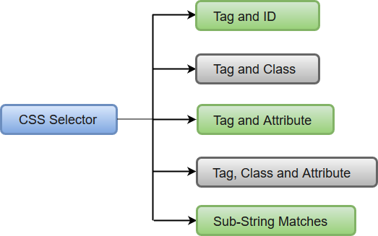
By CSS
Locating web elements through CSS involves use of CSS Selector which identifies an element based on the combination of HTML tag, id, class and attributes.
In WebDriver, CSS Selector works in six modes to identify and locate web elements.

Slide 18
By CSS Selector Ex
By Tag and Id :- driver.findElement(By.cssSelector("input#fname")).sendKeys(”Learn is fun");
By Tag and class :- // Locate the checkbox by cssSelector and check it using click() function driver.findElement(By.cssSelector("input.Automation")).click();
By Tag and attribute :- driver.findElement(By.cssSelector("input[id=fname]")).sendKeys("Selenium Tutorials");
By Tag, class and attribute :- driver.findElement(By.cssSelector("input.gsfi[name=q]")).sendKeys(“cute name");
Sub-String Matches:- provides an interesting feature of allowing partial string matches using ^, $ and*.
Starts with (^): driver.findElement(By.cssSelector("input[id^='fna']")).sendKeys(“info");
Ends with ($) : driver.findElement(By.cssSelector("input[id$='me']")).sendKeys(”ended");
Contains (*): driver.findElement(By.cssSelector("input[id*=’na']")).sendKeys(”contain");
Notes:
"https://www.testandquiz.com/selenium/testing.html”
: You can choose attributes such as id, class and name along with their values when you are locating through CSS - Tag and Attribute Selector.

Slide 19
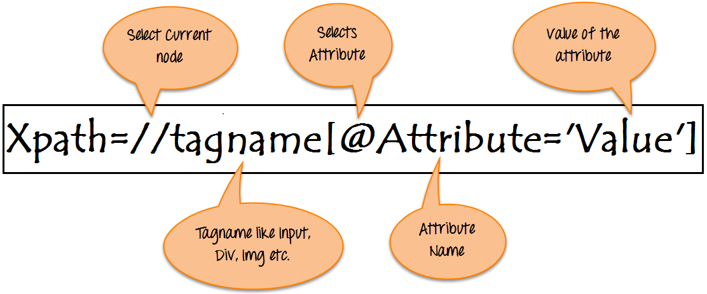
Xpath ?
XPath is defined as XML path.
A syntax or language for finding any element on the web page using XML path expression.
XPath is used to find the location of any element on a webpage using HTML DOM structure.
The basic format of XPath is explained below with screen shot.
There are two types of XPath:
Absolute Xpath
Relative XPath
Notes:
/html[1]/body[1]/ytd-app[1]/div[1]/div[1]/ytd-masthead[1]/div[3]/div[2]/div[2]/ytd-topbar-menu-button-renderer[1]/div[1]/a[1]/yt-icon-button[1]/button[1]/yt-icon[1]

Slide 20
Absolute Path ?
Direct way to find the element, but the disadvantage of the absolute XPath is that if there are any changes made in the path of the element then that XPath gets failed.
The key characteristic of XPath is that it begins with the single forward slash(/) ,which means you can select the element from the root node.
Example : /html[1]/body[1]/div[2]/section[3]/div[1]/div[1]/main[1]/div[1]/div[1]/div[1]/div[1]/div[1]/div[1]/div[2]/p[15]/strong[1]
Notes:
/html[1]/body[1]/ytd-app[1]/div[1]/div[1]/ytd-masthead[1]/div[3]/div[2]/div[2]/ytd-topbar-menu-button-renderer[1]/div[1]/a[1]/yt-icon-button[1]/button[1]/yt-icon[1]

Slide 21
Relative Path ?
The path starts from the middle of the HTML DOM structure.
It starts with the double forward slash (//), which means it can search the element anywhere at the webpage.
You can start from the middle of the HTML DOM structure and no need to write long xpath.
Example : //strong[contains(text(),'Absolute xpath:')]
Notes:
/html[1]/body[1]/ytd-app[1]/div[1]/div[1]/ytd-masthead[1]/div[3]/div[2]/div[2]/ytd-topbar-menu-button-renderer[1]/div[1]/a[1]/yt-icon-button[1]/button[1]/yt-icon[1]

Slide 22
By XPath
XPath is a language used for locating nodes in XML documents.
XPath can be used as a substitute when you don't have a suitable id or name attribute for the element you want to locate.
XPath allows you to select individual element
Different ways of writing dynamic XPaths
Using Single Slash
Using Double Slash
Using Single Attribute
Using Multiple Attribute
Using AND
Using OR
Using contains()
Using starts_with()
Using text()
Using last()

Slide 23
Using Single Slash
Single Slash mechanism is also known as finding elements using Absolute XPath.
Single Slash is used to create XPath with absolute XPath i.e. the XPath would be created to start selection from the document node/ Start node/ Parent node.
The syntax for locating elements through XPath Absolute is written as: //html/body/tag1[index]/tag2[index]/.../tagN[index]
Using Single Slash/Absolute XPath, we can write the Java code along with the dynamic XPath location as: findElement(By.xpath("/html[1]/body[1]/div[1]/div[5]/div[1]/p[1]/input[1]"));
NOTE : XPath Absolute is not recommended because it takes the complete XPath location and if the location of the web element is changed or it belongs to some other parent then XPath will be unable to locate the desired element.
Notes:
XPath Absolute is not recommended because it takes the complete XPath location and if the location of the web element is changed or it belongs to some other parent then XPath will be unable to locate the desired element.

Slide 24
Using Double Slash
Double slash is used to create XPath with relative path i.e. the XPath would be created to start selection from anywhere within the document. - Search in a whole page (DOM) for the preceding string.
Double Slash is recommended when you don't have a suitable id or name attribute for the element you want to locate.
Example : //form//div[@class='row']//div[1]//input[1]
Notes:
XPath Absolute is not recommended because it takes the complete XPath location and if the location of the web element is changed or it belongs to some other parent then XPath will be unable to locate the desired element.

Slide 25
Using Single Attribute
'*'after double slash is to match any tag with the desired text.
Example : findElement(By.xpath("//*[@id="lst-ib"]"));
Using Multiple Attribute
'*'after double slash is to match any tag with the desired text.
Example : driver.findElement(By.xpath("//*[@id='name'][@type='text']"))
Using And
Example : driver.findElement(By.xpath(" //*[@id='name' and @type='text'] "));
Notes:
XPath Absolute is not recommended because it takes the complete XPath location and if the location of the web element is changed or it belongs to some other parent then XPath will be unable to locate the desired element.

Slide 26
Using Or
Example : driver.findElement(By.xpath("//*[@id='name' or @type='text']"))
Using contains
"contains()" is used to identify an element, when we are familiar with some part of the attributes value of an element
Example : findElement(By.xpath("//*[contains (@id,'email')]"))
Notes:
XPath Absolute is not recommended because it takes the complete XPath location and if the location of the web element is changed or it belongs to some other parent then XPath will be unable to locate the desired element.

Slide 27
Using starts_with
"starts-with()" is used to identify an element, when we are familiar with the attributes value (starting with the specified text) of an element.
Example : findElement(By.xpath("//*[starts-with(@id,’name')]"));
Using text
"text() method" is used to identify an element based on the text available on the web page.
Example : findElement(By.xpath("//div/*[text() = 'CONTACT']")).getAttribute("class"));
Using last
"last() method" selects the last element (of mentioned type) out of all input element present.
Example : findElement(By.xpath(”(//input[@type='text'])[last()]")).sendKeys("last input");
Notes:
XPath Absolute is not recommended because it takes the complete XPath location and if the location of the web element is changed or it belongs to some other parent then XPath will be unable to locate the desired element.

Slide 28
Drop-Downs
The 'Select' class in Selenium WebDriver is used for selecting and deselecting option in a dropdown.
The objects of Select type can be initialized by passing the dropdown webElement as parameter to its constructor. WebElement testDropDown = driver.findElement(By.id("testingDropdown")); Select dropdown = new Select(testDropDown);
To select an option from drop-downmenu :-
selectByIndex - used to select an option based on its index, beginning with 0. dropdown.selectByIndex(5);
selectByValue - used to select an option based on its 'value' attribute. dropdown.selectByValue("Database");
selectByVisibleText - used to select an option based on the text over the option. dropdown.selectByVisibleText("Database Testing");
driver.get("https://www.testandquiz.com/selenium/testing.html");
Select dropdown = new Select(driver.findElement(By.id("testingDropdown")));
dropdown.selectByIndex(2)
https://demoqa.com/select-menu
Notes:
XPath Absolute is not recommended because it takes the complete XPath location and if the location of the web element is changed or it belongs to some other parent then XPath will be unable to locate the desired element.

Slide 29
Drop-Downs Select
Method | Description
selectByVisibleText() and deselectByVisibleText() | Selects/deselects the option that displays the text matching the parameter. Parameter: The exactly displayed text of a particular option
selectByValue() and deselectByValue() | Selects/deselects the option whose "value" attribute matches the specified parameter. Parameter: value of the "value" attribute Remember that not all drop-down options have the same text and "value", like in the example below.
selectByIndex() and deselectByIndex() | Selects/deselects the option at the given index. Parameter: the index of the option to be selected.
isMultiple() | Returns TRUE if the drop-down element allows multiple selections at a time; FALSE if otherwise. No parameters needed
deselectAll() | Clears all selected entries. This is only valid when the drop-down element supports multiple selections. No parameters needed
Notes:
XPath Absolute is not recommended because it takes the complete XPath location and if the location of the web element is changed or it belongs to some other parent then XPath will be unable to locate the desired element.

Slide 30
Handle Radio Buttons
<input type="radio" name="group1" value="Mango">Mango<br>
<input type="radio" name="group1" value="Watermelon"> Watermelon <br>
<input type="radio" name="group1" value="Banana">Banana<br>
<hr>
<input type="radio" name="group2" value="Ladyfinger">Ladyfinger<br>
<input type="radio" name="group2" value="Potato">Potato<br>
<input type="radio" name="group2" value="Tomato">Tomato<br>
driver.get("file:///C:/Users/admin/Desktop/radio.html");
driver.findElement(By.xpath("//input[@value='Banana']")).click();
//OR
//calculates the number of radio buttons whose nameis group1
int a = driver.findElements(By.xpath("//input [@name='group1']")).size();
System.out.println(a);
for(int i=1;i<=a;i++)
{
driver.findElements(By.xpath("//input[@name='group1']")).get(2).click();
}
Notes:
XPath Absolute is not recommended because it takes the complete XPath location and if the location of the web element is changed or it belongs to some other parent then XPath will be unable to locate the desired element.

Slide 31
Handle Check Box
driver.navigate().to("https://www.spicejet.com/");
System.out.println(driver.findElement(By.cssSelector("input[id*='SeniorCitizenDiscount']")).isSelected());
driver.findElement(By.cssSelector("input[id*='SeniorCitizenDiscount']")).click();
System.out.println(driver.findElement(By.cssSelector("input[id*='SeniorCitizenDiscount']")).isSelected());
driver.close();
isSelected(): This method determines whether the checkbox is selected or not. If the checkbox is selected, then this method returns true otherwise false.
click(): This method selects the locator. In this case, it is selecting the "Senior Citizen" checkbox
Notes:
XPath Absolute is not recommended because it takes the complete XPath location and if the location of the web element is changed or it belongs to some other parent then XPath will be unable to locate the desired element.

Slide 32
Access Image Links
Image links are the links in web pages represented by an image which when clicked navigates to a different window or page.
Since they are images, we cannot use the By.linkText() and By.partialLinkText() methods because image links basically have no link texts at all.
Resort to using either By.cssSelector or By.xpath. The first method is more preferred because of its simplicity.
driver.navigate().to("http://techgatha.com/creations.html");
driver.findElement(By.cssSelector("a[href^=\"srishti\"]")).click();
if(driver.getCurrentUrl().equals("http://techgatha.com/srishti/flowers.html")) { System.out.println("We are at Srishti Creations");
}
else {
System.out.println("We are NOT ");
}
Thread.sleep(3000);
driver.quit();
Notes:
XPath Absolute is not recommended because it takes the complete XPath location and if the location of the web element is changed or it belongs to some other parent then XPath will be unable to locate the desired element.

Slide 33
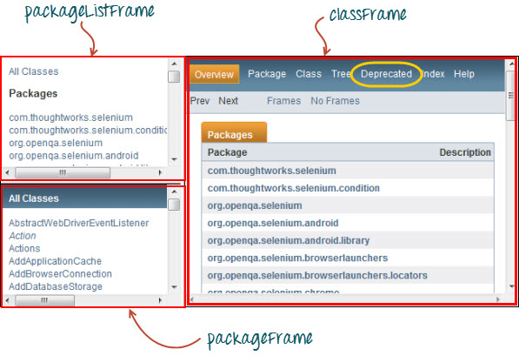
Switch Between Frames
To access GUI elements in a Frame, we should first direct WebDriver to focus on the frame or pop-up window first before we can access elements within them
Ex : https://docs.oracle.com/javase/7/docs/api/
This page has 3 frames whose "name" attributes are indicated above. We wish to access the "Deprecated" link encircled in yellow

Slide 34
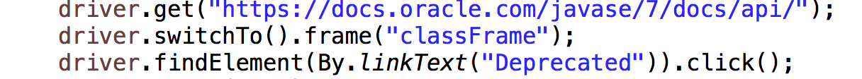
Switch Between Frames Demo
Instruct WebDriver to switch to the "classFrame" frame using the "switchTo().frame()" method.
Use the name attribute of the frame as the parameter for the "frame()" part.

Slide 35
Alert Dialog Box
three methods to accept and reject the Alert depending on the Alert types.
void dismiss() - This method is used to click on the 'Cancel' button of the alert. driver.switchTo().alert().dismiss();
void accept() - This method is used to click on the 'Ok' button of the alert. driver.switchTo().alert().accept();
String getText() - This method is used to capture the alert message. driver.switchTo().alert().getText();
void sendKeys(String stringToSend) - This method is used to send some data to the alert box. driver.switchTo().alert().sendKeys("Text");

Slide 36
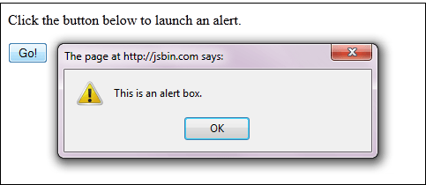
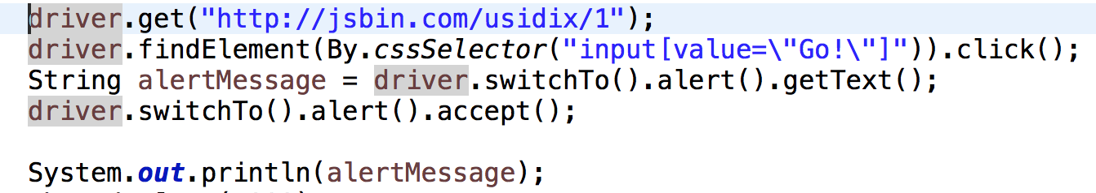
Switch Between Pop-Up
WebDriver allows pop-up windows like alerts to be displayed.
To access the elements within the alert (such as the message it contains), we must use the "switchTo().alert()" method.
use this method to access the alert box and then retrieve its message using the "getText()” method, and then automatically close the alert box using the "switchTo().alert().accept()" method.
Link : http://jsbin.com/usidix/1

Slide 37
Switch Between Windows
When we have multiple windows in any web application, the activity may need to switch control among several windows from one to other in order to complete the operation.
After completion of the operation, it has to return to the main window i.e. parent window
Driver.getWindowHandles() : To handle all opened windows by web driver, we can use "Driver.getWindowHandles()" and then we can switch window from one window to another in a web application. Its return type is Iterator<String>.
Driver.getWindowHandle() : When the site opens, we need to handle the main window by driver.getWindowHandle(). This will handle the current window that uniquely identifies it within this driver instance. Its return type is String.
http://demo.guru99.com/popup.php

Slide 38
Switch Between Windows Demo
driver.get("http://demo.guru99.com/popup.php");
driver.manage().window().maximize();
driver.findElement(By.xpath("//*[contains(@href,'popup.php')]")).click();
String MainWindow=driver.getWindowHandle();
// To handle all new opened window.
Set<String> s1=driver.getWindowHandles();
Iterator<String> i1=s1.iterator();
while(i1.hasNext()){
String ChildWindow=i1.next();
if(!MainWindow.equalsIgnoreCase(ChildWindow)){
// Switching to Child window
driver.switchTo().window(ChildWindow); driver.findElement(By.name("emailid")).sendKeys("gaurav.3n@gmail.com"); driver.findElement(By.name("btnLogin")).click();
// Closing the Child Window.
driver.close();
}
}
// Switching to Parent window i.e Main Window.
driver.switchTo().window(MainWindow);

Slide 39
Waits
There are 5 kinds of waits.
Thread.sleep – it will by default wait for the specified time irrespective if the element was found before that
Pageloadtimeout – to time limit for page to load
Setscripttimeout - javascript when it makes ajax requests
Implicit wait - used to set the default waiting time throughout the program
Explicit wait - used to set the waiting time for a particular instance only

Slide 40
Implicit Wait
It is simpler to code than Explicit Waits.
It is usually declared in the instantiation part of the code.
You will only need one additional package to import. driver.manage().timeouts().implicitlyWait(10, TimeUnit.SECONDS);

Slide 41
Explicit Wait
Explicit waits are done using the WebDriverWait and ExpectedCondition classes.
Wait up to 10 seconds for an element whose id is "username" to become visible before proceeding to the next command.
Declare a WebDriverWait variable WebDriver driver = new ChromeDriver(); WebDriverWait waitdriver = new WebDriverWait(driver, 10);
Use “waitdriver” with ExpectedConditions on portions where we need the explicit wait to occur.
In this case, we will use explicit wait on the ”search filed" (Google home page) input before we type the text ”java tutorial" onto it.

Slide 42
Conditions
Following methods are used in conditional and looping operations
isEnabled() is used when you want to verify whether a certain element is enabled or not before executing a command
isDisplayed() is used when you want to verify whether a certain element is displayed or not before executing a command.
isSelected() is used when you want to verify whether a certain check box, radio button, or option in a drop-down box is selected. It does not work on other elements.

Slide 43
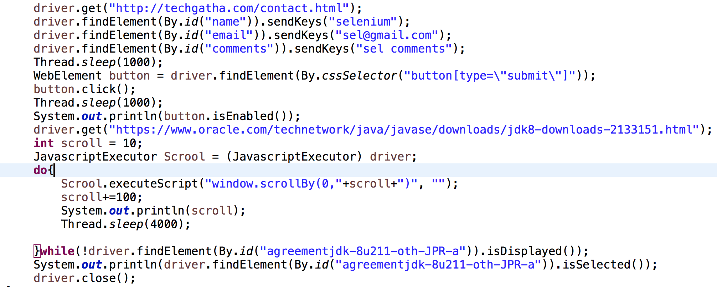
Conditions Demo

Slide 44
Catching Exceptions
When using isEnabled(), isDisplayed(), and isSelected(), WebDriver assumes that the element already exists on the page. Otherwise, it will throw a NoSuchElementException.
To avoid this, use a try-catch block so that the program will not be interrupted.
WebElement txtbox_username = driver.findElement(By.id("username"));
try{
if(txtbox_username.isEnabled()){ txtbox_username.sendKeys("tutorial");
}
} catch(NoSuchElementException nsee){
System.out.println(nsee.toString());
}

Slide 45
Advanced User Interactions -1/2
Special keyboard and mouse events are handled using Advanced User Interactions API, Actions and the Action classes are needed when executing these events
Method | Description
clickAndHold() | Clicks (without releasing) at the current mouse location.
contextClick() | Performs a context-click at the current mouse location. (Right Click Mouse Action)
doubleClick() | Performs a double-click at the current mouse location.
dragAndDrop(source, target) | Performs click-and-hold at the location of the source element, moves to the location of the target element, then releases the mouse. Parameters: source- element to emulate button down at. target- element to move to and release the mouse at.
dragAndDropBy(source, x-offset, y-offset) | Performs click-and-hold at the location of the source element, moves by a given offset, then releases the mouse. Parameters: source- element to emulate button down at. xOffset- horizontal move offset. yOffset- vertical move offset.
keyDown(modifier_key) | Performs a modifier key press. Does not release the modifier key - subsequent interactions may assume it's kept pressed. Parameters: modifier_key - any of the modifier keys (Keys.ALT, Keys.SHIFT, or Keys.CONTROL)
Notes:
https://www.guru99.com/verify-tooltip-selenium-webdriver.html
https://seleniumhq.github.io/selenium/docs/api/java/index.html?org/openqa/selenium/interactions/Actions.html

Slide 46
Advanced User Interactions – 2/2
Method | Description
keyUp(modifier _key) | Performs a key release. Parameters: modifier_key - any of the modifier keys (Keys.ALT, Keys.SHIFT, or Keys.CONTROL)
moveByOffset(x-offset, y-offset) | Moves the mouse from its current position (or 0,0) by the given offset. Parameters: x-offset- horizontal offset. A negative value means moving the mouse left. y-offset- vertical offset. A negative value means moving the mouse down.
moveToElement(toElement) | Moves the mouse to the middle of the element. Parameters: toElement- element to move to.
release() | Releases the depressed left mouse button at the current mouse location
sendKeys(onElement, charsequence) | Sends a series of keystrokes onto the element. Parameters: onElement - element that will receive the keystrokes, usually a text field charsequence - any string value representing the sequence of keystrokes to be sent
Notes:
XPath Absolute is not recommended because it takes the complete XPath location and if the location of the web element is changed or it belongs to some other parent then XPath will be unable to locate the desired element.

Slide 47
Mouse Over an Element
Use the moveToElement() method to mouse-over on table rows.
The cell portion of a <TR> element if not hovered, its color is #FFC455 (orange). After hovering, the cell's color becomes transparent. It becomes the same color as the blue background of the whole orange table.
driver.navigate().to("http://techgatha.com");
WebElement link_Home = driver.findElement(By.linkText("SERVICES"));
// Instantiate a new Actions object.
Actions builder = new Actions(driver);
//Instantiate an Action using the Actions object
Action mouseOverHome = builder.moveToElement(link_Home).build();
String bgColor = link_Home.getCssValue("color");
System.out.println("Before hover: " + bgColor);
System.out.println(Color.fromString(bgColor).asHex());
Thread.sleep(3000);
//Use the perform() method when executing the Action object
mouseOverHome.perform();
bgColor = link_Home.getCssValue("color");
System.out.println("After hover: " + bgColor);
System.out.println(Color.fromString(bgColor).asHex());
Notes:
XPath Absolute is not recommended because it takes the complete XPath location and if the location of the web element is changed or it belongs to some other parent then XPath will be unable to locate the desired element.

Slide 48
Multiple Actions
A series of actions can be performed using the Action and Actions classes. Just remember to close the series with the build() method.
driver.navigate().to("http://techgatha.com/contact.html");
WebElement txtUsername = driver.findElement(By.id("name"));
Action seriesOfActions = builder.moveToElement(txtUsername)
.click()
.keyDown(txtUsername, Keys.SHIFT)
.sendKeys(txtUsername, "hello")
.keyUp(txtUsername, Keys.SHIFT)
.doubleClick(txtUsername)
.contextClick()
.build();
seriesOfActions.perform() ;
Notes:
https://stackoverflow.com/questions/11428026/select-an-option-from-the-right-click-menu-in-selenium-webdriver-java

Slide 49
Drag and Drop
// Launch Website
driver.navigate().to("https://www.testandquiz.com/selenium/testing.html");
//WebElement on which drag and drop operation needs to be performed
WebElement from = driver.findElement(By.id("sourceImage"));
//WebElement to which the above object is dropped
WebElement to = driver.findElement(By.id("targetDiv"));
//Creating object of Actions class to build composite actions
Actions act = new Actions(driver);
//Performing the drag and drop action
act.dragAndDrop(from,to).build().perform();

Slide 50
Upload A File
String baseUrl = "http://demo.guru99.com/test/upload/";
WebDriver driver = new FirefoxDriver();
driver.get(baseUrl);
WebElement uploadElement = driver.findElement(By.id("uploadfile_0"));
// enter the file path onto the file-selection input field uploadElement.sendKeys("C:\\newhtml.html");
// check the "I accept the terms of service" check box driver.findElement(By.id("terms")).click();
// click the "UploadFile" button
driver.findElement(By.name("send")).click();

Slide 51
JavaScriptExecutor
An Interface that helps to execute JavaScript through Selenium Webdriver. JavaScriptExecutor provides two methods "executescript" & "executeAsyncScript" to run javascript on the selected window or current page.
JavaScriptExecutor Methods
executeAsyncScript
With Asynchronous script, your page renders more quickly. Instead of forcing users to wait for a script to download before the page renders. This function will execute an asynchronous piece of JavaScript in the context of the currently selected frame or window in Selenium. The JS so executed is single-threaded with a various callback function which runs synchronously.
executeScript
This method executes JavaScript in the context of the currently selected frame or window in Selenium. The script used in this method runs in the body of an anonymous function (a function without a name). We can also pass complicated arguments to it.
Notes:
In Selenium Webdriver, locators like XPath, CSS, etc. are used to identify and perform operations on a web page.
In case, these locators do not work you can use JavaScriptExecutor. You can use JavaScriptExecutor to perform an desired operation on a web element

Slide 52
JavaScriptExecutor Methods
The script can return values. Data types returned are
Boolean
Long
String
List
WebElement.
Syntax: JavascriptExecutor js = (JavascriptExecutor) driver; js.executeScript(Script,Arguments);
Script – This is the JavaScript that needs to execute.
Arguments – It is the arguments to the script. It's optional.

Slide 53
executeAsyncScript Method
Helps improve performance of test and allows writing test more like normal coding.
Sends a callback to the server-side Testing suite once the script is done and everything inside the script will be executed by the browser and not the server.
//Creating the JavascriptExecutor interface object by Type casting
JavascriptExecutor js = (JavascriptExecutor)driver;
driver.get("http://demo.guru99.com/V4/");
//Maximize window
driver.manage().window().maximize();
//Set the Script Timeout to 20 seconds
driver.manage().timeouts().setScriptTimeout(20, TimeUnit.SECONDS);
//Declare and set the start time
long start_time = System.currentTimeMillis();
//Call executeAsyncScript() method to wait for 5 seconds js.executeAsyncScript("window.setTimeout(arguments[arguments.length - 1], 5000);");
//Get the difference (currentTime - startTime) of times.
System.out.println("Passed time: " + (System.currentTimeMillis() - start_time));
Notes:
The execSync blocks further actions being performed by the Selenium browser but execAsync does not block action
https://stackoverflow.com/questions/31107234/what-is-setscripttimeout-webdriver
https://stackoverflow.com/questions/49871432/what-does-arguments0-and-arguments1-mean-when-using-executescript-method-fro
Now since executeAsyncScript method doesn't block the execution of next line of code, it might be beneficial to use driver.manage().timeouts().setScriptTimeout(30,SECONDS); so that our code can wait for specified amount of time for an asynchronous script to finish execution before throwing an error.
From WebDriver documentation: setScriptTimeout(long time, java.util.concurrent.TimeUnit unit) Sets the amount of time to wait for an asynchronous script to finish execution before throwing an error. This works only for Assync scripts (executeAsyncScript)
Let's run a simple javascript: (Do not set setScriptTimeout ) - Now this shall execute without throwing any issue.
((JavascriptExecutor) driver).executeScript("alert('hello world');");
Lets run a simple Assync Script: ( Do not set setScriptTimeout) - This shall fail with error - "Timed out waiting for async script result after 0ms”
((JavascriptExecutor) driver).executeAsyncScript("window.setTimeout(arguments[arguments.length - 1], 500);");
To resolve the issue: setScriptTimeout to 1 Second:
driver.manage().timeouts().setScriptTimeout(1, TimeUnit.SECONDS); And then run the same Assync Script mentioned above and it shall execute without any error.
Reason: The default timeout for a script to be executed is 0ms. In most cases, including the examples below, one must set the script timeout WebDriver.Timeouts.setScriptTimeout(long, java.util.concurrent.TimeUnit) beforehand to a value sufficiently large enough

Slide 54
executeScript – Click and Generate Alert
//Creating the JavascriptExecutor interface object by Type casting
JavascriptExecutor js = (JavascriptExecutor)driver;
driver.get("http://demo.guru99.com/V4/");
WebElement button =driver.findElement(By.name("btnLogin"));
//Login to Guru99
driver.findElement(By.name("uid")).sendKeys("mngr34926"); driver.findElement(By.name("password")).sendKeys("amUpenu");
//Perform Click on LOGIN button using JavascriptExecutor js.executeScript("arguments[0].click();", button);
//To generate Alert window using JavascriptExecutor. Display the alert message js.executeScript("alert('Welcome to Guru99');");

Slide 55
executeScript – Capture Data and Navigate
//Creating the JavascriptExecutor interface object by Type casting
JavascriptExecutor js = (JavascriptExecutor)driver;
driver.get("http://demo.guru99.com/V4/");
//Fetching the Domain Name of the site. Tostring() change object to name.
String DomainName = js.executeScript("return document.domain;").toString();
System.out.println("Domain name of the site = "+DomainName);
//Fetching the URL of the site. Tostring() change object to name
String url = js.executeScript("return document.URL;").toString();
System.out.println("URL of the site = "+url);
//Method document.title fetch the Title name of the site.Tostring() change object to name
String TitleName = js.executeScript("return document.title;").toString();
System.out.println("Title of the page = "+TitleName);
//Navigate to new Page i.e to generate access page. (launch new url) js.executeScript("window.location = 'http://demo.guru99.com/'");

Slide 56
executeScript – Scroll Page
//Creating the JavascriptExecutor interface object by Type casting
JavascriptExecutor js = (JavascriptExecutor)driver;
//Launching the Site.
driver.get("http://moneyboats.com/");
//Maximize window
driver.manage().window().maximize();
//Vertical scroll down by 600 pixels
js.executeScript("window.scrollBy(0,600)");

Slide 57
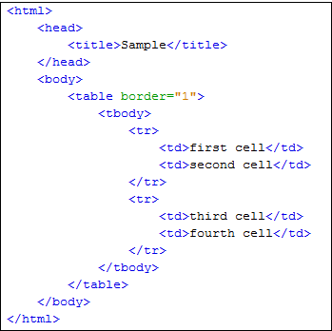
Handle Web Table
Set the Parent Element (table) : XPath locators in WebDriver always start with a double forward slash "//" and then followed by the parent element. "//table".
Add the child elements : The element immediately under <table> is <tbody> so we can say that <tbody> is the "child" of <table>. And also, <table> is the "parent" of <tbody>. All child elements in XPath are placed to the right of their parent element, separated with one forward slash "/" like the code shown below. “//table/tbody”
Add Predicates : The <tbody> element contains two <tr> tags. To get value “Fourth Cell” use predicates which are numbers or HTML attributes in []. //table/tbody/tr[2]
Add succeeding child elements : The next element we need to access is the second <td>. //table/tbody/tr[2]/td[2]
Notes:
Since we are dealing with tables, the parent element should always be the <table> tag. The first portion of our XPath locator should, therefore, start with "//table".

Slide 58
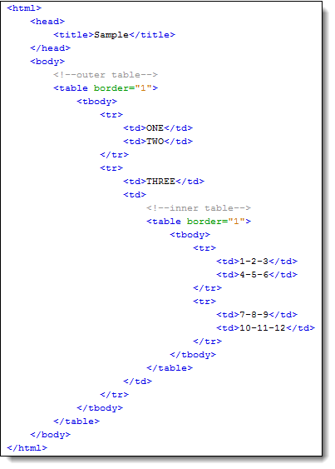
Handle Nested Web Table
Notes:
//table/tbody/tr[2]/td[2]/table/tbody/tr/td[2]
Using attributes as predicates
http://demo.guru99.com/test/newtours/
//table[@width=\"270\"]/tbody/tr[4]/td

Slide 59
Dynamic Web Table rows and columns
Data is dynamic i.e. Number of rows and columns are NOT fixed.
To fetch no of rows and columns for dynamic table :
wd.get("http://demo.guru99.com/test/web-table-element.php");
//No.of Columns
List col = wd.findElements(By.xpath(".//*[@id=\"leftcontainer\"]/table/thead/tr/th")); System.out.println("No of cols are : " +col.size());
//No.of rows
List rows =wd.findElements(By.xpath(".//*[@id='leftcontainer']/table/tbody/tr/td[1]")); System.out.println("No of rows are : " + rows.size()); wd.close();

Slide 60
Dynamic Web Table cell value
wd.get("http://demo.guru99.com/test/web-table-element.php");
wd.manage().timeouts().implicitlyWait(20, TimeUnit.SECONDS);
WebElement baseTable = wd.findElement(By.tagName("table"));
//To find third row of table
WebElement tableRow = baseTable.findElement(By.xpath("//*[@id=\"leftcontainer\"]/table/tbody/tr[3]"));
String rowtext = tableRow.getText();
System.out.println("Third row of table : "+rowtext);
//to get 3rd row's 2nd column data
WebElement cellIneed = tableRow.findElement(By.xpath("//*[@id=\"leftcontainer\"]/table/tbody/tr[3]/td[2]"));
String valueIneed = cellIneed.getText();
System.out.println("Cell value is : " + valueIneed);

Slide 61
Dynamic Web Table Maximum of a column
driver.get("http://demo.guru99.com/test/web-table-element.php");
String max; double m=0,r=0;
//No. of Columns
List col = wd.findElements(By.xpath(".//*[@id='leftcontainer']/table/thead/tr/th"));
System.out.println("Total No of columns are : " +col.size());
//No.of rows
List rows = wd.findElements(By.xpath (".//*[@id='leftcontainer']/table/tbody/tr/td[1]"));
System.out.println("Total No of rows are : " + rows.size());
for (int i =1;i<rows.size();i++) {
max= wd.findElement(By.xpath("html/body/div[1]/div[5]/table/tbody/tr[" + (i+1)+ "]/td[4]")).getText();
NumberFormat f =NumberFormat.getNumberInstance();
Number num = f.parse(max);
max = num.toString();
m = Double.parseDouble(max);
if(m>r) { r=m; } }
System.out.println("Maximum current price is : "+ r);

Slide 62
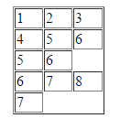
Dynamic Web Table Get All Values
wd.get("http://demo.guru99.com/test/table.html");
WebElement mytable = wd.findElement(By.xpath("/html/body/table/tbody"));
List < WebElement > rows_table = mytable.findElements(By.tagName("tr"));
int rows_count = rows_table.size();
for (int row = 0; row < rows_count; row++) {
//To locate columns(cells) of that specific row.
List < WebElement > Columns_row =
rows_table.get(row).findElements(By.tagName("td"));
//To calculate no of columns (cells). In that specific row.
int columns_count = Columns_row.size();
System.out.println("Number of cells In Row " + row + " are " + columns_count);
//Loop will execute till the last cell of that specific row. for (int column = 0; column < columns_count; column++) {
// To retrieve text from that specific cell.
String celtext = Columns_row.get(column).getText();
System.out.println("Cell Value of row number " + row + " and column number " + column + " Is " + celtext); }}
Notes:
wd.get("http://demo.guru99.com/test/table.html"); //To locate table. WebElement mytable = wd.findElement(By.xpath("/html/body/table/tbody")); //To locate rows of table. List < WebElement > rows_table = mytable.findElements(By.tagName("tr")); //To calculate no of rows In table. int rows_count = rows_table.size(); //Loop will execute till the last row of table. for (int row = 0; row < rows_count; row++) { //To locate columns(cells) of that specific row. List < WebElement > Columns_row = rows_table.get(row).findElements(By.tagName("td")); //To calculate no of columns (cells). In that specific row. int columns_count = Columns_row.size(); System.out.println("Number of cells In Row " + row + " are " + columns_count); //Loop will execute till the last cell of that specific row. for (int column = 0; column < columns_count; column++) { // To retrieve text from that specific cell. String celtext = Columns_row.get(column).getText(); System.out.println("Cell Value of row number " + row + " and column number " + column + " Is " + celtext); } System.out.println("-------------------------------------------------- "); }

Slide 63
Verify Static Tool Tip
For accessing or verifying the static tooltips which are implemented using the HTML "title" attribute, we can simply use the getAttribute("title") method of the WebElement..
String baseUrl = "http://demo.guru99.com/test/social-icon.html";
System.setProperty("webdriver.chrome.driver","G:\\chromedriver.exe");
WebDriver driver = new ChromeDriver(); driver.get(baseUrl);
String expectedTooltip = "Github";
// Find the Github icon at the top right of the header
WebElement github = driver.findElement(By.xpath(".//*[@class='soc-ico show-round']/a[4]"));
//get the value of the "title" attribute of the github icon
String actualTooltip = github.getAttribute("title");
//Assert the tooltip's value is as expected
System.out.println("Actual Title of Tool Tip"+actualTooltip); if(actualTooltip.equals(expectedTooltip)) {
System.out.println("Test Case Passed"); }
driver.close();

Slide 64
Verify Dynamic Tool Tip
If title attribute is not used then use the "Advanced User Interactions API" provided by the Web Driver to create the mouse hover effect and then retrieve the tooltip for the element.
String baseUrl = "http://demo.guru99.com/test/tooltip.html"; System.setProperty("webdriver.chrome.driver","G:\\chromedriver.exe");
WebDriver driver = new ChromeDriver();
String expectedTooltip = "What's new in 3.2";
driver.get(baseUrl);
WebElement download = driver.findElement(By.xpath(".//*[@id='download_now']"));
Actions builder = new Actions (driver);
builder.clickAndHold().moveToElement(download);
builder.moveToElement(download).build().perform();
WebElement toolTipElement =
driver.findElement(By.xpath(".//*[@class='box']/div/a"));
String actualTooltip = toolTipElement.getText();
System.out.println("Actual Title of Tool Tip "+actualTooltip); if(actualTooltip.equals(expectedTooltip)) {
System.out.println("Test Case Passed");
}
driver.close();

Slide 65
Check Broken Links
Make sure there are no broken links on the site as user should not land on error page.
Manual checking of links is a tedious task, because each webpage may have a large number of links & manual process has to be repeated for all pages.
How to check the Broken Links and images
Collect all the links in the web page based on <a> tag.
Send HTTP request for the link and read HTTP response code.
Find out whether the link is valid or broken based on HTTP response code.
Repeat this for all the links captured.
Notes:
Broken links are links or URLs that are not reachable. They may be down or not functioning due to some server error
An URL will always have a status with 2xx which is valid. There are different HTTP status codes which are having different purposes. For an invalid request, HTTP status is 4xx and 5xx.

Slide 66
Check Broken Links Example
String homePage = http://www.zlti.com , url = "";
HttpURLConnection huc = null;
int respCode = 200;
driver = new ChromeDriver();
driver.manage().window().maximize();
driver.get(homePage);
List<WebElement> links = driver.findElements(By.tagName("a"));
Iterator<WebElement> it = links.iterator();
while(it.hasNext()){
url = it.next().getAttribute("href");
System.out.println(url);
if(url == null || url.isEmpty()){
System.out.println("URL is either not configured for anchor tag or it is empty");
continue; }
if(!url.startsWith(homePage)){
System.out.println("URL belongs to another domain, skipping it.");
continue; }
try { huc = (HttpURLConnection)(new URL(url).openConnection());
huc.setRequestMethod("HEAD");
huc.connect();
respCode = huc.getResponseCode();
if(respCode >= 400){
System.out.println(url+" is a broken link"); }
else{ System.out.println(url+" is a valid link"); }
} catch (MalformedURLException e) {
e.printStackTrace(); }
catch (IOException e) {e.printStackTrace(); } }
driver.quit();
Notes:
Broken links are links or URLs that are not reachable. They may be down or not functioning due to some server error
An URL will always have a status with 2xx which is valid. There are different HTTP status codes which are having different purposes. For an invalid request, HTTP status is 4xx and 5xx.

Slide 67
Take Screen Shot
Screenshots are desirable for bug analysis.
type cast WebDriver instance to TakesScreenshot.
driver.get("http://demo.guru99.com/V4/");
//Call take screenshot function
this.takeSnapShot(driver, "c://test.png") ;
public static void takeSnapShot(WebDriver webdriver,String fileWithPath) throws Exception{
//Convert web driver object to TakeScreenshot
TakesScreenshot scrShot =((TakesScreenshot)webdriver);
//Call getScreenshotAs method to create image file
File SrcFile=scrShot.getScreenshotAs(OutputType.FILE);
//Move image file to new destination
File DestFile=new File(fileWithPath);
//Copy file at destination
FileUtils.copyFile(SrcFile, DestFile);
}
Notes:
NOTE: Selenium version 3.9.0 and above does not provide Apache Commons IO JAR. You can simply download them https://commons.apache.org/proper/commons-io/download_io.cgi and call them in your project

Slide 68
Reference Links
https://www.techbeamers.com/selenium-webdriver-tutorial/
https://www.toolsqa.com/selenium-tutorial/
assgn -> https://www.guru99.com/alert-popup-handling-selenium.html
https://seleniumhq.github.io/selenium/docs/api/java/index.html?org/openqa/selenium/interactions/Actions.html
https://www.toolsqa.com/automation-practice-form/
https://demos.telerik.com/aspnet-ajax/
Notes:
Assgn -> http://demo.guru99.com/test/delete_customer.php

Slide 69
Practice sites
https://www.rahulshettyacademy.com/locatorspractice/
https://www.rahulshettyacademy.com/AutomationPractice/
Notes:
Assgn -> http://demo.guru99.com/test/delete_customer.php

Slide 70

Any Question ?

Slide 71


7738460004 shalini06mittal@gmail.com
Thank you !

