Slide 1
Selenium
Shalini Mittal
Corporate Trainer

Slide 2
Handle Cookies
A HTTP cookie is comprised of information about the user and their preferences.
It stores information using a key-value pair.
It is a small piece of data sent from Web Application and stored in Web Browser, while the user is browsing that website.
Query Commands for cookies driver.manage().getCookies(); // Return The List of all Cookies driver.manage().getCookieNamed(arg0); //Return specific cookie according to name driver.manage().addCookie(arg0); //Create and add the cookie driver.manage().deleteCookie(arg0); // Delete specific cookie driver.manage().deleteCookieNamed(arg0); // Delete specific cookie according Name driver.manage().deleteAllCookies(); // Delete all cookies
Notes:
Each cookie is associated with a name, value, domain, path, expiry, and the status of whether it is secure or not. In order to validate a client, a server parses all of these values in a cookie.
When Testing a web application using selenium web driver, you may need to create, update or delete a cookie

Slide 3
Cookies Add and Get
driver.get("http://flipkart.com/");
driver.manage().window().maximize();
/*
We need to import "org.openqa.selenium.Cookie" to initialize the
* instance of Cookie In this example we are passing, name=mycookie and
value=123456789123
*/
Cookie cookieName = new Cookie("myCookie", "Learn Selenium WebDriver 3.x");
driver.manage().addCookie(cookieName);
/* getCookies() function is used to fetch all the cookies present in the
web page.
* All the cookies we are string in Set of type Cookie.
*/
Set<Cookie> cookiesList = driver.manage().getCookies();
/* Printing all the cookies stored in the cookiesList set. */
for (Cookie getcookies : cookiesList) {
System.out.println("Notice the custom cookie in this list: " + getcookies);
}
Notes:
Each cookie is associated with a name, value, domain, path, expiry, and the status of whether it is secure or not. In order to validate a client, a server parses all of these values in a cookie.
When Testing a web application using selenium web driver, you may need to create, update or delete a cookie

Slide 4
Cookies Delete
/* We can delete single cookie using deleteCookie() method
by passing the cookie.
*/
driver.manage().deleteCookie(cookieName);
cookiesList = driver.manage().getCookies();
System.out.println("*** Now the myCookie should not be listed below ***");
for (Cookie getcookies : cookiesList) {
System.out.println(getcookies);
}
System.out.println("*** myCookie should not be listed above ***");
/* We can delete single cookie using deleteCookieNamed() method
* only passing the cookie name(String).
*/
driver.manage().deleteCookieNamed("myCookie");
cookiesList = driver.manage().getCookies();
System.out.println("Now the myCookie should not be listed below");
for (Cookie getcookies : cookiesList) {
System.out.println(getcookies);
}
Notes:
Each cookie is associated with a name, value, domain, path, expiry, and the status of whether it is secure or not. In order to validate a client, a server parses all of these values in a cookie.
When Testing a web application using selenium web driver, you may need to create, update or delete a cookie

Slide 5
AutoIT tool
A freeware tool that uses a combination of mouse movement, keystrokes and window control manipulation to automate a task which is not possible by selenium webdriver.
Selenium is an open source tool that is designed to automate web-based applications on different browsers but to handle window GUI and non HTML popups in application. AutoIT is required as these window based activity are not handled by Selenium
Download and install autoIT : https://www.autoitscript.com/site/autoit/downloads/
Open SciTE.exe' file, the AutoIT editor opens
click on 'Au3Info.exe' file, the element identifier opens and click on file on upload dialog to identify the elements
Notes:
https://www.guru99.com/use-autoit-selenium.html

Slide 6
Installation Steps
Notes:
https://www.guru99.com/use-autoit-selenium.html

Slide 7
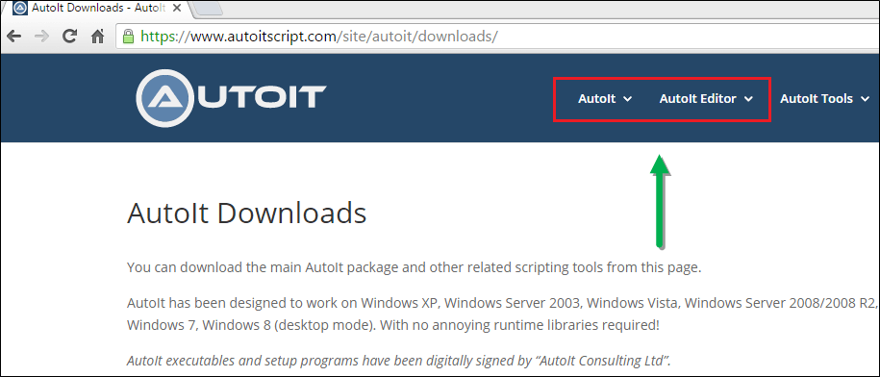
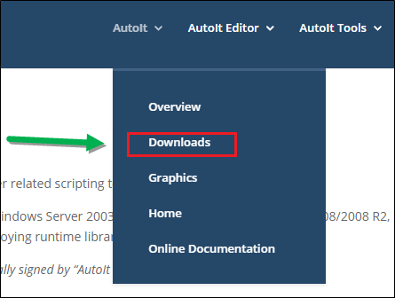
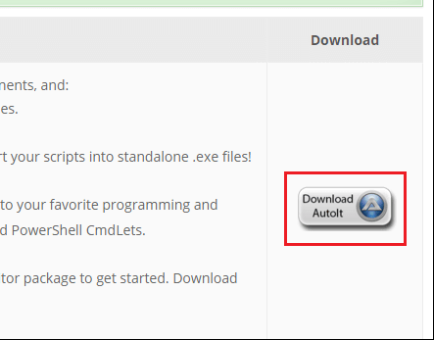
Notes:
https://www.guru99.com/use-autoit-selenium.html

Slide 8
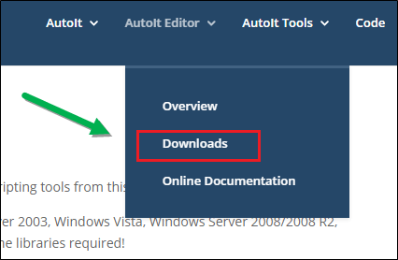
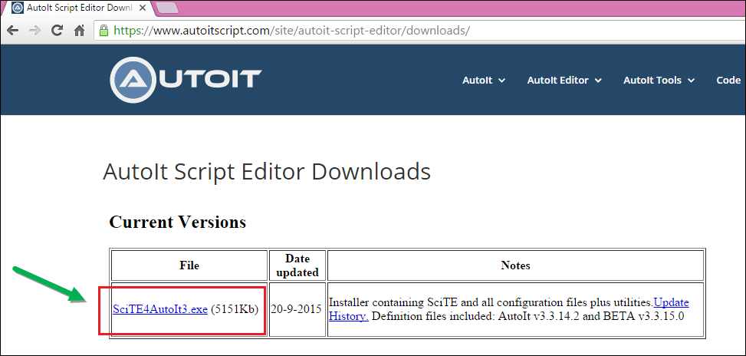
For Installing AutoIT-
Click on both AutoIT setup one by one .
Notes:
https://www.guru99.com/use-autoit-selenium.html

Slide 9
Finder Steps
Notes:
https://www.guru99.com/use-autoit-selenium.html

Slide 10
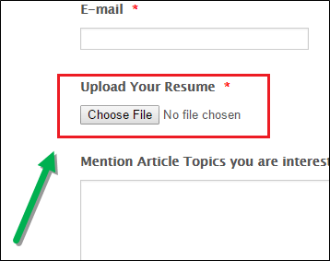
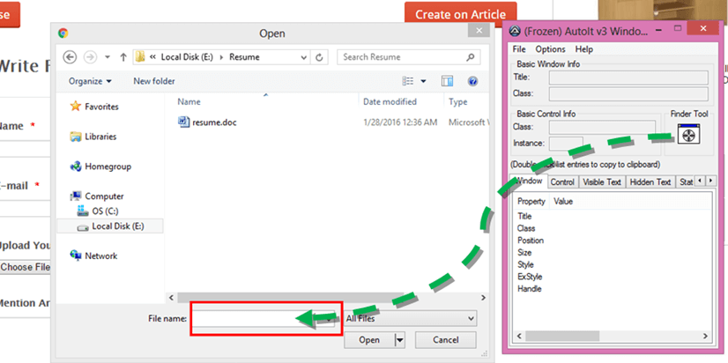
open file uploader window by clicking on 'Choose File'
Notes:
https://www.guru99.com/use-autoit-selenium.html

Slide 11
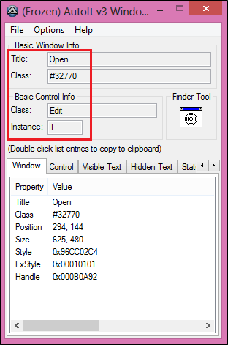
open AutoIT script editor, goto 'C:\Program Files (x86)\AutoIt3\SciTE' and click on 'SciTE.exe’
ControlFocus(" title "," text ",controlID ) //Sets input focus to a given control on a window.
ControlSetText(" title "," text ",controlID ," File path which need to upload " )
// Sets text of a control.
ControlClick(" title "," text ",controlID ) //Sends a mouse click command to a given control.
Notes:
https://www.guru99.com/use-autoit-selenium.html

Slide 12
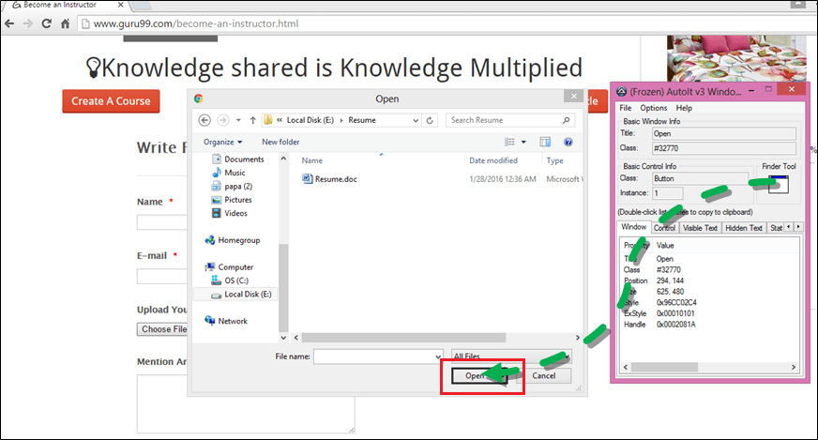
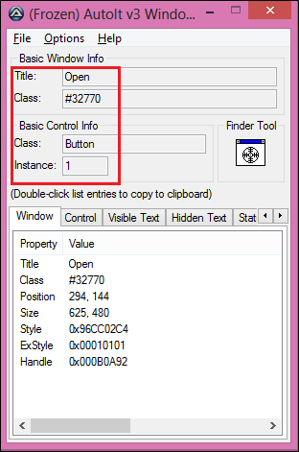
Now drag the finder tool on the "Open" button element of file uploader window to find the basic attribute information
For compiling this script, you have two options " compile script x64 " and " compile script x86 ", if you have windows 32-bit machine then u go with " compile script x86 " and for windows 64-bit machine then u go with " compile script x64 .
ControlClick("Open","","Button1") //This method click on 'Open' button of file uploader.
save the script as " FileUpload " at the given location ( E:\AutoIT ).
Notes:
https://www.guru99.com/use-autoit-selenium.html

Slide 13
Import java.io.IOException;
import org.openqa.selenium.By;
import org.openqa.selenium.WebDriver;
import org.openqa.selenium.firefox.FirefoxDriver;
public class FileUpload { public static void main(String[] args) throws IOException {
WebDriver driver=new FirefoxDriver();
driver.get("https://compresspng.com/");
driver.manage().timeouts().implicitlyWait(10, TimeUnit.SECONDS);
driver.findElement(By.xpath("//span[contains(text(),'Upload Files')]")).click();
Thread.sleep(2000);
Runtime.getRuntime().exec("C:\\Users\\Shalini Mittal\\Documents\\fileupload.exe");
driver.close();
}
}
Notes:
https://www.guru99.com/use-autoit-selenium.html

Slide 14
Sikuli tool
A tool to automate graphical user interfaces (GUI) using “Visual Image Match” method.
In Sikuli, all the web elements should be taken as an image and stored inside the project.
Sikuli will trigger GUI interactions based on the image visual match, the image which we have passed as the parameter along with all methods.
Download sikuli - https://launchpad.net/sikuli/+download
Install the jar file
Notes:
https://drive.google.com/drive/folders/0B5v_nInLNoquczdRR0I1UmFuOWM
http://roadtoautomation.blogspot.com/2013/01/how-to-capture-images-using-sikuli.html – IDE
https://www.youtube.com/watch?v=CjqETVOSUJk - tutorial
https://launchpad.net/sikuli/+download - jar file
http://www.softwaretestingmaterial.com/sikuli-guide-integrate-sikuli-with-selenium/ - tutorial

Slide 15
Sikuli Methods -1/4
#1: Creating Object for Screen Class The screen is a base class provided by Sikuli. We need to create an object for this screen class first, then only we can access all the methods provided by Sikuli.
Syntax: Screen s=new Screen();
#2: Click On An Element This method used to Click on the specific image present on the screen.
Syntax: s.click(“<<image name>>”);
Example: s.click(“test.png”);
#3: Right Click On An Element This method used to right click on the specific image present on the screen.
Syntax: s.rightClick(“<<image name>>”);
Example: s.rightClick(“test.png”);
Notes:
Each cookie is associated with a name, value, domain, path, expiry, and the status of whether it is secure or not. In order to validate a client, a server parses all of these values in a cookie.
When Testing a web application using selenium web driver, you may need to create, update or delete a cookie

Slide 16
Sikuli Methods -2/4
#4: find An Element This method used to find a specific element present on the screen.
Syntax: s.find(“<<image name>>”);
Example: s.find(“test.png”);
#5: Double Click on An Element This method used to trigger a double click event on a specific image present on the screen.
Syntax: s.doubleClick(“<<image name>>”);
Example: s.doubleClick(“test.png”);
#6: Check whether an Element present on the Screen This Method is used to check whether the specified element is present on the screen.
Syntax: s.exists(“<<image name>>”);
Example: s.exists(“test.png”);
Notes:
Each cookie is associated with a name, value, domain, path, expiry, and the status of whether it is secure or not. In order to validate a client, a server parses all of these values in a cookie.
When Testing a web application using selenium web driver, you may need to create, update or delete a cookie

Slide 17
Sikuli Methods -3/4
#7: Type a string on a Textbox This Method is used to enter the specified text on the Text box.
Syntax: s.type(“<<image name>>”,”String to be typed”);
Example: s.type(“test.png”,”HI!!”);
#8: Wheeling on a particular image This method is used to perform wheeling action on the element image.
Syntax: s.wheel(“<<image name>>”,<<int position>>,<<int direction>>);
Example: s.wheel(“test.png”,25,0);
#9: Drag and Drop a Image/Element This method is used to drag and drop a specified image from source position to target position.
Syntax: s.dragDrop(“<<source image name>>”,”<<target image name>>”);
Example: s.dragDrop(“test.png”,”test1.png”);
Notes:
Each cookie is associated with a name, value, domain, path, expiry, and the status of whether it is secure or not. In order to validate a client, a server parses all of these values in a cookie.
When Testing a web application using selenium web driver, you may need to create, update or delete a cookie

Slide 18
Sikuli Methods -4/4
#10: Roll Hover on a particular image This method is used to perform roll hover event on the specified image.
Syntax: s.hover(“<<image name>>”);
Example: s.hover(“test.png”);
#11: Paste Copied String This method used to paste text on the specified textbox.
Syntax: s.paste(“<<image name>>”,”test”);
Example: s.paste(“test.png”,”test”);
Notes:
Each cookie is associated with a name, value, domain, path, expiry, and the status of whether it is secure or not. In order to validate a client, a server parses all of these values in a cookie.
When Testing a web application using selenium web driver, you may need to create, update or delete a cookie

Slide 19
Firefox Profile
Firefox profile is the collection of settings, customization, add-ons and other personalization settings that can be done on the Firefox Browser.
You can customize Firefox profile to suit your Selenium automation requirement.
Firefox profile is just like different users using Firefox. Firefox saves personal information such as bookmarks, passwords, and user preferences which can be edited, deleted or created using the program manager.
For windows 7 > /AppData/MozillaFirefoxProfile_name.default
Notes:
Each cookie is associated with a name, value, domain, path, expiry, and the status of whether it is secure or not. In order to validate a client, a server parses all of these values in a cookie.
When Testing a web application using selenium web driver, you may need to create, update or delete a cookie

Slide 20
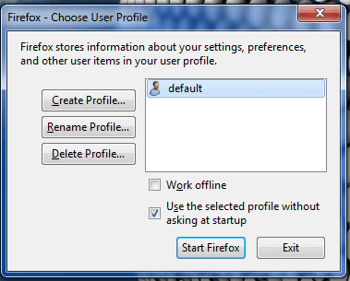
Create Firefox Profile
First of all close the Firefox if open.
Open Run (windows key + R) and type firefox.exe –p and click OK
OR
On 64 bit : Windows: "C:Program Files(x86)Mozilla Firefox.exe" –p
A dialogue box will open named Firefox – choose user profile
Select option "Create Profile" from the window, and a wizard will open. Click on next
Notes:
Each cookie is associated with a name, value, domain, path, expiry, and the status of whether it is secure or not. In order to validate a client, a server parses all of these values in a cookie.
When Testing a web application using selenium web driver, you may need to create, update or delete a cookie

Slide 21
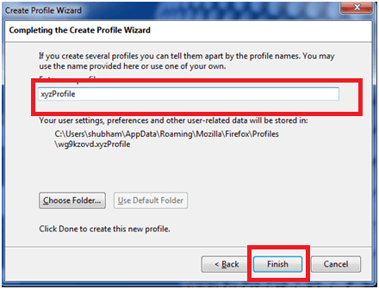
Create Firefox Profile
Give your profile name which you want to create and click on finish button
Now your profile is ready you can select your profile and open Firefox.
Notes:
You will notice that the new Firefox window will not show any of your Bookmarks and Favorite icons.
Note: The last selected profile, will load automatically at next Firefox launch. You will need to restart profile manager if you wish to change profiles.

Slide 22
Automation Script for Selenium
import java.io.File;
import java.util.concurrent.TimeUnit;
import org.openqa.selenium.WebDriver;
import org.openqa.selenium.firefox.FirefoxDriver;
import org.openqa.selenium.firefox.FirefoxProfile;
import org.openqa.selenium.firefox.internal.ProfilesIni;
public class FirefoxProfile {
public static void main(String[] args) {
ProfilesIni profile = new ProfilesIni();
FirefoxProfile myprofile = profile.getProfile("xyzProfile");
// Initialize Firefox driver
WebDriver driver = new FirefoxDriver(myprofile);
//Maximize browser window
driver.manage().window().maximize();
//Go to URL which you want to navigate driver.get("http://www.google.com");
//Set timeout for 5 seconds so that the page may load properly within that time
driver.manage().timeouts().implicitlyWait(5, TimeUnit.SECONDS);
//close firefox browser
driver.close(); }
}
Notes:
You will notice that the new Firefox window will not show any of your Bookmarks and Favorite icons.
Note: The last selected profile, will load automatically at next Firefox launch. You will need to restart profile manager if you wish to change profiles.

Slide 23
Reference Links
http://roadtoautomation.blogspot.com/2013/01/how-to-capture-images-using-sikuli.html – IDE
https://www.youtube.com/watch?v=CjqETVOSUJk - tutorial
https://launchpad.net/sikuli/+download - jar file
http://www.softwaretestingmaterial.com/sikuli-guide-integrate-sikuli-with-selenium/ - tutorial
Notes:
Assgn -> http://demo.guru99.com/test/delete_customer.php

Slide 24

Any Question ?

Slide 25


7738460004 shalini06mittal@gmail.com
Thank you !

