Slide 1
Selenium Page Object Model
Shalini Mittal
Corporate Trainer

Slide 2
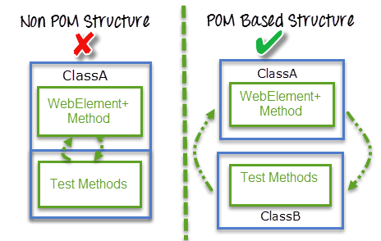
What?
A design pattern to create Object Repository for web UI elements
For each web page in the application, there should be corresponding page class.
This Page class will find the WebElements of that web page and also contains Page methods which perform operations on those WebElements
Name of these methods should be given as per the task they are performing, i.e., if a loader is waiting for the payment gateway to appear, POM method name can be waitForPaymentScreenDisplay().
Notes:
Each cookie is associated with a name, value, domain, path, expiry, and the status of whether it is secure or not. In order to validate a client, a server parses all of these values in a cookie.
When Testing a web application using selenium web driver, you may need to create, update or delete a cookie

Slide 3
Advantages
Operations and flows in the UI should be separated from verification. This concept makes our code cleaner and easy to understand.
Object repository is independent of test cases, so we can use the same object repository for a different purpose with different tools. For example, we can integrate POM with TestNG/JUnit for functional Testing and at the same time with JBehave/Cucumber for acceptance testing.
Code becomes less and optimized because of the reusable page methods in the POM classes.
Methods get more realistic names which can be easily mapped with the operation happening in UI. i.e. if after clicking on the button we land on the home page, the method name will be like 'gotoHomePage()'
Notes:
Each cookie is associated with a name, value, domain, path, expiry, and the status of whether it is secure or not. In order to validate a client, a server parses all of these values in a cookie.
When Testing a web application using selenium web driver, you may need to create, update or delete a cookie

Slide 4
POM Structure
TwitterHomePage
VeriFyTwitterPage
TwitterLoginPage
TwitterProfilePage
Notes:
https://drive.google.com/drive/folders/0B5v_nInLNoquczdRR0I1UmFuOWM

Slide 5
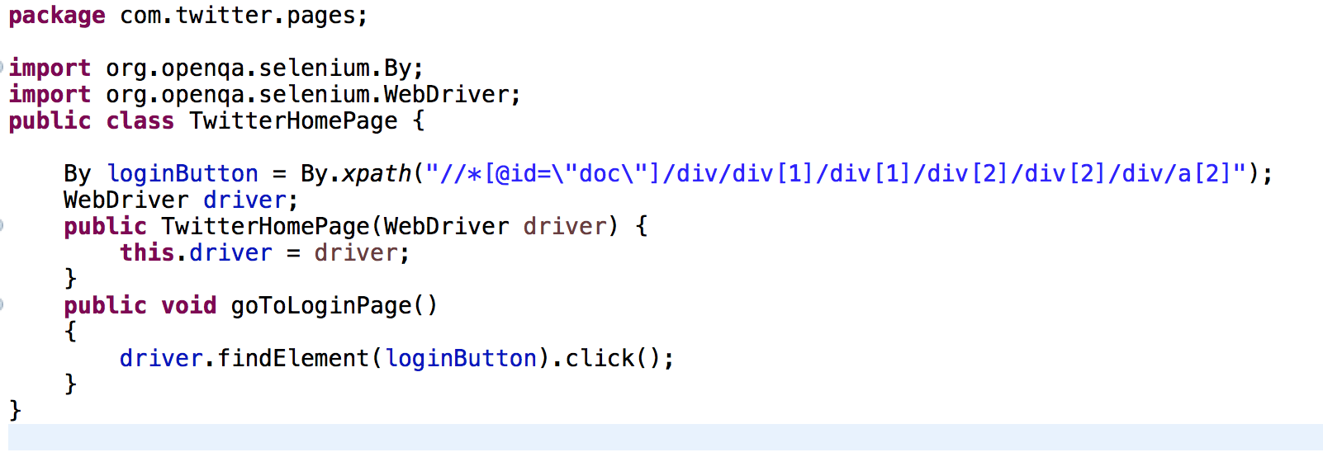
TwitterHomePage
Notes:
loginButton = By.xpath("//*[@id=\"doc\"]/div/div[1]/div[1]/div[2]/div[2]/div/a[2]");

Slide 6
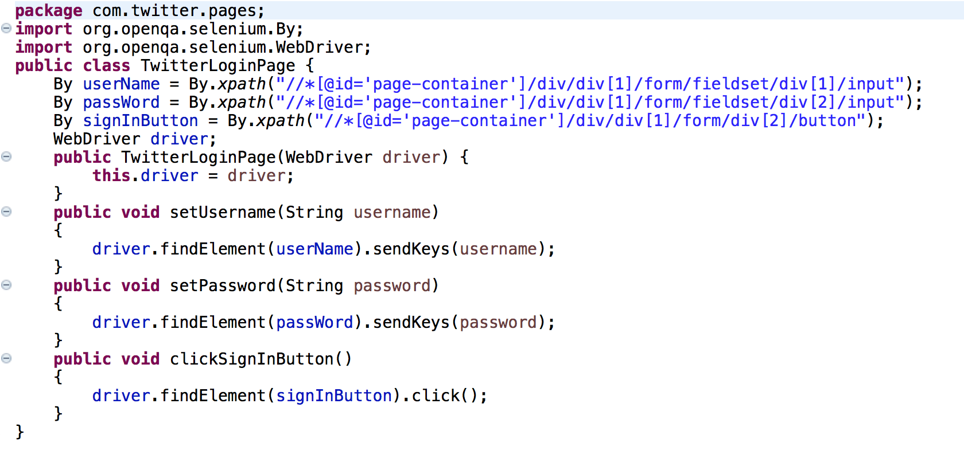
TwitterLoginPage
Notes:
By userName = By.xpath("//*[@id='page-container']/div/div[1]/form/fieldset/div[1]/input");
By passWord = By.xpath("//*[@id='page-container']/div/div[1]/form/fieldset/div[2]/input");
By signInButton = By.xpath("//*[@id='page-container']/div/div[1]/form/div[2]/button");

Slide 7
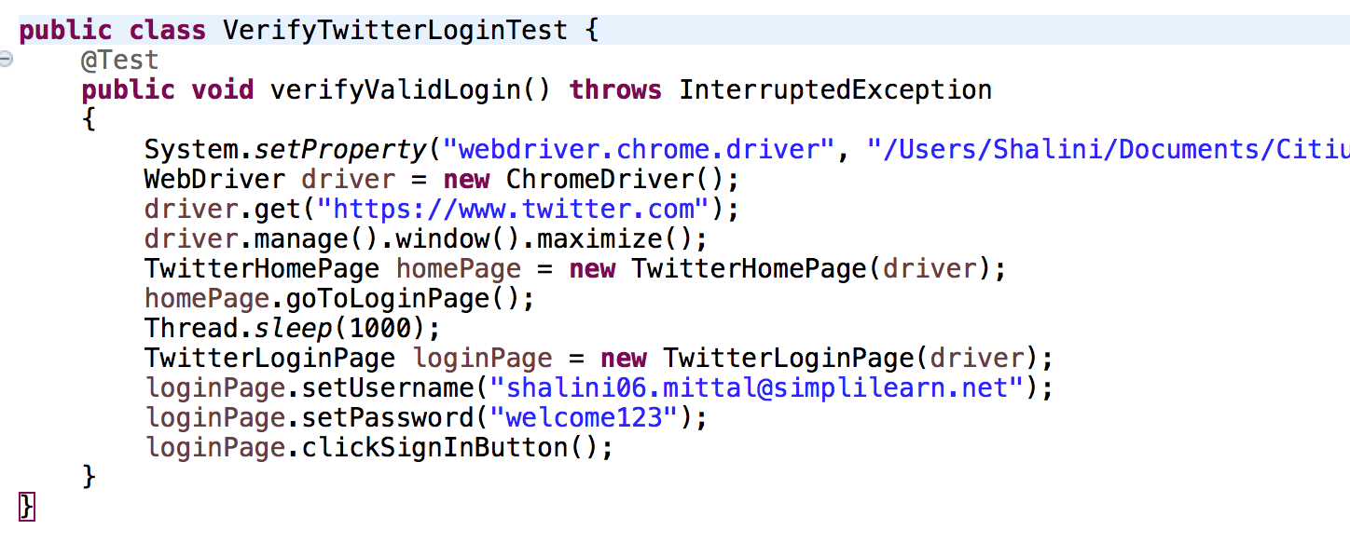
VerifyTwitterLoginTest
Notes:
By userName = By.xpath("//*[@id='page-container']/div/div[1]/form/fieldset/div[1]/input");
By passWord = By.xpath("//*[@id='page-container']/div/div[1]/form/fieldset/div[2]/input");
By signInButton = By.xpath("//*[@id='page-container']/div/div[1]/form/div[2]/button");

Slide 8
TwitterProfilePage
Complete the below class and test if after clicking on Profile,
the profile name is displayed or not
public class TwitterProfilePage {
WebDriver driver ;
By profileLink = //get the path
By profileName = //get the path
public TwitterProfilePage(WebDriver driver) {
this.driver = driver;
}
public void goToProfilePage()
{
}
public String getProfileName()
{
}
}

Slide 9
Page Object Model with Page Factory
Page Factory is an inbuilt Page Object Model concept for Selenium WebDriver but it is very optimized.
Here as well, we follow the concept of separation of Page Object Repository and Test Methods. Additionally, with the help of PageFactory class, we use annotations @FindBy to find WebElement.
We use initElements method to initialize web elements
@FindBy can accept tagName, partialLinkText, name, linkText, id, css, className, xpath as attributes.
Lets see the example ==➔
Notes:
Each cookie is associated with a name, value, domain, path, expiry, and the status of whether it is secure or not. In order to validate a client, a server parses all of these values in a cookie.
When Testing a web application using selenium web driver, you may need to create, update or delete a cookie

Slide 10
Create Configuration class
package com.twitter.util;
public class Config {
//TwitterLoginPage
public static final String username = "//*[@id=\"page-container\"]/div/div[1]/form/fieldset/div[1]/input";
public static final String password = "//*[@id=\"page-container\"]/div/div[1]/form/fieldset/div[2]/input";
public static final String signinButton = "//*[@id=\"page-container\"]/div/div[1]/form/div[2]/button";
//TwitterHomePage
public static final String loginButton = "//*[@id=\"doc\"]/div/div[1]/div[1]/div[2]/div[2]/div/a[2]";
//TwitterLandingPageProfileLink
public static final String profileLink = "//span[contains(text(),'Profile')]";
//ProfileLandingPage
public static final String loggedInId = "//span[@class='css-901oao css-16my406 css-bfa6kz r-hkyrab r-1qd0xha r-1vr29t4 r-ad9z0x r-bcqeeo r-3s2u2q r-qvutc0']//span[@class='css-901oao css-16my406 r-1qd0xha r-ad9z0x r-bcqeeo r-qvutc0']//span[@class='css-901oao css-16my406 r-1qd0xha r-ad9z0x r-bcqeeo r-qvutc0'][contains(text(),'@Testing')]";
public static void setBrowserDrivers() {
System.setProperty("webdriver.chrome.driver", "/Users/Shalini/Documents/Citius_backup/selenium/chromedriver");}}
Notes:
Each cookie is associated with a name, value, domain, path, expiry, and the status of whether it is secure or not. In order to validate a client, a server parses all of these values in a cookie.
When Testing a web application using selenium web driver, you may need to create, update or delete a cookie

Slide 11
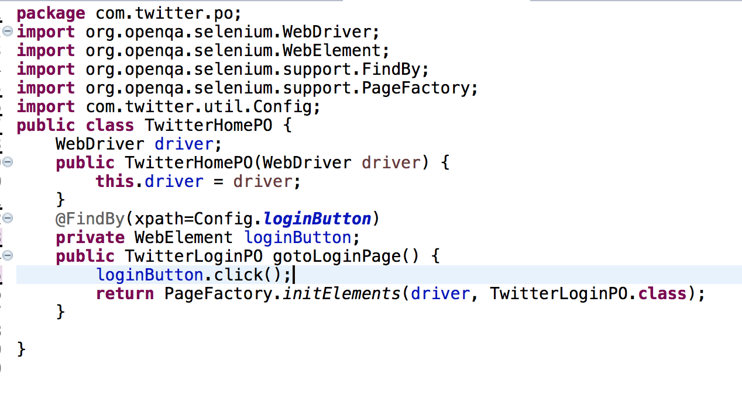
Home page
Notes:
Each cookie is associated with a name, value, domain, path, expiry, and the status of whether it is secure or not. In order to validate a client, a server parses all of these values in a cookie.
When Testing a web application using selenium web driver, you may need to create, update or delete a cookie

Slide 12
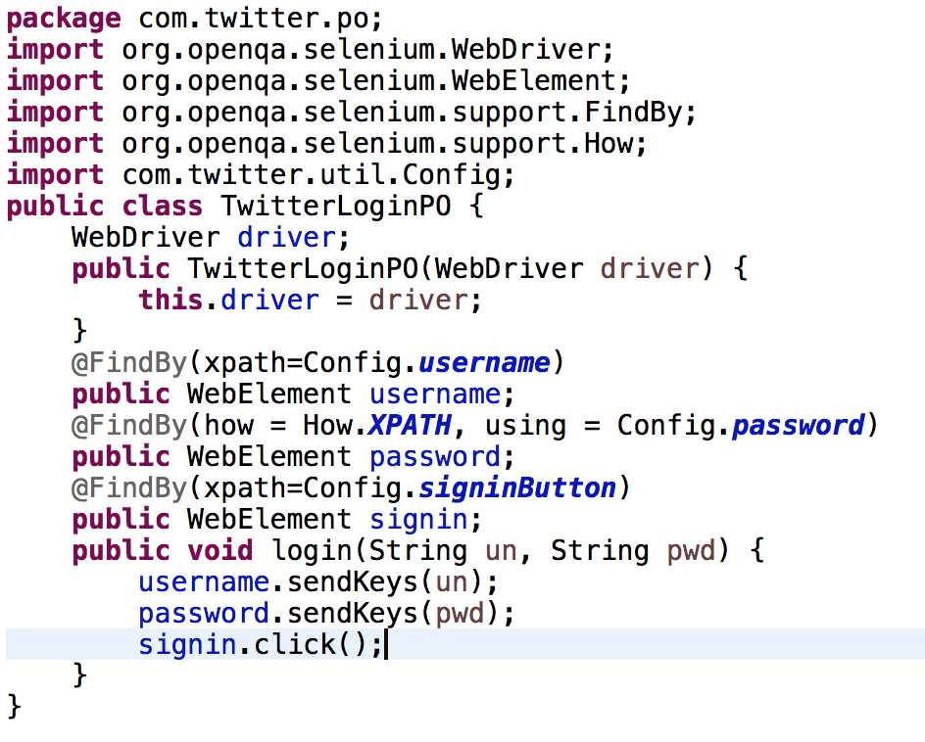
Login page
Notes:
Each cookie is associated with a name, value, domain, path, expiry, and the status of whether it is secure or not. In order to validate a client, a server parses all of these values in a cookie.
When Testing a web application using selenium web driver, you may need to create, update or delete a cookie

Slide 13
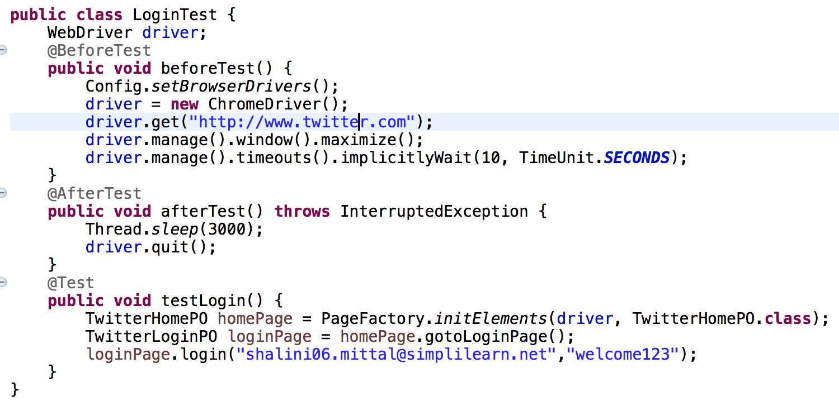
Login Test
Notes:
Each cookie is associated with a name, value, domain, path, expiry, and the status of whether it is secure or not. In order to validate a client, a server parses all of these values in a cookie.
When Testing a web application using selenium web driver, you may need to create, update or delete a cookie

Slide 14
Assignment
Create a class TwitterlandingPO
Write method to click onProfile link
Check the username on the profile page and validate
Notes:
Each cookie is associated with a name, value, domain, path, expiry, and the status of whether it is secure or not. In order to validate a client, a server parses all of these values in a cookie.
When Testing a web application using selenium web driver, you may need to create, update or delete a cookie

Slide 15

Any Question ?

Slide 16


7738460004 shalini06mittal@gmail.com
Thank you !

